Slide 1
All you need to know about Leaves & Absences
User guide
Last updated
September 2024

Slide 2
At the end of this training, users will be able to:
Training Objectives
View and create absence requests.
Validate absence requests (for managers).

Slide 3
Use the "Staff leaves & absences" module as an employee
Training Program
Viewing your leave balance.
Accessing the leave schedule.
Creating an absence request.
use the "staff leaves & absences" module as a manager
Validating leave requests.

Slide 4
As an Employee

Slide 5
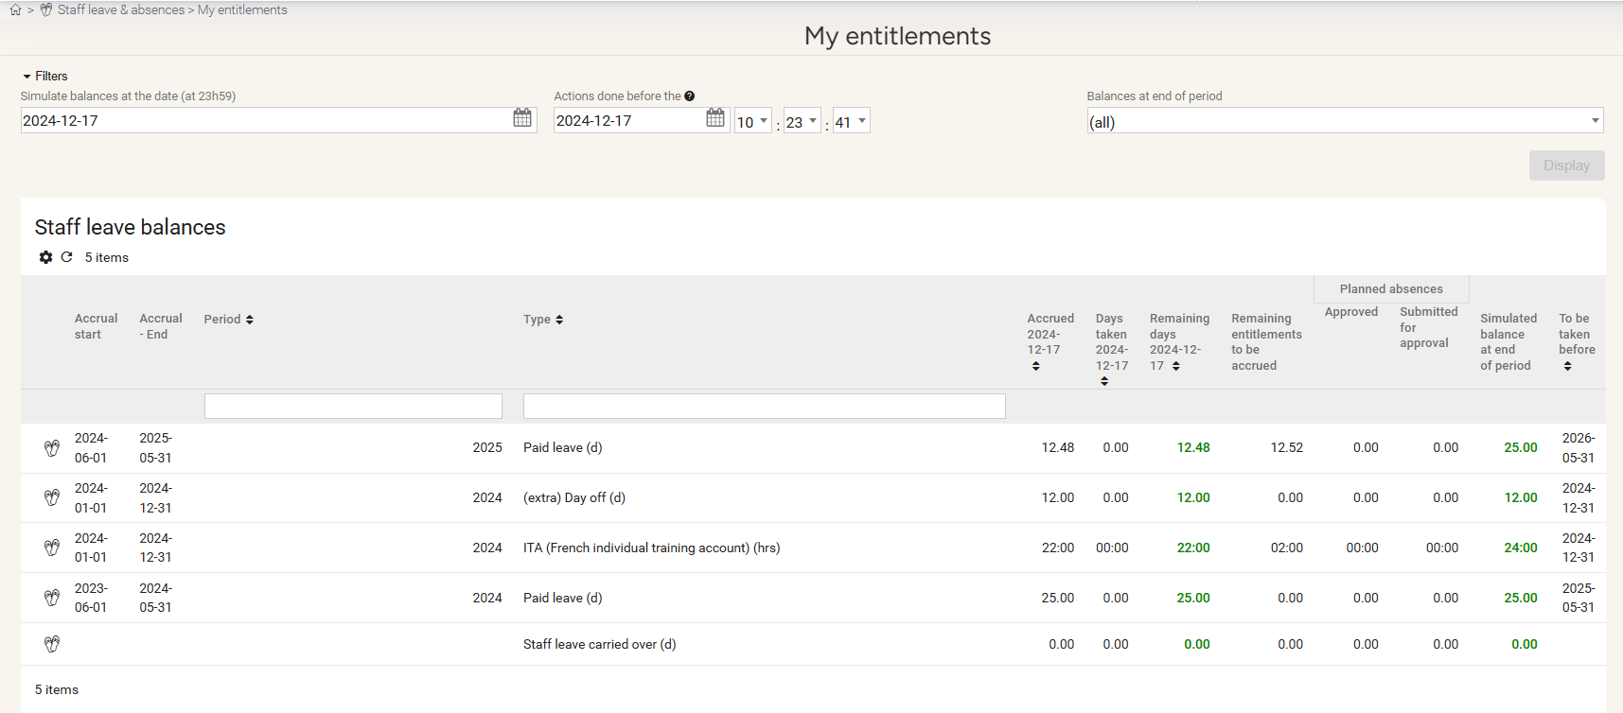
As an employee
Reviewing your leave balance
Go to the "Staff Leaves and Absences" module and select "My entitlements"
View your leave balances and trackers :
Period (Year)
Leave type
Number of leave days accrued to date
Number of leave days taken to date
Remaining leave balance to be taken
The deadline by which leave balances should be taken

Slide 6
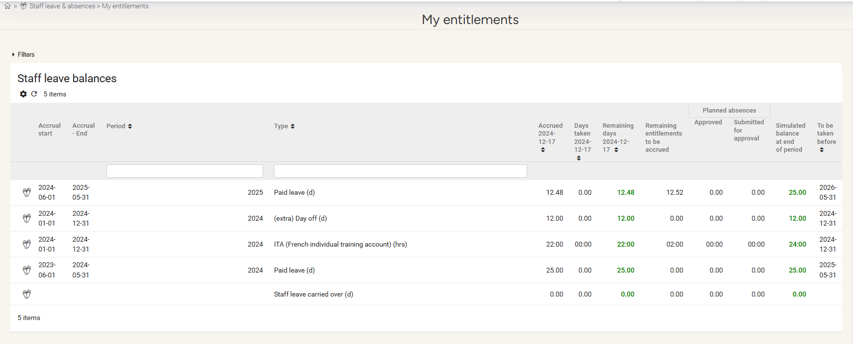
As an employee
Reviewing your leave balance
You can simulate your leave balance as of a given date by clicking on "Filters".
​

Slide 7
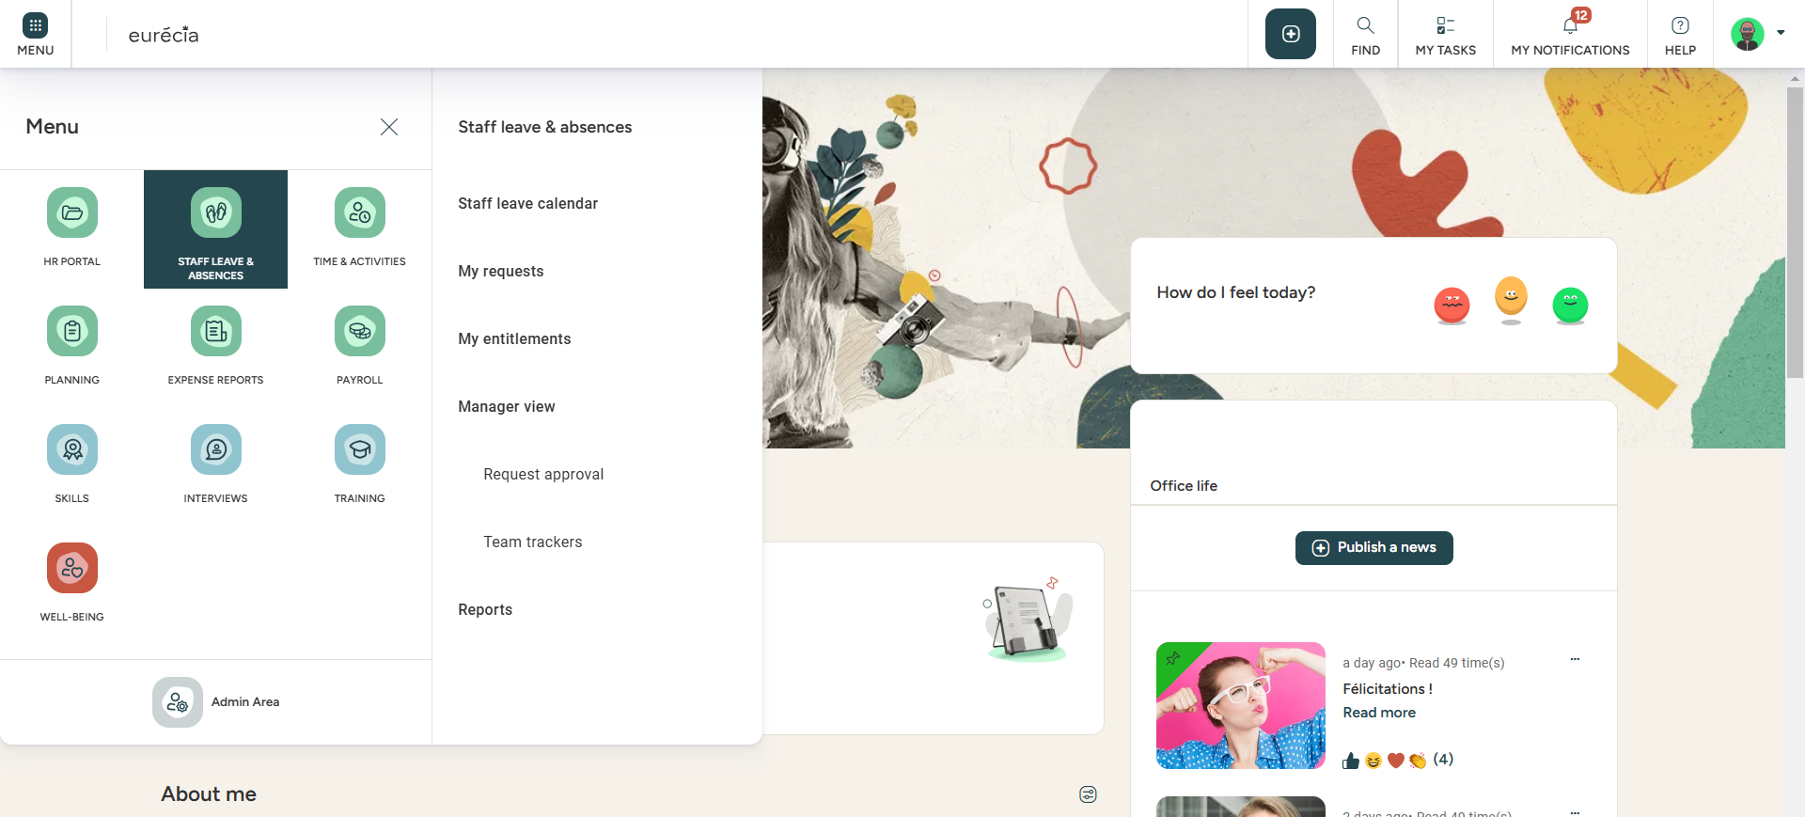
As an employee
Accessing the staff leave calendar
In the left menu, under the "Staff Leaves and Absences" module, select "Staff Leave Calendar".

Slide 8
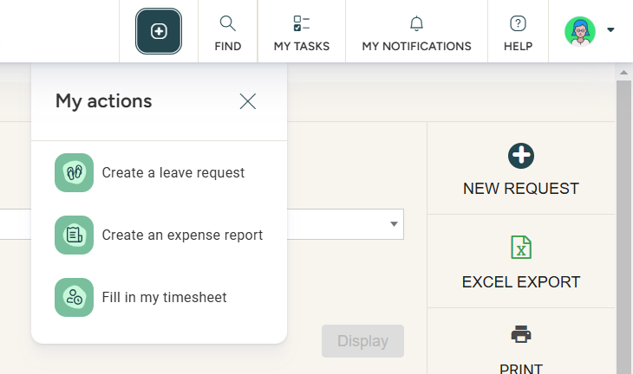
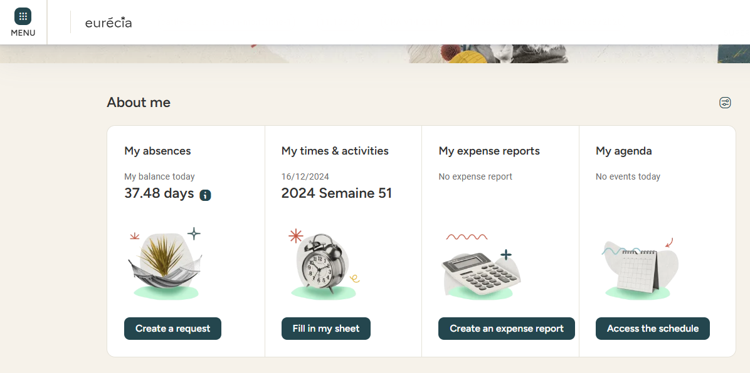
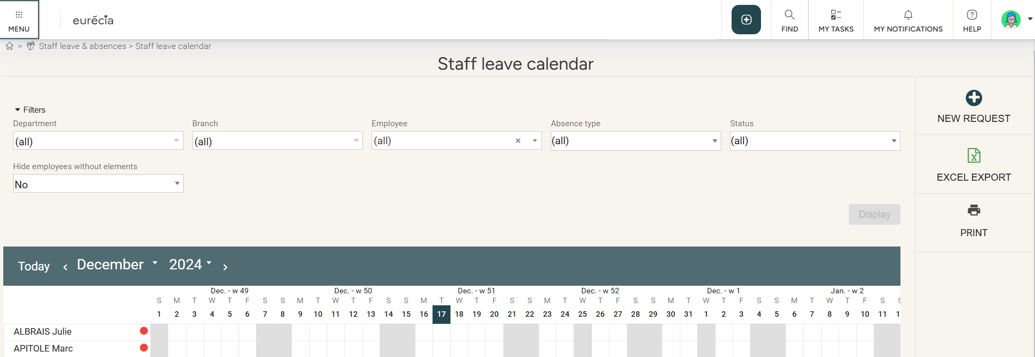
As an employee
Requesting leaves or absences
You can create a new absence request from:
The top banner: "My actions"
The homepage: "About me" > Create a request
The "Staff Leave Calendar"

Slide 9
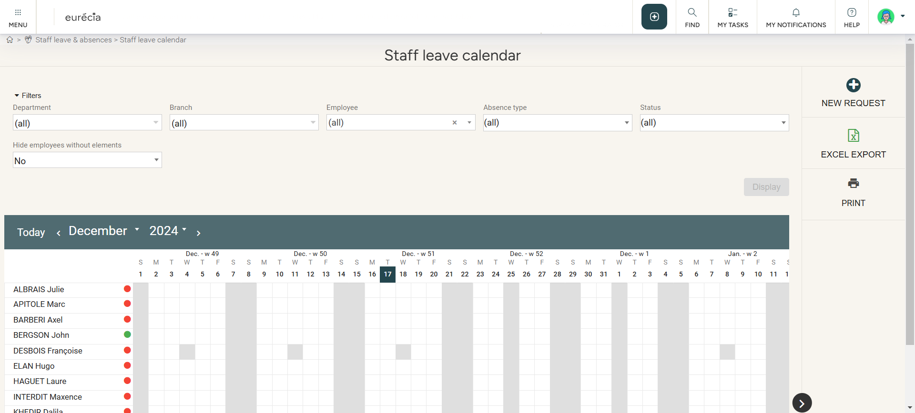
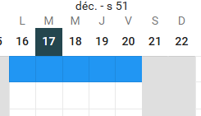
As an employee
Requesting leaves or absences from the staff leave calendar
Select the start and end dates directly from your line in the schedule, then click the "New Request" button.

Slide 10
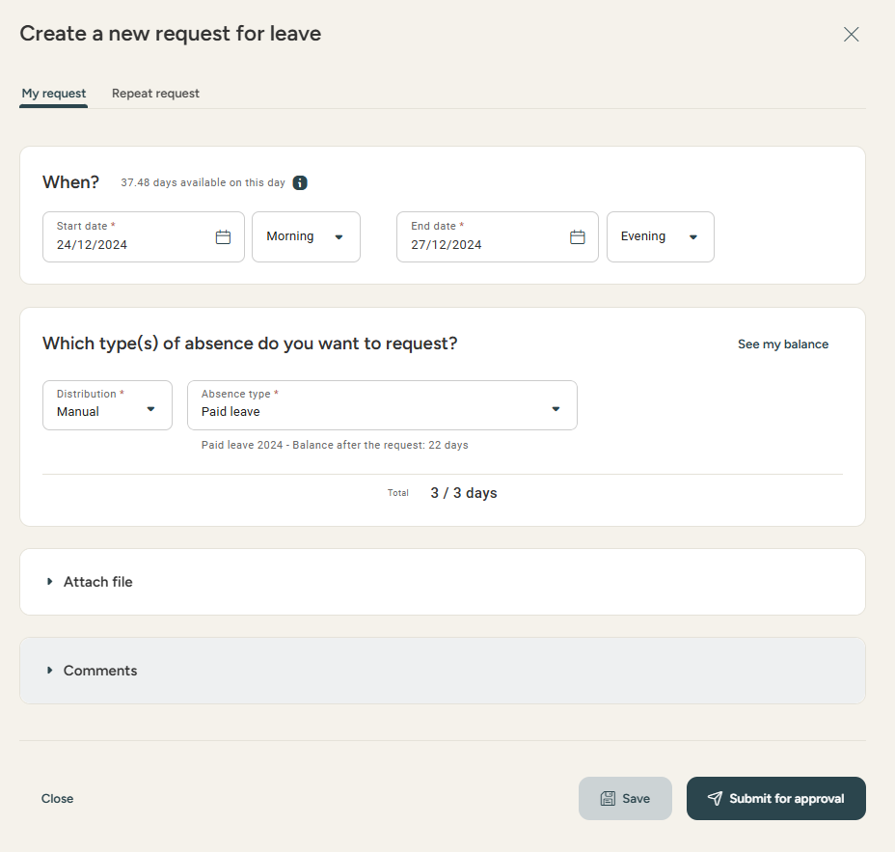
As an employee
Creating a leave or Absence Request
Verify the accuracy of the dates selected on the schedule.
Select the desired type of leave.
Attach a file (optional).
Add a comment or document (optional).
Click "Submit for approval" to finalize the request. Or "Save" to keep it as a draft and submit it for appoval later.

Slide 11
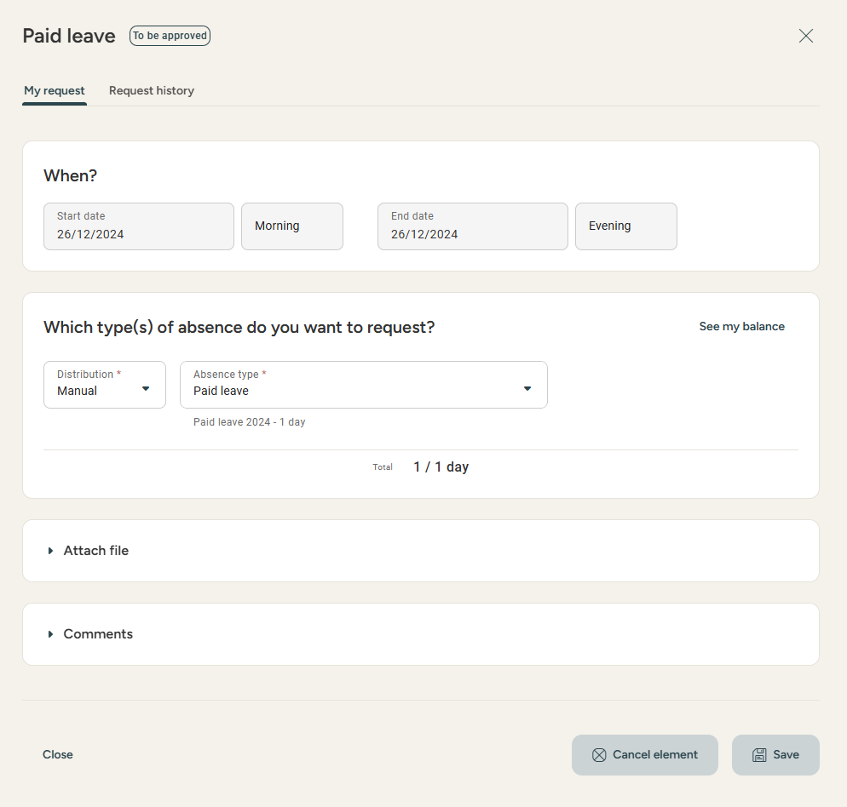
As an employee
Cancelling a leave or an Absence Request
You may cancel a request you have submitted that has not yet been validated.
Either from the list of your requests by clicking on the icon next to the request or from the request details page.
You may also submit a cancellation request to your manager if the request has laready been validated.

Slide 12
As a Manager

Slide 13
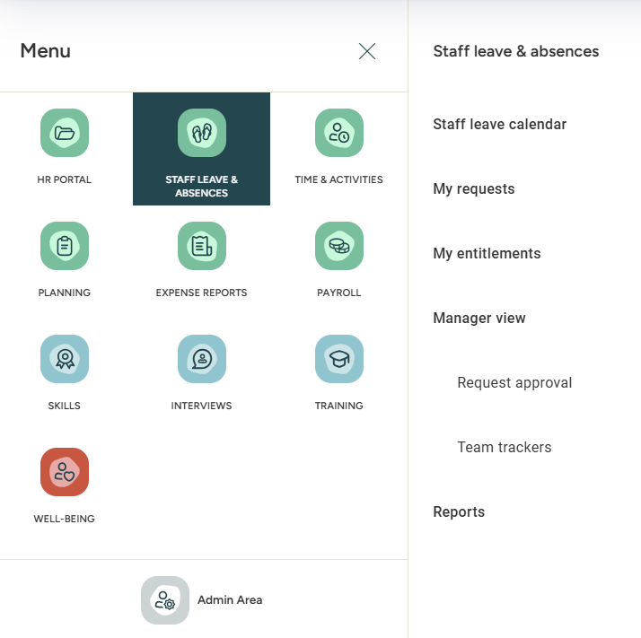
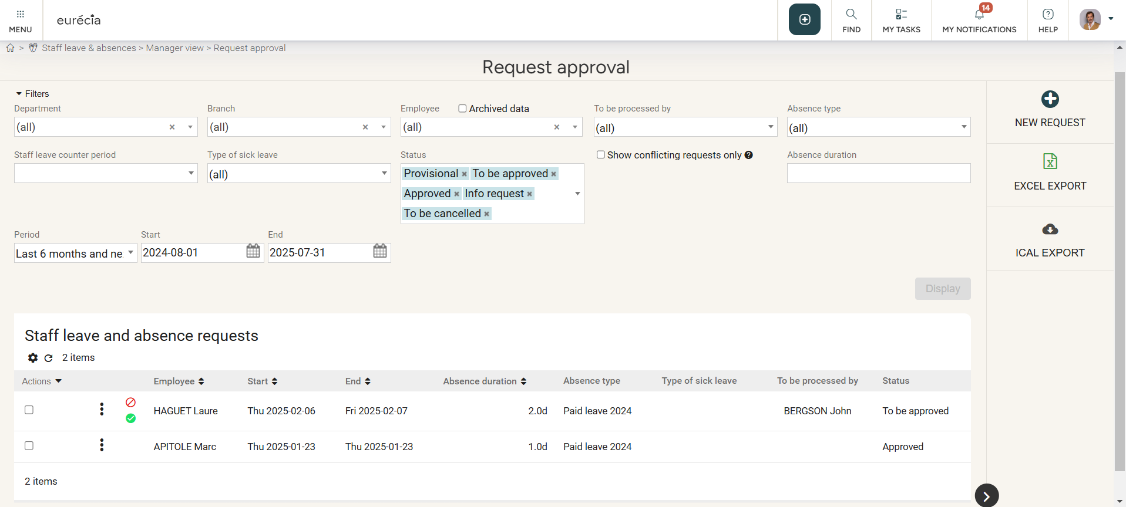
As a manager
Approving leave and absence requests
In the "Staff leave calendar" module, select "Managier view" and "Request approval".

Slide 14
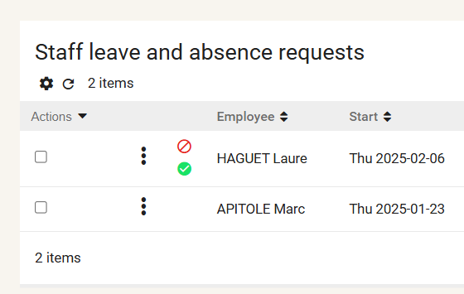
As a manager
Approving leave and absence requests
You can filter leave requests and absences by:
Department/branche
Employee
Validation manager
Absence type
Leave/RRT balance year
Type of leave
Request status
Number of days
Period
Start and end dates
You can approve or reject a request with one click.

Slide 15
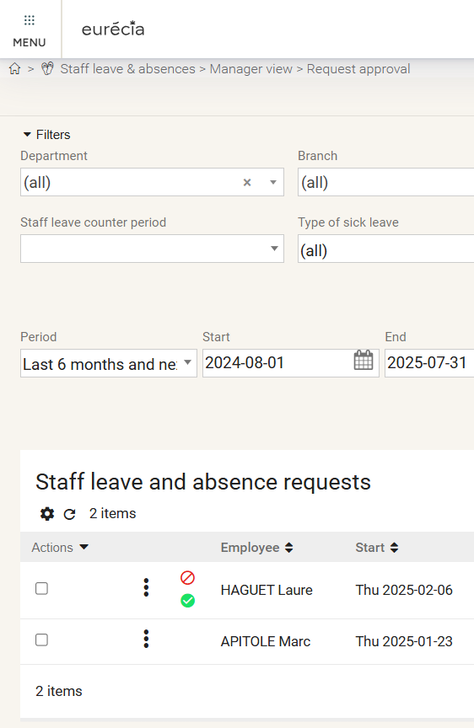
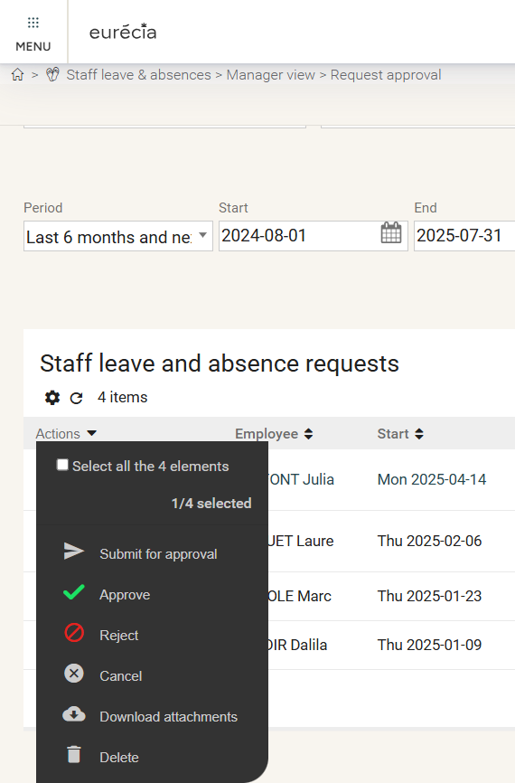
As a manager
Approving leave and absence requests
You may approve mutliple requests simultaneously by selecting the employees and clicking on "Actions".

Slide 16
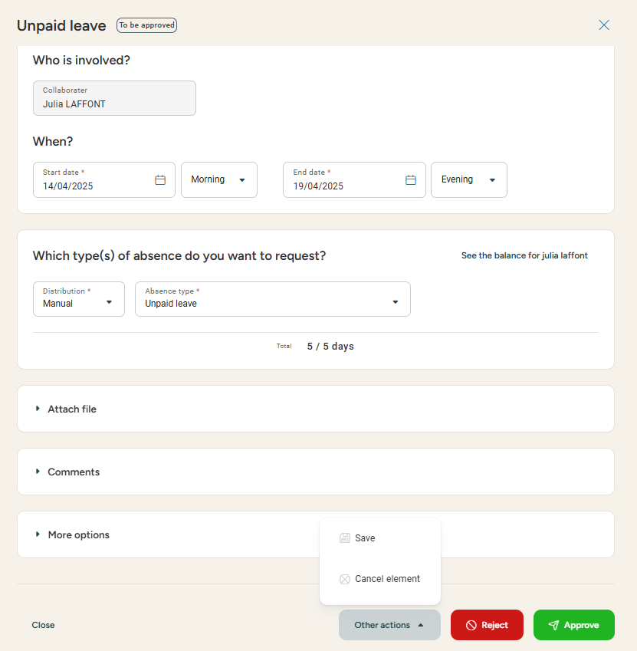
As a manager
Approving leave and absence requests
You may approve an absence by opening each request.
You may as well reject or ask for more information (or request changes) via a comment to the employee.

Slide 17
Still having doubts? All answers are within your reach.
Adresse mail administrateur
Help center

