Slide 1



All you need to know about
Expense reports
Administrator training guide
Last updated
July 2025

Slide 2

At the end of this training, administrators will be able to:
Training objectives
Create an expense report for employees
Control and approve expense reports
Process the reimbursement of expense reports and generate the associated exports
Define employee reimbursement profiles
Set up different types of expenses
Manage displays and spending limits
Manage report criteria

Slide 3


Module features
Training program
Creating and approving expense reports
Managing expense reports
Undertaking accounting exports
Admin area
Create and edit the settings for expense types, expense report profiles, and groupings
Managing report criteria

Slide 4
Module features
01

Slide 5
Creating and approving expense reports

Slide 6
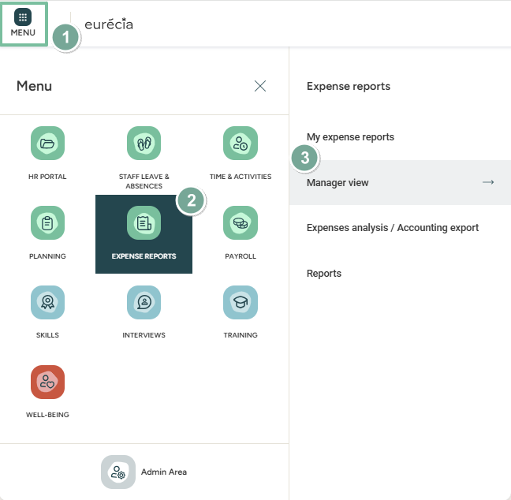

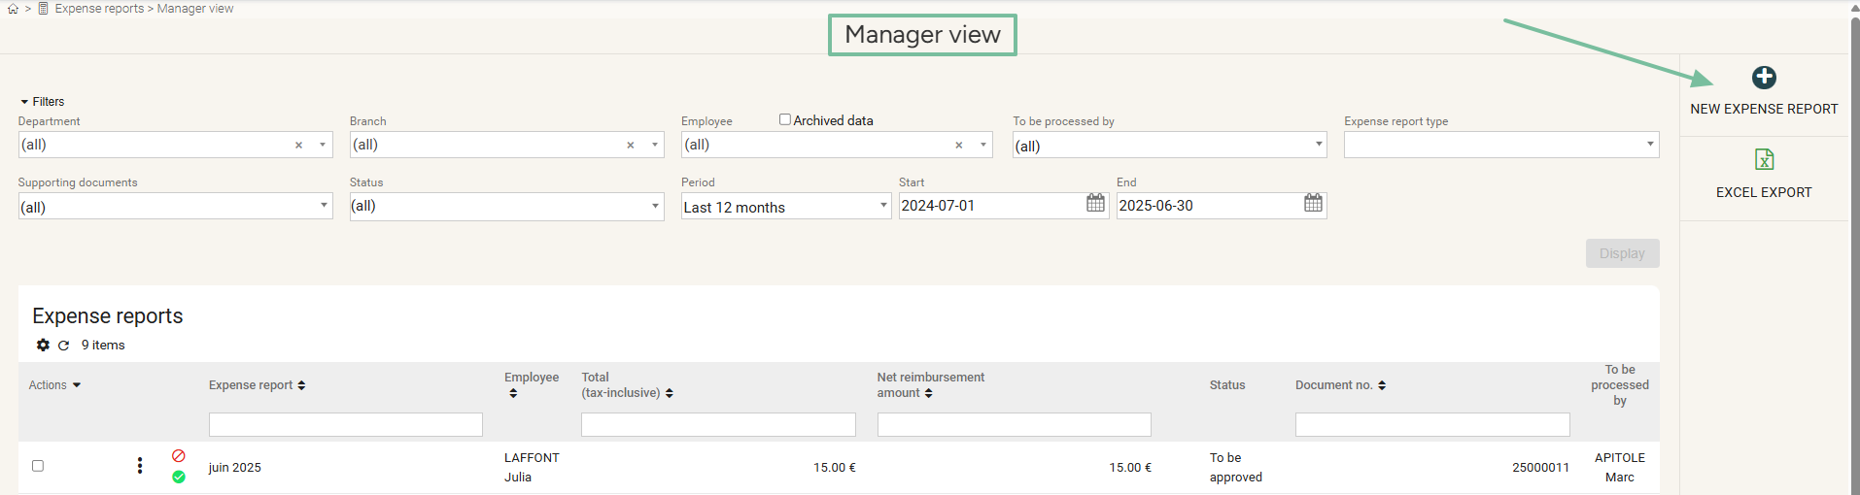
Creating expense reports
Creating a new expense report for an employee
Access: Menu > Expense reports > Manager view > New expense report

Slide 7
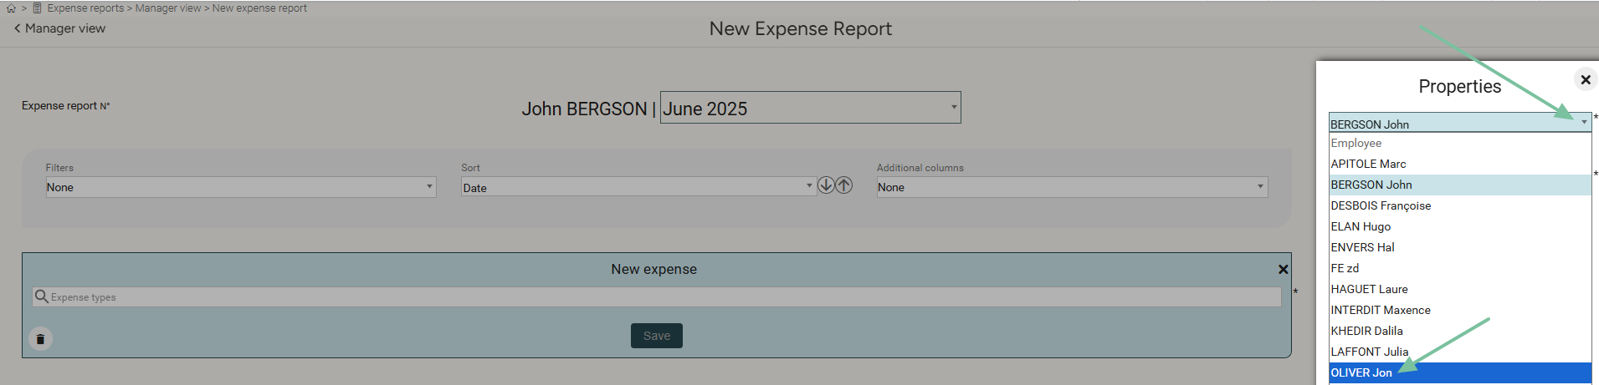
Creating an expense report
Creating a new expense report on behalf of an employee
Click on the name to select the relevant employee
Fill in the expense report: expense type, date, receipt…
Save
(Admin name)

Slide 8
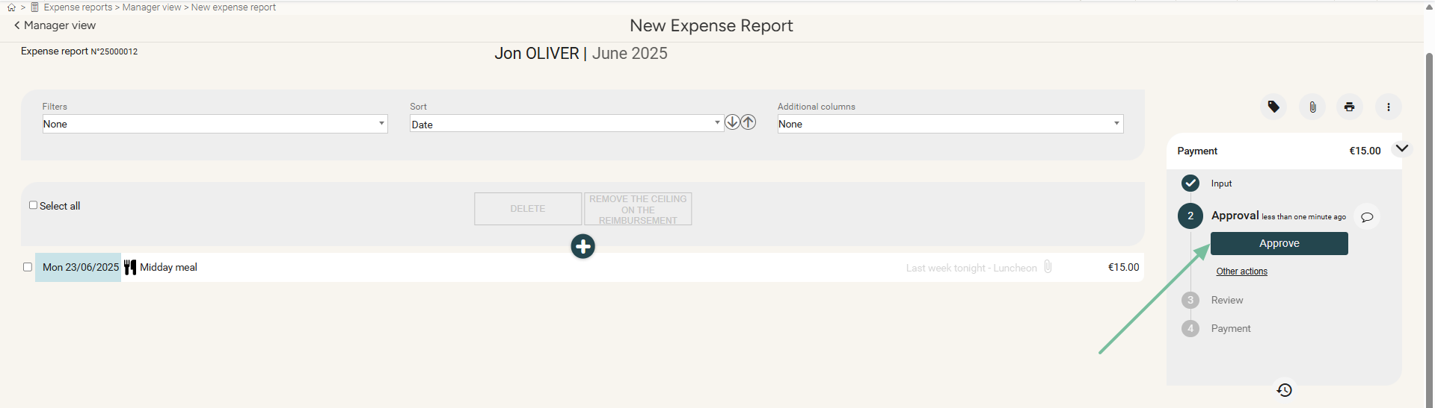
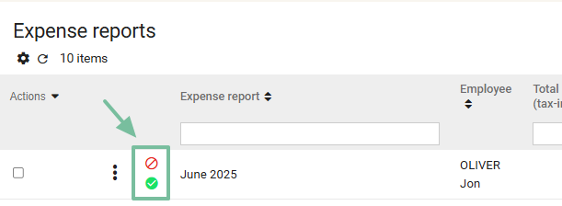
Approving or refusing expenses reports
Either in the details of the expense report:
Or from the list of expense reports, using the markers:

Slide 9
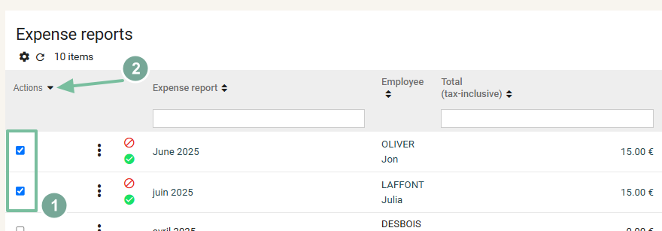
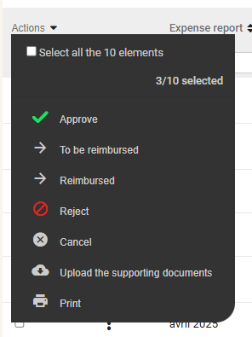

Approving or refusing expense reports – cont.
Or even through a bulk action:
From the bulk actions, you can also print out the receipts or the expense reports:

Slide 10
Managing expense reports

Slide 11
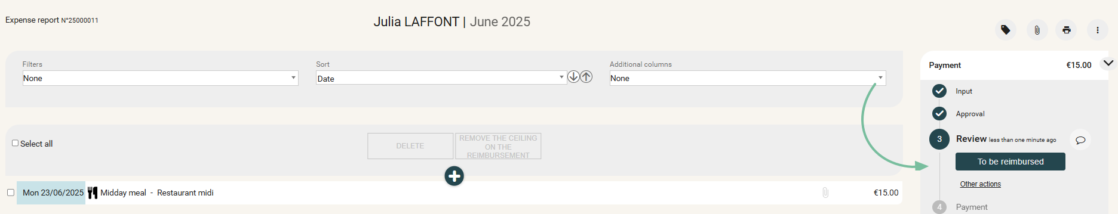
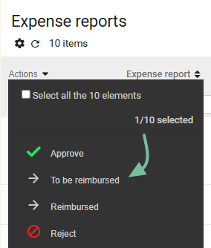
Controling and reimbursing expense reports
Setting an expense report to the “To be Reimbursed” status
means validating the whole report and giving approval for the refund process:
Individually, within each expense report:
Or through a bulk action, from the list of expense reports, using the “To be Reimbursed” action:

Slide 12
Accounting exports

Slide 13
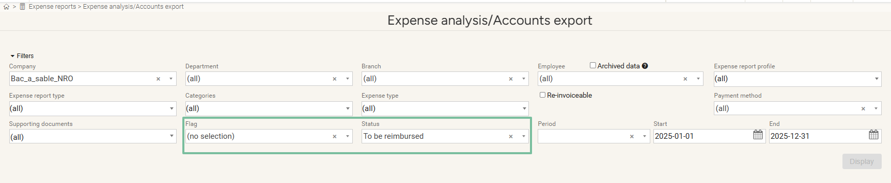
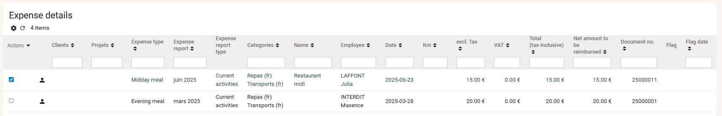
Generating accounting exports
THE Expense reports file
Expense reports > Expense analysis/Account exports

Slide 14

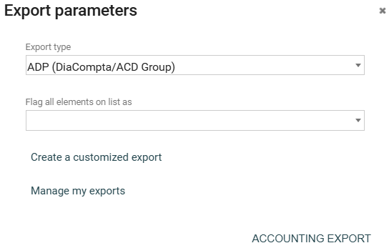

Generating accounting exports
Expense reports file
You may proceed with exports under different formats:
  Excel format:
  Accounting software formats:

Slide 15
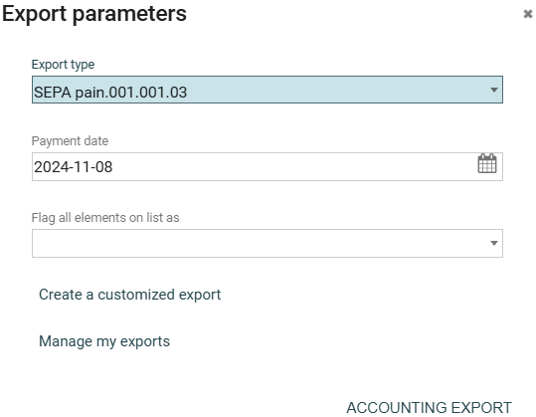
Generating accounting exports
SEpa documents and transfer slips
The SEPA transfer document will be generated from your accounting software
You can, if you wish, generate a recap sheet of all the transfers that need to be sent:

Slide 16
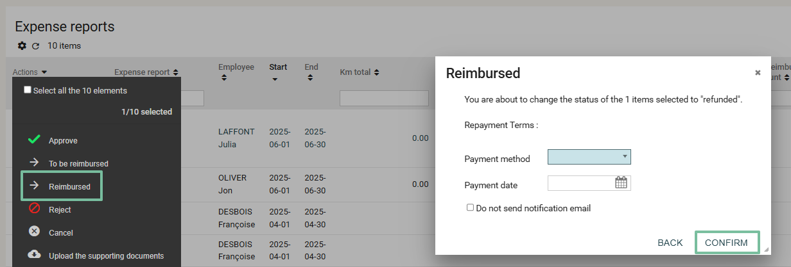
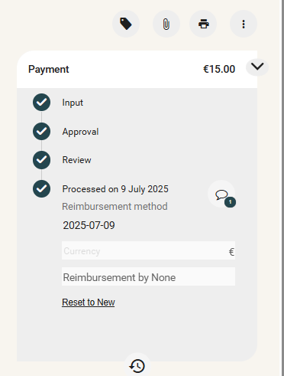
ENDING THE REIMBURSEMENT PROCESS
Marking expense reports as reimbursed
Access: Expense reports > Manager view
Filter the expense reports currently “To be Reimbursed” and then, through a bulk action, set them to the status “Reimbursed”:

Slide 17
Admin area
02

Slide 18
Creating and modifying different types of expenses

Slide 19
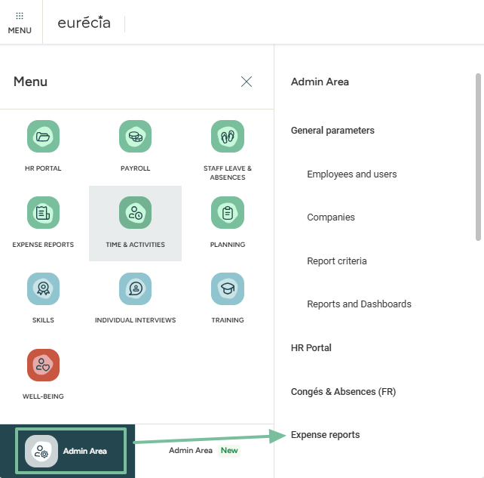
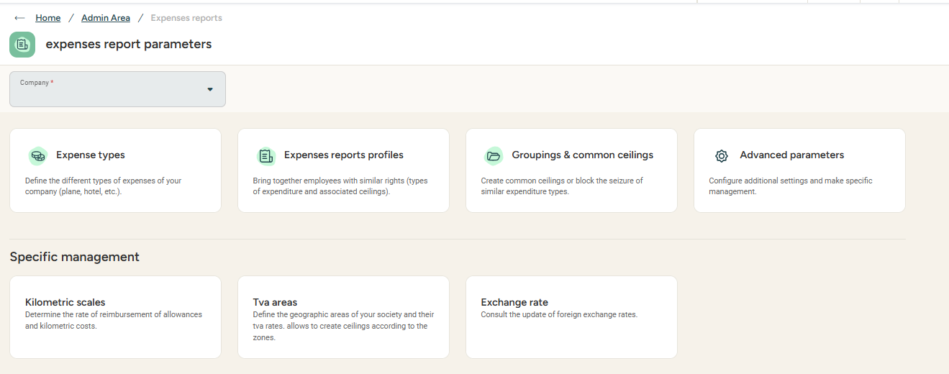
Accessing the expense report settings
Access : Admin area > Expense reports

Slide 20
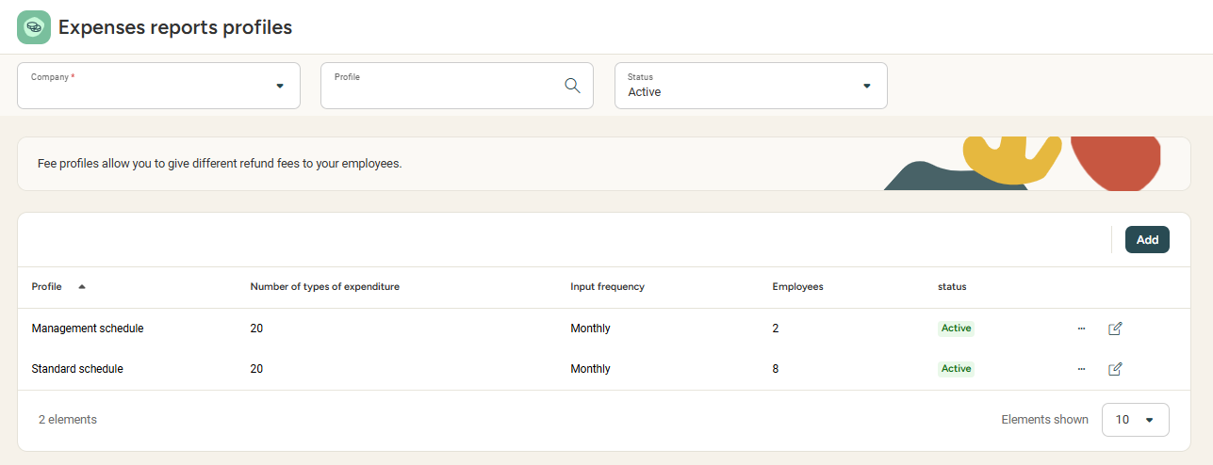
Setting up types of expenses and expense profiles
Creating expense report profiles
Access : Admin area > Expense reports > Expense report profiles
Profiles gather all expenses an employee may use. For example, if some employees are not allowed to use “evening restaurant” expenses, a specific profile for these employees will be required.
Please note that a profile can be duplicated if only a few changes need to be made.

Slide 21
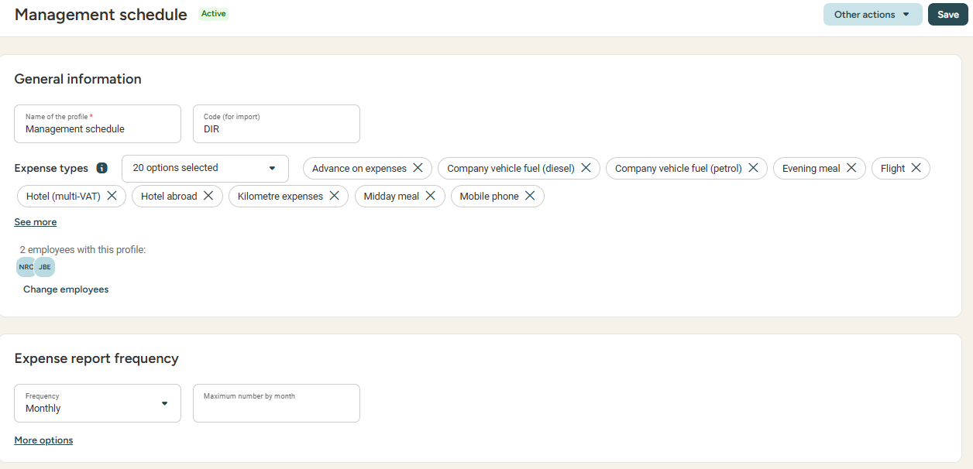
Setting up types of expenses and expense profiles
Creating expense report profiles
From the profile, it's possible to:
Define the expense report frequency (free, weekly or monthly)
Limit the maximum number of expense reports allowed monthly
Determine a deadline to the expense input period
Customise the info displayed and/or required during input
Link expense types to the profile
Link employees to the profile

Slide 22
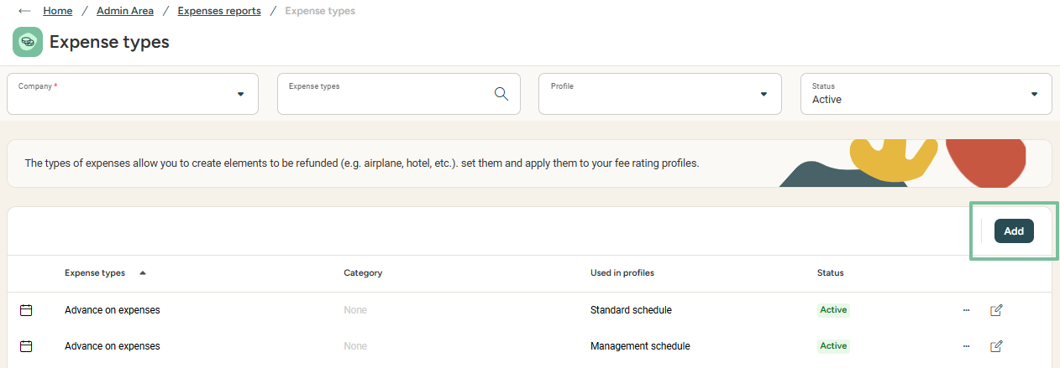
Setting up types of expenses and expense profiles
Creating expense types
Access : Admin area > Expense reports > Expense types
  Please note that a type of expense can be duplicated as well (e.g. if the charge account differs from one profile to another)

Slide 23
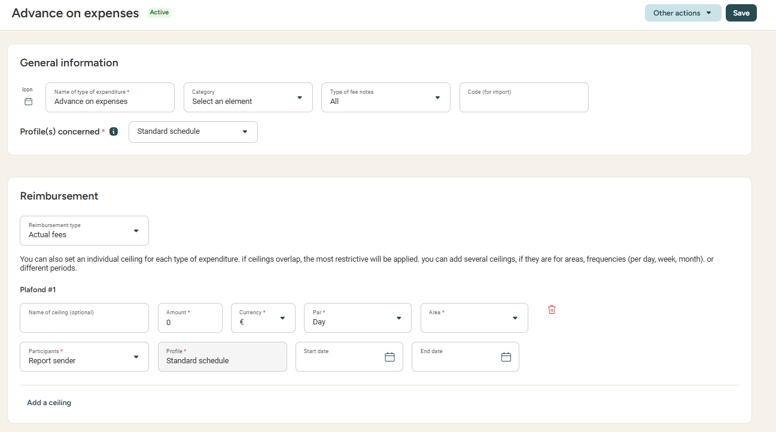
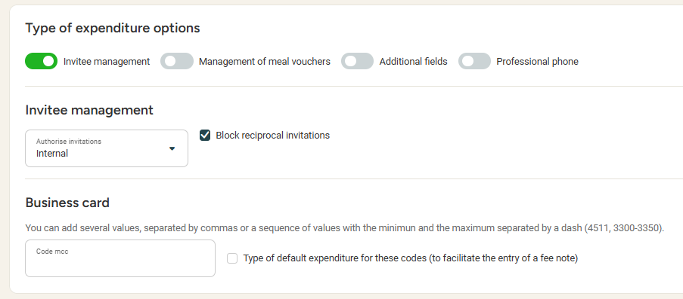

Setting up types of expenses and expense profiles
Creating expense types
Keep in mind that an expense type can be linked to several reimbursement profiles
Here I can manage:
Accounting information: charge account, VAT account, VAT rates and recoverable VAT %
Types of reimbursement (Actual fees, lump sum, km expenses) and reimbursement ceilings (note: a single expense types can be linked to several profiles if the cap is different)
Invitee and meal voucher processing for meal-related expenses
The possibility to add a quantity in the expense for hotel nights

Slide 24
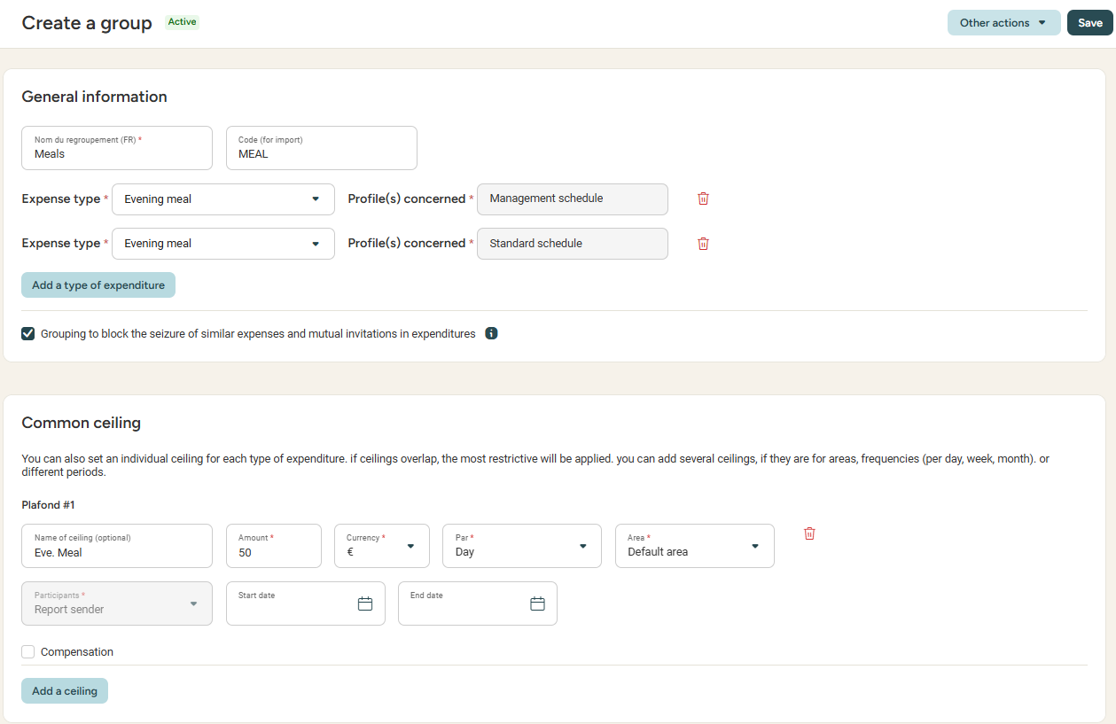
Setting up groupings and common ceilings
Access : Admin area > Expense reports > Groupings & common ceilings
Please note:
An expense grouping allows you to manage reciprocal invitations, for example.
The common ceiling is applied to a group of expenses (e.g. the daily meal ceiling can include the lunch and evening meal expenses). To add a ceiling to a single type of expense, please report to the 'expense types' section.

Slide 25
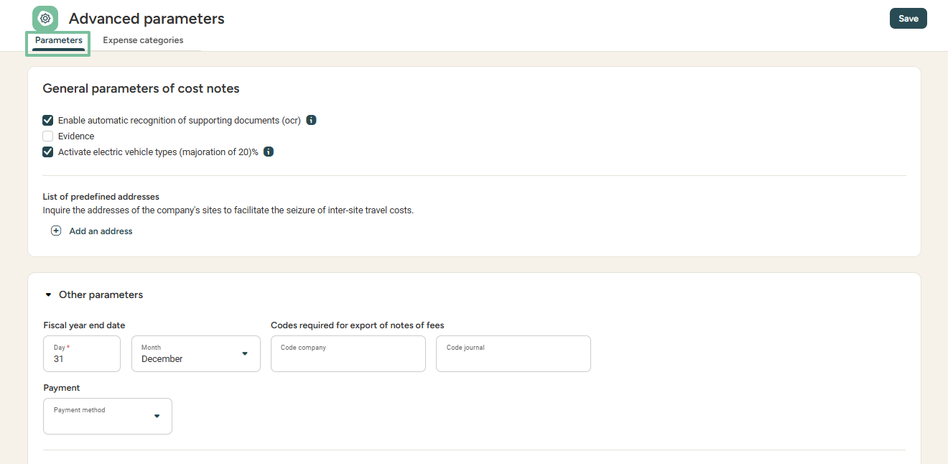
Advanced settings
Access : Admin area > Expense reports > Advanced parameters
From here, you can:
Manage the automatic recognition (OCR) and legitimacy verification of supporting documents ("Evidence")
Enable the 20% surtax on electric vehicules if you use the URSAFF scale
Save predefined addresses for the usage of Google Maps
Enable the management of types of expenses (in case of specific management rules)

Slide 26
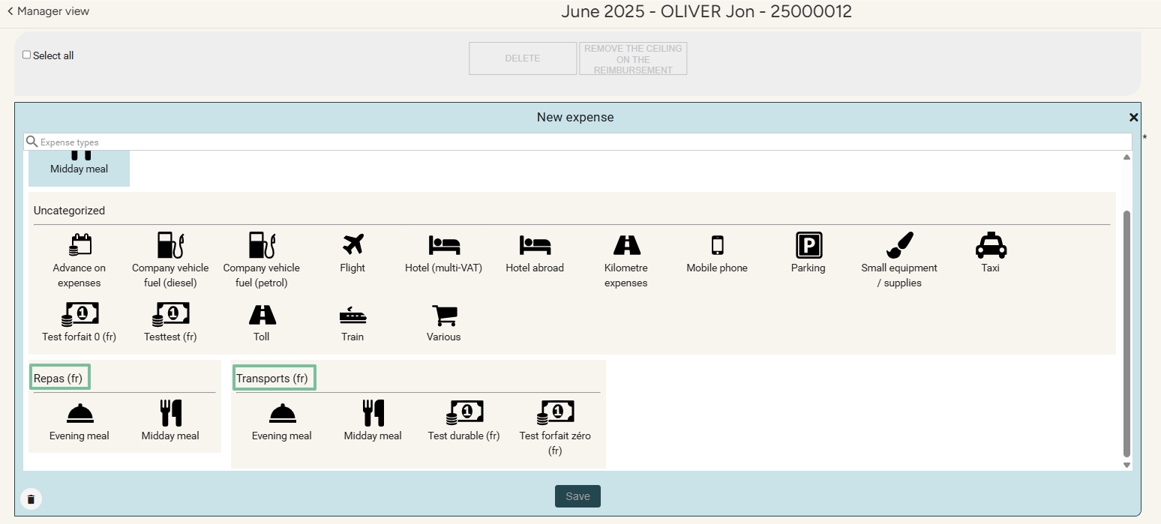
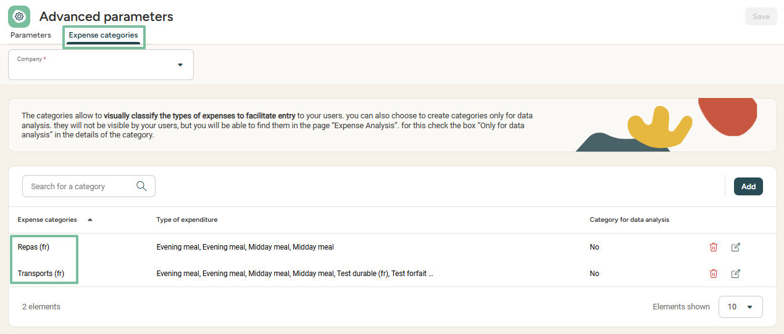
Advanced settings – Expense categories
Access : Admin area > Expense reports > Advanced parameters > Expense categories
Expense categories allow you to create groupings:
Either for analysis purposes (from "Expense analysis/Account exports")
Or for easier display, by regrouping expenses
while creating an expense report

Slide 27
Managing report criteria
Notes:
Changer "Report Criteria" pour "Analytical axes"

Slide 28
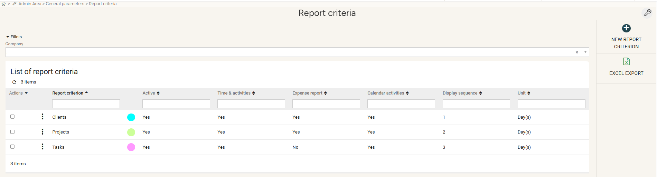
Managing report criteria
The report criteria menu
Access : Admin area > General parameters > Report criteria > Open
Report criteria allow for the allocation of time spent on one or more activities,
for statistical purposes or in the context of intermediate validations.

Slide 29
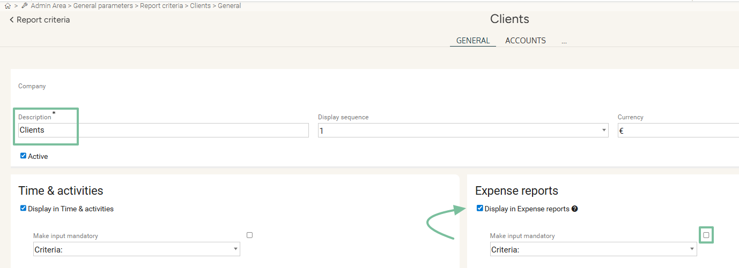
Managing report criteria
Creating A NEW report criteriON
Access : Admin area > General parameters > Report criteria > Open > New report criterion
In the "General" tab:
Give a name to the criterion in the “Description” field.
Check the box “Display in Expense Reports” to use this criterion in expense reports.
Check the box “Make input mandatory” if you want this axis to be required when submitting expense reports

Slide 30
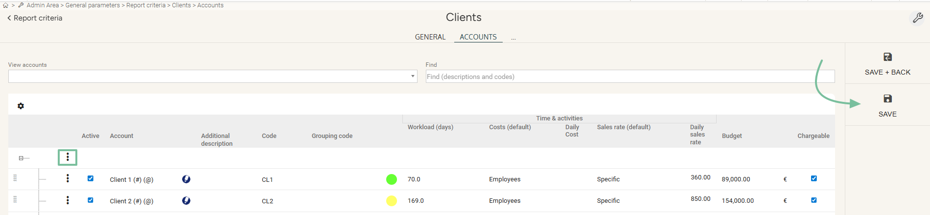
Managing report criteria
Creating or duplicating report criteria
Access : Admin area > General parameters > Report criteria > Open > [Selected criterion] > Accounts
In the "Accounts" tab:
Click on the three vertical dots, then choose “Insert a new line” to create an account.
In the newly created line, enter the account name in the “Account” column,
along with the desired information in the other columns.
Click “Save”.

Slide 31
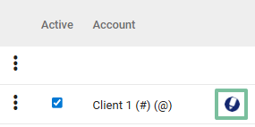
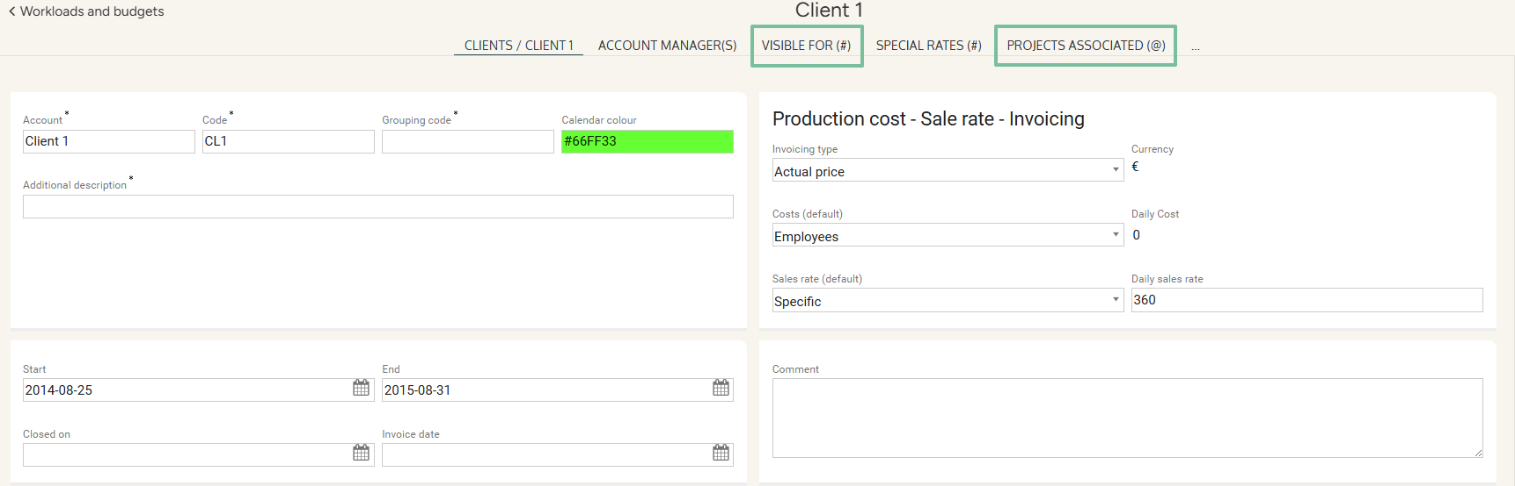
Managing report criteria
Setting up a report criterion
In the "Accounts" tab:
  Click on the pen icon to bring any changes:
The “Visible For” tab allows you to restrict the visibility of an analytical account to certain users.
The last tab is named after the next criterion and allows you to create links between criteria.

Slide 32
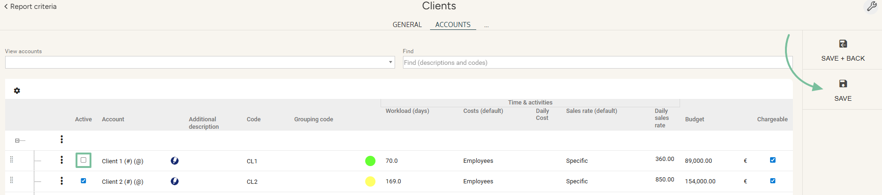
Managing report criteria
Deactivating an account
Access : Admin area > General parameters > Report criteria > Open >[Selected criterion] > Accounts
In the "Accounts" tab:
Uncheck the box in the “Active” column to deactivate the selected account.
Click “Save”.

Slide 33
Still have questions?
All the answers are within your reach.
support@eurecia.com
Help center

