Slide 1


All you need to know about
Interviews
user training guide
Last updated
July 2025

Slide 2


Employee usage
Training program
Accessing my interviews
Preparing my interview
Manager usage
Conducting an interview
Validating an interview
Manager & employee usage
Viewing an interview
Printing an interview

Slide 3
Employee usage
01

Slide 4
Accessing my interviews

Slide 5
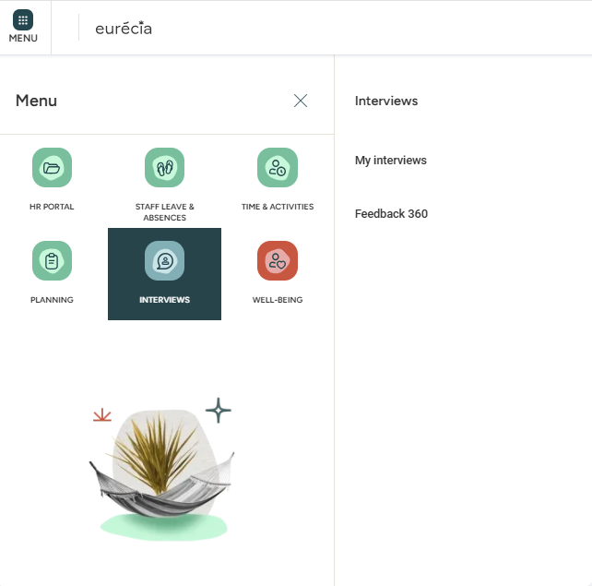


Employee usage
Accessing my interviews
From your homepage, access your interviews
by clicking Menu > Interviews > My interviews :

Slide 6
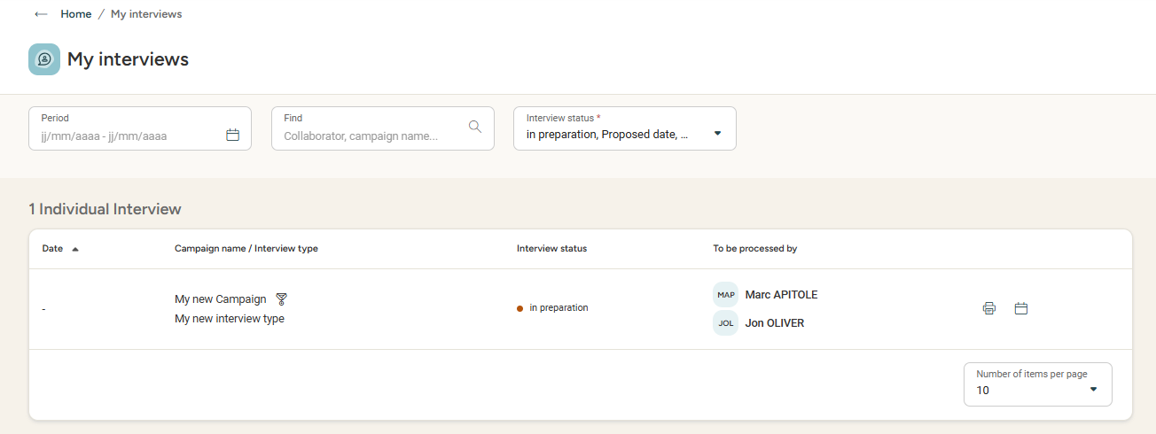
Employee usage
Accessing my interviews
You can find the interview you're interested in by:
using the different filters at your disposal (time period, interview status – in preparation, proposed date, done...)
Looking up the name of the interview campaign

Slide 7
Preparing my interviews

Slide 8
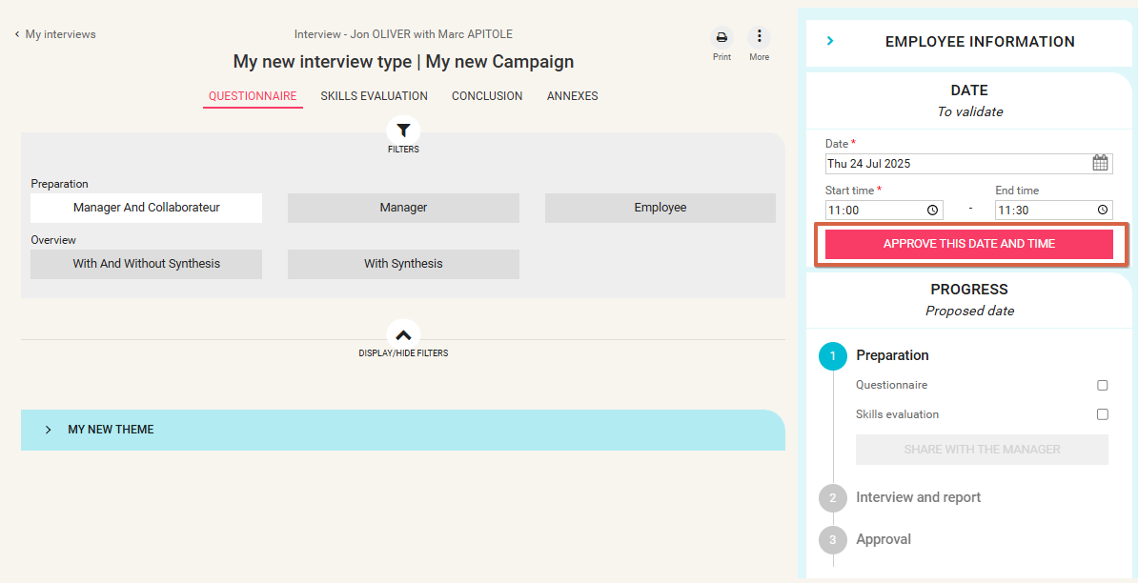
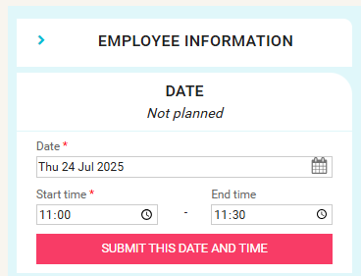
Employee usage
Setting the interview date
Approving an interview date:
To accept an interview date proposed by my manager:
Open the interview
Click on Approve this date and time
To propose an interview date:
Open the interview
In the "Date" section, enter a date and start time
Submit this date and time for approval

Slide 9
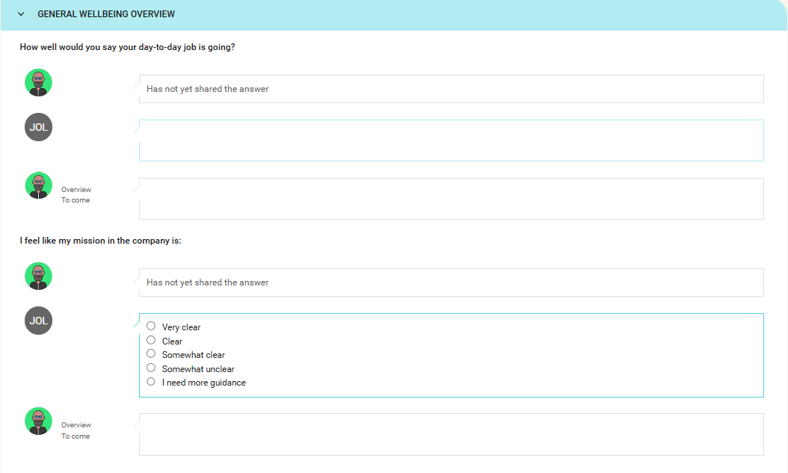

Employee usage
Preparing my interview
Preparing answers to questionnaire:
As an employee,
I answer
the questions next to my photo or my initials.
The interview questionnaire is organised into different themes to group the questions.
If my manager has prepared the interview and shared their preparation, I can see their responses next to their photo/initials. Otherwise, the phrase "Has not yet shared the answer" appears.
The Overview field is marked
'to come':
it will be activated during the face-to-face interview.

Slide 10
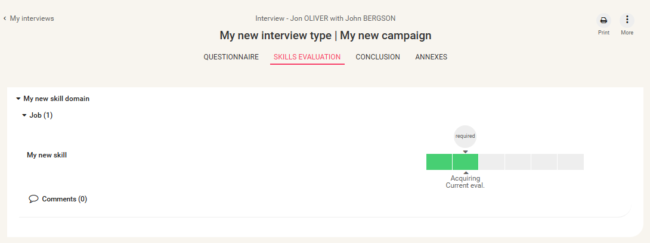

Employee usage
Preparing my interview
Evaluating skills (If the Skills module is activated)
For each displayed skill,
I pre-evaluate my level
by clicking on the gauge.
The required level for my job
is indicated by the "Required" icon.
I can also see my level as evaluated in the previous assessment and possibly the evaluation done
by my manager if they have shared it.

Slide 11
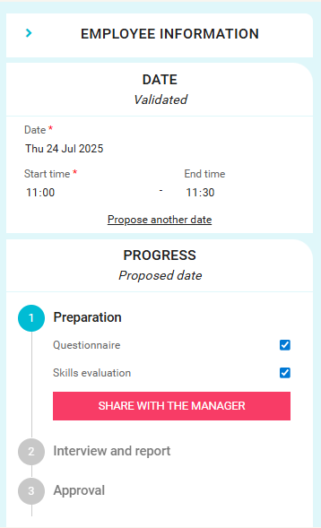
Employee usage
Preparing my interviews
Sharing my answers with my managers
I can share my interview preparation
with my manager if I wish.
I can choose to share either (or both):
My answers to questionnaires
My skills self-evaluation
Once information is shared, any modification will be automatically shared.

Slide 12
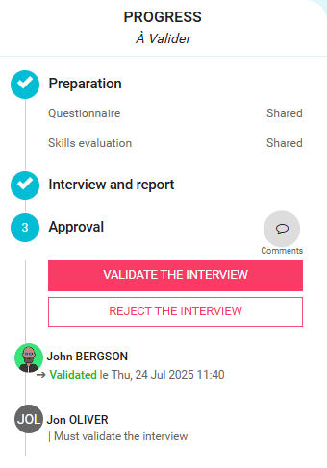
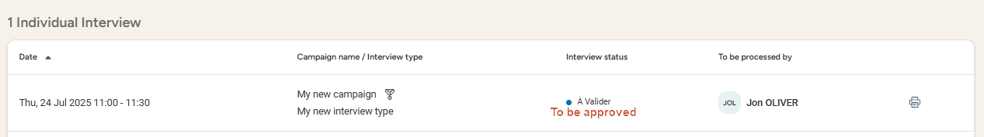
Employee usage
Validating or contesting the interview
Approving or contesting an interview
When my manager has completed the report, I receive a notification email. I can then approve or contest the interview.
The status of my interview is To be approved.
I can click on the interview to go into detail and access the validation.
What happens if I reject the approval of the interview?
I must provide a comment with further details about the rejection. Then an email is sent to my manager, who can make the necessary changes and send the report to me again.

Slide 13
Manager usage
02

Slide 14
Conducting an interview

Slide 15
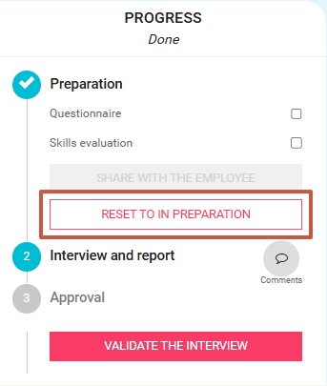
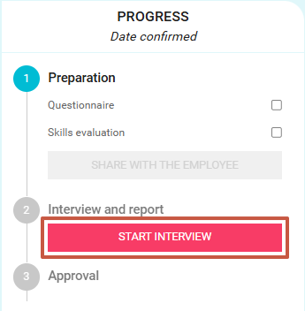
Manager usage
Conducting an interview- questionnaire
Starting an interview face to face
I click Start interview
to begin the face-to-face interview.
If I want to go back to the previous step, I click Reset to In preparation

Slide 16
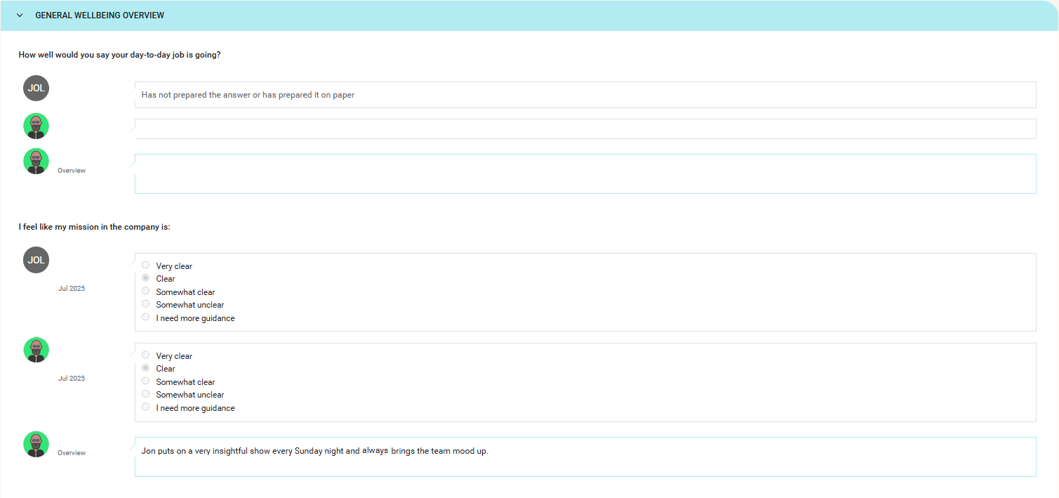
Manager usage
conducting an interview - questionnaire
Completing overviews for each question
I can view the answers for each question if they have been shared by the employee.
If my employee has published their responses but has not entered anything in some questions, the message
Has not yet shared the answer or prepared it on paper appears.
I enter the summary of our exchanges in the Overview section.

Slide 17
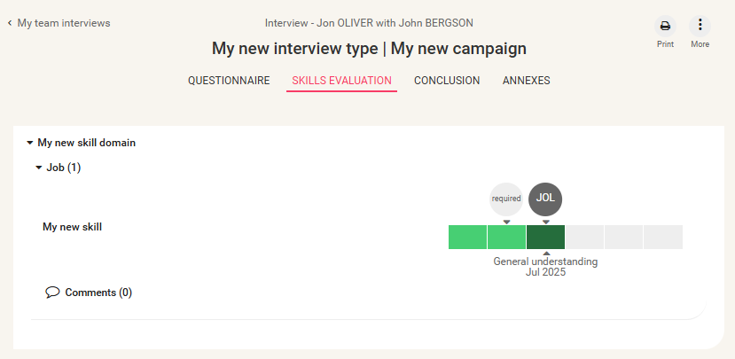
Manager usage
Conducting an interview – skill evaluation
Evaluating skills (If the Skills module is activated)
Here I can find the pre-evaluation of skills done by the employee during the preparation if the employee has decided to share this information.
I can also adjust my own evaluation based on my preparation if I wish.

Slide 18
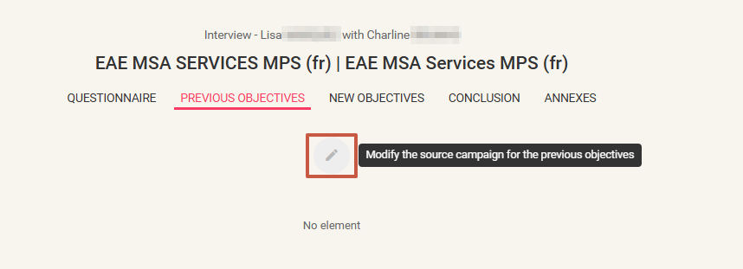

Manager usage
Undertaking an interview – Previous objectives
Evaluating previous objectives
In the 'Previous objectives' tab, I find the objectives set during the previous interview campaign:
If only one previous campaign is detected, the previously set objectives automatically appear.
If multiple source campaigns are detected by the system, I can choose the campaign from which I want to retrieve the objectives by clicking on
In the window that opens, I choose the relevant campaign and click on modify.

Slide 19
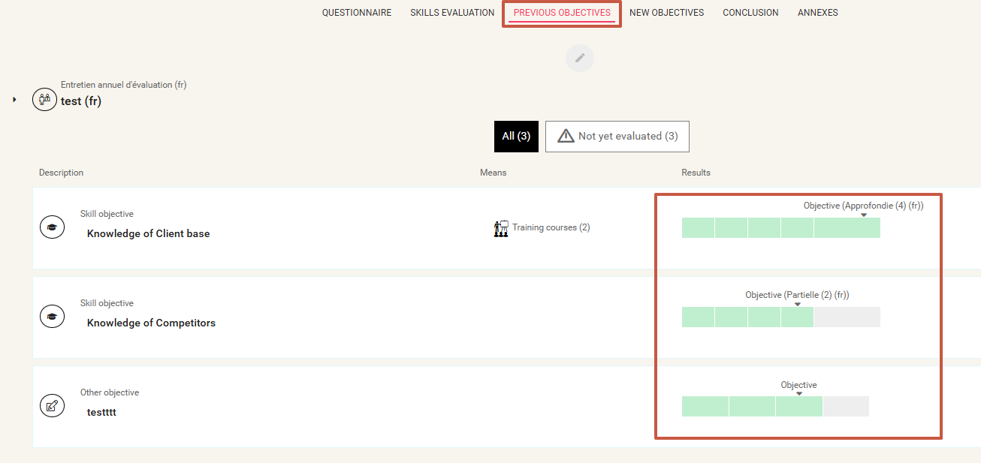
Manager usage
Undertaking an interview – previous objectives
Evaluating previous objectives
Each objective can be evaluated with a rating depending on the type of objective.

Slide 20
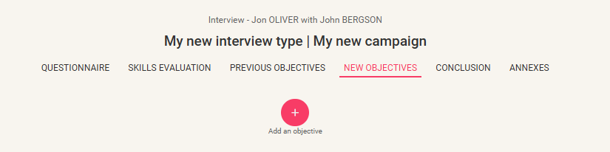
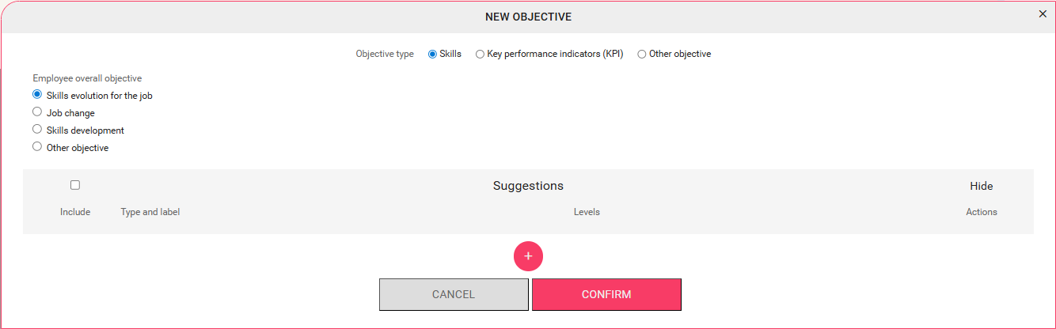
Manager usage
Undertaking an interview – new objectives
Setting New objectives for the coming year
In the New Objectives tab, click on the Add an objective button to create a new objective.
There are 3 types of objectives:
Skills: (If the "Skills" module is activated)
Enables the evaluation
of the employee's skills
Key Performance Indicators (KPI)
Other objective:
Free field

Slide 21
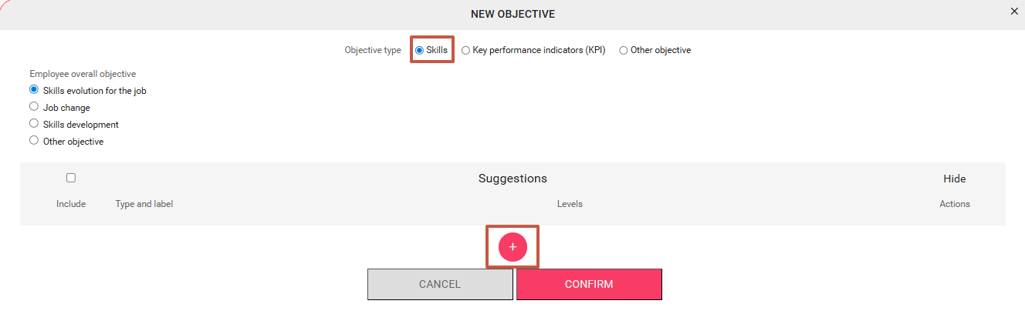
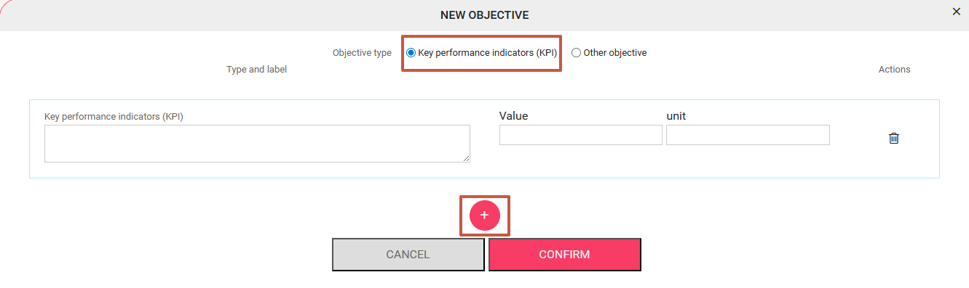
Manager usage
Undertaking an interview – new objectives
Setting New objectives for the upcoming year
Skills:
Select the relevant skills and expected levels to be achieved.
KPI:
Enter the objective label, expected target and unit.
Other objective:
Enter the objective description

Slide 22
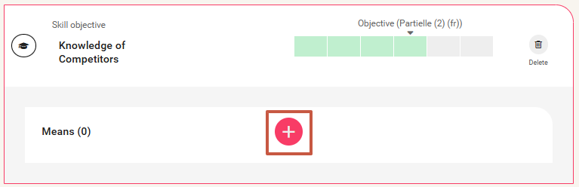
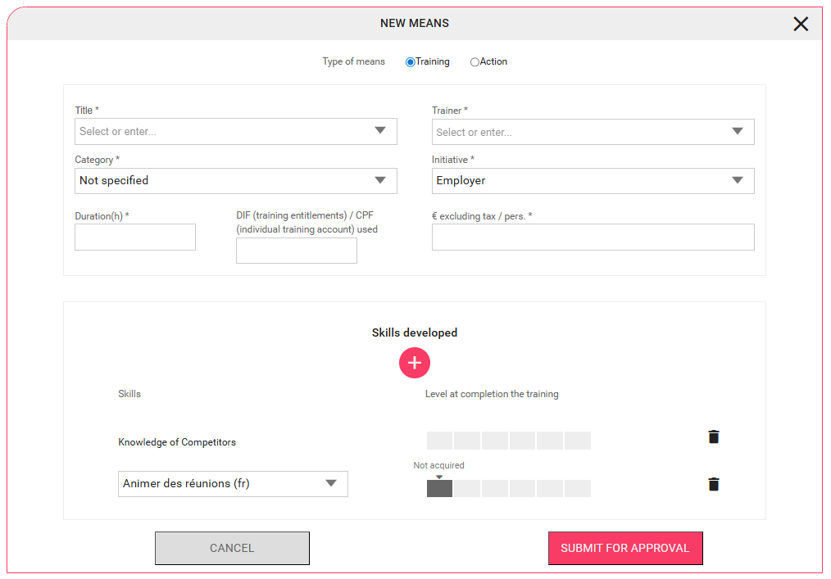
Manager usage
Undertaking an interview – means to achieve objectives
Entering a Means to achieve relevant objectives (If the Training module is activated)
Once the objective is added, click on an objective name to display the details, then click on the "+" button.
It is possible to add the employee to a training present in the training catalog.
To do this, in the Title field, enter the name of the training.
If it exists, click on it to fill in all the elements.
If it does not exist, enter the desired training name and fill in the fields.
Note: Anyone added to training from the interviews will not be automatically enrolled in the training but will have the status "Envisaged".

Slide 23
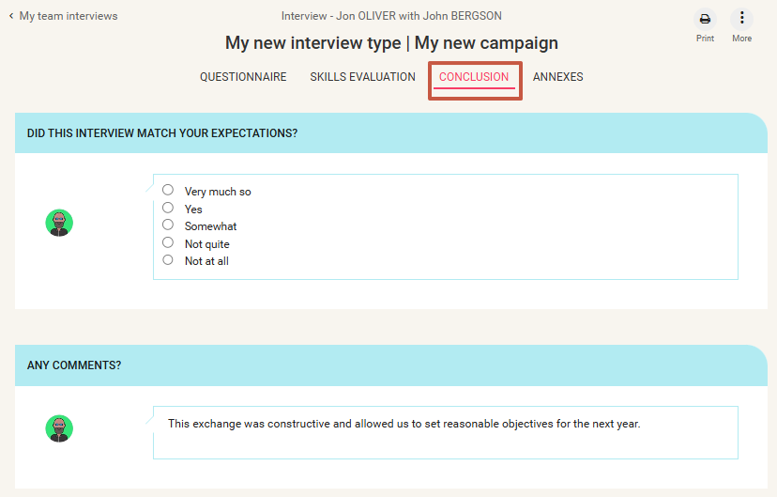
Manager usage
Undertaking an interview - conclusion
Completing conclusion elements
In the Conclusion tab, you can now enter the answers to the conclusion questions.
These questions are only available at the last stage of the interview, so they cannot be prepared in advance.
Note: Only managers can fill this information!

Slide 24
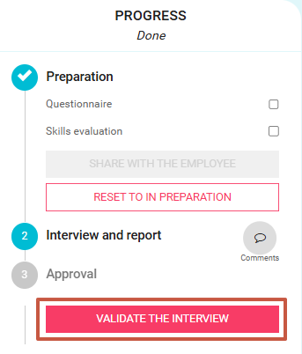
Manager usage
Undertaking an interview – finalising the interview
Validating the interview
Once completed, I, as a manager, can submit the interview for approval by clicking on the "Validate the interview" button.
Depending on the approval cycle, the relevant person (often the employee) will receive an email to validate the interview.

Slide 25

Manager usage
Undertaking an interview – resetting the interview
Resetting the interview status to In preparation
In case of an error, you can always return to the preparation stage to make modifications.
To do this, simply click on Reset to In preparation.

Slide 26
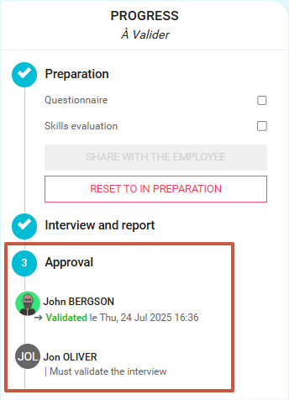
Manager usage
Validating an interview - overview
Reviewing the interview approval history
Here you will find the details of the actions taken during the interview as well as the actions to be taken by each actor.

Slide 27
Manager & Employee usage
03

Slide 28
Reviewing current & past interviews

Slide 29
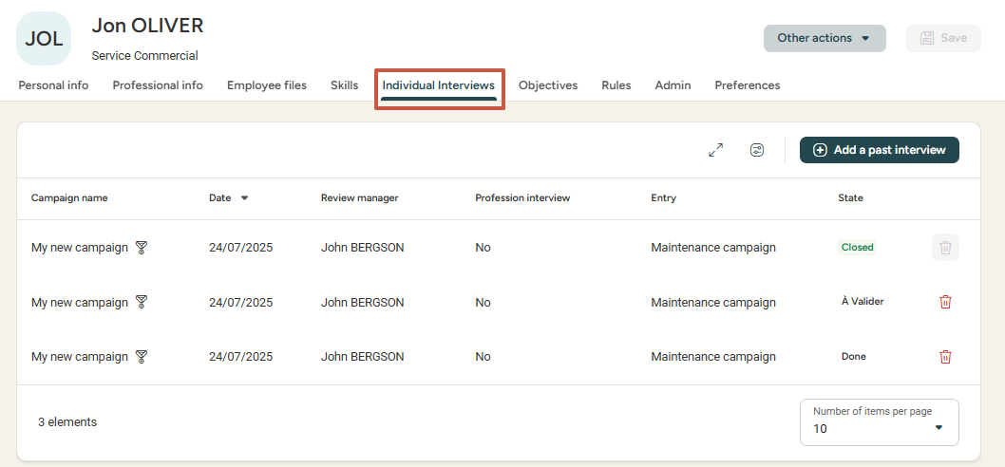
Manager & Employee usage
Reviewing current & past interviews
Interview history
Whether I am an employee or a manager, I access the history of completed interviews in the employee record's Individual nterviews tab.
I find the list of all ongoing and past interviews in a single tab.

Slide 30
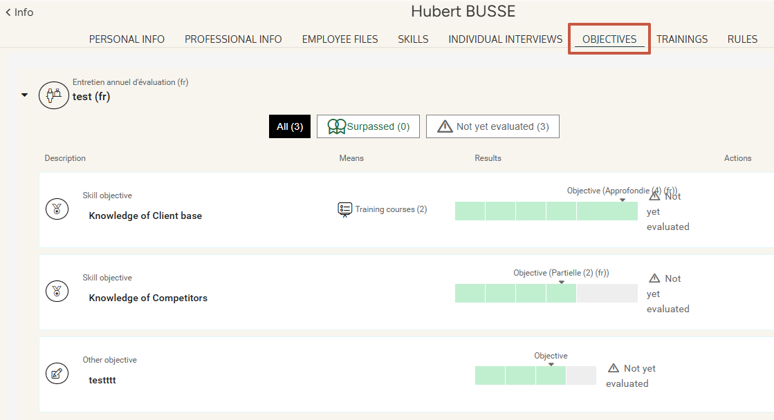
Manager & Employee usage
Reviewing objectives
Reviewing objectives
Whether I am an employee or a manager, I access the set objectives via the employee record's Objectives tab.
I find the list of past years' objectives with their evaluations as well as my upcoming objectives.

Slide 31
Printing interviews

Slide 32
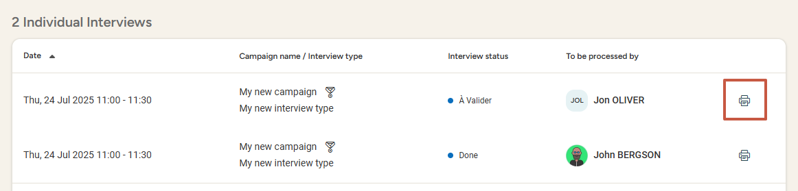
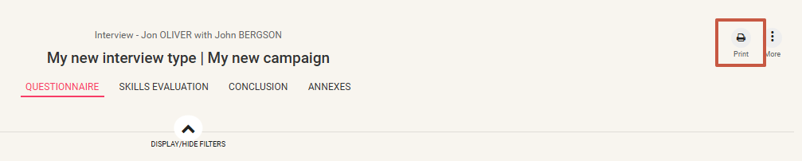
Manager & Employee usage
Printing interviews
Printing interviews
I can print my interview at any stage of the process (whether the interview is in preparation, completed, closed...)
From the list of current & past interviews:
« My interviews » as an employee
« My team interviews » as a manager
In the interview details:

Slide 33
Still have questions?
All the answers are within your reach.
Admin email address
Help Center

