Slide 1


All you need to know about
Interviews
Admnistrator training guide
Last updated
July 2025

Slide 2

At the end of this training , administrators will be able to:
Training objectives
Set up rights for the talent modules
Set up and manage interviews
Create and monitor interview campaigns

Slide 3

MODULE features
Training program
Setting up rights
Creating and managing a type of Interview
Creating and monitoring interview campaigns

Slide 4
Module features
01

Slide 5
Setting up rights
02

Slide 6
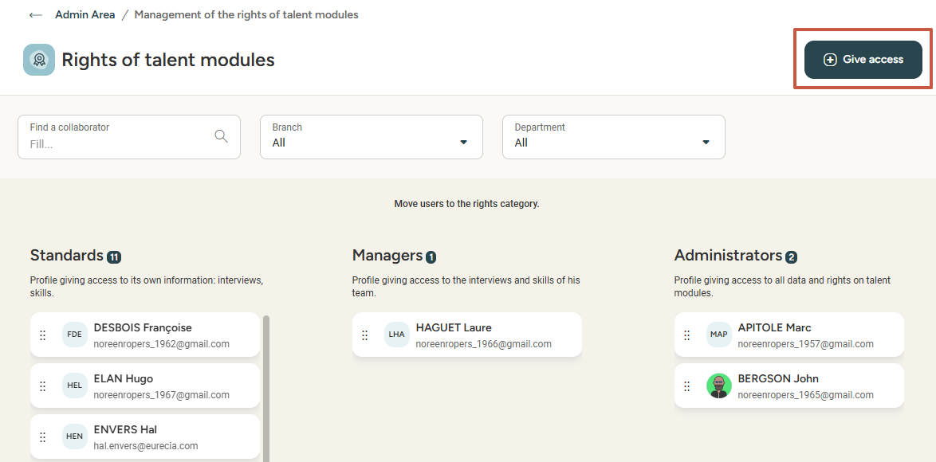

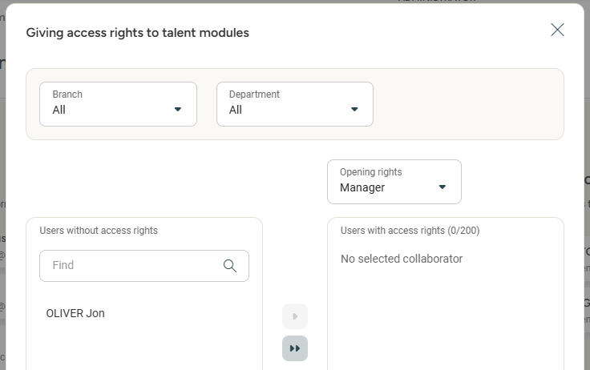


Managing permission for talent modules
Managing rights for the talent modules
Access: Menu > Admin area > SIRH rights
This step concerns solely the employees
for whom the talent modules are activated.
Drag and drop employees into the appropriate sections: standard employees,
managers who need to conduct interviews,
and administrators who create
and manage interview campaigns.
Please note: an employee cannot
be in two sections simultaneously.
It is possible to assign rights in bulk
by clicking the Give Access button.
Select the category of rights for
the selected employees, then click
the "Move All" button to apply
the changes:

Slide 7
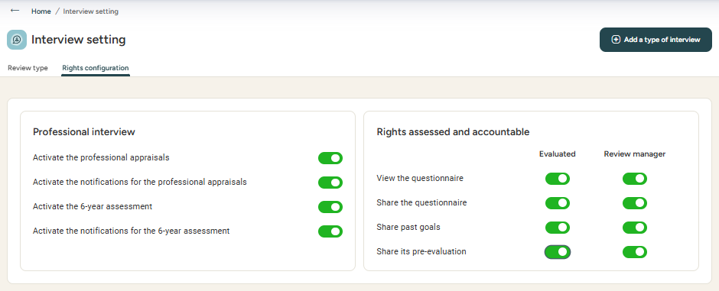
Managing permission for talent modules
Managing rights for types of interviews
Access: Menu > Admin area > Annual interviews
Professional interview settings (Left side):
Allows you to define the settings to apply
to professional interviews.
By enabling notifications for professional and 6-year review interviews, the administrator will receive a notification
at the beginning of each month with the list of employees eligible for these interviews when they reach 2 or 6 years
of seniority in the company.
Managing visibilities (Right side):
Allows defining the rights for both employees and managers during
the interview preparation phase:
View the questionnaire gives access to preparation questions
Share the questionnaire so each can see the other's questionnaire
Share past objectives during the preparation phase
Share pre-evaluation to publish the skills assessment,
if the Skills module is activated

Slide 8
Setting up and managing interviews
02

Slide 9
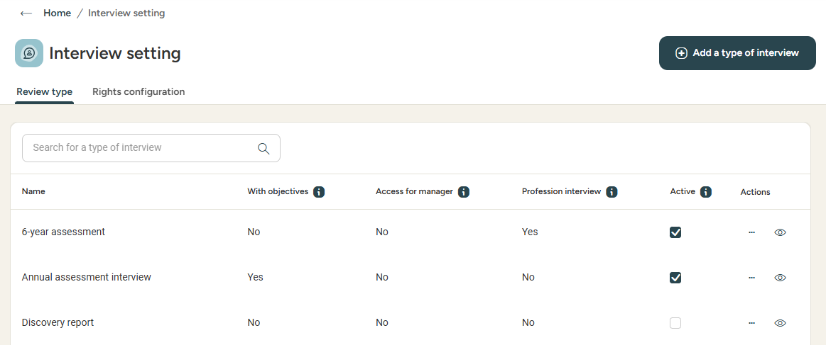
Setting up interviews
Reviewing the type of interview
Access: Admin area > Interviews > Interview setting
In the "Review type" tab,
you can find all the existing interview types ready to be used, including drafts.
From this window,
it is possible to activate
or deactivate interviews, edit or delete them, and preview the question framework
and print the questionnaire.
Activate or deactivate a type of interview
Duplicate or delete
Preview the interview
Type of interview
Professional interview or 6 Year review

Slide 10
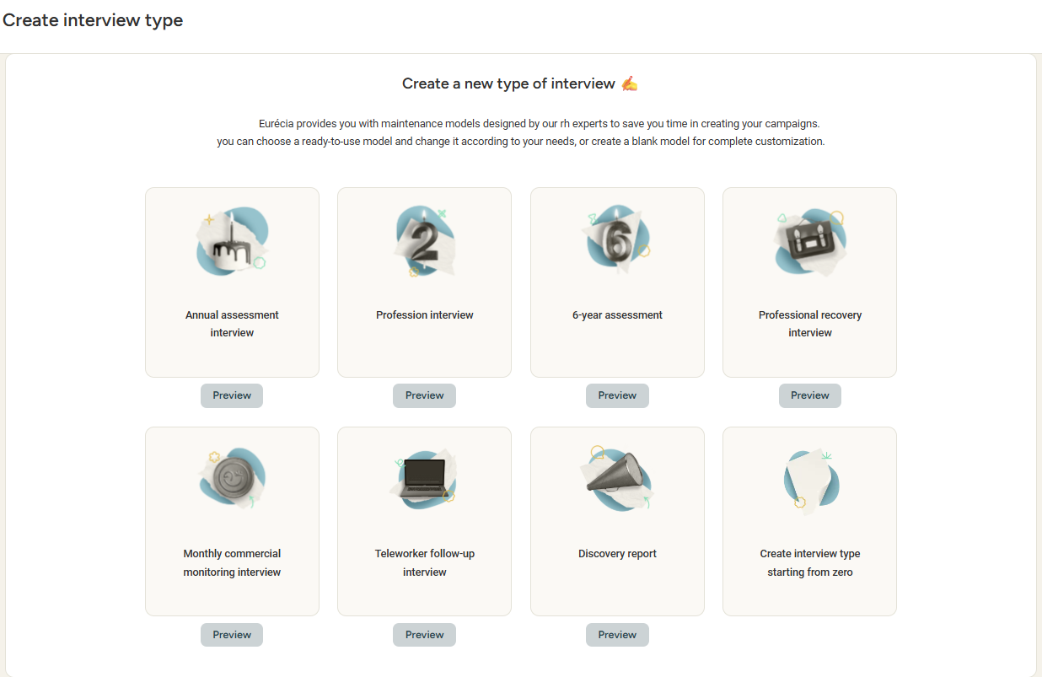

Setting up interviews
Creating a type of interview
Access: Admin area > Interviews > Interview setting
By clicking the Add a type of interview button accessible from the previously seen "Review type" tab...
...the administrator can create an interview type, either from a Eurécia template or from scratch, editing the question set and previewing the edited questionnaire.

Slide 11
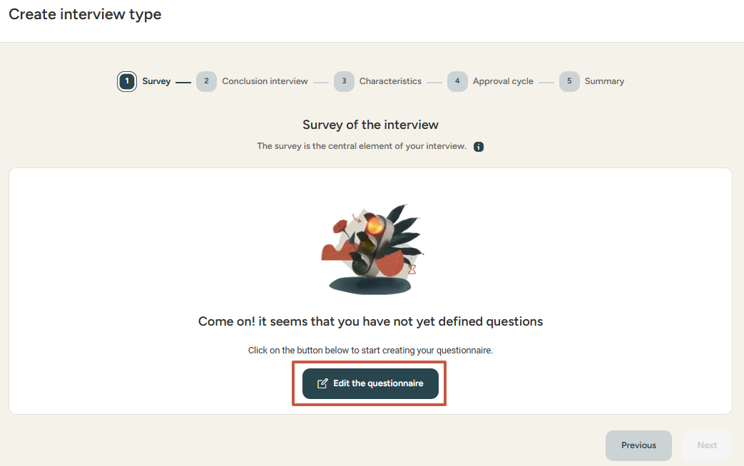
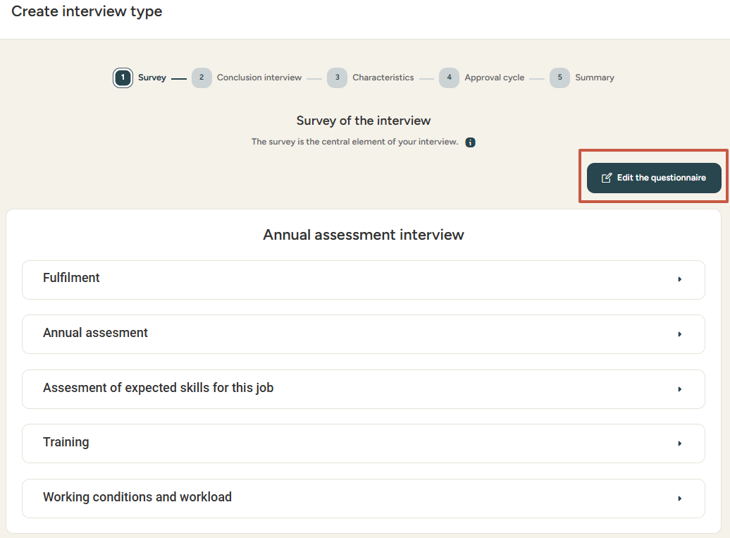
Setting up interviews
editing a type of interview - Questionnaire
Access: Admin area > Interviews > Interview setting > Add a type of interview
From scratch...
Select the interview type to edit.
Clicking Create interview type starting from zero leads to a page
with steps to creating the interview questionnaire:
Questionnaire
Interview Conclusion
General Characteristics
Approval cycle
Summary
Click Edit the Questionnaire
to customize themes and questions.
...or from an existing questionnaire!

Slide 12
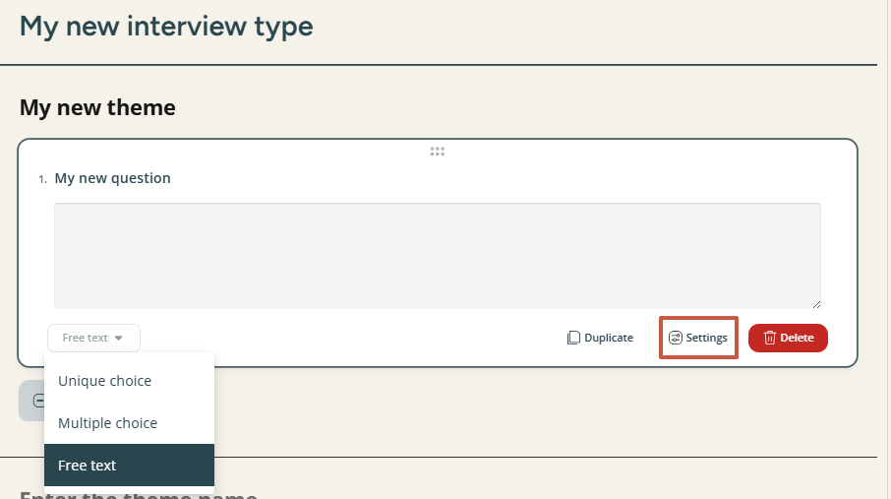
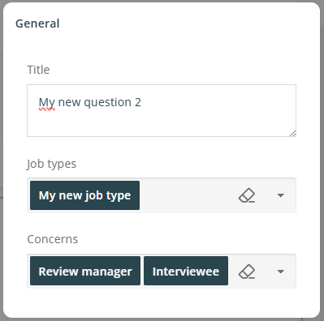
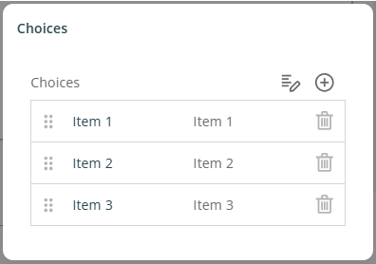
Setting up interviews
editing a type of interview – Questionnaire - II
You can choose between single-choice, multiple-choice, or free-text questions
for the questionnaire.
To better structure it, use the editing features by clicking the Settings button visible on each question box.
The settings allow you to:
Specify the title of each question
Determine who should answer the question
(the evaluated / interview manager / both)
Select the question type (single choice, multiple choice, free text)
Arrange questions logically and coherently
These options allow you to personalise and organise
the questionnaire according to specific evaluation needs.

Slide 13
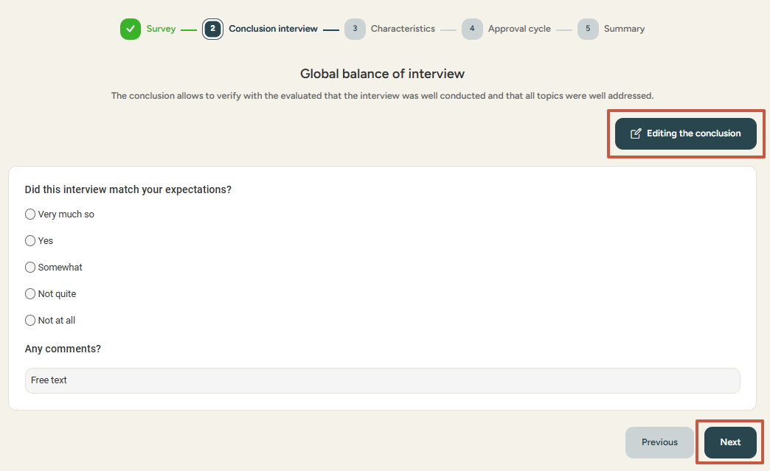
Setting up interviews
editing a type of interview- conclusion
The interview conclusion ensures all topics have been covered and the interview went smoothly.
A default conclusion is provided but can be edited to fit your needs. You can modify and personalise the questions, in the same way as the questionnaire.
Conclusion elements are filled only by the interview manager.

Slide 14
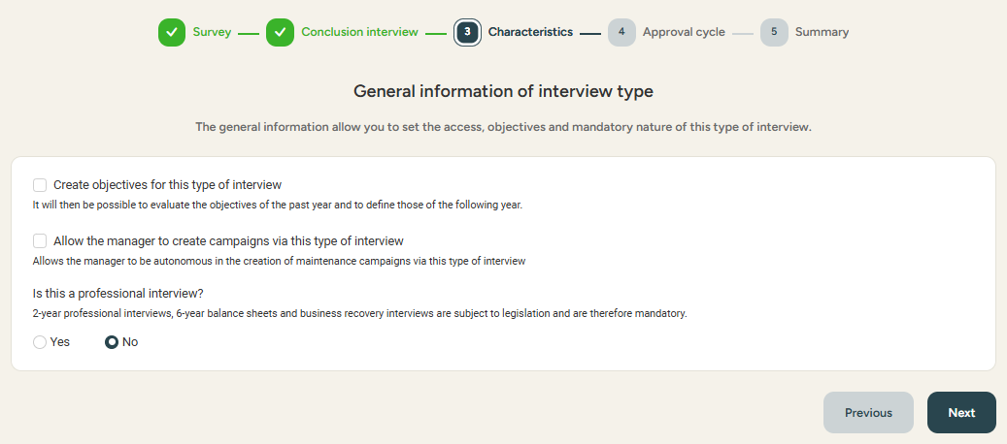
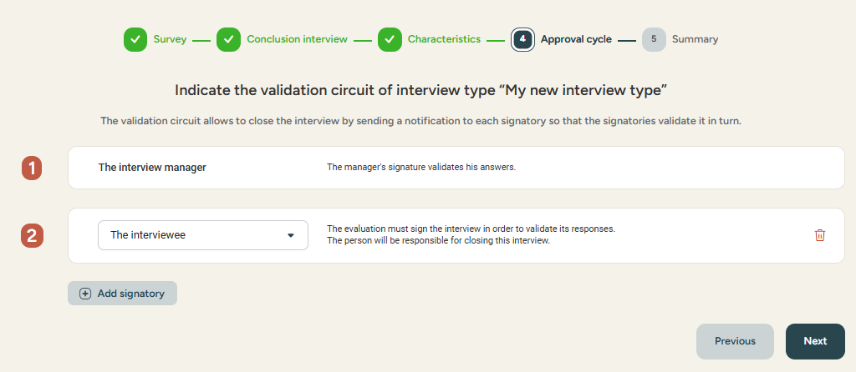
Setting up interviews
editing a type of interview- Characteristics
Defining characteristics (3) allows for the setting of essential elements of the interview, such as:
  Creating objectives for this interview type: evaluate the previous year's objectives and define those for the next year
  Allowing the manager to create campaigns via the selected or newly created interview type
  Determining if it is a professional interview (every 2 years),
  a 6-year review, or any other mandatory interviews
The approval cycle (4) is crucial for finalising the interview.
The administrator can define an approval cycle suitable for the selected or newly created interview type.
By default, the interview manager and the evaluated are proposed.
The administrator can add signatories by clicking the Add a Signatory button.
Each signatory will receive a notification to validate the interview in turn.
Once all previous steps are completed, it is possible to view a summary (5) of the interview creation. This review ensures all information is correct before finalising the interview.

Slide 15
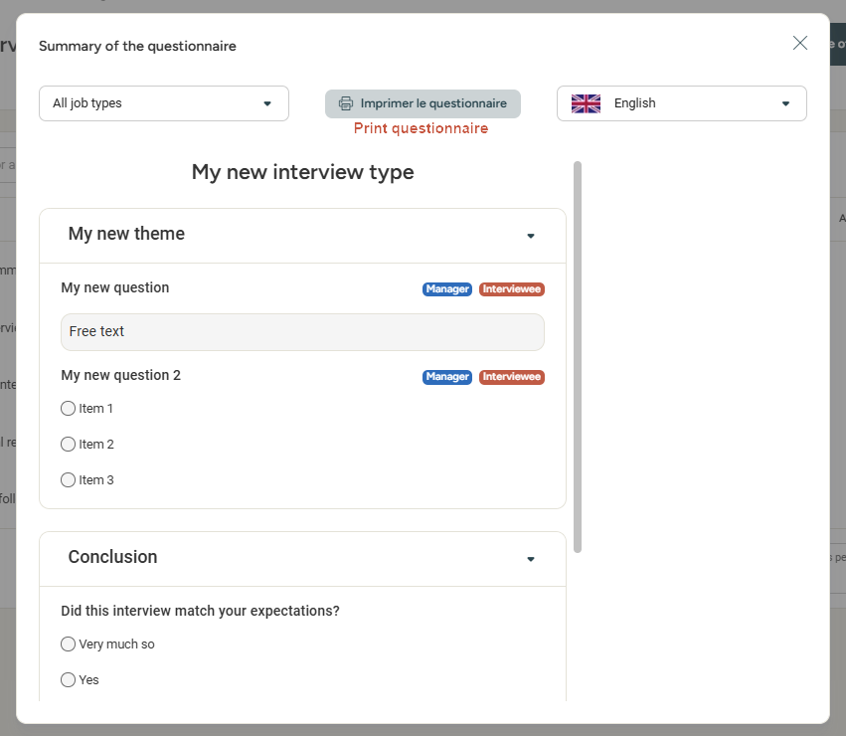
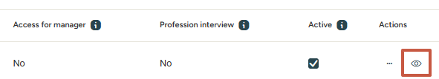
Setting up interviews
Previewing and printing a questionnaire
You can preview and/or print the interview questionnaires from the Interview setting menu:

Slide 16
Creating
and monitoring interview campaigns
03

Slide 17
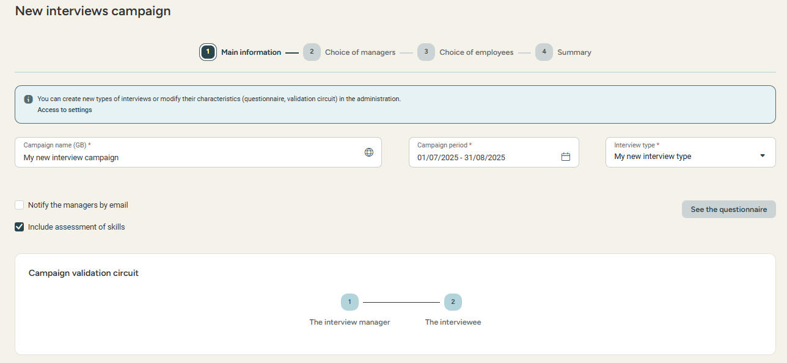

Setting up interview campaigns
Creating a new campaign
Access: Menu > Interviews > Campaigns > Create a campaign
Note: this campaign will only
be visible to the talent
module administrators.
Managers will not have access
to other managers' interviews
in this campaign.
Set up a name and start and end dates for the campaign.
Select the type of interview:
  If selecting a "professional interview" type and if relevant, you cancheck the "6-year assessment" box:
    →More info on the Eurécia help center.
Check the Notify the managers by email box if you wish to inform interview managers about the campaign creation.
Check the Include assessment of skills box for the employee and their manager to evaluate each skill before the interview.
Click Next to access other steps to determine the people involved in the campaign.

Slide 18
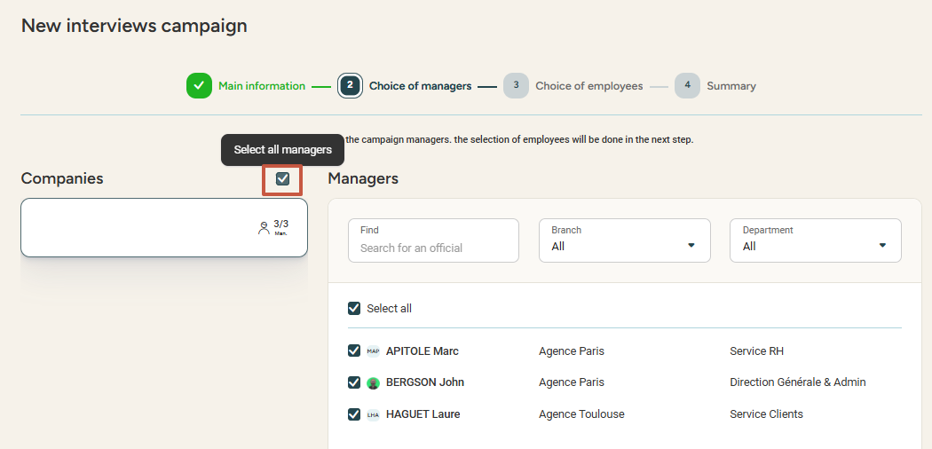
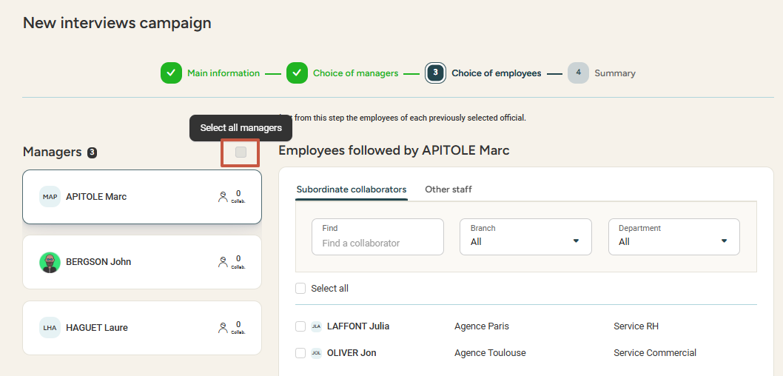
Setting up interview campaigns
selecting participants
You can determine the managers, then the employees, who will participate in this campaign.
Check the Select all managers box if you want to select all managers automatically, or manually select the managers you wish to involve in the campaign. In the next step, check Select all managers to automatically select all of their subordinates, or select employees manually.
It is also possible to determine an interview manager other than the direct manager.
By default, employees are linked to their N+1 manager (see the "Subordinate collaborators" tab), but it is possible to choose another interview manager by assigning other employees to the interview manager (see the "Other staff" tab).
Selection of Managers
Selection of Employees

Slide 19
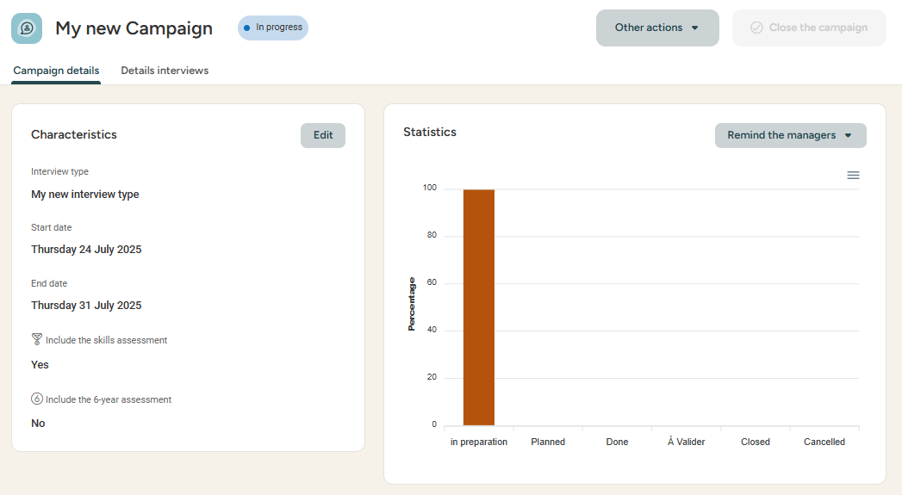
Setting up interview campaigns
Monitoring campaigns
Access: Menu > Interviews > Campaigns (> Select campaign)
The campaign manager or administrator can monitor the campaign, status of each interview, and remind managers to take action if necessary.
Note:
Interview managers can find their interviews in the My Team's Interviews menu (access: Interviews > My team interviews)

Slide 20
Still have questions ?
All the answers are within your reach.
support@eurecia.com
Help center

