Slide 1



All you need to know about
Payroll
Support de formation administrateur
Last updated
July 2025

Slide 2

By the end of the training, administartors will be able to
Training objectives
Prepare and process payroll elements
Generate export files for payroll processing
Generate payslip imports

Slide 3


module functionalities
Training program
Generating an export file for absences
Generating an export file for worked hours
Generating a payroll grid
Generating meal voucher files
Importing payslips
Administrator area
Identifying the different types of leaves and absences to be exported & setting up the relevant codes
Identifying relevant worked hours to be exported. Setting up relevant codes for overtime/additional hours
Setting up meal vouchers
Setting up and managing payroll grids

Slide 4
Module features
01

Slide 5
Generating the Absence Export
File

Slide 6
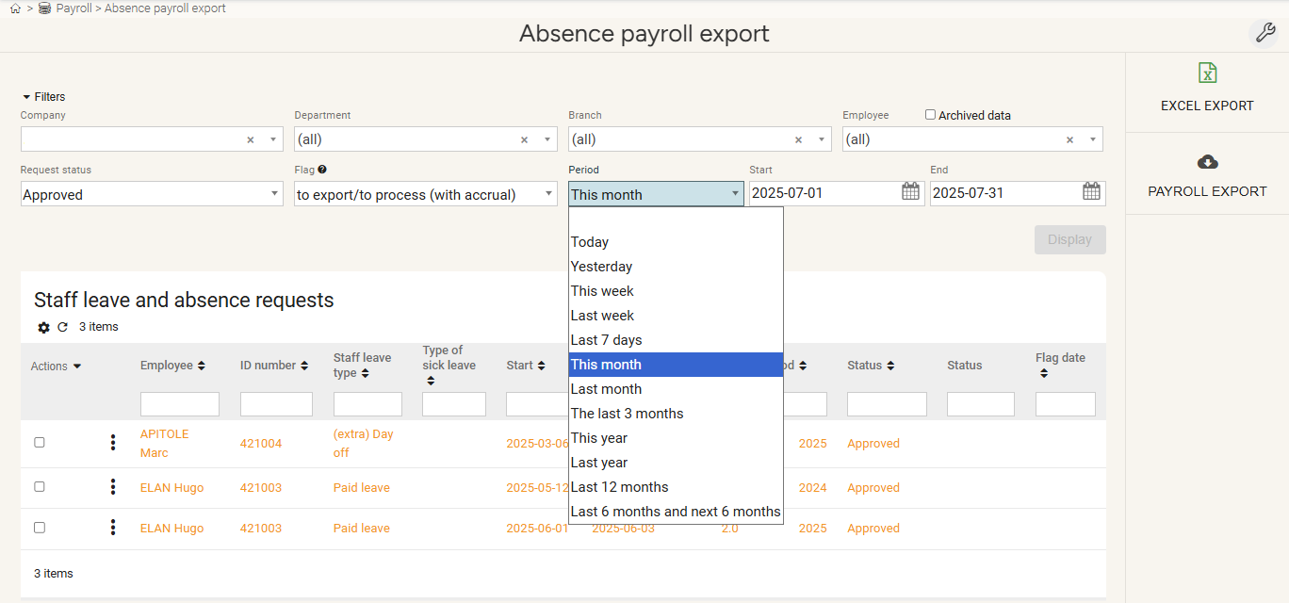

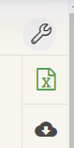

ABSENCE EXPORT FILE
EXPORTING LEAVES AND ABSENCES
Access: Menu > Payroll > Absence payroll export
Generates a file in the required format for payroll softwares.
Generates an Excel file of absences (for review).

Slide 7
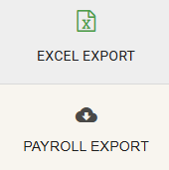
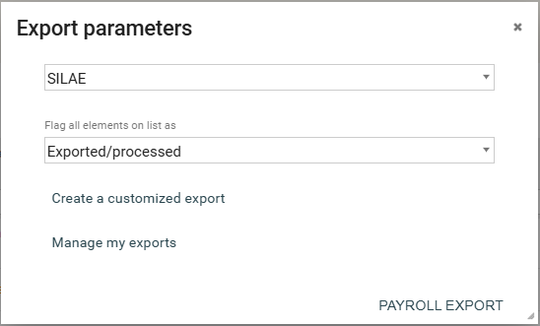
ABSENCE EXPORT FILEABSENCE EXPORT FILE
marking data
Access: Menu > Payroll > Absence payroll export
Flagging allows you to virtually "stamp" the absences exported to payroll software as well as meal vouchers.

Slide 8
Generating the Hours Export
File

Slide 9
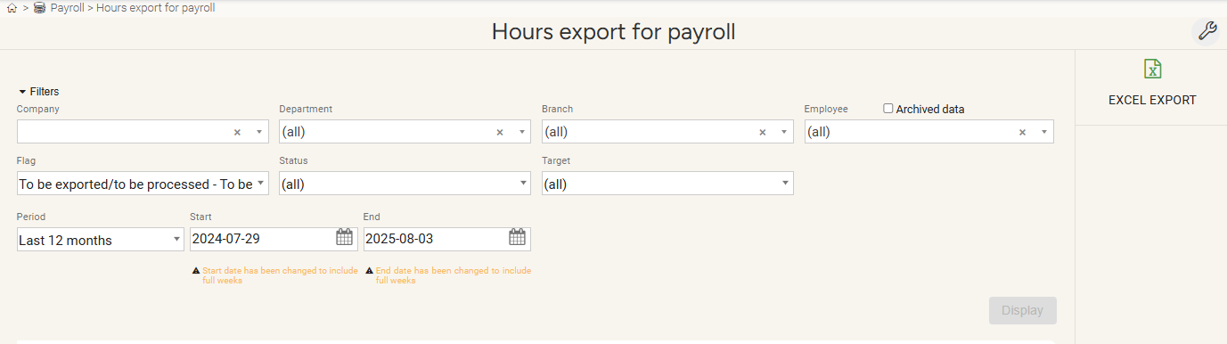
EXPORT HOURS TO PAYROLL
EXPORTING OVERTIME/ADDITIONAL HOURS
Access: Menu > Payroll > Hours export for payroll
This menu displays all extra hours worked by employees. All data orginate from timesheets (Time & activities).
The 'Status' and 'target' filters reflect actions taken within timesheets.
The file generated from this menu will include the overtime entered in the validated timesheets, for which the "transfer" action has been performed for payroll purposes.
Please note: this data can only be exported as an Excel file.

Slide 10
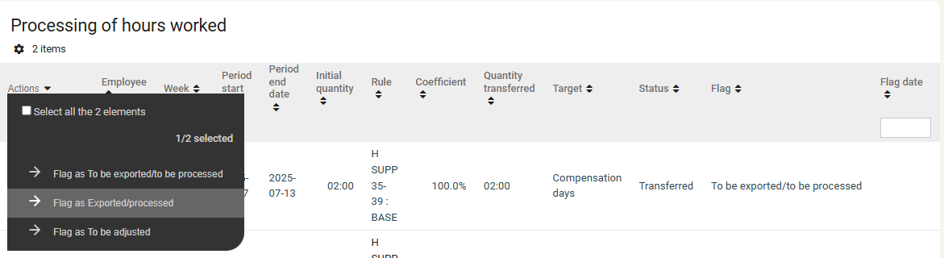
TRANSFER OF OVERTIME
flagging data
Access: Menu > Time & Activities > Transfer of overtime
Flagging this data serves as a virtual "stamp" for the hours previously exported within your Excel file.

Slide 11
Generating
Payroll Grids

Slide 12
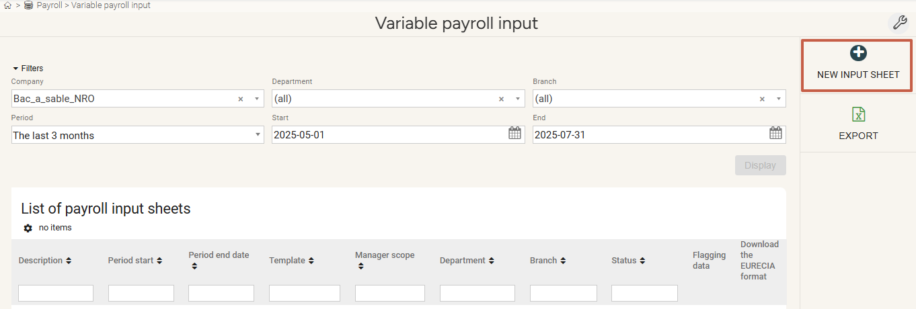
PAYROLL GRIDS
GeneratING the monthly payroll griDS
Access : Menu > Payroll > Variable payroll input

Slide 13
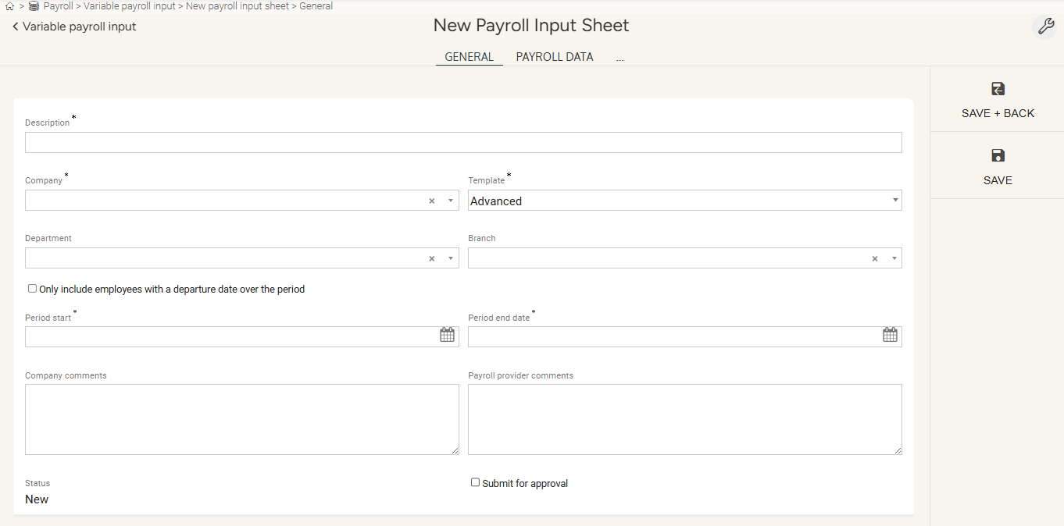
PAYROLL GRIDS
GENERATING PAYROLL GRIDS
Access : Menu > Payroll > Variable payroll input

Slide 14
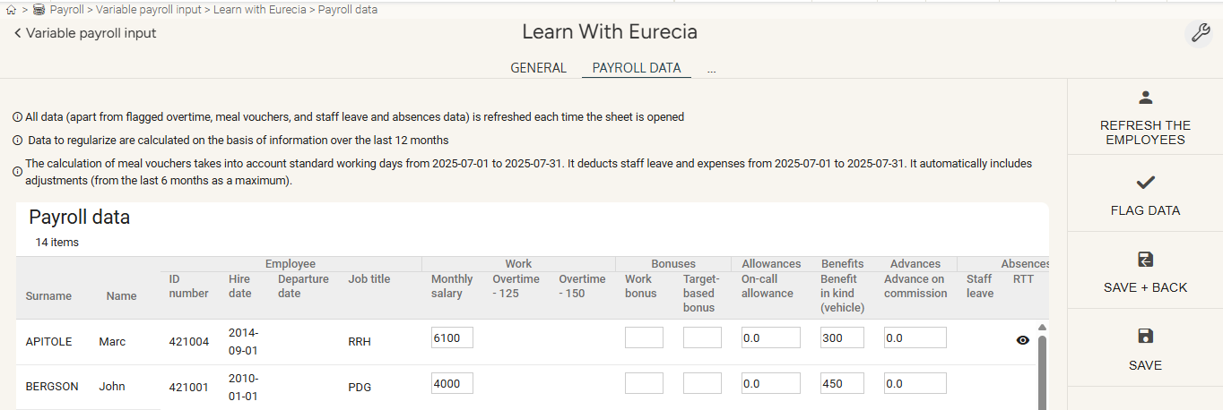
PAYROLL GRIDS
GENERATING PAYROLL GRIDS
Access : Menu > Payroll > Variable payroll input
Data is automatically retrieved from the platform and/or manually entered,
depending on the configuration of the payroll fields, and whether or not the HR Portal module is subscribed to.

Slide 15
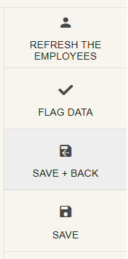
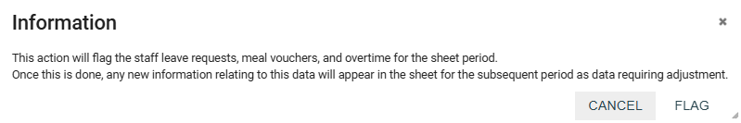
PAYROLL GRIDS
flaggING DATA
Access : Menu > Payroll > Variable payroll input
Flagging allows virtual stamping for:
Leaves and absences
Overtime and additional hours
Meal vouchers

Slide 16
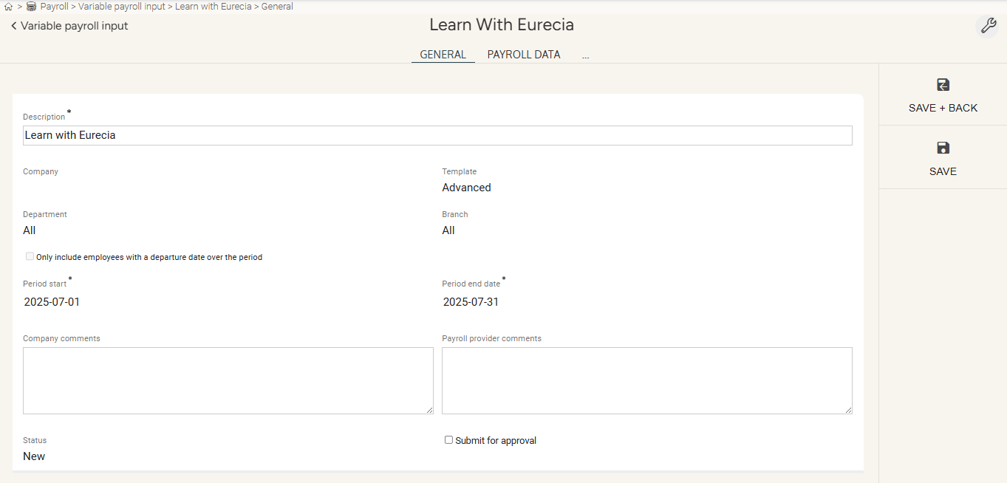
PAYROLL GRIDS
VALIDATING PAYROLL GRIDS
Access : Menu > Payroll > Variable payroll input

Slide 17
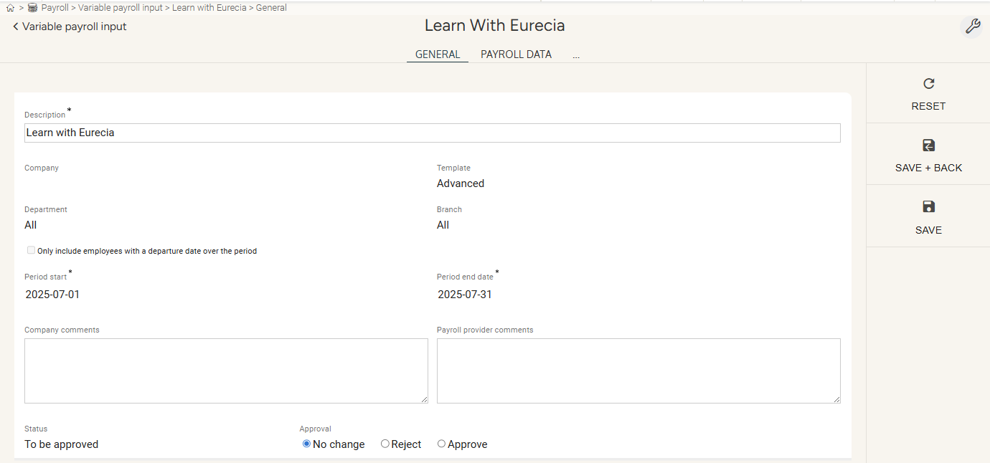
LA GRILLE DES ELEMENTS VARIABLES DE PAIE
Approving the pay grid
Access : Menu > Payroll > Variable payroll input
Approving the grid breaks the link between the grid and the employee file.
Any future changes in the employee file will not affect the validated grid.

Slide 18
Generating the Meal Voucher File

Slide 19
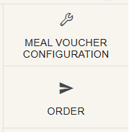
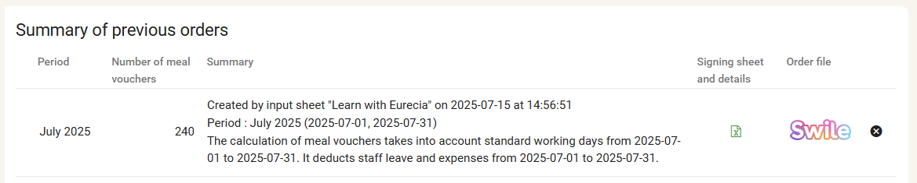

MEAL VOUCHER FILE
GENERATING THE FILE
Access : Menu > Payroll > Meal vouchers
Generates a file including:
Details about employees' attendance and meal voucher deductions
An order slip, in the format expected by chosen meal voucher provider

Slide 20
Importing
Payslips

Slide 21
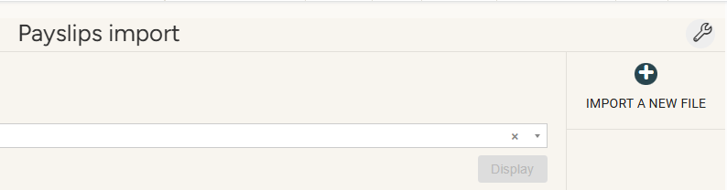
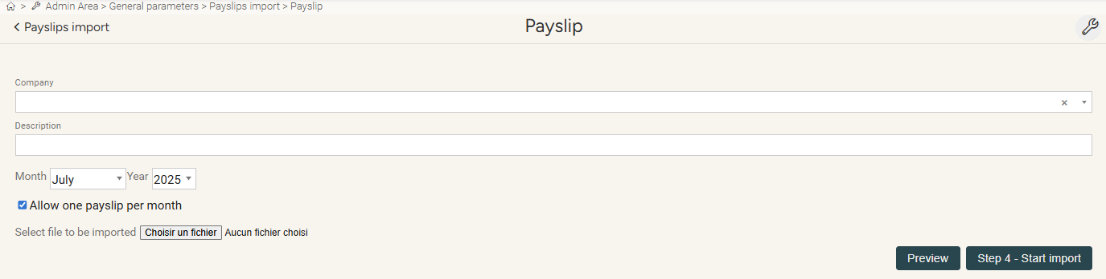
IMPORTING PAYSLIPS
Access: Menu > Payroll > Payslips import
Prerequisites
The employee's social security number, first name, and last name must match exactly on the employees' payslips and Eurécia.

Slide 22
Administrator
Area
02

Slide 23
Exporting relevant leaves & absences for payroll purposes

Slide 24
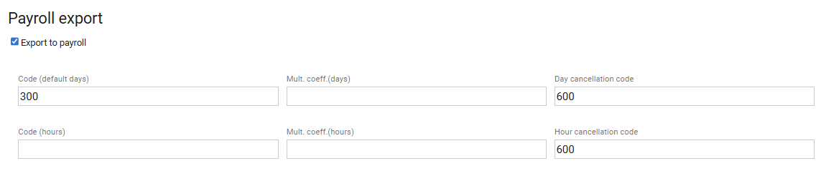
EXPORTING LEAVES & ABSENCES
IDENTIFYING THE DIFFERENT TYPES OF LEAVES & ABSENCES TO BE EXPORTED AND SETTING UP PAYROLL CODES
Access : Menu > Admin Area > Staff Leaves & Absences > Staff leave types > Open
Select the relevant type of leave or absence. Fill in the relevant code in "Code (defaults pay)"
Please note: Codes may differ accross different softwares

Slide 25
Configuring overtime for exports

Slide 26
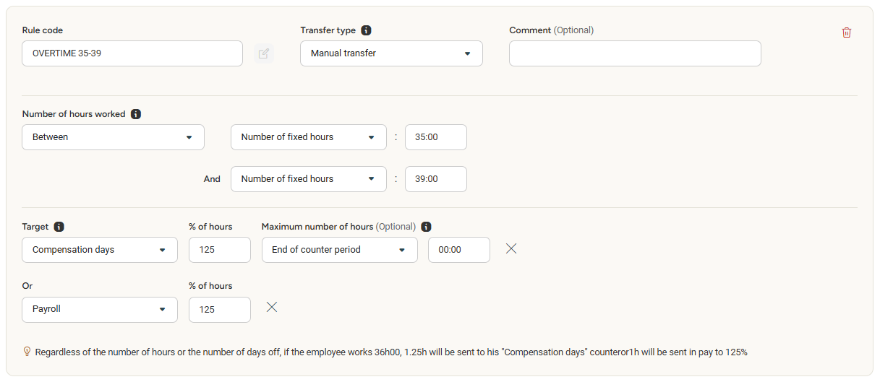

OVERTIME/ADDITIONAL HOURS
IdentifyING overtime/additional hours to BE exportED
and filLING in payroll codes.
Access : Menu > Admin Area > General parameters > Overtime profiles

Slide 27
Setting up
Meal Vouchers

Slide 28
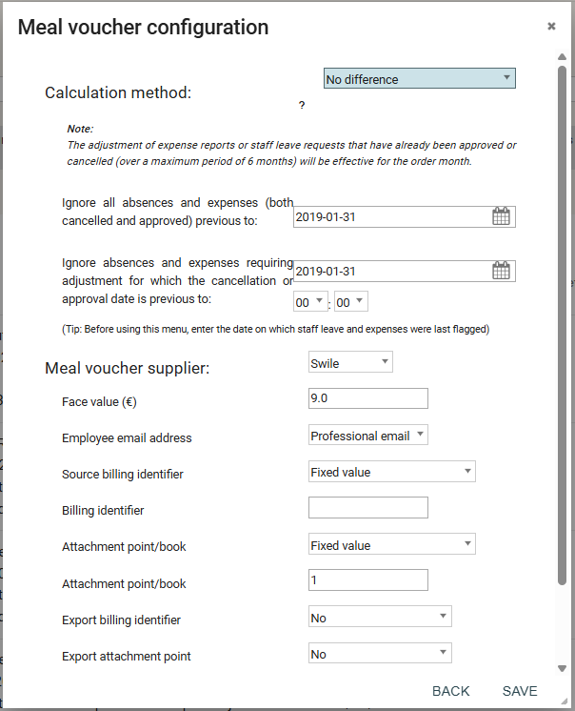
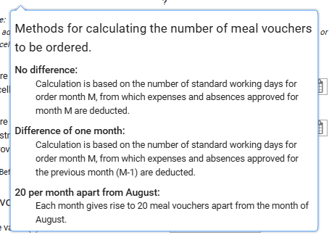
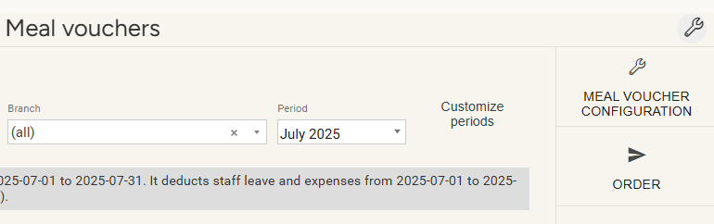
SETTING UP MEAL VOUCHERS
Setting up meal vouchers allocation and deduction rules
• Access : Menu > Payroll >Meal vouchers

Slide 29
Setting up payroll grids

Slide 30
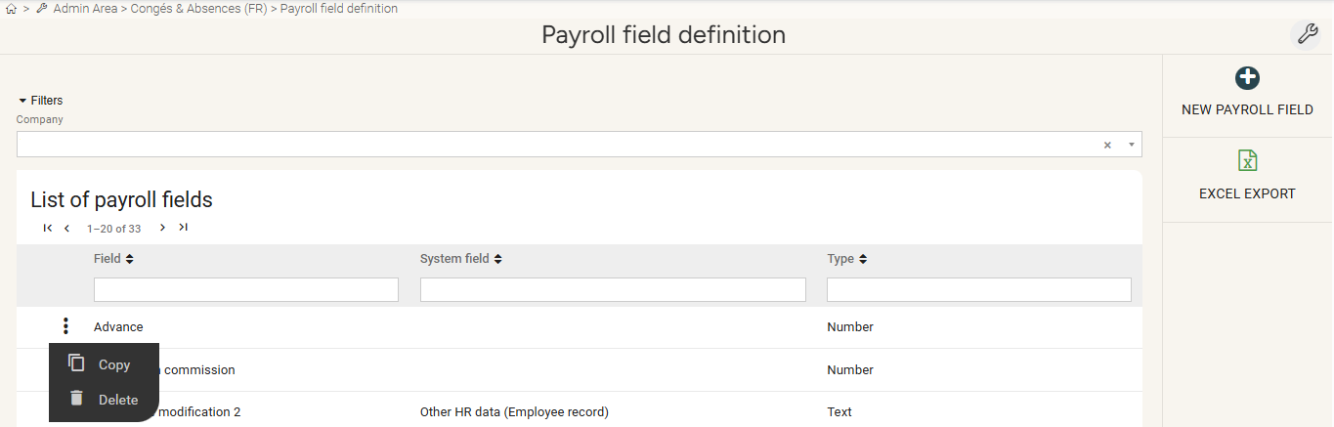
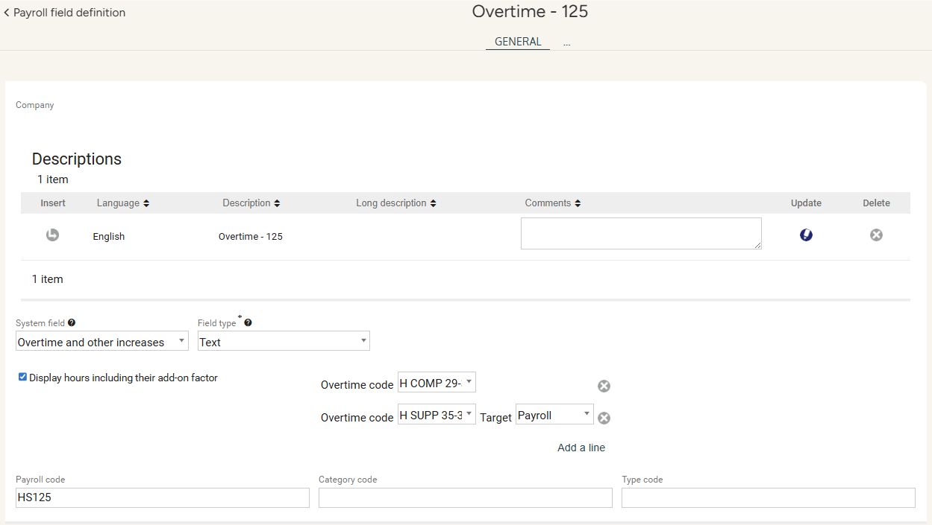
SETTING UP PAYROLL GRIDS
CREATING Or duplicating PAYROLL GRID FIELDS
Access : Menu > Admin Area > Staff leave & absences > Fields definition

Slide 31
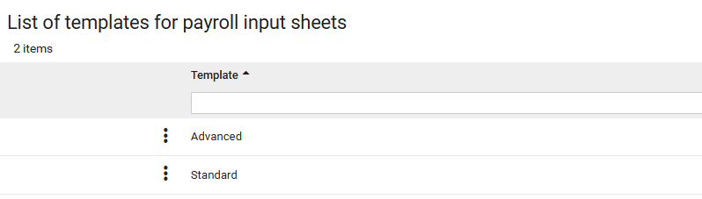

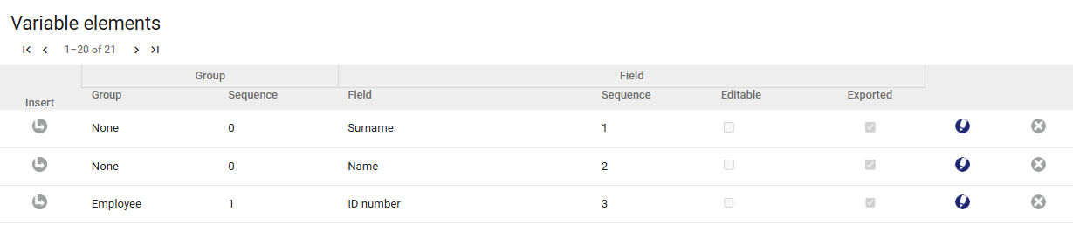
SETTING UP PAYROLL GRIDS
CREATING or editing PAYROLL GRID MODELS
Access : Menu > Admin Area > Staff leave & absences > Grid models
Change a field in a model
Add new fields to a model
Delete a field in a model

Slide 32
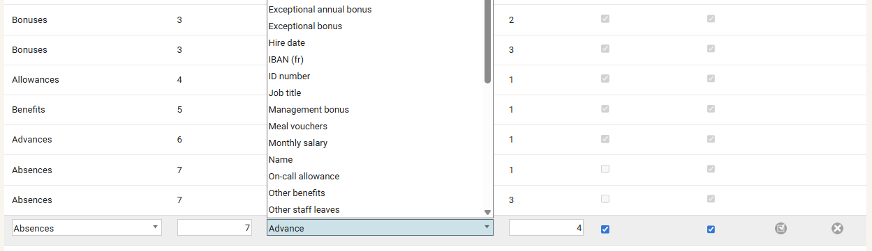
SETTING UP PAYROLL GRIDS
Creating or editing payroll grid models
Access : Menu > Admin Area > Staff leave & absences > Grid models
Add new fields to a model
Select a field previously created in "Fields definition"

Slide 33
Still have questions?
All answers are within your reach.
support@eurecia.com
Help center

