Slide 1


All you need to know about
Time & Activities
User guide
Last updated
August 2026

Slide 2

At the end of this training, users will be able to:
Training objectives
Manage their own timesheets
Review their own overtime
Review time & activities related data

Slide 3

As an employee
Trainign program
Reviewing timesheets
Editing timesheets – time tracking
Editing timesheets – activity tracking
Reviewing overtime
as a manager
Approving timesheets
Reviewing overtime
Reviewing and analysing time and activities related data

Slide 4
As an
Employee
01

Slide 5
Reviewing
Timesheets

Slide 6
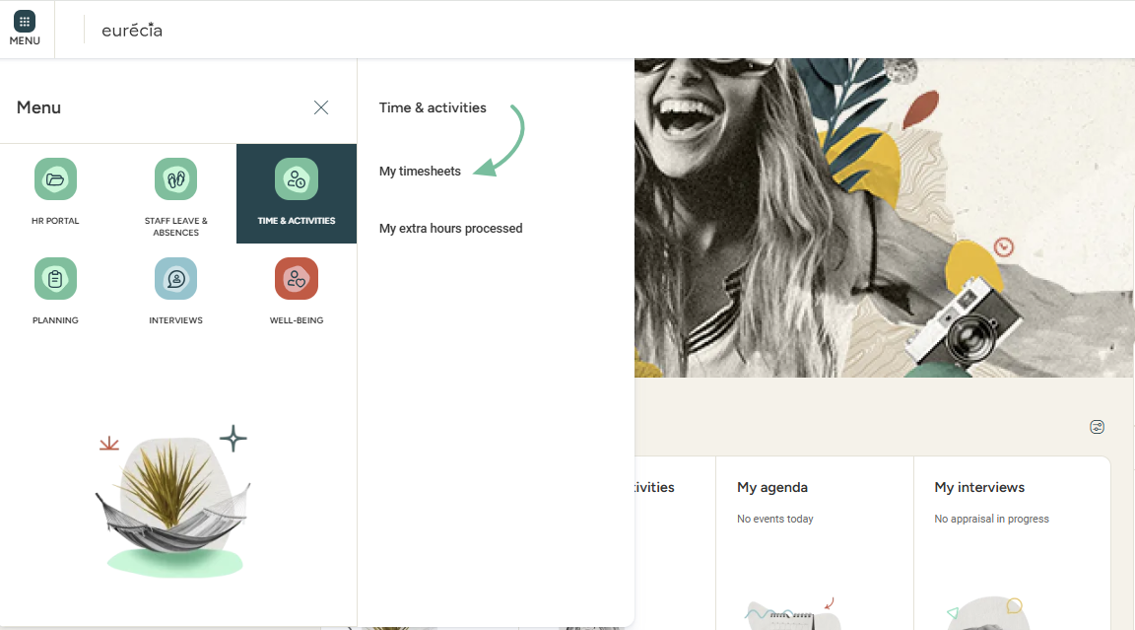
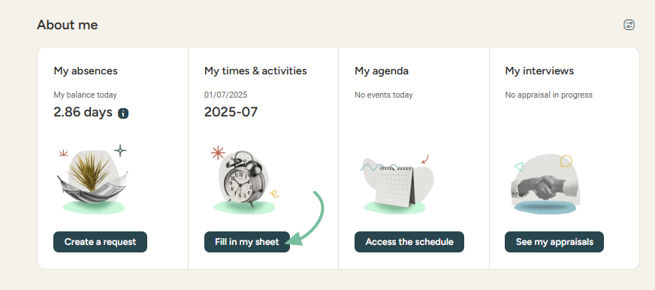
As an employee
Reviewing your own timesheets
From the homepage:
• Go to the "Time & Activities" module and select
"My timesheets":
• Or go to the
"About me" section
and click on "Fill in my sheet":

Slide 7
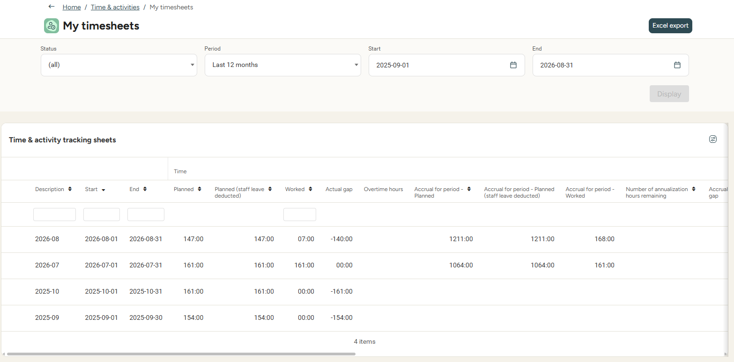
As an employee
viewing your own timesheets
You can access all your automatically generated timesheets.
To open a timesheet, click on the desired one from the list.

Slide 8
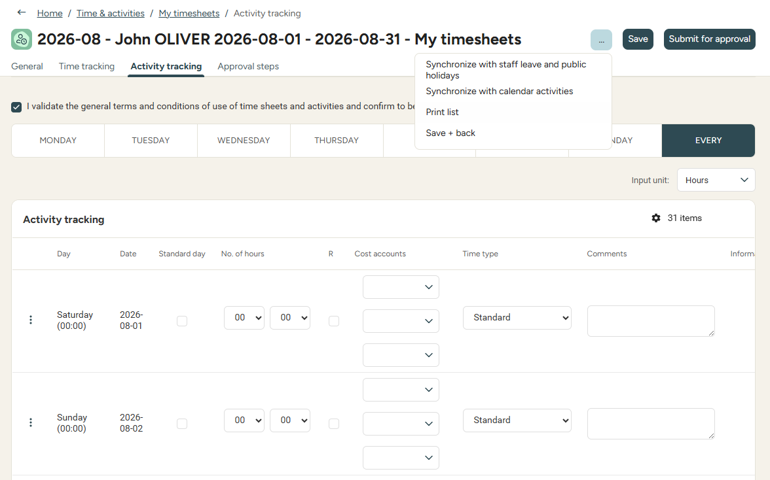
As an employee
Viewing your own timesheets
The timesheet contains daily details for a specific week.
Tracking can be done
by time or by activities
The timesheet can also be synchronised with the 'staff leave and public holidays' and the 'work shift'.

Slide 9
Editing time tracking

Slide 10
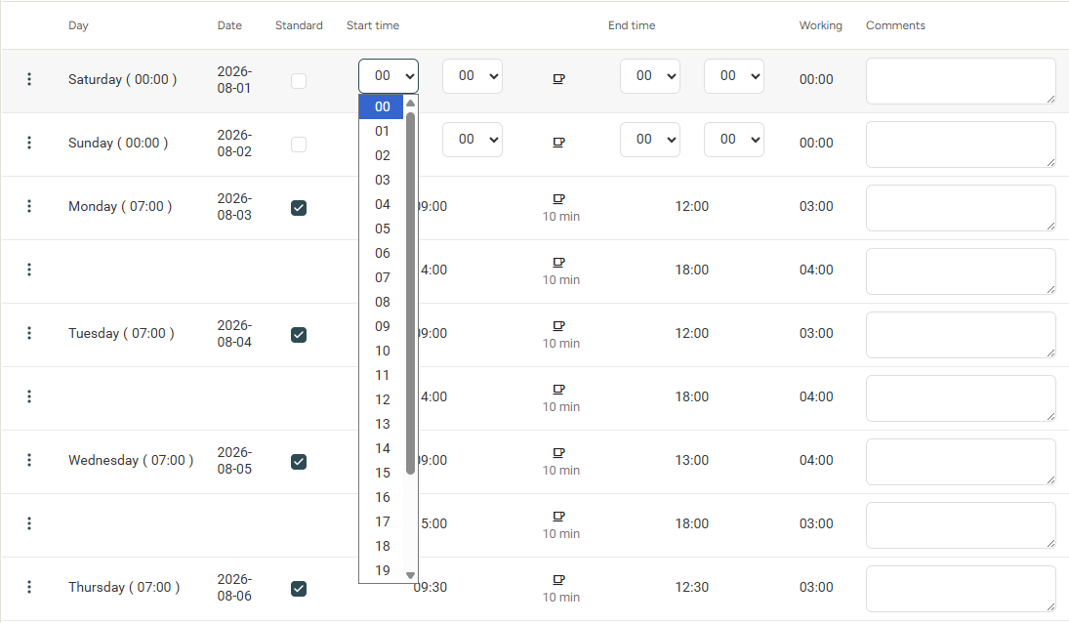
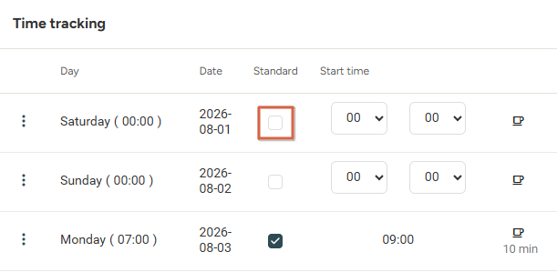
As an employee
Editing time tracking
Time tracking
If you want to enter overtime for a day, you must first uncheck the “Standard” day:
You can then change
the start and end times:

Slide 11
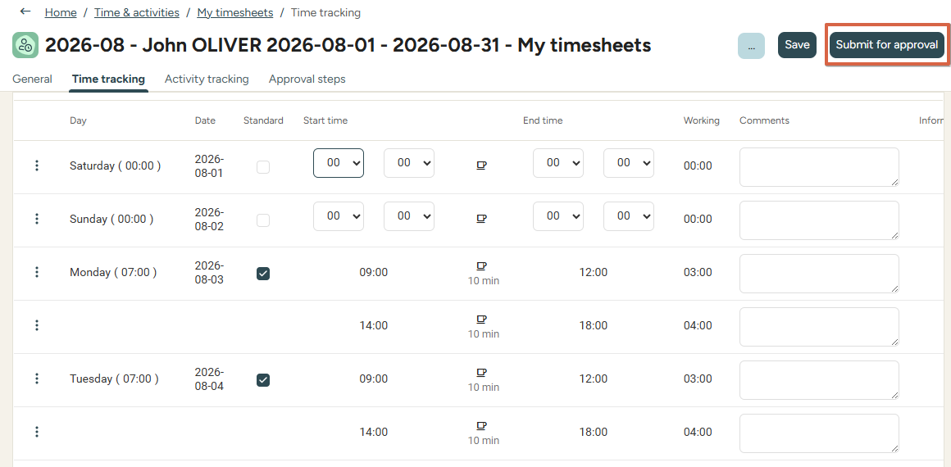
As an employee
Editing time tracking
Once all your hours are entered, you can submit your timesheet for validation to your manager.
The “Submit for approval” button is located in the top right.

Slide 12
Editing activity tracking

Slide 13
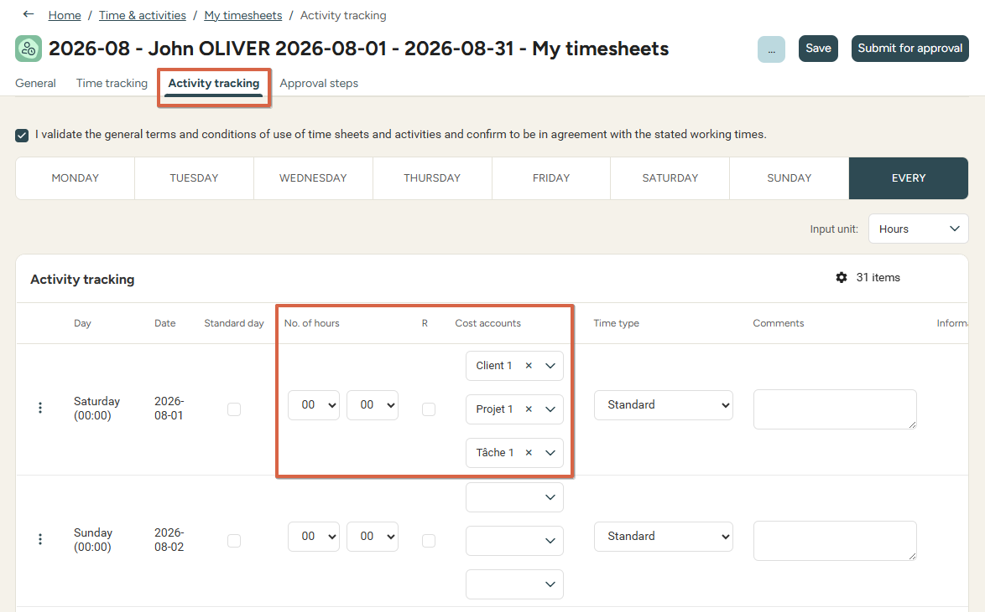
As an employee
Editing activity tracking
Activity tracking
If tracking is done by activities, the “Activity tracking” tab allows you to enter your worked hours based on report criteria and accounts
You can also synchronize the week’s tracking with leave and activities already entered in the activity calendar.

Slide 14
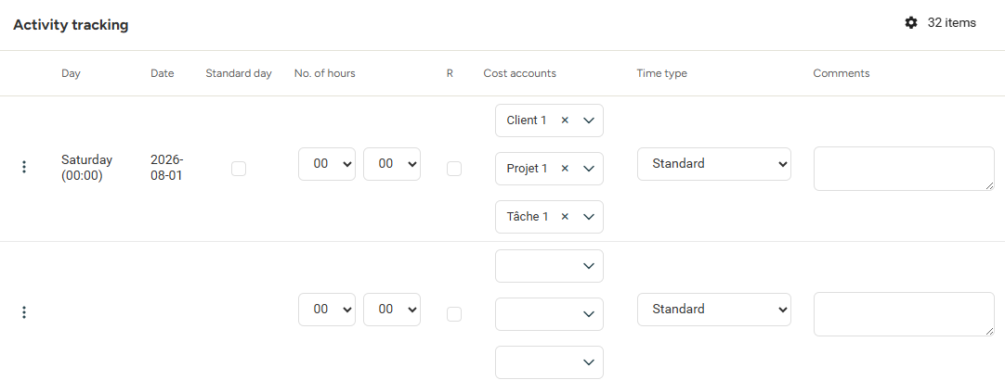
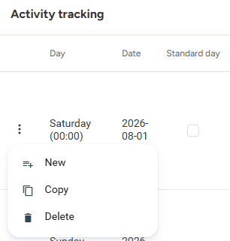
As an employee
editing activity tracking
To enter new activities, click on the three dots to the left for a specific day:
Then select “New”:

Slide 15
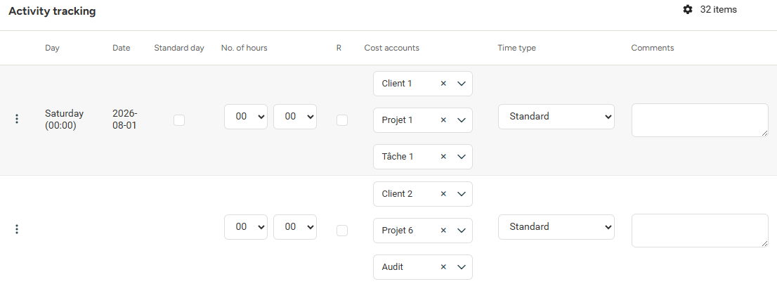

As an employee
Changing activity tracking
You can choose different units - days or hours:
Enter the number of hours or days spent on an cost account/report criterion.
A comment can be added
if necessary.

Slide 16
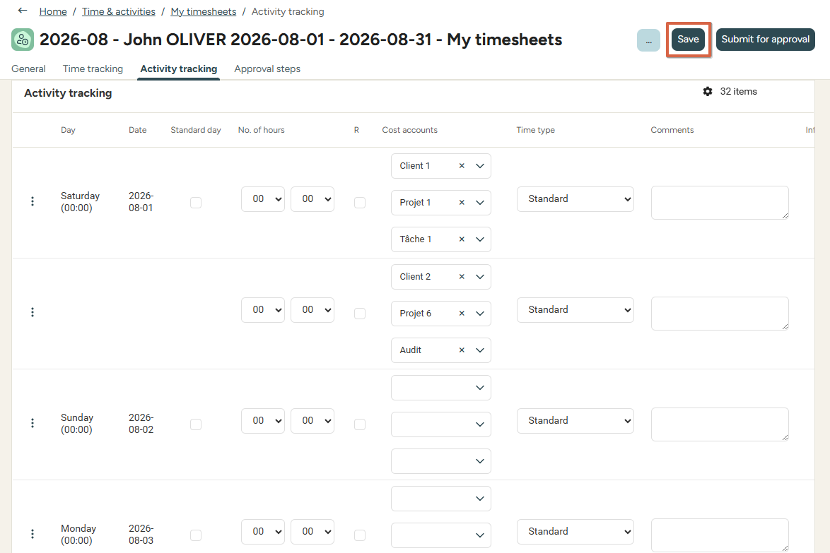
As an employee
Changing activity tracking
Whenever changes are made to a timesheet, do not forget to save the changes.
Saving a timesheet allows you to get back to it later on while keeping previously entered information. You will then add new information befre submitting for approval.

Slide 17
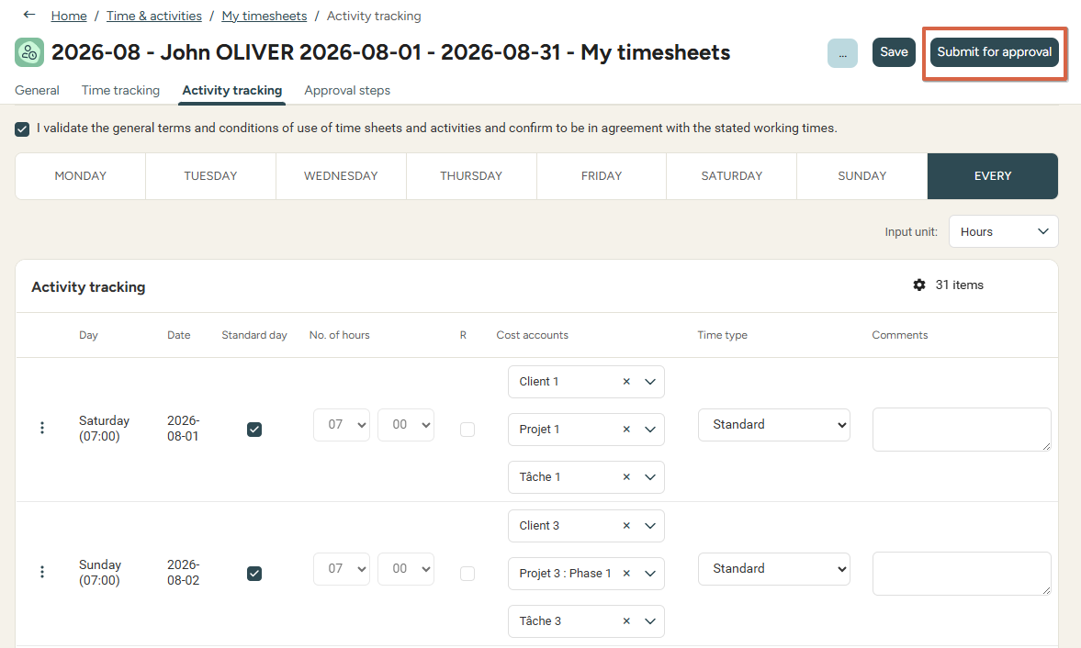
As an employee
Changing activity tracking
Once all activities are entered, you can submit the timesheet for approval.
Please note: Only submit a timesheet for approval when sure no further changes will be needed.

Slide 18
Reviewing overtime

Slide 19

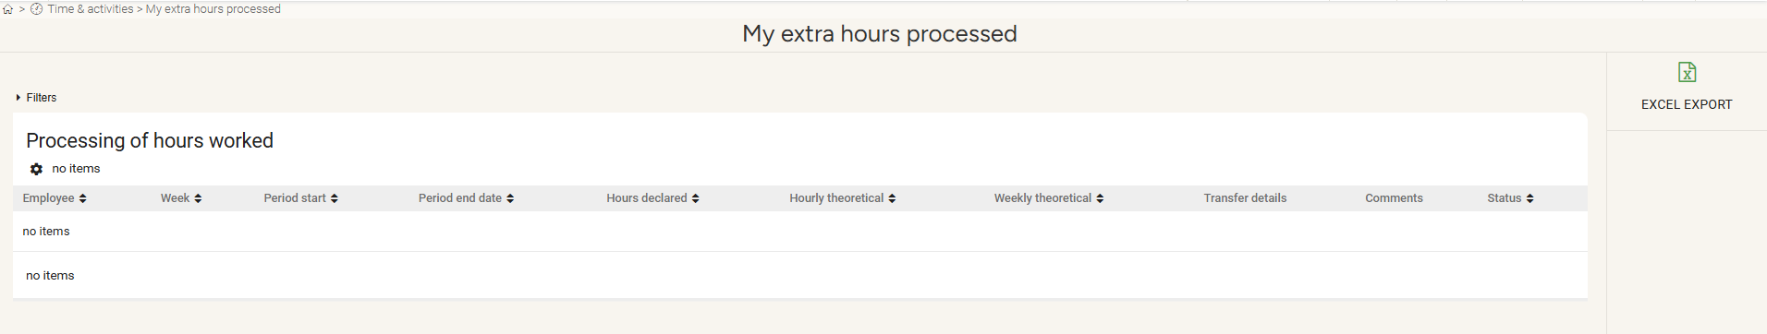
As an employee
Reviewing overtime
Review your overtime from the “Time and activities” module by clicking on “My extra hours processed"
You can view all your overtime, know the status of their processing, and transfer details.

Slide 20
As a manager
02

Slide 21
Approving timesheets

Slide 22
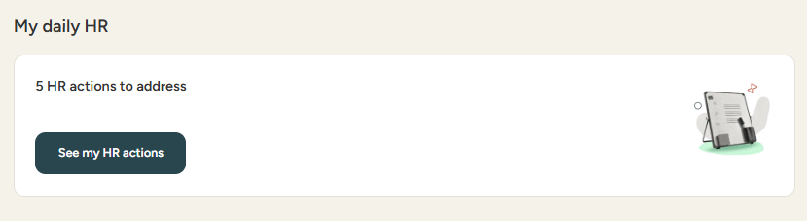
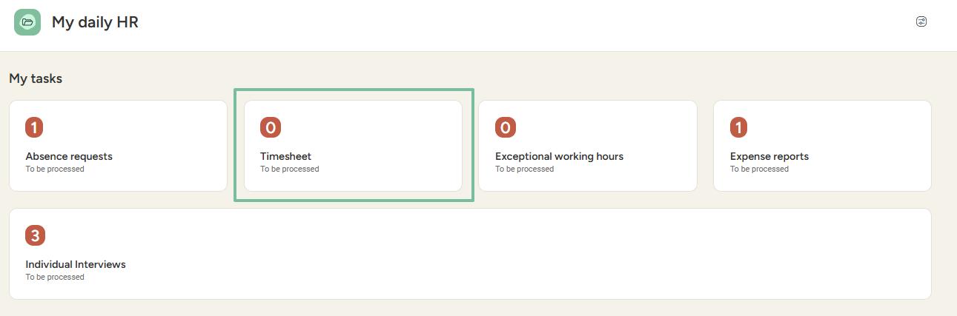
As a manager
Approving timesheets
From the “Time and activities” module, select “Manager view” to access all your employees’ timesheets.
You can also access it via the shortcut on your homepage:

Slide 23
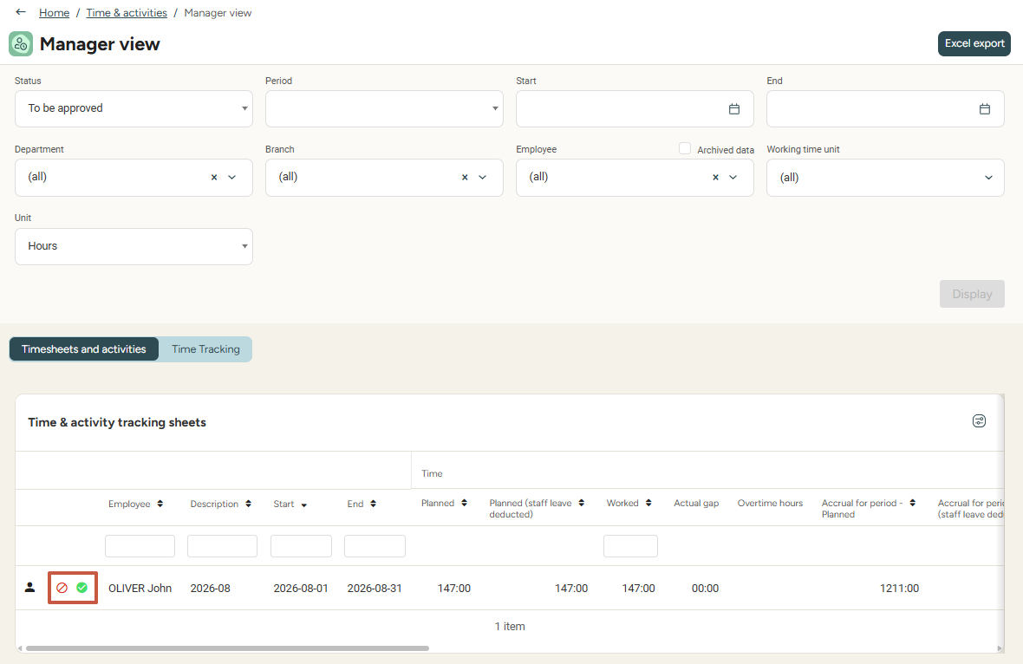

As a manager
Approving timesheets
You can approve or refuse your employees’ timesheets
with a single click via the approval button:

Slide 24
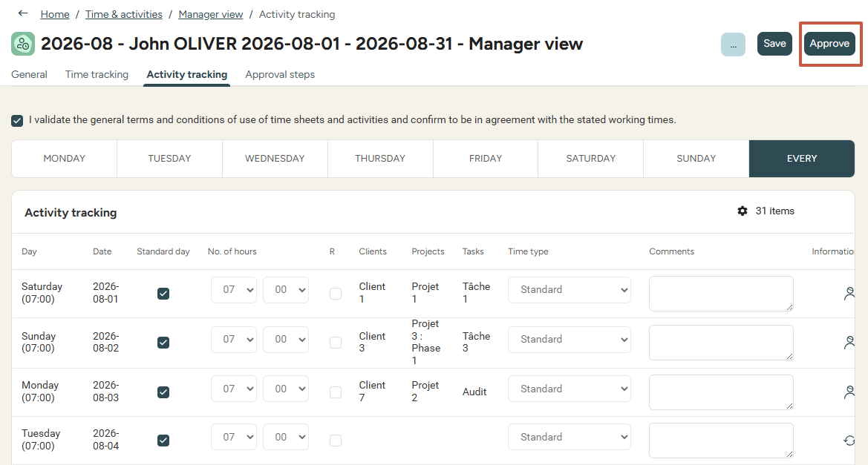
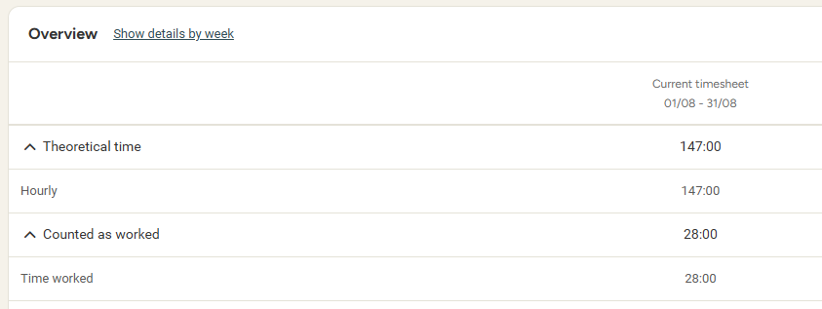
As a manager
Approving timesheets
In each timesheet, you can find the hours entered by the employee, their comments,
and the total number of hours worked
over a specific period (at the bottom of the page).
From here,
you can also approve the employee’s timesheet.

Slide 25
Reviewing overtime transfers

Slide 26
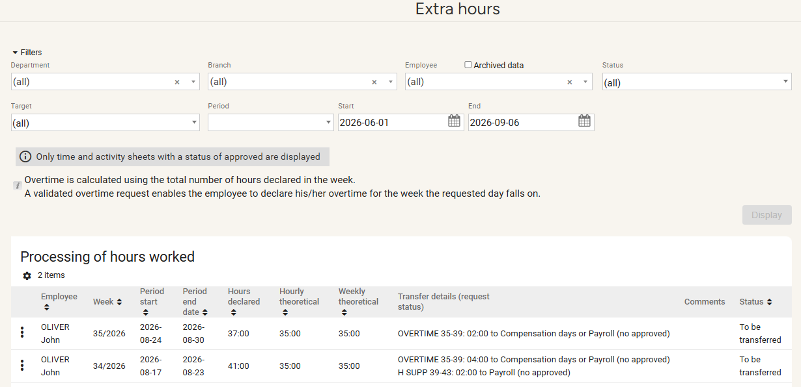
As a manager
Reviewing overtime transfers
Access the "Extra hours” from the “Time and Activities” module.
The transfer of overtime can only be reviewed once the timesheet is approved.

Slide 27
Time & activity analysis

Slide 28
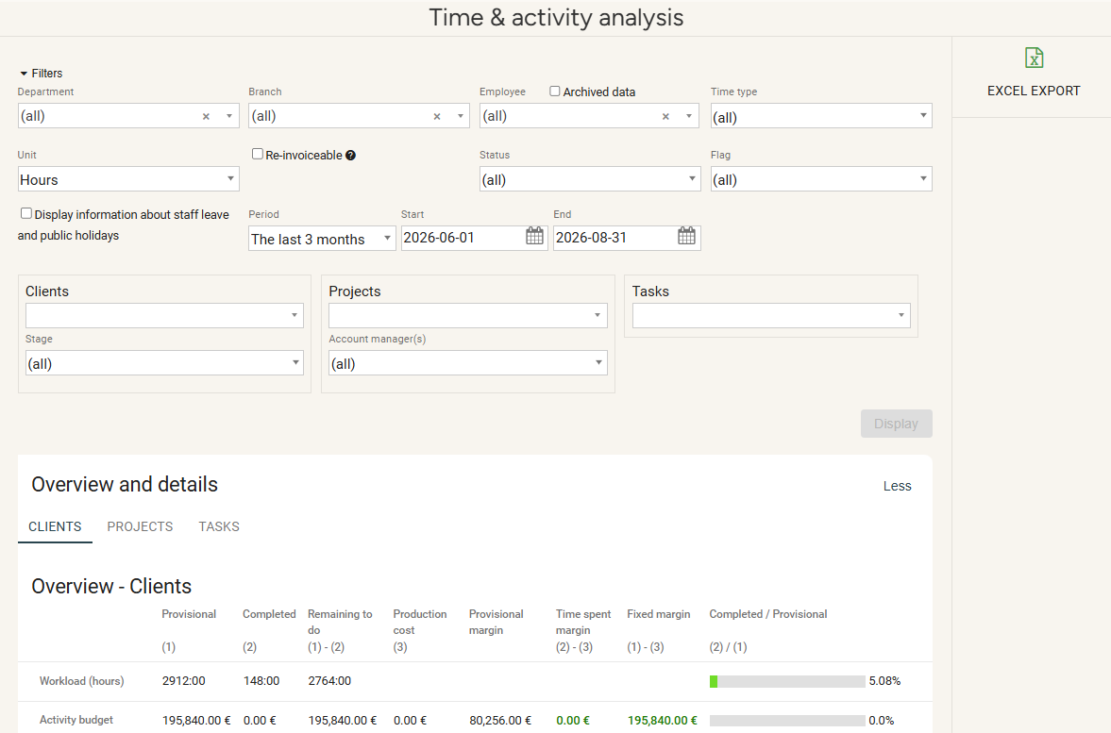
As a manager
Time & activity analysis
Access “Time and activity analysis” from the “Time & activities” module.
This feature will display the different activities entered by employees, by report criteria and accounts.

Slide 29
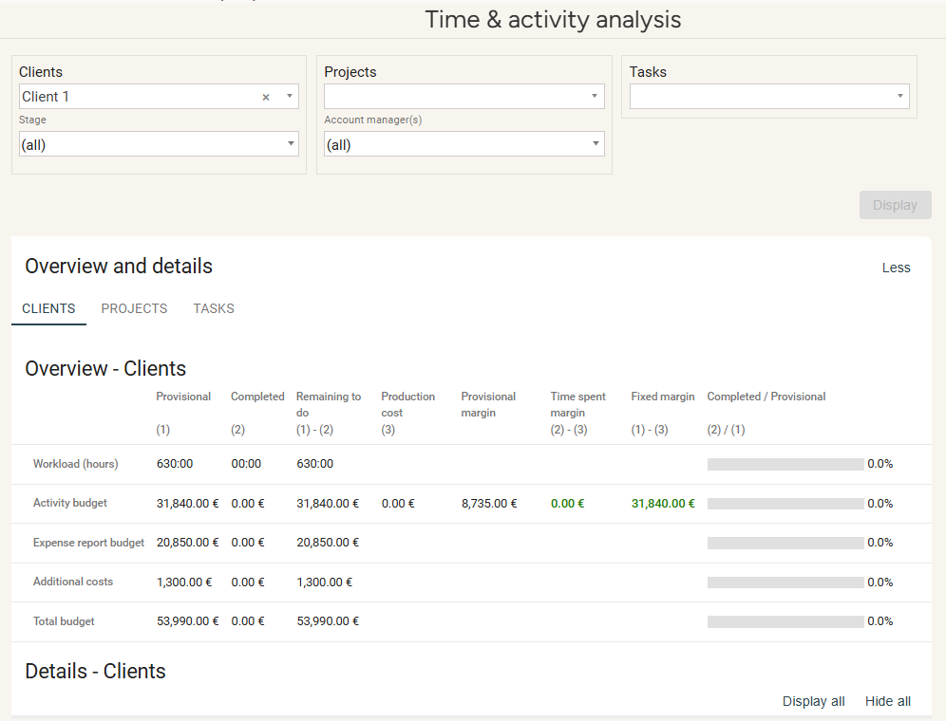
As a manager
Time & activity analysis
Overviews can be displayed by report criteria (e.g., client, projects, and tasks):
You can also access the analysis details of each report criterion
(e.g., details of the Client 1 criterion ):

Slide 30
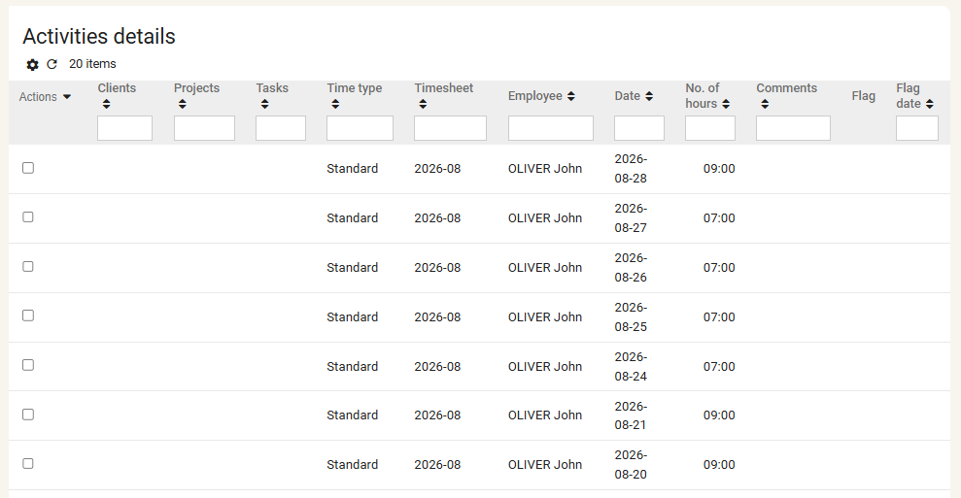
As a manager
Time & activity analysis
You can review the list of the different activities and their details at the bottom of the page.
You can filter activities undertaken by each employee.
Once again, filters allow you to refine your search!

Slide 31
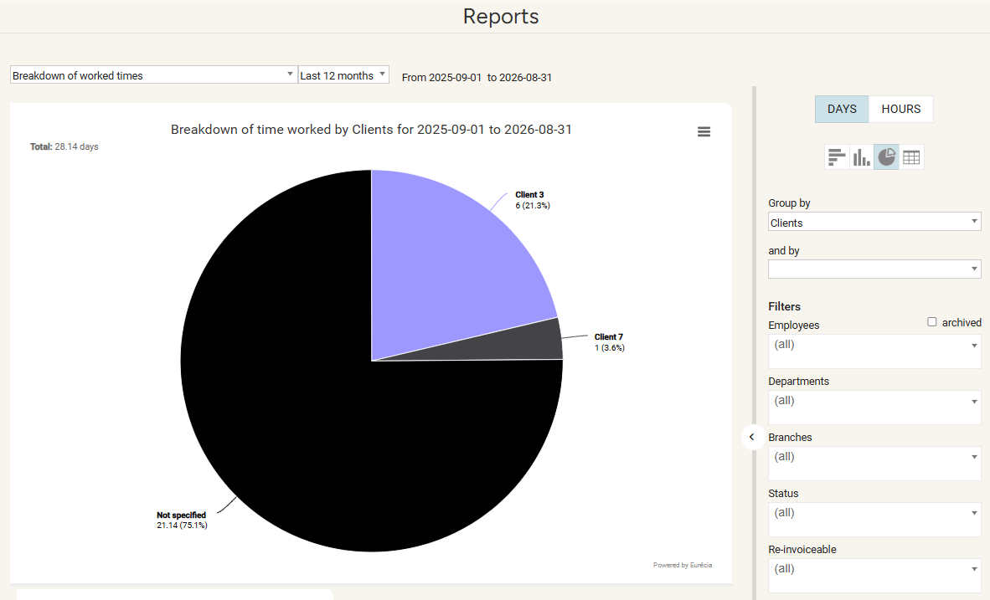
As a manager
Time & activity analysis
Access "Reports" from the "Time & activities" module.
This feature displays graphs about evolution and distribution of time spent on specific activities, as well as cost breakdown.
Several reports can be exported and used in Excel.​
​
Each report can be refined using a wide choice of filters. (employees, branches, etc.)
Please note: this data is retrieved from the Activity tracking tab in the employees' sheets.

Slide 32
Still need help ?
All answers are within your reach.
support@eurecia.com
Help center

