Slide 1
o
+
+
o
o
+
User Guide
+
o
+
Employee & Manager
Bien plus qu’un SIRH…

Slide 2
HR Portal

Slide 3
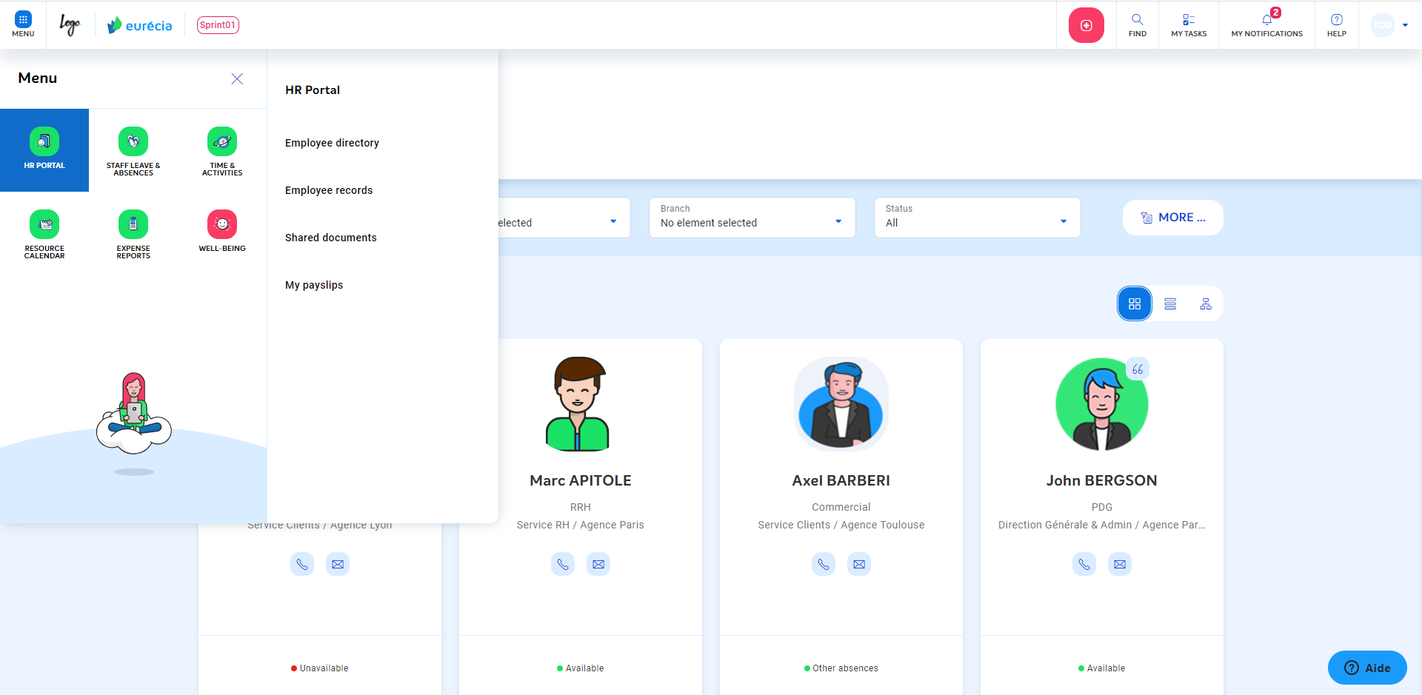
Standard employee profile – Employee directory
From the "HR Portal" module and selecting "Employees directory", you access the employee directory listing all employees of the company.
The directory can inform the email, function, department, branch and phone of each employee.

Slide 4
Standard employee profile – Employee directory
Warning : you can access your own employee sheet by clicking on your name. But you do not have access to the employee sheet for other employees.

Slide 5
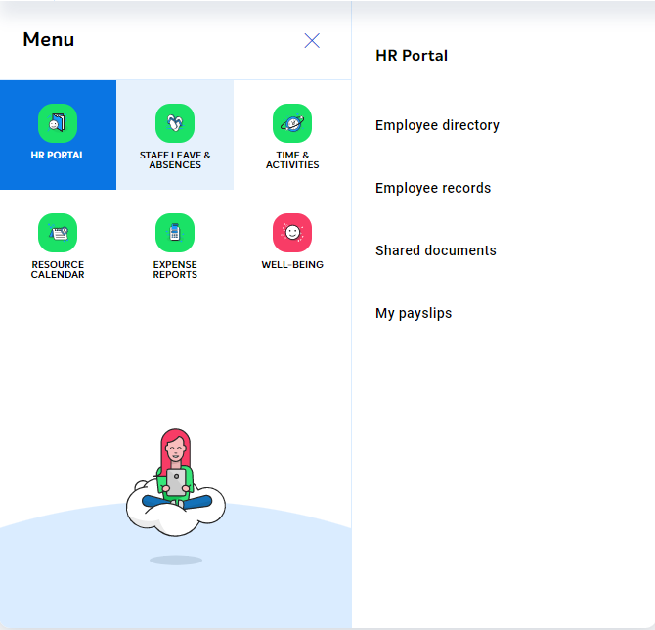
Standard employee profile – Employee record
In the "HR Portal" module, access to the "Employee records".
The "Employee records" allows you to view all the events and changes that took place in your employee life :
Hiring or departure date
Change of function
Branch change
etc.

Slide 6
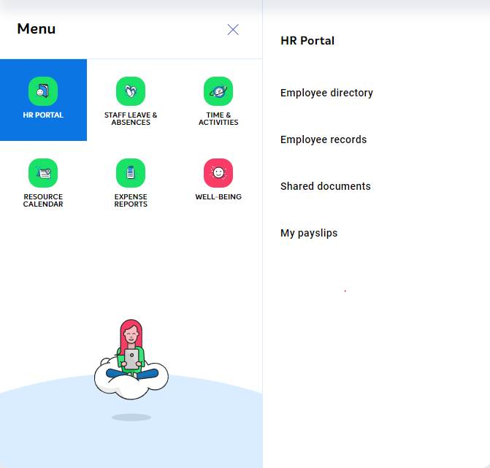
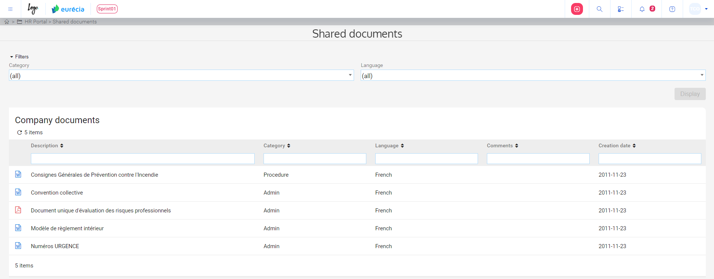
Standard employee profile – Shared documents
In the "HR Portal" module, go to "Shared documents".
You have the possibility to consult the administrative documents shared by the company:
Rules and regulations
Collective agreement
Safety rules
Information note
Etc.

Slide 7
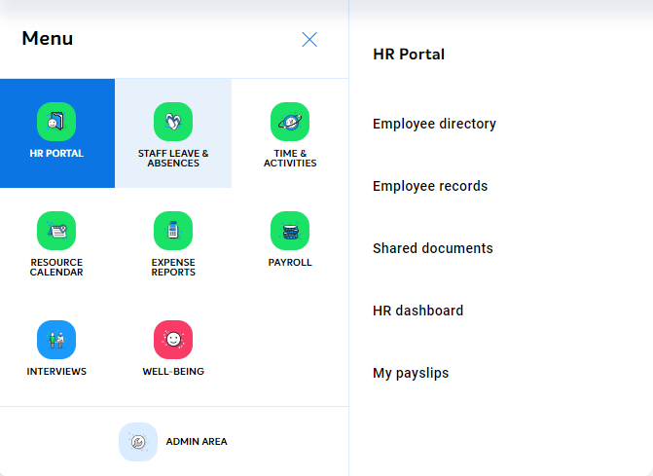
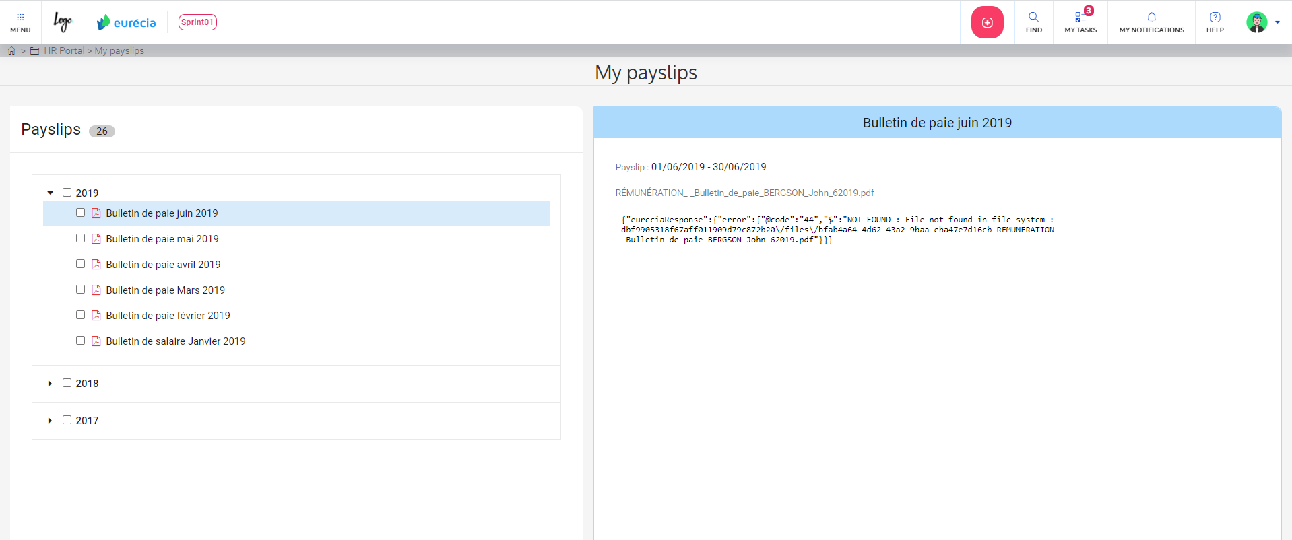
Standard employee profile – Your pay slips
In the "HR Portal" module, go to "My pay slips".
You can consult your pay slips by clicking directly on the required slip.
All you have to do is click on the download link.

Slide 8
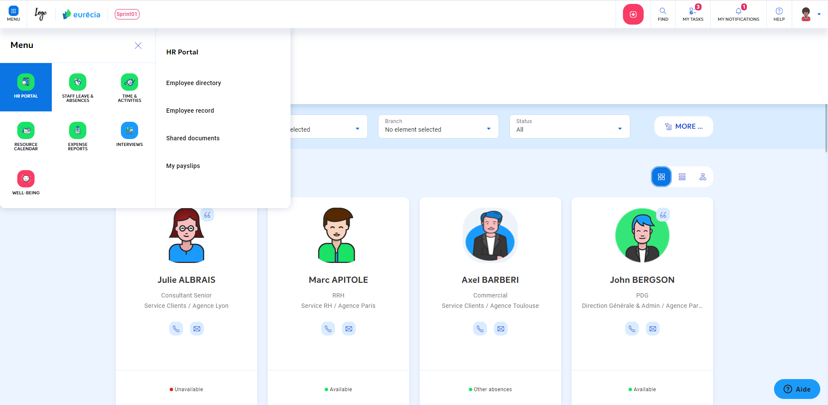
Manager – Employee directory
From the "HR Portal" module and selecting “Info", you access the employee's directory listing all employees of the company.
The directory can inform the email, function, department, branch and phone of each employee.
You can only access your own employee sheet and those of your team members by clicking on their name.

Slide 9
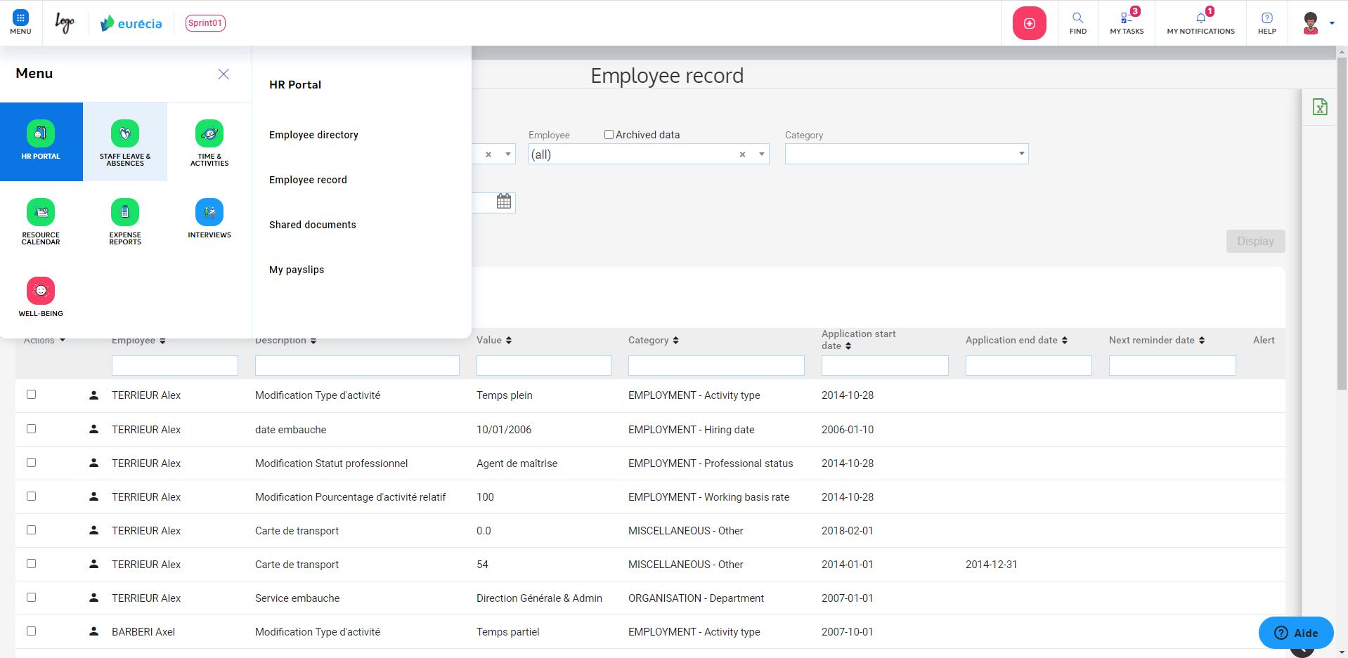
Manager – Employee Record
From the "HR Portal" module, access to "Employee record".
The "Employee record" allows you to see all the events and changes that took place in the employee’s life.
The "Employee record" of each of your team members is also available for you.
To consult the record of a particular employee, select him in the "Employee" filter.

Slide 10
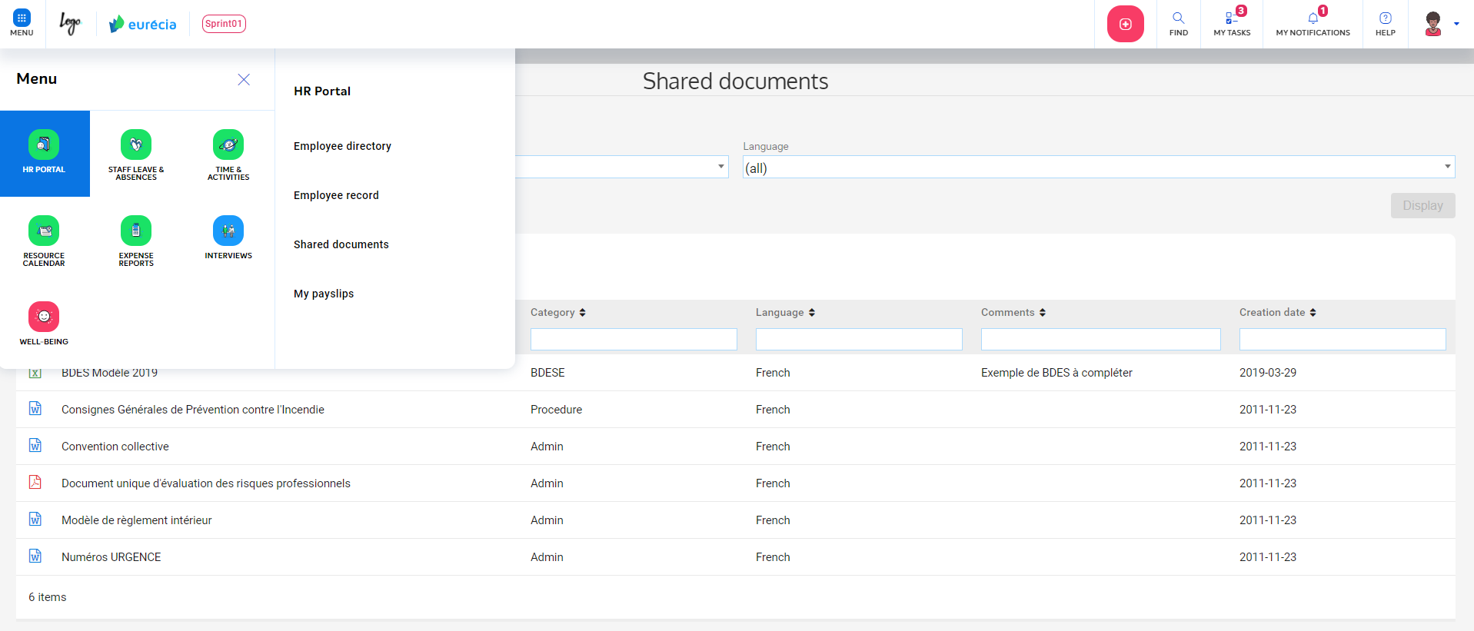
Manager – Shared documents
In the "HR Portal" module, go to "Shared documents".
You have the possibility to consult the administrative documents shared by the company:
Rules and regulations
Collective agreement
Safety rule
Information note
Etc.

Slide 11
o
+
+
o
o
+
support@eurecia.com
+ 33 (0)5 62 20 49 37
www.eurecia.com
+
o
+
Bien plus qu’un SIRH…
www.eurecia.com

