Slide 1
Training tool Admin Payroll

Slide 2
Training objective
At the end of the training session, admin will be able to
Prepare and process variable payroll elements
Generate exports files for payroll
Extract and integrate payslips

Slide 3
Training program
Module area
Employee and users
Employee record management
Create the absence export file
Create the trackers transfer export file
Create the overtime hours file
Create the input sheet of variable payroll
Create the meal vouchers file
Extract and integrate payslips
Team trackers management
Admin area
Identify the types of absences to be exported and enter the codes for the payroll types
Identify payroll type codes for overtime and extra hours
Set up meal vouchers
Create a variable payroll input sheet

Slide 4
Module Area

Slide 5
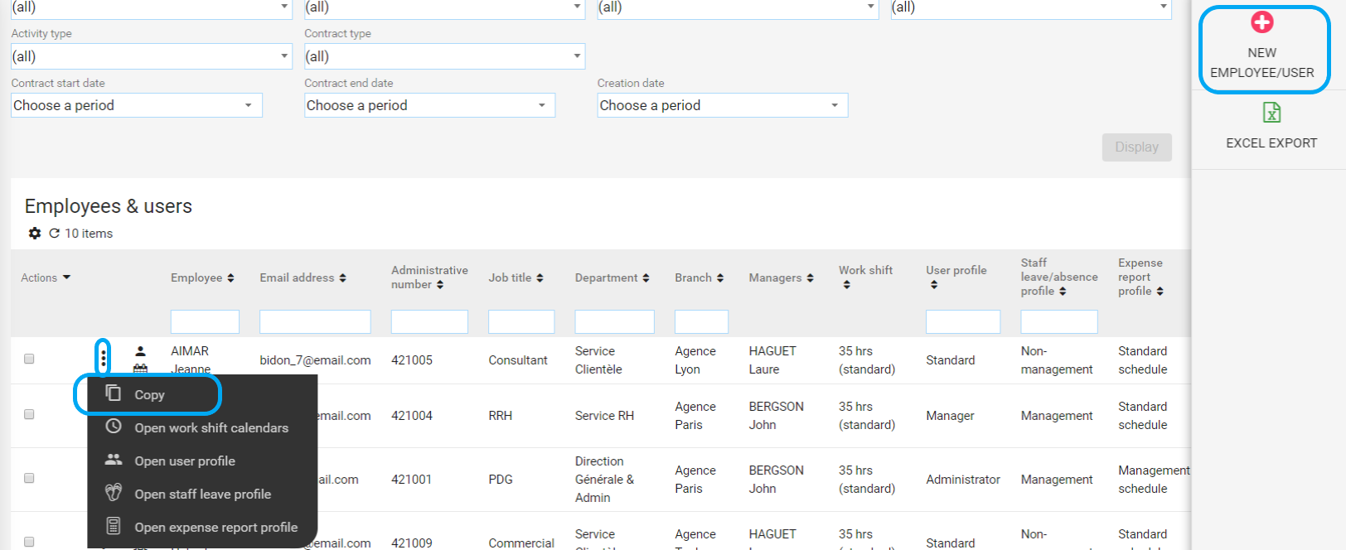
Create new employees
Creation of an employee
Access : Payroll > Employee and users

Slide 6
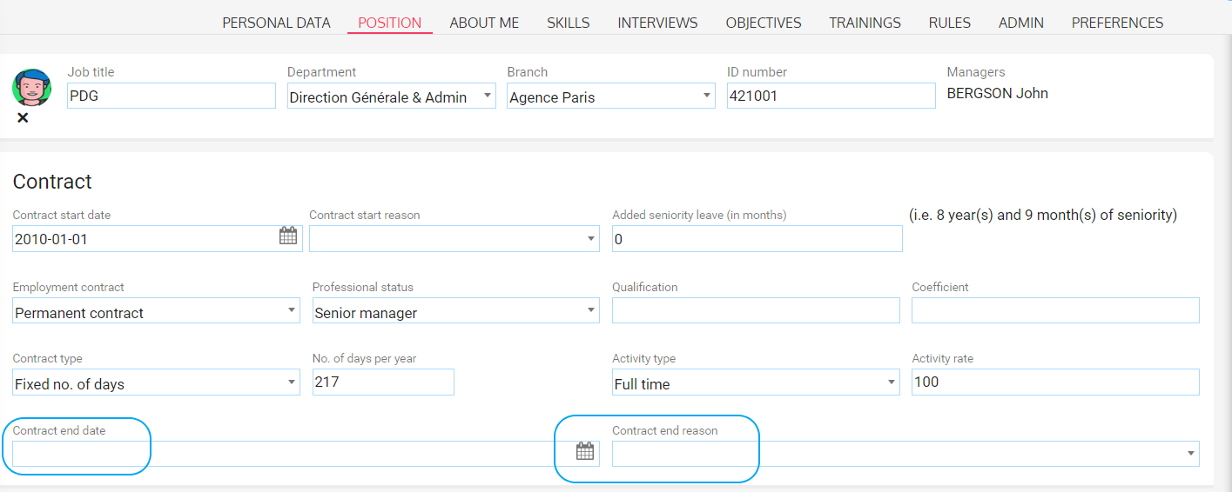
Archived users
Archived a user
Access : Payroll > Employee and users

Slide 7
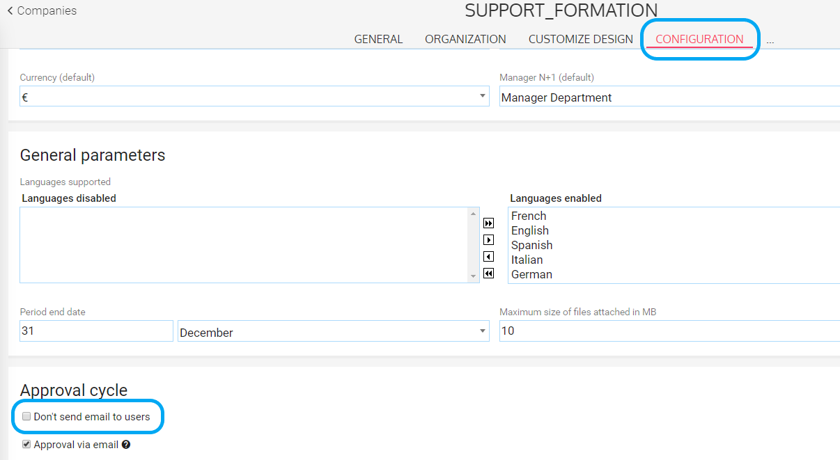
Send access email
Activate the « to send email to users » option
Access: Admin area > General settings > Company record > Open > Configuration
Envoyer les identifiants
Access : Payroll > Employee and users

Slide 8
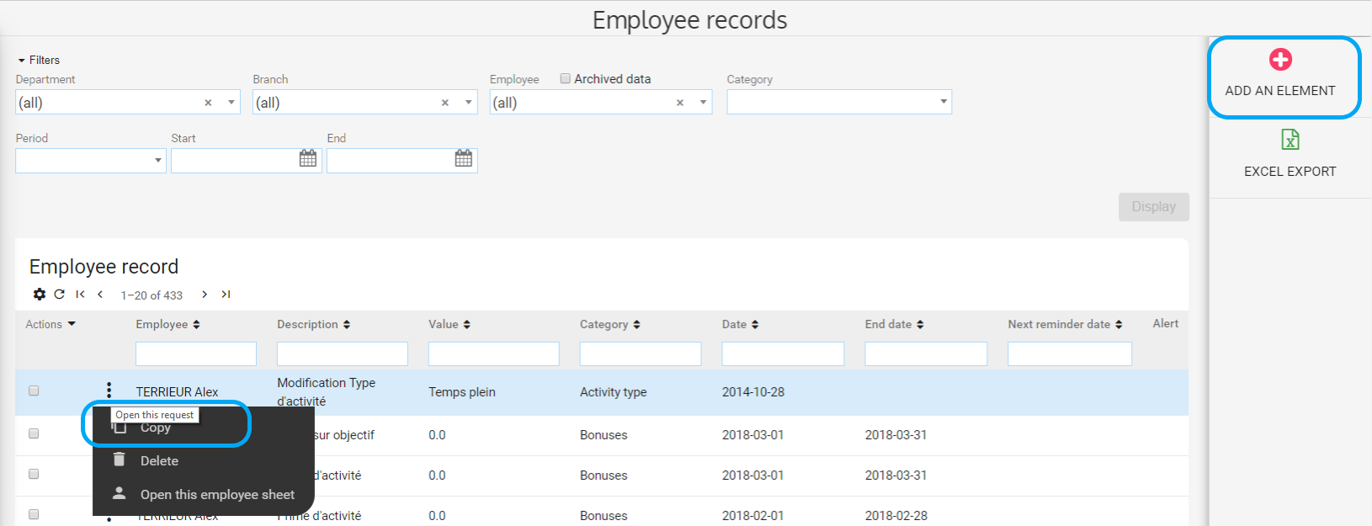
Employee records management
Add elements in the employee records
Access: Payroll > Employee records

Slide 9
Employee records management
Filter by category
Access: Payroll > Employee records

Slide 10
Create the absence export file
Access : Payroll> Pay export for absences
To create absences file to an excel format (allows to control)
To create absences file to the format expected by the payroll software

Slide 11
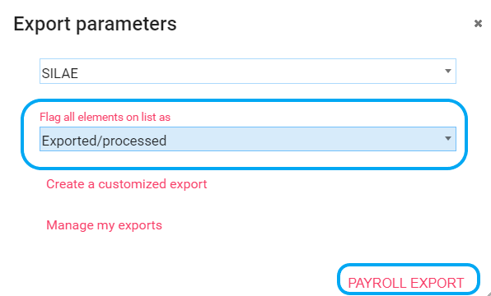
Create the absence export file
Access : Payroll> Pay export for absences
Allows to virtually approve the absences that have been exported to the payroll software and meal vouchers.

Slide 12
Create the trackers transfer export file
Access : Payroll > Entitlements transfers
Depending on the transfer date: Allows you to determine the days of Time in lieu or paid leave or other absences transferred to a different tracker (example to the Staff leave carried over)
Exemple :
Source tracker: Paid leave
Target tracker: Staff leave carried over
Quantity : 1
You will have to deduct 1 day of paid leave in the balance on the payslip.

Slide 13
Create the over time hours and extra hours export file
Access : Payroll > Export hours to payroll

Slide 14
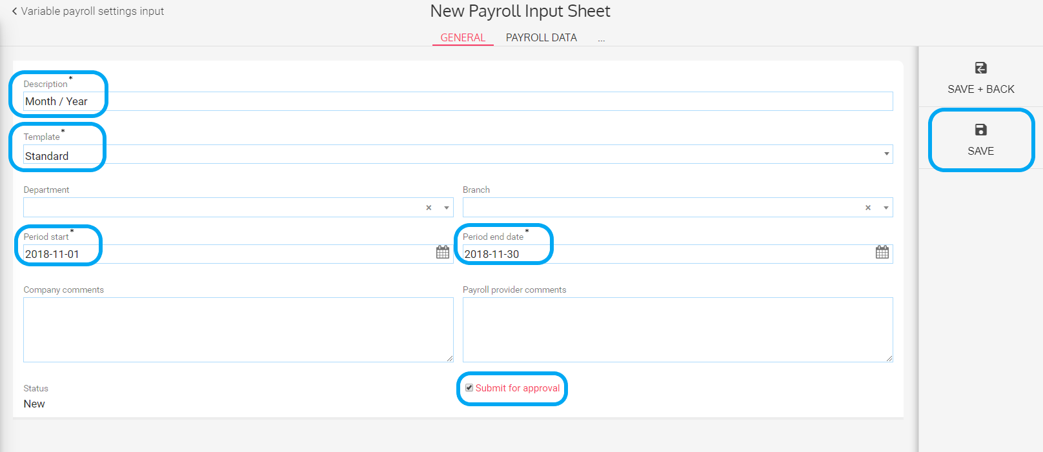
Create the input sheet of variable payroll
Create the input sheet of variable payroll
Access : Payroll > Variable payroll settings input

Slide 15
Create the input sheet of variable payroll
Fill in the input sheet of variable payroll
Access : Payroll > Variable payroll settings input
Data is automatically uploaded from the platform according to the settings and whether you have subscribed to the HR Portal module or not.

Slide 16
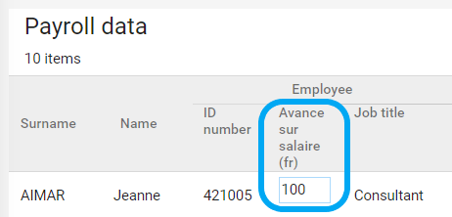
Create the input sheet of variable payroll
Fill in the input sheet of variable payroll with the HR Portal module
Access : Payroll > Variable payroll settings input
Input sheets of variable payroll
Employee record

Slide 17
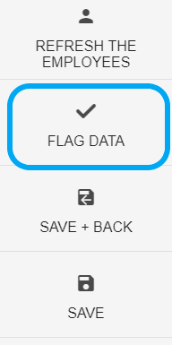
Create the input sheet of variable payroll
Flag data and approve the input sheet
Access : Payroll > Variable payroll settings input > Select a input sheet > Payroll data
To flag data allows to virtually « check » the following elements if they are configured in the input :
Over time and extra hours
Leave & absences
Meal vouchers
Approving the input sheet allows to split connections between the input sheet and :
Employee sheet
Employee record

Slide 18
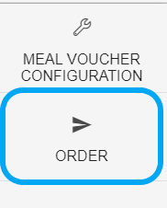
Create the meal vouchers file
Access : Payroll > meal vouchers
Permet de générer les fichiers suivants :
Feuilles d’émargement
Détail des déductions
Fichier de commande au format attendu par le fournisseur

Slide 19
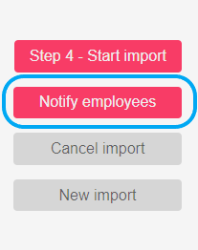
Extract and integrate payslips
Access : Payroll > Extract and integrate payslips
PREQUIRED
For each employee, the social security number, the last and first names have to be the same in Eurécia and in the payroll software.
Allows to send an email to employees notifying that their payslip is available.

Slide 20
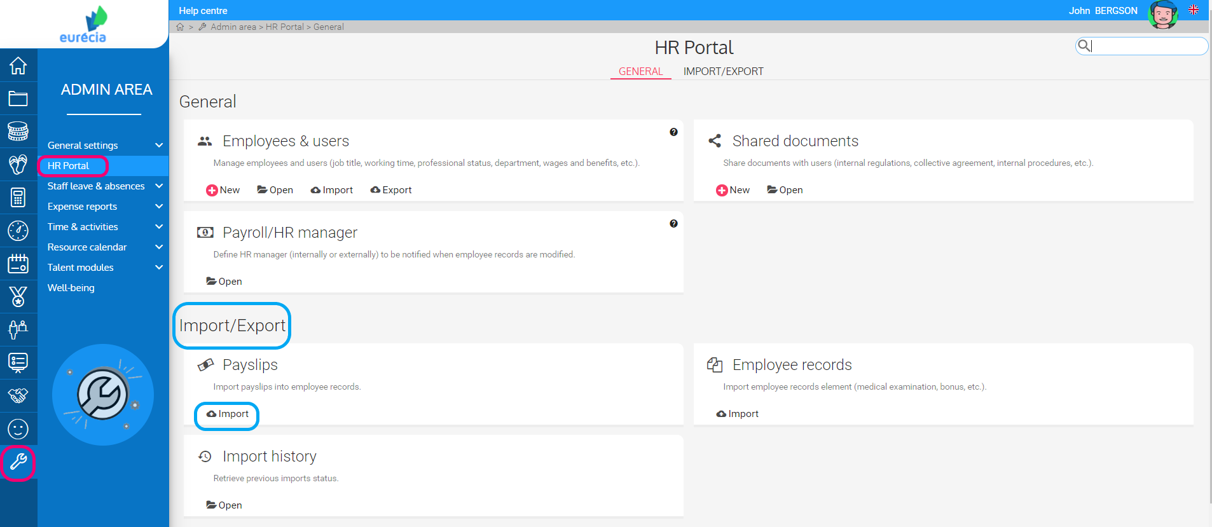
Extract and integrate payslips
Access: Admin area > HR Portal > Payslips > Import

Slide 21
Admin area

Slide 22
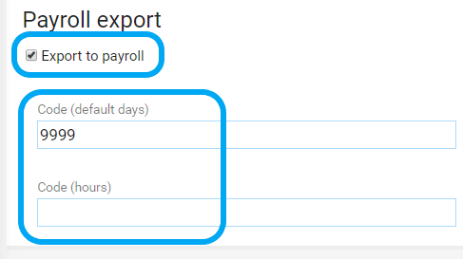
Identify the types of absences to be exported and enter the codes for the payroll types
Configure the absences types to export
Access: Admin area > Staff leave and absences > Staff leave and absences types > Create a new staff leave
Can vary according to your payroll software

Slide 23
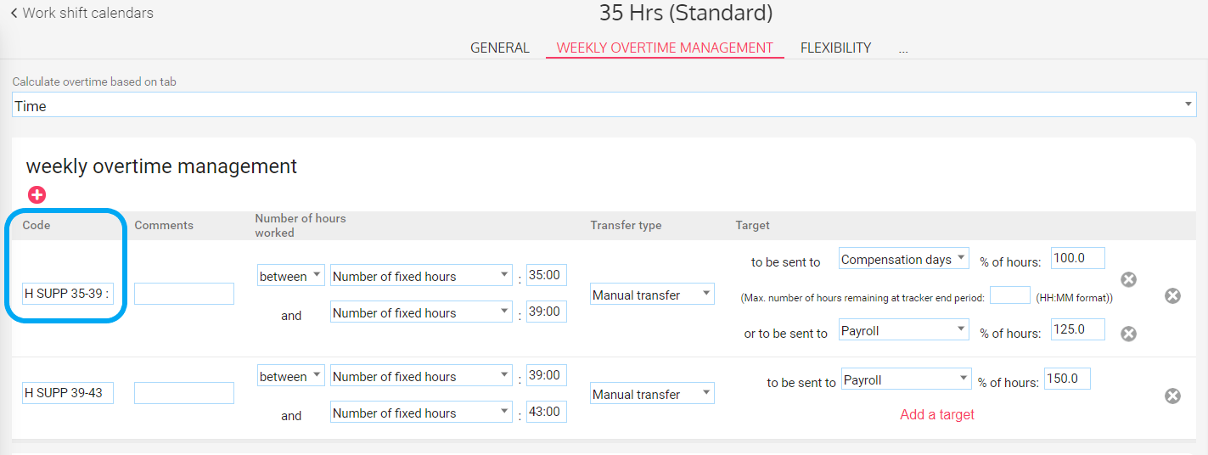
Identify payroll type codes for overtime and extra hours
Configure Work shift calendars
Access: Admin area > General settings > Work shift calendars > Open > Select one

Slide 24
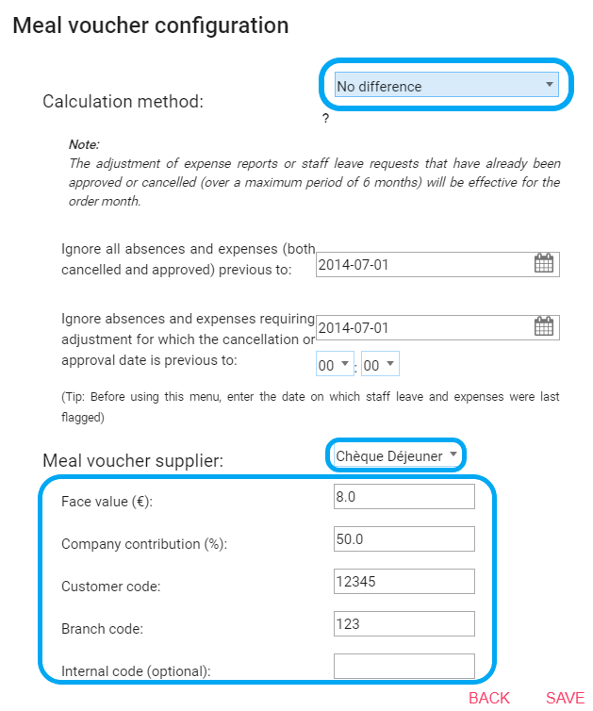
Configure meal vouchers
Configure management rules and the supplier
Access: Payroll > Meal Vouchers > Meal voucher configuration

Slide 25
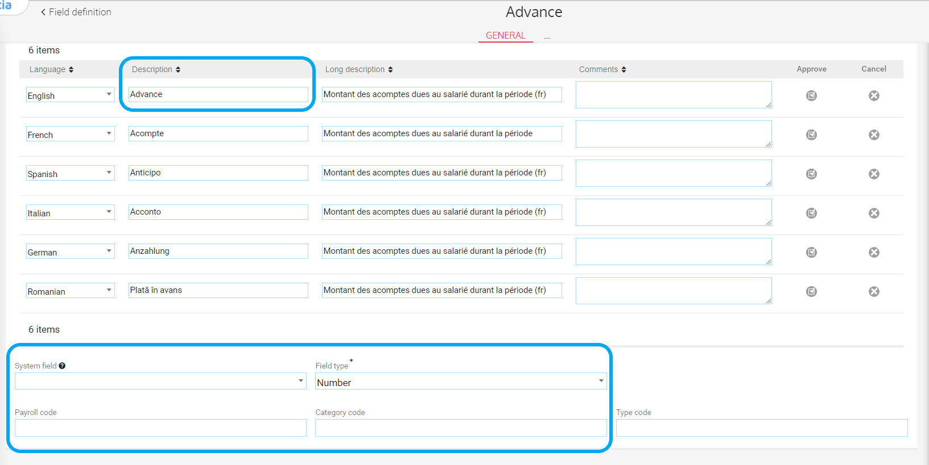
Create an input sheet of variable payroll
Create input sheets fields
Access: Admin area > Staff leave and absences > Administration > Field definition

Slide 26
Create an input sheet of variable payroll
Create the grid model
Access: Admin area > Staff leave & absences > Variable payroll elements > Grid models > Open
To add a field
To modify a field
To delete a field

Slide 27
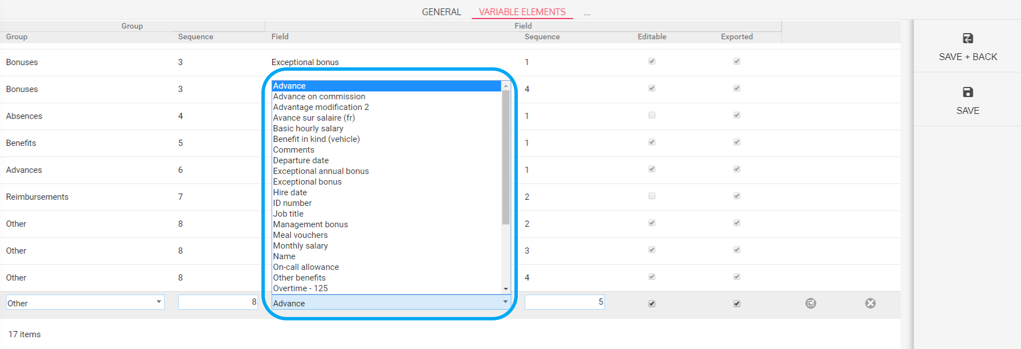
Create an input sheet of variable payroll
Create the grid model
Access: Admin area > Staff leave & absences > Variable payroll elements > Grid models > Open
List of fields created previously

Slide 28
support@eurecia.com
05 62 20 49 37

