Slide 1
All you need to know about Planning
Administrator training guide
Last updated
November 2024

Slide 2
At the end of this training, administartors will be able to:
Training objectives
Understand the features of the planning module
View and track employee schedules and activities
Create new schedules and new time slots
Synchronize plannings with calendars

Slide 3
module features
Training program
Tracking employee schedules
Tracking employee activities
Admin Area
Creating different schedules and managing visibility
Synchronizing schedules with Google or Outlook (Exchange)

Slide 4
Team Calendar, Employee time tracker

Slide 5
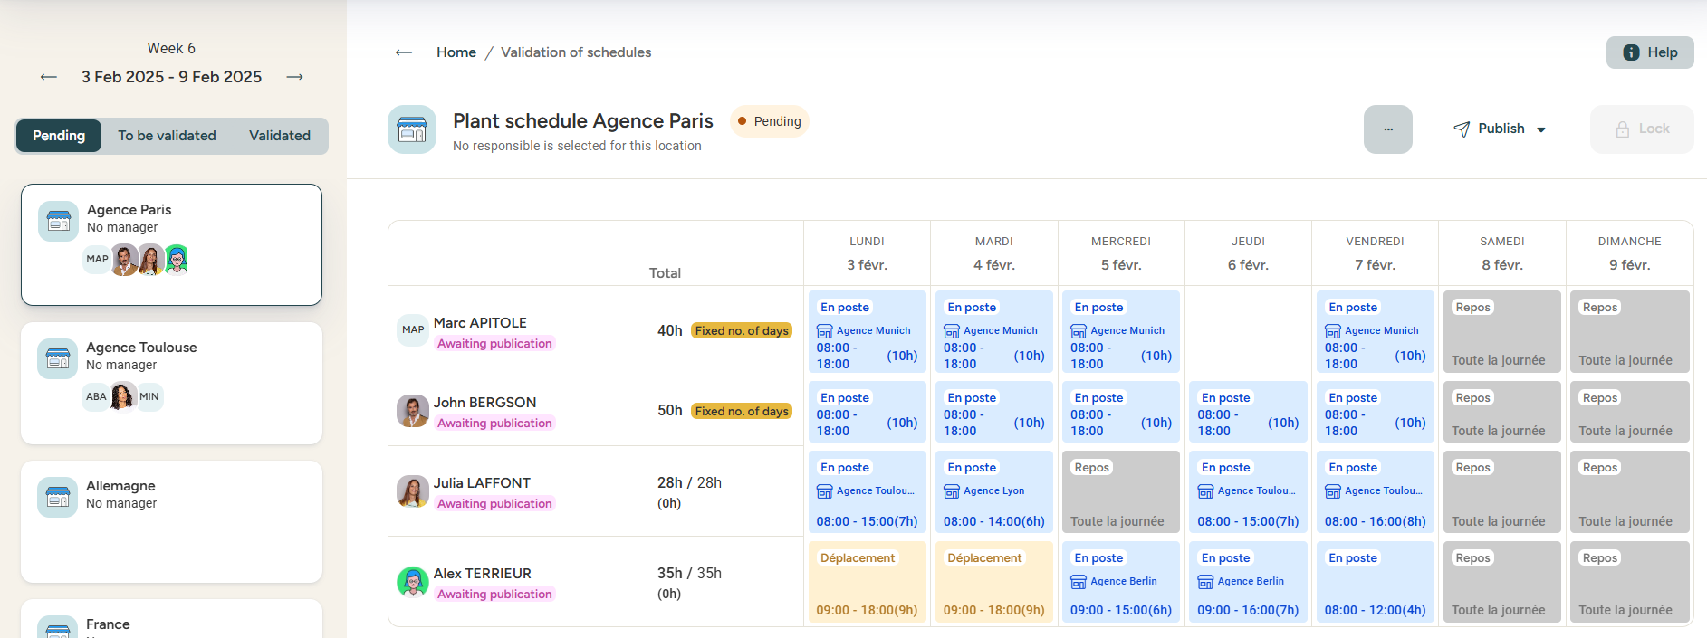
Team calendar
Planning, Publication, validation
"Pending": schedules that have not yet been locked by managers.
"To be validated": final schedules published and locked by managers.
"Validated": schedules that have been validated by an administrator.

Slide 6
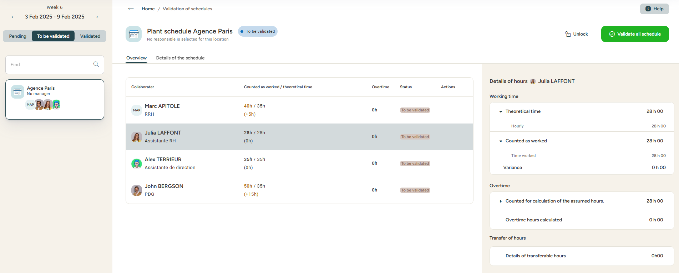
Team calendar
Calculating payroll variables
When you select a schedule with the status ‘to be validated,’ you access a summary of the hours worked during the week and the number of overtime hours calculated for each employee.
You can find the weekly schedule in the ‘Details of the schedule’ tab. It is possible to make changes to the schedule from this interface.

Slide 7
Activity schedule, Employee activity schedule

Slide 8
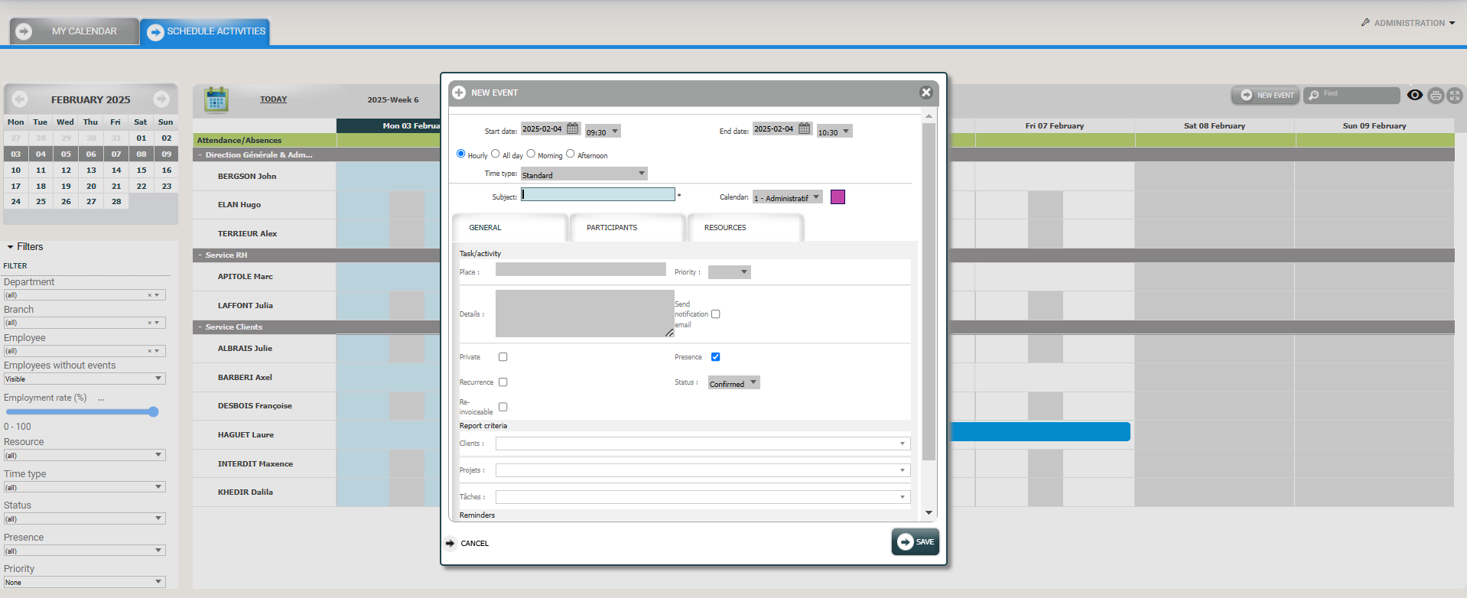
My calendar / Activity schedule
Creating a new event
Access: Menu > Planning > Activity Schedule
Click on « New event » to create an activity.
Select the relevant slot:
Time slot = For a customized time slot, choose the dates and time.
All day = Eurécia uses the work shift calendar.
Morning = Eurécia uses the start and end time of the morning work shift calendar.
Afternoon = Eurécia uses the start and end time of the afternoon work shift calendar.
Subject : Enter the subject of the activity.
Note: If you manage analytical axes, selecting an axis on this tab may fill in the “Subject” field.
Calendar : Select the schedule corresponding to this new activity.

Slide 9
Activity schedule
Two ways to access the Resources
Access: Menu > Planning > Activity schedule
Access: Menu > Admin Area > Resource Calendar > Resources or material resources

Slide 10
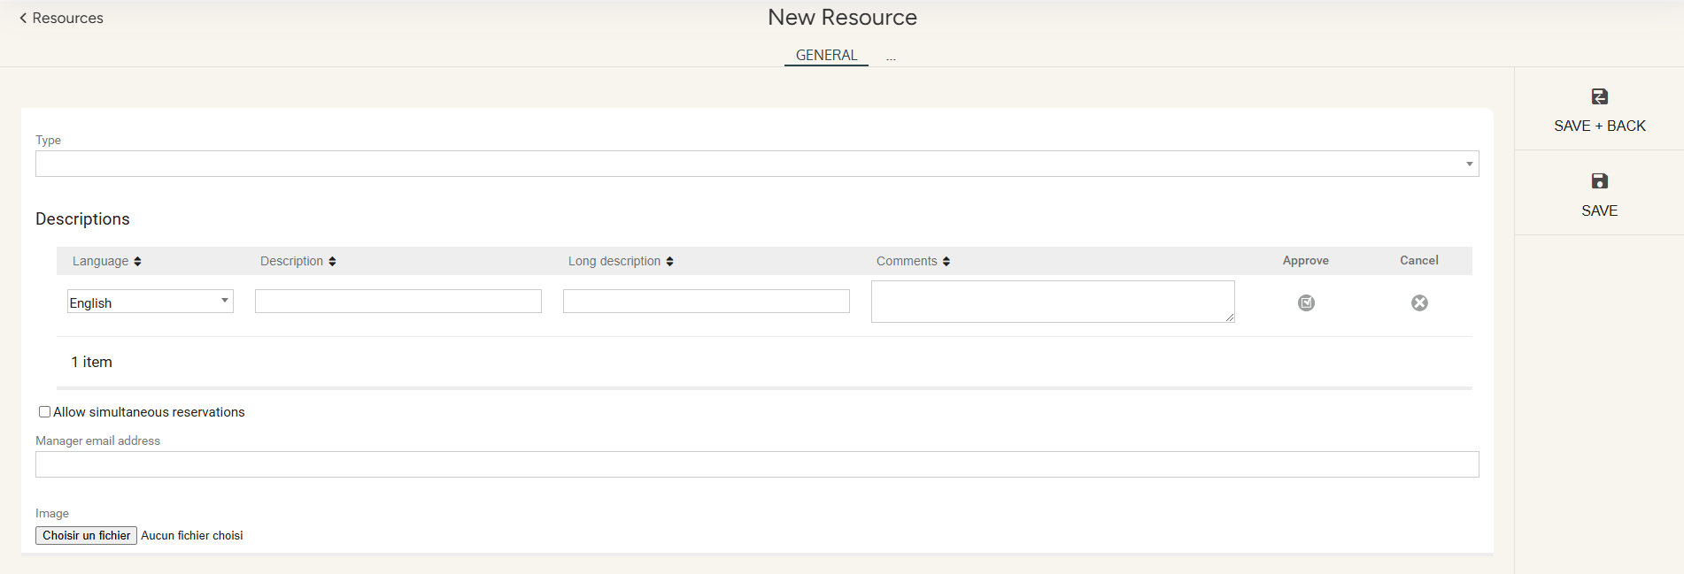
Activity schedule
Creating, changing and managing resources
Access : Menu > Planning > Activity schedule or Admin Area > Resource calendar > Material resources
1/ Select the type of resource : car, meeting room, equipment …
2/ Enter a description
3/ You can enter a long description and comment if you wish
4/ « Approve » the line
5/ Enter the e-mail of the resource manager (for information purposes)
6/ It is possible to associate a photo to your resource

Slide 11
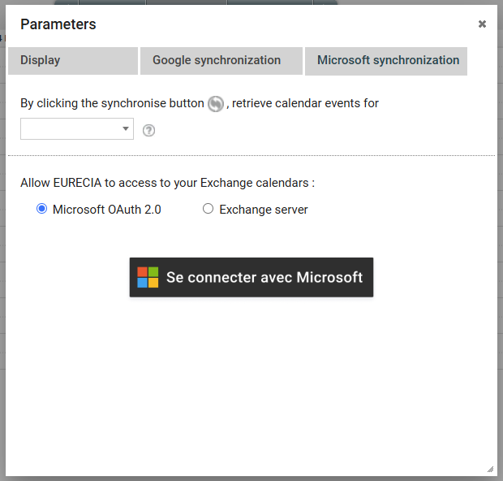
Activity Schedule
Sycnhronising calendars
Access : Menu > Planning > My calendar
Select the relevant calendar to be synchronized

Slide 12
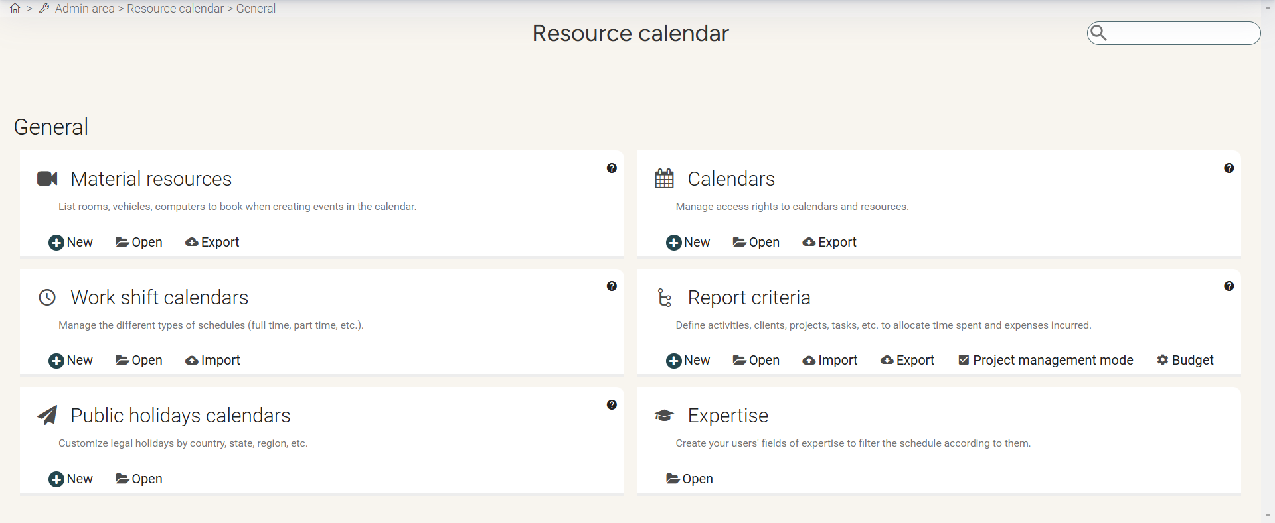
Activity Schedule
Creating different calendars and managing visibilities
Access : Admin Area > Resource calendar > Calendars

Slide 13
Activity Schedule
Creating different calendars and managing visibilities
Access : Admin Area > Resource calendar > Calendars
To manage rights and visibility, open the calendar you wish to modify by clicking on it

Slide 14
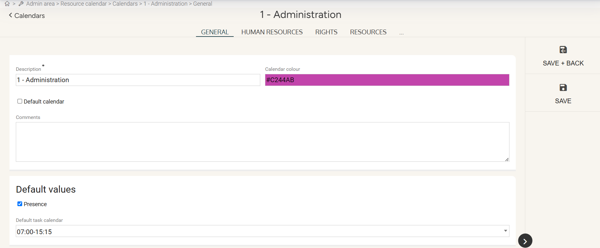
Activity Schedule
Creating different calendars and managing visibilities
Access : Admin Area > Resource calendar > Calendars
The "General" tab allows you to define the characteristics of your schedule (schedule color, schedule name…).

Slide 15
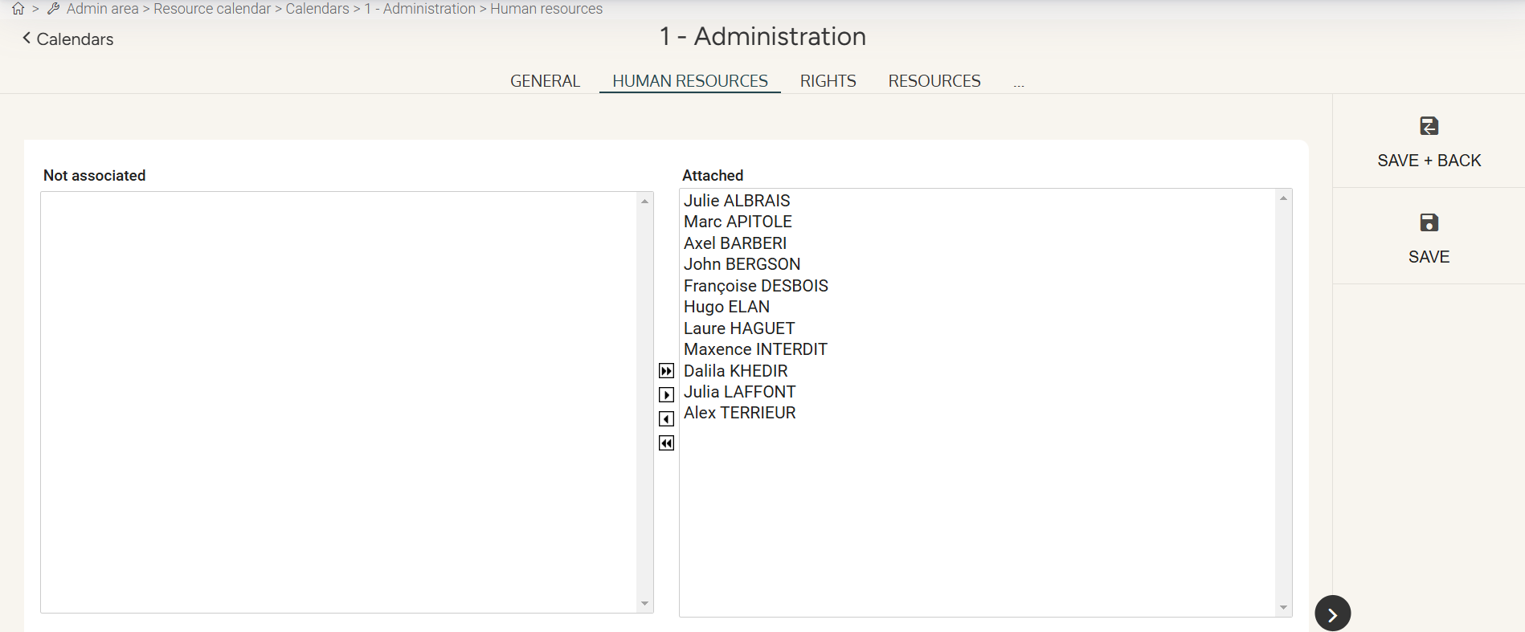
Activity Schedule
Creating different calendars and managing visibilities
Access : Admin Area > Resource calendar > Calendars > List of calendars
The "Human resources" tab allows you to assign the schedule to your employees.
Simply select the employees who should see the schedule and move them to the “attached” box using the arrows.

Slide 16
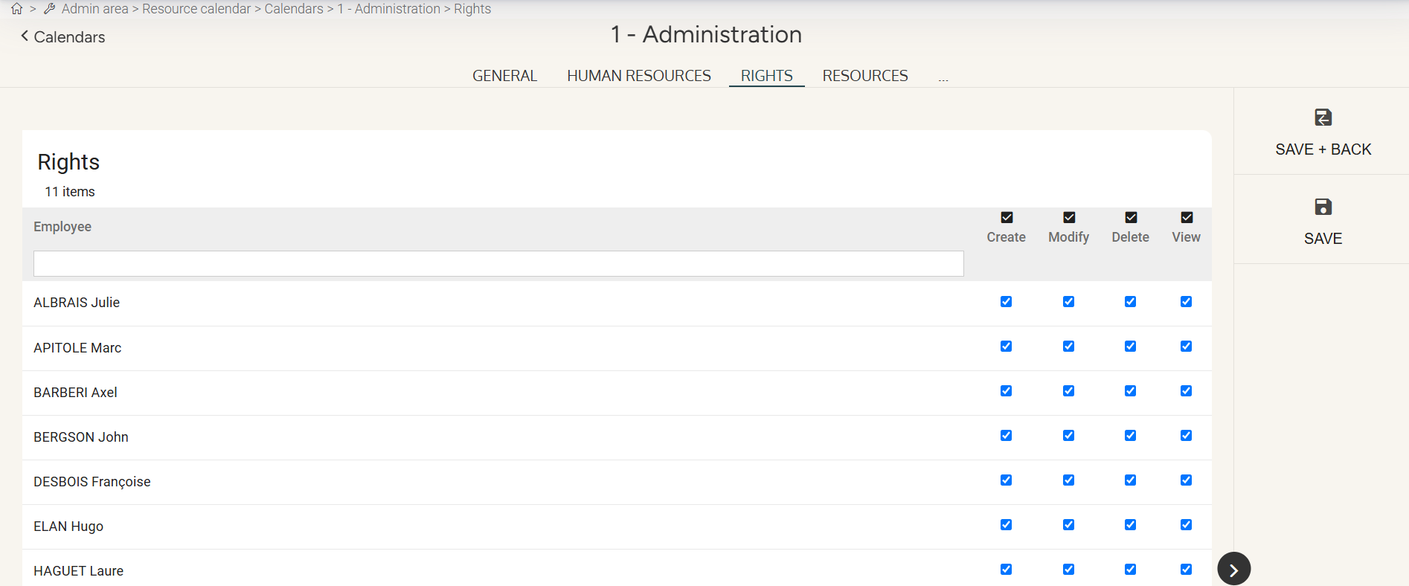
Activity Schedule
Creating different calendars and managing visibilities
Access : Admin Area > Resource calendar > Calendars > List of calendars
The "Rights" tab allows you to define the actions that employees can perform on the events of the concerned schedule.

Slide 17
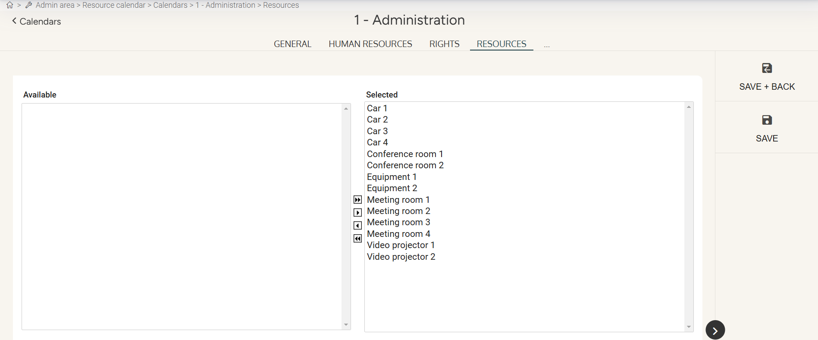
Activity Schedule
Creating different calendars and managing visibilities
Access : Admin Area > Resource calendar > Calendars > List of calendars
The "Resource" tab allows you to define which material resources (vehicles, rooms…) can be reserved when creating an event on the schedule using the arrows.

Slide 18
Still having doubts? All your answers within reach.
support@eurecia.com
Help center

