Slide 1
All you need to know about Leaves & Absences
Administrator training guide
Last updated
September 2024

Slide 2
At the end of this training, administrators will be able to:
Training Objectives
Manage employees' records within the company
Process and manage various types of leave requests from employees
Manage staff leave balances
Set up different types of leave and leave profiles

Slide 3
module features
Training program
Creating and modifying leave requests
Validating leave requests
Viewing and modifying leave balances
Rounding off the acquired paid leave rights
Transfering remaining leaves at the end of a period
Generating split days
Generating staff leave and absences reports
Administrator area
Modifying settings for leave types and absences.
Adjusting leave and absence profiles.

Slide 4
Module features

Slide 5
Creating and modifying leave requests

Slide 6
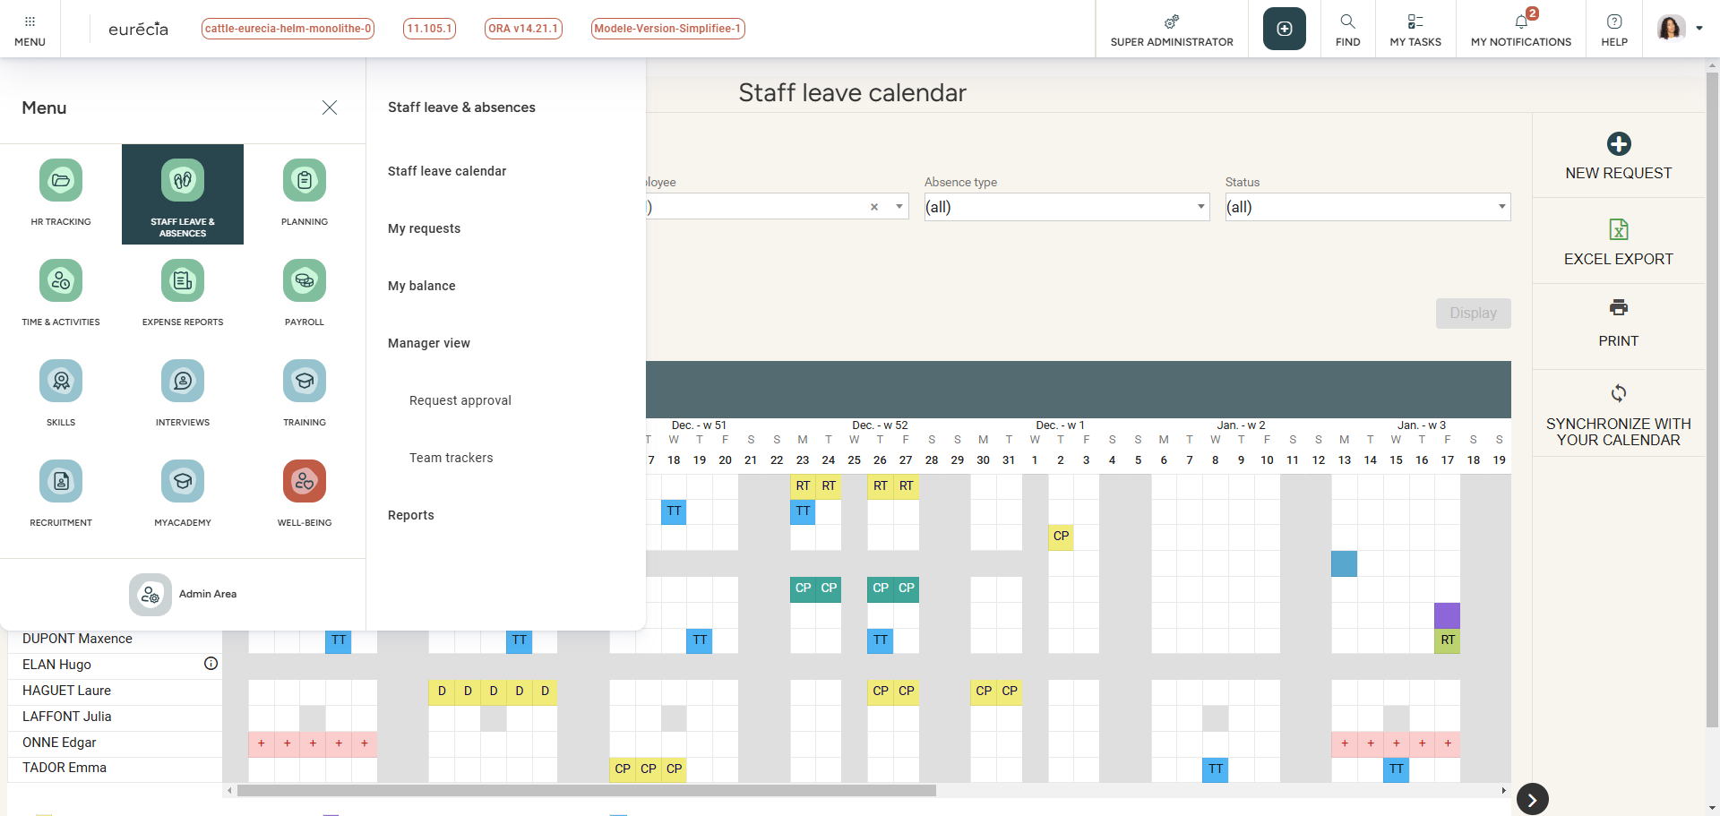
Creating and Modifying Leave Requests
Two ways to request leave:
Method 1 : Go to Staff Leave & Absences > Staff Leave Calendar.

Slide 7
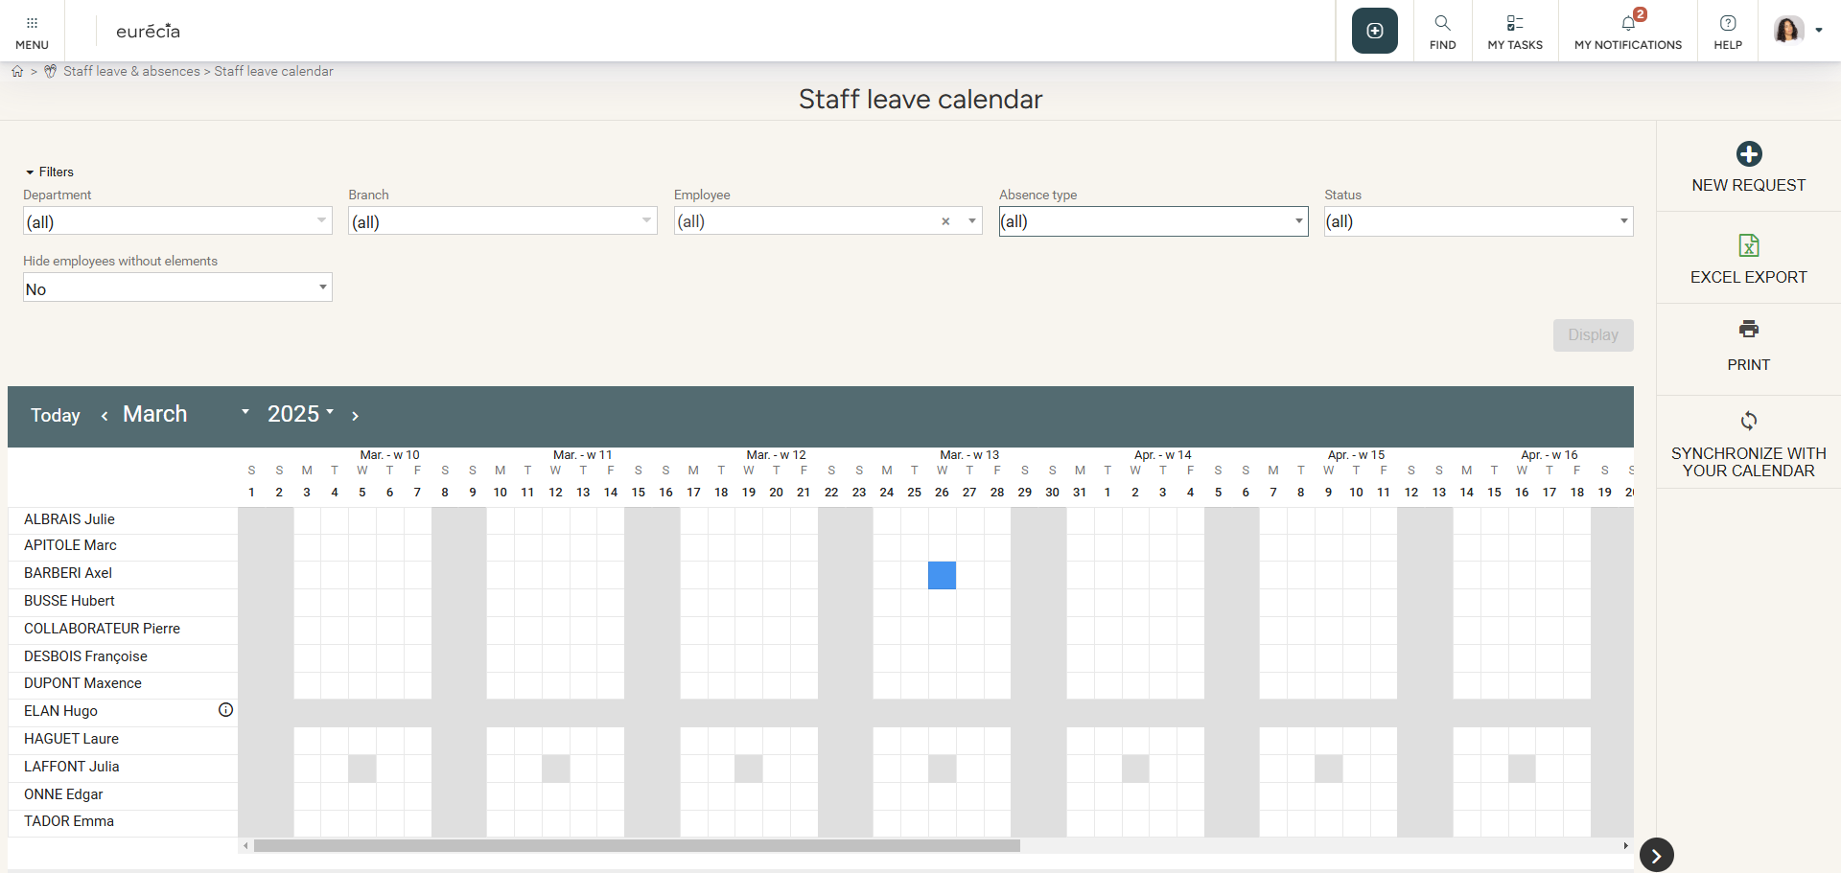
Creating and Modifying Leave Requests
Two ways to request leave:
Method 1 : You can directly select leave days on the calendar and click on "New Request."

Slide 8
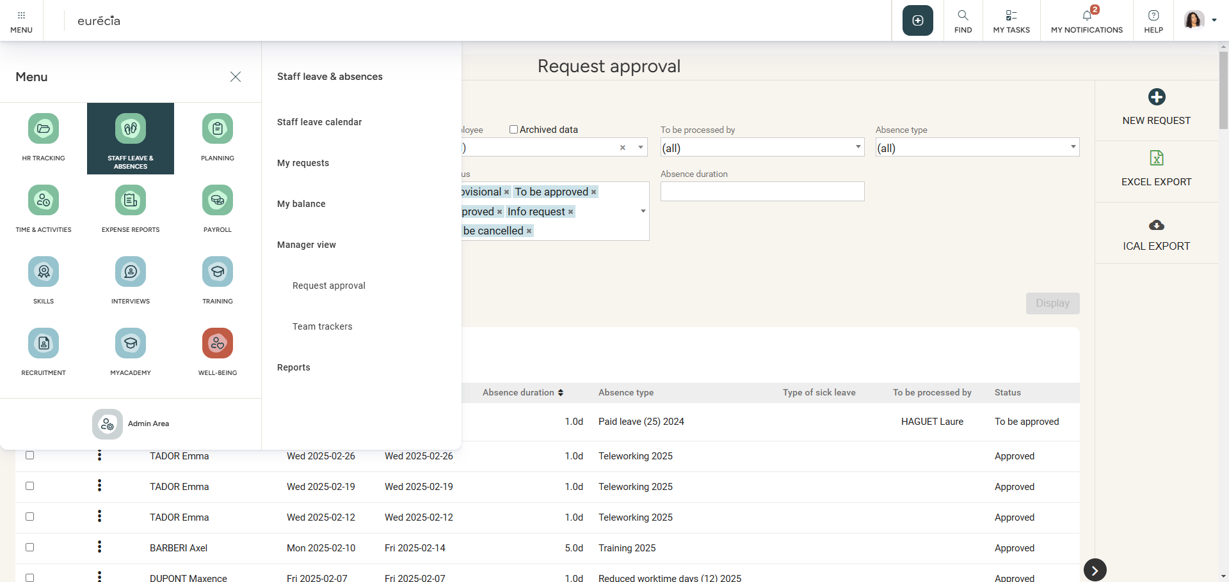
Creating and Modifying Leave Requests
Two ways to request leave:
Method 2 : Go to Staff Leave & Absences > Request Approval.

Slide 9
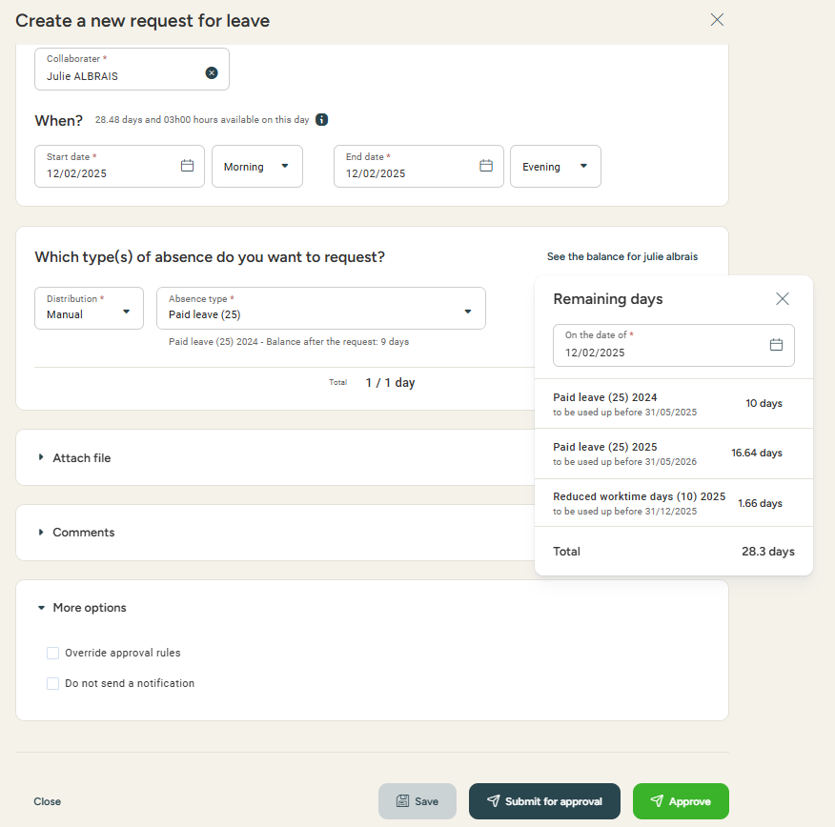
Create and Modify Leave Requests
Requesting leaves & overriding aproval rules
Modify employee’s details, start/end dates, and if you wish to request a half-day, you can choose either from morning, noon or night.
You can request a leave manually or automatically.
In automatic mode, the system will select the priority type of leave based on the settings.
View employee’s leave balances.
Attach a file if required.
Options:
Submit for approval following the regular validation process.
Approve immediately and bypass validation.
Override approval rules when necessary (insufficient balance, mandatory attachments).

Slide 10
Validating Leave Requests

Slide 11
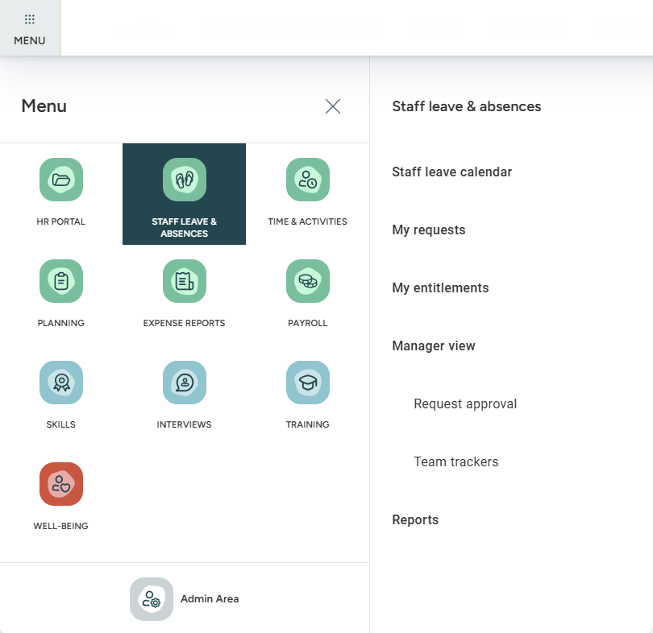
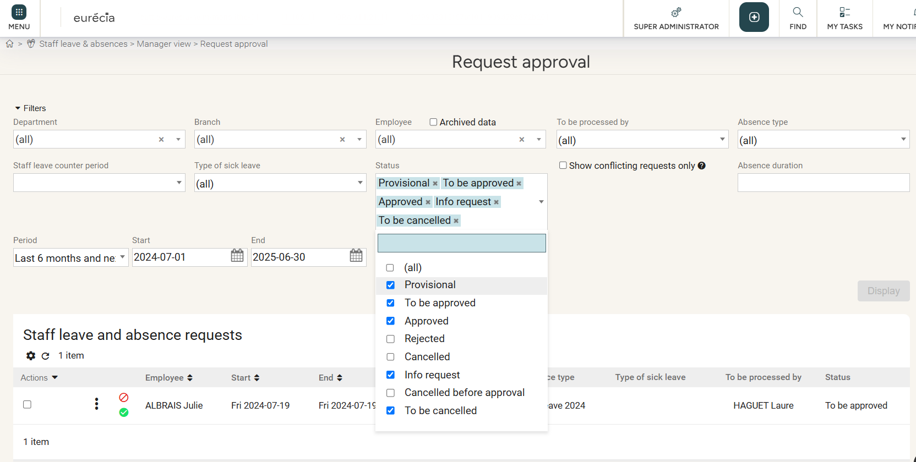
Validating Leave Requests
Manage employees' leave requests
Use filters to find the leave requests you want to manage.

Slide 12
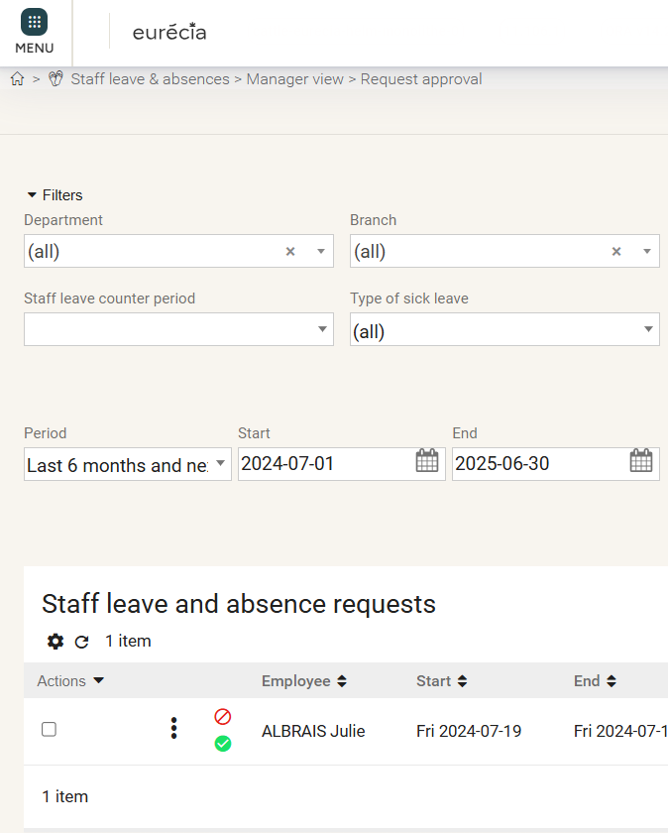
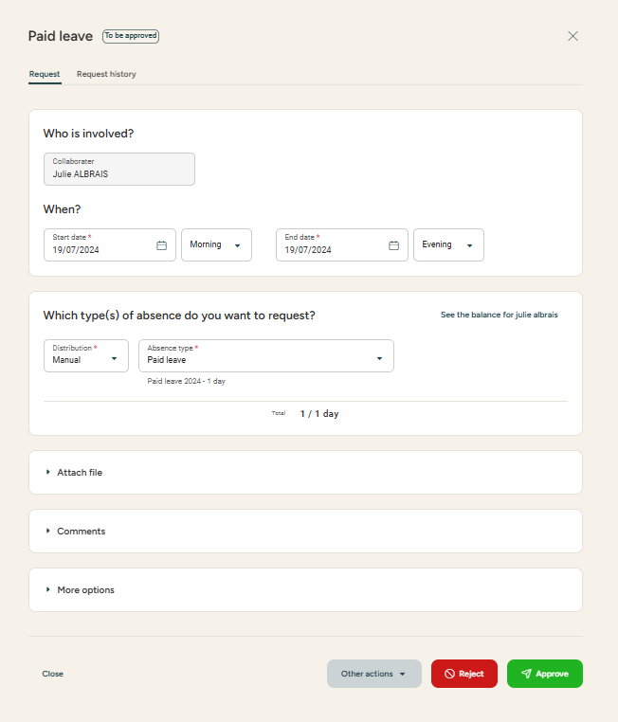
Validating Leave Requests
Access : Leaves & Absences > Request Approval
Manage employees' leave requests
Approve or reject directly from the main consultation page.
View details by entering the request, then approve, reject, or ask for more information.

Slide 13
Viewing and Modifying Leave Balances

Slide 14
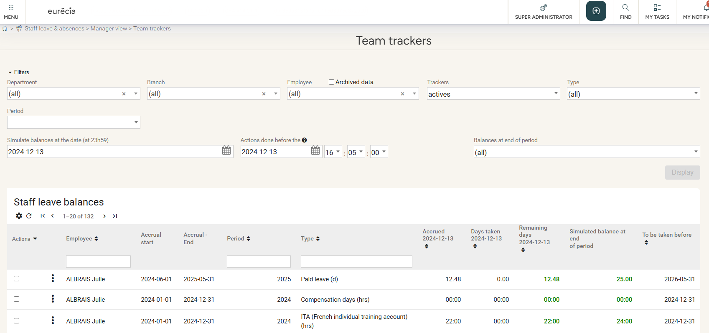
Reviewing and Modifying Leave Balances
Reviewing leave balances
Access : Leaves & Absences > Team Trackers
Filter by leave type, year, or employee.

Slide 15
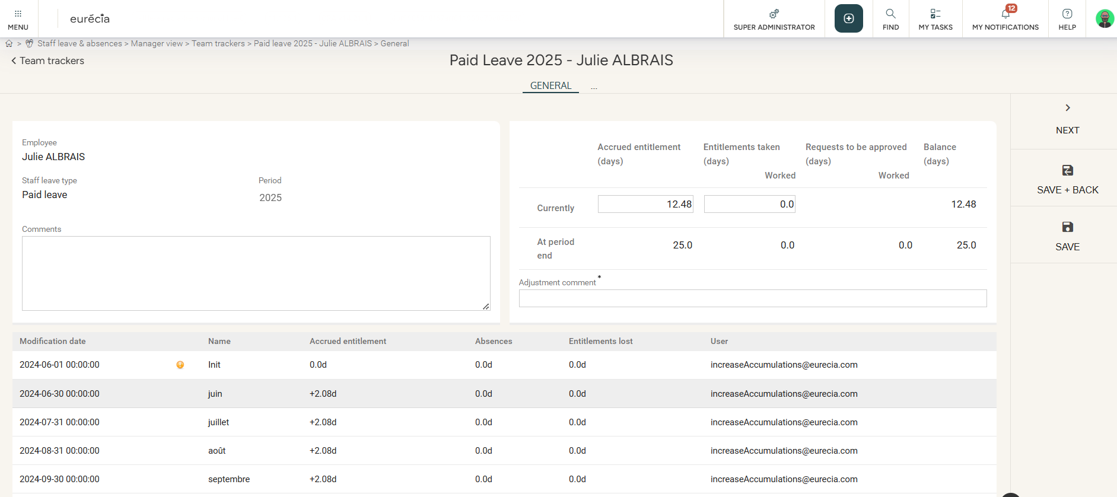
Reviewing and Modifying Leave Balances
Modifying leave balances
Choose the tracker you wish to change:
Modify the balance manually and include a reason for the adjustment.
The entire balance history is saved here.

Slide 16
Bulk Actions on Leave Balances

Slide 17
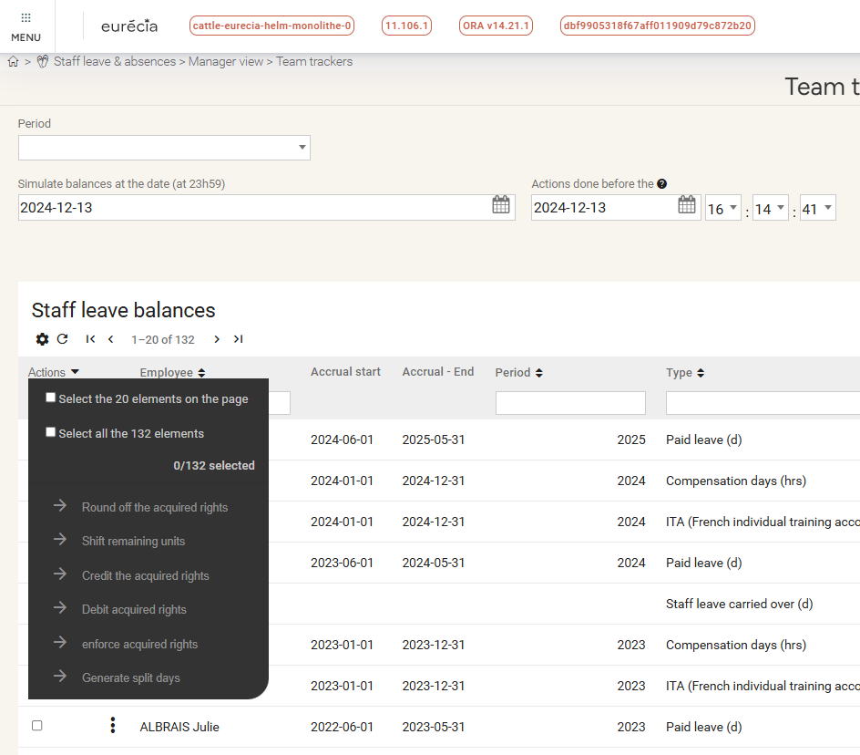
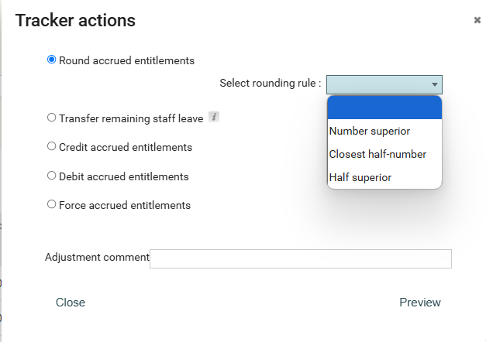
Bulk Actions on Leave Balances
Rounding Leave Entitlements
You can use a bulk action to round off balances for multiple trackers at once:
Select the "Round off the acquired rights" option and set the rounding rules.
Use the "Actions" button for bulk modifications, like rounding off leave days.

Slide 18
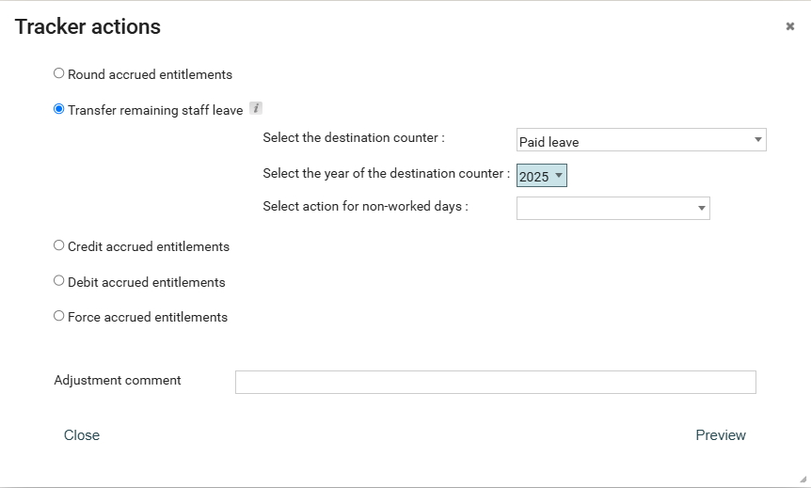
Bulk Actions on Leave Balances
Managing Leave Carryovers
You can use a bulk action to carry over balances for multiple trackers at once:
Use the "Actions" button for bulk carryover adjustments.
Select the "Carryover" option, choose the destination tracker, and review before confirming.

Slide 19
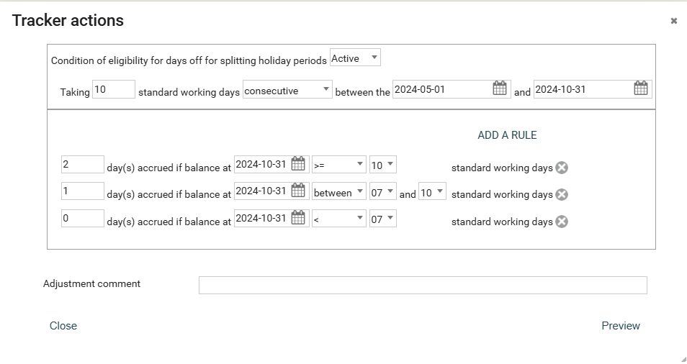
Bulk Actions on Leave Balances
Generating split Days
You can use a bulk action to generate split days :
Use the "Actions" button to generate additional days for split days.
Set up the company’s rules before generating extra leave days.

Slide 20
Using Reports

Slide 21
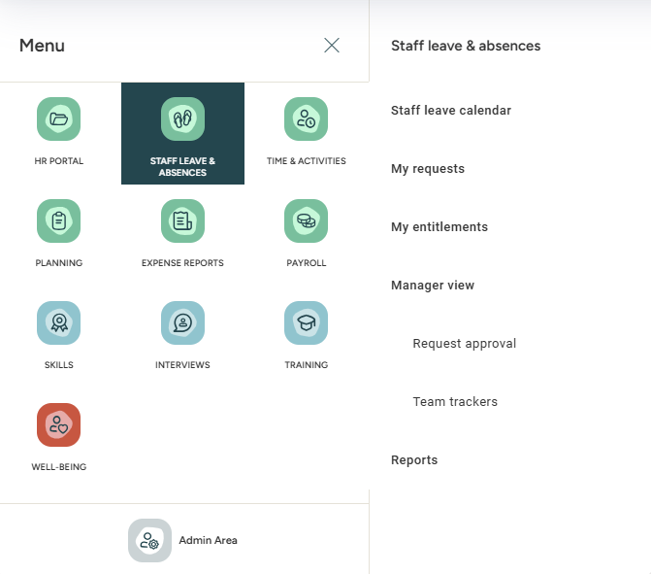
Using Reports
Exporting data
Export your data, including workday tracking, leave balances, or graphs generated by the Eurécia system.

Slide 22
Administrator Area

Slide 23
Modifying Staff Leaves & Absences settings

Slide 24
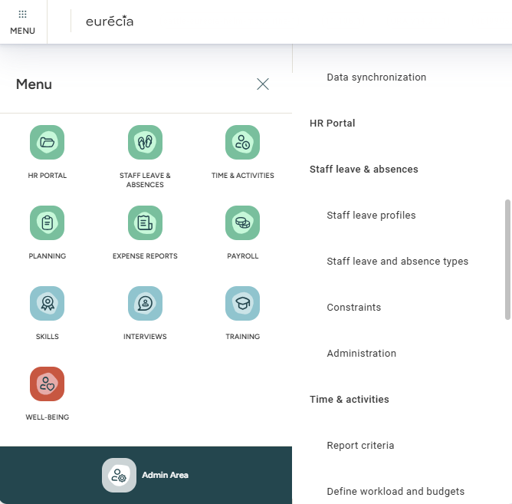
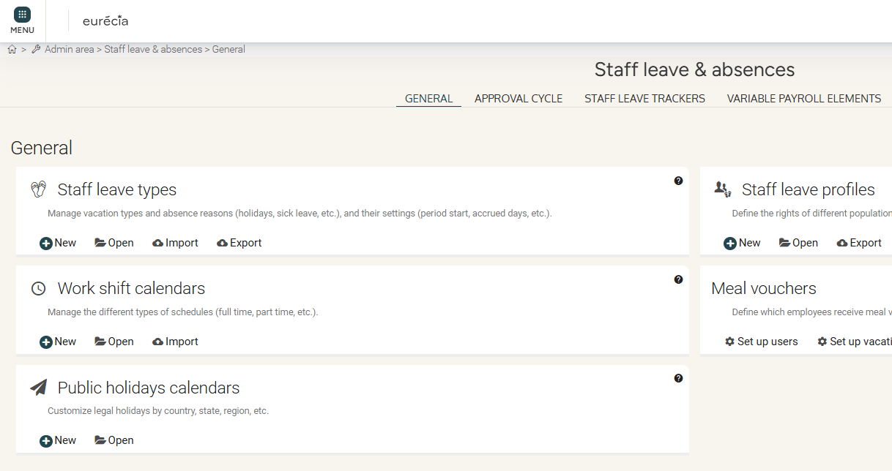
Modifying staff leaves & absences settings
Creating a new type of absence or leave
Access: Admin Area > Staff Leaves & Absences > Staff Leave Types

Slide 25
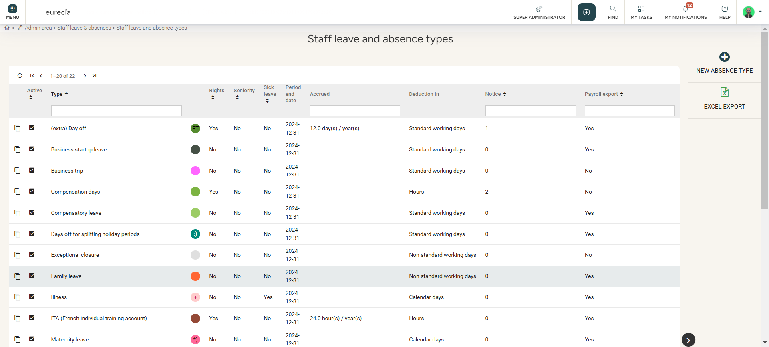
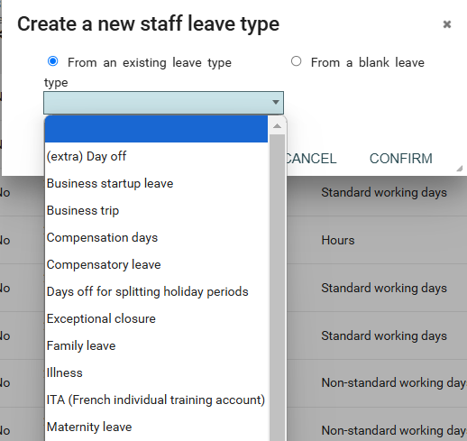
Modifying staff leaves & absences settings
Creating a new type of leave or absence
Creating a new leave type or duplicating an existing one.

Slide 26
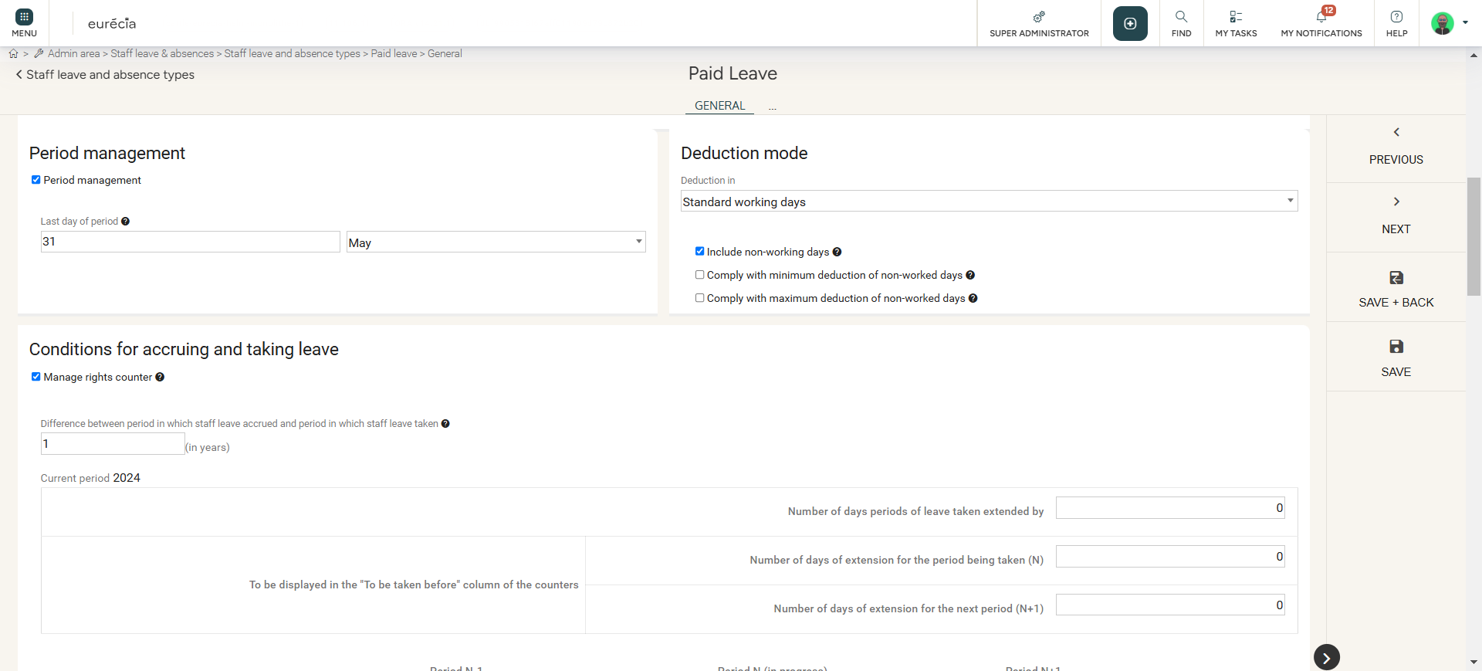
Modifying staff leaves & absences settings
Creating a new type of leave or absence
In each type of leave or absence, it is possible to change:
Description, calendar colour, font colour
Leave period
Deduction mode (Standard working days, calendar days, etc...)
Accruals, length of service holidays, etc...
Conditions upon requesting leave: notice period, minimum and maximum of days, etc...

Slide 27
Modifying staff leaves & absences profiles

Slide 28
Modifying staff leaves & absences profiles settings
Creating a new staff leave profile
Access : Admin Area > Staff leave & absences > Staff leave profiles

Slide 29
Modifying staff leaves & absences profile settings
Creating a new staff leave profile
Access : Admin Area > Staff leave & absences > Staff leave profiles
Staff leave profiles provide access to different types of leaves and absences to users. You can create a new staff leave profile by selecting "New staff leave profile". You can duplicate an existing profile as well.
Examples :
"Manager" profile has access to Paid Leave and RTT.
"Non-manager" profile has access only to Paid Leave.

Slide 30
Modifying staff leaves & absences profile settings
Creating a new staff leave profile
Whenever ypu change a profile's setting, you have access to three different tabs:
The "General" tab, in which you can change the absence or leave's name and description.
The "Staff leave and absence types" tab allows you to add or remove different types of leaves and absences. You can also define the priority, which the system will rely on to use available balance in a specific order.

Slide 31
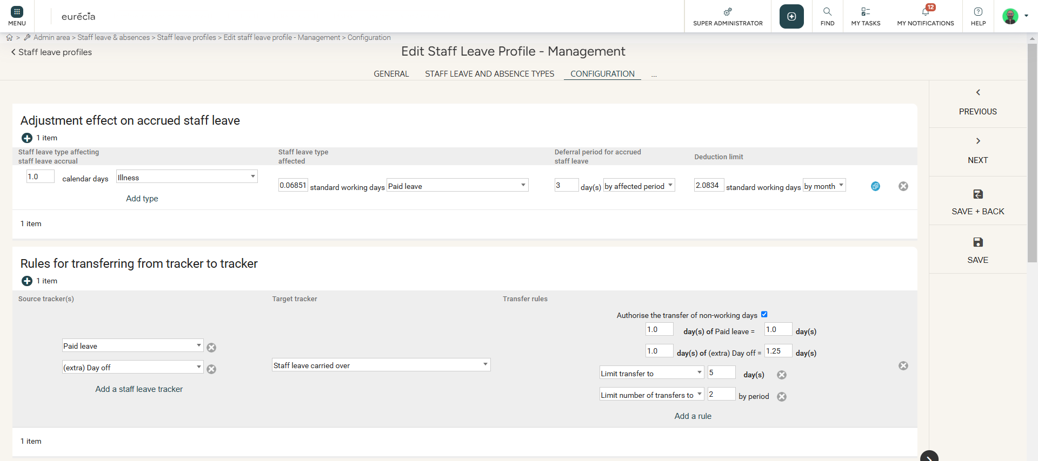
Modifying staff leaves & absences profile settings
Creating a new staff leave profile
The "Configuration" tab allows you to change several other settings:
Adjustments effect on accrued staff leave (Annual leave, etc...)
Rules for transferring from tracker to tracker
Types of leave that cannot be used contiguously
Types of leave that cannot be taken over multiple days
…

Slide 32
Still having doubts? All answers are within your reach.
support@eurecia.com
Help center

