Slide 1



All you need to know about
Planning
User guide
Last updated
November 2024

Slide 2

At the end of this training, employees and managers will be able to:
Training objectives
Create or modify events
Review calendars
Enter employee’s activities

Slide 3


As an employee
Training program
Get familiar with the interface features: display, printing…
Create, modify, and manage events
Check your schedule
As a manager
Enter activities for my employees
Enter schedules for my employees

Slide 4
As an employee

Slide 5
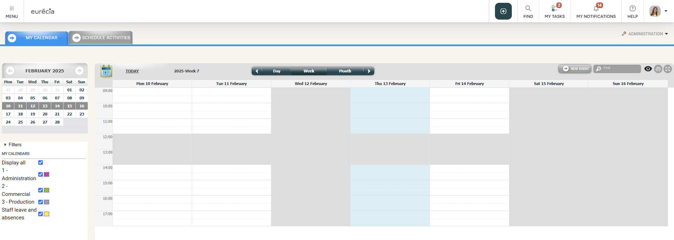


Get familiar with the features
My calendar
Access: Menu > Planning > My Calendar
My Calendar allows you to schedule your appointments by creating a new event

Slide 6
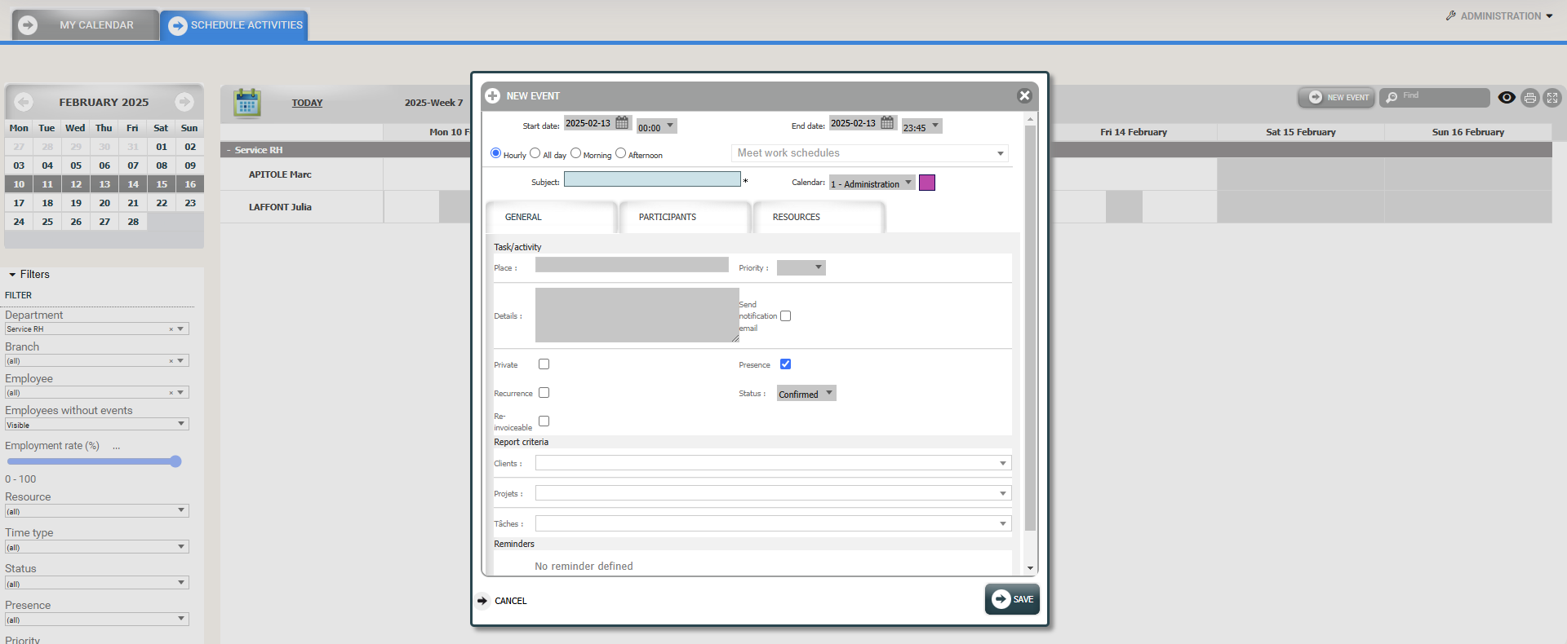
My calendar / Activity Schedule
Create a new event
Access: Menu > Planning > Activity Schedule
Click on « New event » to create an activity.
Select the relevant slot:
Hourly = Choose the dates and time for a personalized time slot
All day = Eurecia uses the work schedule
Morning = Eurecia uses the start and end time of the work schedule for the morning
Afternoon = Eurecia uses the start and end time of the work schedule for the afternoon
Subject : Enter the subject of the activity
Note: If you manage analytical axes, selecting an axis on this same tab may fill in the “Subject” field.
Calendar : Select the schedule corresponding to this new activity

Slide 7
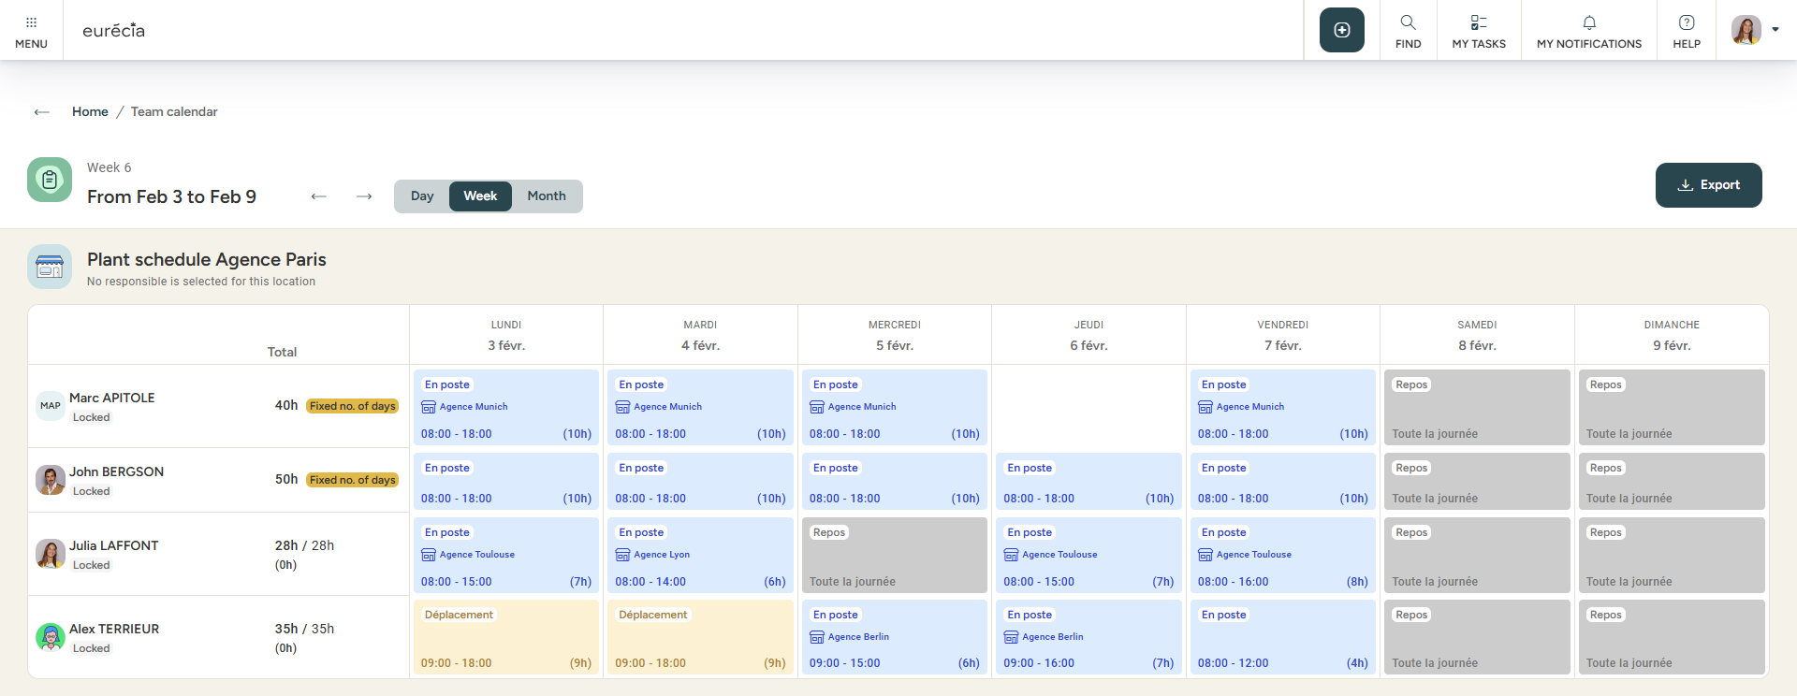
Team calendar
Access : Menu > Planning > Team Calendar
  You can navigate from weeks to weeks by using the arrows.
  To print your schedule or save it as a PDF, click on « Export ».

Slide 8
As a manager

Slide 9
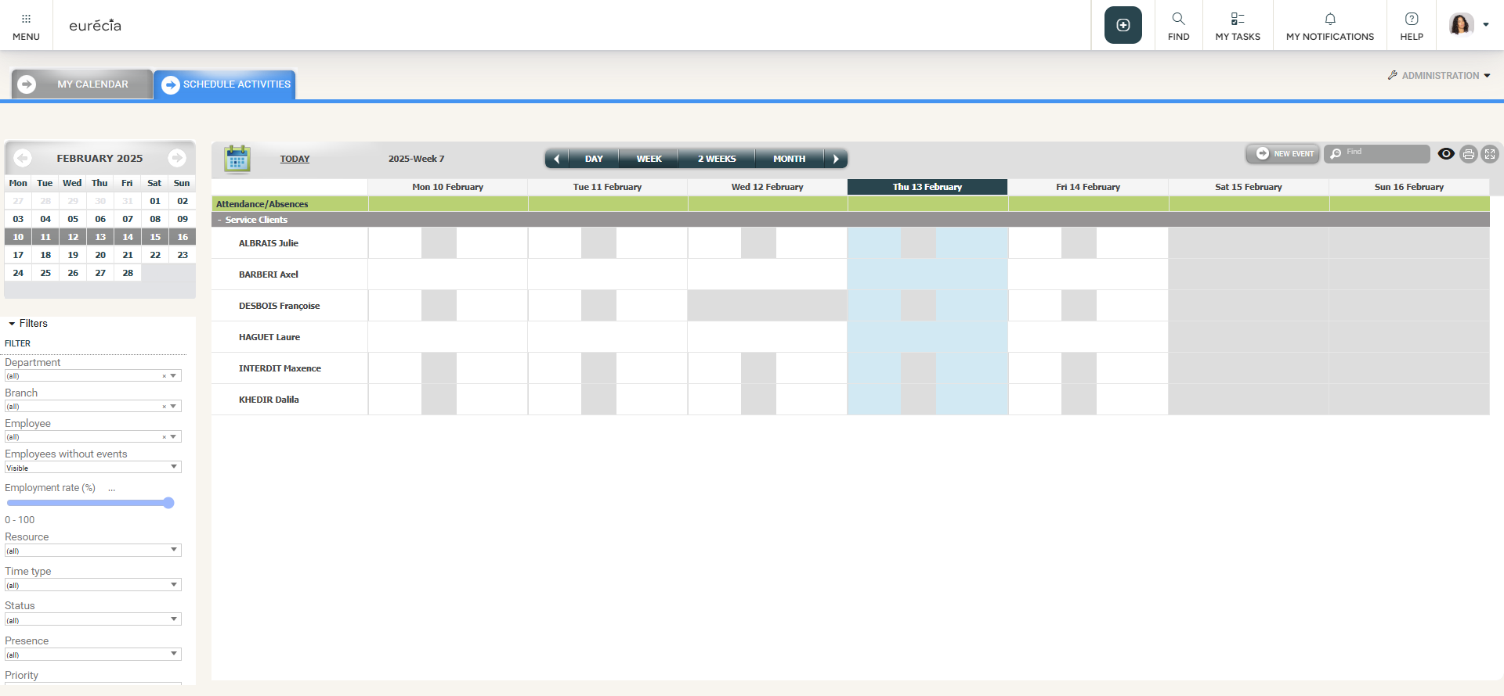
Accessing the activity schedule
Activity Schedule
Access : Menu > Planning > Activity Schedule
This allows you to view all the calendars of your team members.
The filters allow you to display the team schedule based on departments, branches, employees and more …

Slide 10
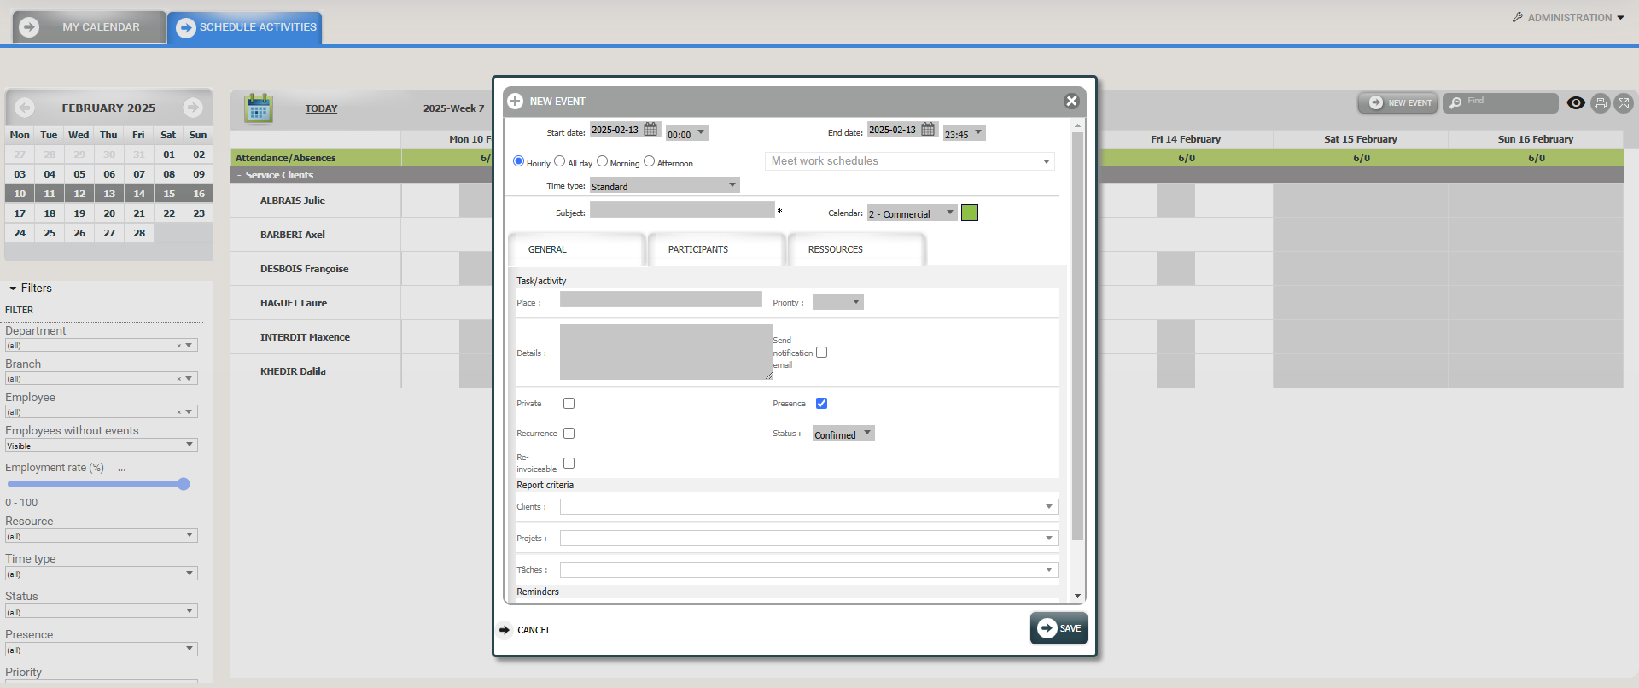
Manage activities for my employees
Creating a new event
Access : Menu > Planning > Activity Schedule
Click on « New event » to create a new activity
Select the relevant time slot:
Hourly = Choose the dates and time for a personalized time slot
All day = Eurecia uses the work schedule
Morning = Eurecia uses the start and end time of the work schedule for the morning
Afternoon = Eurecia uses the start and end time of the work schedule for the afternoon
Subject : Enter the subject of the activity.
Note: If you manage analytical axes, selecting an axis on this same tab may fill in the “Subject” field.
Calendar : Select the schedule corresponding to this new activity.

Slide 11
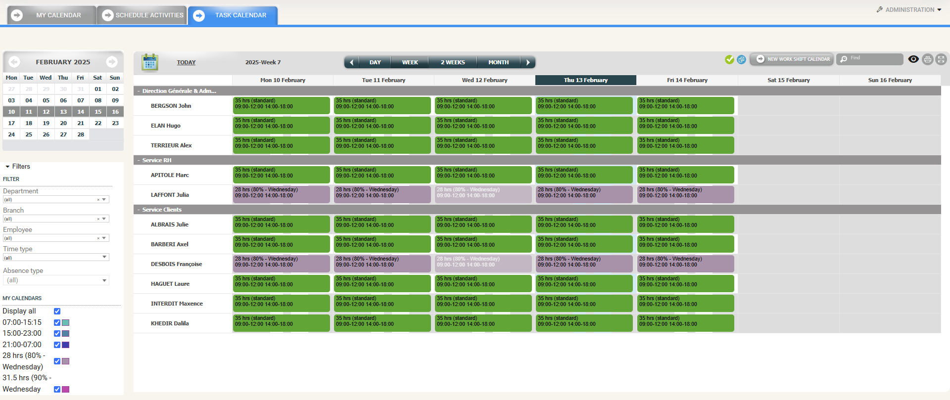
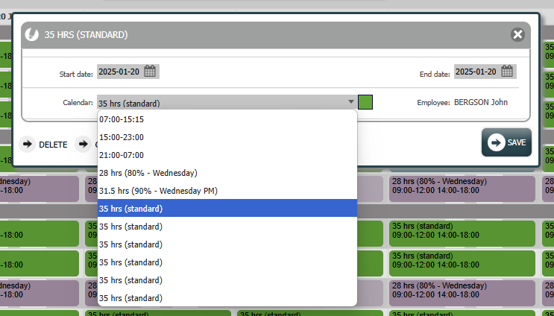
Managing hourly schedules for my employees
Task calendar
Access : Menu > Planning > Task Calendar
In this schedule, you can assign hours to your team members by clicking on a time slot

Slide 12
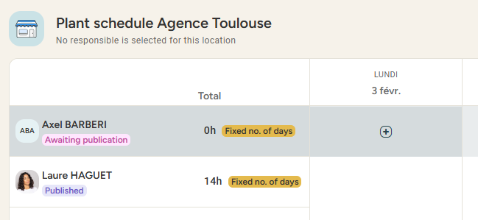
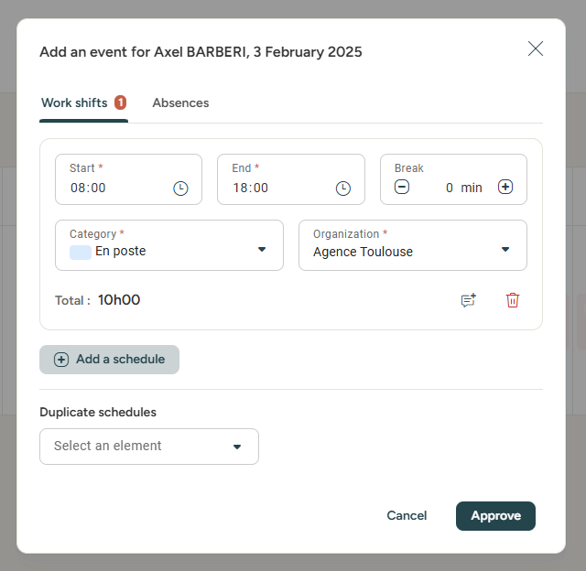
Scheduling my employees
Team calendar
Access : Menu > Planning > Team Calendar
Hover over the time slot you wish to schedule and click on it
Choose between a work shift or an absence
Specify the start and end times, the optional break (which will be deducted from the working time), and the type of activity performed (on-site / travel / training / …) and the organization
Add a work shift
schedule if needed

Slide 13
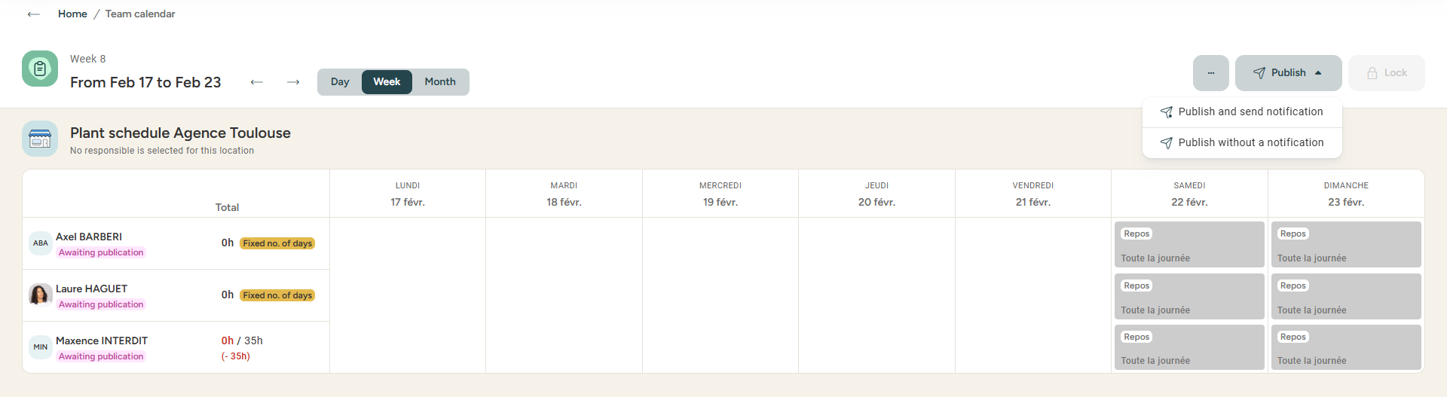
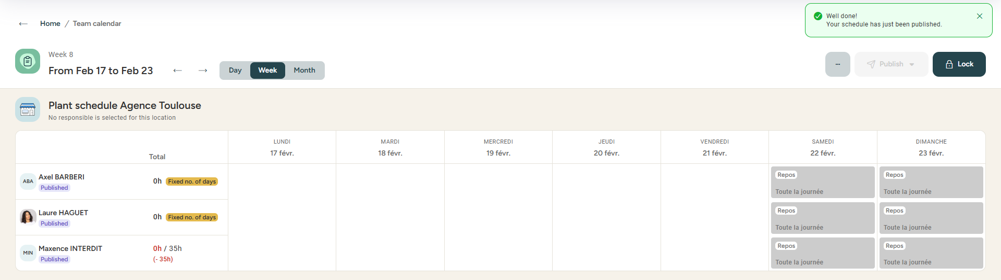
Team calendar
Sharing your planning
Access : Menu > Planning > Team calendar
Enter the schedule and publish it to share with your team. When your planning is final (or at the end of the week), you can lock it.

Slide 14
Still having doubts?
All your answers within reach.
Adresse mail administrateur
Help center

