Slide 1


All you need to know about
HR Portal
Administrator training guide
Last updated
November 2024

Slide 2
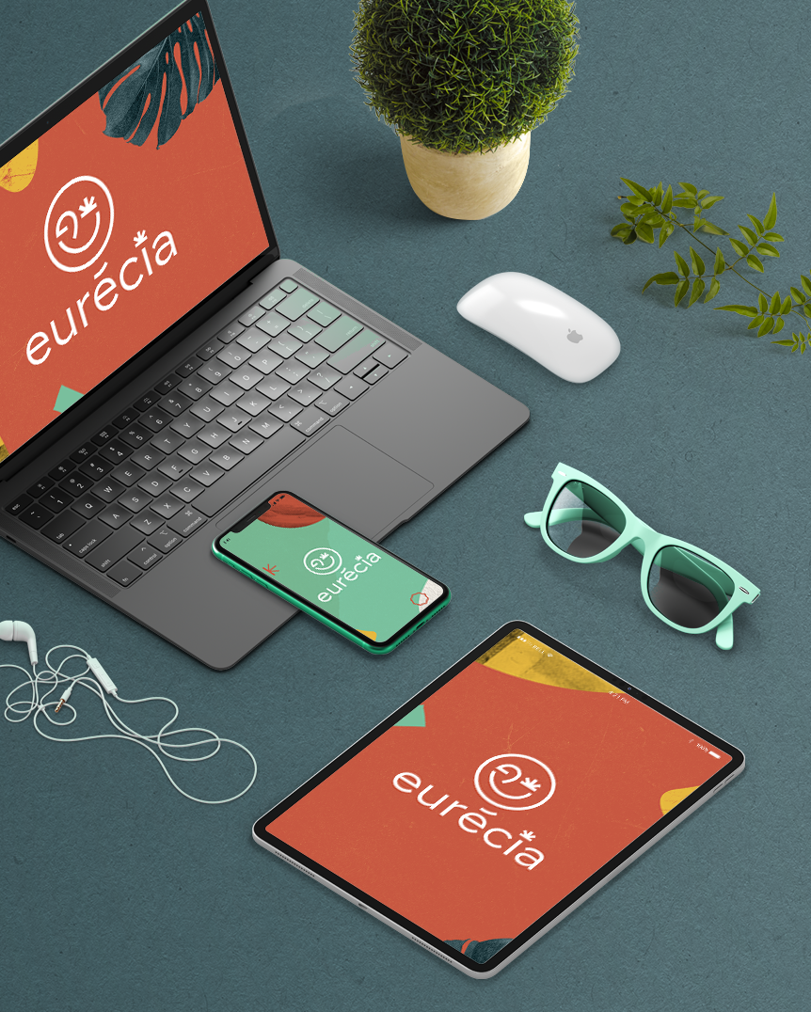
At the end of this training, administrators will be able to:
Training objectives
Manage the employee lifecycle and archive elements in their file
Add an element to the employees’ records
Share documents
Import payslips
View HR dashboard
Prepare for the onboarding and offboarding of employees

Slide 3



Module features
Training program
Managing employee lifecycle
Administration of employees’ records
Creation of document templates
Adding shared company documents
HR dashboard
Managing alerts
Onboarding/Offboarding management (Models, tasks, welcome email, onboarding form)
Payslips import
Admin area
Managing access to HR related tasks
Setting up employees’ files

Slide 4
Module features

Slide 5
Managing the employee lifecycle

Slide 6
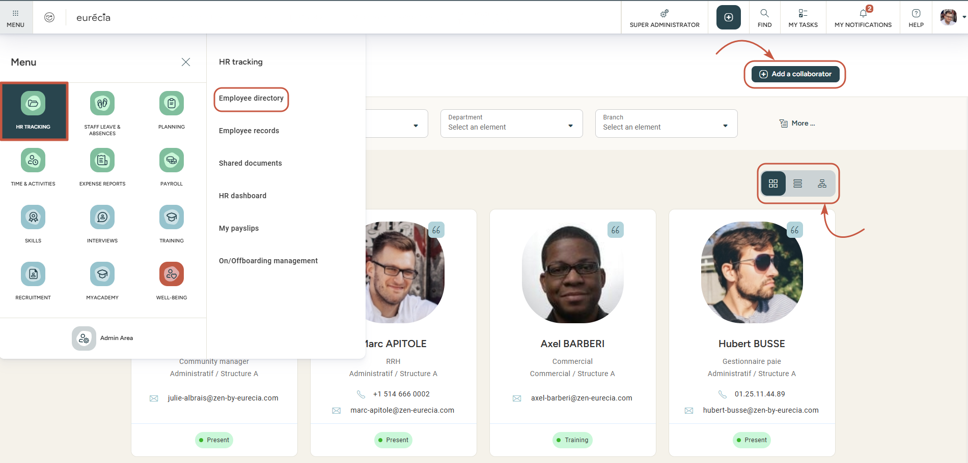
Managing employee lifecycle
Access n°1: HR portal > Employee directory
Add a new user from this screen
Display the directory as a list or as mosaics
Good to know ! By clicking on an employee’s line, you can access their employee file.

Slide 7
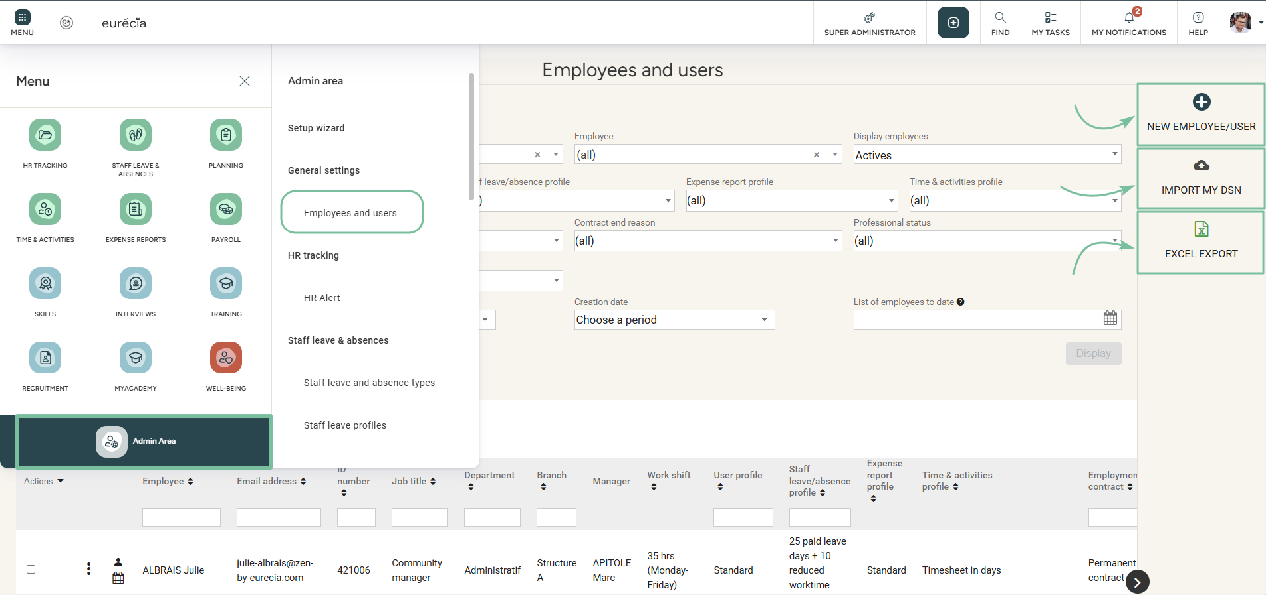
Managing employee lifecycle
Access N°2: admin area > general settings > employee directory
New employee/User
Import "DSN"
Export employee related data

Slide 8
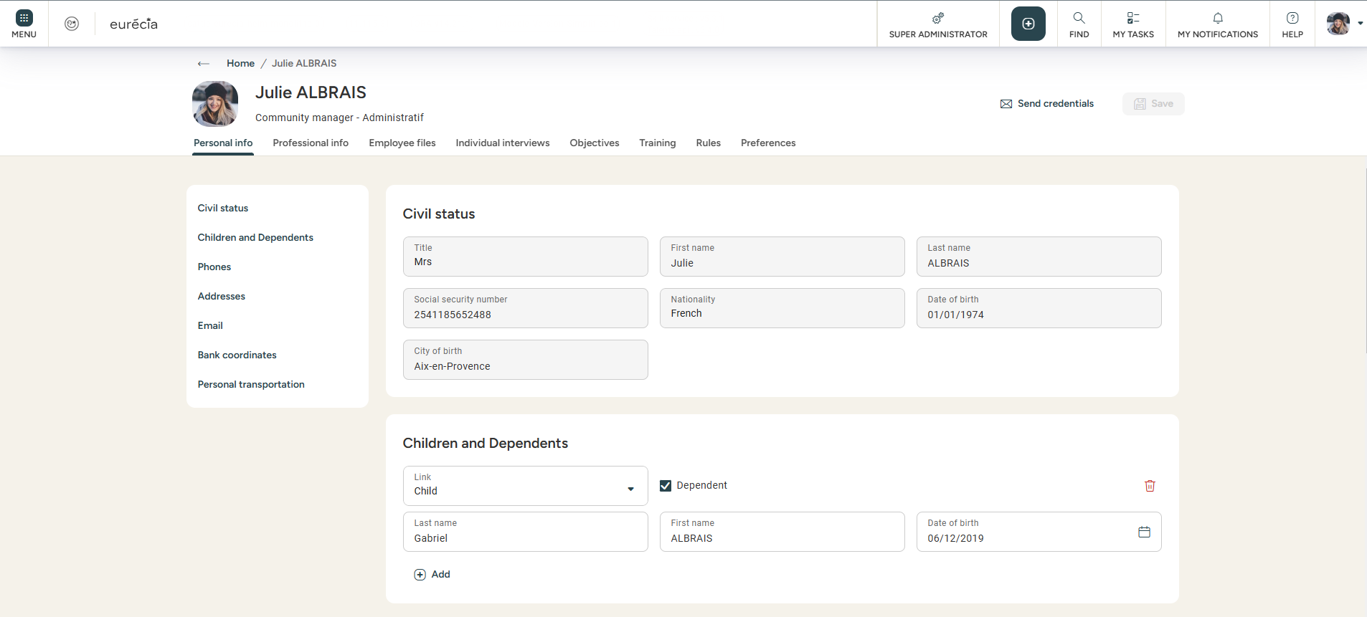
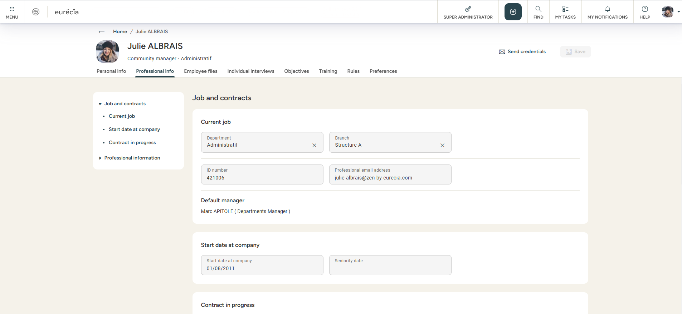
Managing employee lifecycle
Employee directory overview
You can change the employee’s information in the "Personal info" and "Professional Info« tabs.

Slide 9
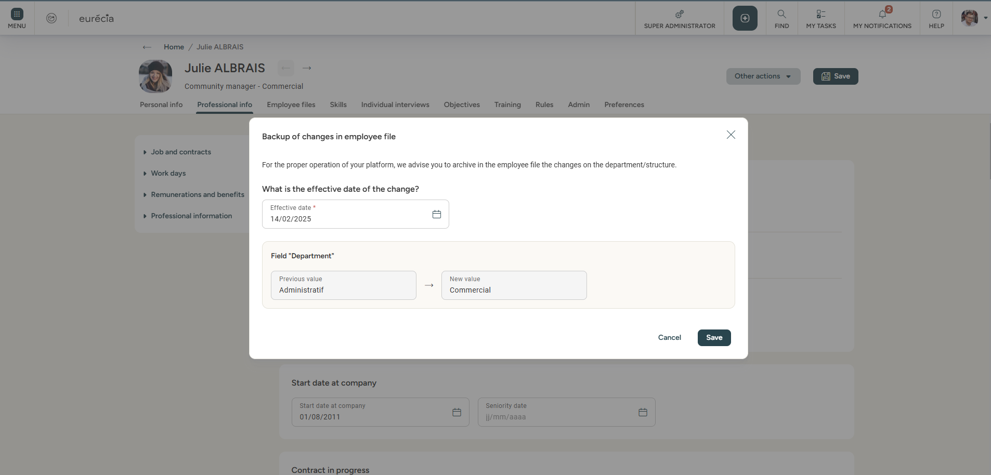
Managing employee lifecycle
Data history in the employee’s file
When you modify certain fields in the employee’s file, Eurécia suggests to store the values in the “Employee file” when you save it.
This allows you to track the chronology of the employee’s changes.

Slide 10
Employee files

Slide 11
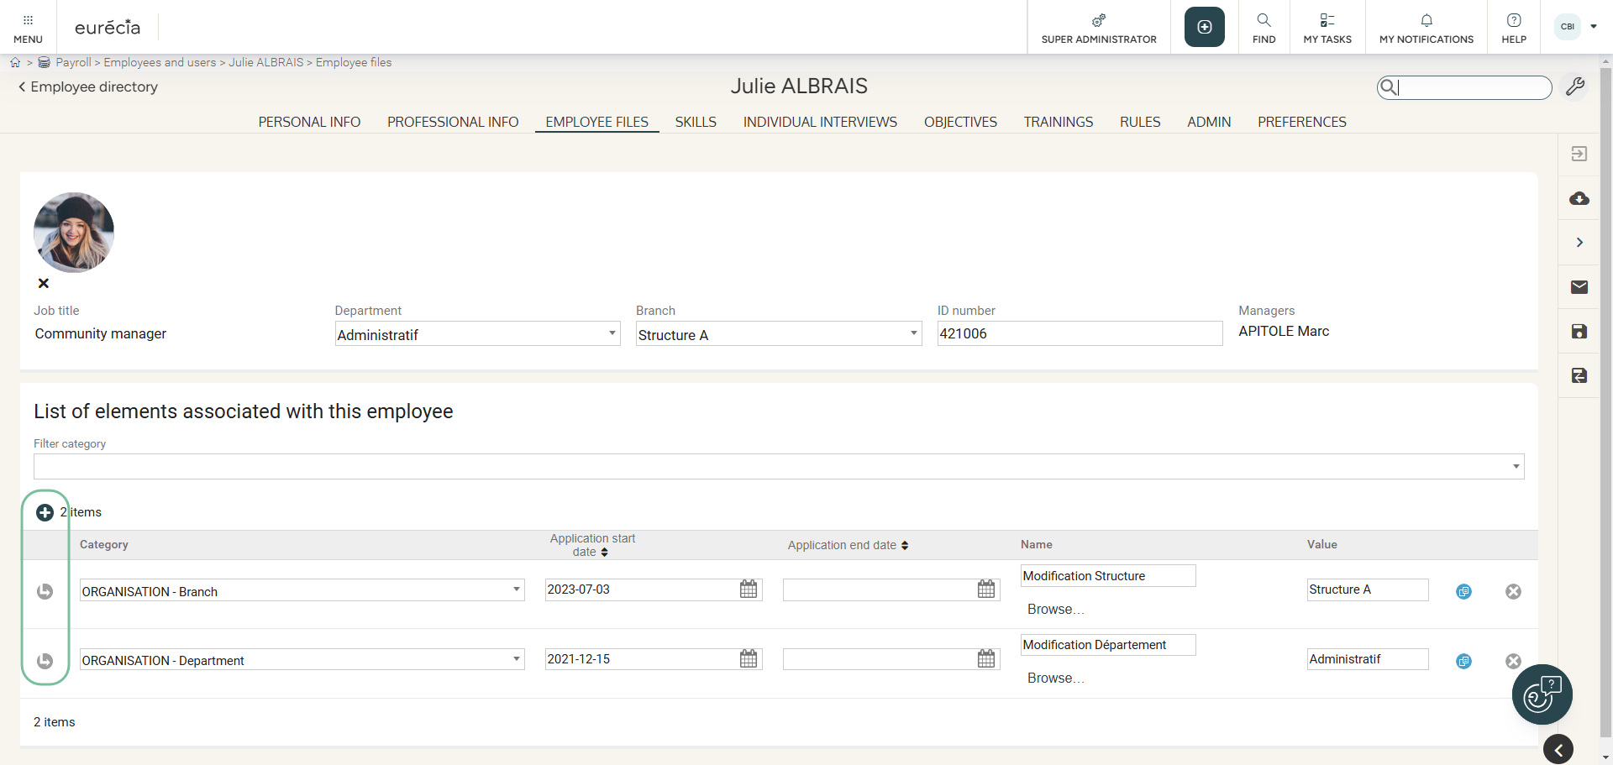
Adding elements to employee files
From the employee directory
You can create elements in the employee records from the employee file itself, to attach the employee’s contract, certificates and more.

Slide 12
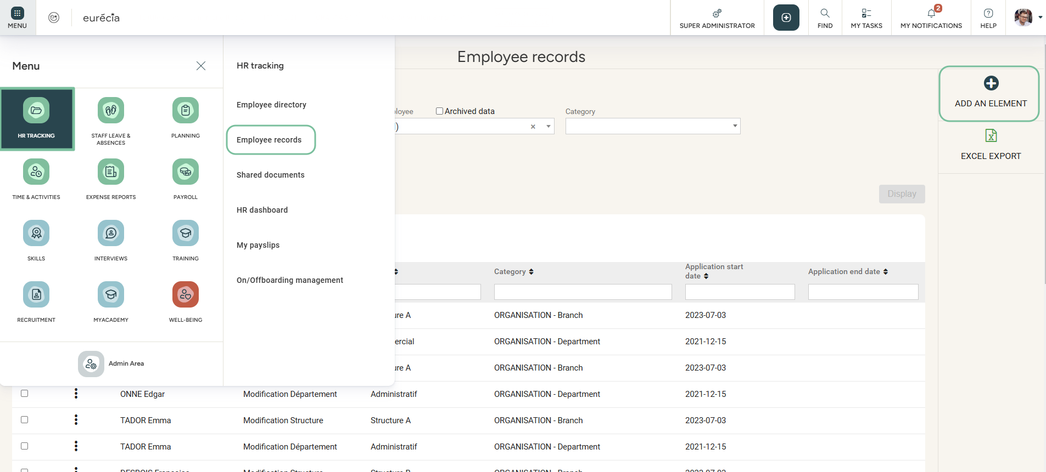
Adding elements to employee files
Access : HR Portal > Employee records
Lastly, you can also create elements in your employees’ files directly from the employee’s records in the HR portal module.
Good to know ! You can add a document from your computer or from a document template.

Slide 13
COMING SOON…
Employee files

Slide 14
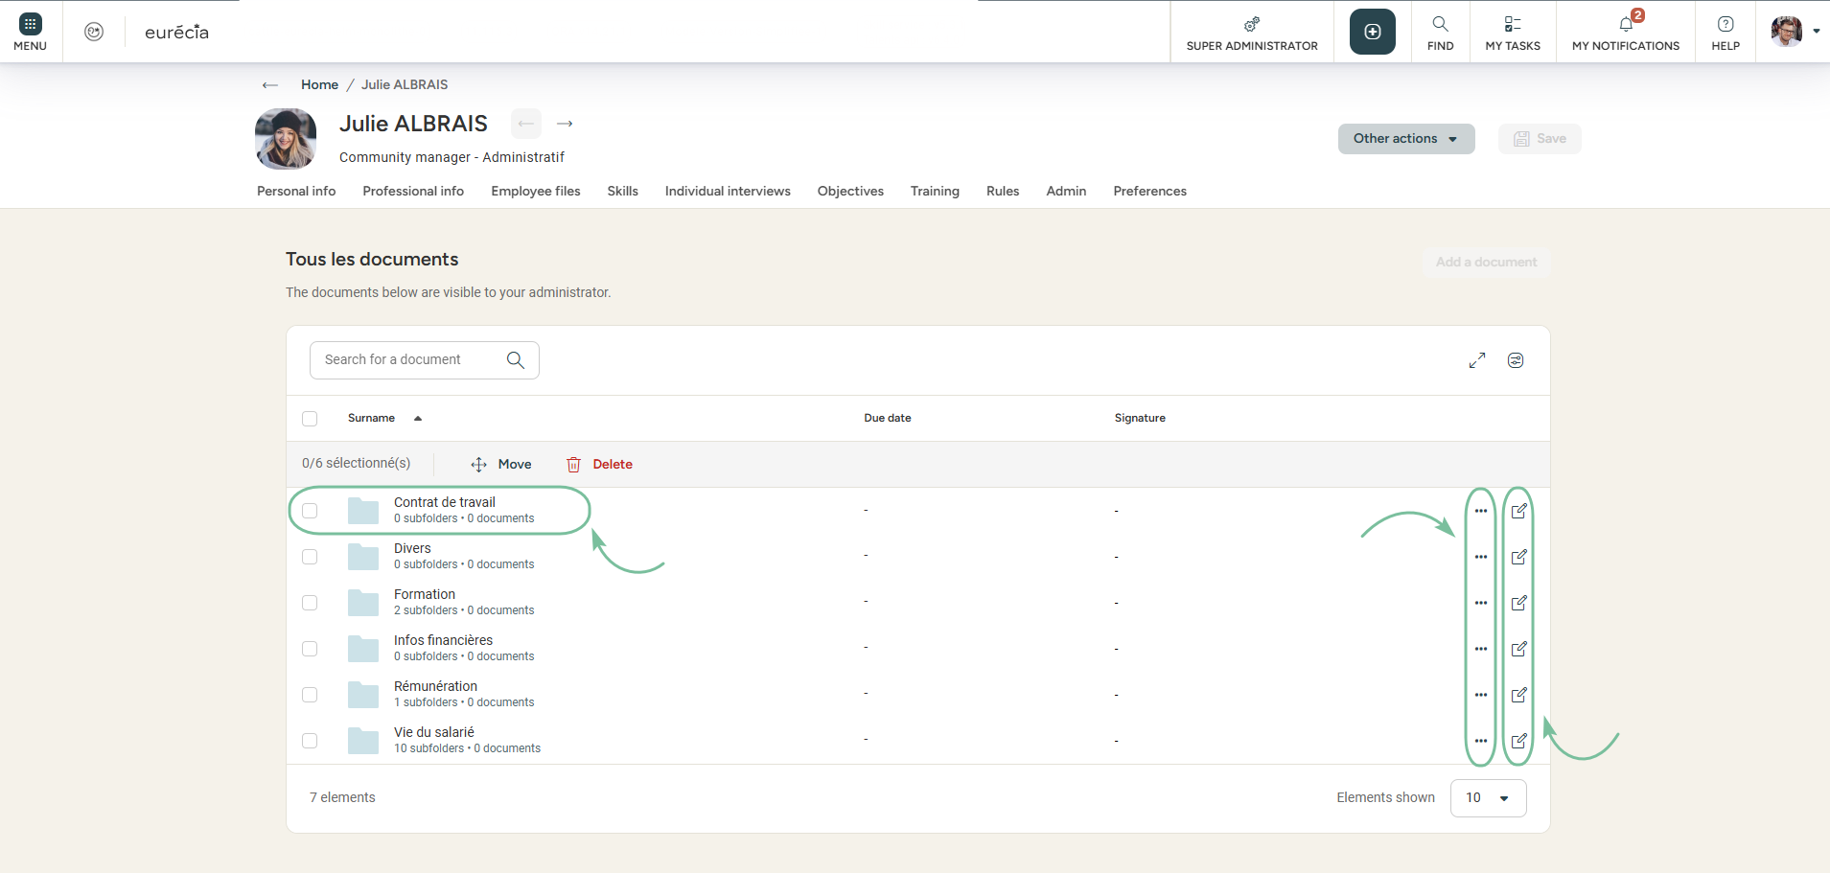
Adding documents to employee files
From the employee’s file
Click on the folder to add a document
To move or to delete the folder
To change folder’s settings
You can add files in the NEW employee’s file from the employee’s file itself, to attach the employee’s contract, certificates and more…

Slide 15
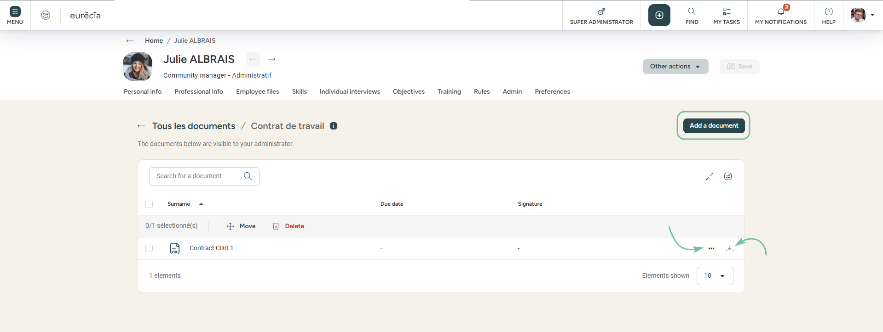
Adding document to employee files
From the employee directory
To add a new document
To move or to delete the document
To download the document on your device
You can add as many documents as you like.

Slide 16
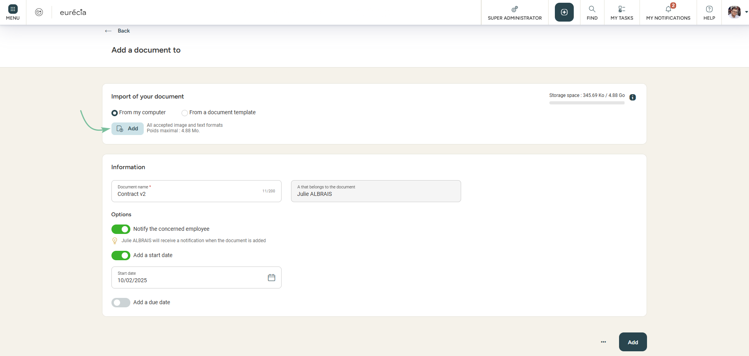
Adding document to employee files
From the employee directory
Click here to add a document from your computer
You can import a document in the first block area.
You can notify the employee that a document has been added in his files.
The start and due dates are optional, but can be used to set up alerts at a later date..

Slide 17
Templates

Slide 18
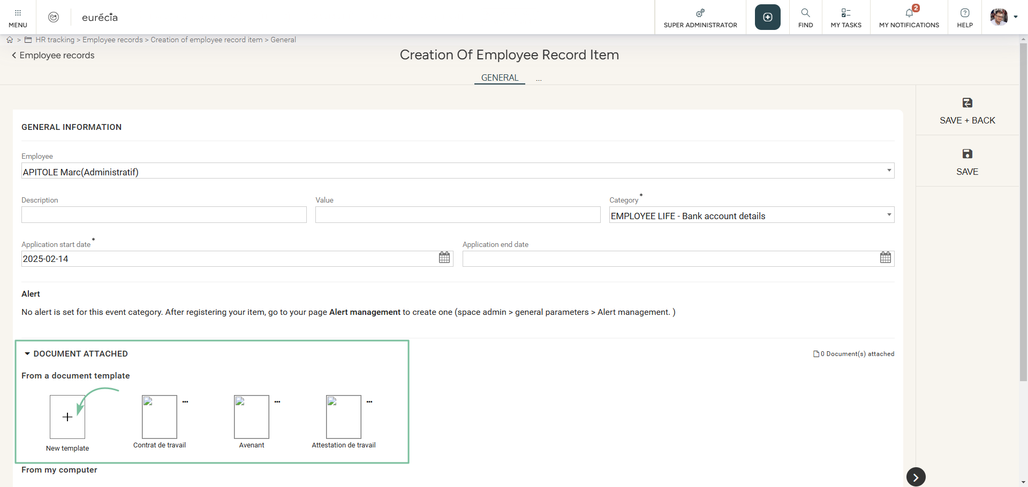
Creating document templates
Access: HR Portal > employee records > add an element

Slide 19
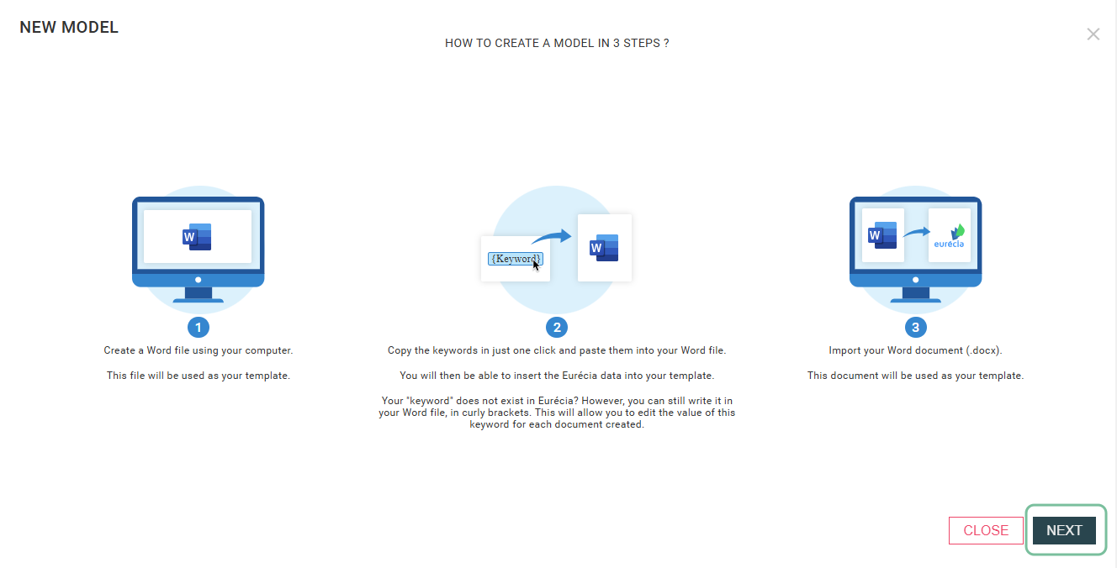
Creating document templates
Creating a new template

Slide 20
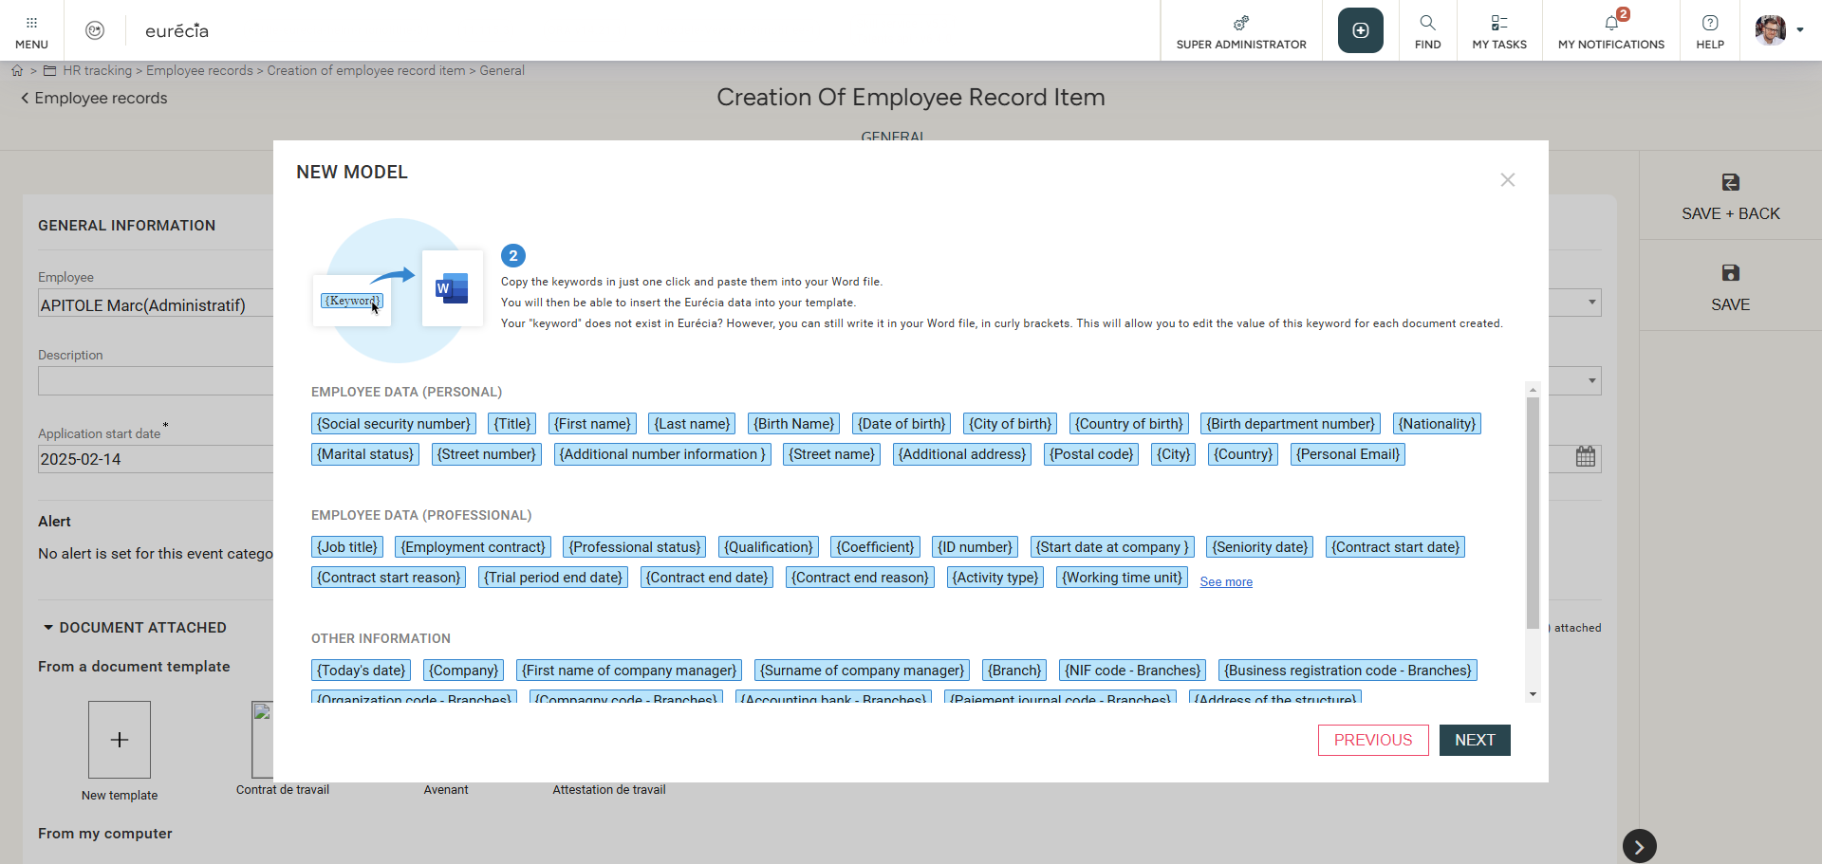
Creating document templates
Creating a new template
When creating templates via Microsoft Office Word, specific tags may be copied and pasted from Eurécia and integrated into the document.
This will allow the documents upon generation to be automatically filled in with related data from Eurécia.

Slide 21
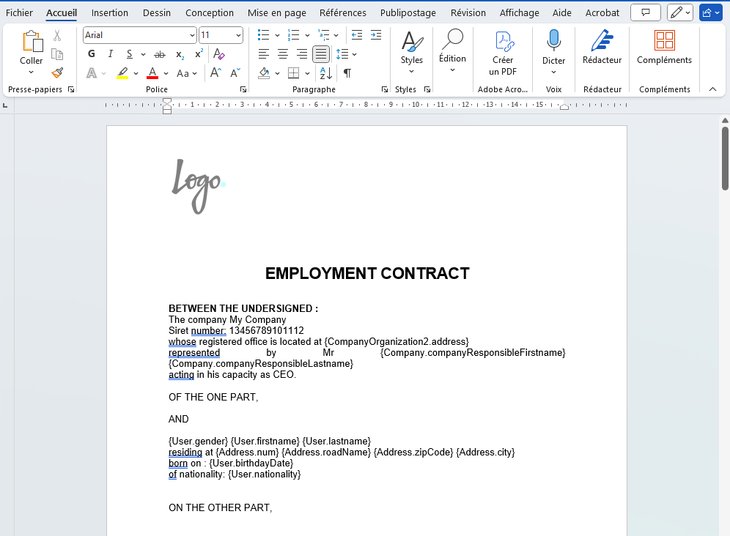
Creating document templates
Creating a new template
Step 1: In Eurécia, click on the data you want to integrate into your document.
Step 2: Paste this data into your Word document.
Step 3: you can copy and paste as many data as you need to create your template.

Slide 22
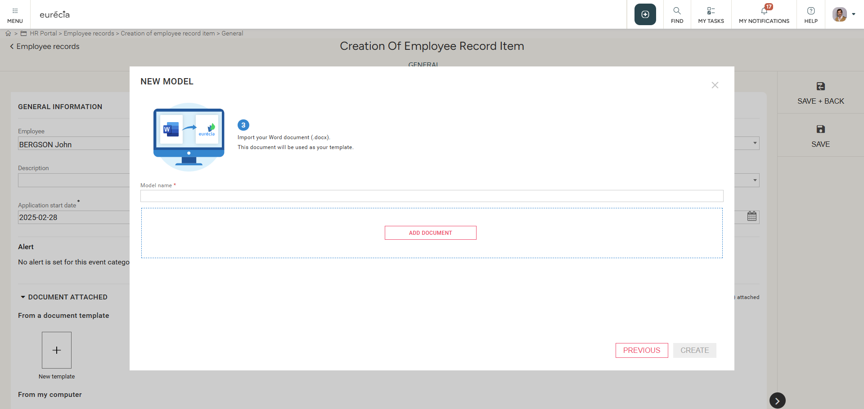
Creating document templates
Creating a new template
Save your Word document on your computer then go on to the next step in Eurécia and import the document.
You can now use it for any of your employees.

Slide 23
Shared documents

Slide 24
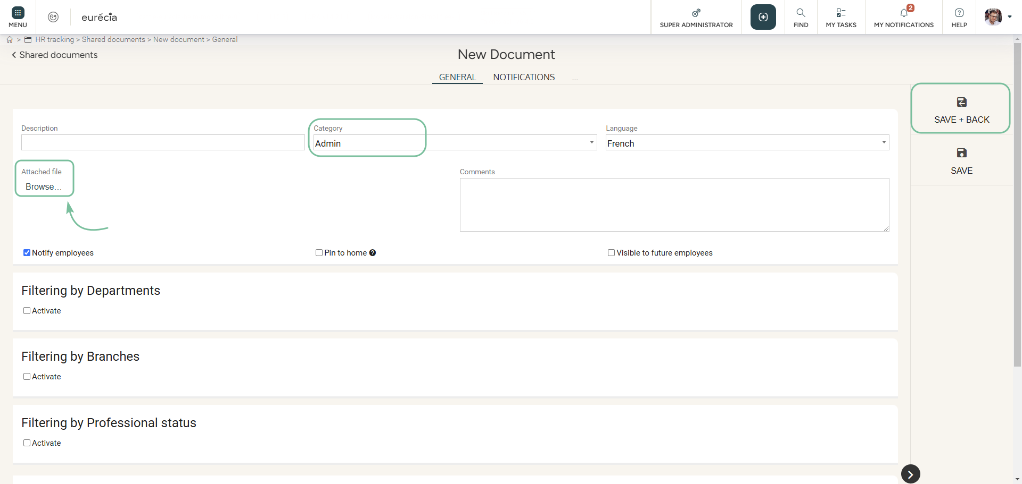
Company shared documents
Access: HR POrtal > Shared documents > Add a document
Click here to add a document from your computer
By default, the document will be visible to all employees in their HR portal > Shared documents.
Visibilities may be managed by Department, Structure and more…

Slide 25
HR dashboard

Slide 26
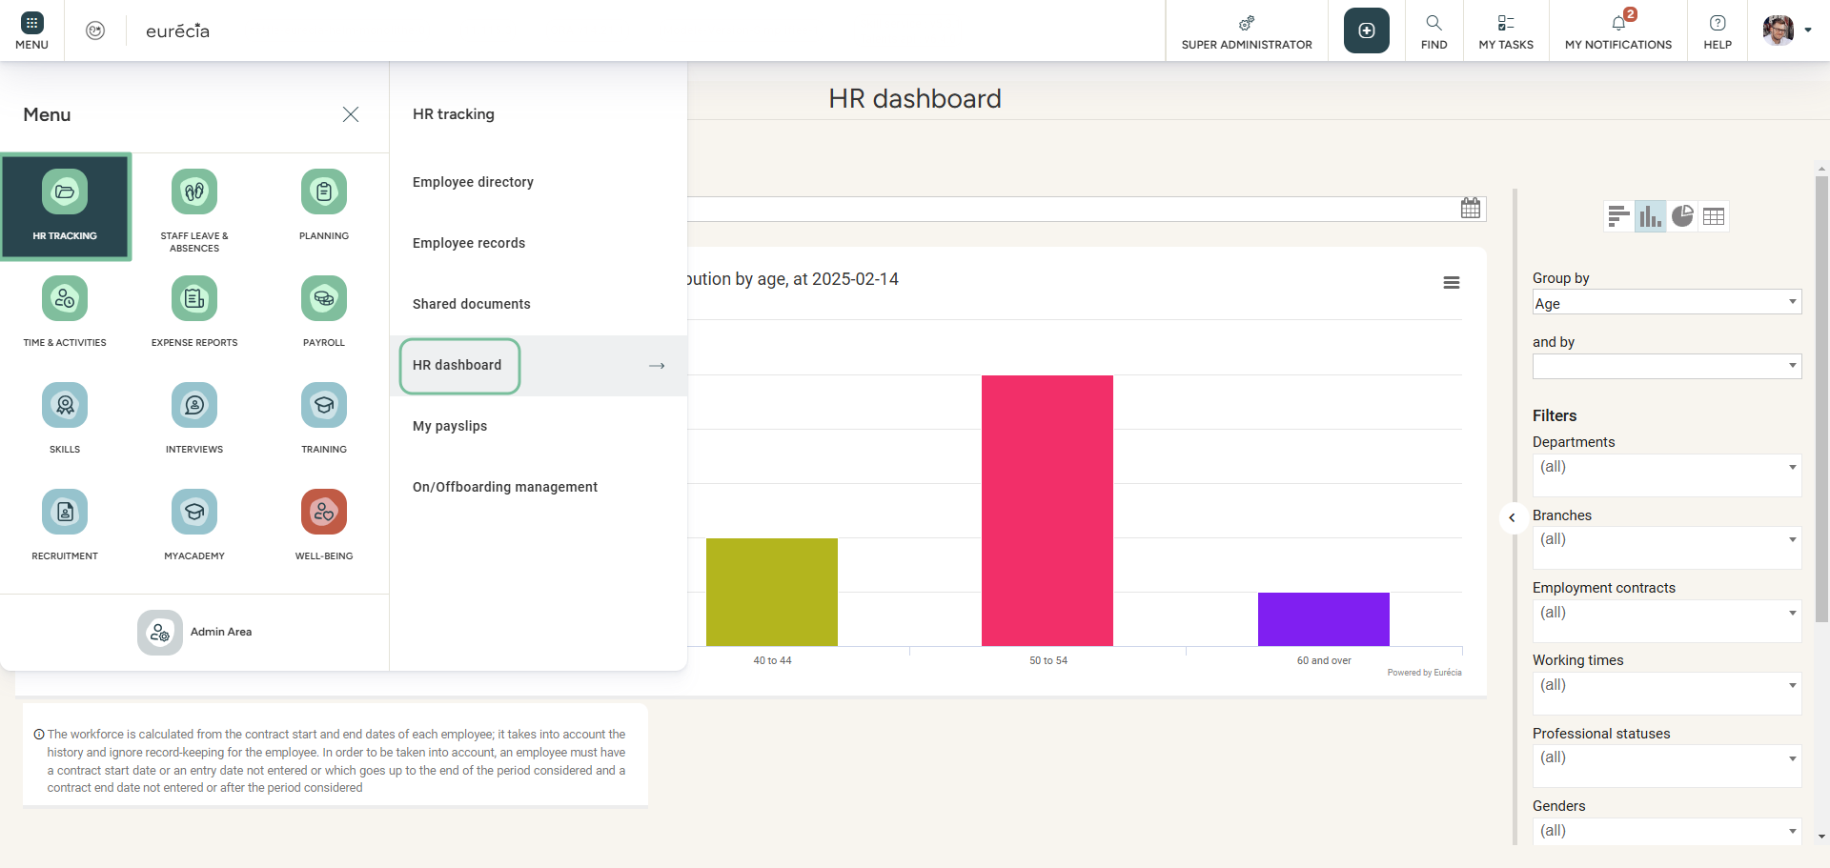
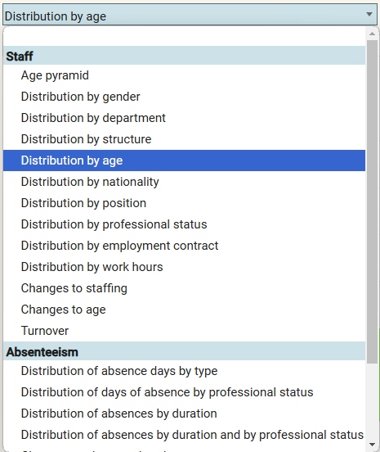
HR dashboard
Access: HR Portal > HR dashboard

Slide 27
My daily HR

Slide 28
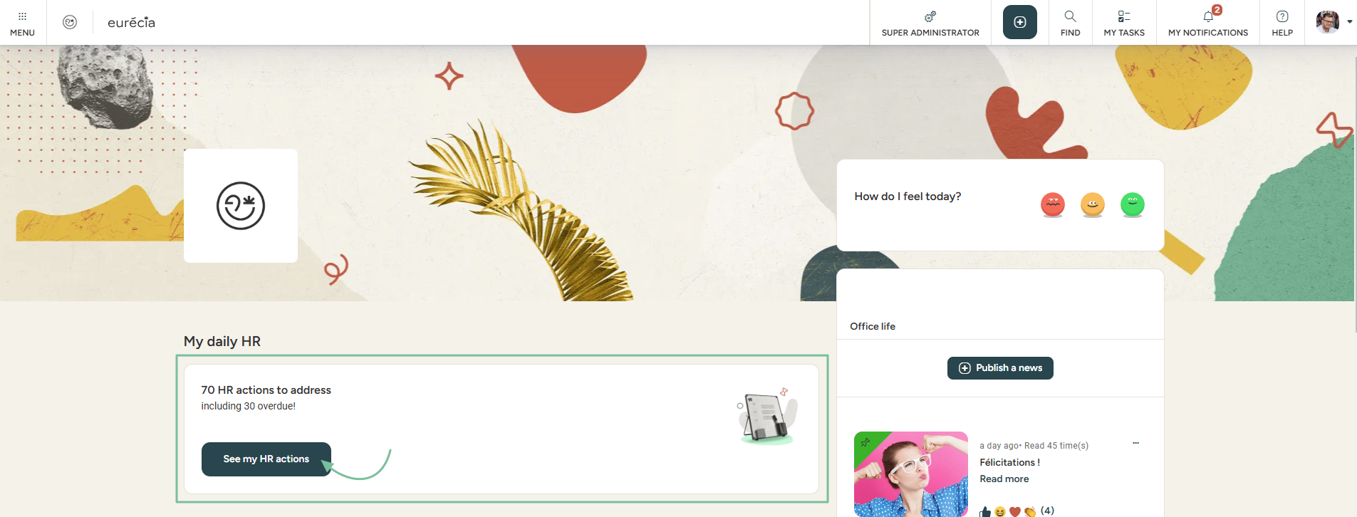
My daily HR – Manage my alerts
Access: Home page
Any employee with access to My Daily HR can create reminders and alerts for themselves and possibly other employees.
You can access a simple, visual, and collaborative to-do list with tasks.
Good to know ! Don’t have access to My Daily HR? It can be activated via :
Admin Area > General ettings > Management of HR alerts.

Slide 29
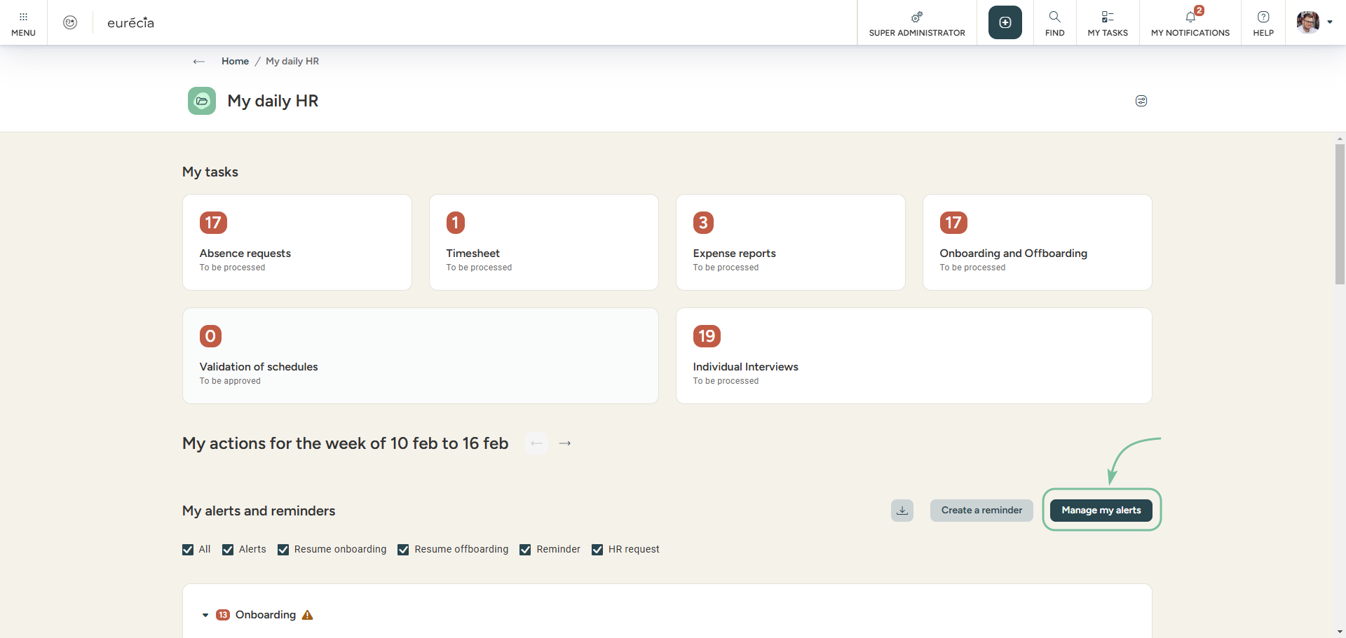
My daily HR – Manage my alerts
Creating new alerts
Click on "Manage my alerts"

Slide 30
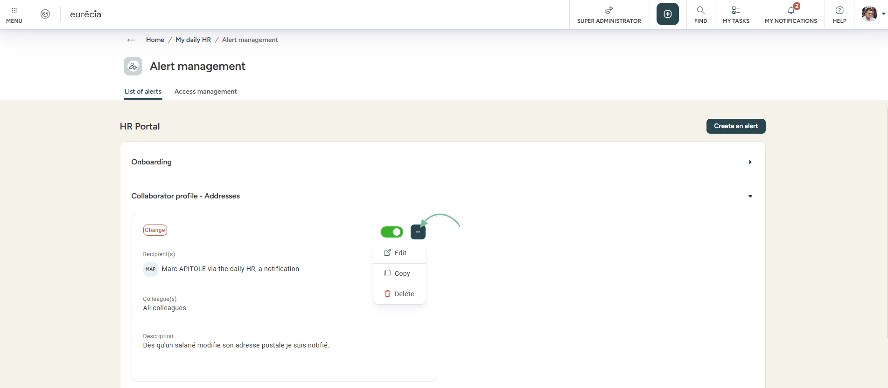

My daily HR – Manage my alerts
Creating new alerts
In the "List of alerts" tab, all my personalized alerts will be displayed. New alerts may be added by clicking on the button :
Good to know ! In order to facilitate the process, alerts can be duplicated.

Slide 31
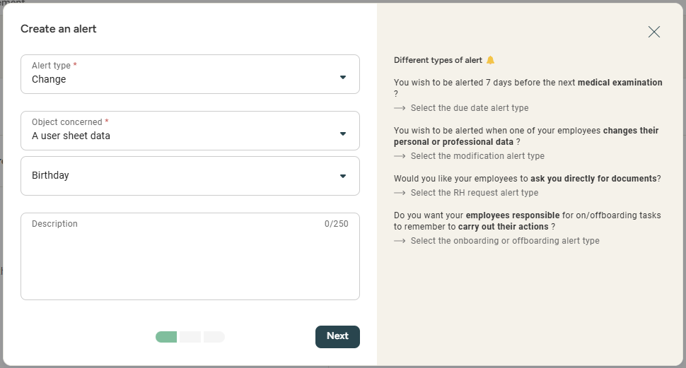
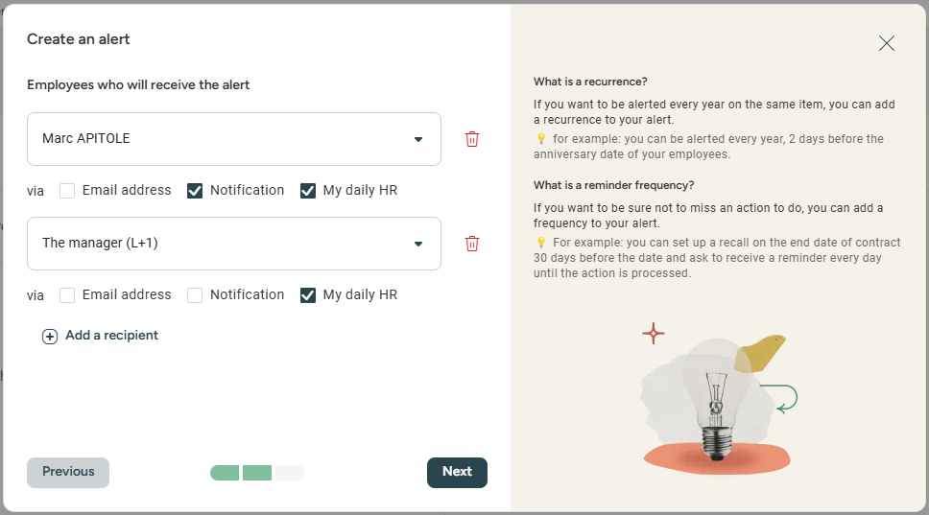
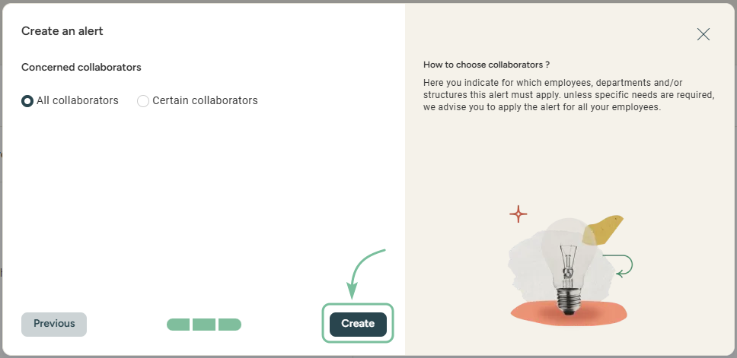
My daily HR – Manage my alerts
Creating new alerts
You can choose between different types of alerts : when a deadline is approaching, when sensitive elements have been changed or to anticipate an on/offboarding.
Once you’ve made a choice, you can select the reason for the alert: birthdays, contract end date, trial period end date and more…
Setting up alerts helps in notifying relevant recipients several days before an actual deadline or in case of any changes.

Slide 32
On/Offboarding Management

Slide 33
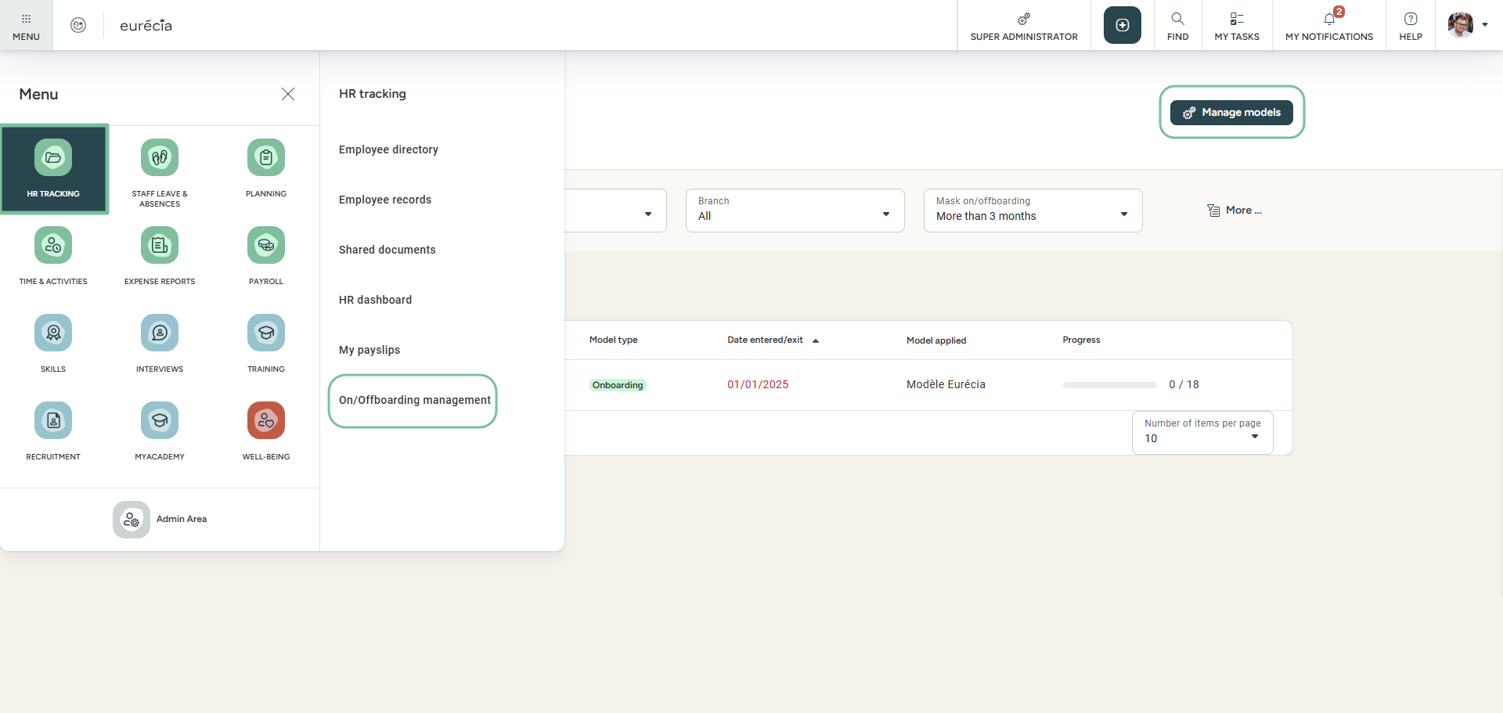
Managing On/Offboarding
Access: HR Portal > On/offboarding management
With the help of dashboards, you can get a clear idea of when your employees will be joining and leaving your company.
Progress can be monitored and manager. Tasks can be created using templates management.

Slide 34
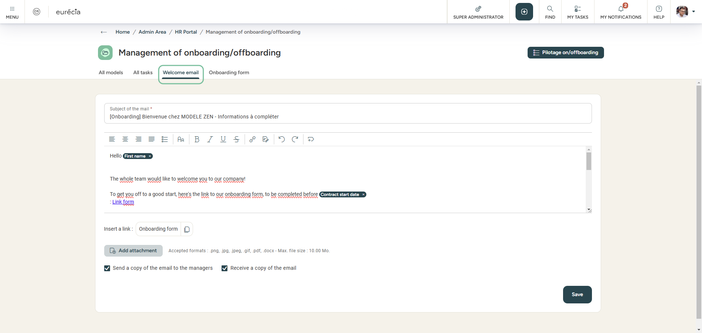
Managing On/Offboarding
Welcome email
You can set up a custom welcome e-mail.
The purpose of this e-mail is to inform the employee of the elements they need to communicate to their new employer.
It also gives them access to Eurécia to complete their employee file.

Slide 35
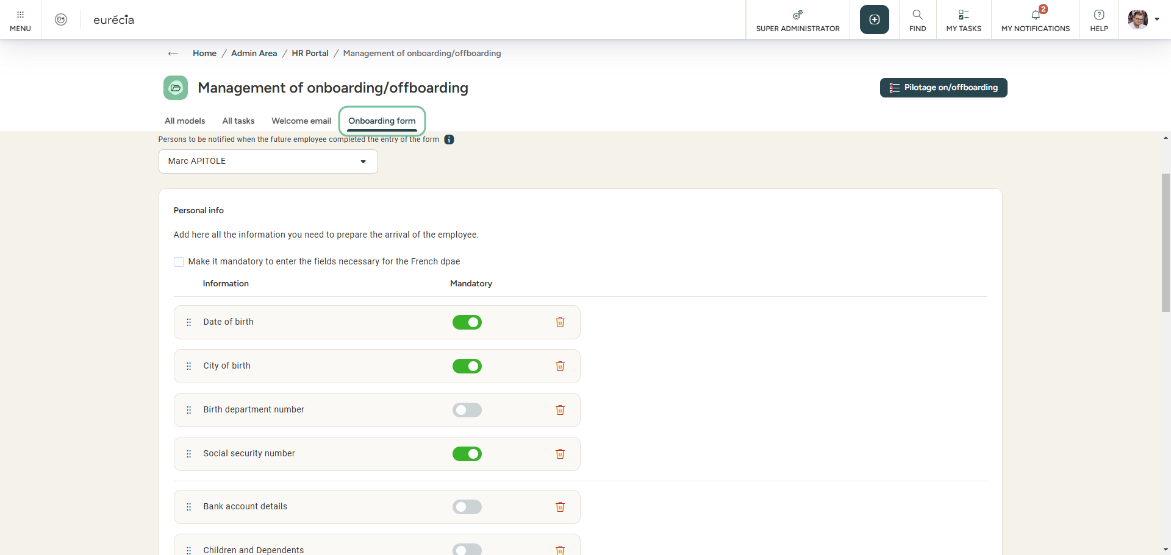
Managing On/Offboarding
Onboarding form
In the onboarding form you can select elements that will be requested from the employee via the welcome email.
The links in the email will redirect the employee to the form, where they can fill in their personal information and submit the required documents.
The documents and information are automatically transferred to the employee file and records.

Slide 36
Importing payslips

Slide 37
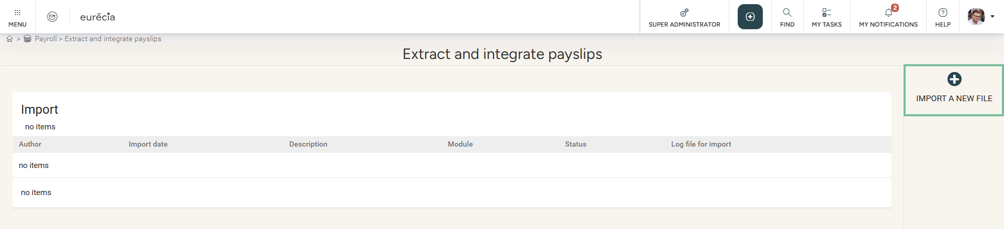
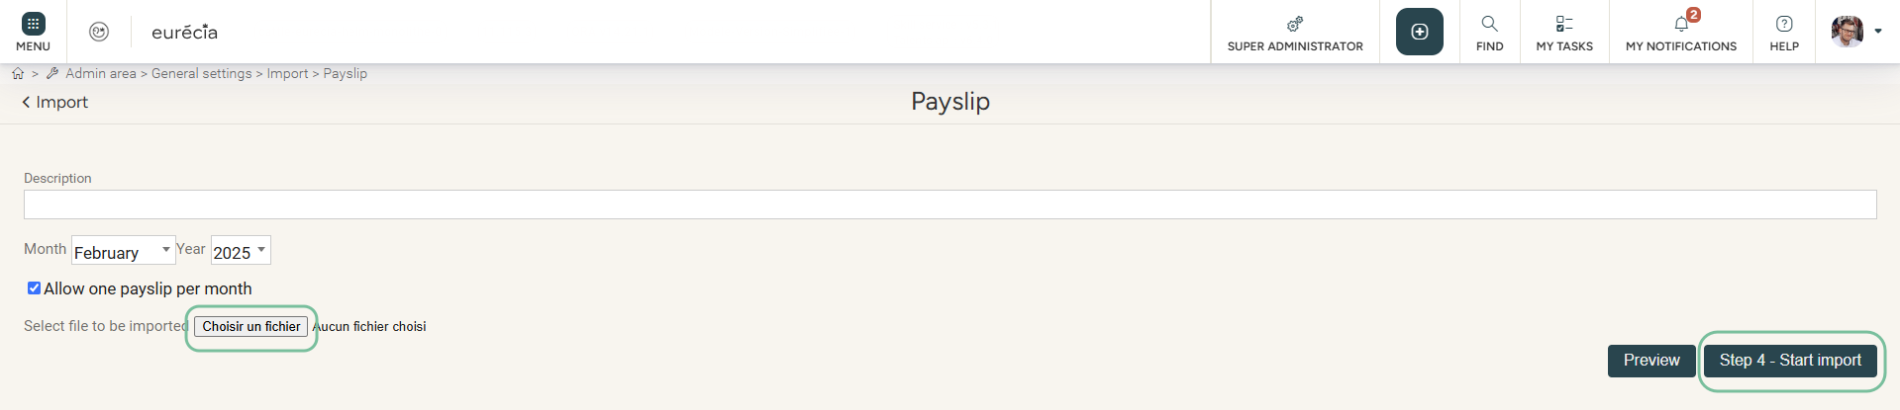
Payslips import
Access: Menu > Payroll > Payslip import
Good to know ! For each employee, the social security number (national insurance number), first name, and last name must be identical in the payroll software and Eurécia.

Slide 38
Admin
Area

Slide 39
Managing access to "My Daily HR"

Slide 40
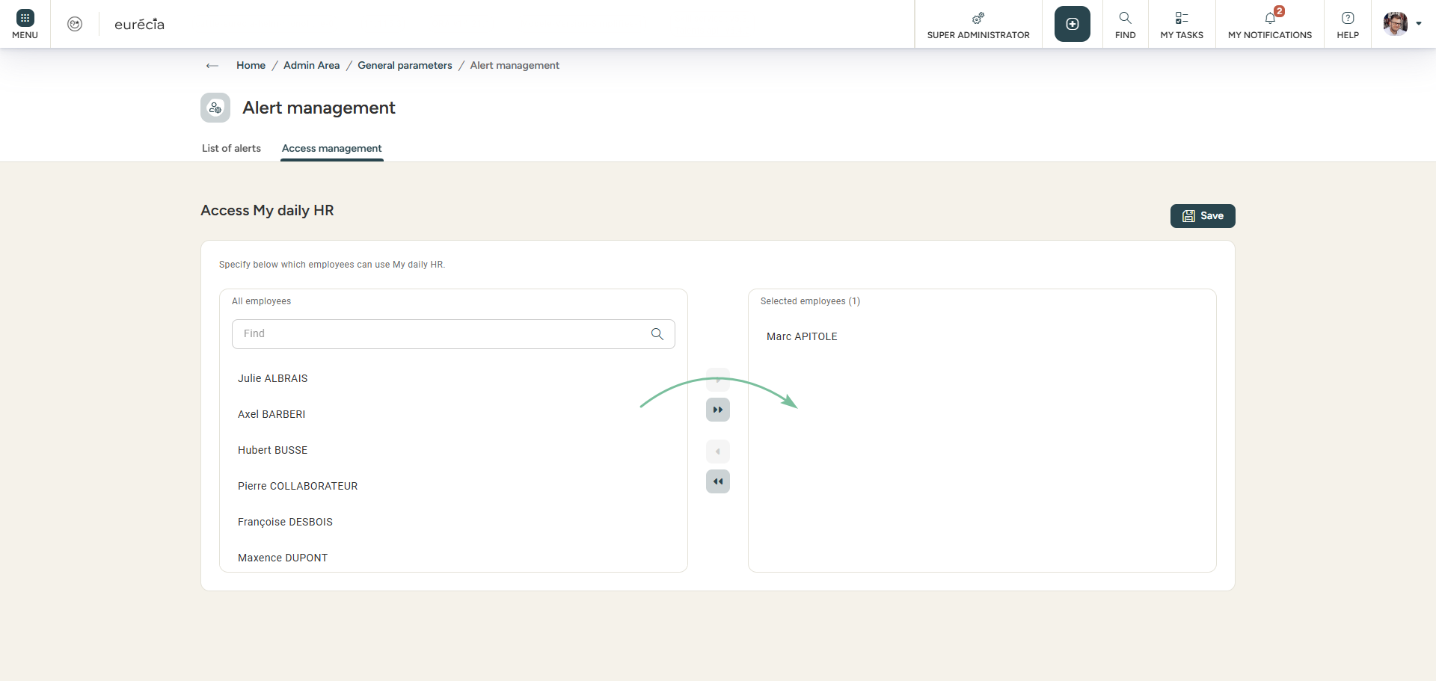
HR Alerts
Access: Admin area > general settings > Management of HR alerts
From the « Access management » tab, you can activate the daily HR for your employees.
They will be able to set their own alerts and benefit from the monitoring dashboard.

Slide 41
Setting up the new employee’s file

Slide 42
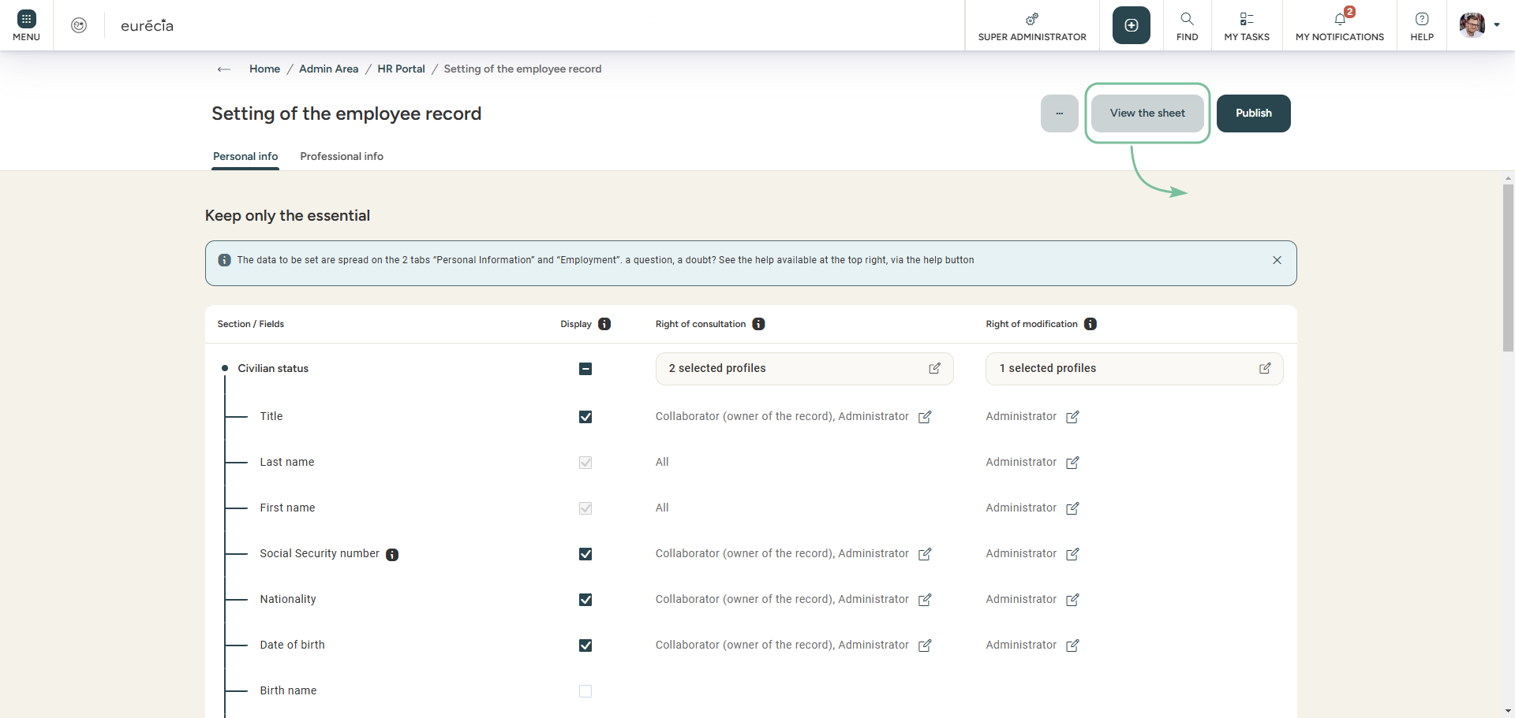
The new employee file
Access: Admin area > HR portal > USER SHEET CONFIGURATION
View your work before publication
With to the new employee’s file, it is now possible to customize the information your employees can see and/or modify.
If you’re not interested in a particular field, do not display it.
Do not forget to publish your work once you’ve finished customissing it..

Slide 43
Still having doubts?
All answers within your reach.
support@eurecia.com
Help center

