Slide 1
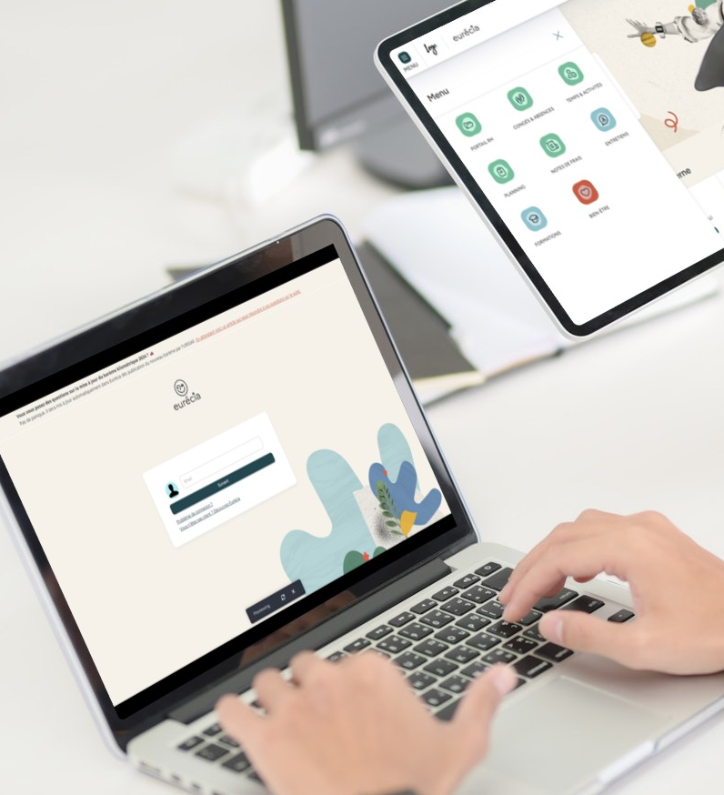

All you need to know about
HR Portal
User guide
Last updated
November 2024

Slide 2



Module features
Training program
Access the employee directory
Access the employee file
View shared documents
Access payslips
Find my employee file

Slide 3
Employee usage

Slide 4
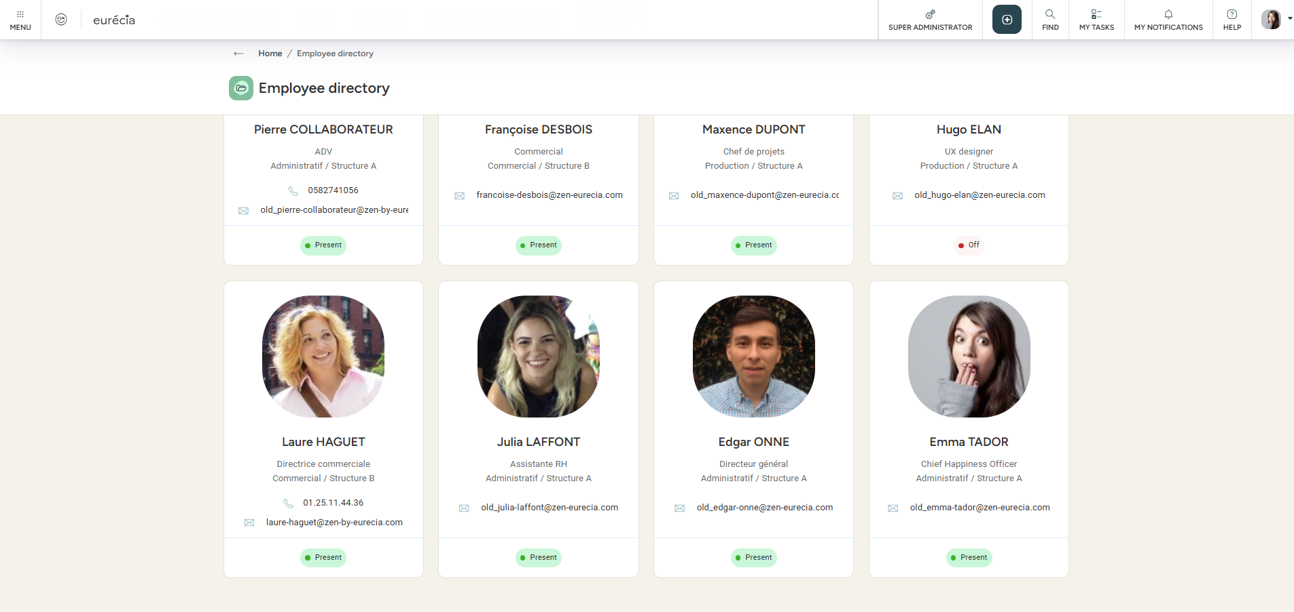
Employee directory
As a user
From the “HR Portal” module and by selecting “Employee directory,” you can access the employee directory listing all the company’s employees.
The directory can display each epmloyee’s email address, job title, department, structure, and phone number.
Note : You can access your own employee file by clicking on your name. However, you do not have access to other employees’ files.

Slide 5
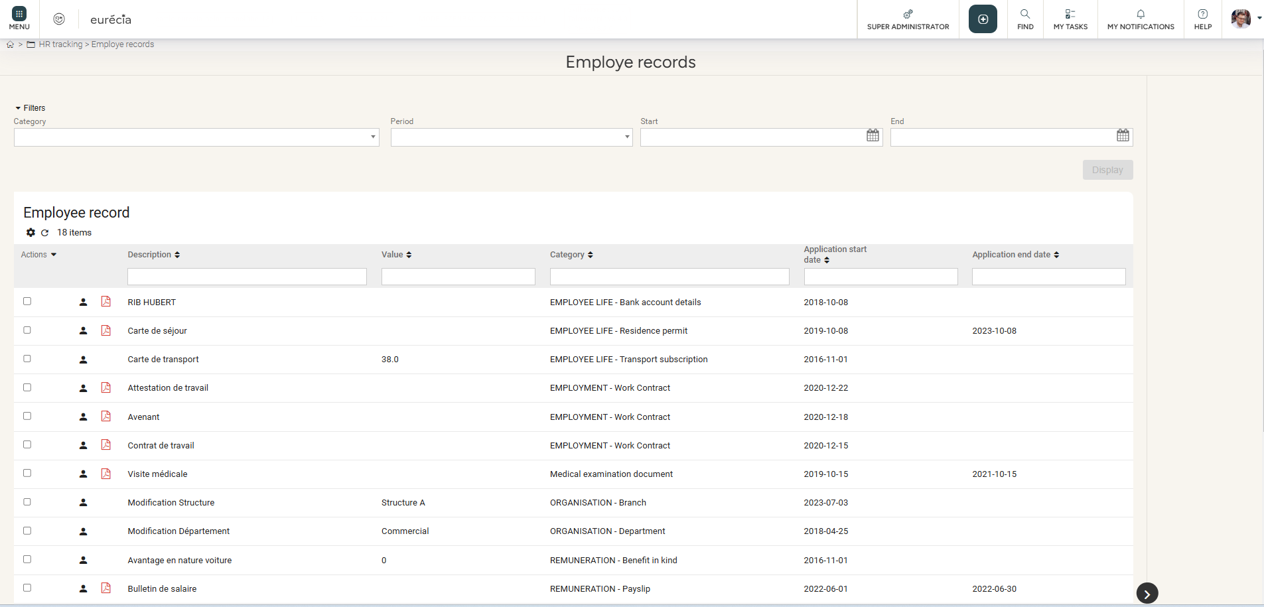
Employee records
as a user
From the “HR Portal” module and by selecting “Employee records,” you can review all the events and changes that have occurred in your professional life:
Recruitment or departure date
  Change of job title
  Change of structure
  And more …

Slide 6
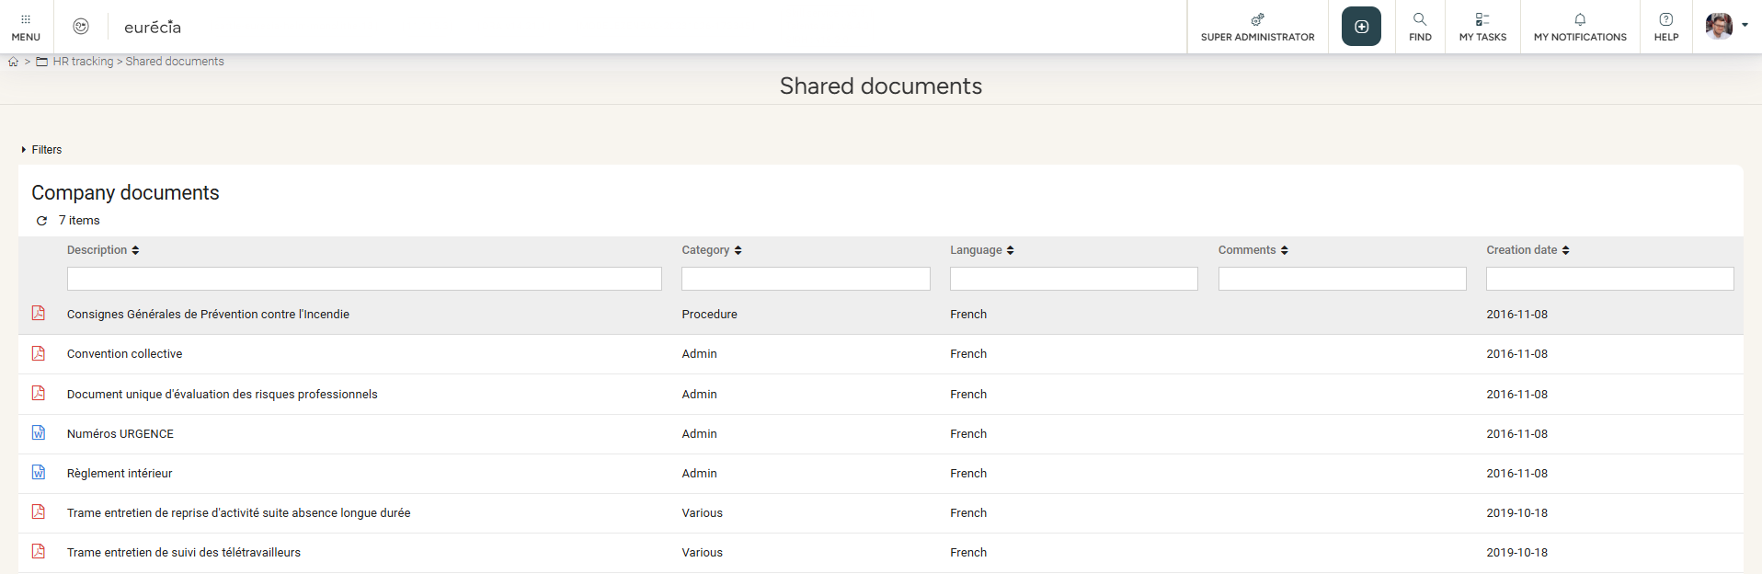
Shared documents
As a user
From the “HR Portal” module and by selecting “Shared documents,” you can view all documents shared by the company:
  Rules and regulations
  Collective agreement
  Safety instructions
  Information notes
  And more

Slide 7
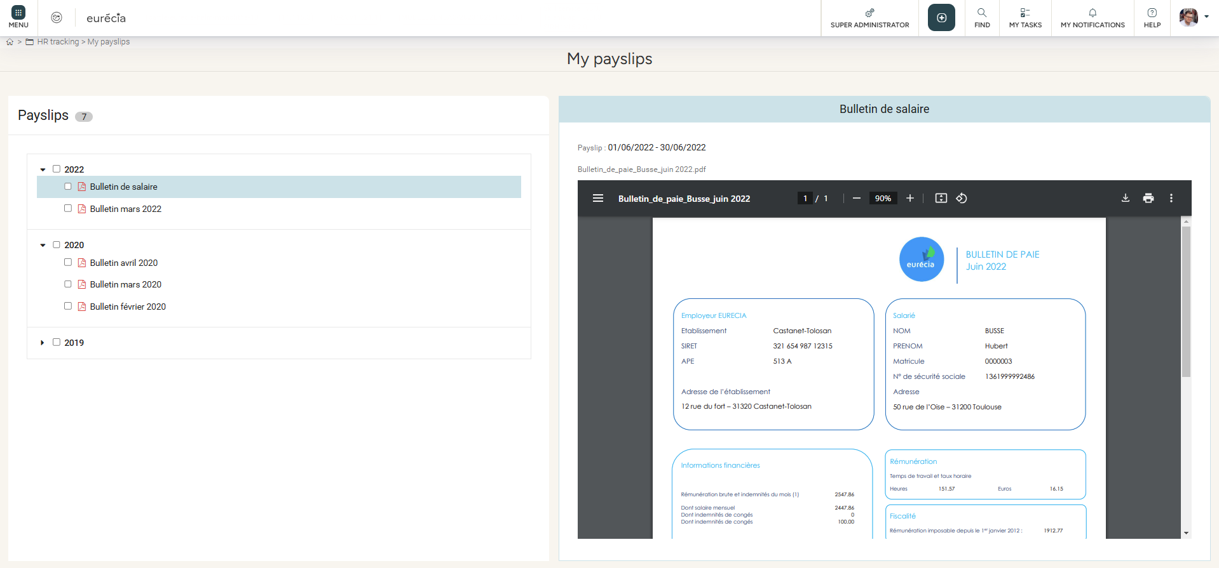
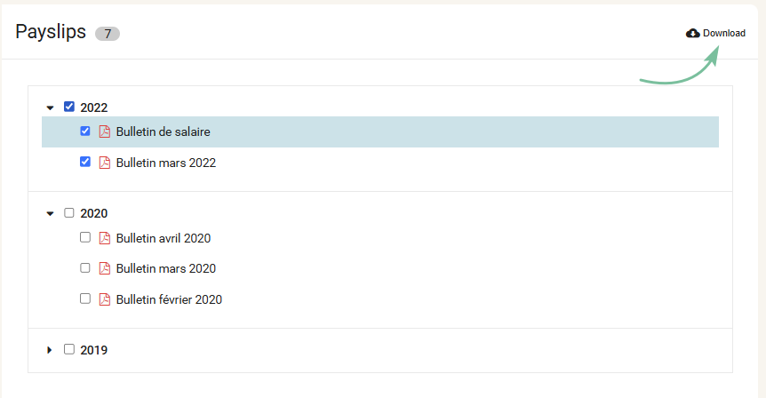
My Payslips
As a user
From the “HR Portal” module and by selecting “My payslips,” you can access all your payslips.
You can click directly on the payslip you want and download it.

Slide 8
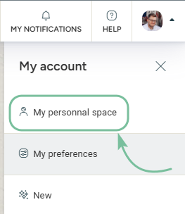
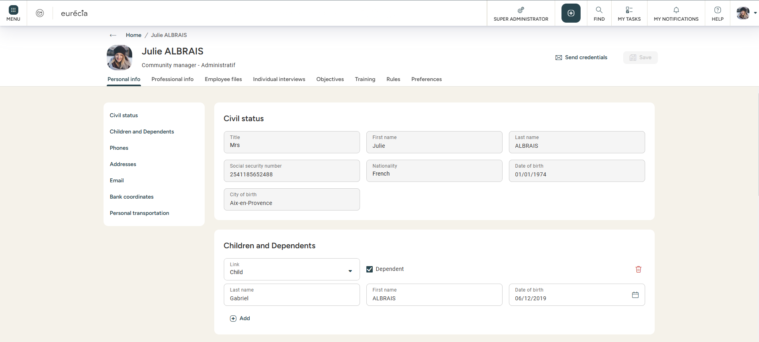
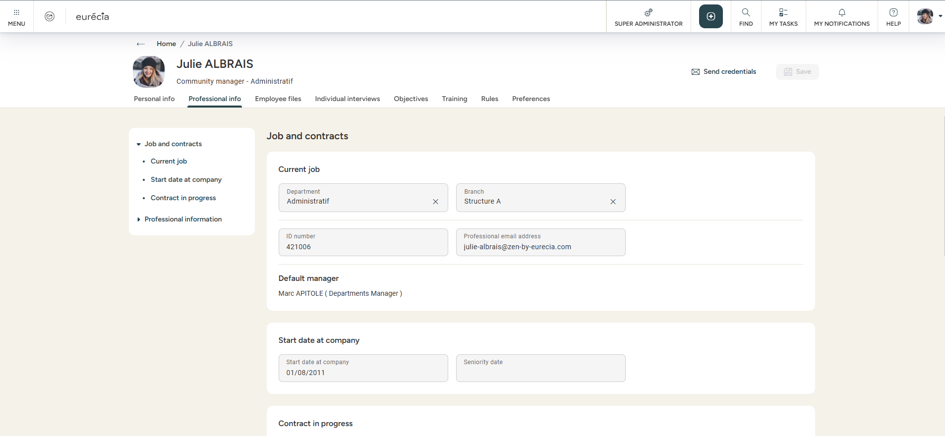
Employee file
As a user
From your personal space, you can find all your personal and contractual information!

Slide 9
Still having doubts?
All answers within your reach.
Administrator email address
Help center

