Slide 1
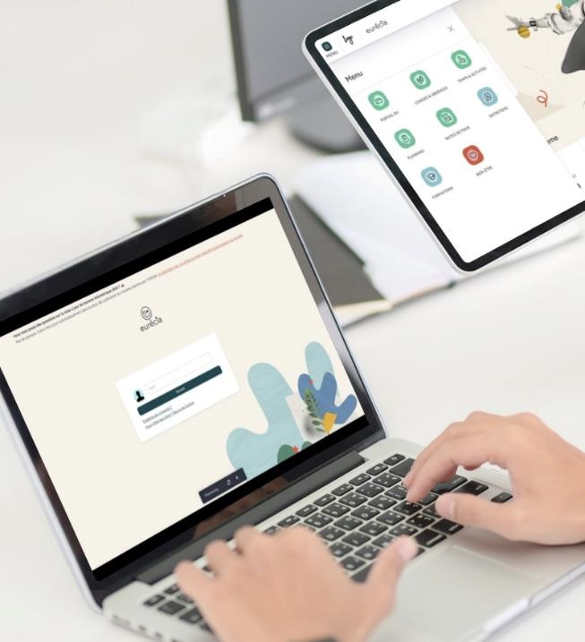


All you need to know about
Expense reports
User training guide
Last updated
June 2025

Slide 2


As an employee
Training program
Expense reports' approval cycle
Creating an expense report
Creating an expense
As a manager
Approving expense reports

Slide 3
As an employee
01

Slide 4
Expense reports' approval cycle

Slide 5






Expense reports' approval cycle
New​
expense​
report​
Submission for approval
Employee
More info
required
Approval
Refusal
Manager
"To be reimbursed"
status
Reimbursement
Accountant

Slide 6
Creating an expense report

Slide 7

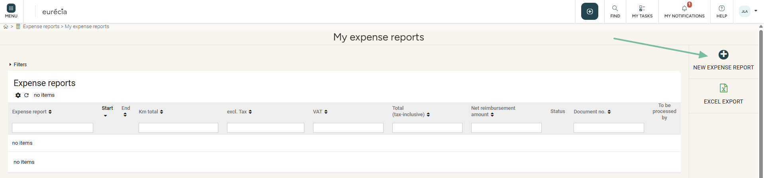
Employee
Creating a new expense report
To create an expense report, you have several options:
  In the top banner, click on the “My Actions” icon then Create an expense report
  On the home page, create an expense report directly from the "About me" section
  From the Menu (top left), go to "Expense reports" and choose "My expense reports":

Slide 8
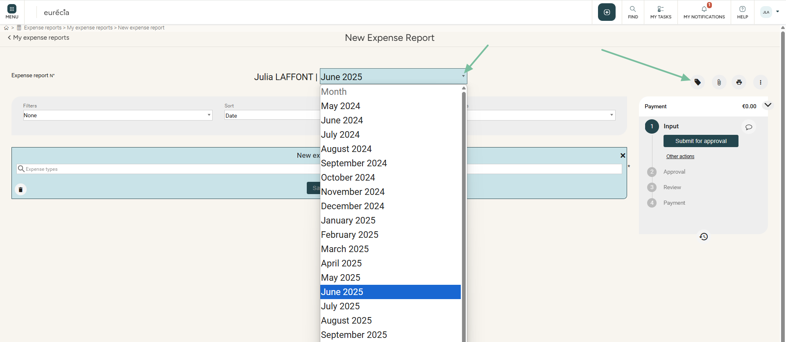
Employee
Creating an expense report for a specific month:
  By default, Eurécia creates the expense report for the current month
  You can select a different month thanks to the drop-down menu in the title of the expense report, or by clicking on the properties icon:

Slide 9
Creating an expense

Slide 10
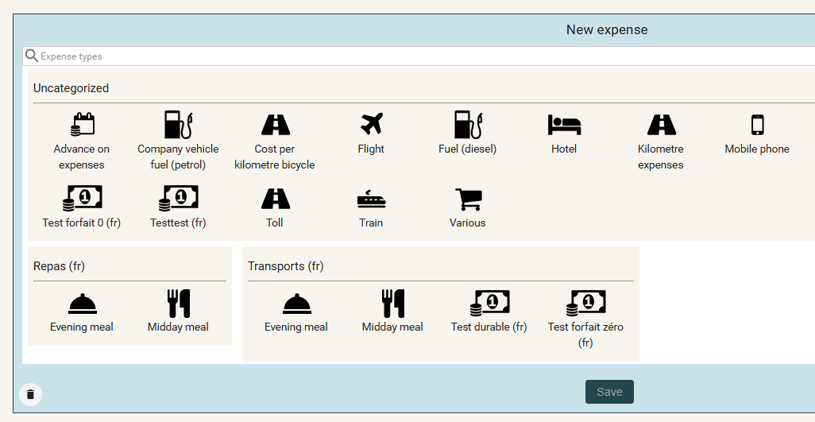
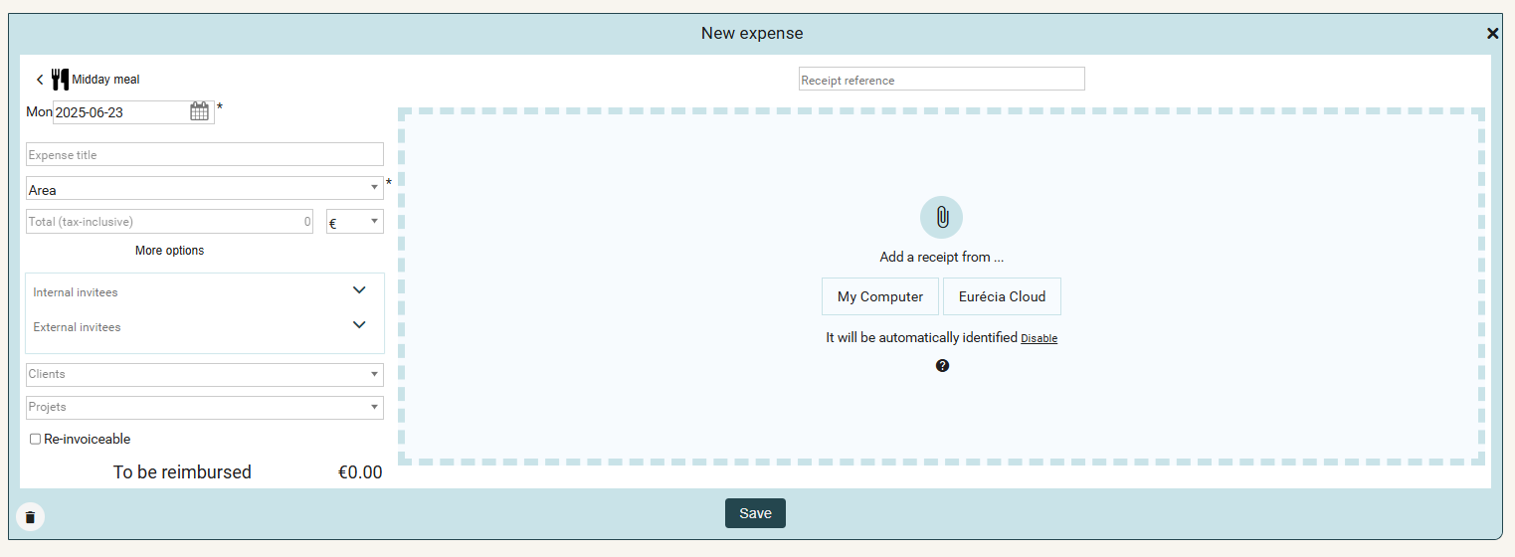
Employee
Creating an expense
  Choose an expense type thanks to the pictograms:
  Enter the date, amount, and receipt (automatically recognised by the OCR if the document is a PDF):

Slide 11
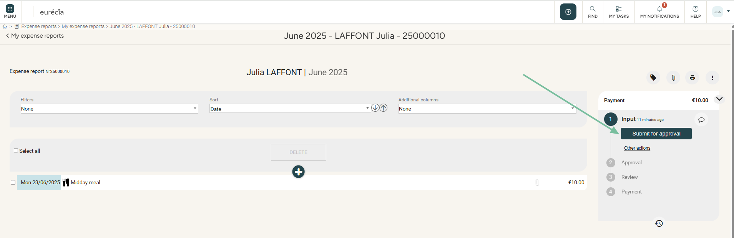
Employee
Creating an expense
  Once all your expenses are saved, you can submit the report for approval:

Slide 12
As a manager
02

Slide 13
Approving expense reports

Slide 14
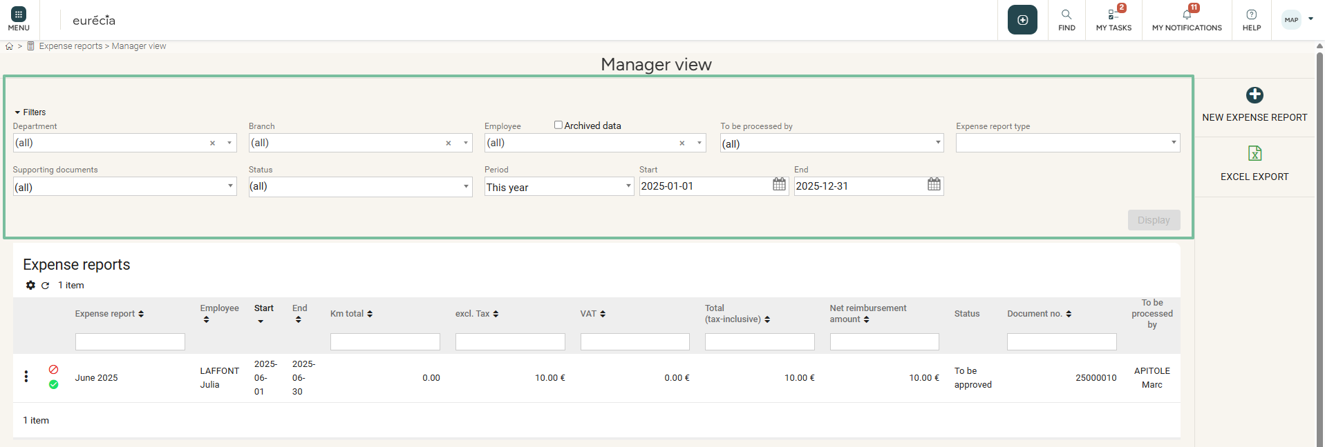
Manager
Approving expense reports
From the Menu > Expense Reports, select “Manager View” to access the list of expense reports categorised by:
  Employee
  Start & End dates
  Expense details (e.g. KMs, excl. tax, VAT, tax-inclusive total, net reimbursement amount, status, document no., “to be processed by”)
  The filters allow you to narrow down the expense
  reports to a specific department, branch
  or employee. You can also display expense
  reports that are:
  - To be approved
  - To be reimbursed
  - Reimbursed
  - Rejected

Slide 15
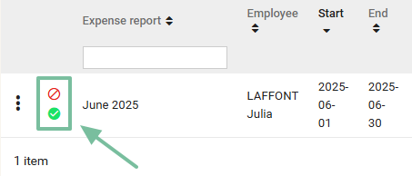
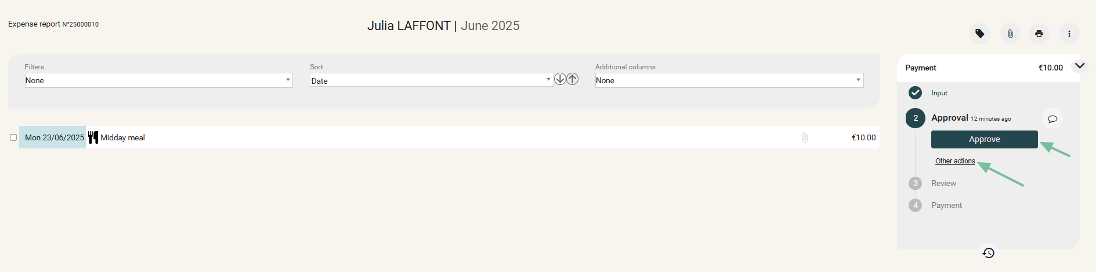
Manager
Approving expense reports
An expense report can be approved or rejected with a single click:
  You can also access the details of the expense report by clicking on it in the list.
  From the detailed view, you can choose to reject the expense report or request more information
  (by clicking Other actions), or to approve the expense report directly, initiating the refund process:

Slide 16
Still have questions?
All the answers are within your reach.
Admin email address
Help center

