Slide 1


All you need to know about
Time & Activities
Administrator training guide
Last updated
July 2025

Slide 2

At the end of this training, administrators will be able to:
Training objectives
Set up and manage work shift calendars
Manage and set up overtime
Set up time and activities profiles
Manage report criteria
Manage employee timesheets
  Creation
  Modification
  Handling overtime

Slide 3



Module features
Training program
Creating timesheets for employees
Managing overtime
Administrator area
Managing work shift calendars
Managing overtime
Managing Time & Activities Profiles
Managing report criteria

Slide 4
Module features

Slide 5
Creating employees' timesheets

Slide 6
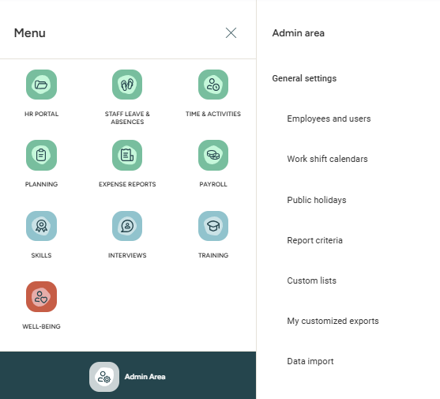
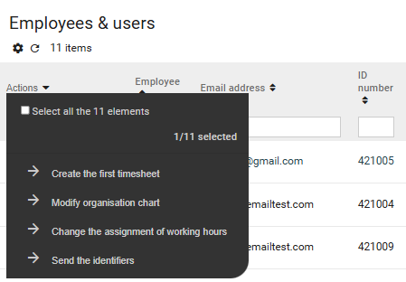
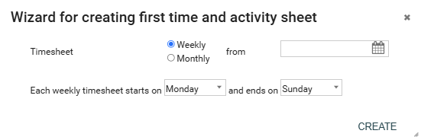
Managing timesheets
Creating timesheets
Access: Admin Area > General parameters > Employees and users
To create timesheets, click on the "Actions" menu and choose "Create the first timesheet."
The wizard allows you to create timesheets for all selected employees. You can create weekly or monthly timesheets.

Slide 7
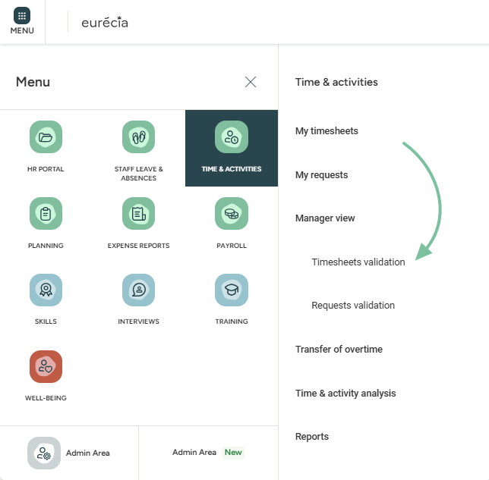
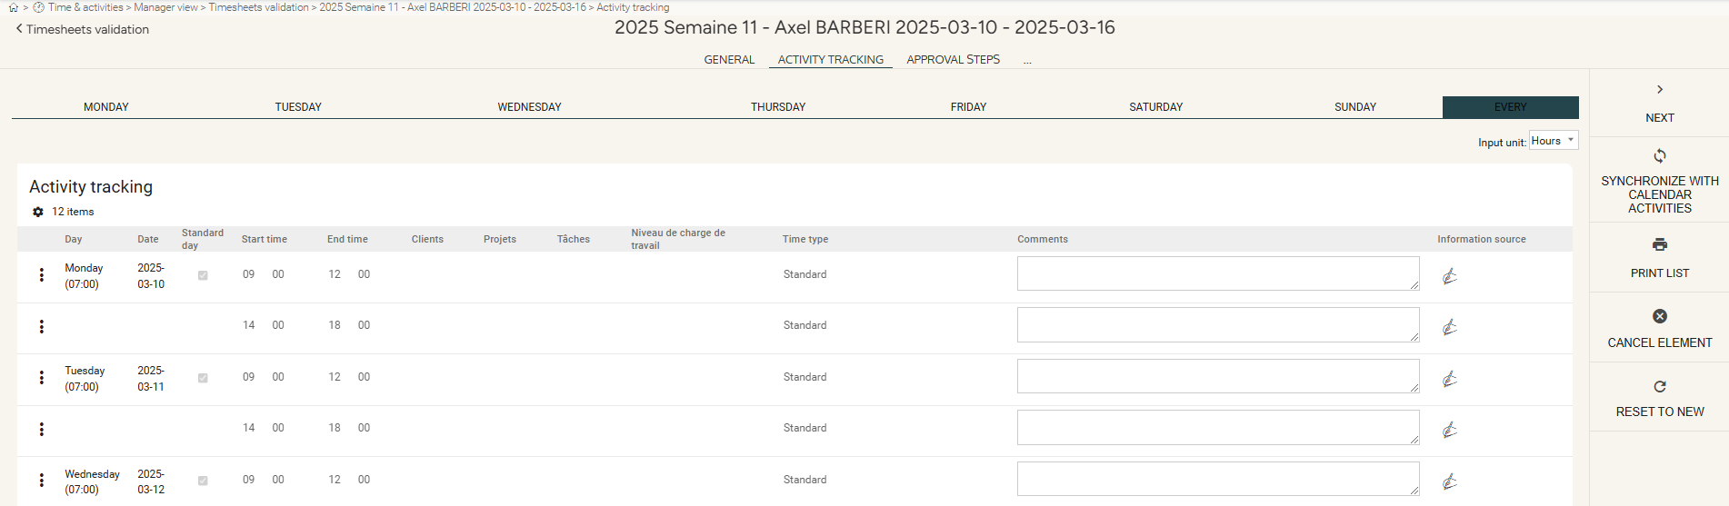

Managing timesheets
Resetting a timesheet
Access: Time & Activities > Manager view > Timesheets validation
Common case: An approved timesheet can no longer be modified, and its overtime hours are taken into account.
However, you can reset the timesheet by clicking on "Reset to new".
It will:
  Change the timesheet's status from "Approved" to "New"
  Allow changes on the timesheet
  Reset the approval cycle
  Cancel overtime transfers

Slide 8
Managing overtime

Slide 9
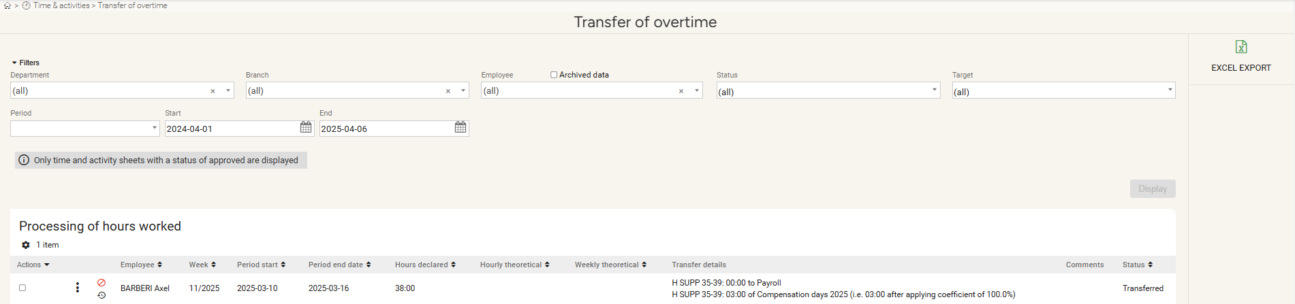
Managing overtime
Reviewing and exporting
Access: Time & Activities > Manager view
If overtime is being transferred automatically, overtime is given the status ‘Transferred’ as soon as the timesheet is validated.
An overtime summary is displayed at the bottom of each timesheet.
Access: Time & Activities > Transfer of overtime
Once approved, a timesheet cannot be changed. Overtime hours are taken into account.

Slide 10
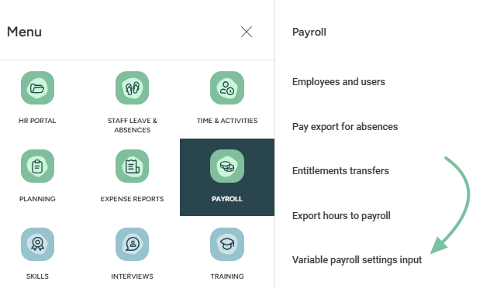
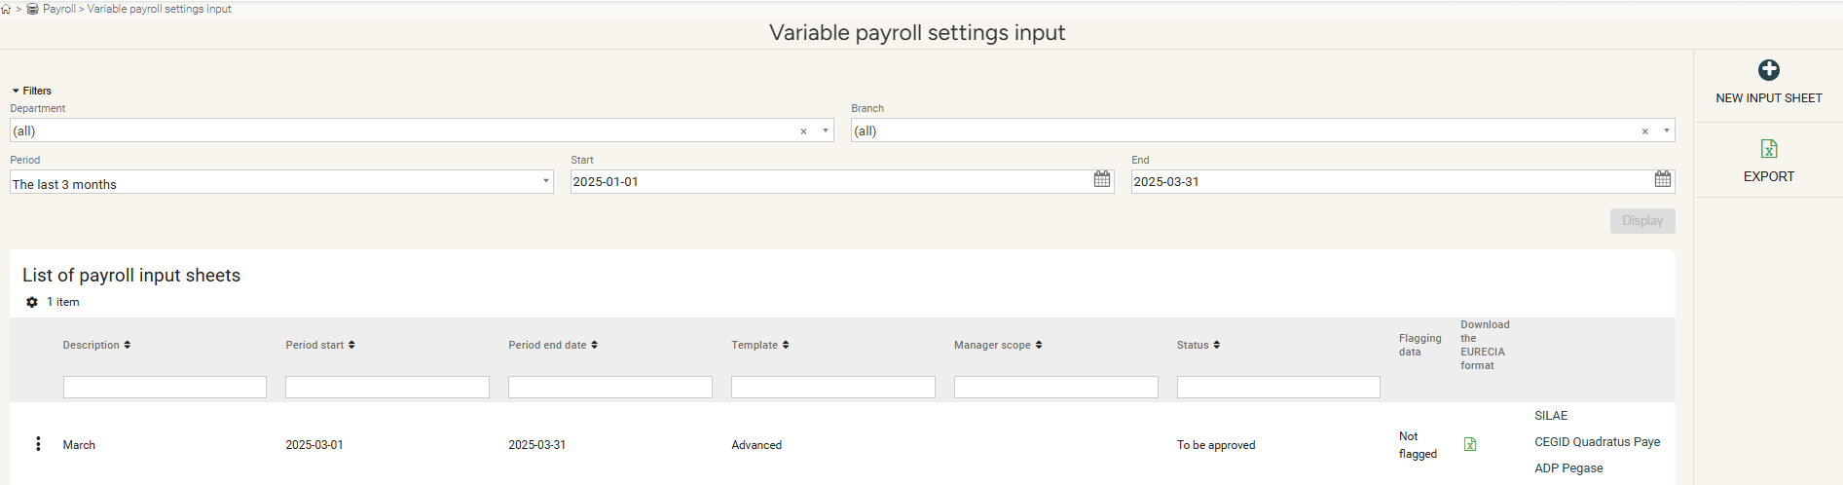
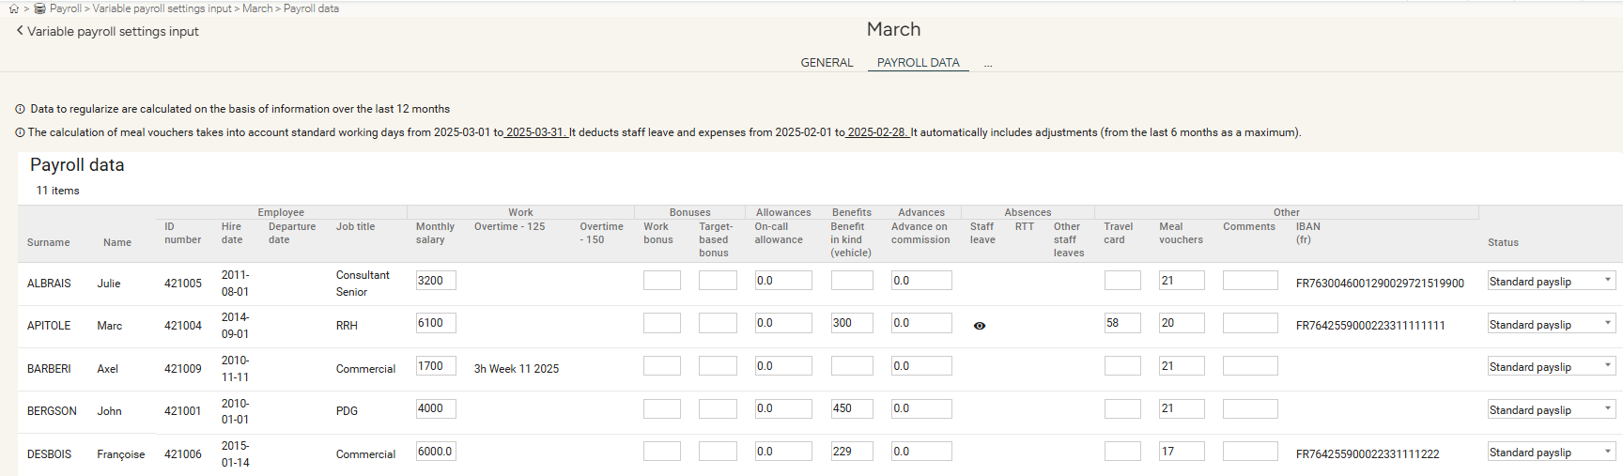
Managing overtime
Reviewing and exporting (Payroll grids)
Access: Payroll > Variable payroll input
Transferred overtime hours automatically appear in payroll grids for the desired period.
The grid can then be exported in Excel format or in the format expected by the payroll software.

Slide 11
Admin Area

Slide 12
Managing work shift calendars

Slide 13
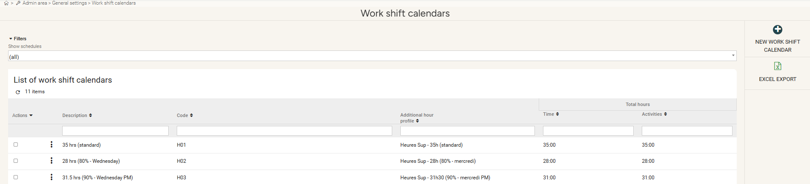
Managing work shift calendars
Creating or duplicating work shift calendars
Access: Admin Area > Time & Activities > Work shift calendars > Open
You can duplicate an existing work shift calendar from the 3 dots, or create a new work shift calendar from the top right button.
You can simply click on the line to open a work shift calendar.

Slide 14
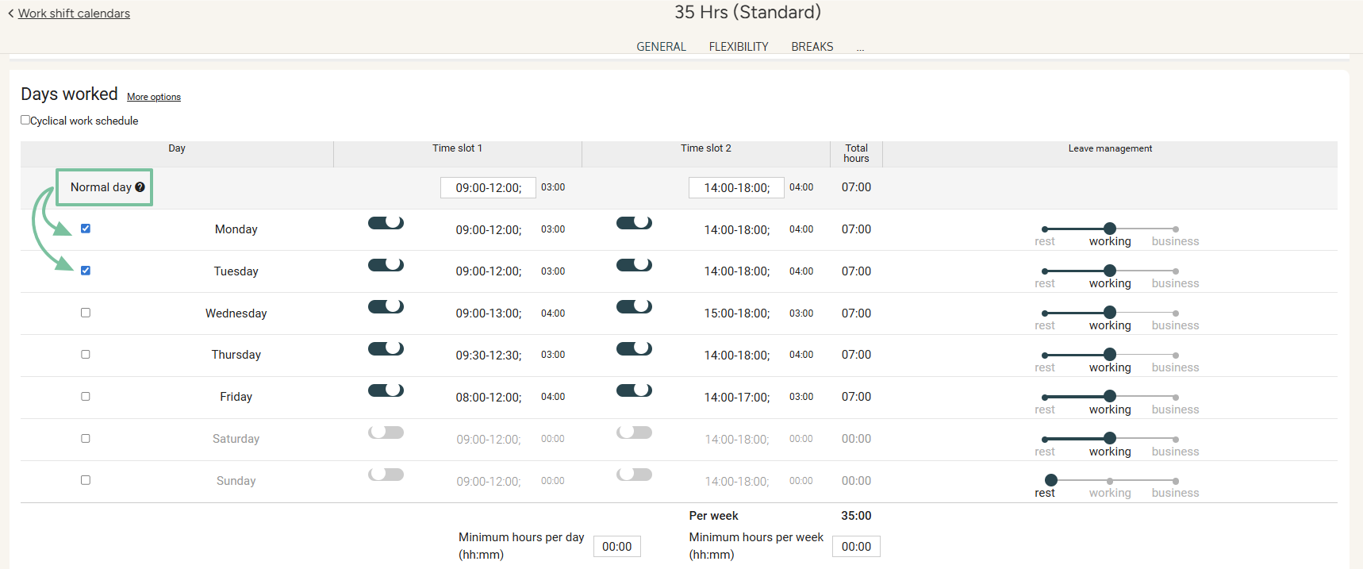
Managing work shift calendars
Creating or duplicating work shift calendars
Access: Admin Area > Time & Activities > Work shift calendars > Open
You can set a typical day type in the grey area.
Doing this will allow you to simply check the box on days that are identical to this typical day.

Slide 15
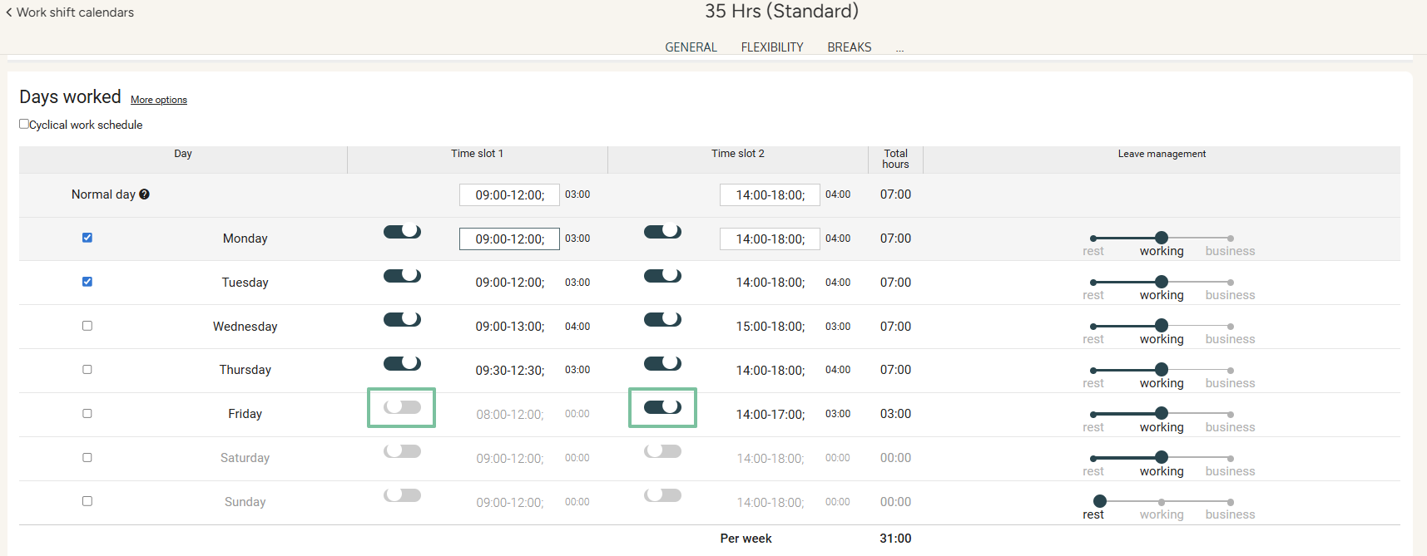
Manage work hift calendars
Creating or duplicating work shift calendars
Access: Admin Area > Time & Activities > Work shift calendars > Open
If a half-day is worked, slide to the right (blue).
If a haf-dayl is off, slide to the left (grey).

Slide 16
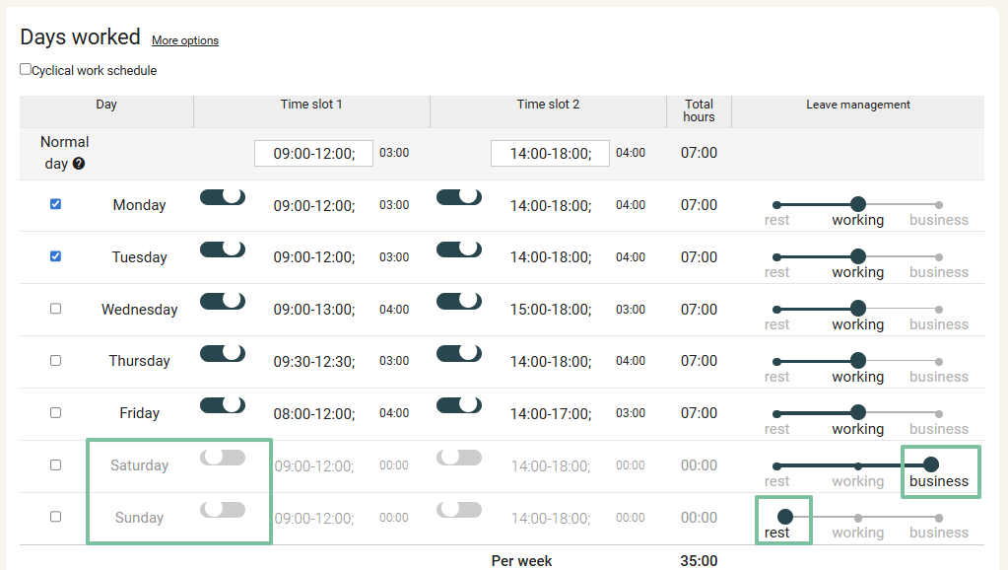

Managing work shift calendars
Setting up work shift calendars – Business days
Access: Admin Area > Time & Activities > Work shift calendars > Open
For example: Monday to Friday are worked
Modify the 'Leave management' column:
For Saturday, set it to "business day"
For Sunday, set it to "rest"
For all other days (Monday to Friday) set to "working days"

Slide 17
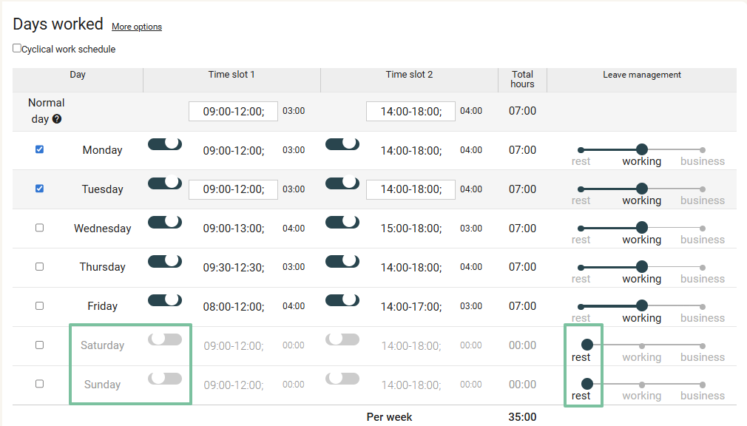
Managing work shift calendars
Setting up work shift calendars – working days
Access: Admin Area > Time & Activities > Work shift calendars > Open
For example, Monday to Friday are worked:
Modify the 'Leave management' colum :
Set up both Saturday and Sunday to "rest"
Set up all other days (Monday to Friday) to "working days"

Slide 18
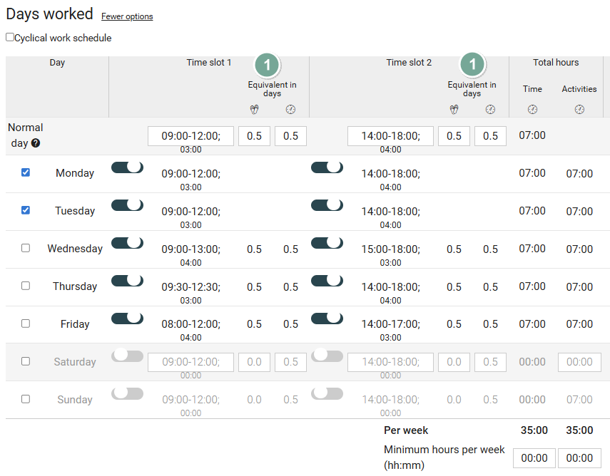
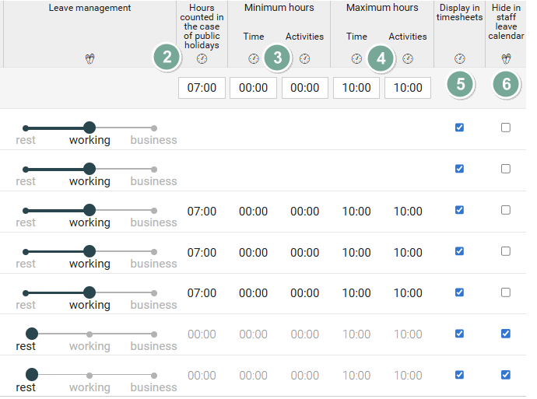
Managing work shift calendars
Setting up work shift calendars – Going further
Access: Admin Area > Time & Activities > Work shift calendars > Open
Equivalent in days: Used for calculating leave days
Hours counted in the case of public holidays : Used for managing overtime during public holidays
Minimum hours : Minimum number of hours to be worked per day
Maximum hours : Maximum number of hours to be worked per day
Display in timesheets : Used for hiding or displaying specific days on timesheets
Hide in staff leave calendar : Grey out days in the staff leave calendar

Slide 19
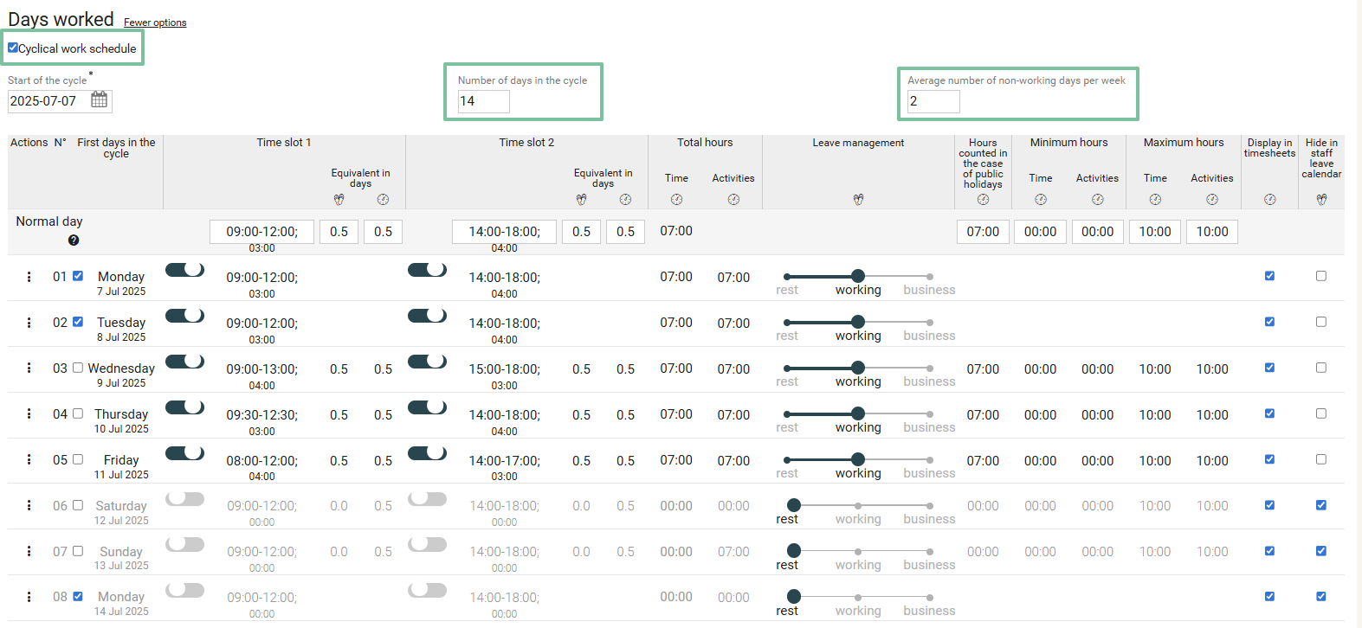
Managing work shift calendars
Setting up work shift calendars – cyclical work schedule
Access: Admin Area > Time & Activities > Work shift calendars > Open
Example for a Monday to Friday work schedule with one Monday out of the two not worked:
Check the « Cyclical work schedule » box and choose the starting date for the cycle.
Enter the number of days in the cycle. This creates the number of lines required.
Enter the number of non-working days in the week (important for working days and leave calculation).

Slide 20
Managing overtime

Slide 21
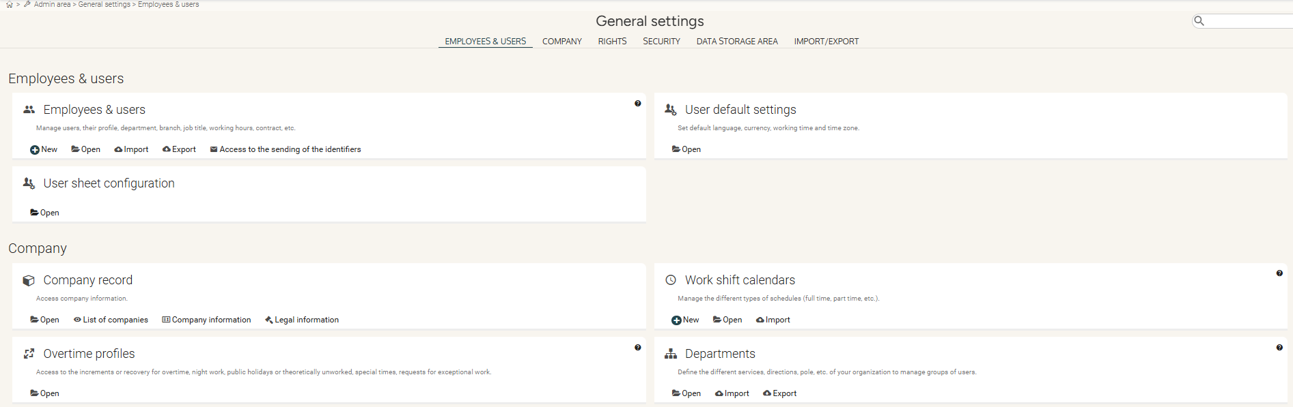

Managing overtime
Setting up overtime profiles, add-ons and special times
Access: Admin Area > General Settings > Overtime profiles

Slide 22
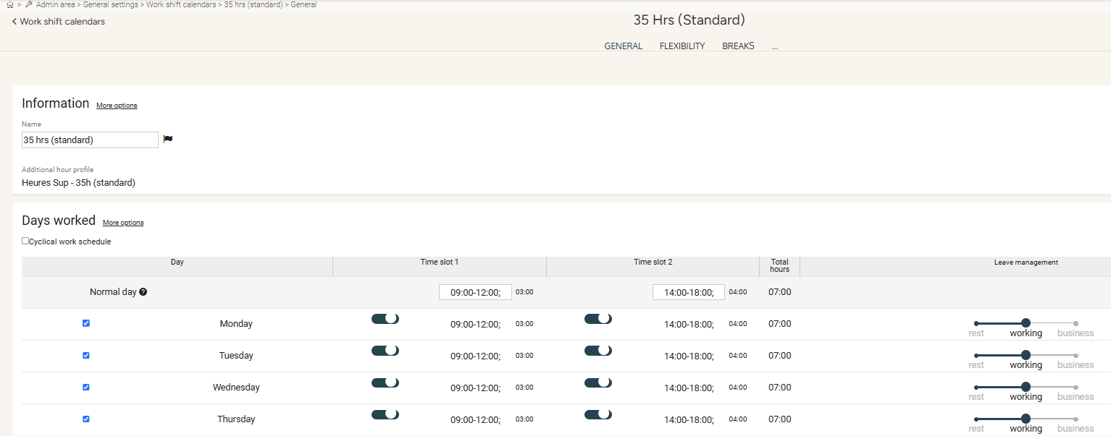
Managing overtime
Setting up overtime profiles, premiums and special times
Access: Admin Area > Time & Activities > Work shift calendars > Open > Additional hour profile
To access a relevant overtime profile from an existing work shift schedule :

Slide 23
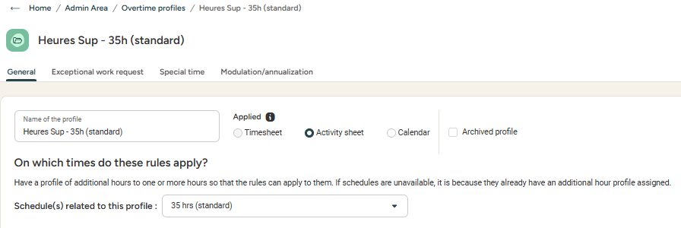
Managing overtime
Setting up overtime profiles, add-ons and special times
Access: Admin Area > Time & Activities > Overtime profiles
Name the overtime profile.
Choose which environment the overtime will apply to:
  Timesheets: If overtime should be calculated from the "Time tracking" tab.
  Activity sheets: If overtime should be calculated from the "Activity tracking" tab.
  Calendar: If overtime should be calculated from the team calendar.
Choose the schedule that will be linked to this overtime management: here, 35h (standard).

Slide 24
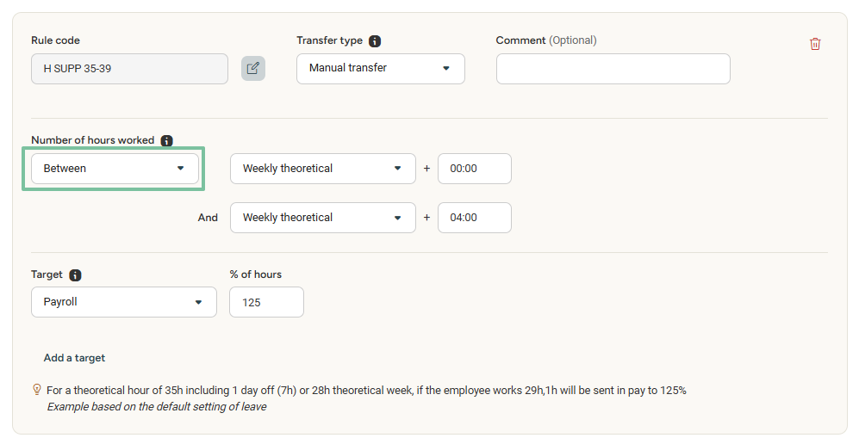
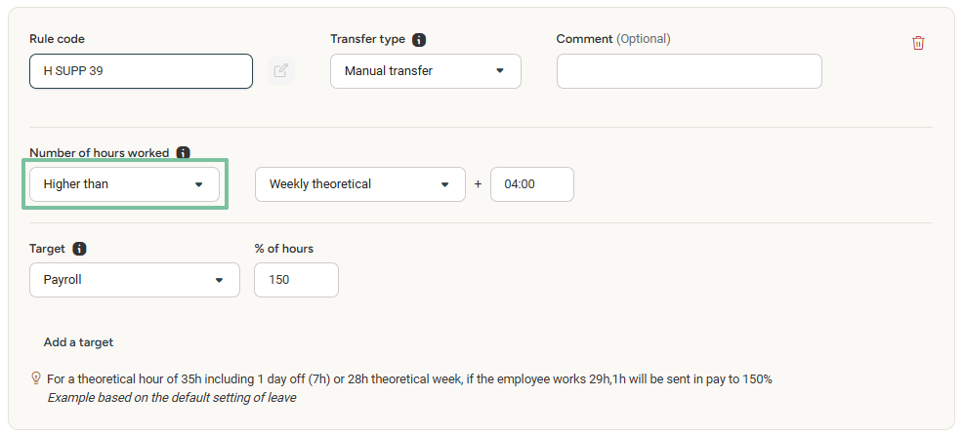
Managing overtime
Setting up overtime profiles, add-ons and special times
Access: Admin Area > Time & Activities > Overtime profiles
Example: 35 hours per week work schedule with overtime management
Between the theoretical week +0 and +4 and above the weekly theoretical +4:
Up to 4 hours of overtime, the hours are paid with a 125% increase.
Result: If a person has worked one hour over the weekly theorical, 1 hour and 15 minutes will be transferred to payroll.
Beyond 4 hours of overtime, the hours are paid with a 150% increase.
Result: If a person has worked one hour over the weekly theoretical +4, 1 hour and 30 minutes will be transferred to payroll.

Slide 25
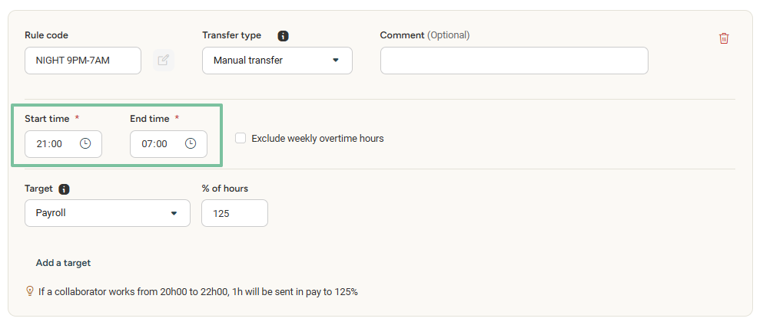
Managing overtime
Night shifts
Access: Admin Area > Time & Activities > Overtime profiles
Example: 39 hours per week work schedule with overtime management
Night hours are set to start at 9pm and end at 7am the following morning.
Night hours are paid with a 125% increase.

Slide 26
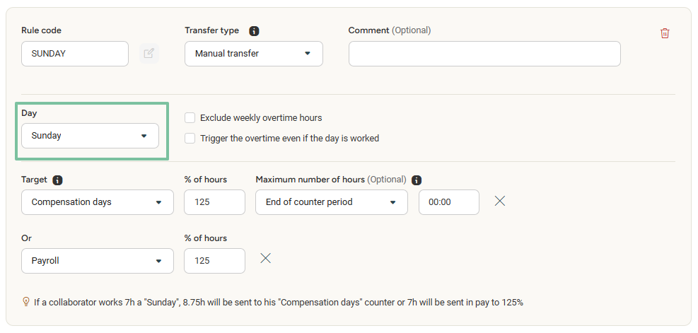
Managing overtime
Non-working days
Access: Admin Area > Time & Activities > Overtime profiles
Example of a work schedule with overtime management in case of work on a day usually not worked (Sunday).
Hours worked on Sunday are compensated with a 125% increase, either as recovery time or in payroll.

Slide 27
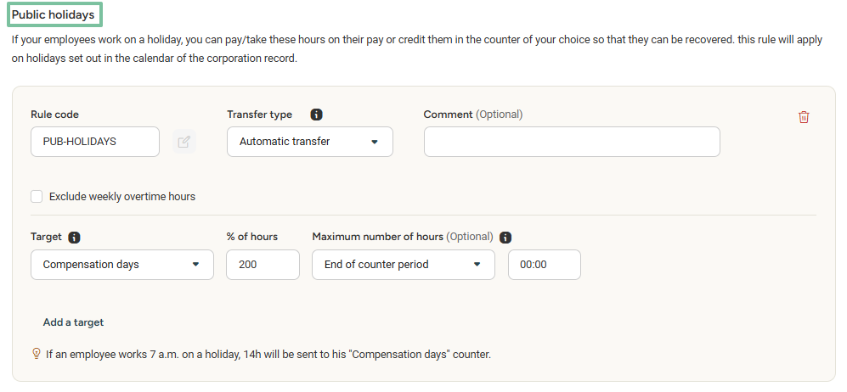
Managing overtime
Public holidays
Access: Admin Area > Time & Activities > Overtime profiles
Public holidays are set up in the public holiday calendar (Admin Area > General settings > Public holidays calendars)
In this example, hours worked on public holidays are compensated with recovery time at a 200% increase.
For further information: Help Center Article

Slide 28
Managing
Time & Activities profiles

Slide 29
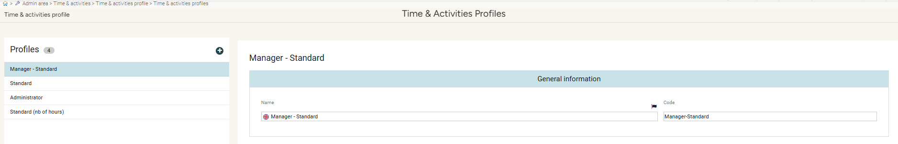
Managing Time & Activities profile
Setting up Time & activities profiles
Access: Admin Area > Time & Activities > Time & activities profiles
Create a new profile by clicking on the + or select an existing profile from the Profiles section to the left.
Specify the name of the new profile (by clicking on the flag, I can access translations).
Specify the profil code. This will be used in case of data import. Each code must be unique.

Slide 30
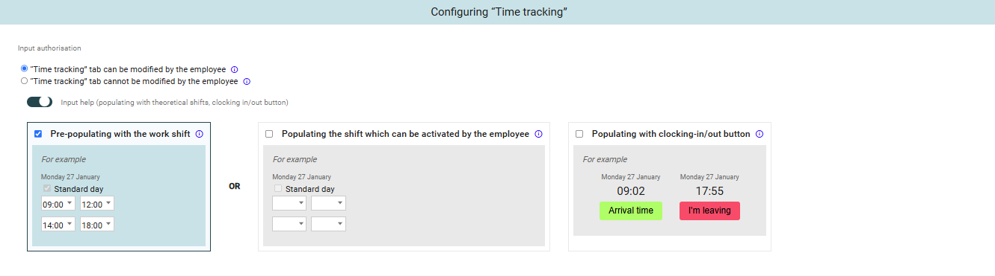
Managing Time & Activities profile
Setting up Time & activities profiles – Time tracking
Access: Admin Area > Time & Activities > Time & activities profiles > Type(s) of Tracking
In "Input Authorisation", choose whether employees can enter or modify their own data: ’Time tracking tab can be modified by the employee’ or "Time tracking tab cannot be modified by the employee".
Depending on your choice, different options will be offered.

Slide 31
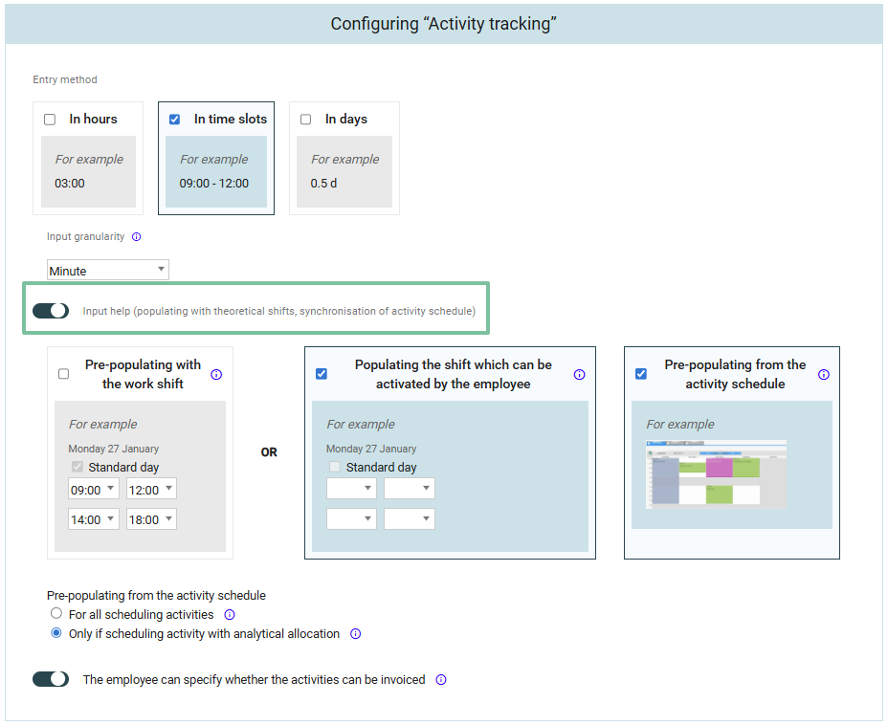
Managing Time & Activities profile
Setting up Time & activities profiles – Time tracking
Access: Admin Area > Time & Activities > Time & activities profiles > Type(s) of Tracking
You may activate the the « input help » option if:
  You wish for timesheets to be pre-filled automatically with relevant work schedules.
  You wish for timesheets to be pre-filled with relevant work schedules whenever the "standard day" box is checked
  You wish for timesheets to be filled directly by time clocks.
Note: the last two options may be activated simultaneously.
You can decide to leave "Input help" unticked if employees fill up their timesheets manually

Slide 32
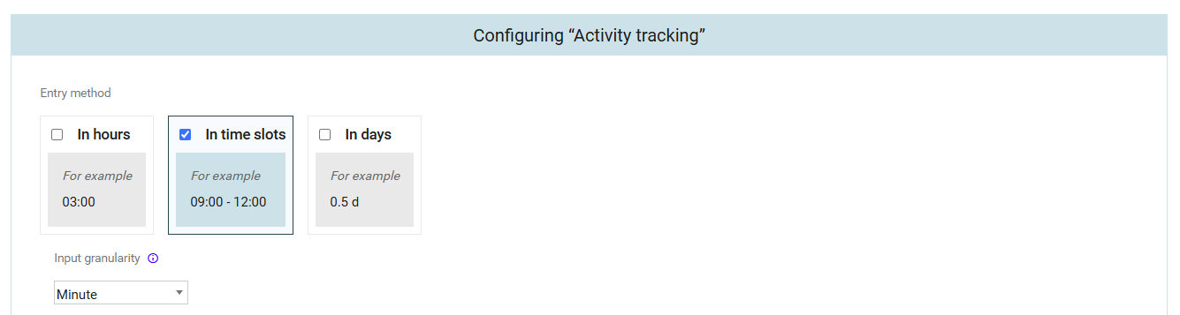
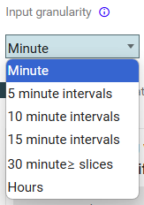
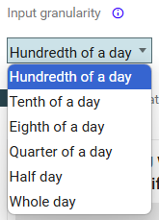
Managing Time & Activities profile
Setting up Time & activities profiles – Activity tracking
Access: Admin Area > Time & Activities > Time & activities profiles > Configuring "Activity Tracking"
I select the entry method:
  In hours, I indicate the desired granularity: Minute, 10 minutes, 15 minutes, 30 minutes, whole hours.
  In time slots, I indicate the desired granularity: Minute, 10 minutes, 15 minutes, 30 minutes, whole hours.
  In days, I indicate the desired granularity: Hundredth of a day, tenth of a day, eighth of a day, quarter of a day, half a day, whole day.

Slide 33
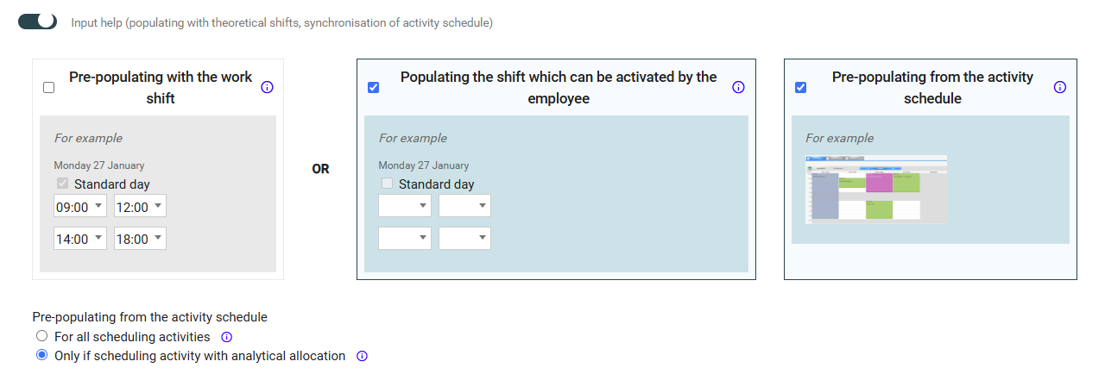
Managing Time & Activities profile
Setting up Time & activities profiles – Activity tracking
Access: Admin Area > Time & Activities > Time & activities profiles > Configuring "Activity Tracking"
I choose whether I want timesheets to be pre-filled or not via the ‘input help’ option. If activated:
  Timesheets may be pre-filled with employees' relevant work schedules.
  Timesheets may be pre-filled with employees' relevant work schedules whenever the ‘standard day’ option is ticked.
  Timesheets may be pre-filled with employees' activity schedules.

Slide 34
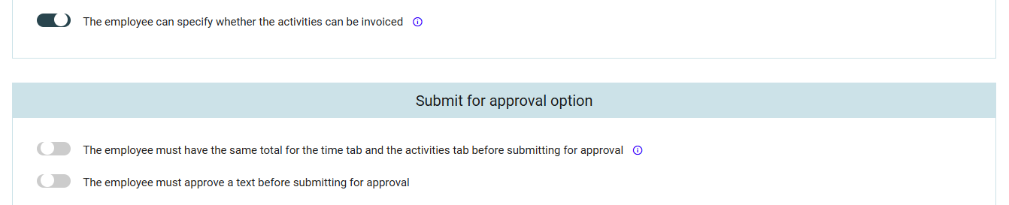
Managing Time & Activities profile
Setting up Time & activities profiles – Activity tracking
Access: Admin Area > Time & Activities > Time & activities profiles > Configuring "Activity Tracking"
If any activity should be invoiced to a third party, you may activate the relevant option so the employee can specify whether the activities can be invoiced or not.
Whenever both ‘Time tracking’ and ‘Activity tracking’ are activated simultaneously, the option to check the consistency between both tabs may be selected.
Once completed, do not forget to save changes. You can create as many profiles as needed.

Slide 35
Managing analytics and report criteria

Slide 36
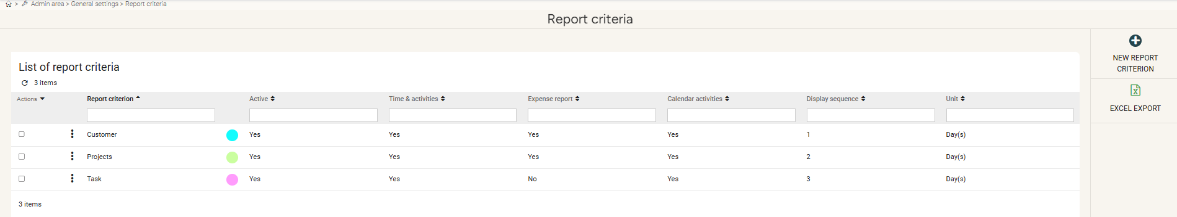
Managing analytics
Creating or duplicating report criteria
Access: Admin Area > Time & Activities > Report criteria > Open
Report criteria allow for the allocation of time spent on one or more activities for statistical purposes or within the framework of intermediate validation.

Slide 37
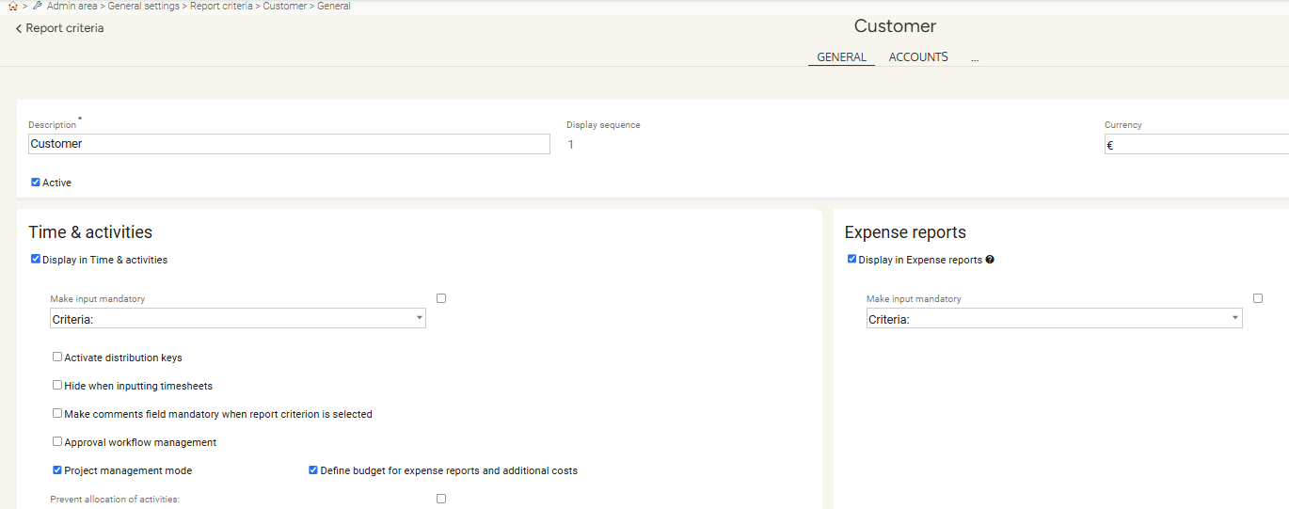

Managing analytics
Creating or duplicating report criteria
Access: Admin Area > Time & Activities > Report criteria > Open
In the "General" tab:
Give a name to the report criterion.
Check the ‘Display in Time & activities’ box. Once activated, the criterion can be used in timesheets.
If you check the ‘Make input mandatory’ box, this criterion will be required whenever employees enter their time.

Slide 38
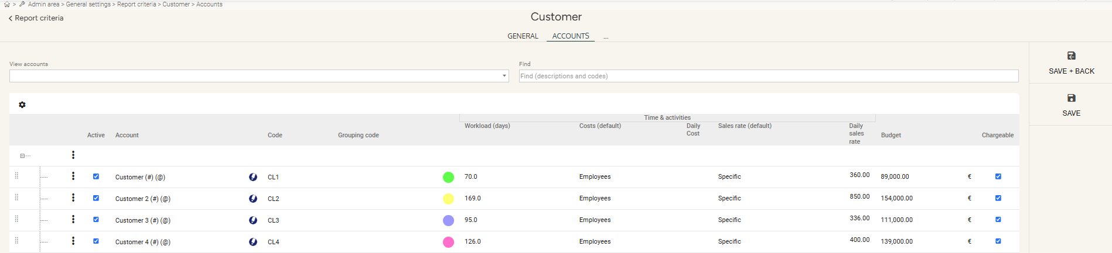
Managing analytics
Creating or duplicating report criteria
Access: Admin Area > Time & Activities > Report criteria > Open > [Chosen criterion] > Accounts
In the ‘Accounts’ tab:
Click on the three vertical dots, then choose ‘Insert a new line’ to create an account.
In the newly created line, enter the account name in the ‘Account’ column, as well as the desired information in the other columns.
Click ‘Save’.

Slide 39
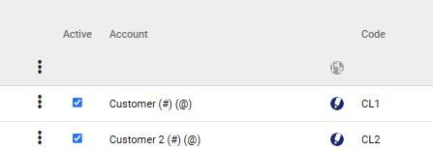
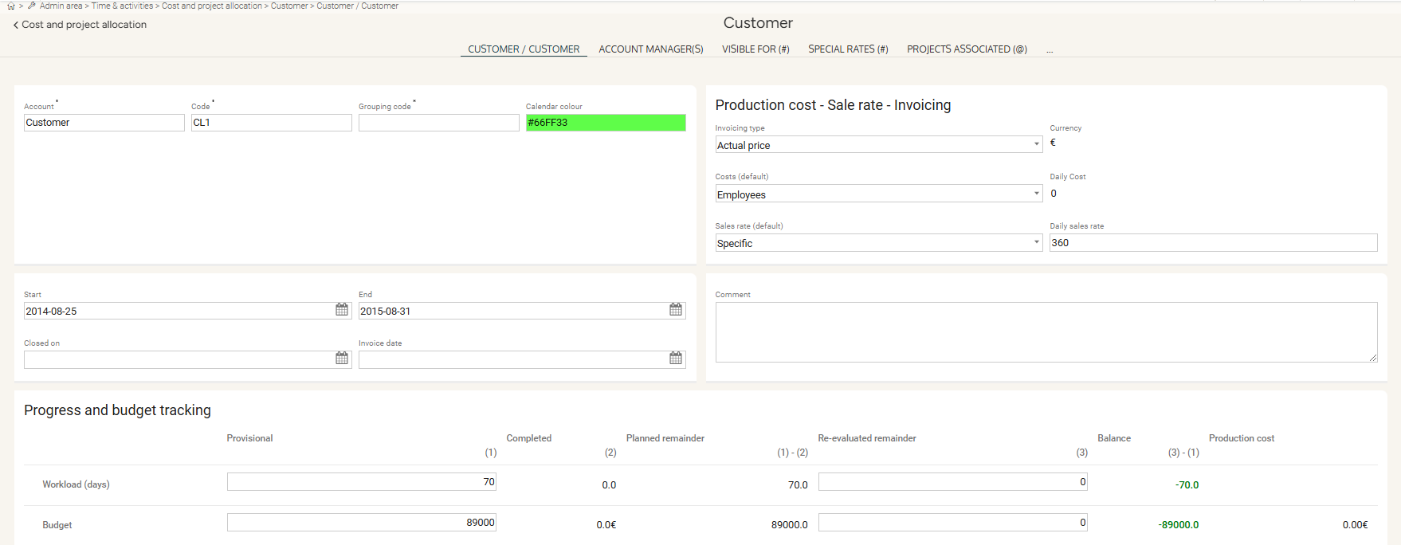
Managing analytics
Setting up a report criterion
Access: Admin Area > Time & Activities > Report criteria > Open > [Chosen criterion] > Accounts
In the ‘Accounts’ tab :
Click on the pencil ‘icon’ in order to edit details.
The first tab, named after the selected criterion and account, is used for budget tracking.
The ‘Account manager(s)’ tab is used for time validation purposes by specific project managers.
The ‘Visible for’ tab extends or restricts the visibility of a specific analytical account to certain users.
The ‘Special rates’ tab is used to manage specific costs and sales prices by account and by user.
The last tab is named after the next criterion and is used to link the criteria together if needed.

Slide 40

Managing analytics
Deactivating an analytical account
Access: Admin Area > Time & Activities > Report criteria > Open > [Chosen criterion] > Accounts
In the ‘Accounts’ tab:
Uncheck the box in the ‘Active’ column to deactivate an account.
Click ‘Save’

Slide 41
Still have questions?
All answers are within your reach.
support@eurecia.com
Help center

