Slide 1
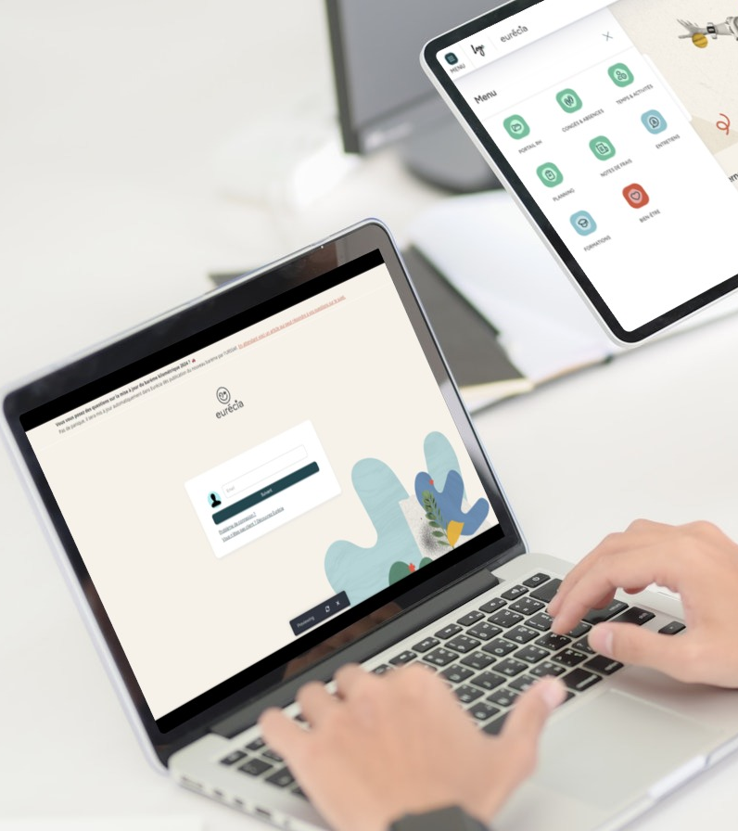

All you need to know about Skills
Admnistrator training guide
Last updated
July 2025

Slide 2

At the end of this training , administrators will be able to:
Training objectives
Manage a skill catalogue
Manage a job type catalogue
Set up the different skill levels

Slide 3

MODULE features
Training program
Creating and editing skills
Creating and editing job types
Linking skills to a job type or training
Linking job types to employees
Accessing the skill overview

Slide 4
Module features
01

Slide 5
Creating and editing skills

Slide 6
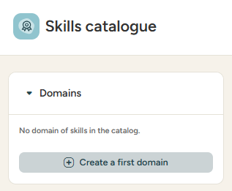
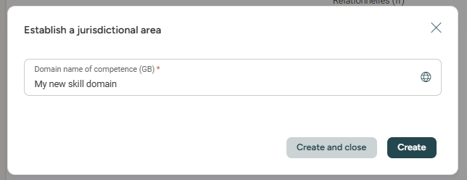

Managing a skills catalogue
Creating a skill domain
ACCESS: Menu > Skills > Skills catalogue
Click the + icon or the create button to create a new skills domain
Click create or create and close to save the new skill domain
Skill domains allow you to organise skills by thematics.

Slide 7
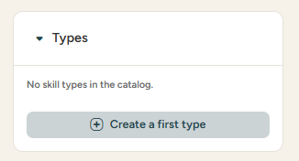
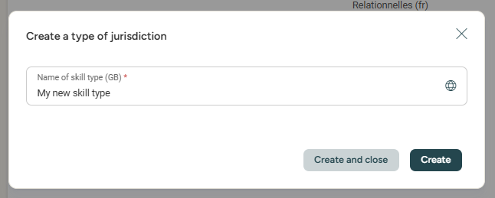
Managing a skills catalogue
Creating a skill type
ACCESS: Menu > Skills > Skills catalogue
Click the + icon or the create button to create a new skill type
Click create or create and close to save the new skill type
Skill types allow you to organise skills by category.

Slide 8

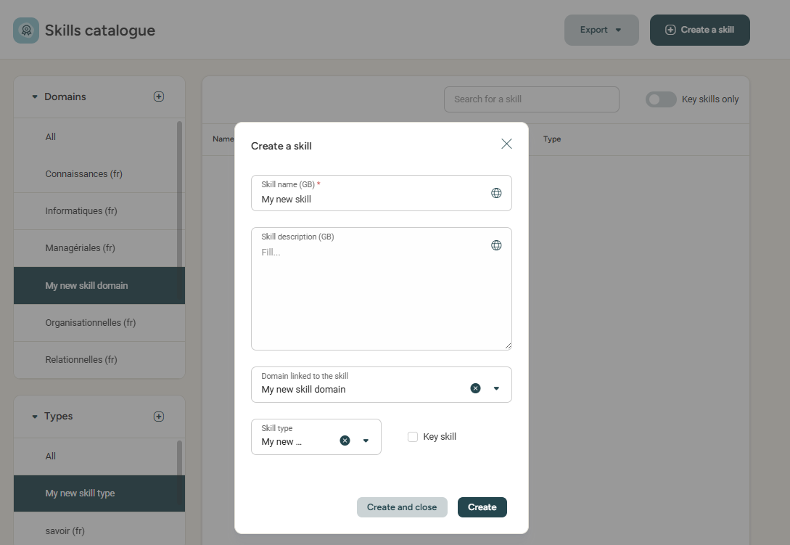

Managing a skills catalogue
Creating a skill
ACCESS: Menu > Skills > Skills catalogue
To create a new skill click :
Fill in the information :
Skill name
Skill description
Domain linked to the skill
Skill type
Check/Uncheck Key skill
Linking the skill domain and type is
not mandatory, but can be useful
in order to categorise/filter your skill catalogue.
A key skill is a skill that is essential in your company.
For example, speaking English is a key skill
for a company operating internationally.

Slide 9
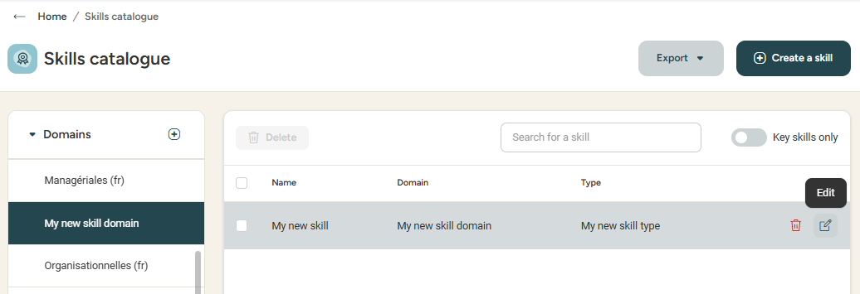
Managing a skills catalogue
modifiying a skill
ACCESS: Menu > Skills > Skills catalogue
To edit the info about a skill,
click the pen icon
Please note: A skill can not be deleted whilst still linked
to a job, training or employee.

Slide 10
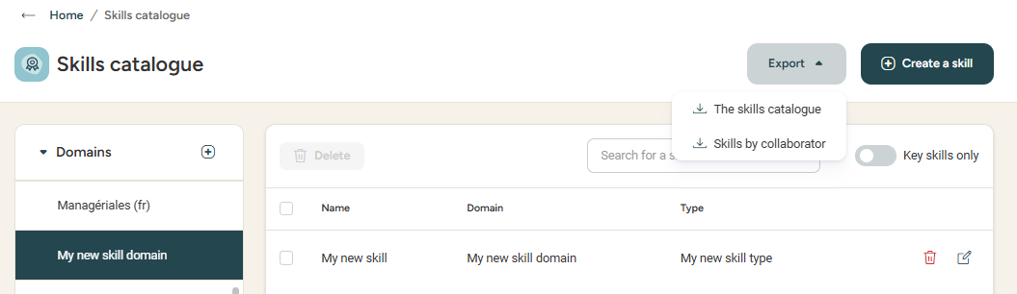
Managing a skills catalogue
Exporting the skill catalogue
ACCESS: Menu > Skills > Skills catalogue
Good to know! Exports are sent directly to your inbox.

Slide 11
Creating and editing job types

Slide 12
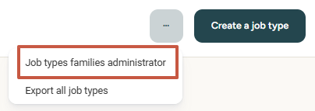
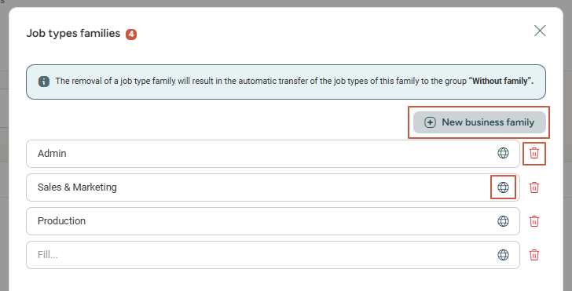
Managing a jobs catalogue
creating a job type family
ACCESS: Menu > Skills > Job types
Job types can be organised by families.
To access the existing job type families, click :
Add a new job type family
Delete a job type family
Add title translations in different languages

Slide 13
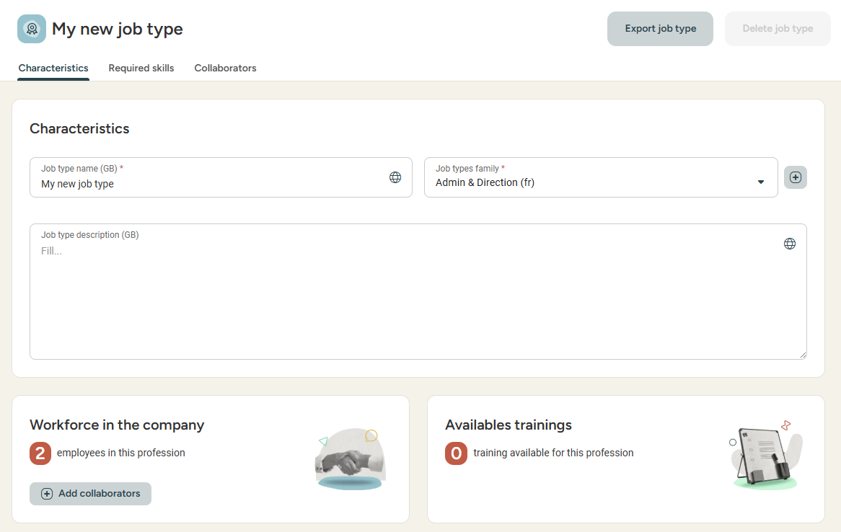

Managing a jobs catalogue
Creating a job type
ACCESS: Menu > Skills > Job types
From this menu, you can fill the relevant info for this job type :
Job type name
Job type family
Job type description
Missions

Slide 14
Linking skills to a job type or training

Slide 15
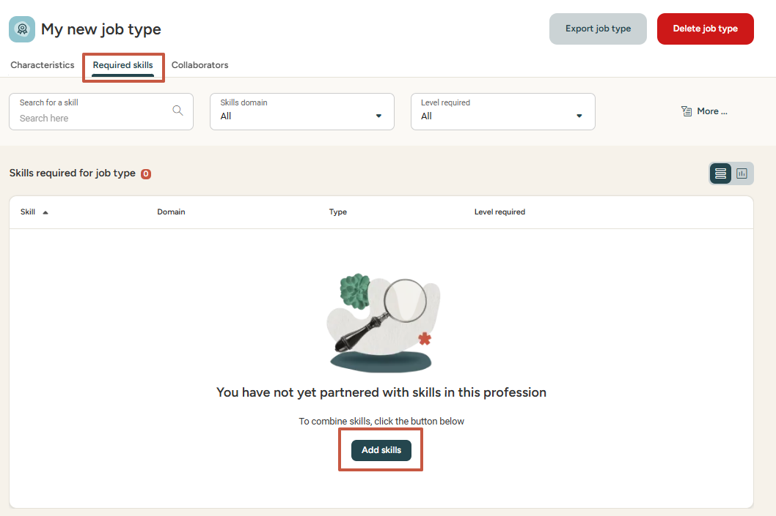
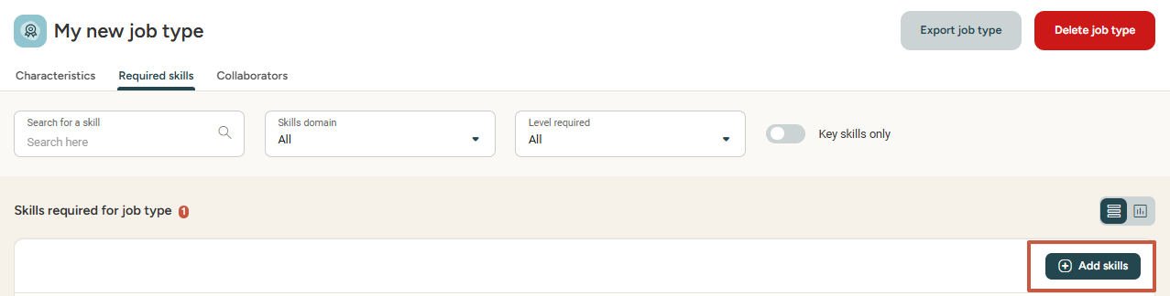
Managing a job type catalogue
Linking a skill to a job type
ACCESS: Menu > Skills > Job types
In order to finalise the job type creation, it is essential to link skills to it from the required skills tab.
Add as many skills as necessary to your job type.

Slide 16
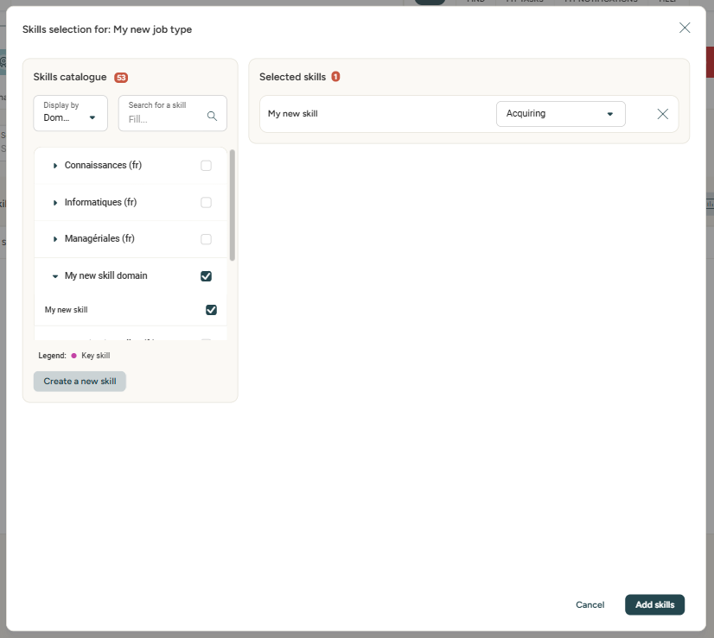
Managing a job type catalogue
Linking a skill to a job type
ACCESS: Menu > Skills > Job types
In order to finalise the job type creation, it is essential to link skills to it.
Select the level required for this skill.
Select the skill
you wish to link
(by checking the box)
Click add skills, and voila!

Slide 17
Linking a job type to an employee

Slide 18
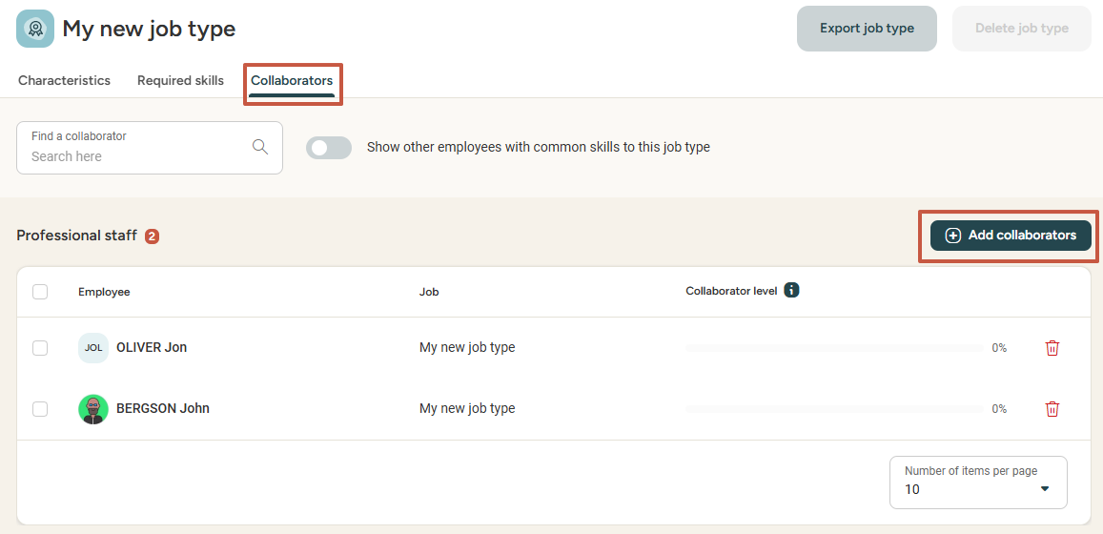
Managing a job type catalogue
Linking a job type to an employee
ACCESS: Menu > Skills > Job types
In order to finalise the job type creation, it is essential to link employees to it.
.
Doing this will enable you:
To analyse your company's skillset by filtering employees who have acquired selected skills.
Link training programs to them in order to develop these skills (if the Training module is subscribed to)
Conduct skill evaluations (if the Interviews module is subscribed to)
Allow your employees to conduct self-evaluations on job types different to their own.

Slide 19
Accessing the skills overview

Slide 20
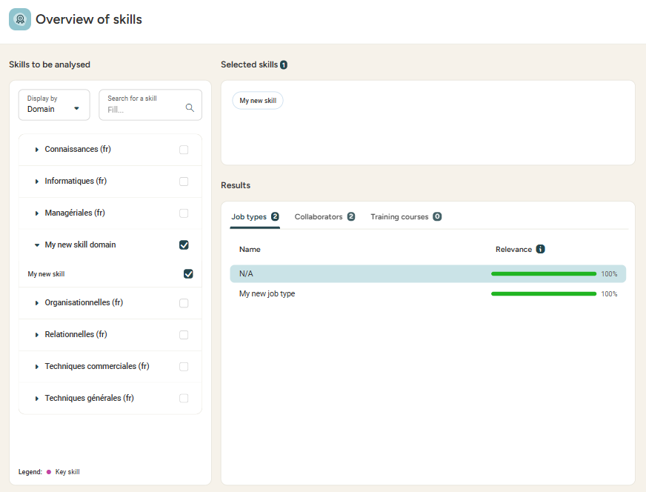
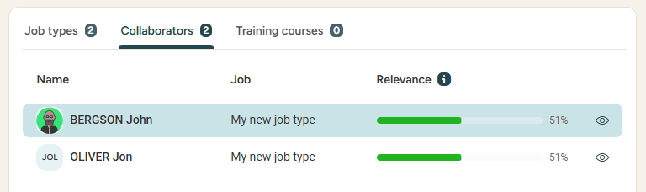
Exploiting the data
Skills overview
ACCESS: Menu > Skills > Overview of skills
Select the skills you wish to analyse.
Visualise the job types, employees and trainings linked to the skill.

Slide 21
Admin area
02

Slide 22
Creating, editing, deactivating and deleting skill levels

Slide 23
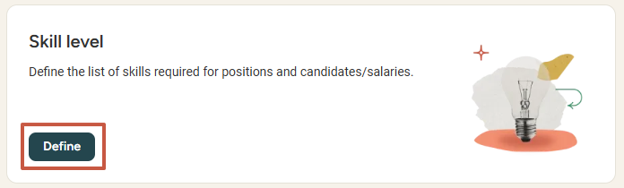
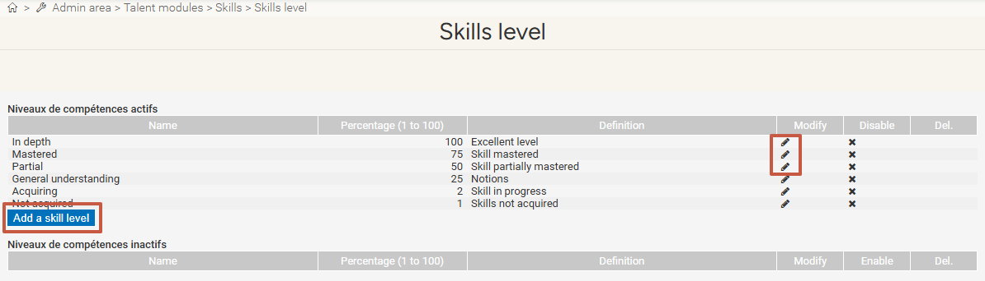
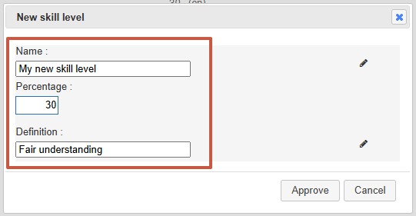
Setting up skill levels
Creating / editing a skill level
ACCESS: Menu > Admin area > Skills
Click the pen icon
to edit the skill level
Click on Add a skill level
Fill in the name, percentage of completion and definition for the new/edited skill level,
then click approve.

Slide 24
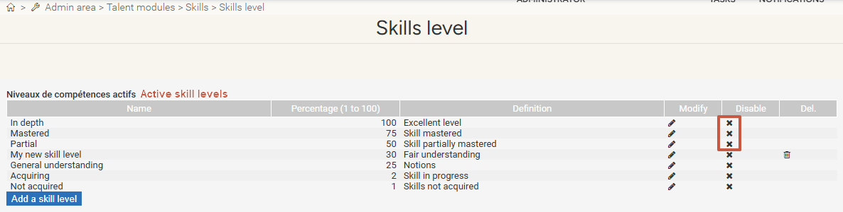
Managing skill levels
Deactivating / Deleting a skill level
ACCESS: Menu > Admin area > Skills
Click the cross to deactivate a skill level.
The skill level now appears in the disabled skill level category:
Click the bin icon to delete it.
Please note: You can disable but not delete default levels.

Slide 25
Still have questions ? All the answers are within your reach.
support@eurecia.com
Help center

