Slide 1


All you need to know about
Training
Admnistrator training guide
Last updated
July 2025

Slide 2

At the end of this training , administrators will be able to:
Training objectives
Understand the Training module features
Set up a training plan

Slide 3


MODULE features
Training program
Creating a training catalogue
Managing training intentions
Arbitrating the training plan
Setting up and monitoring trainings
Monitoring the training costs and budget
Admin area
Attibuting rights for the Talent modules
Creating different financial devices and expense types

Slide 4
Module features

Slide 5
Creating a catalogue

Slide 6
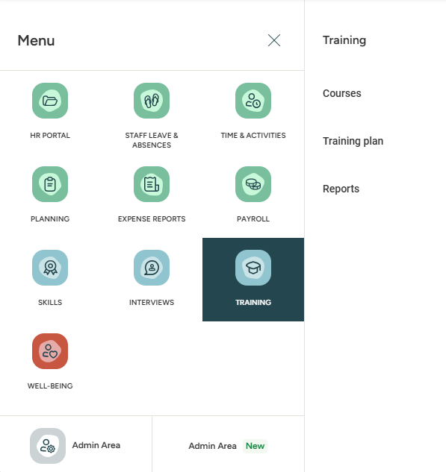

Accessing the Training module
MENU > Training
This module allows you to set a training catalogue, organise enrolment to training sessions, manage the acquisition of new skills (completed training) and define training plans.
Training management is done through two menus:
Courses
Training plan

Slide 7
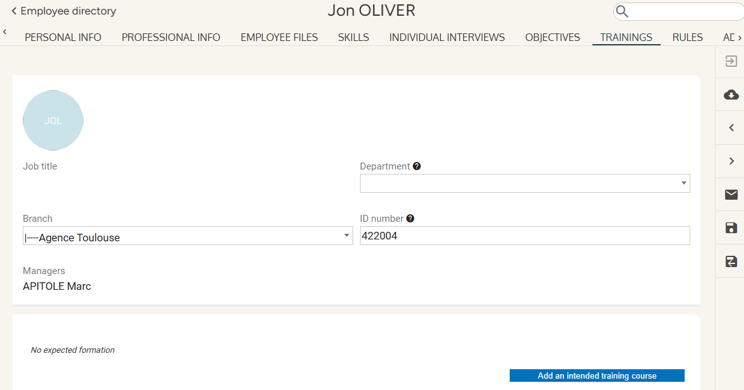
Accessing the module
Employee sheet
Employees can also follow upcoming or completed training from their employee sheet.
Administrators can add an intended training plan from the employee sheet directly.

Slide 8
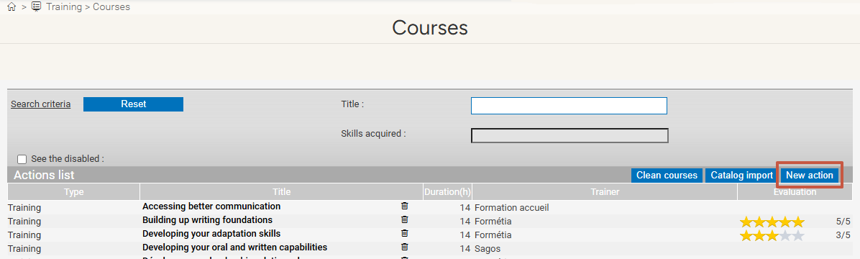
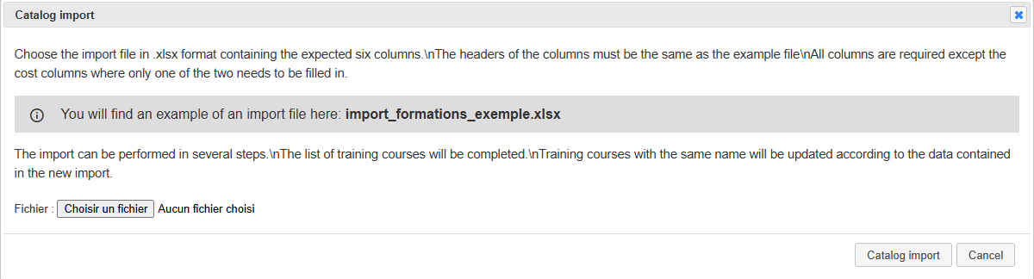
Creating a catalogue
MENU > training > courses
From the Courses catalogue, clicking New action allows you to add a new training course. A service provider, duration and cost must be defined, as well as skills and job types linked to this training if relevant.
The Catalogue import button allows you to import an Excel catalogue. An import template is available:

Slide 9


Creating a catalogue
MENU > training > Courses
Please note that the Clean courses button will delete any training that has never been taken on Eurécia.
However, clicking the bin icon will only deactivate the trainings:
You can then reactivate them at any point by checking the See the disabled box and clicking the arrow:
The Courses catalogue provides you with a list of trainings, as well as a state of play of the available and intended courses. It allows you to create a training plan and follow the acquisition
and development of skills by employees once training is completed. To manage costs and financing plans, you can work directly from the Training plan menu.

Slide 10
Managing training intentions

Slide 11
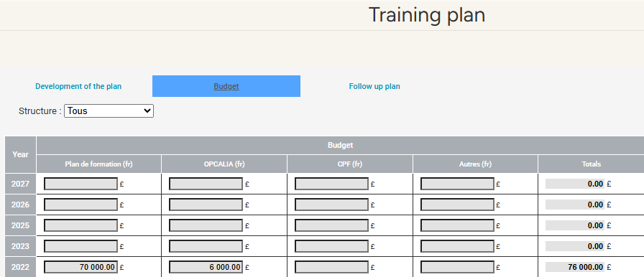
Drafting a plan
MENU > training > training plan
In order to draft a training plan over one or several calendar years, it is necessary to define a budgeting plan, ensure that the costs remain consistent with the intended budgets, as well as report on the skill acquisition in the employee records. To do so, you can use the Training plan menu.
Before Validating the scenario, it is necessary to check whether the intended budget is coherent, by switching to the Budget tab. You can also do so by clicking directly on 'Display the totals details' next to the Validate scenario button in the Development of the plan tab.

Slide 12
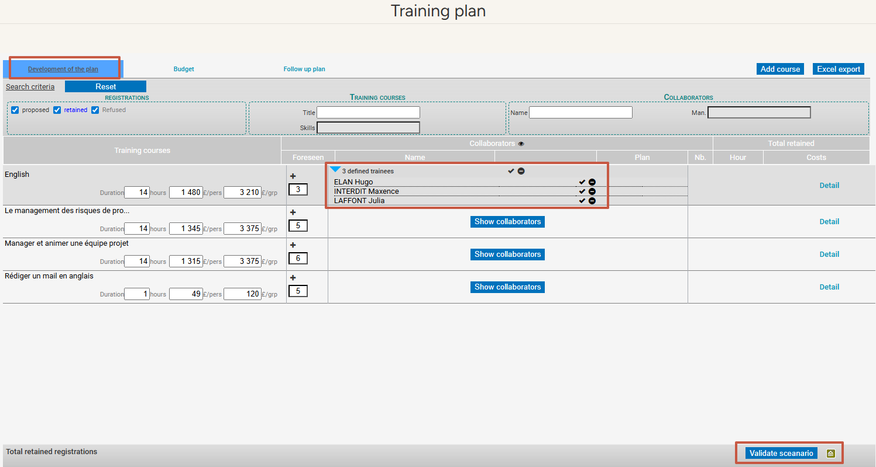
Drafting a plan
MENU > training > training plan
When the budget is set, go to the Development of the plan tab to define its conditions:

Slide 13
Arbitrating the plan

Slide 14
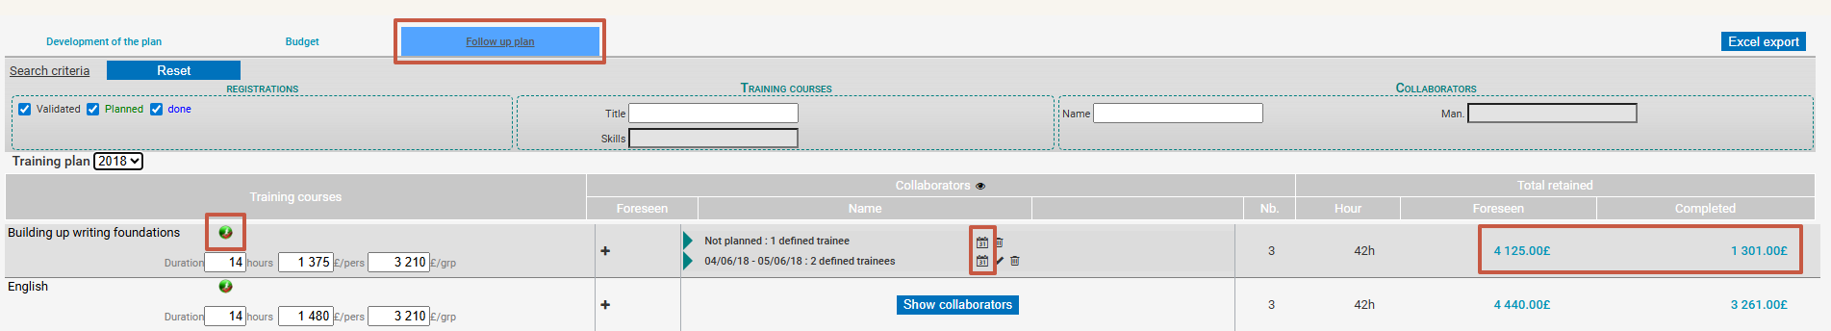
Validating the plan
MENU > training > training plan
When training sessions have been planned and employees scheduled on the relevant dates and intended budget (aligned with the projected budget), the scenario can be validated. Selecting the correct calendar year thanks to the drop-down menu is important.
The training costs are compiled into the totals from the moment actions are validated (by clicking √). Training for which the scenario was validated must now be managed from the Follow up plan tab.

Slide 15
Setting up and monitoring trainings

Slide 16

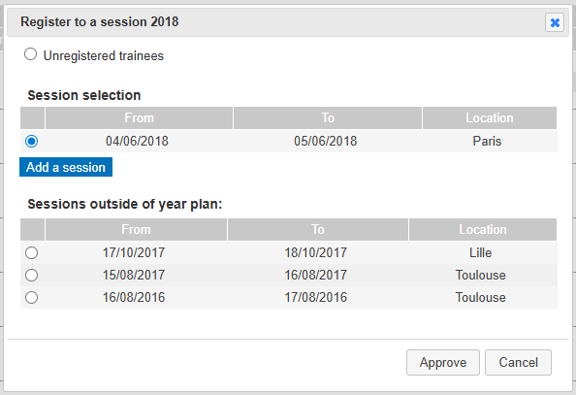


Monitoring the plan
MENU > training > training plan
The follow up plan menu allows you to:
Validate the skills featured in the training:
Plan dates for training sessions and cancel them if needed (by setting them back to 'planned'). (NB: sessions can also be planned at the same time as the plan is validated).
Delete employees scheduled for a session:

Slide 17
Monitoring the budget with different training costs

Slide 18
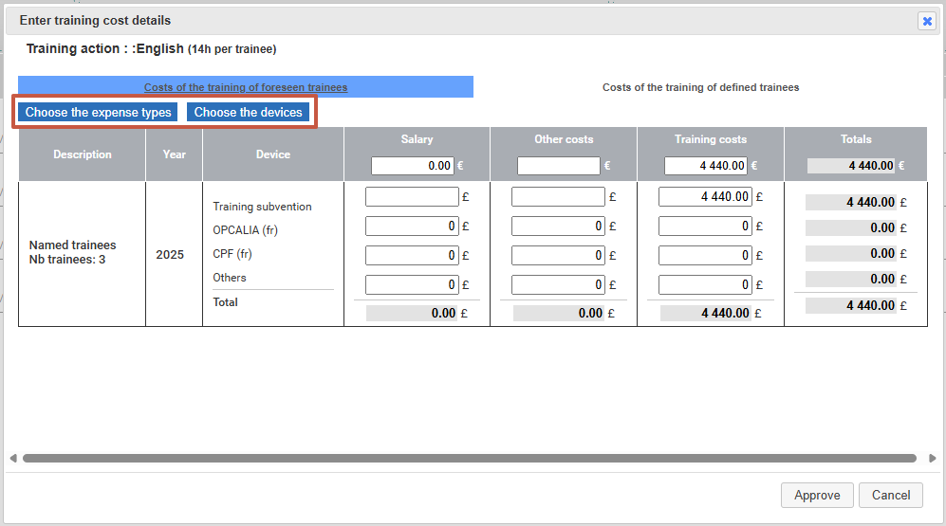
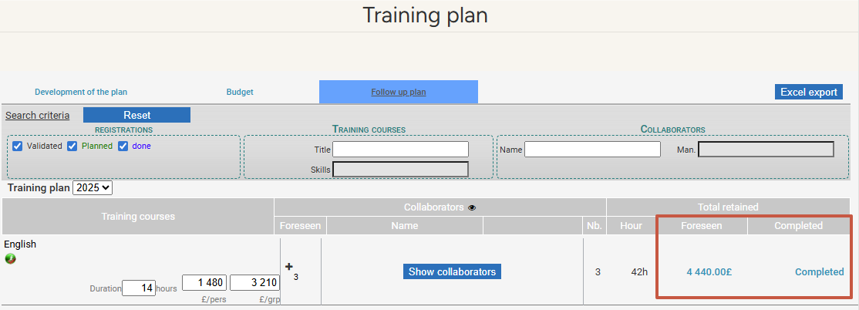
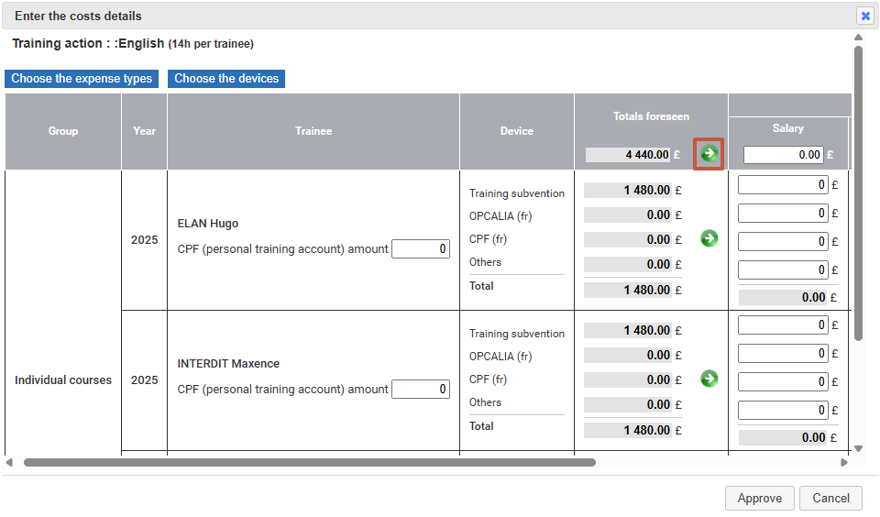

Monitoring the plan
MENU > training > training plan > Follow up plan > Validated scenari
Input the training cost details: 'Foreseen' column:
Input the actual cost incurred: 'Completed' column:
By default, the amount entered in the header will be spread evenly accross all financial devices. It is entirely possible to edit these amounts manually and individually.
The arrows allow you to copy the amounts automatically from the Intended column to the Realised column.

Slide 19

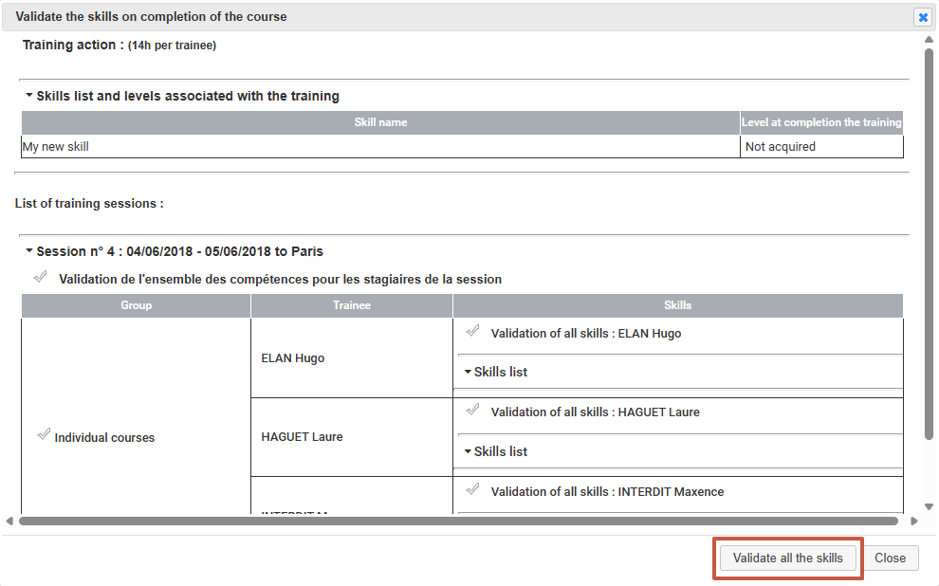
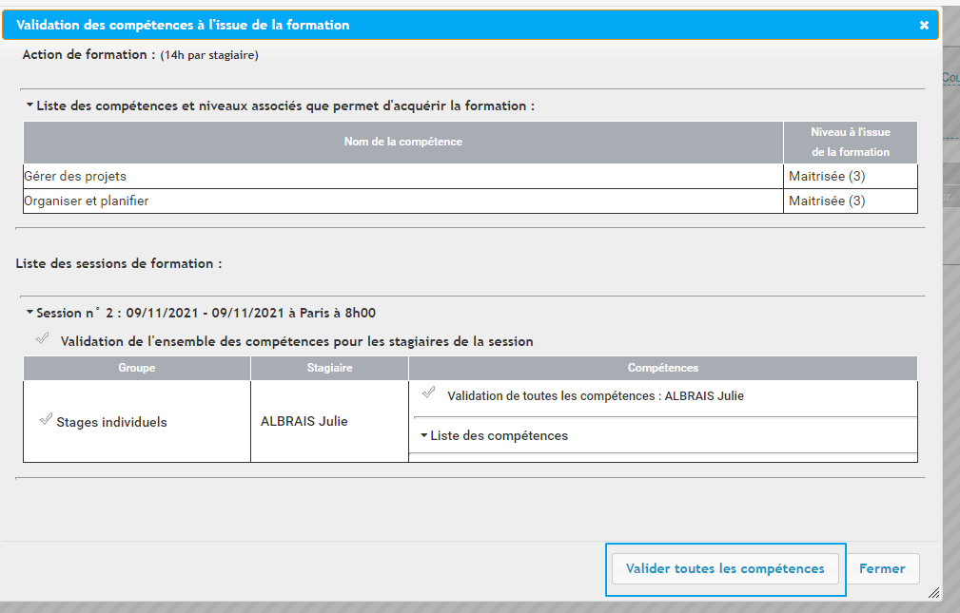
Monitoring the plan
MENU > training > follow up plan
Validating all the skills featured in a training session:

Slide 20
Admin area

Slide 21
Attributing rights for the Talent modules

Slide 22
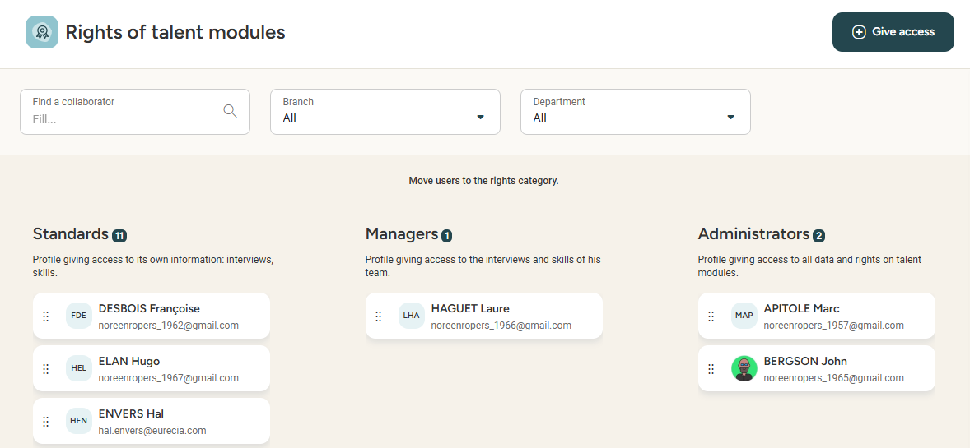

Attributing rights to Talent modules
MENU > admin area > sirh rights
Simply drag & drop employees
from one section to another!
The rights to the Talent modules allow you to classify users depending on their authorised access to the modules.
Administrator access: any person in charge of managing the training catalogue and monitoring the follow-up plan.
Manager access: any person allowed to propose training sessions for employees.
Standard access: any person allowed to participate in a training session.

Slide 23
Creating different financial devices and expense types

Slide 24
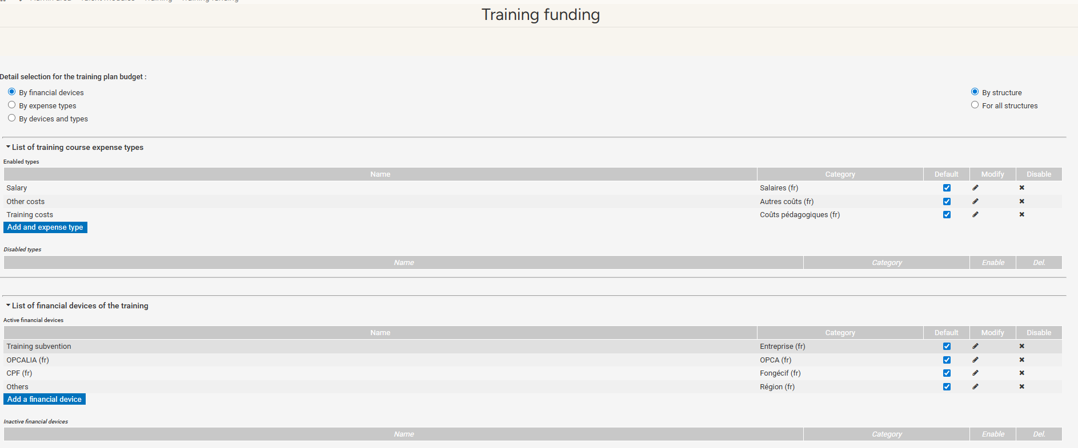
Training funding
MENU > admin area > training
From this menu, you can:
Define the input details for the training plan budget
Create different expense types for the training plan
Create different financial devices for the training plan
Please note : at least 3 expense types and 3 financial devices must be created to allow for the input of your budget.

Slide 25
Still have questions?
All the answers are within your reach.
support@eurecia.com
Help center

