Slide 1


All you need to know about
Training
Management
Administrator training guide
Last updated
August 2025

Slide 2


Module features
Training program
Enriching the training catalogue
Managing and deleting training
Collecting your employees' training needs
Approving or refusing training requests
Exporting training requests
Admin area
Attributing rights for the Talent modules

Slide 3
Module features

Slide 4
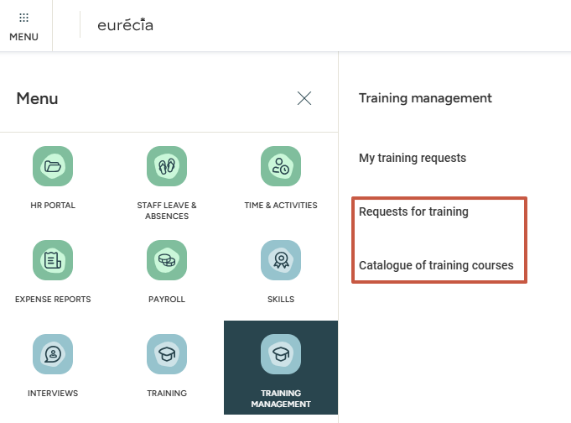
Accessing the module
MENU > Training management
This module allows you to enrich a training catalogue and to collect your employees' training needs.
The Training Management module features two menus:
Requests for training
Catalogue of training courses

Slide 5
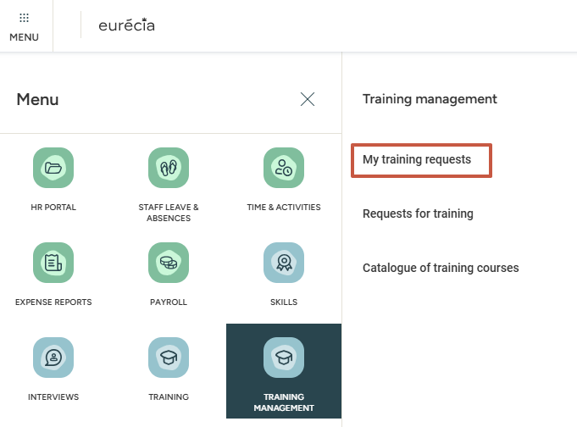
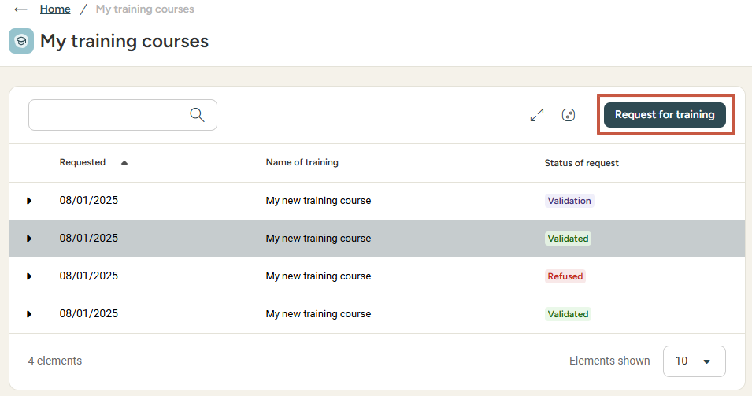

Accessing the module
my training requests
Employees also have a dedicated access allowing them to track their own training requests.

Slide 6
Creating a training catalogue

Slide 7
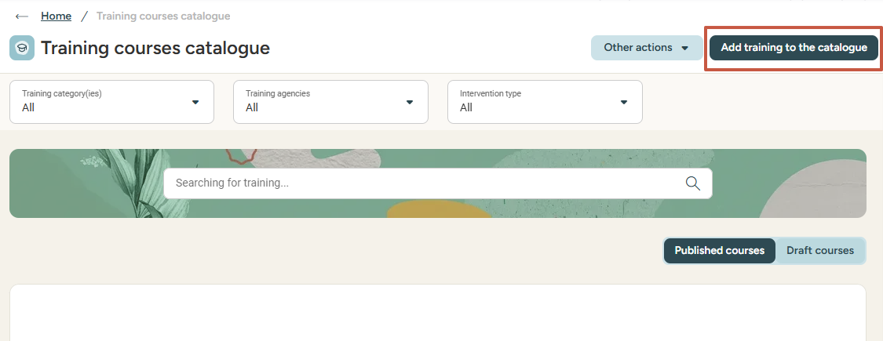
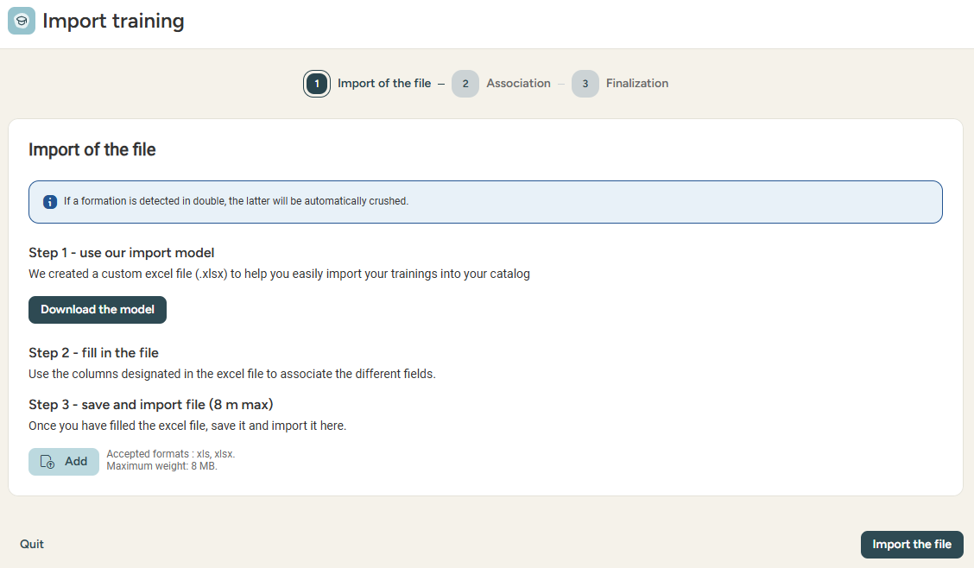
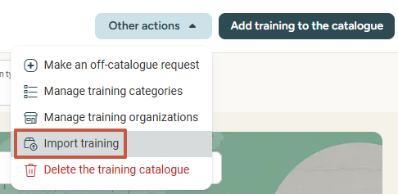
Creating a catalogue
MENU > training management > CATALOGUE of training courses
From the catalogue, you can click Add training to the catalogue (or Other actions > add training to the catalogue) to add new training. A service provider, duration and cost must be defined and a training program attached.
Good to know: a training course saved as a draft is only visible to Administrators, not to Standard employees.
Click Import training to import a catalogue in an Excel format. A import template is available to guide you:

Slide 8
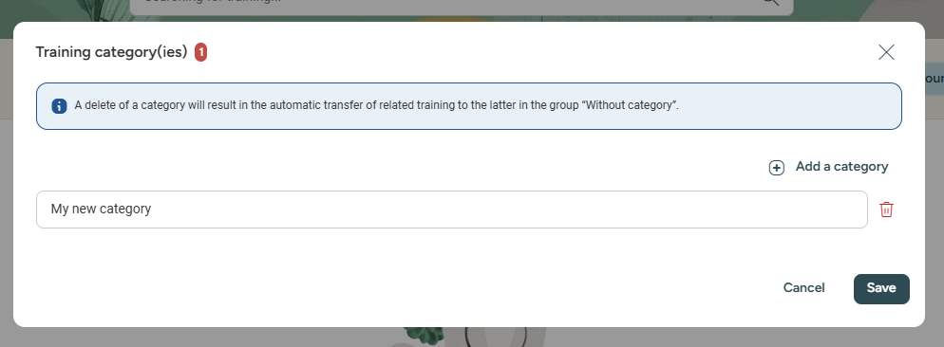
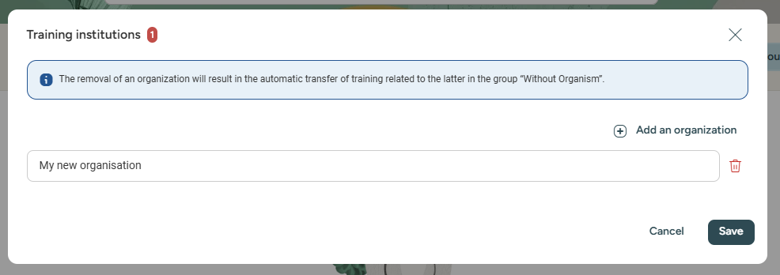
Creating a catalogue – categories & organisations
MENU > training management > catalogue of training courses
From the catalogue of training courses, click Other actions to access:
Manage training categories to add categories allowing you to filter trainings and facilitate your search.
Manage training organisations to add institutions, allowing you to filter trainings and facilitate your search.

Slide 9
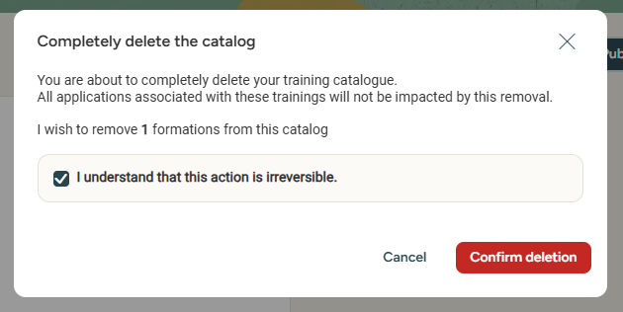
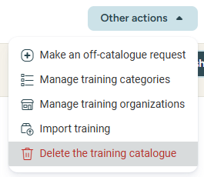
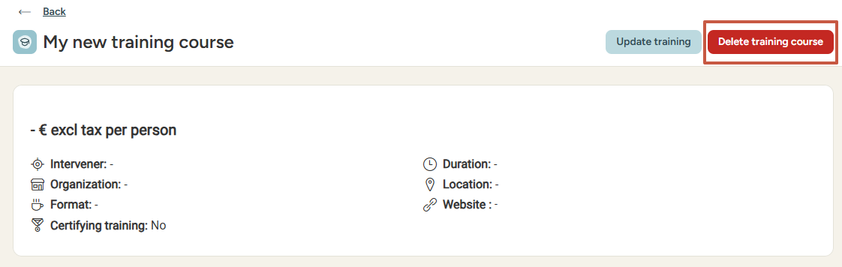
Creating a catalogue – deleting training
MENU > training management > catalogue of training courses
Keep in mind that clicking Delete the training catalogue will delete all the trainings courses saved in the catalogue without impacting the associated requests.
If you wish to clear out some courses individually, you can open a course and click Delete training course:

Slide 10
Collecting your employees' training needs

Slide 11
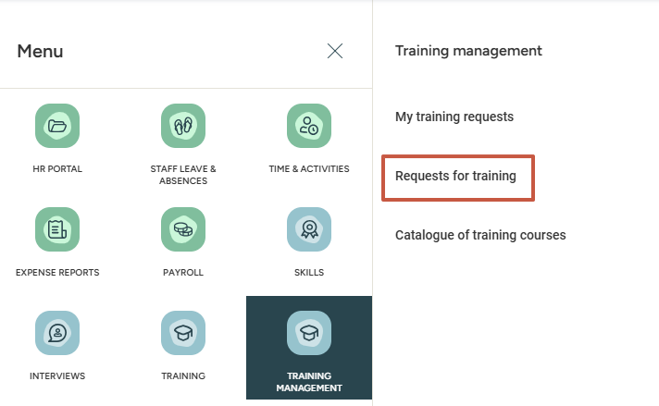
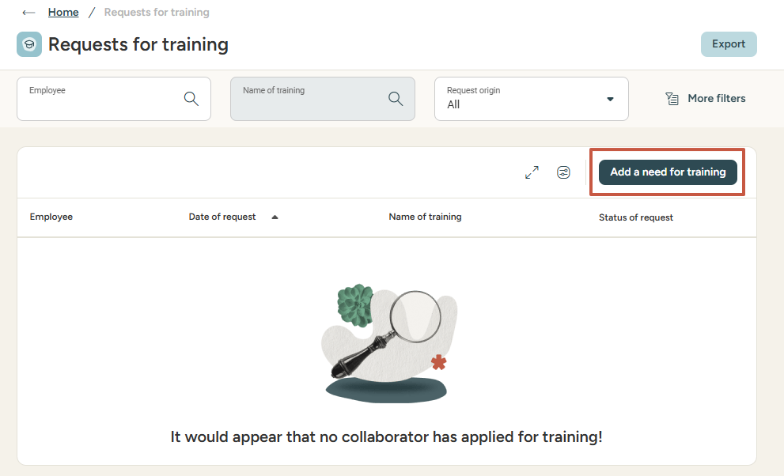
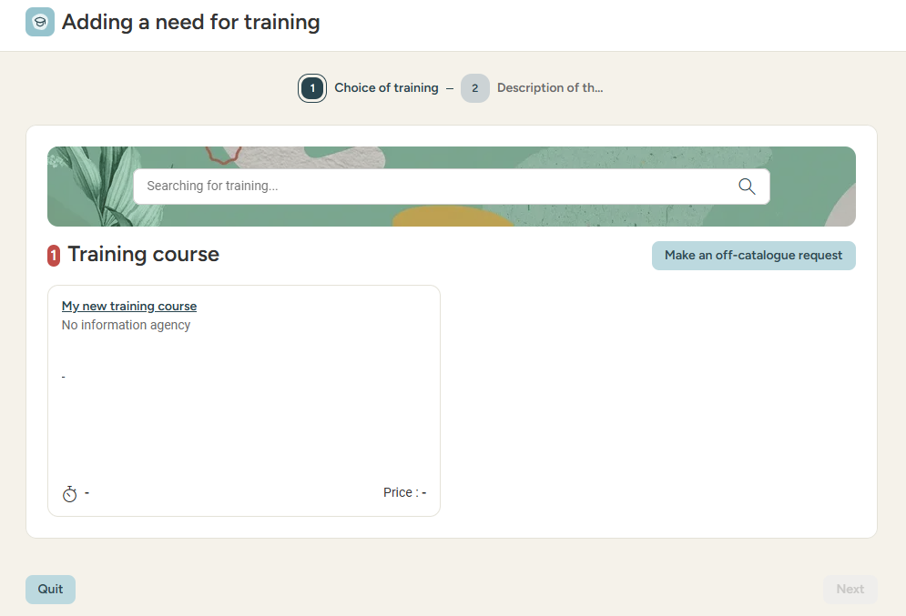
Requests for training
Adding a 'need for training' (from training requests)
As an Administrator, you can add a need for training on behalf of another employee.
If you cannot find the desired training course
in the catalogue, you can select
Make an off-catalogue request.
Goog to know: no approval cycle will be applied. The request will be automatically validated.

Slide 12
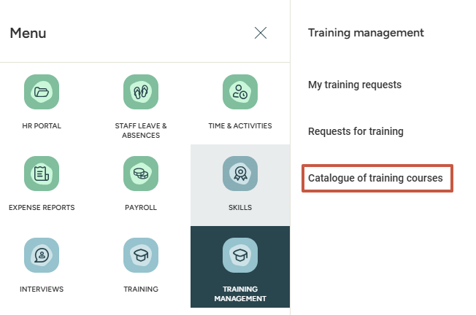
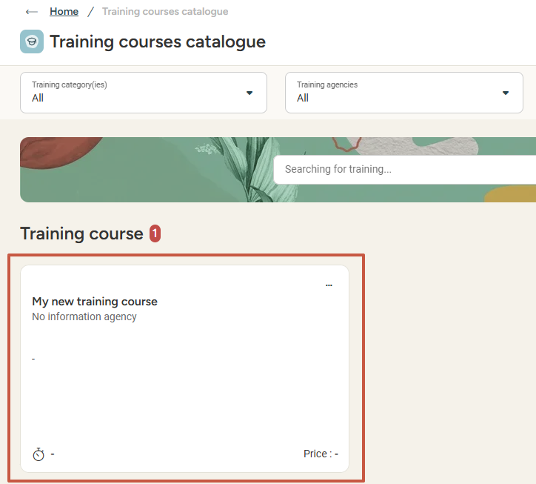
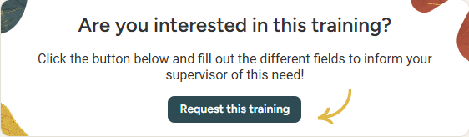
Requests for training
Adding a 'need for training' (from the catalogue)
As an Administrator, you can add a need for training on behalf of another employee.
If you cannot find the desired training course
in the catalogue, you can select
Make an off-catalogue request.
Goog to know: no approval cycle will be applied. The request will be automatically validated.

Slide 13
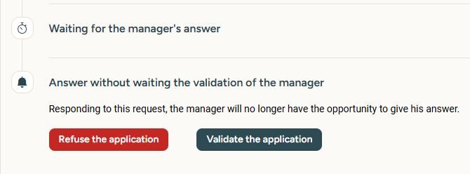
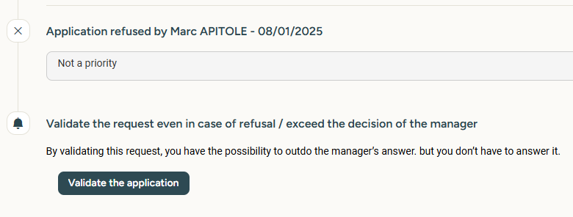
Training requests
approval cycle
The approval cycle of a training request is defined as follows by default:
Level 1: Employee's direct manager/supervisor (N+1)
Level 2: Talent module administrator
As an administrator, when can you intervene in the approval cycle?
You can override the manager's validation.
You can validate a request previously refused by the manager.

Slide 14
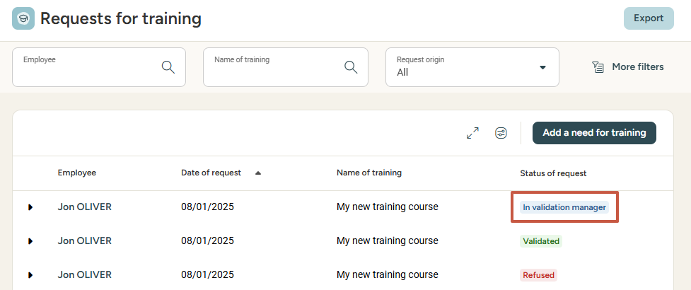
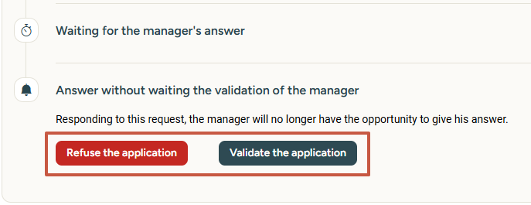
Training requests
Approving or refusing a training request

Slide 15
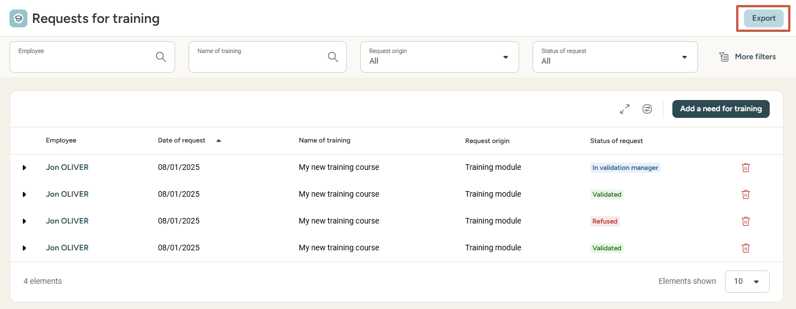
Training requests
Exporting training requests

Slide 16
Admin area

Slide 17
Attributing rights for the Talent modules

Slide 18
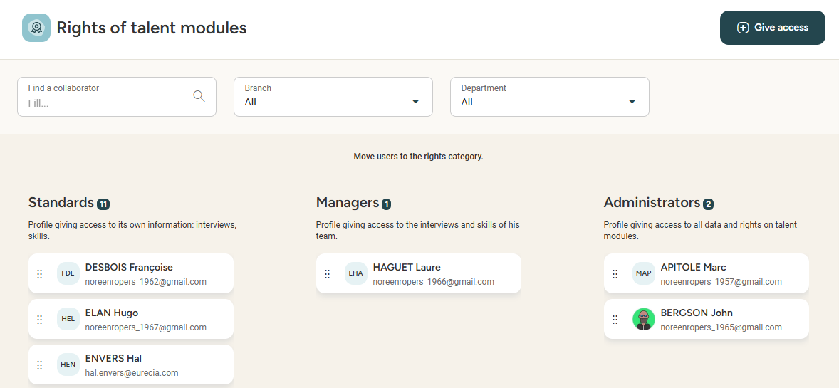

Attributing rights to Talent modules
MENU > admin area > sirh rights
Simply drag & drop employees
from one section to another!
The rights to the Talent modules allow you to classify users depending on their authorised access to the modules.
Administrator access: any person in charge of managing the training catalogue and monitoring the follow-up plan.
Manager access: any person allowed to propose training sessions for employees.
Standard access: any person allowed to participate in a training session.

Slide 19
Still have questions?
All the answers are within your reach.
support@eurecia.com
Help center

