Slide 1


All you need to know about
Training
Management
user training guide
Last updated
August 2025

Slide 2


Employee usage
Training program
Requesting training
Navigating the training courses catalogue
Manager usage
Requesting training for members of your team:
From training requests
From the catalogue
From an interview
Approving or refusing a training request

Slide 3
Employee usage
01

Slide 4
Requesting training

Slide 5
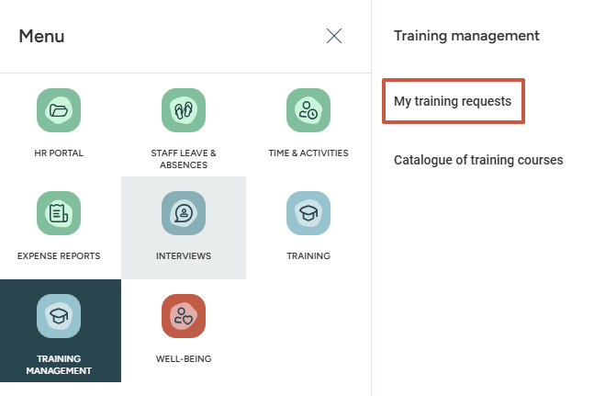
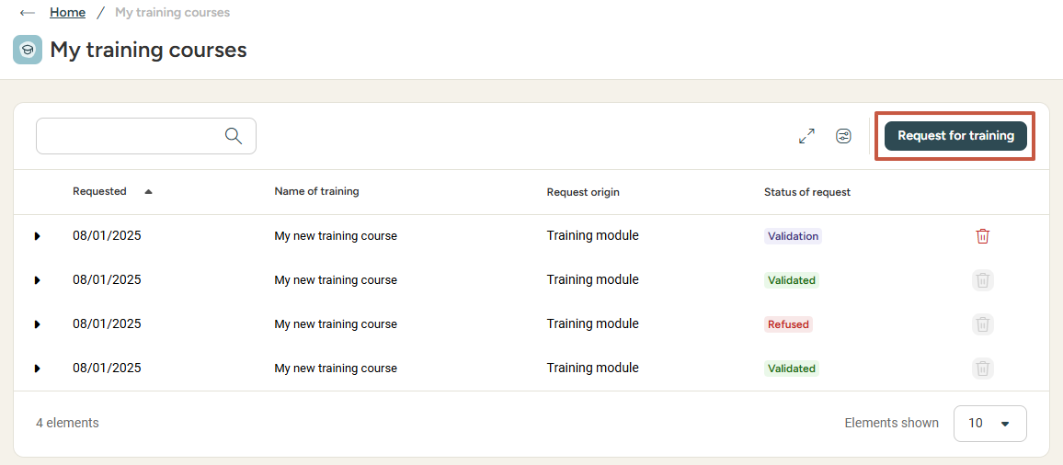
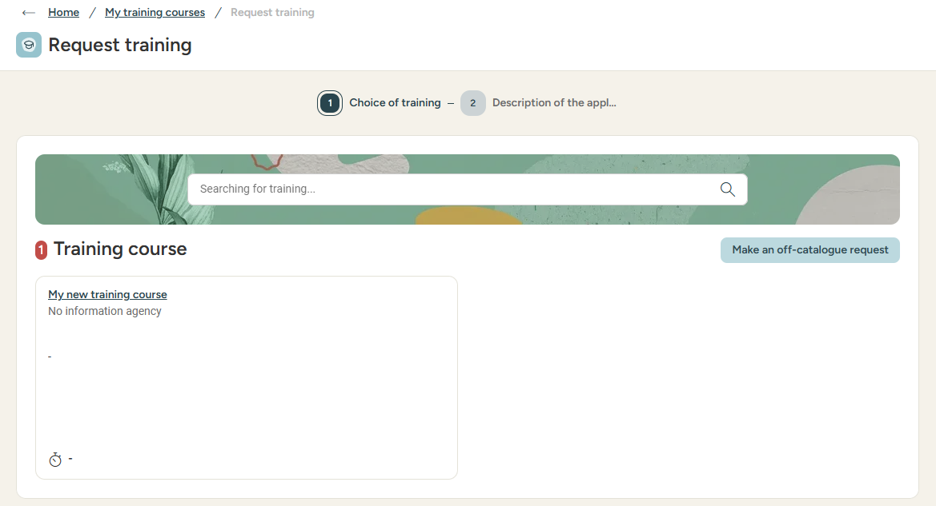

Training requests
Requesting training (from 'my requests')
Select the desired training course and detail your needs to your direct supervisor (N+1) and administrator.
If you cannot find the desired training course in the catalogue, you can click
Make an off-catalogue request.

Slide 6
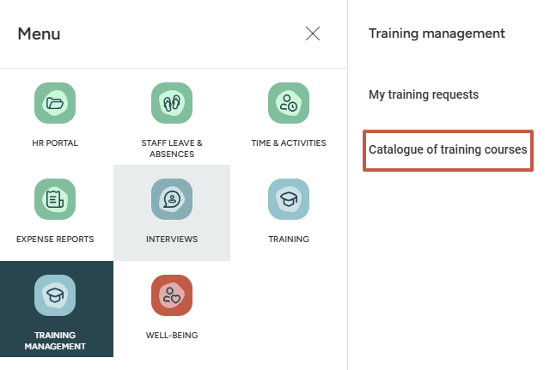
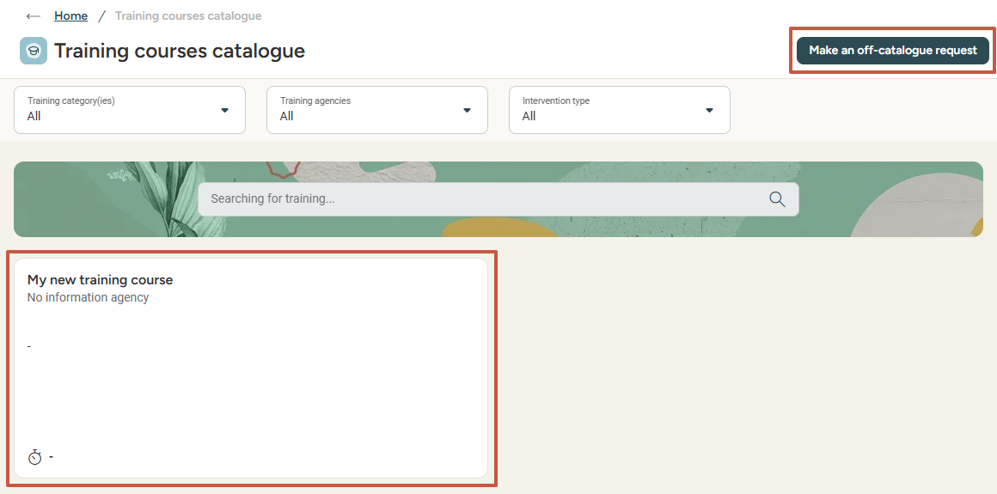
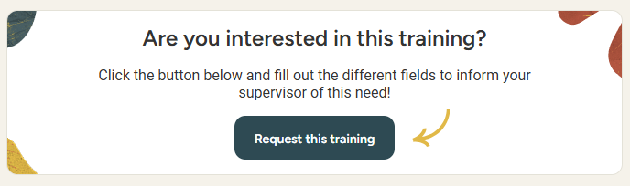

Training requests
Requesting training (from the catalogue)
Select the desired training course and detail your needs to your direct supervisor (N+1) and administrator.
If you cannot find the desired training course in the catalogue, you can click
Make an off-catalogue request.

Slide 7
Navigating the training catalogue

Slide 8
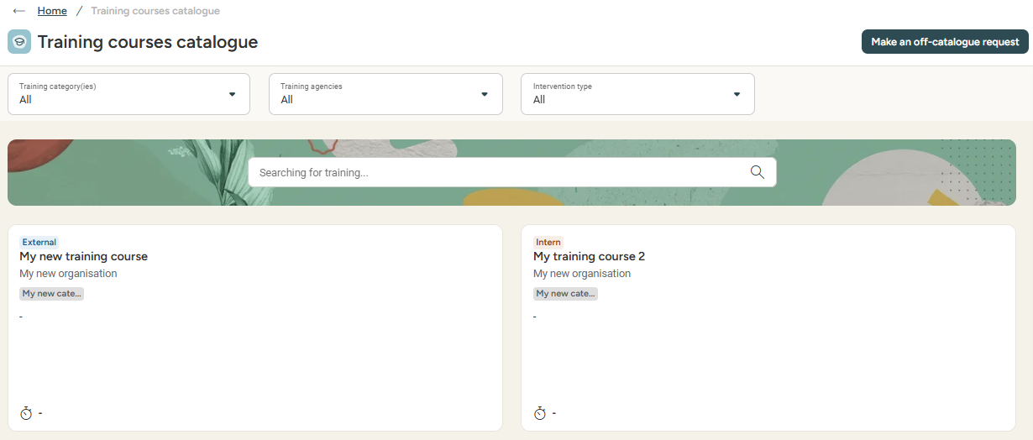
Catalogue of training courses
Navigating the catalogue
Explore the training catalogue thanks to the different filters available to you: Training categories, Training agencies, Intervention Type.
You can also look for training thanks to the search bar.
If you have any question about a training course, feel free to reach out to your administrator.

Slide 9
Manager usage
02

Slide 10
Requesting training for members of your team

Slide 11
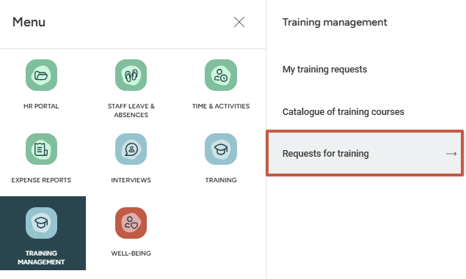
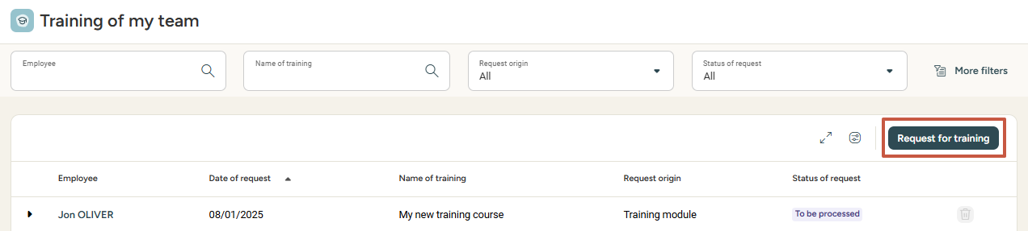
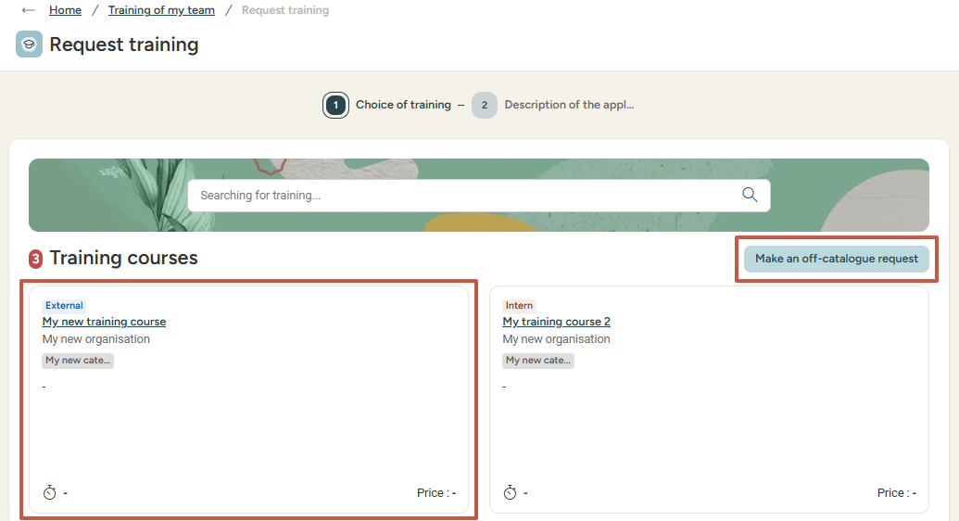
Requesting training for my team
Creating a training request (from training requests)
Via the Requests for training menu, you can find your team's requests
and create a training need for your subordinates.
You can then click on Request for training, allowing you to select an existing training course or make an off-catalogue request!

Slide 12
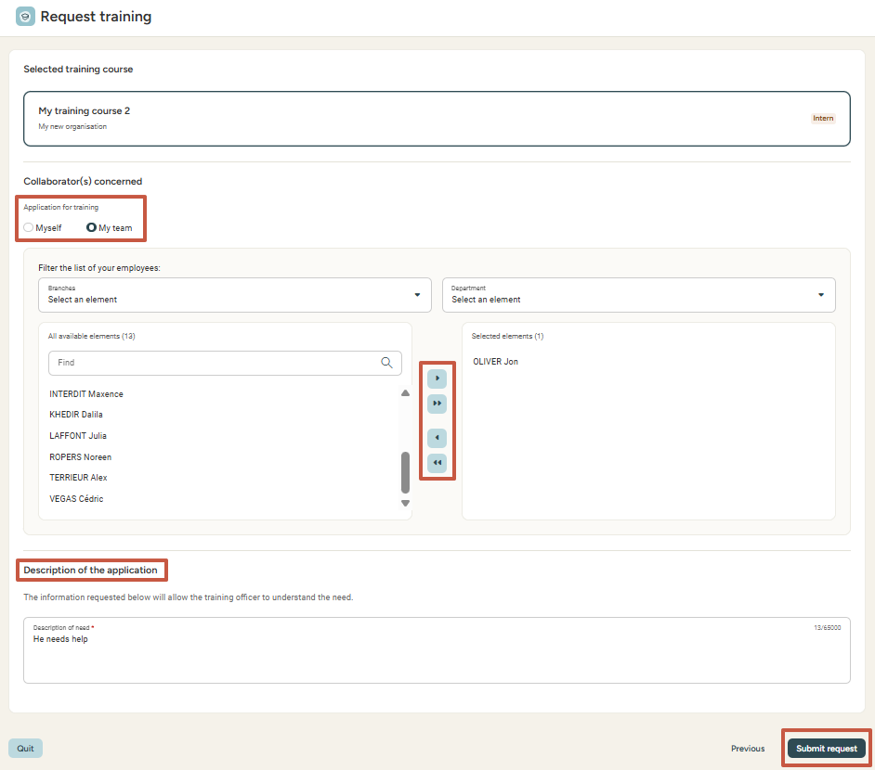
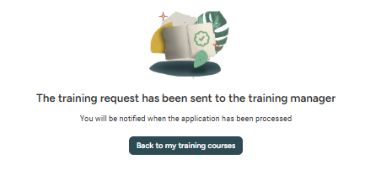
Requesting training for my team
Creating a training request (from training requests)
Once you have chosen a training course, click Next to indicate which employee(s) you wish to add to the request, then add a description of the application and submit the request.
Please note: once the training request has been added as manager, the approval cycle is activated. Requests will be sent for approval
to the person in charge of trainings.

Slide 13
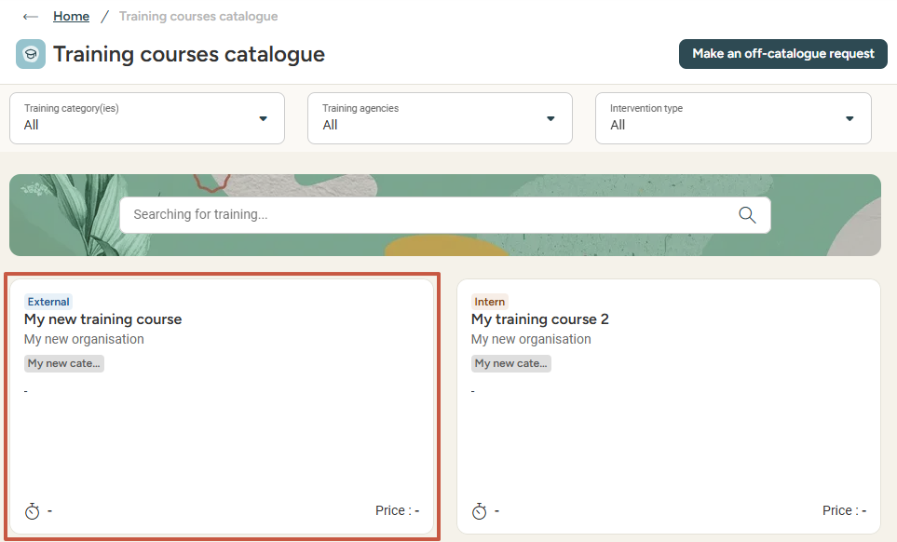
Requesting training for my team
creating a training request (from the catalogue)
You can select an existing training course
from the catalogue, by clicking on it:
This allows you to visualise the training course details and access
the training request form directly by clicking Request this training:
You know how the rest goes! 😊
Indicate which employee(s) is/are concerned by this request and add a description to submit the training request for your team member or for yourself.

Slide 14
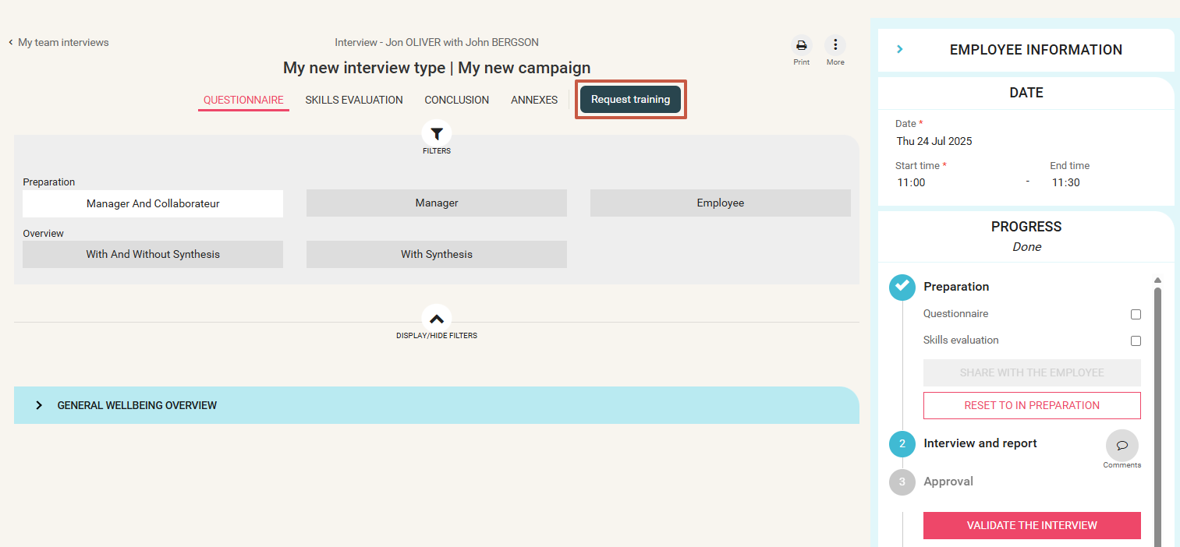

Requesting training for my team
creating a training request (from interviews)
If you are an interview manager, you will have the ability to create
a training request for your team member directly from the interview form.
Once the interview is started, the Request training button will appear:
Clicking the button will
redirect you
to the training course catalogue.

Slide 15
Approving or refusing a training request

Slide 16
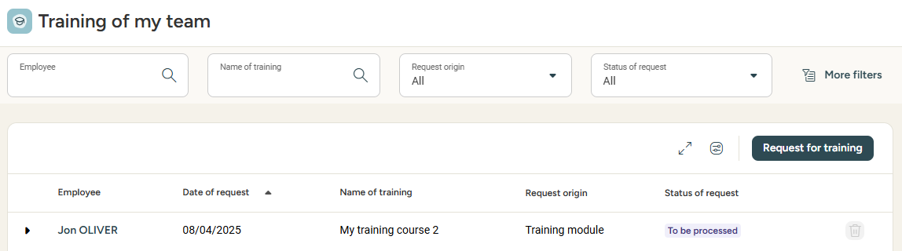
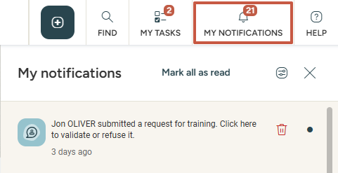
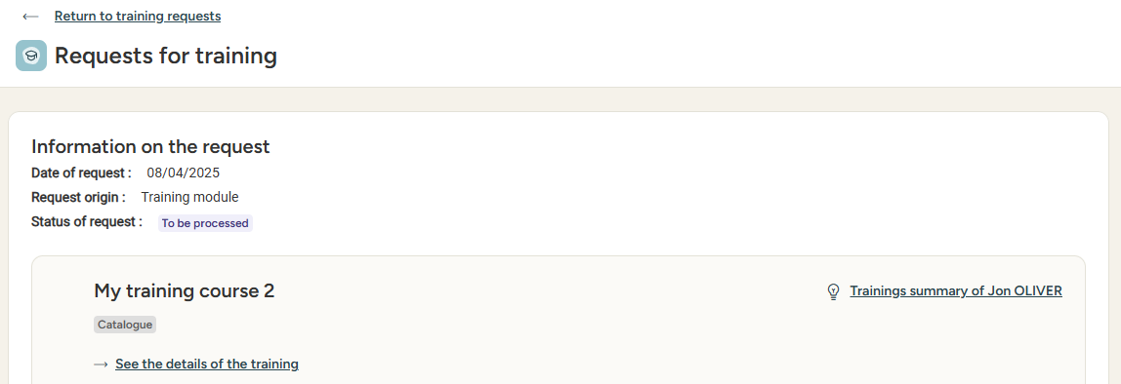
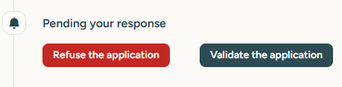
Approving or refusing a training request
All the requests awaiting approval will be tagged to be processed:
You will be notified when a team member creates a training request:
You can also access requests via
Requests for training:
You can click on the notification to see details about the request and approve or refuse it:

Slide 17
Still have questions?
All the answers are within your reach.
support@eurecia.com
Help center

