Slide 1


All you need to know about
Well-being
user training guide
Last updated
August 2025

Slide 2

At the end of this training, users and managers will be able to:
Training objective
Share their mood daily
Keep track of their team's well-being

Slide 3


As an employee
Training program
Sharing your daily mood
As a manager
Sharing your daily mood
Reviewing and comparing results

Slide 4
As an employee
01

Slide 5
Sharing your daily mood

Slide 6
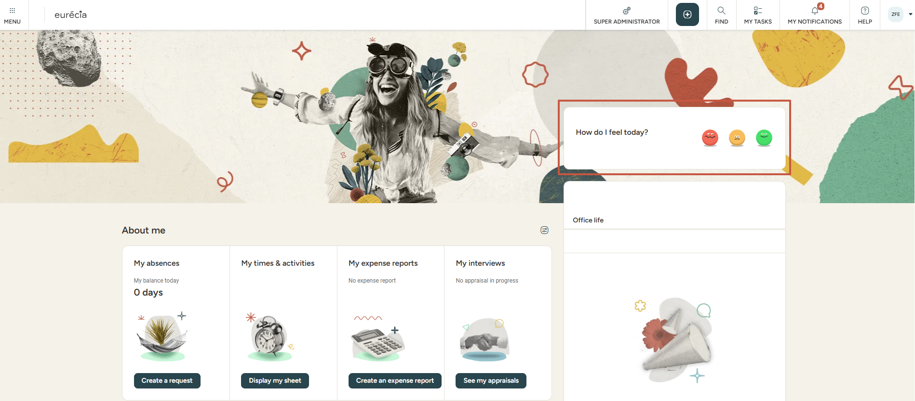


As an employee
Well-being :Sharing your daily mood
From the home page, employees can rate
their daily mood by clicking on the relevant icon
All votes are anonymous.

Slide 7
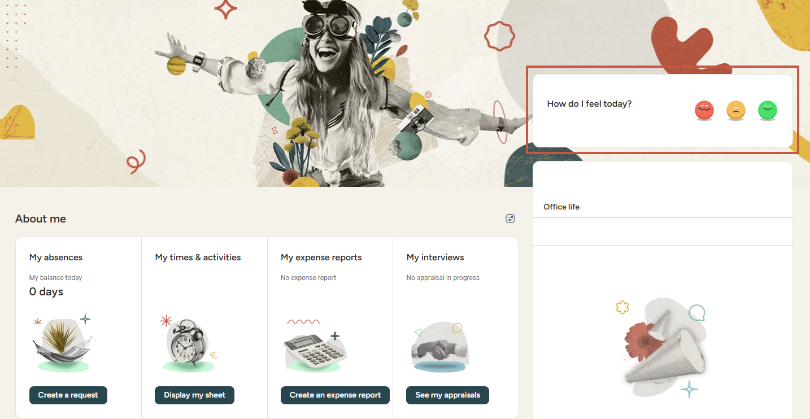
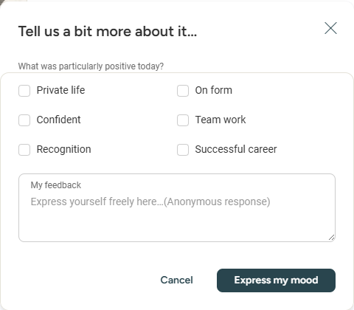
As an employee
Well-being :Sharing your daily mood
After selecting the relevant mood, employees can provide further details and/or feedback.

Slide 8
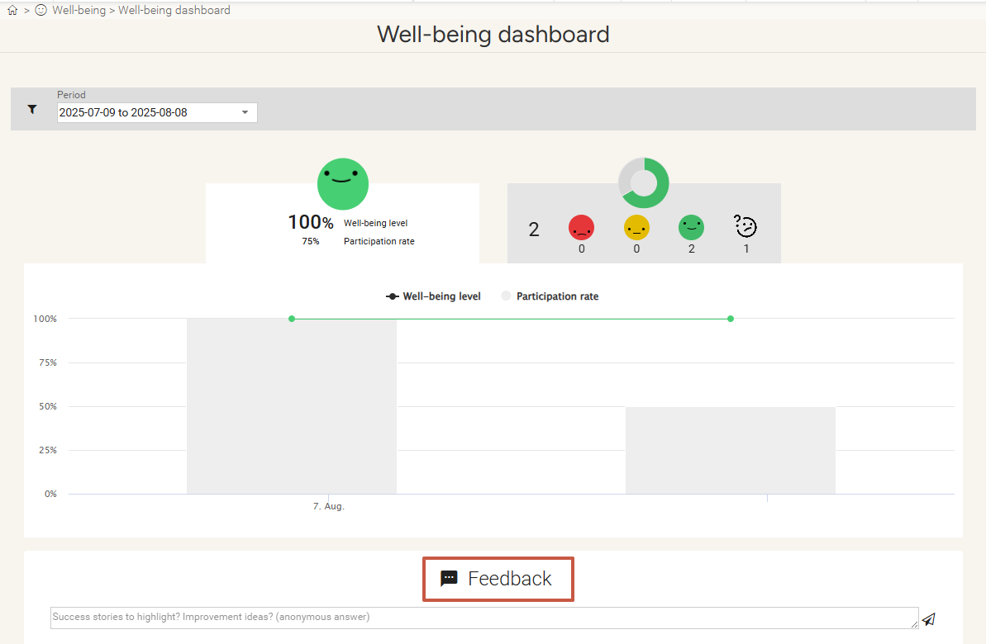
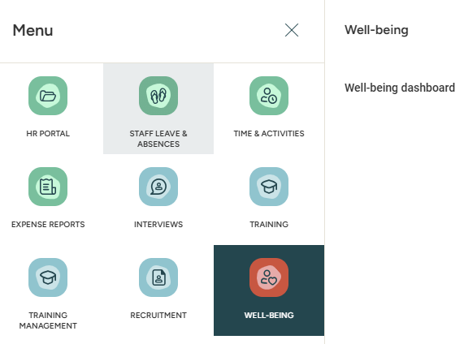
As an employee
Well-being: Sharing your daily mood
Once the daily mood is chosen, employees can review the average well-being results of previous days for their department and structure. They may add a remark, comment, or suggestion.
Voting results can be accessed by clicking on the Well-being dashboard in the Well-being module.
Voting graph as well as anonymous feedback from employees' services will be displayed.

Slide 9
As a manager
02

Slide 10
Sharing your daily mood

Slide 11
As a manager
Well-being: Sharing your daily mood
From the home page, managers may share their daily mood using the smileys.
Each vote is anonymous.

Slide 12
As a manager
Well-being: Sharing your daily mood
Further details and feedbacks can be provided after voting.
Again, details are anonymous.

Slide 13
As a manager
Well-being: Share your daily mood
Once the daily mood is chosen, managers may review average well-being results of previous days for their departments and structures. They may add a remark, comment, or suggestion.
Voting results may be accessed clicking on "Well-being Dashboard" within the "Well-being" module.
Voting graph as well as anonymous feedback from employees' services will be displayed.

Slide 14
Reviewing & comparing results

Slide 15
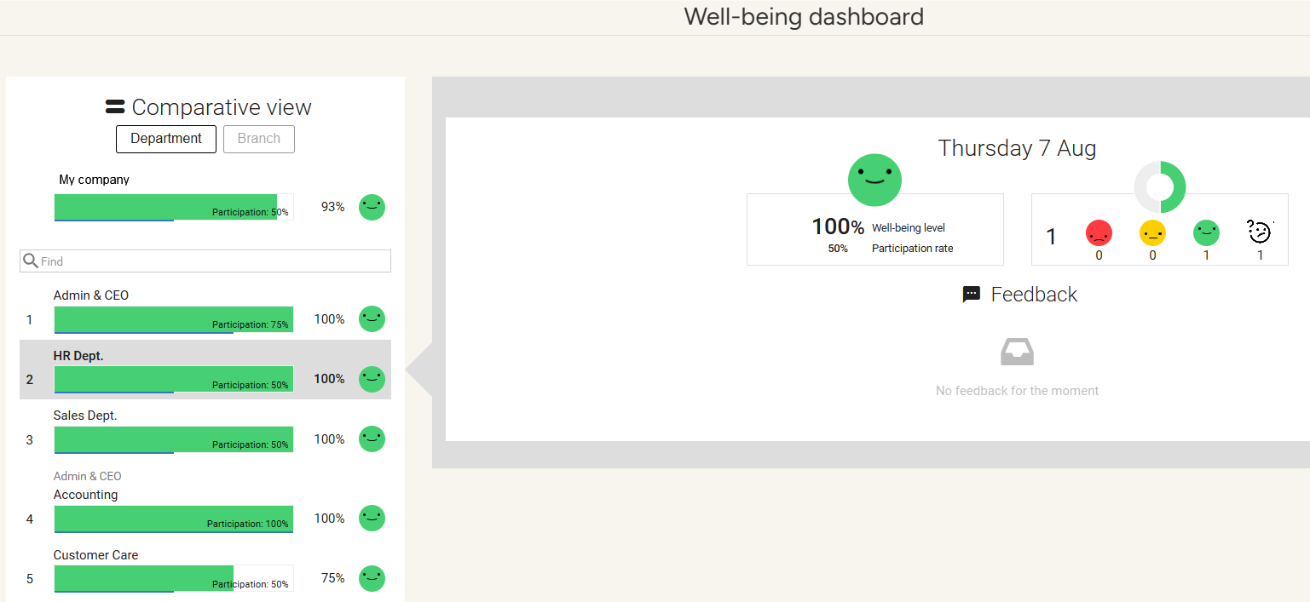
As a manager
Well-being: Sharing your daily mood
Managers can review or compare well-being rates between different departments and structures.

Slide 16
Still have questions ?
All the answers are within your reach.
Contact your administrator
Help center

