Slide 1


All you need to know about
Well-being
Administrator training guide
Last updated
August 2025

Slide 2

At the end of the training, administrators will be able to:
Training objective
Set up and review the well-being rate of their employees

Slide 3


Module features
Training program
Well-being dashboard
Admin area
Reviewing well-being rates
user area
Expressing daily mood

Slide 4
Module features
01

Slide 5
Well-Being dashboard

Slide 6
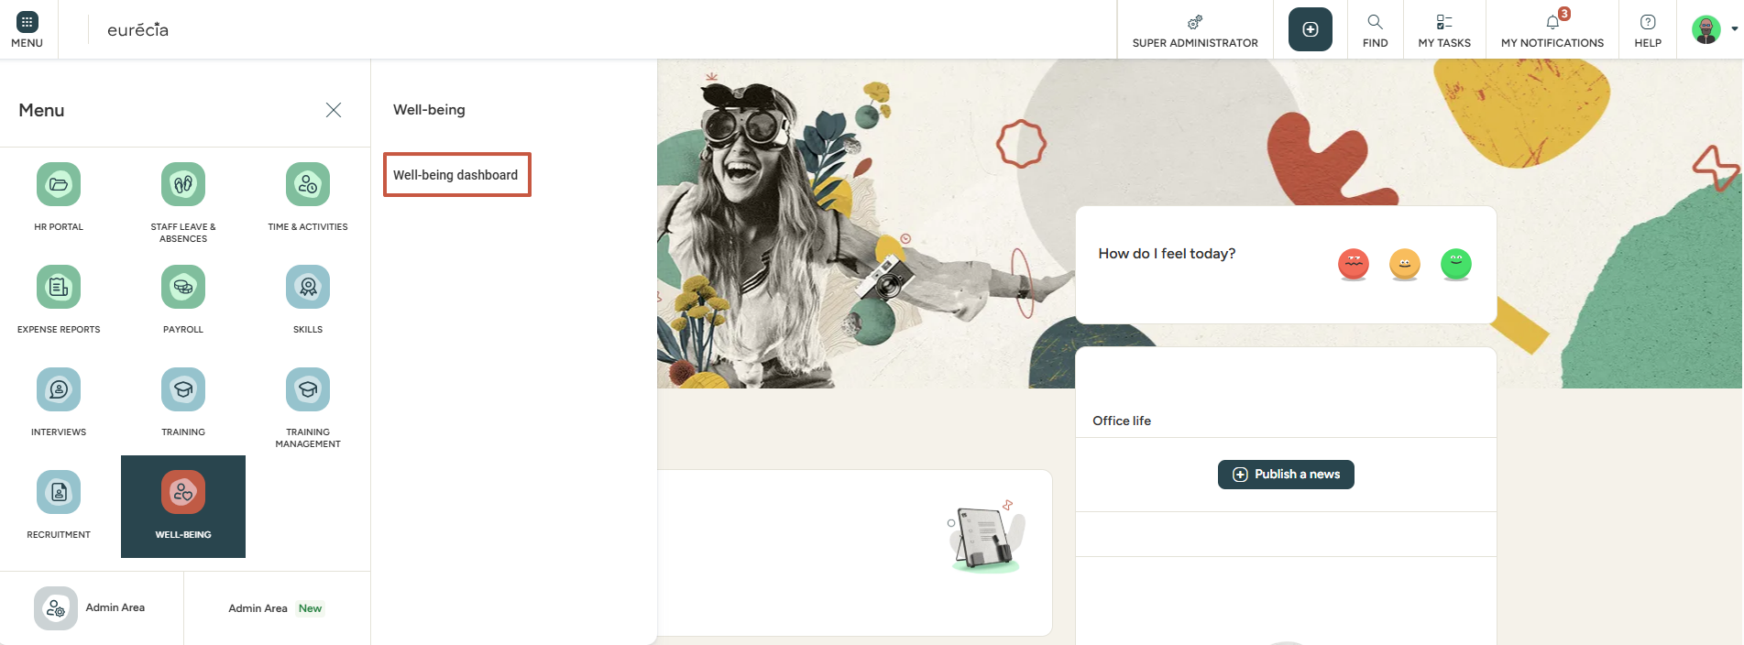

Well-being dashboard
Access: Well-being > Well-being dashboard

Slide 7

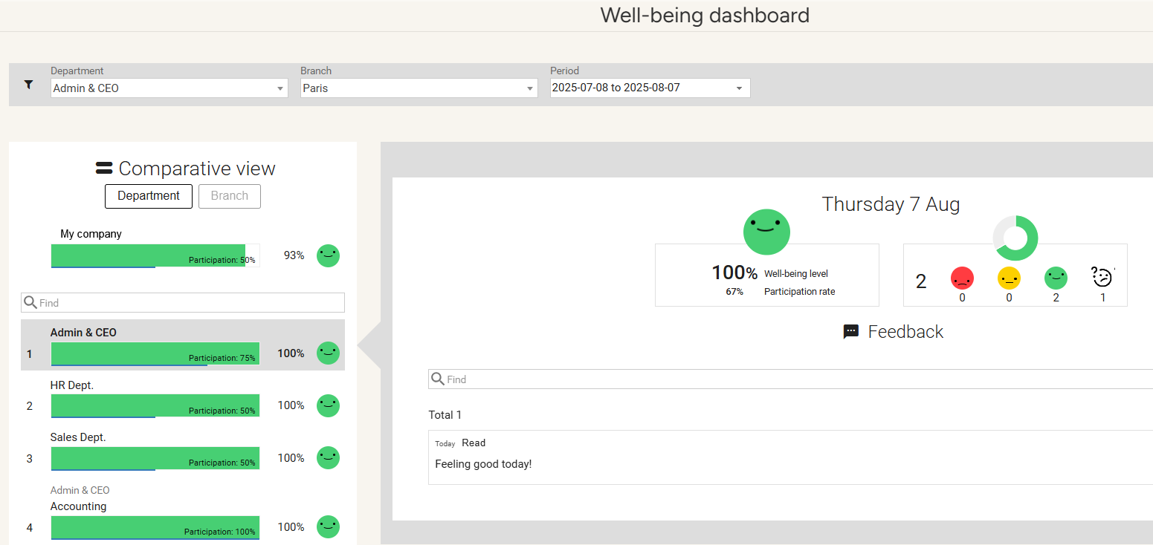
Well-being dashboard
Access: Well-being > Well-being dashboard
A chart displays the employees' votes and feedback by structure and department. All answers are kept anonymous.

Slide 8
Admin area
02

Slide 9
Reviewing well-being rates

Slide 10
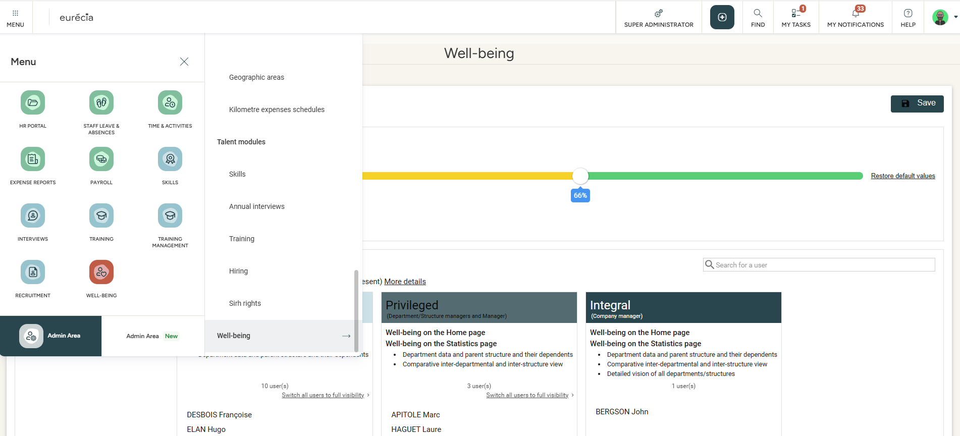
Setting well-being rates
Access: Admin Area > Well-being

Slide 11
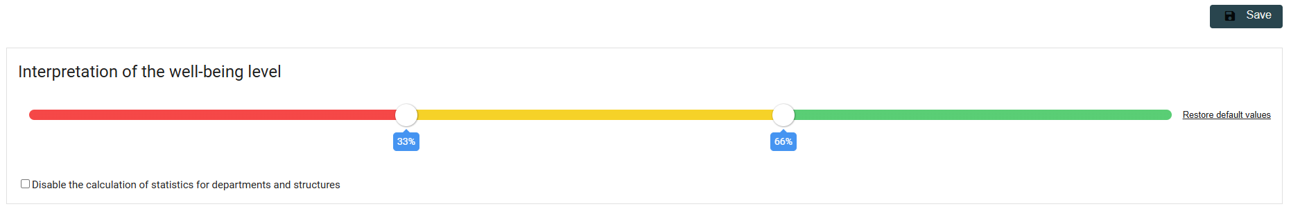
Setting well-being rates
Access: Admin Area > Well-being
Interpretation of the homepage emojis can be adapted by modifying sliders accordingly.

Slide 12
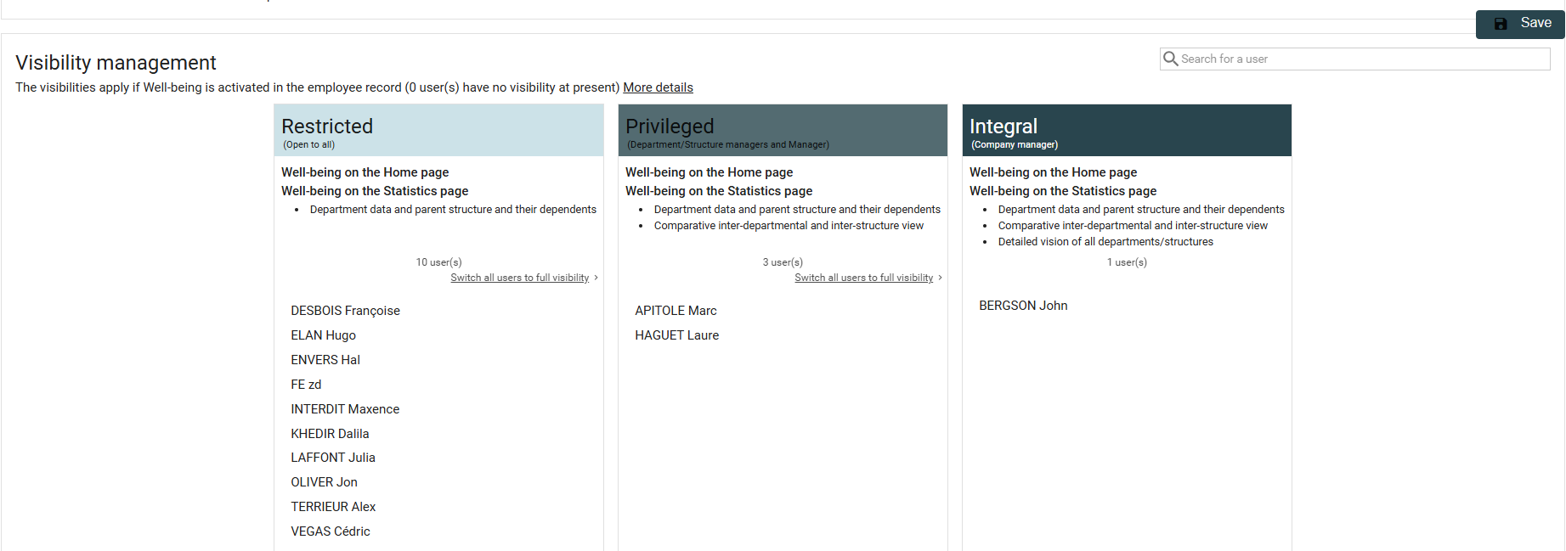
Setting well-being rates
Access: Admin Area > Well-being
Employees' visibility over the well-being can be managed through drag and drop actions.

Slide 13
Admin area
03

Slide 14
Expressing daily mood

Slide 15
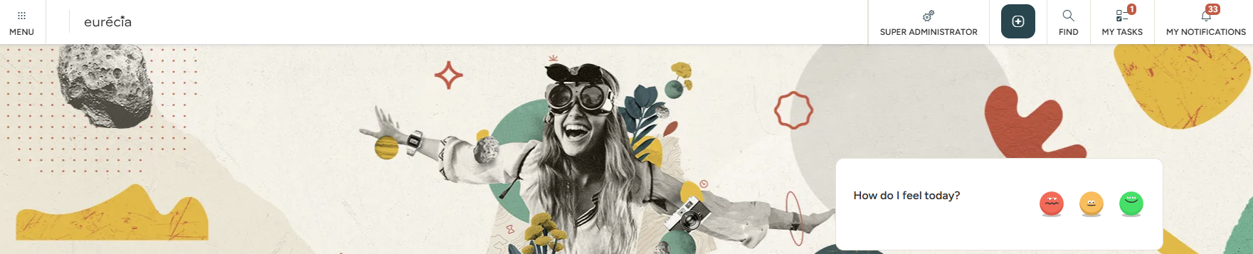
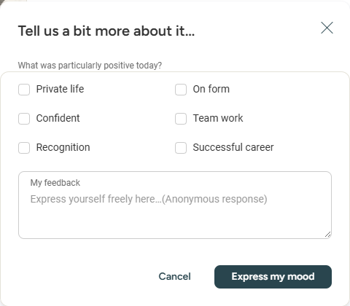
Well-being
Access: Home page
Every day, employees can express their daily mood using the Well-being module on the home page by selecting the corresponding emoji:
Green: Happy​
Yellow: Average​
Red: Unhappy
Once the daily mood icon is selected, employees can provide details and add feedback via the free text box or by checking one or more of the proposed options
All the feedback provided is anonymous.

Slide 16
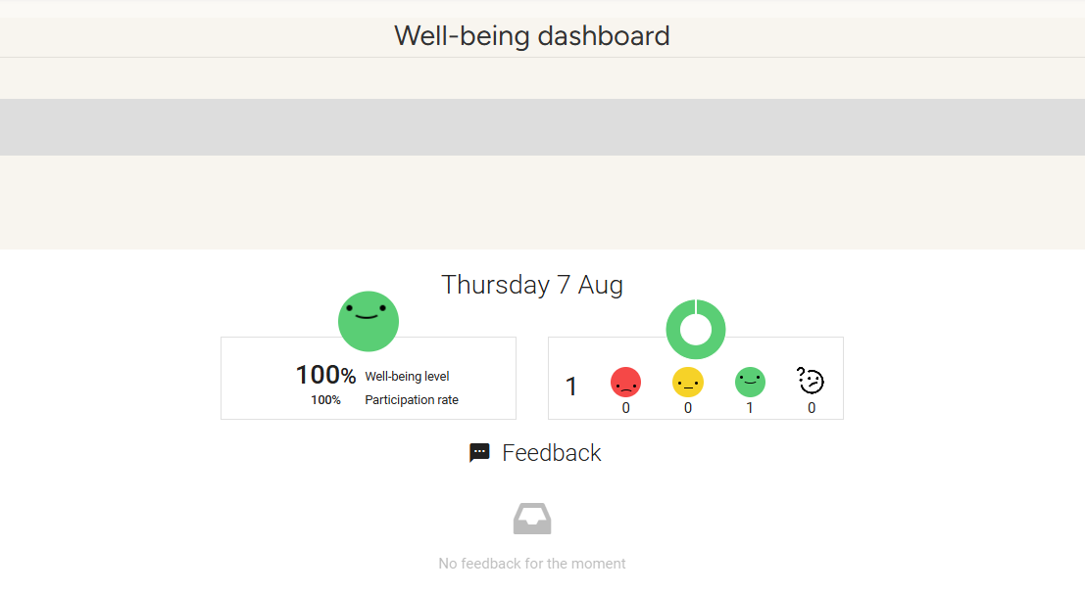
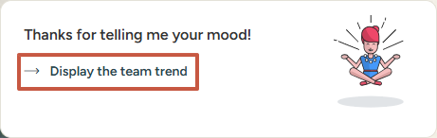
Well-being
Access: Home page
Once the daily mood is chosen, the user sees the average well-being of previous days for their department, structure, and company. They can also add a remark, comment or suggestion.

Slide 17
Still have questions ?
All the answers are within your reach.
support@eurecia.com
Help center

