Slide 1
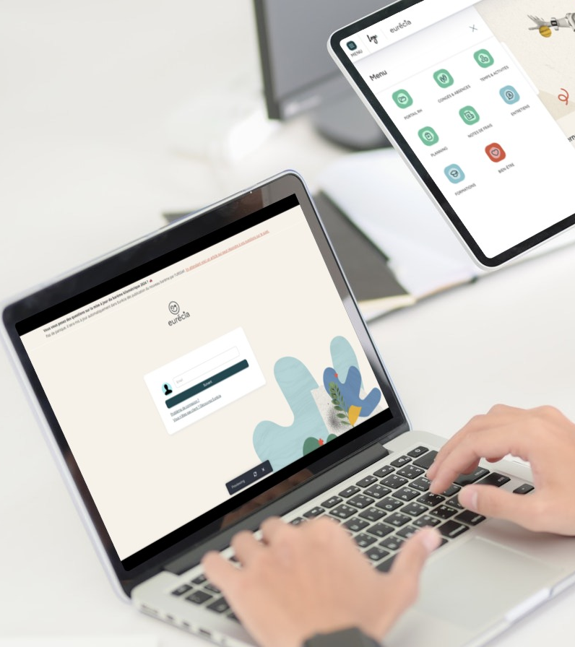

All you need to know about
Expense reports
Training support administrators
Last updated
April 2026

Slide 2

By the end of this training, administrators will be able to:
Training objectives
Create an expense report for an employee
Validate and review expense reports
Process reimbursements and generate related exports
Define employee reimbursement profiles
Configure the company’s expense types
Manage display groupings and limits
Administer report criteria

Slide 3

Your module features:
Training program
Creating and validating expense reports
Managing expense reports
Generating accounting exports
Administrator area
Creating and editing expense types, reimbursement profiles, and groupings
Managing report criteria

Slide 4
Your module features

Slide 5
Creating and validating expense reports

Slide 6
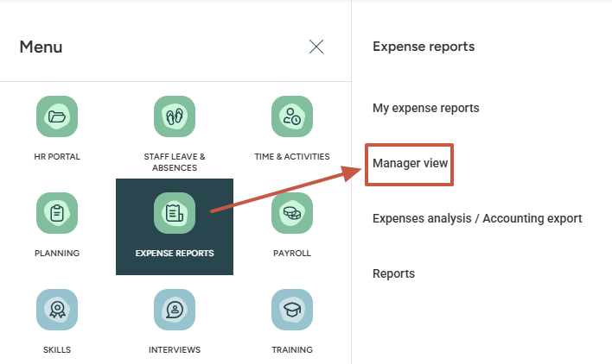
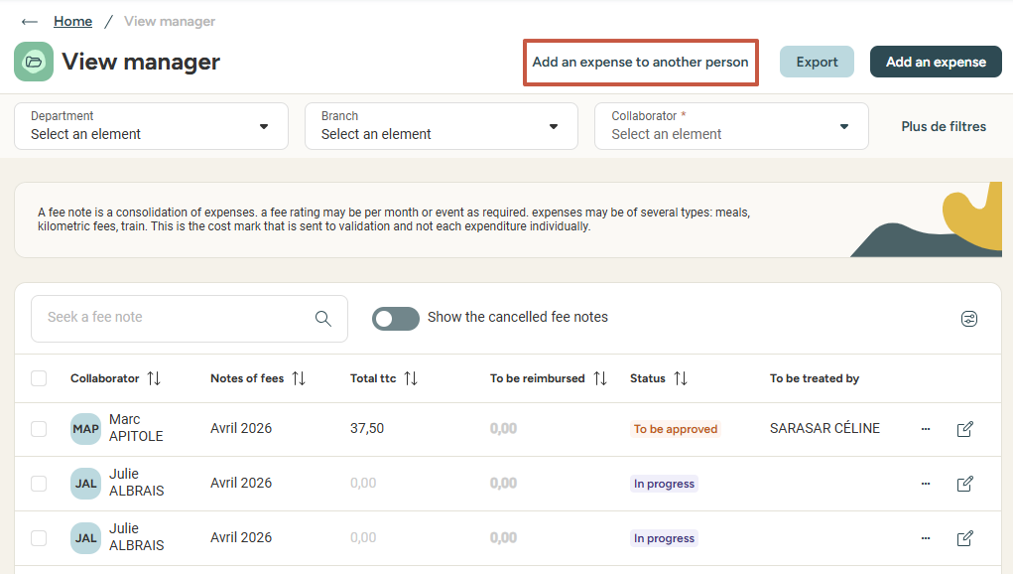
Creating an expense report for a coworker
Access: Expense Reports > Manager View > Add an expense to another person

Slide 7
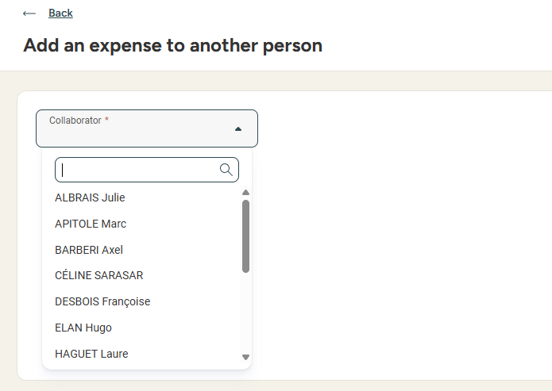
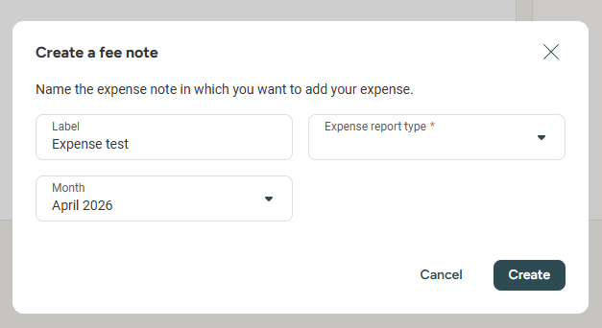
Creating an expense report for a coworker
Select the employee’s name from the dropdown list
Create the expense report: Title, Expense report type and Period

Slide 8
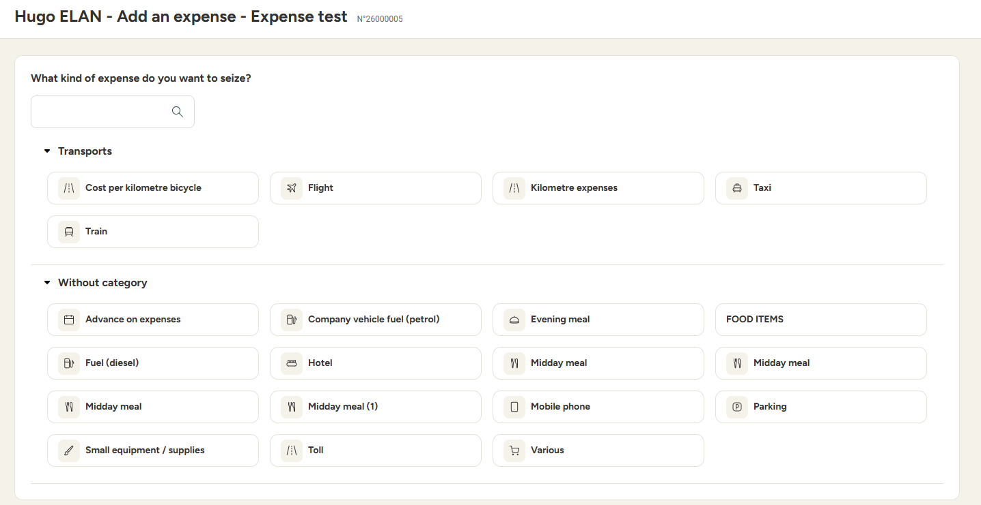
Creating an expense report for a coworker
Select the expense you want to add by clicking the pictogram, then enter the details:

Slide 9
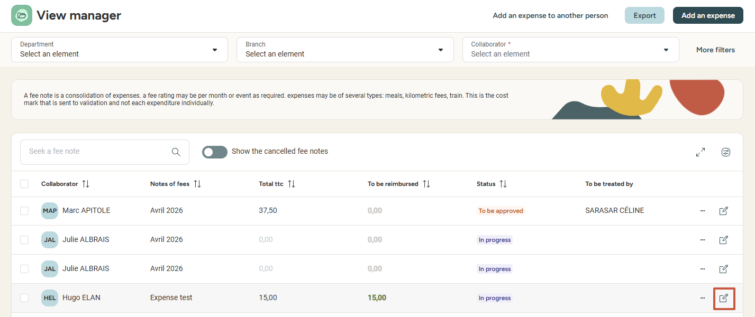
Editing an expense report for a coworker
Select the expense report in the manager view
Click the pencil icon at the end of the line to edit

Slide 10
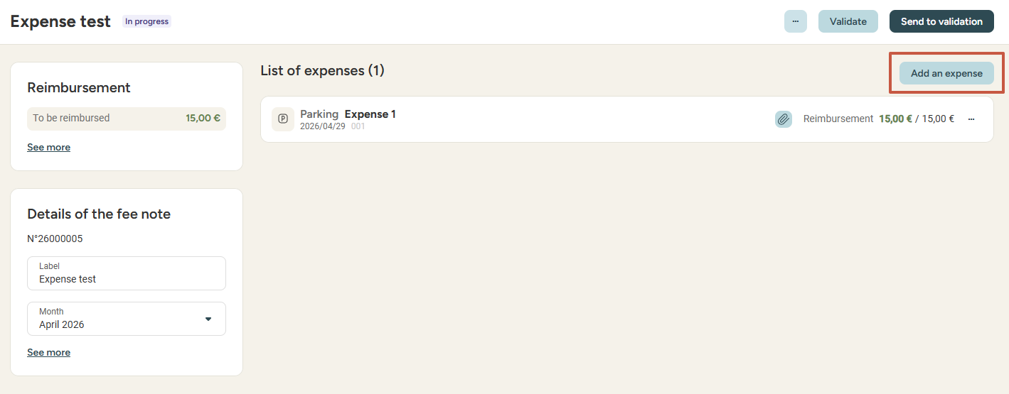
Adding a new expense for a coworker
In the expense details, select Add an expense

Slide 11
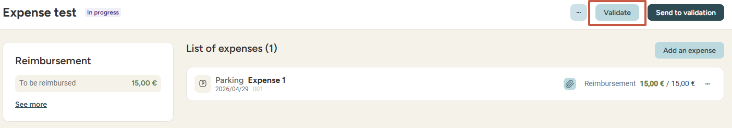
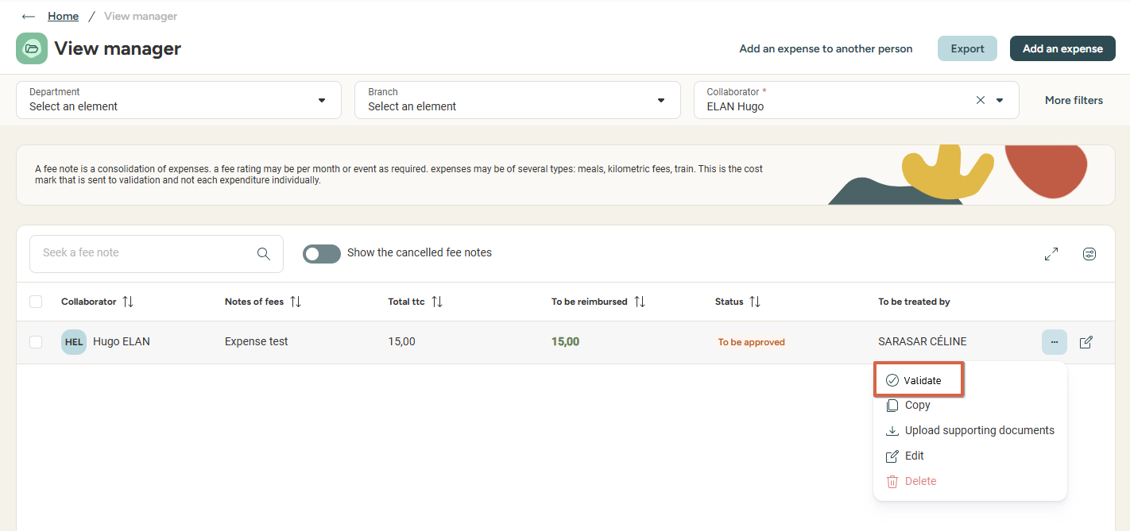
Approving an expense report
Within the detailed view of the report:
Or from the list of reports: click the three dots icon → Validate (once the report is sent to validation)

Slide 12
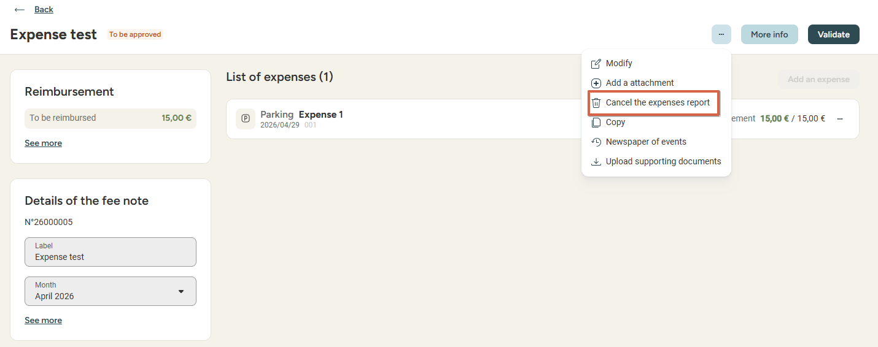
Cancelling an expense report
In the report details, click the three dots → Cancel the expense report

Slide 13
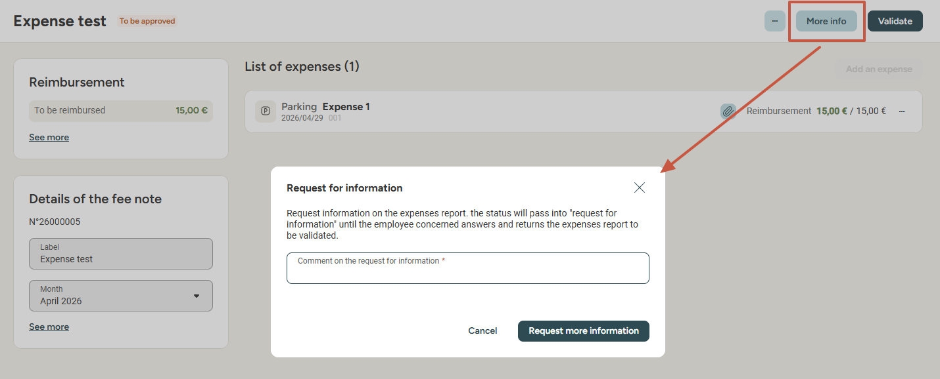
Cancelling an expense report
Before final validation, you can request additional information or adjustments from the employee.
In the report details, click More info and enter your message.
The report is returned to the employee, who can update and re-submit the report.

Slide 14
Managing expense reports

Slide 15
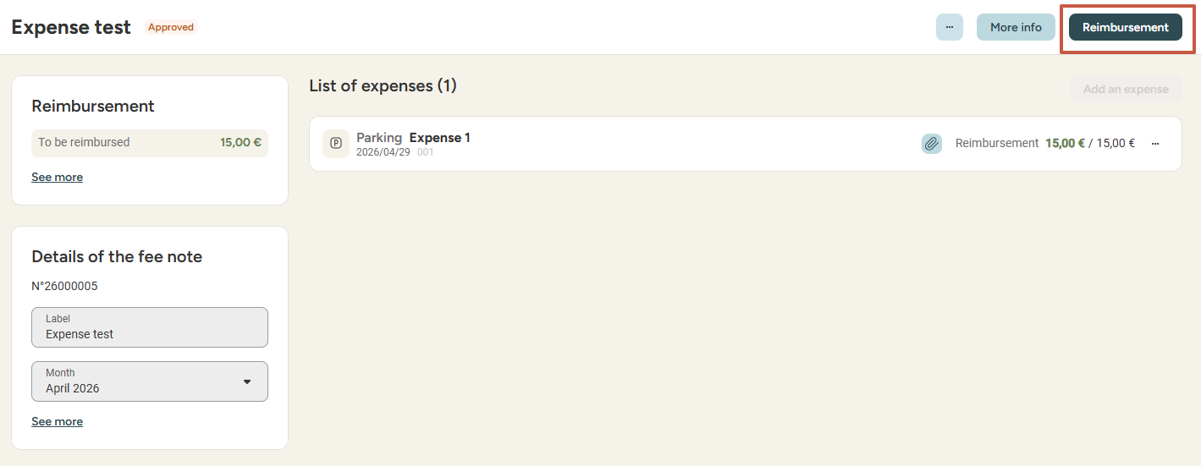
Reviewing and reimbursing expense reports
Setting a report to 'To be reimbursed' confirms everything is correct and starts the reimbursement process
In each report, click on Reimbursement

Slide 16
Generating accounting exports

Slide 17
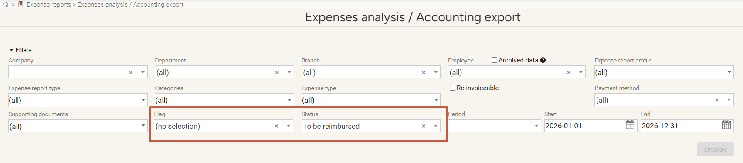
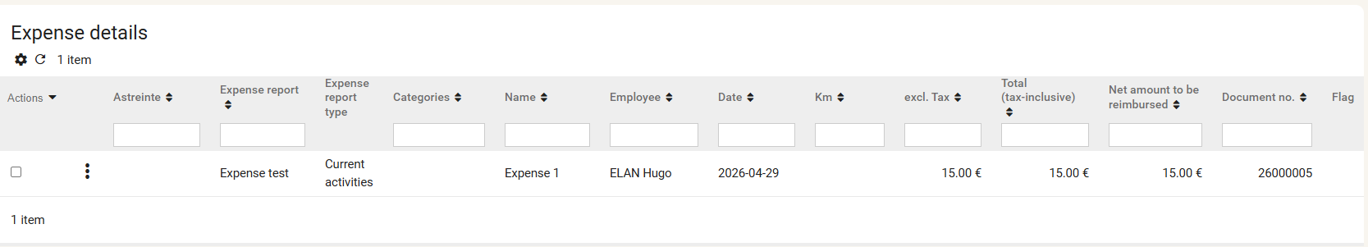
Generating accounting exports
Expense report file
Expense Reports – Expense Analysis / Accounting Export

Slide 18


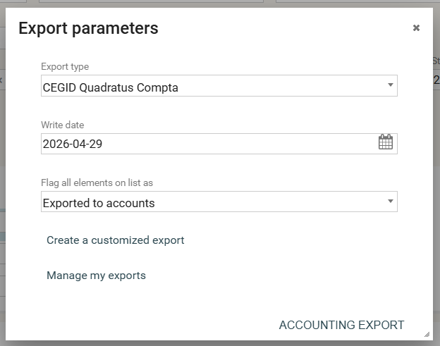
Generating accounting exports
Expense report file
On the right side of the page, you can export:
  In Excel format:
  In the format expected by your accounting software:

Slide 19
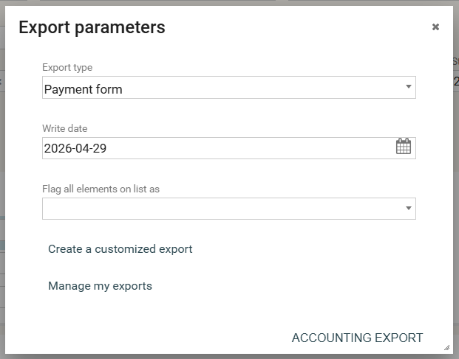
Generating accounting exports
SEPA file and bank transfer form
SEPA transfer files are generated in your accounting software
You can also generate a transfer summary report:

Slide 20
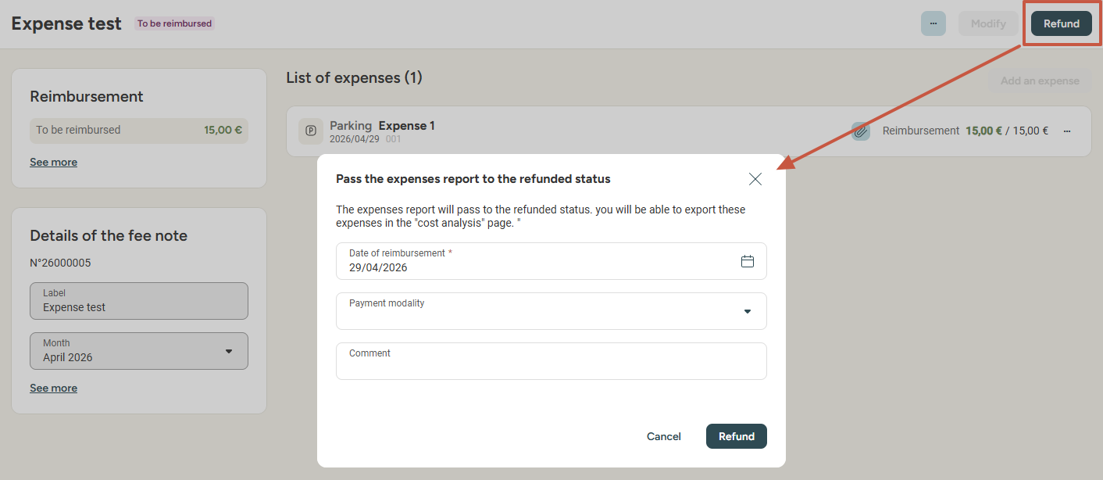
Closing the reimbursement process
Mark reports as reimbursed
Access: expense reports -> Manager view
Filter reports with the To be reimbursed status. In each report, click Refund and enter a reimbursement date (defaults to today's date) and a payment method. You can add a comment if needed:

Slide 21
Admin area

Slide 22
Creating and managing expense types

Slide 23
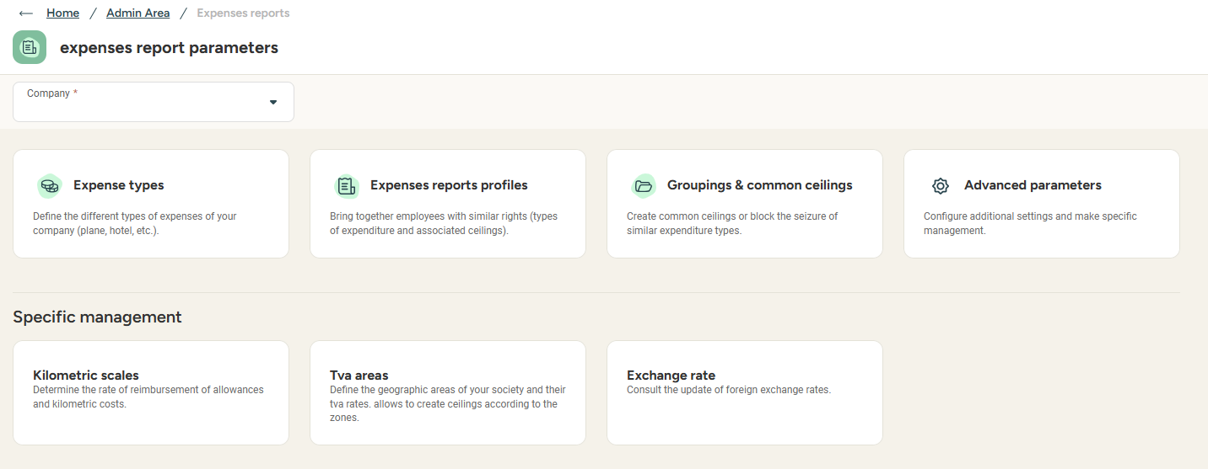
Accessing expense report configuration
Access: Admin Area (new) > Expense reports

Slide 24
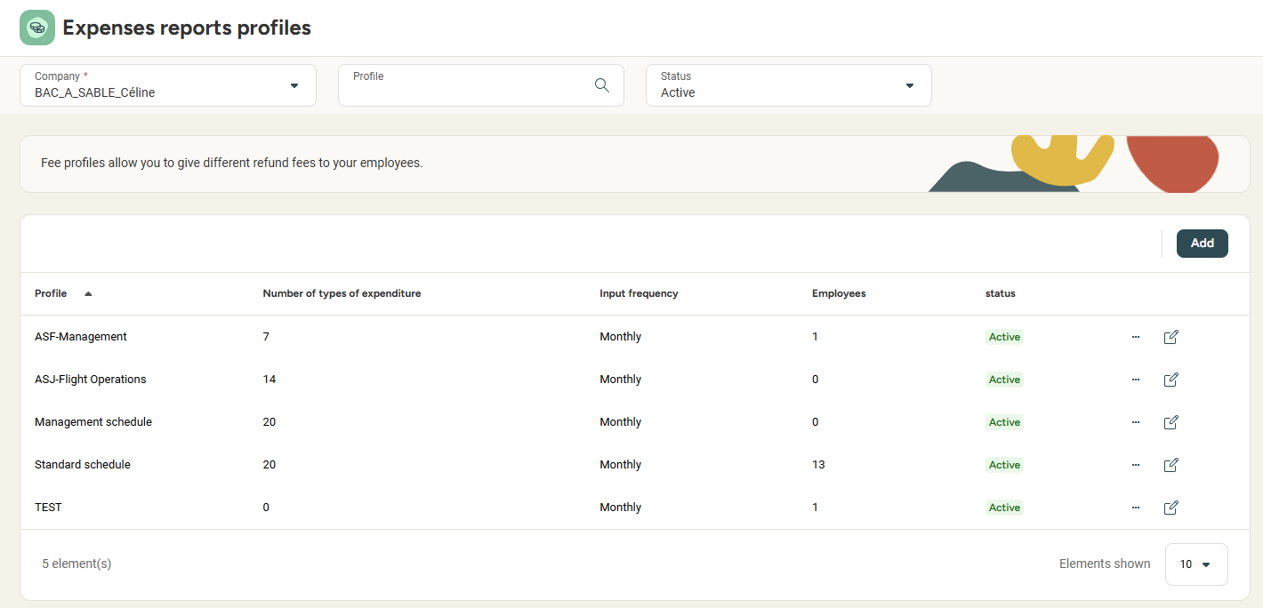
Configuring reimbursement profiles and expense types
Creating expense report profiles
Access: Admin Area (new) > Expense Reports > Profiles
A profile includes all the expenses an employee can input. If, for example, some users are not allowed to input dinner expenses, it will be best to create separate profiles for different categories of users.
Profiles can be duplicated to save some time!

Slide 25
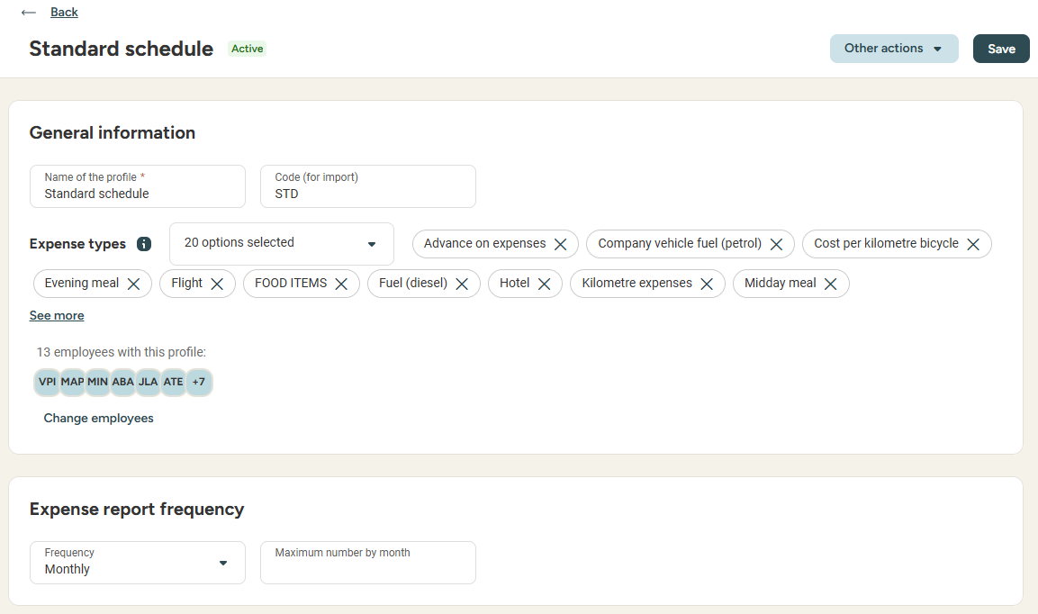
Managing expense report profiles and expense types
Creating expense report profiles
From the expense profile, you can:
Define an input frequency for expense reports (weekly or monthly)
Set the maximum number of reports per period
Define input deadlines
Adjust displayed and required fields in expenses
Assign a list of expense types to the profile
Assign profile to employees

Slide 26
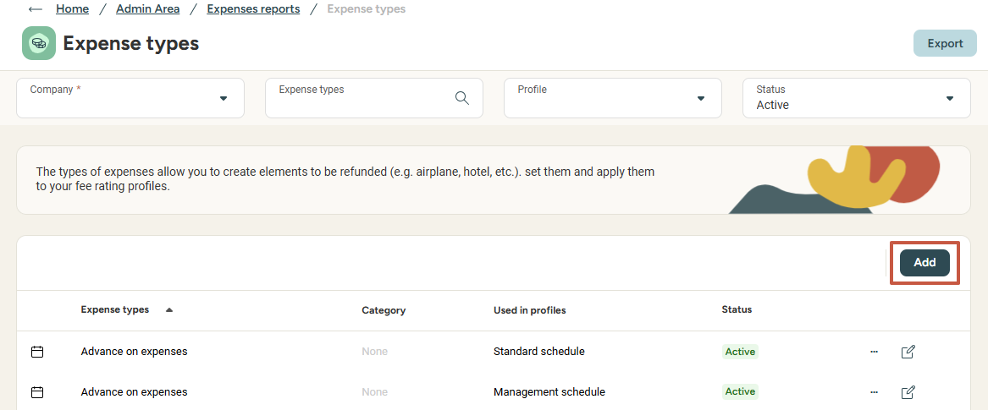
Managing expense report profiles and expense types
Creating expense types
Access: Admin area (new) > Expense reports > Expense types
Expense types can be duplicated (e.g., if the expenditure accounts are different depending on the expense profile)

Slide 27
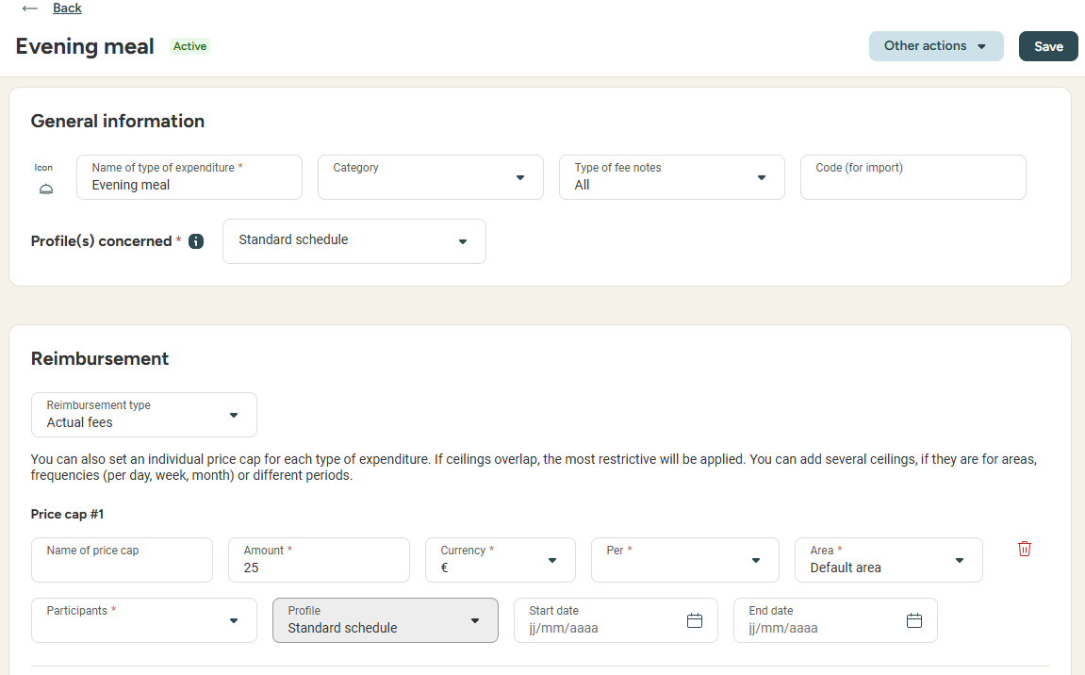
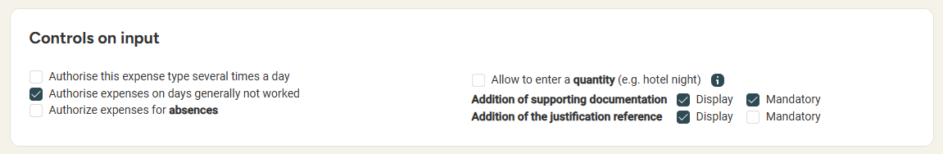
Managing expense report profiles and expense types
Creating expense types
Expense types can be linked to multiple expense profiles
Key configuration points:
Accounting information: expenditure account, VAT account, VAT rate, recoverable VAT %
Reimbursement type: flat rate, actual expenses, etc. + spending limits (Note: a single expense type can be linked to several profiles even if the spending limit or each profile is different)
Guest management and meal voucher deductions
Possibility of inputing an amount of nights spent for hotel expenses

Slide 28
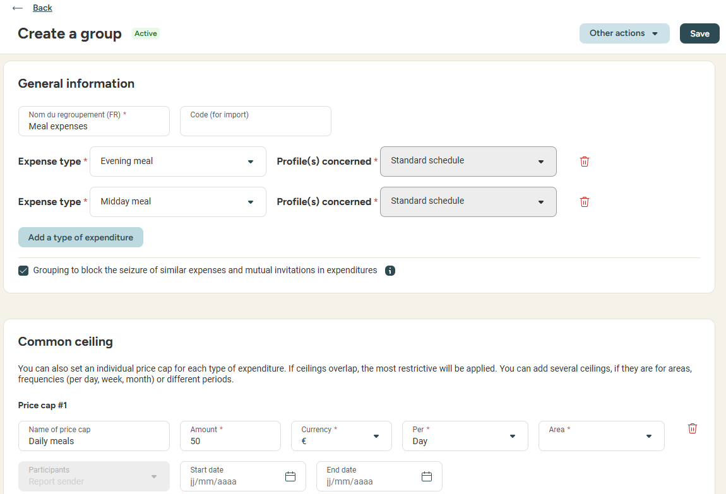
Managing groupings and common ceilings
Access: Admin area (new) > Expense reports > Groupings & common ceilings
Please note:
Groupings allow management of related expenses (e.g., shared invitations)
A common ceiling applies to a group of expense types (for exemple, a daily meal limit including lunch and dinner expenses). If you wish to configure a different spending limit for each expense type, please refer to 'expense type' management.

Slide 29
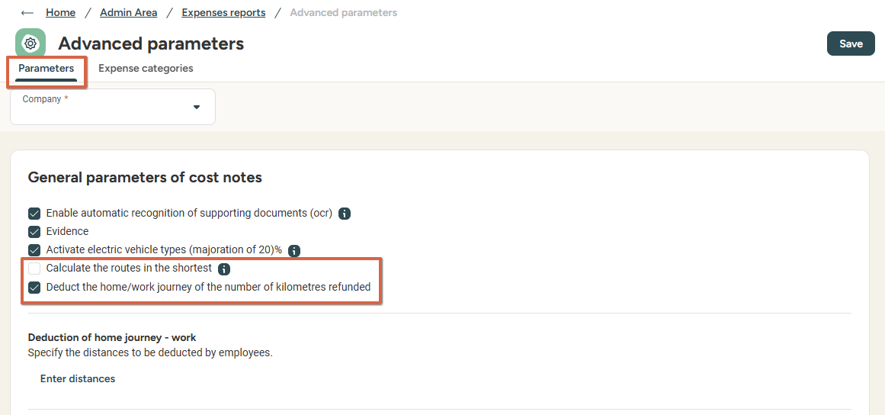
Advanced parameters
Access: Admin area (new) > Expense reports > Advanced parameters
Main managing points in this menu:
Enabling OCR (automatic recognition) and compliant supporting documents (Evidence)
Enabling +20% allowance for electric vehicles (if the URSSAF scale is used)
Enabling shortest route calculation for mileage reimbursement
Enabling the deduction of home/work journey for mileage reimbursement. When the option is activated, you can input work/home distance for each employee.
Creating and managing specific expense categories

Slide 30
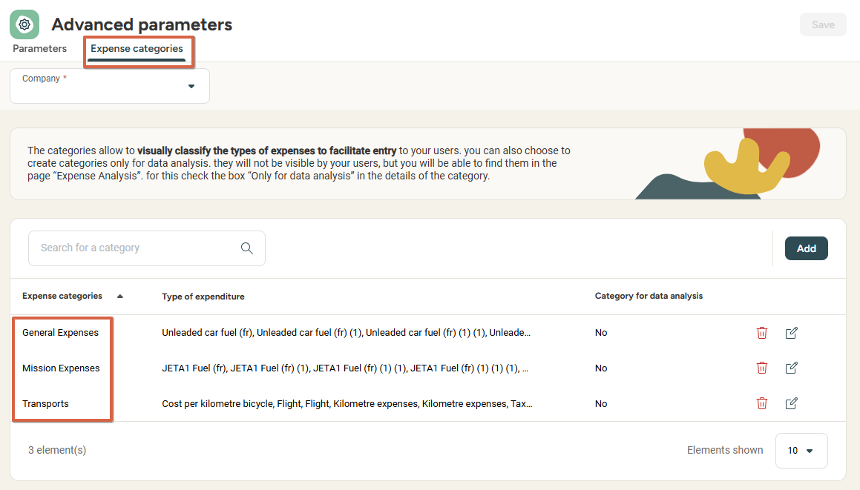
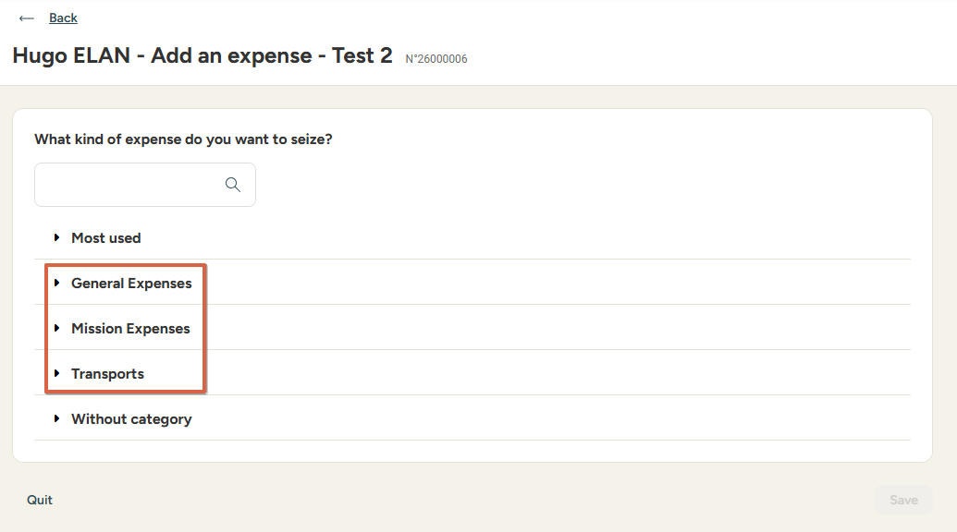
Advanced parameters
Access: Admin area (new) > Expense reports > Advanced parameters > Expense categories
Expense categories allow grouping for:
Analytic purposes (in the Expense analysis / accounting export menu)
Visual organisation purposes to group up expense types during input.

Slide 31
Managing report criteria

Slide 32
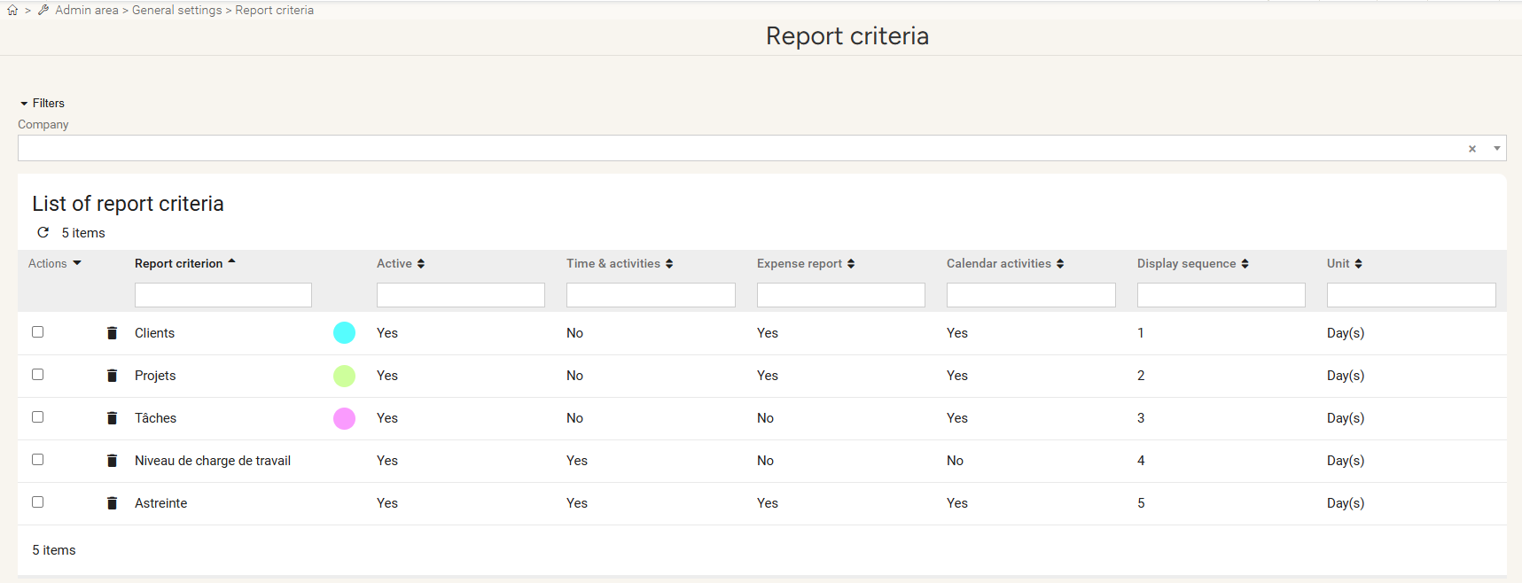
Managing Report Criteria
Creating or duplicating report criteria
Access: Admin Area > General Settings > Report Criteria > Open
Report Criteria is Used to allocate time or expenses to activities for reporting or validation purposes.

Slide 33
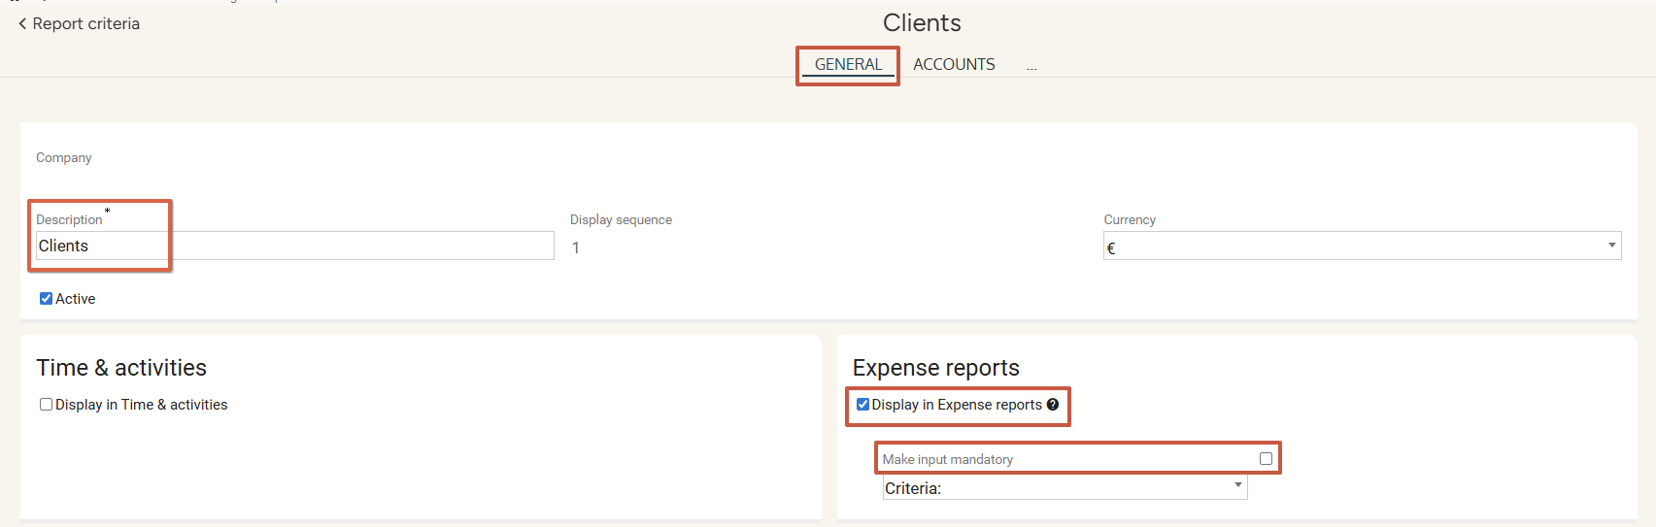
Managing Report Criteria
Creating or duplicating report criteria
Access: Admin Area > General Settings > Report Criteria > Open
In the GENERAL tab:
Enter a name for the report criterion in Description
Check Display in Expense reports to allow input in expense reports
Check Make input mandatory in expense reports if needed

Slide 34
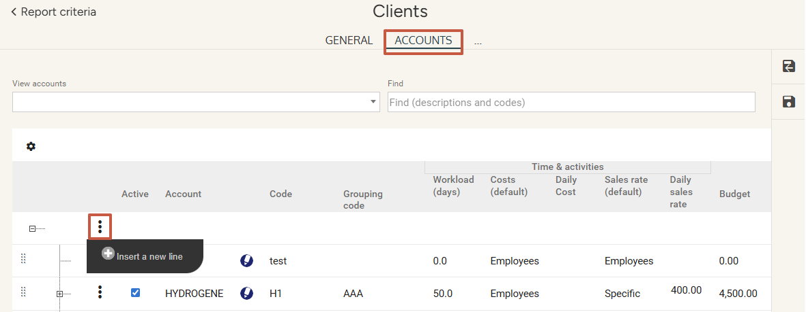
Managing Report Criteria
Creating or duplicating report Accounts
Access: Admin Area > General Settings > Report Criteria > Open > Accounts tab
In the ACCOUNTS tab:
Click the 3 dots then Insert new line to create a new account.
In the newly created line, enter a name and other relevant info for the new account.
Click Save.

Slide 35
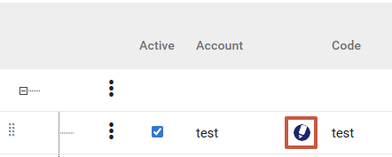
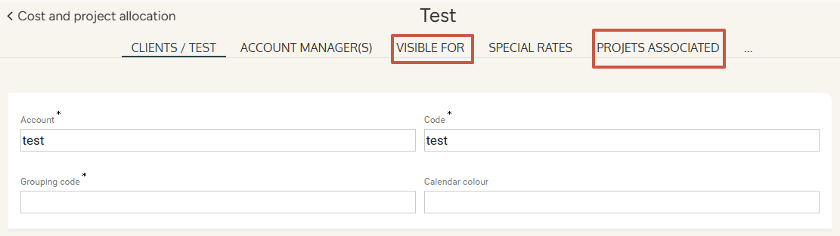
Managing Report Criteria
Managing report accounts
In the ACCOUNTS tab:
  Click the pencil pictogram to edit the account:
The Visible for tab allows you to limit which users the account should be displayed to.
The last tab is named after the following criterion and allows you to link criteria together.

Slide 36
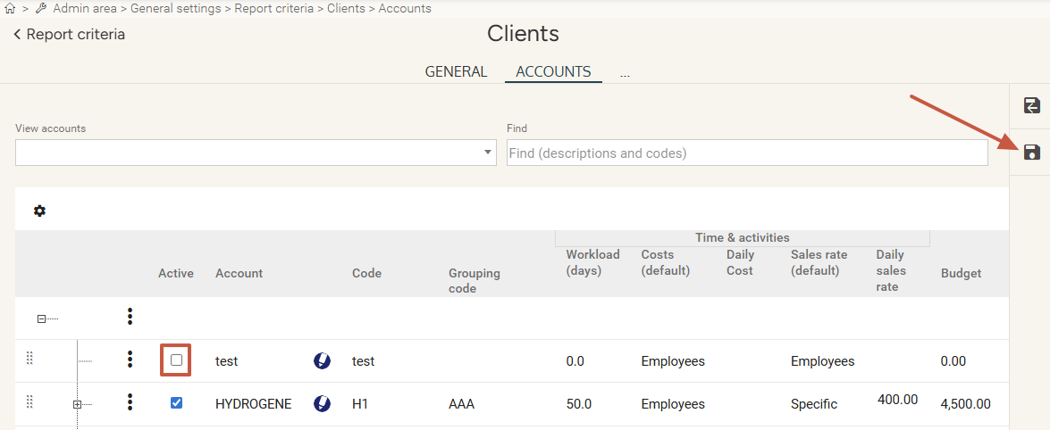
Managing Report Criteria
Deactivating a report account
Access: Admin Area > General Settings > Report Criteria > Open > Accounts
In the ACCOUNTS tab:
Uncheck the Active box to deactivate the account.
Click Save.

Slide 37
Still have questions?
All the answers are within your reach.
support@eurecia.com
Help center

