Slide 1
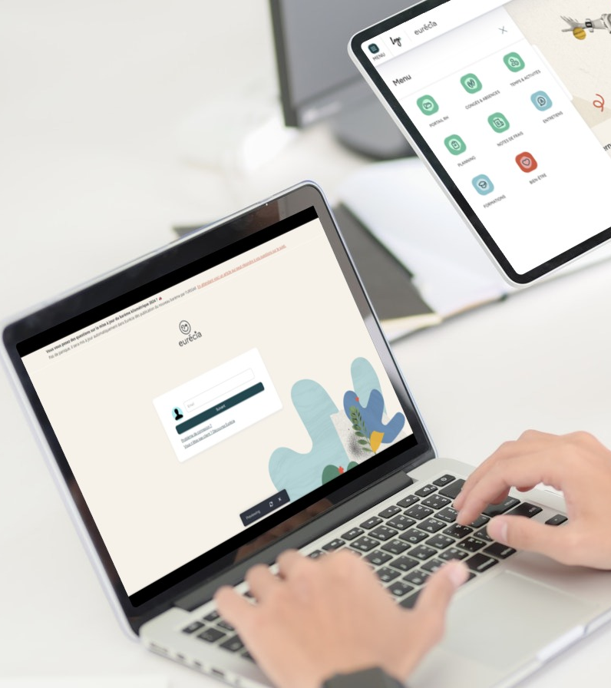

All you need to know about
Expense reports
user training guide
Last updated
April 2026

Slide 2

As an employee
Training program
Expense reports' approval cycle
Adding an expense to an expense report
Submitting a report for approval
Following my expense report's status
As a manager
Approving expense reports

Slide 3
As an employee
01

Slide 4
Expense reports' approval cycle

Slide 5



Expense reports' approval cycle
New​
expense​
report​
Submission for approval
Employee
More info
required
Approval
Refusal
Manager
"To be reimbursed"
status
Reimbursement
Accountant

Slide 6
Creating an expense report

Slide 7
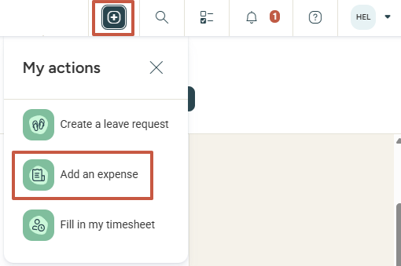
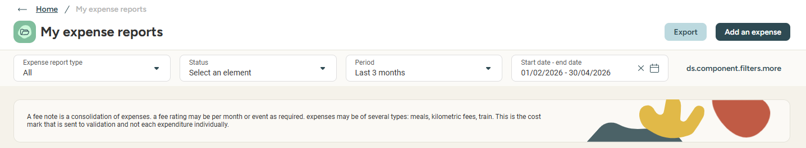
As an employee
Creating a new expense report
To create an expense report, you have several options:
  1 - In the top banner, click on the “My Actions” icon then Add an expense:
  2 - On the home page, create an expense report directly from the "About me" section
  3 - From the Menu (top left), go to "Expense reports" and choose "My expense reports":

Slide 8
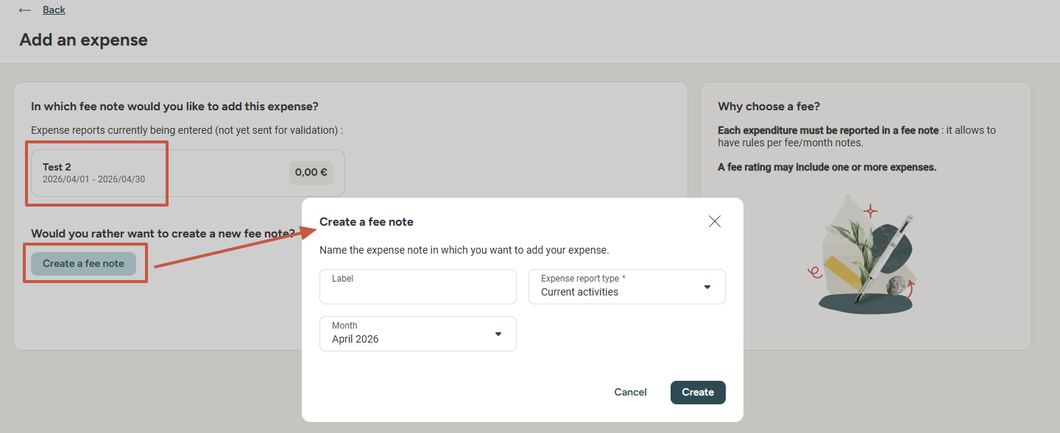
As an employee
Grouping expenses for a month
  Eurecia allows you to add your expenses in a currently existing expense report or to create a new expense for the current month.
  By default, the current month is selected; however, you can select another month at this step.

Slide 9
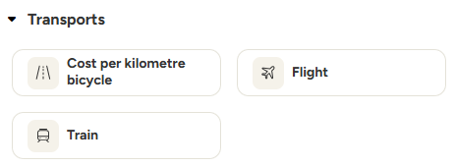
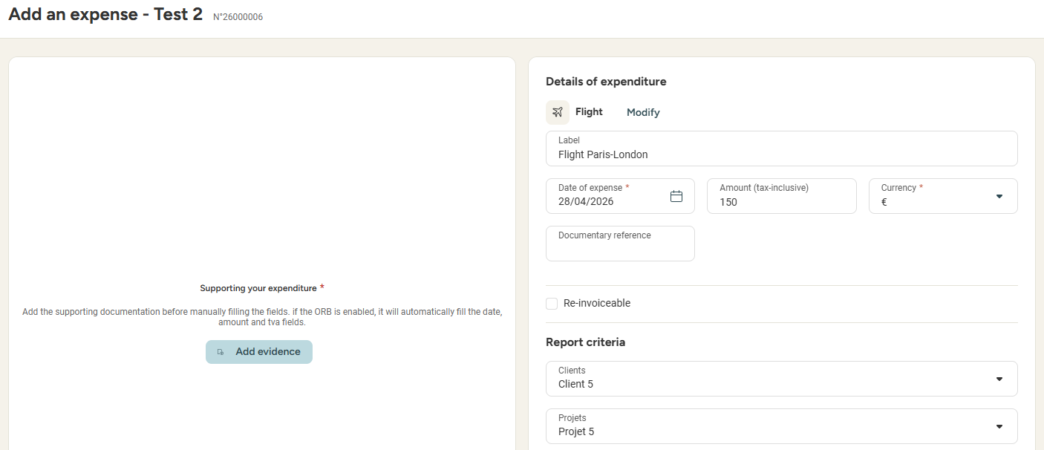
As an employee
Adding an expense to the report
  Select the expense by clicking on one of the available pictograms
  Enter a date and amount for the expense, as well as a supporting document (automatically recognised by the OCR if active)

Slide 10
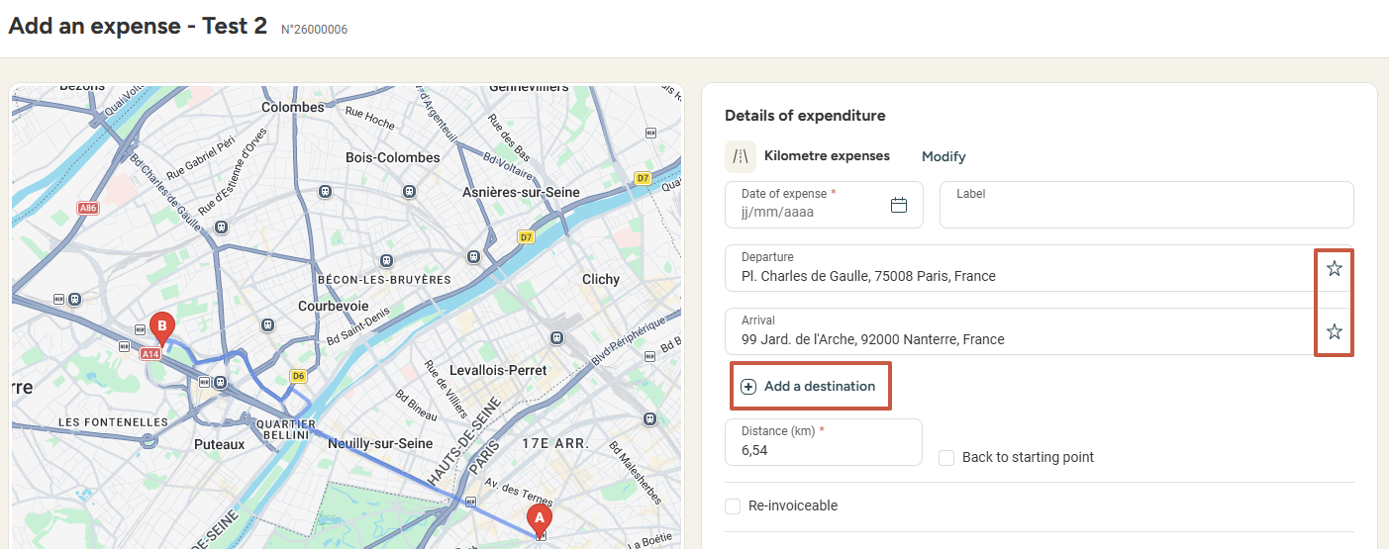
As an employee
Focusing on mileage reimbursement
  When inputing a mileage to be reimbursed, I can add stop-offs to my journey. I can also add or save favourite addresses by clicking the star icon (I can have a maximum of 5 favourite addresses).

Slide 11
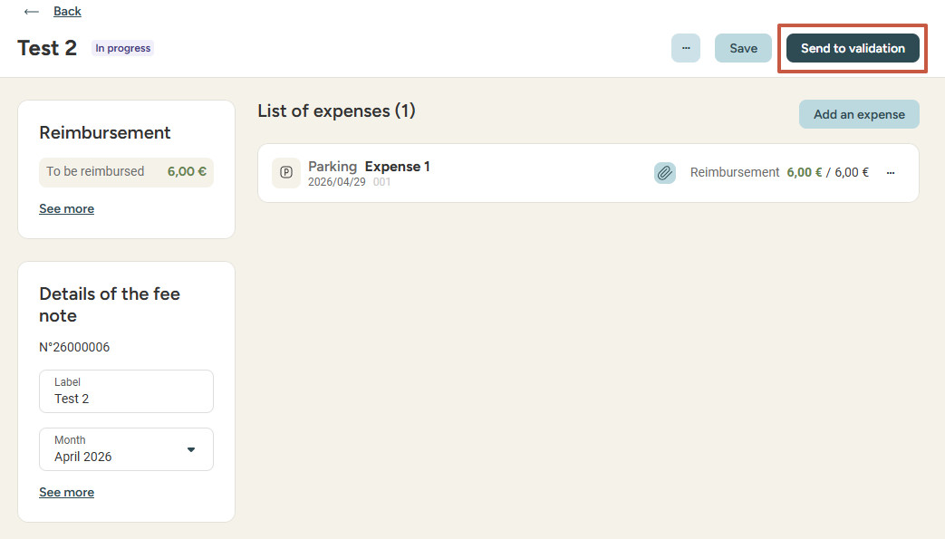
As an employee
Submitting your reports for Approval
  Once all of your expenses are complete and saved, you can submit the expense report for approval:

Slide 12
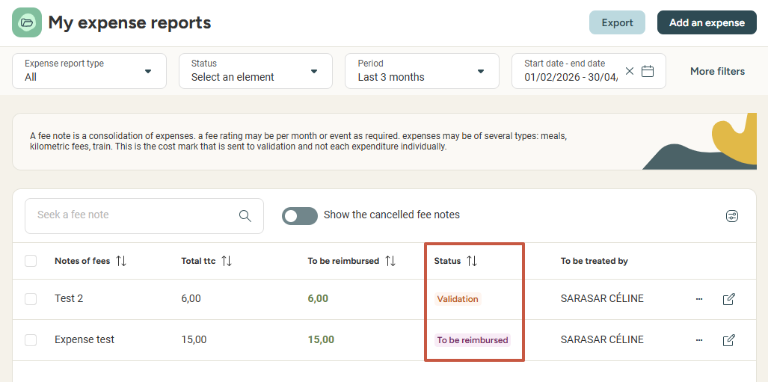
As an employee
Viewing my expense reports' current status
  Keep an eye on your expense reports' current status and be notified when the reimbursement has gone through, via Menu > Expense reports > My expense reports:

Slide 13
As a manager
02

Slide 14
Approving expense reports

Slide 15
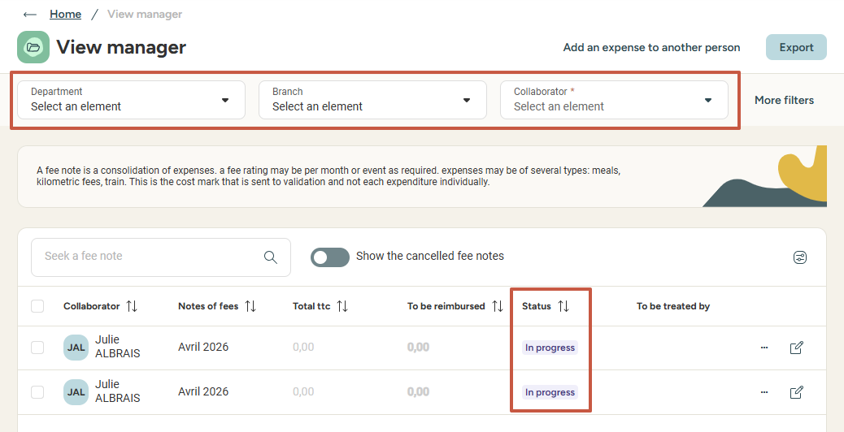
As a manager
Approving expense reports
From the Menu > Expense Reports, select “Manager View” to access the list of expense reports categorised by:
  Employee
  Period
  Reimbursement amount
  Status
  Filter by employee, branch or department, or
  select More Filters to narrow down the expense
  reports according to your needs

Slide 16
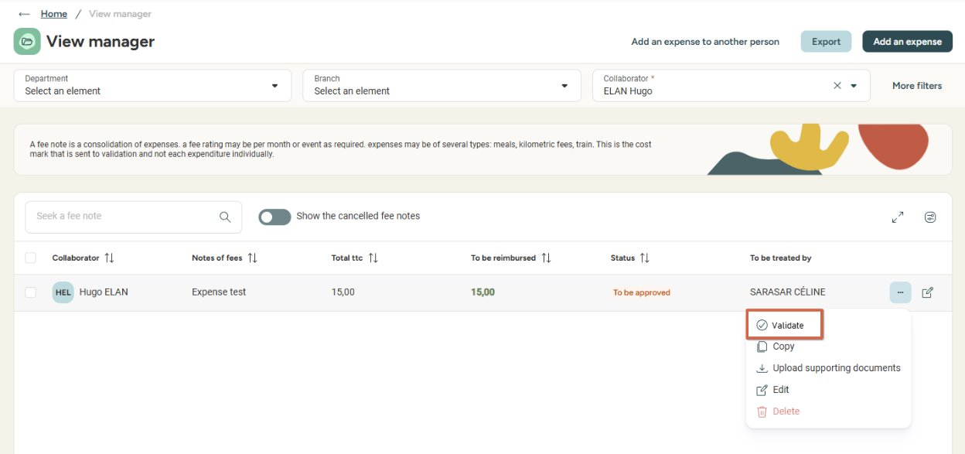
As a manager
Approving expense reports
An expense report can be approved with a single click from the list:

Slide 17
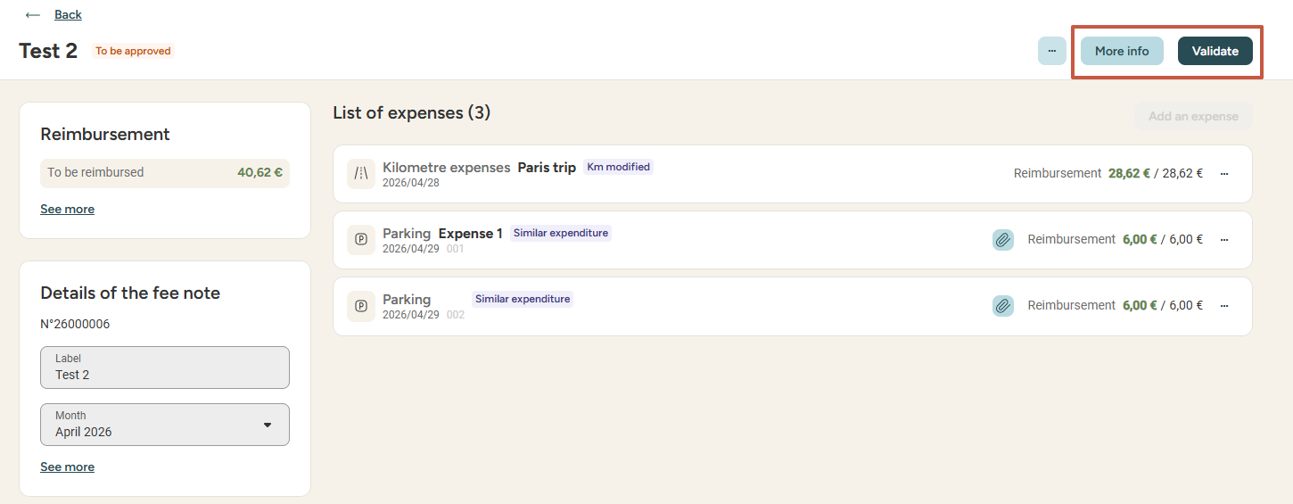
As a manager
Approving expense reports
You can also access a detailed view of the expense report by clicking on it in the list
  In this detailed view, you can request More Info, Add an expense (by first clicking the three dots and selecting Modify),
  or Validate the expense report to begin the reimbursement process.

Slide 18
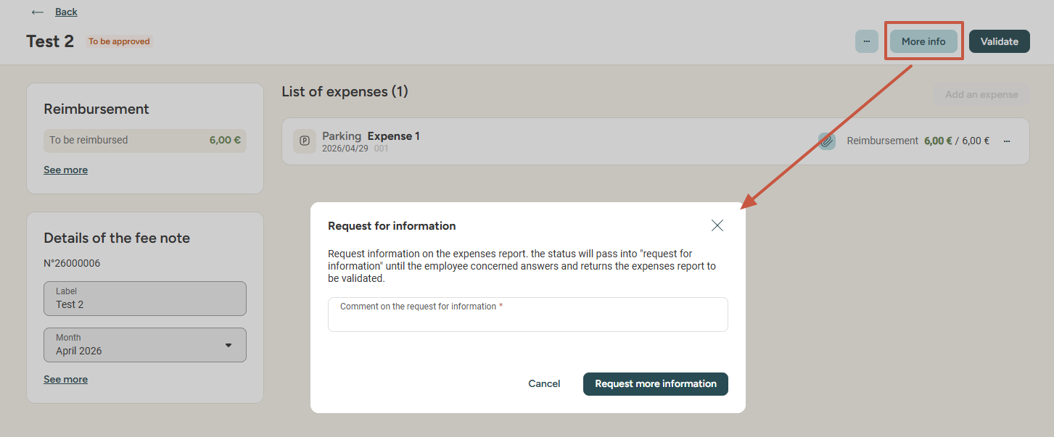
As a manager
Requesting more info
From the detailed view of the expense report, you can require More info to the employee submitting the report. The employee is then notified that they can answer your query, edit the report and submit it again for approval.

Slide 19
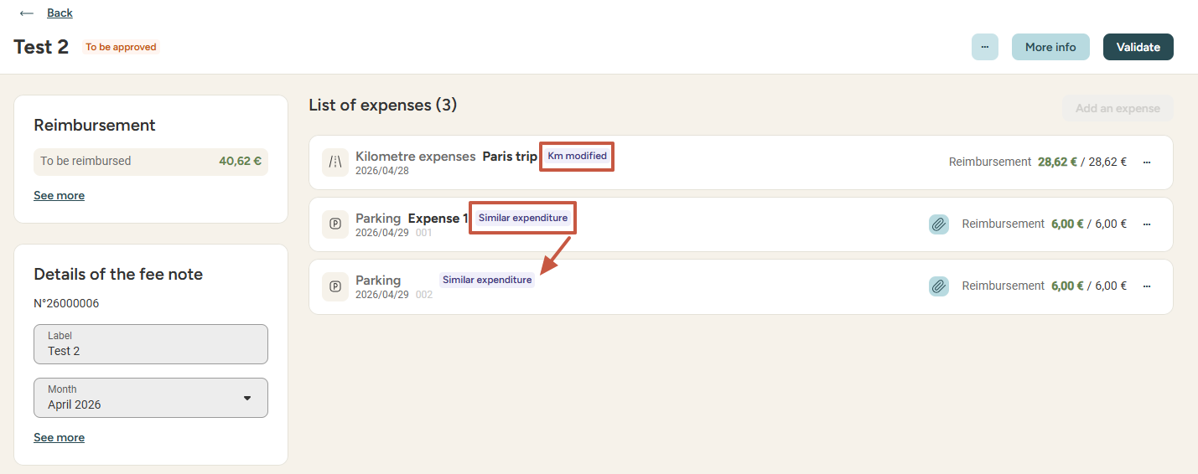
As a manager
FoCUSing on expense information
From the detailed view of the expense report, you can visualise tags informing you if the number of Kms/Miles was manually edited, if the date of an expense is in the future, or if two expenses are similar within the report.

Slide 20
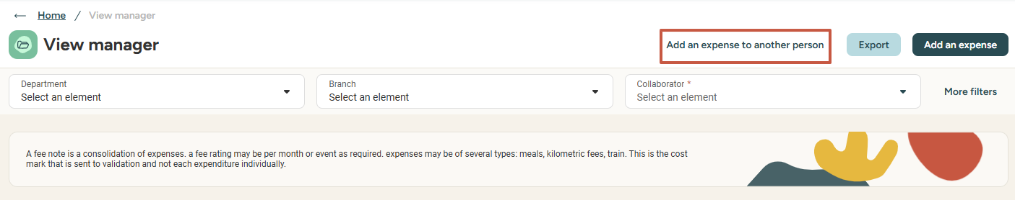
As a manager
inputing expense reports for a subordinate
As a manager, from the Manager view menu of the Expense Report module, you have the possibility of adding an expense for one of your subordinates by clicking Add an expense to another person

Slide 21
Still have questions?
All the answers are within your reach.
Support@eurecia.com
Help center

