Slide 1


Training guide
Employees & managers
www.eurecia.com

Slide 2

Time and activities

Slide 3

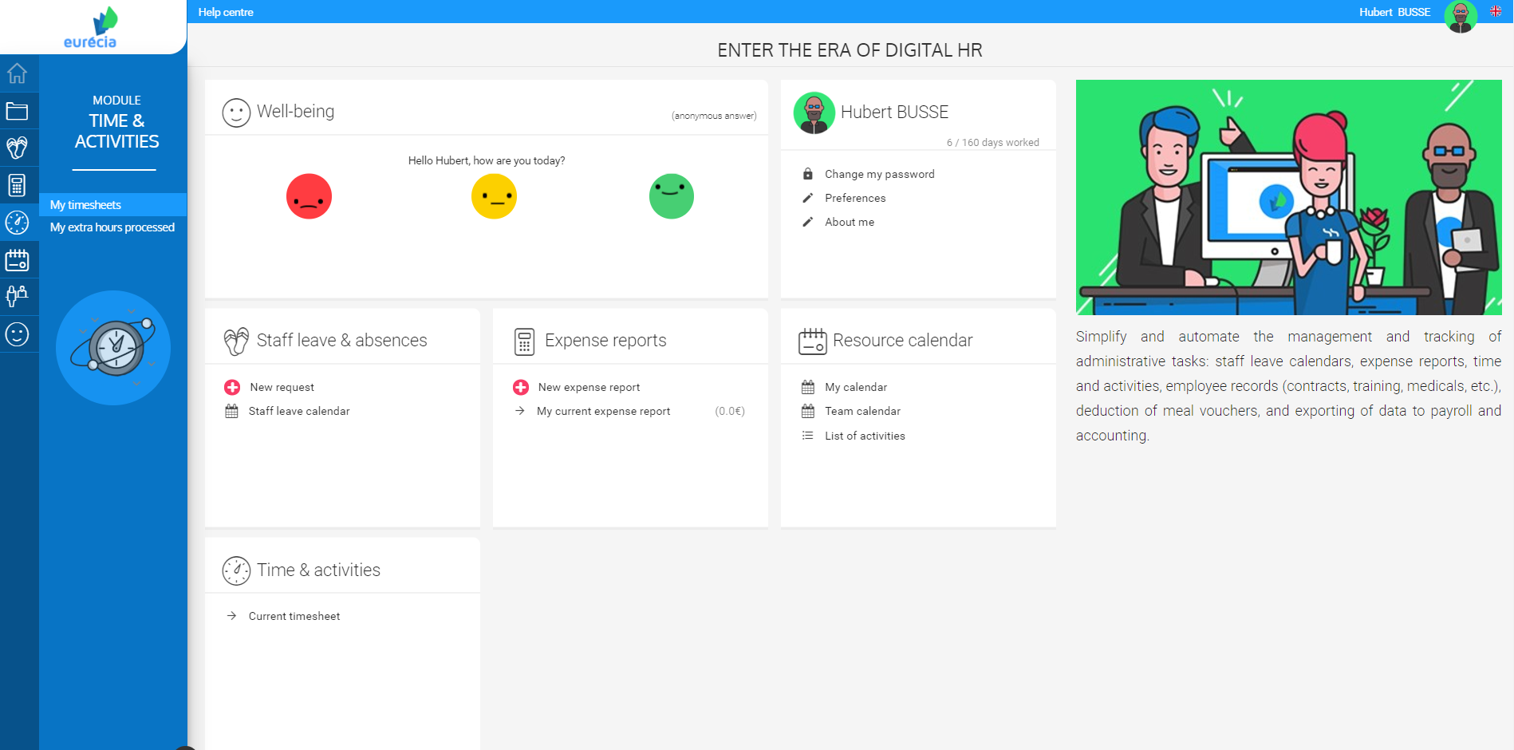
Employee – Consult my TimeSheet
  From the homepage of Eurécia, go to « Time and Activities » module then to my « Timesheet »,

Slide 4
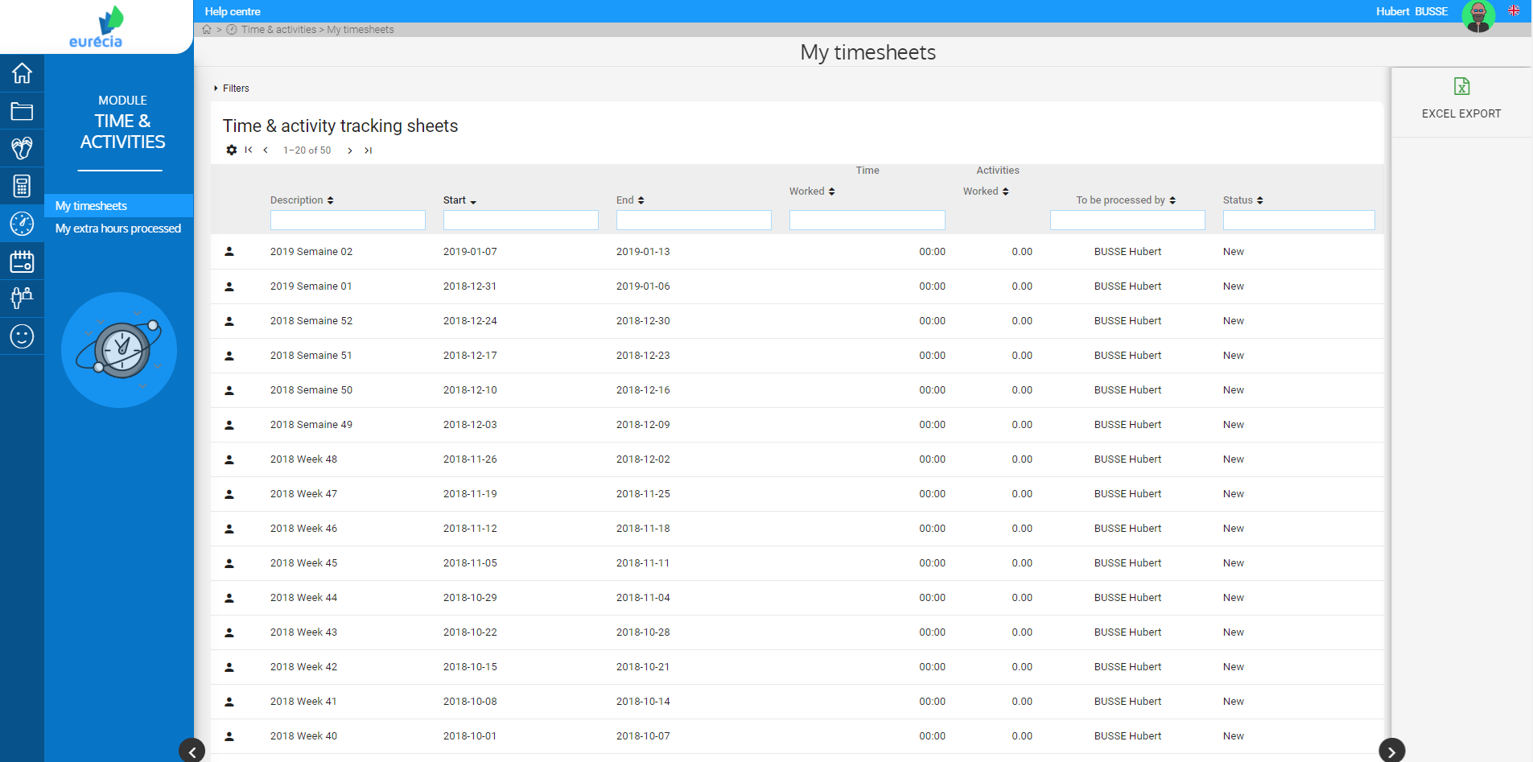
Employee – Consult my timesheet
You have acces to all your timesheets automatically generated.
To open a sheet, click on the one you want to open.

Slide 5
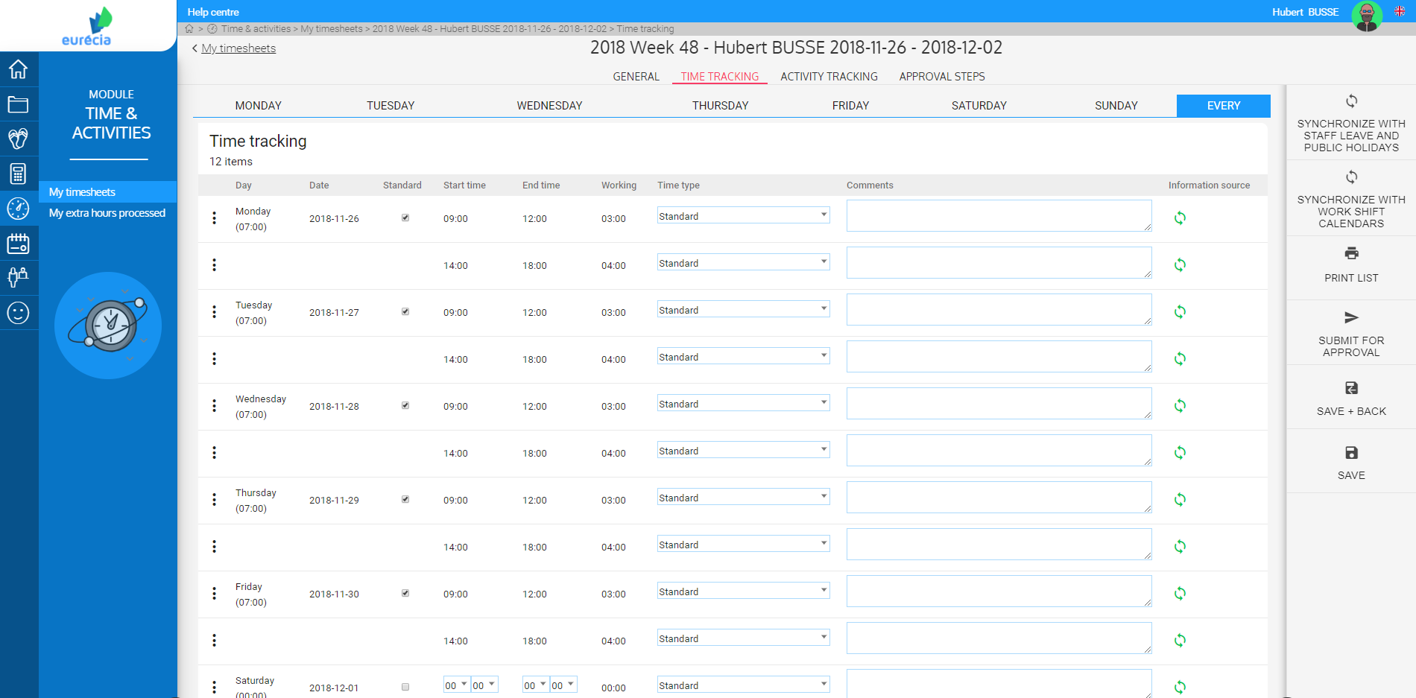
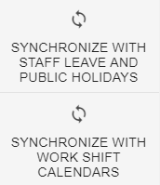
Employee – Consult my timesheet
The timesheet contains the details by day of the week in question.
The tracking can be in time or in activities.
The timesheet can be synchronized with staff leave and work shift calendars from the right sidebar.

Slide 6
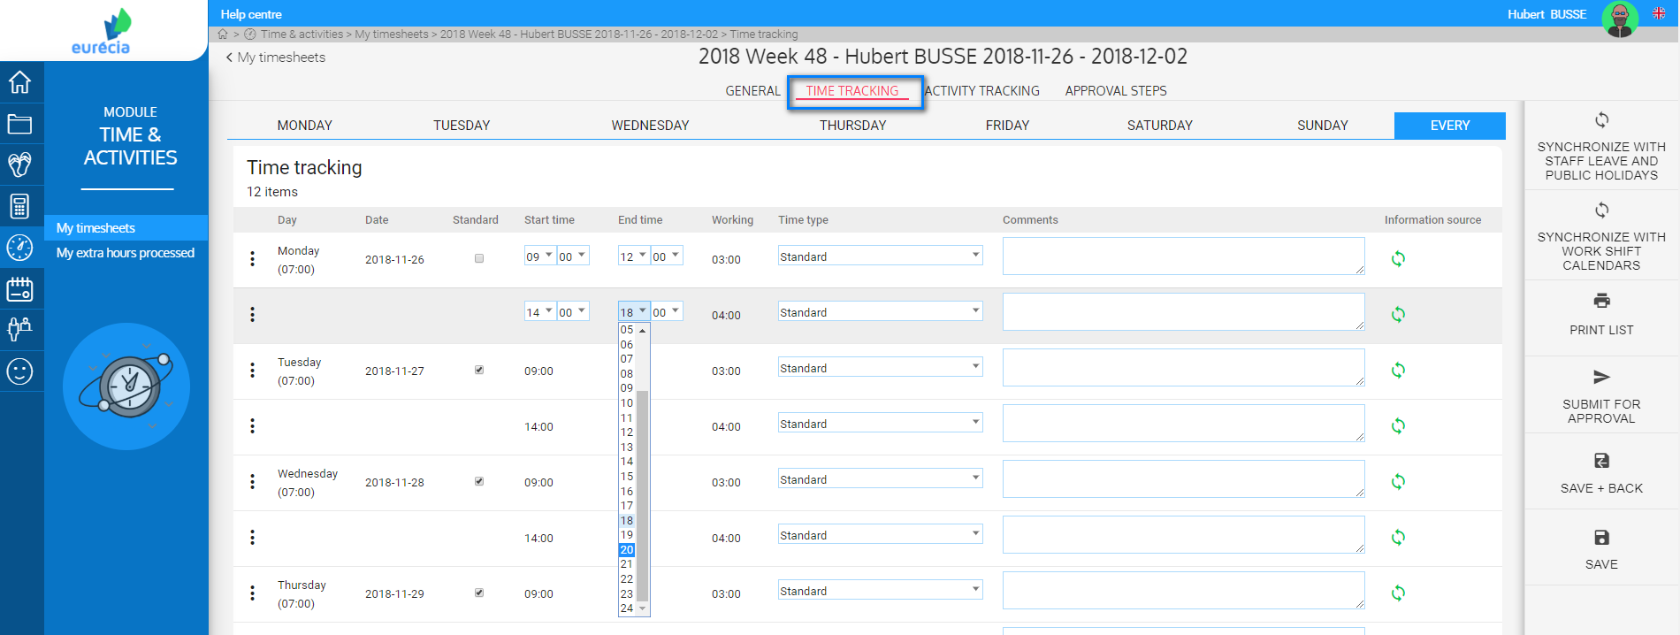
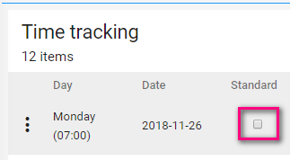
Employee – Edit timesheet
Time tracking
If you want to fill-in overtime hours in a day, you have to deactive « Standard ».
You can then edit start and end times.

Slide 7
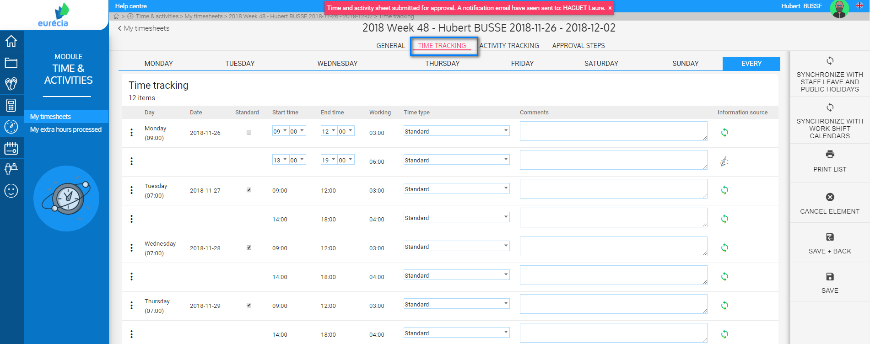

Employee – Edit timesheet
Once you entered your overtime hours, you can Submit for approval the timeheet to your manager.
You can find the option « Submit for approval » on the right sidebar.
Warning : submit the timesheet for approval once you are sure that your timesheet is correct.

Slide 8
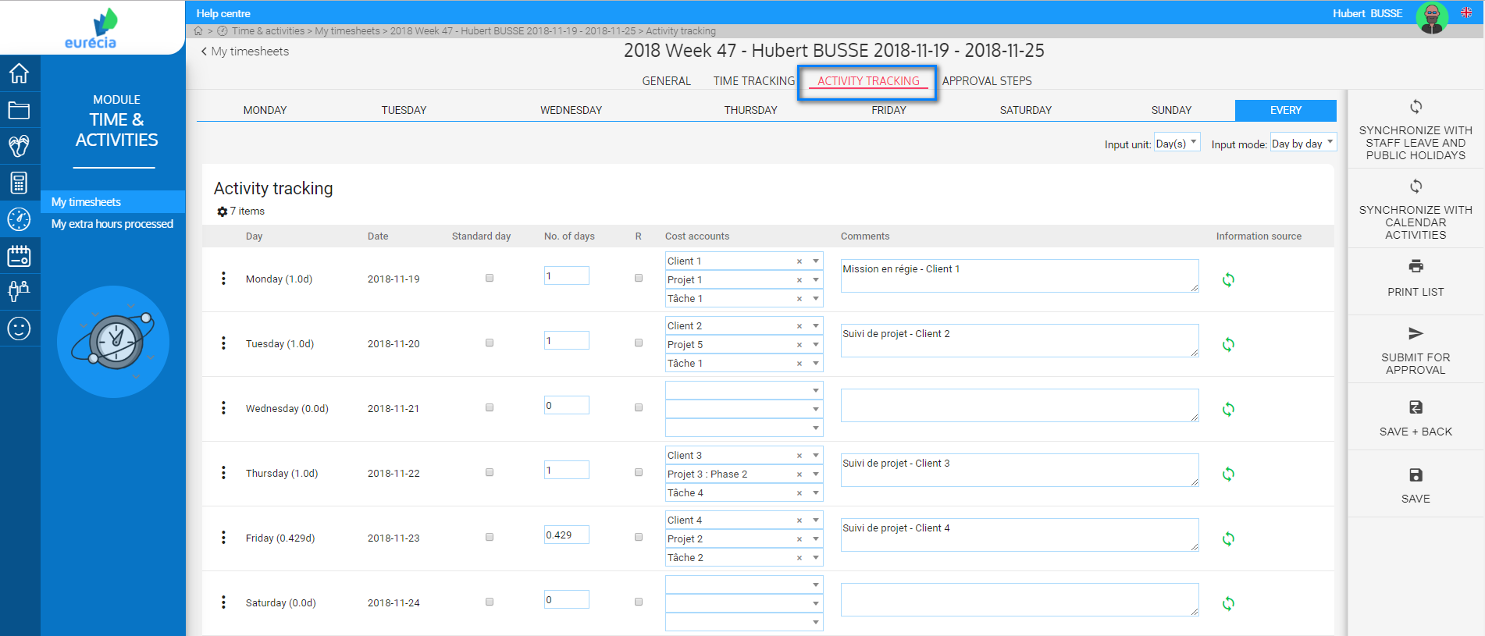
Employee – Edit timesheet
Activity tracking
If the tracking is done by activities, the "Activity tracking" tab will allow you to enter your hours worked according to the criterion and analytical accounts.
You can also synchronized the weekly tracking with staff leave and calendar activities already filled in the calendar.

Slide 9
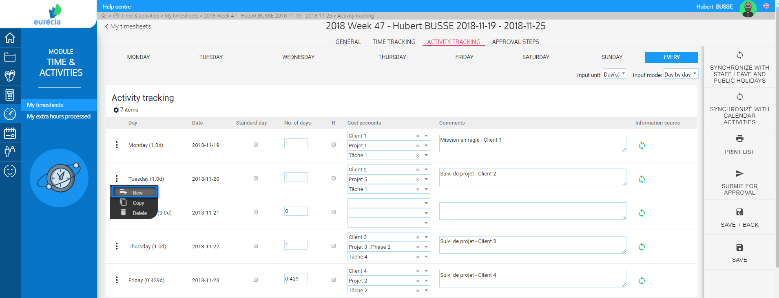
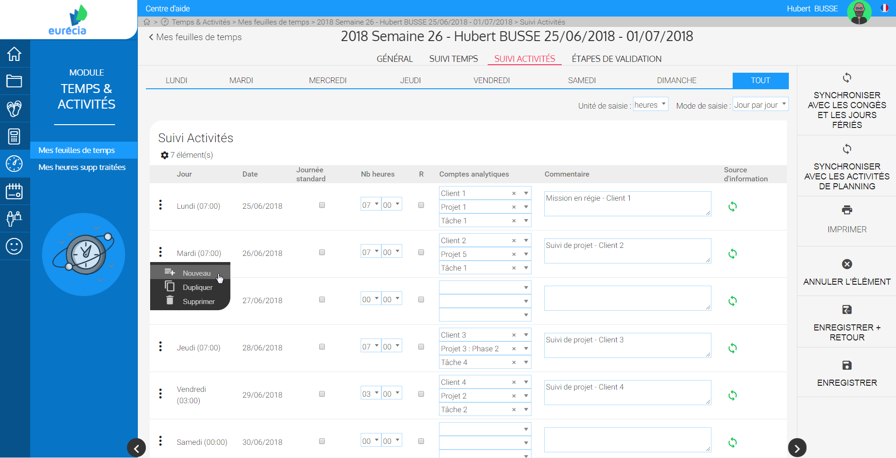
Employee – Edit timesheet
To fill in new activities click on the three points « » on the day you want to edit.
Then click on « New ».

Slide 10
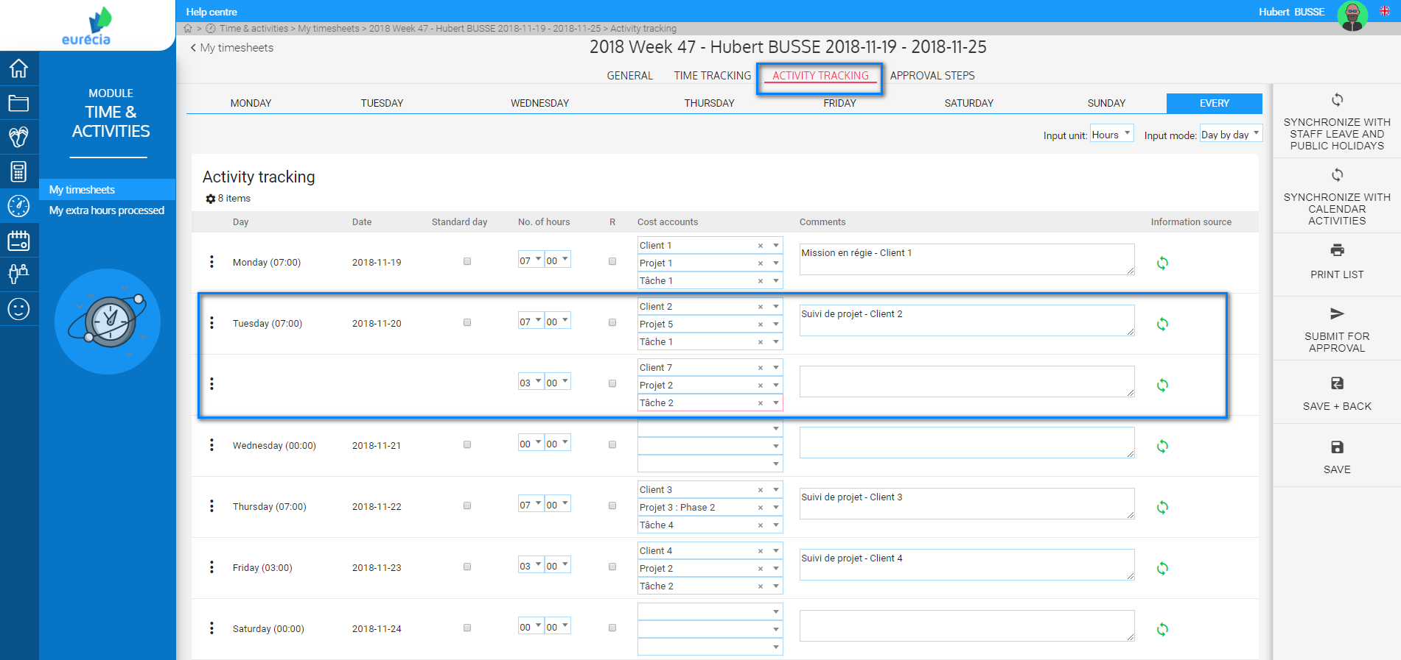

Employee – Edit timesheet
Input unit can be days or hours.
You can enter the number of hours spent and the analytical accounts to which they were spent.
You can also add a comment.

Slide 11
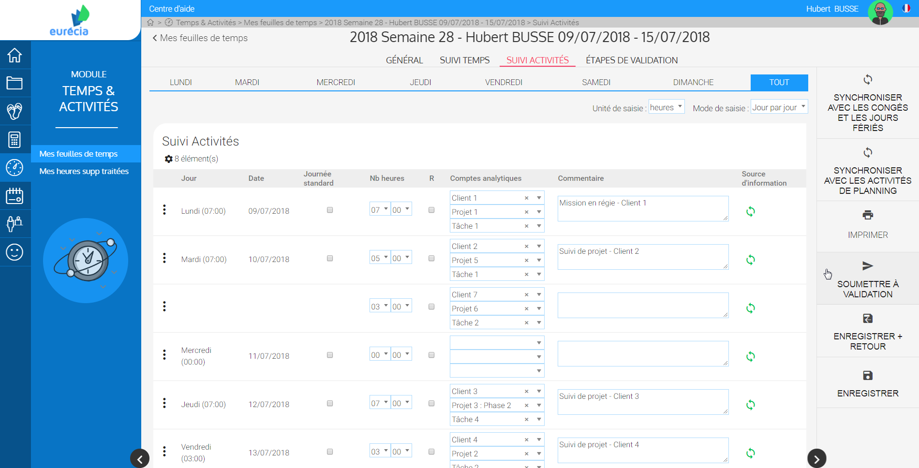
Employee – Edit timesheet
Once you entered all your activities, you can Submit for approval the timeheet to your manager.
Warning: submit the timesheet for approval once you are sure that your timesheet is correct.

Slide 12
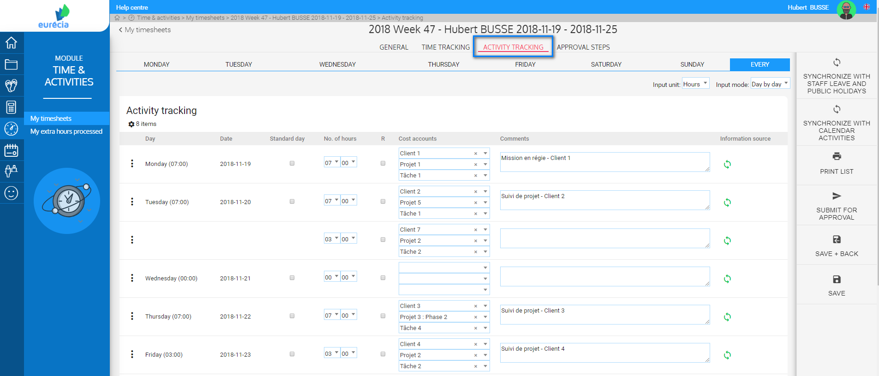
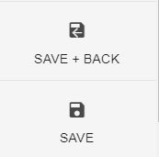
Employee – Edit timesheet
After you have edited a time or activity sheet, you can save it to save the changes.
This option allows you to come back to it later in order to enter new hours before submitting it for final validation.

Slide 13
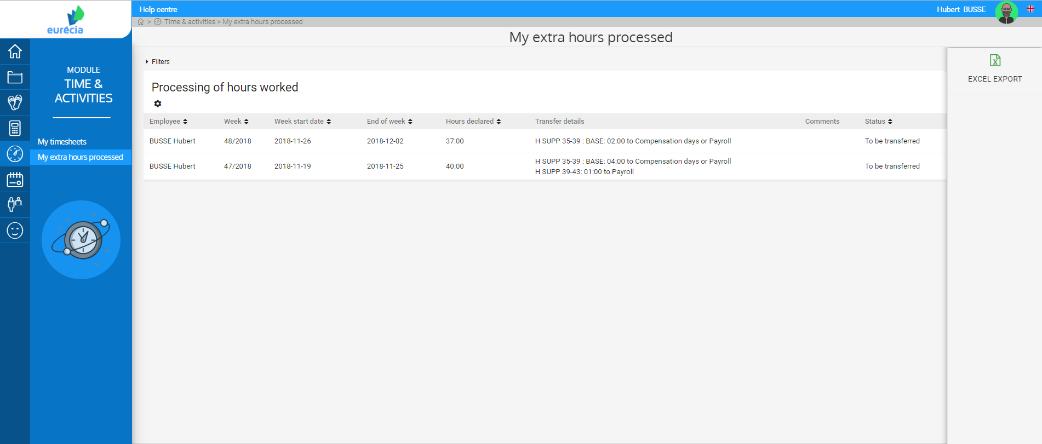
Employee – Consult porcessed extra hours
You can access to yout processed extra hours from « Time and activities » module and then by clicking on « My extra hours processed »,
You can consult your extra hours, see their status and the transfer details.

Slide 14

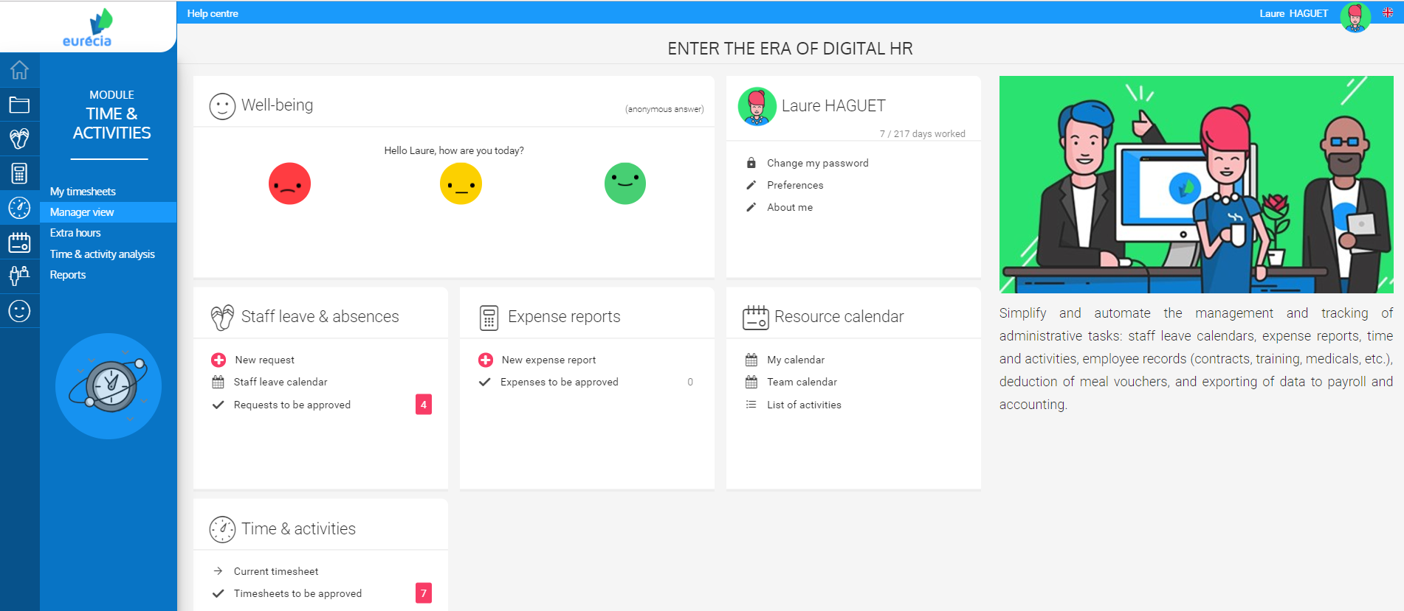
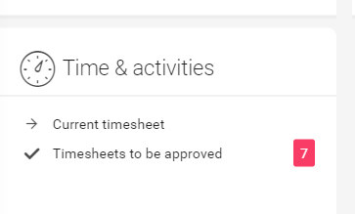
Manager – Timesheet approval
From the "Time and activities" module, select "Manager view" to access all your employees' time sheets.
You can also access it via the shortcut on your home page.

Slide 15
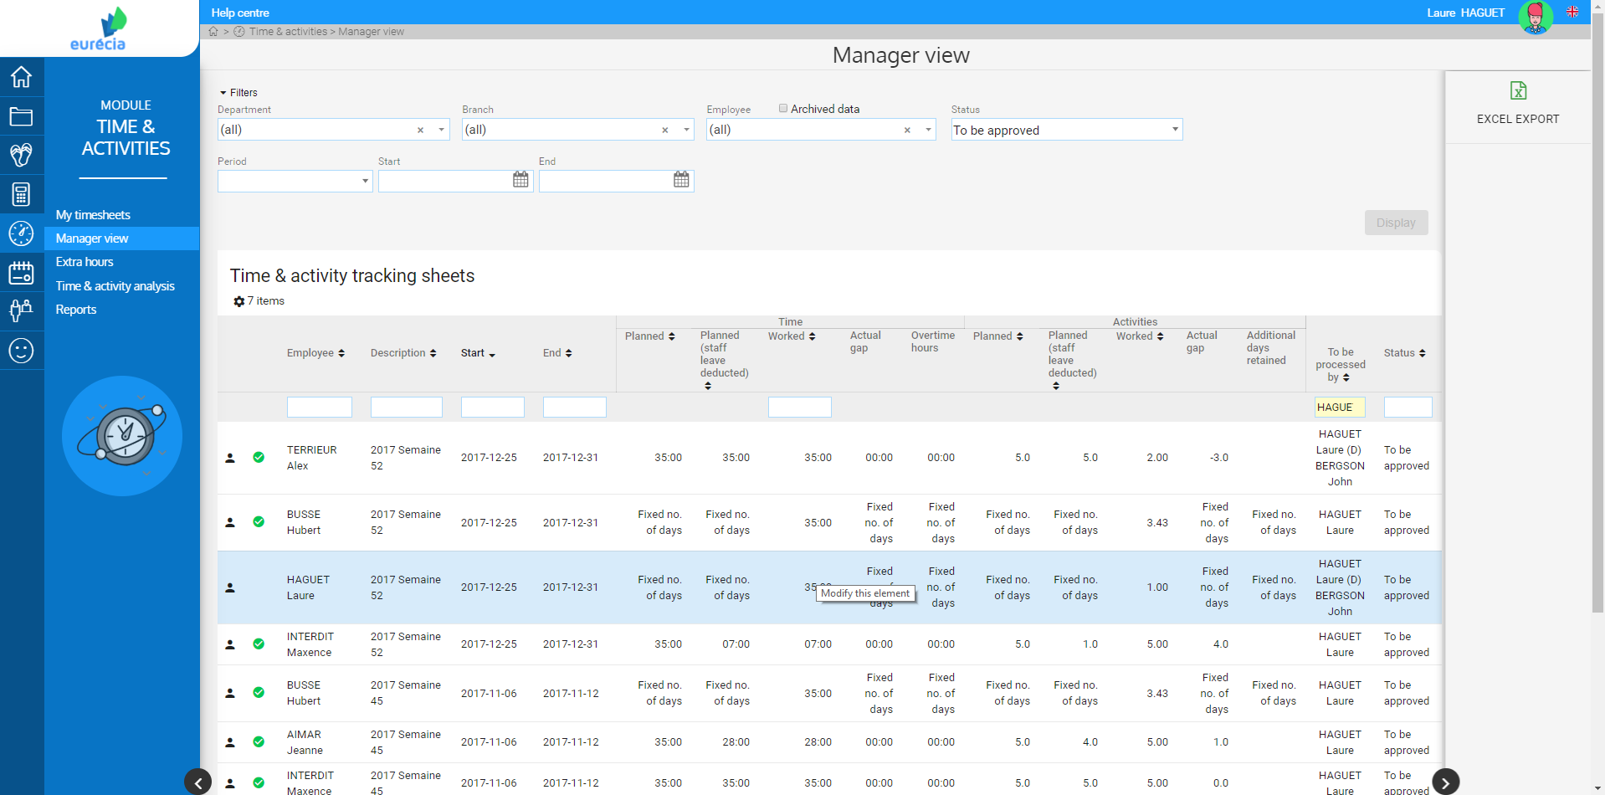

Manager – Timesheet approval
You can approve your employees timesheets within one click.
You can also access the details of the timesheet edited by your collaborator by clicking on it.

Slide 16
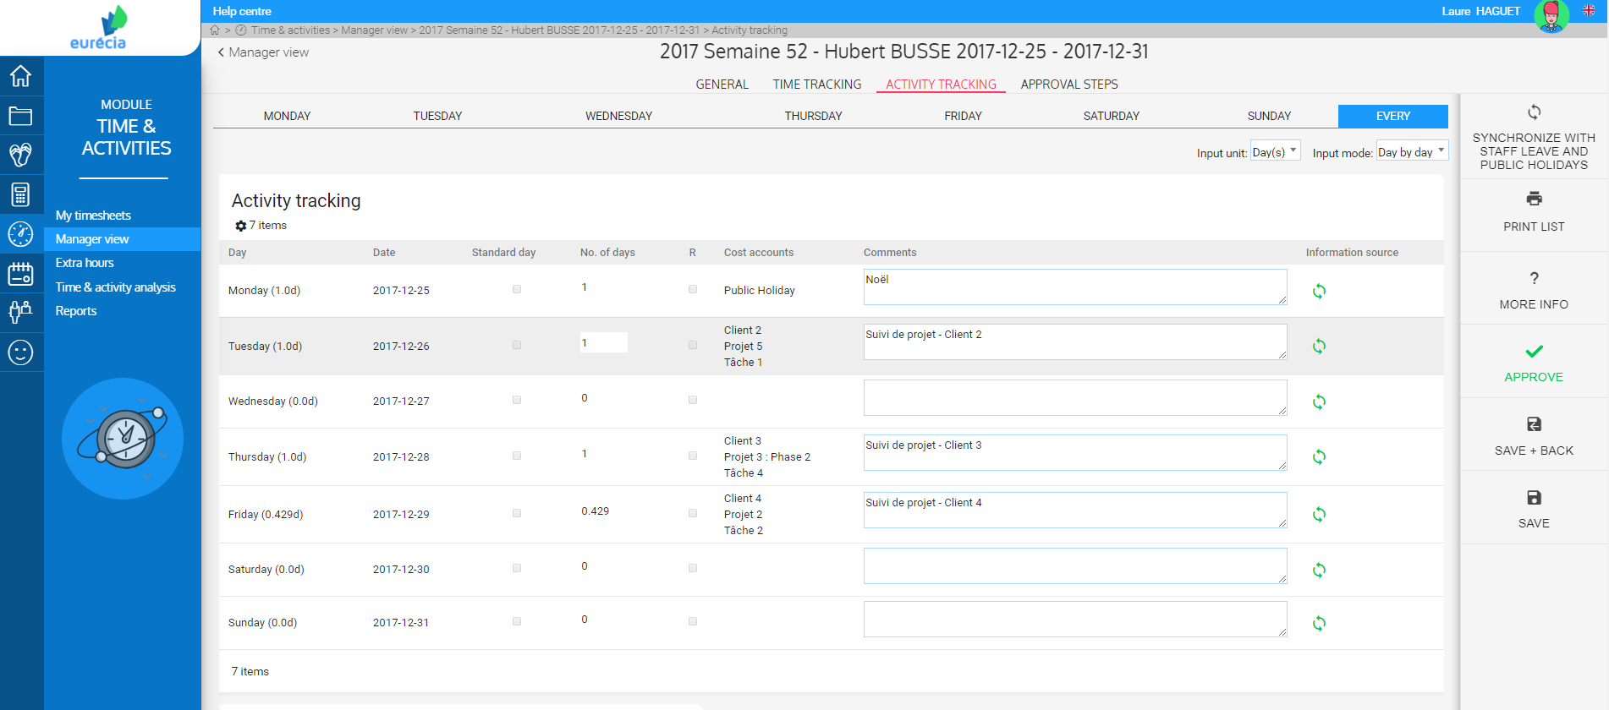
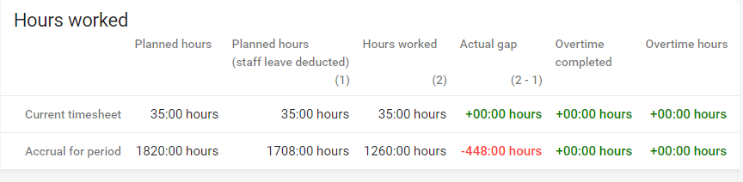
Manager – Timesheet approval
In the timesheet detail, you can see the hours filled-in by your employee, the comments ans the tracker of worked hours.
And you can also approve it from this page.

Slide 17
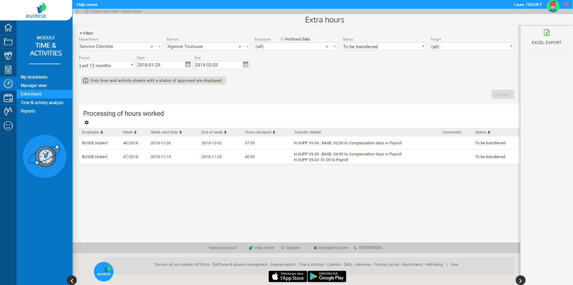
Manager – Consult processed extra hours
Access the "Extra hours" consultation from the "Time and Activities" module.
The transfer of extra hours can only be viewed once the timesheet has been validated.

Slide 18
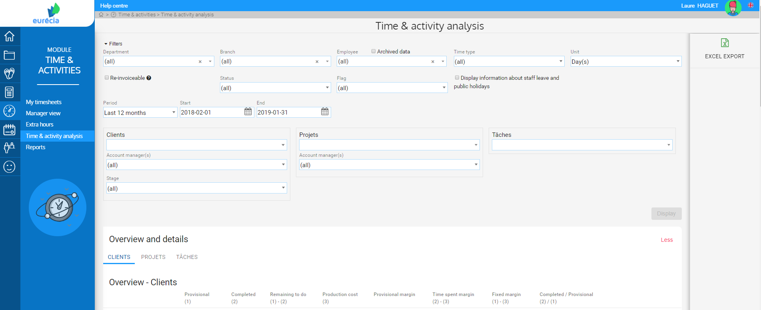
Manager – Time & Activity analysis
Access "Time and Activity Analysis" from the "Time & Activity" module.
You will find here the analysis of the accounts and analytical axes according to the time and activities filled in by the employees.

Slide 19
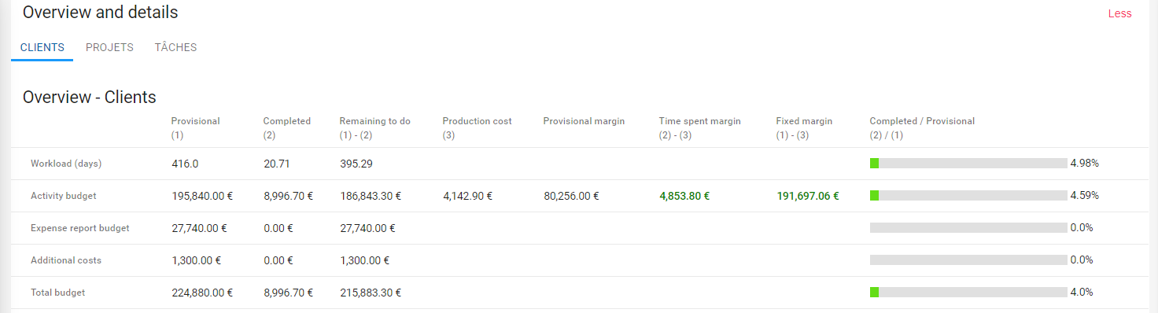
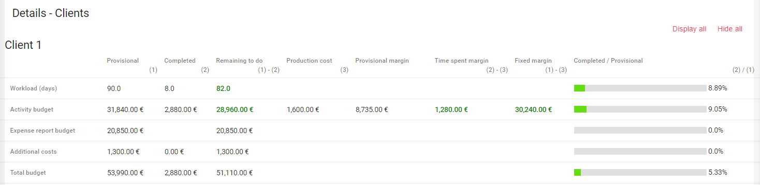
Manager – Time & Activity analysis
Overviews can be displayed by report criteria (client, projects, tasks),
You can also access the analysis details of each analytical account (here the details of Client 1 analytical account).

Slide 20
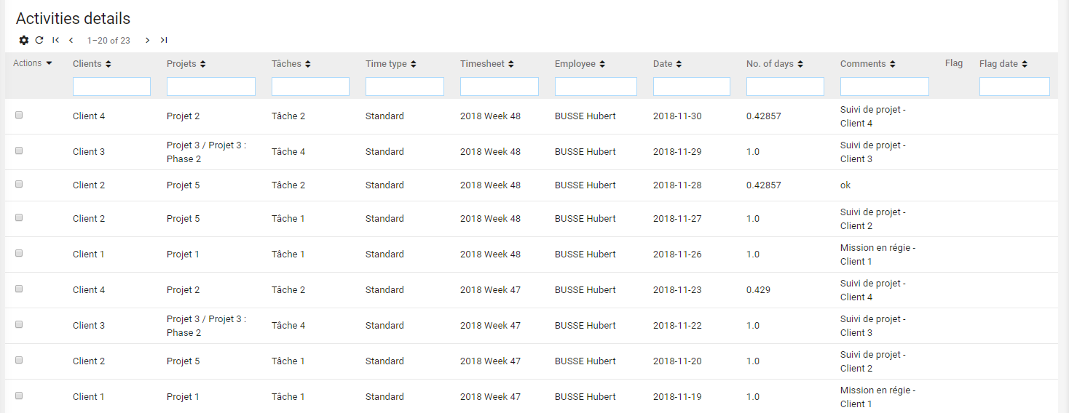
Manager – Time & Activity analysis
At the bottom of the page you can also consult the list of activities in detail.
You will find every activity of all employees.
Once again, the filters allow you to refine your search.

Slide 21
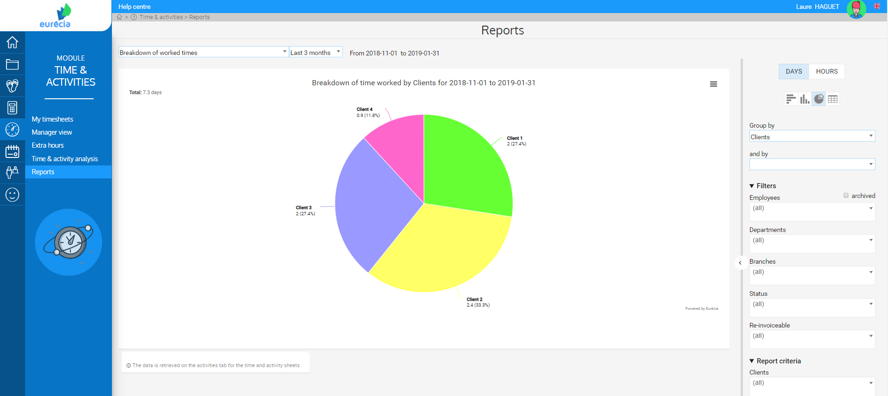
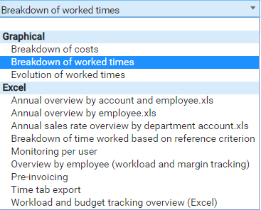
Manager – Consult processed extra hours
Access to « Reports » from « Time & Activities » module.
Here you will find graphs on the evolution and distribution of working time as well as on the breakdown of costs.
You also have several reports that can be exported to Excel.
Each report can be refined by a wide selection of filters.

Slide 22

www.eurecia.com

