Slide 1


User Guide
Employee & Manager
www.eurecia.com

Slide 2

Expense reports

Slide 3



Approval workflow of an expense report
Employee
New expense report
Manager
Additional information request
Approved
Rejected
Accountant
Checking + Approval + To be reimbursed
Checking + Additional information request
N.B. : each action of the collaborator is notified by an automatic email to the manager, and the employee is also notified after each action of the manager.
Reimbursed

Slide 4
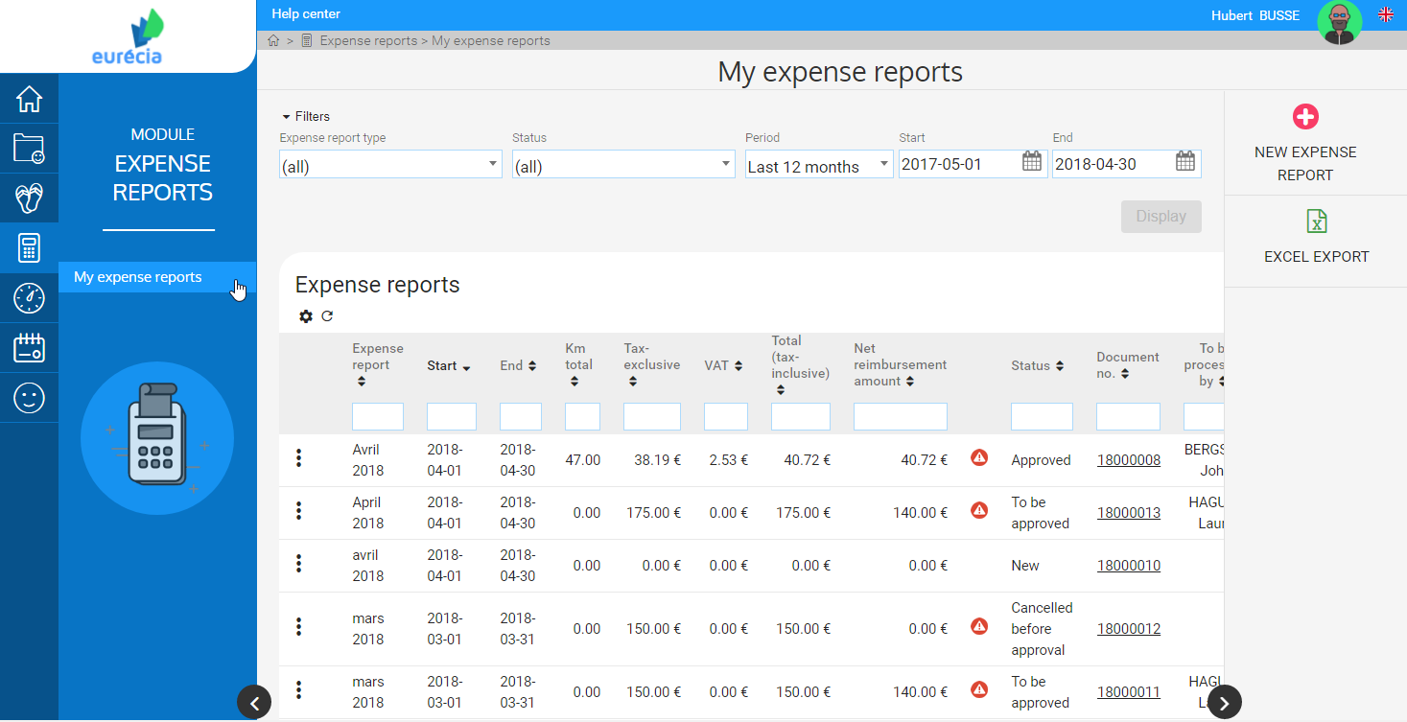

Employee - Creating an Expense Report
  In the "Expense Reports" module, select "My expense reports" to access your expense report list.
  Select the “ New Expense Report" button to create a new note.
  Expense Reports are sorted by:
  Report information (KM, tax exclusive, VAT, total tax-inclusive, net reimbursement amount)
  Status
  Document number

Slide 5
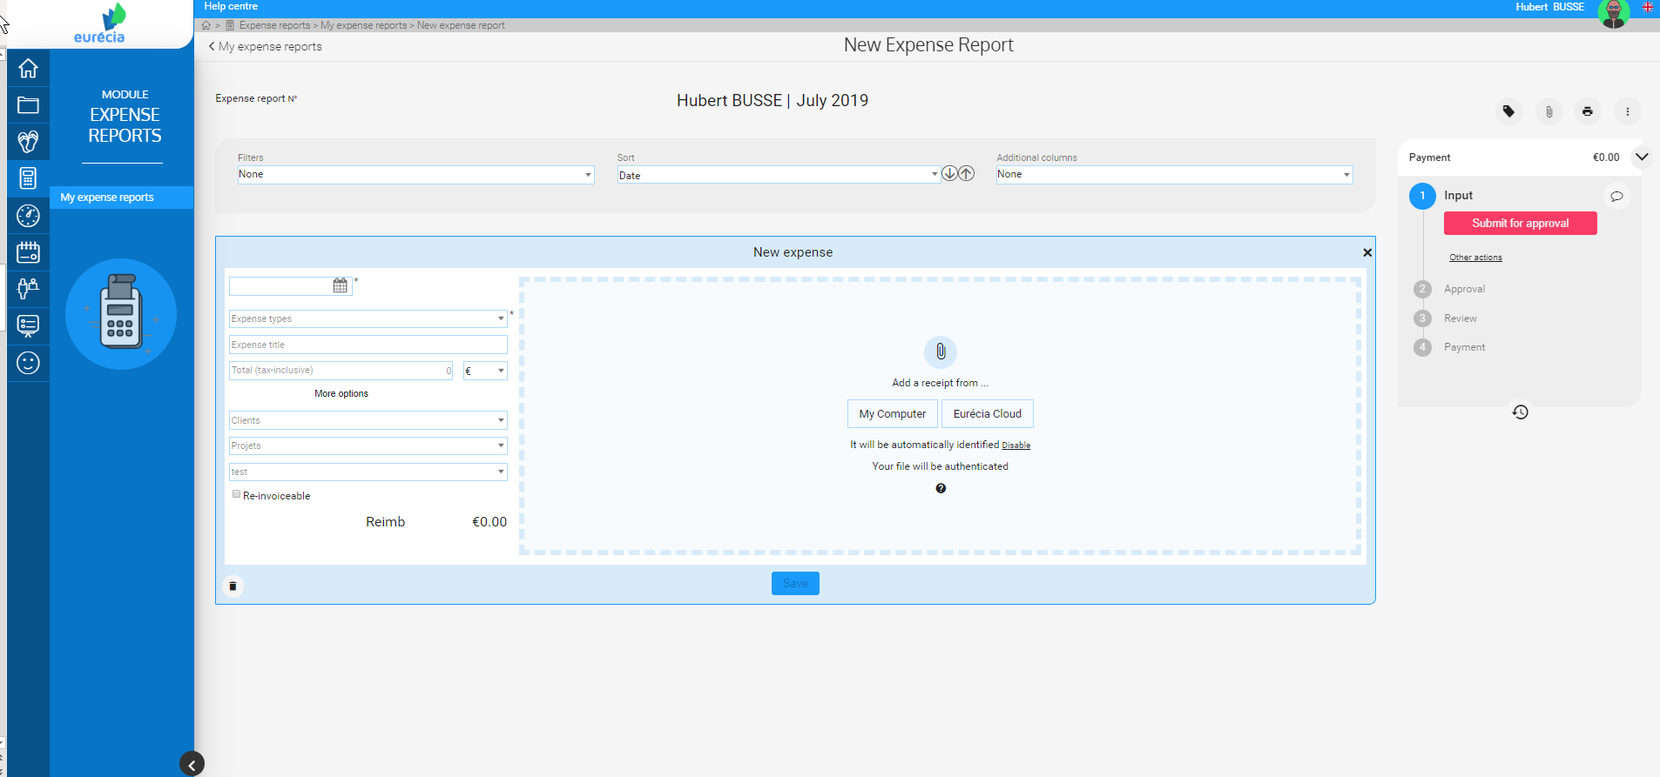
Employee - Creating an Expense Report
  By default, Eurécia initiates the expense report for the current month.
  If you wish to change the month of the expense report, you can do so by clicking on the month in the title or on the properties icon.

Slide 6
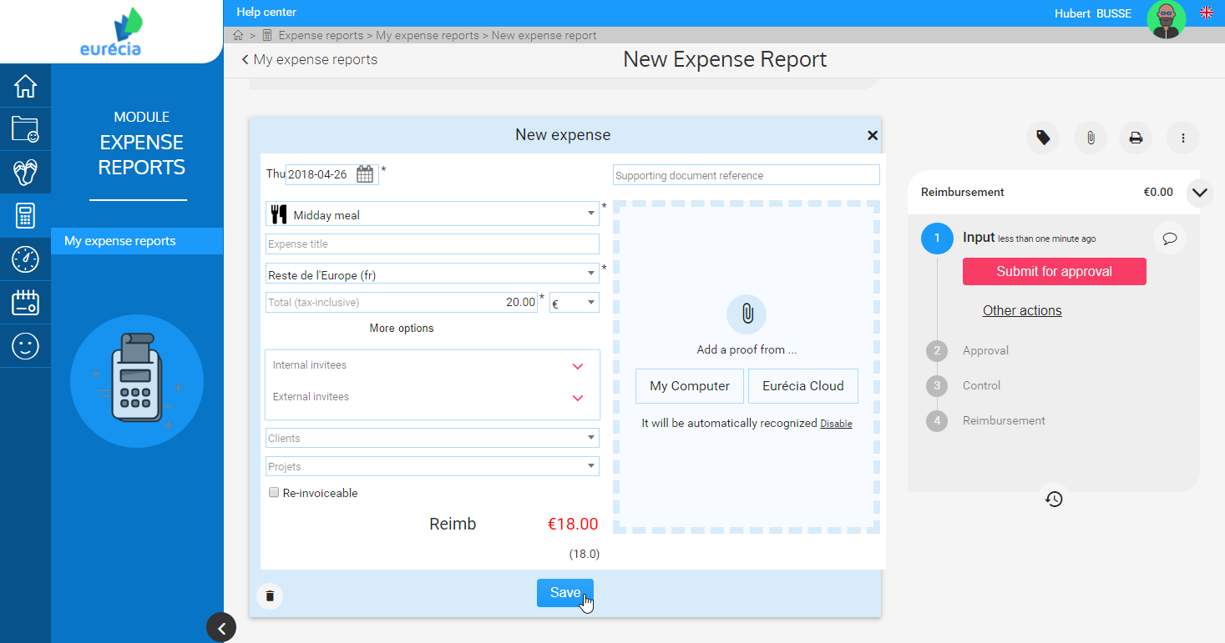
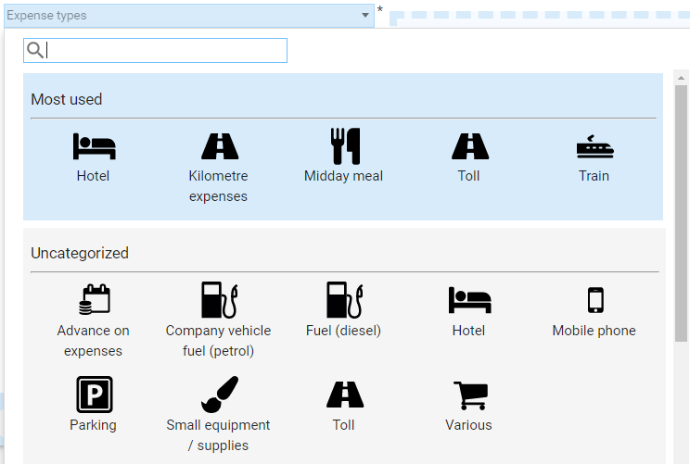
Employee - Creating a Expense Report
Interface for creating a new expense report
Fill in for each expense :
The expense date
The expense type
The expense amount
Proof of payment

Slide 7
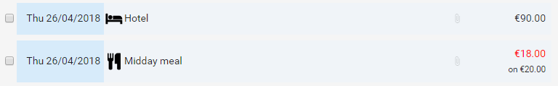
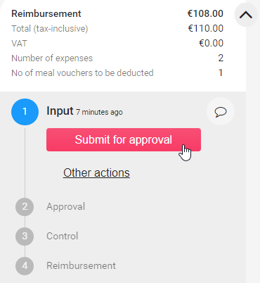
Employee - Creating a Expense Report
Once all of your expenses lines are completed, you can submit for approval the expense report:

Slide 8
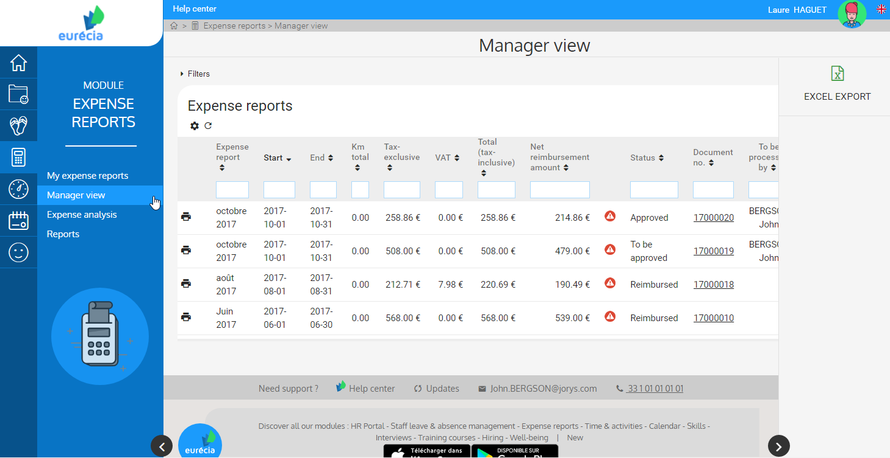
Manager – Expense reports approval
From the "Expense Reports" module, select "Manager view" to access the list of expense reports sorted by :
Employee
Period
Report information (KM, before tax, VAT, total tax-inclusive, net reimbursement amount)
Status
Document number
The filter allows you to keep only the exepense reports of a department, a branch or a specific employee. Or to display only the expense reports to be validated, reimbursed, rejected, etc.

Slide 9
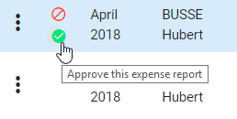
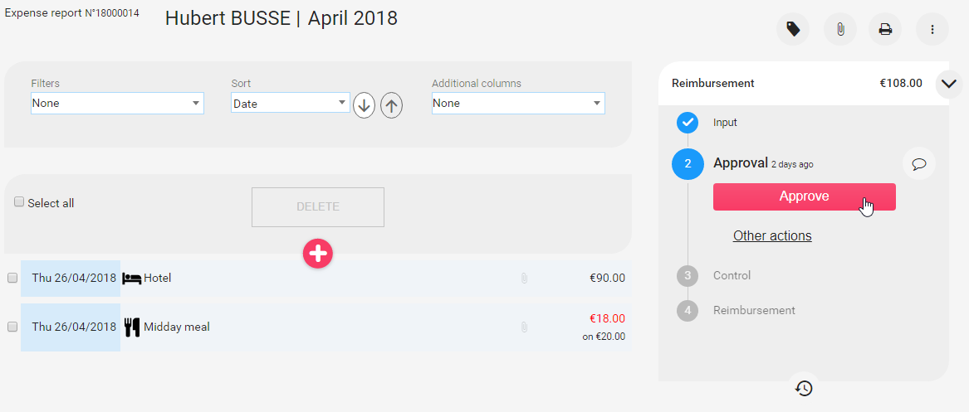
Manager – Expense reports approval
The expense report can be approved or refused in one click.
You can access the detail of the expense report by clicking on it in the list.
From the details page, you can also approve the expense report to start the reimbursement procedure.
Or you can reject or ask more information to the employee by selecting "Other actions".

Slide 10

www.eurecia.com

