Slide 1


All you need to know about
HR Portal
user training guide
Last updated
May 2026

Slide 2

Module features
Training program
Accessing the employee directory
Accessing my Documents
Accessing my payslips
Viewing shared documents
Finding my employee file

Slide 3
As a user

Slide 4
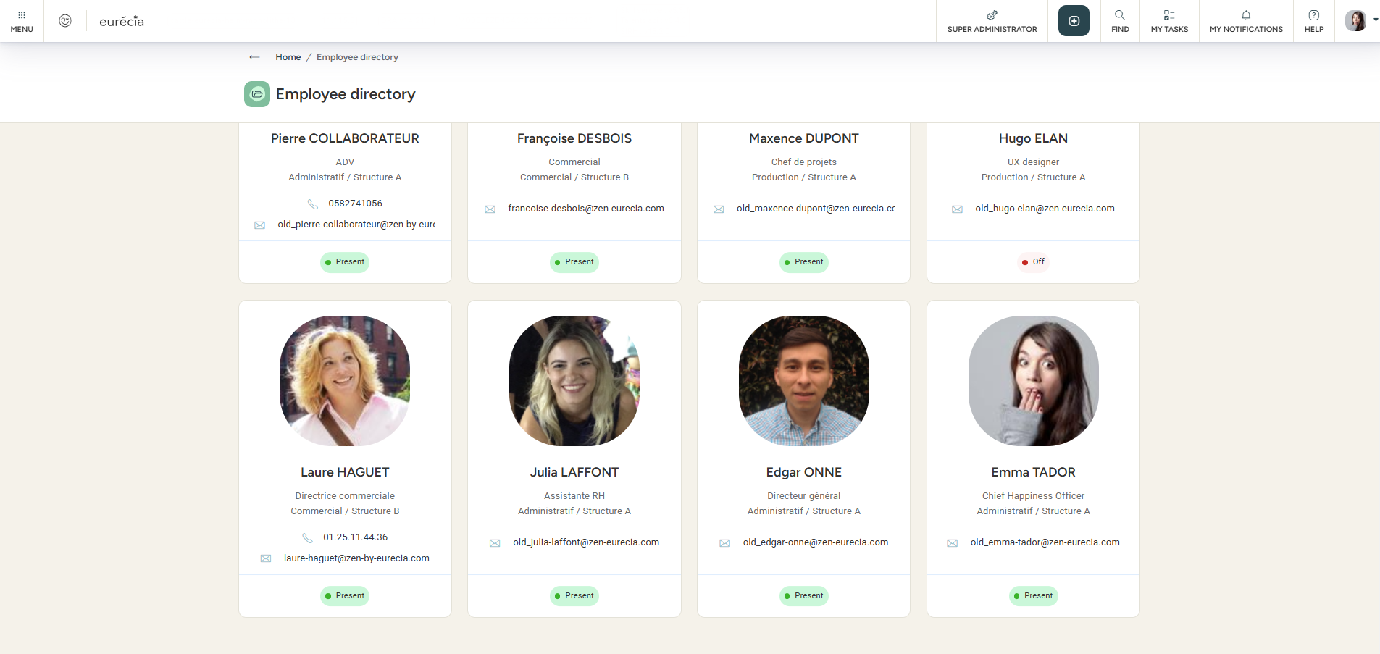
The employee directory
Accessing the directory
From the HR Portal module and by selecting Employee directory, you can access the employee directory listing all the company’s employees.
The directory can display each employee’s email address, job title, department, structure, and phone number.
Note : You can access your own employee file by clicking on your name. However, typically, you do not have access to other employees’ files (depending on the settings applied by your administrator)

Slide 5
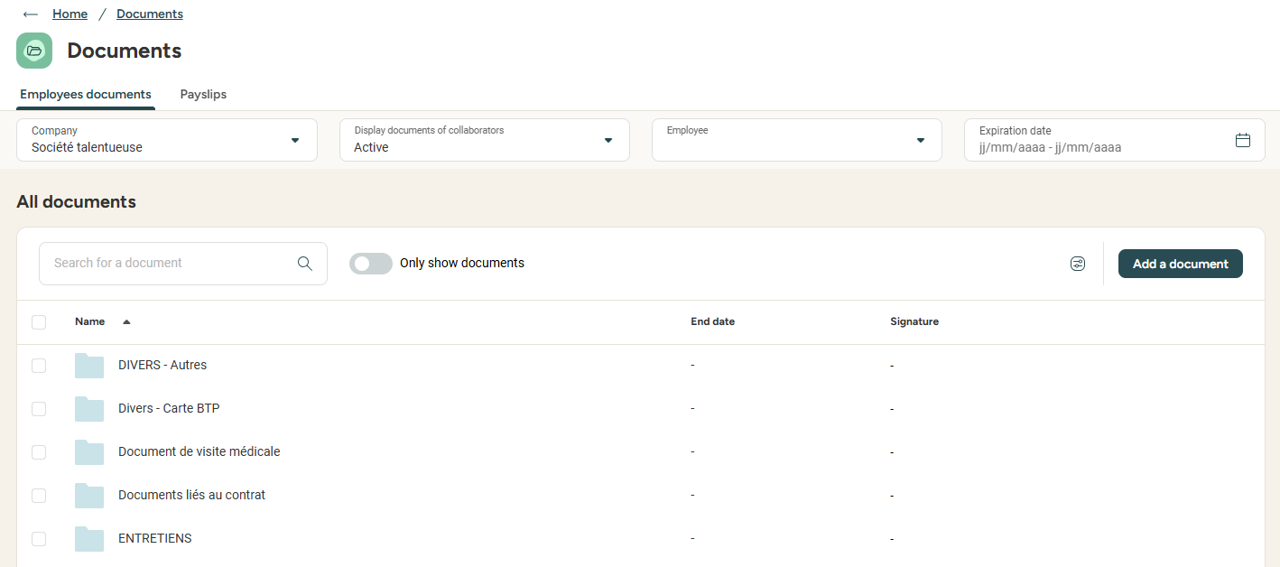
The documents’ space
Accessing your documents
From the HR portal module and by selecting Documents, you can view the documents linked to your professional life:
Work contract
CV
Driving license & registration…
If permitted by the settings, you can also add documents yourself to your space:
Work from home insurance papers
Authorisation papers…

Slide 6
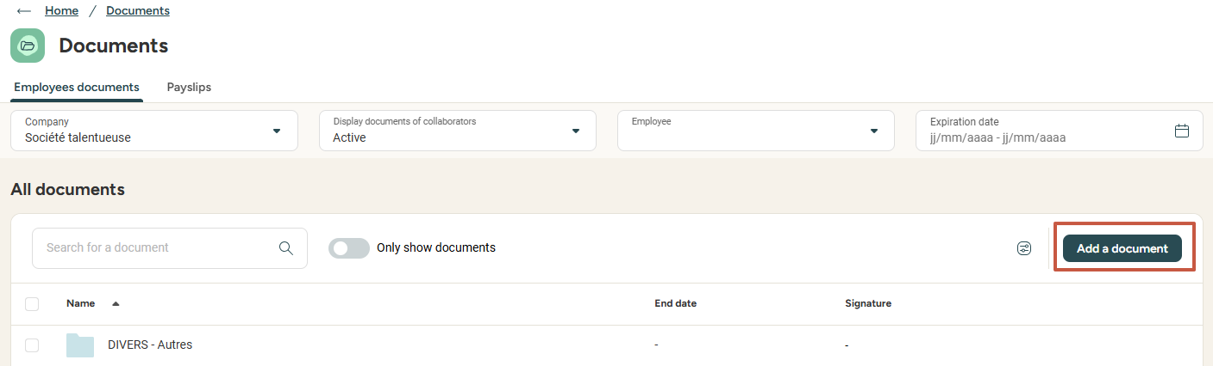
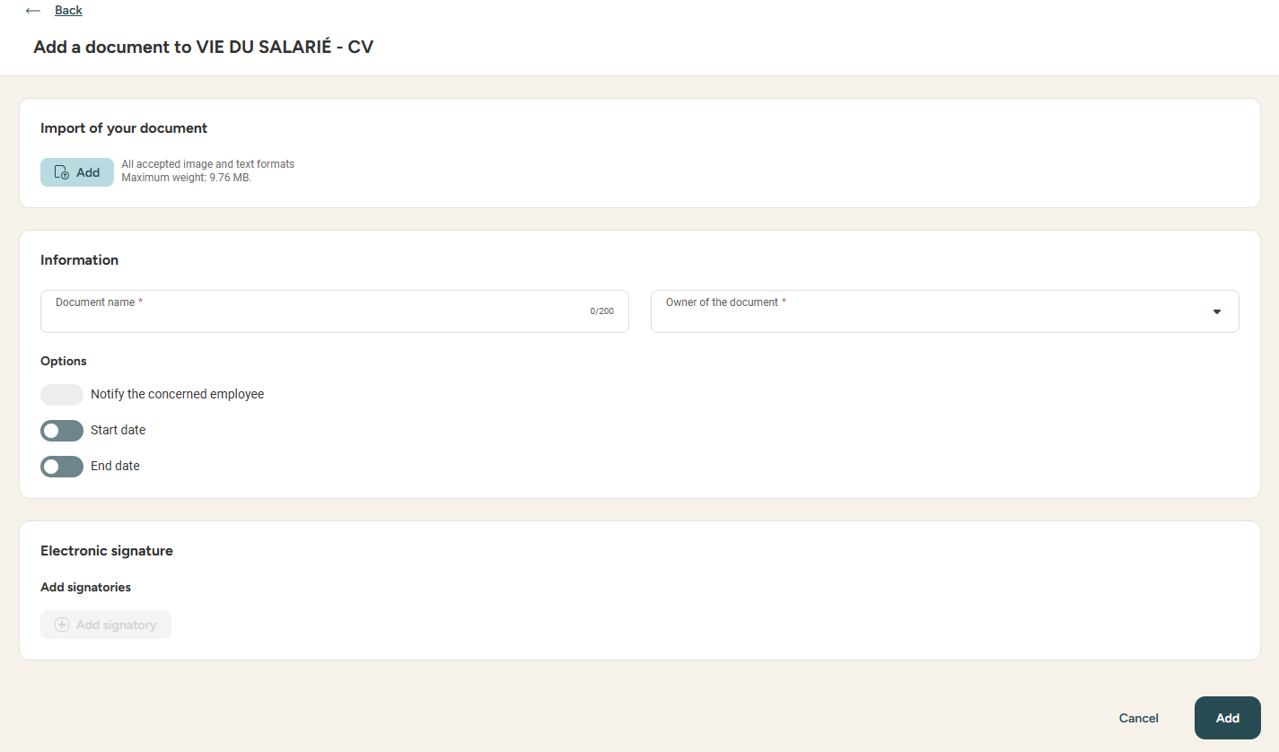
The documents’ space
Adding documents
The first step is very easy: simply click on Add a document!
You can then select which folder the document should be added to (only the folders you are allowed to edit are proposed at this step) and fill out the information:
  File upload
  File name
  Validity start date
  Validity end date
Finally, click Add
Pro tip: the validity start and end dates allow the activation of deadline notifications in order to stay on top of documents to update.

Slide 7
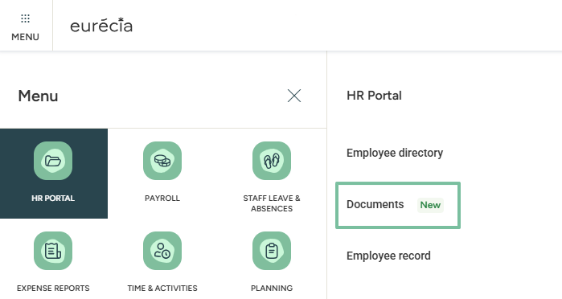
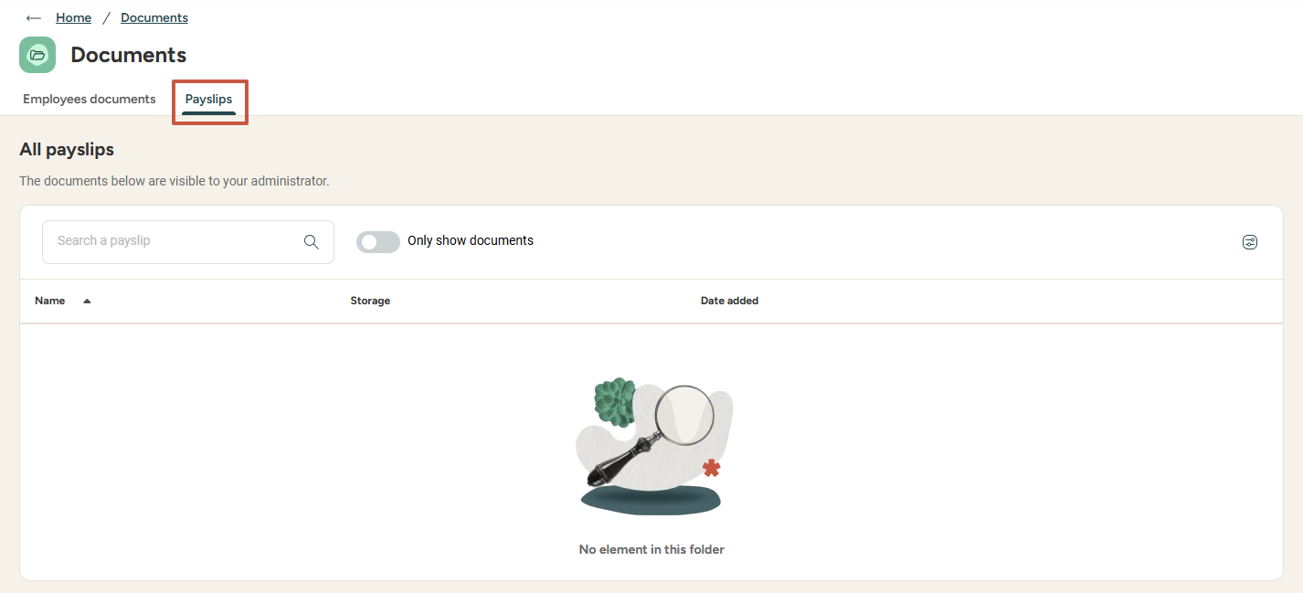
The documents’ space
Accessing your payslips
From the HR Portal module and by selecting Documents, then Payslips, you can access all your payslips.
You can click directly on the payslip you want and download it.

Slide 8
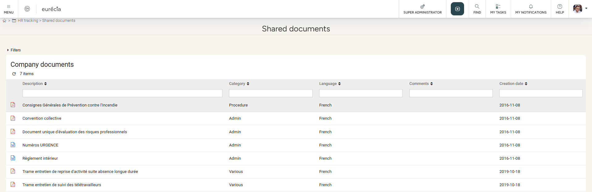
Shared documents
User view
From the HR portal module and by selecting Shared documents, you can view all documents shared by the company:
  Rules and regulations
  Collective agreement
  Safety instructions
  Information notes
  And more

Slide 9
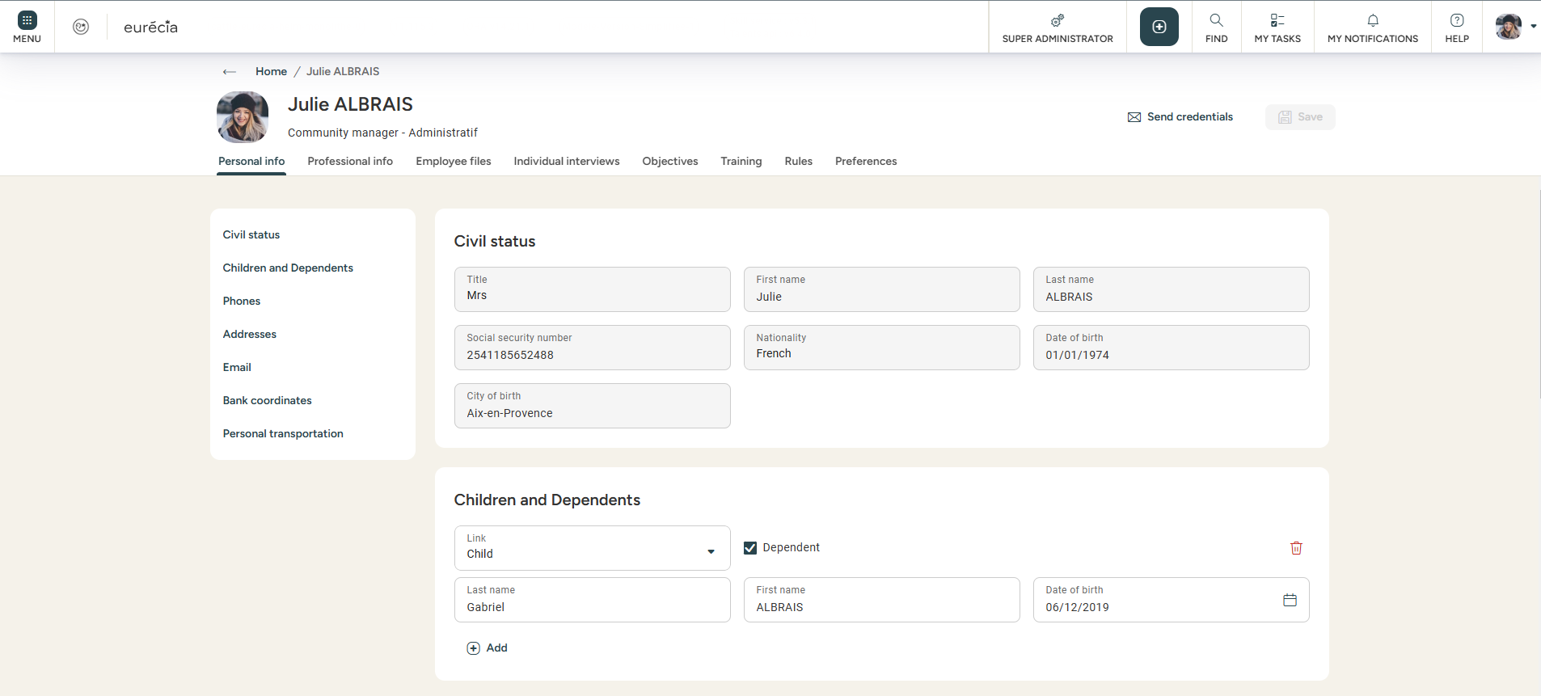
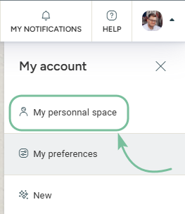
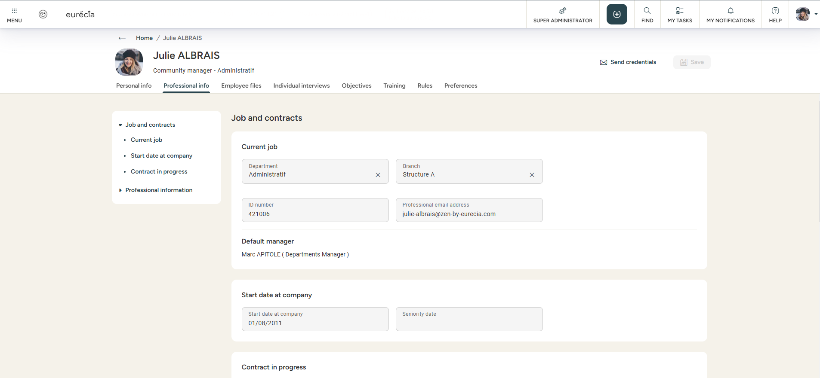
My employee file
Accessing my own file
From your personal space, you can find all your personal and contractual information! Depending on the settings input by your administrator, you may also have editing rights on some of the fields in your file.

Slide 10
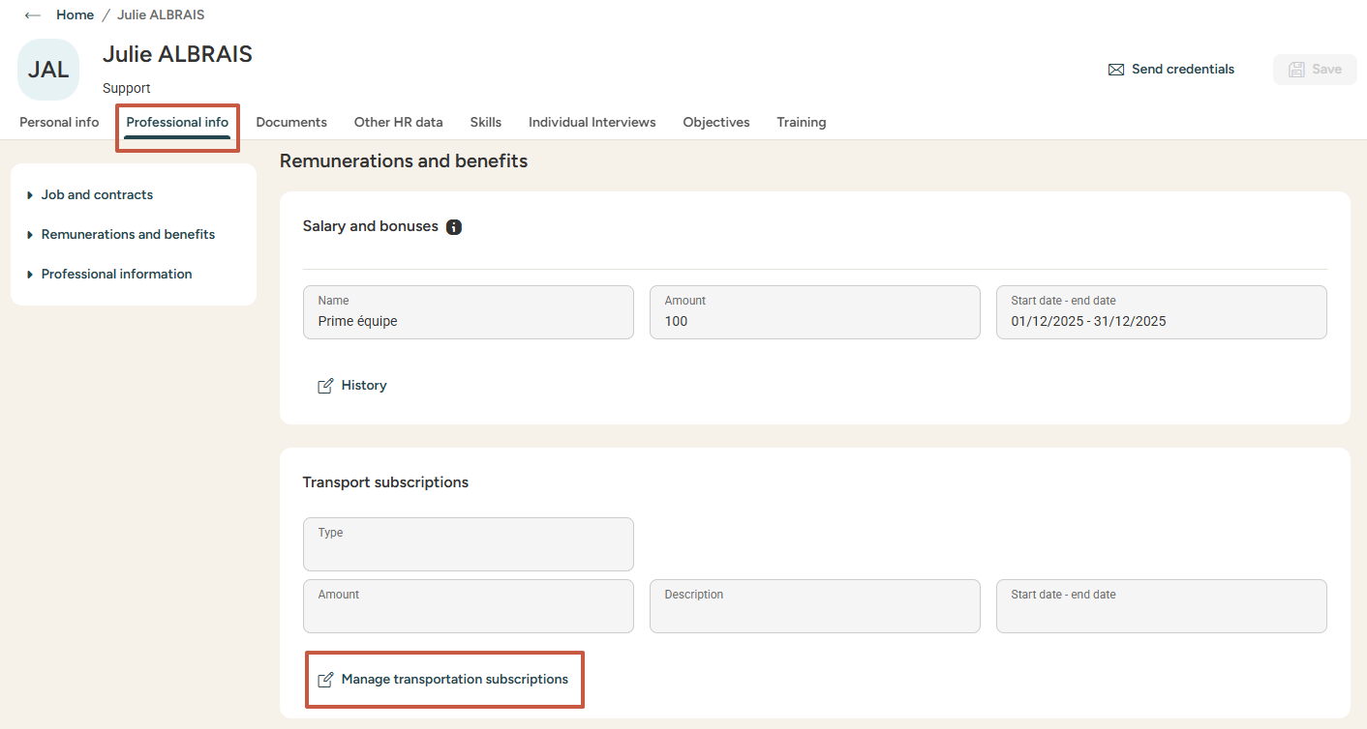
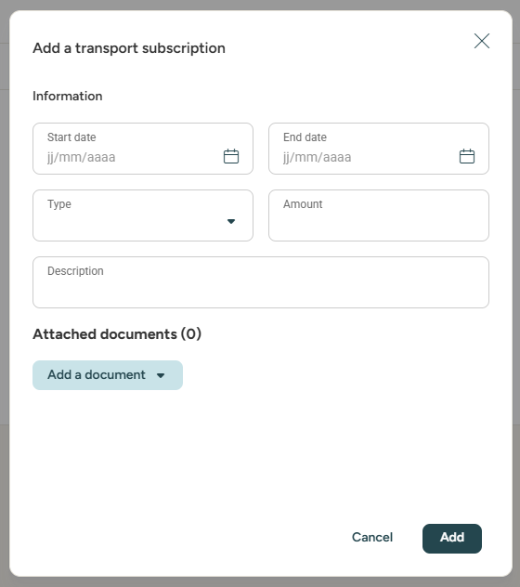
My employee file
  How can I input my public transport subscription in my file?
Adding a transport subscription
    From the Professional info tab of your file, scroll down to Transport subscription management to Add a subscription, indicating:
      A start and end date to the subscription, so as to be notified when it needs to be renewed;
      Adding the type of subscription (Train, public transport, etc.) as well as the amount for the period (month, trimester, year) indicated with the start and end date
      A supporting file, which you can upload from your computer or directly from your Documents space

Slide 11
Still have questions?
All the answers are within your reach.
Contact your administrator
Help center

