Slide 1


All you need to know about
Skills
Admnistrator training guide
Last updated
May 2026

Slide 2

admin area
Training program
MODULE features
Creating and editing skills
Creating and editing job types
Linking skills to a job type
Linking job types to employees
Accessing the skill overview
Creating, editing, deactivating and deleting skill levels

Slide 3
Module features
01

Slide 4
Creating and editing skills

Slide 5
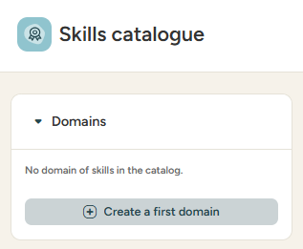
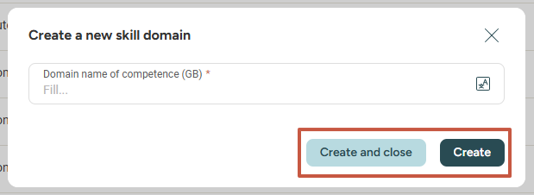
Managing a skills catalogue
Creating a skill domain
ACCESS: Menu > Skills > Skills catalogue
Click the + icon or the create button to create a new skills domain
Click create or create and close to save the new skill domain
Skill domains allow you to organise skills by thematics.

Slide 6
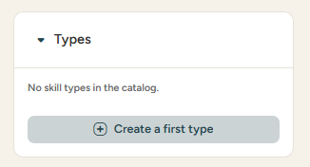
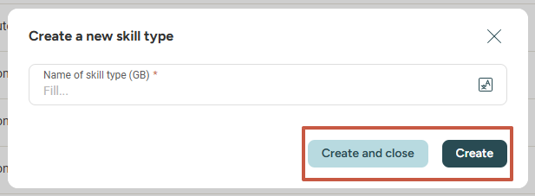
Managing a skills catalogue
Creating a skill type
ACCESS: Menu > Skills > Skills catalogue
Click the + icon or the create button to create a new skill type
Click create or create and close to save the new skill type
Skill types allow you to organise skills by category.

Slide 7

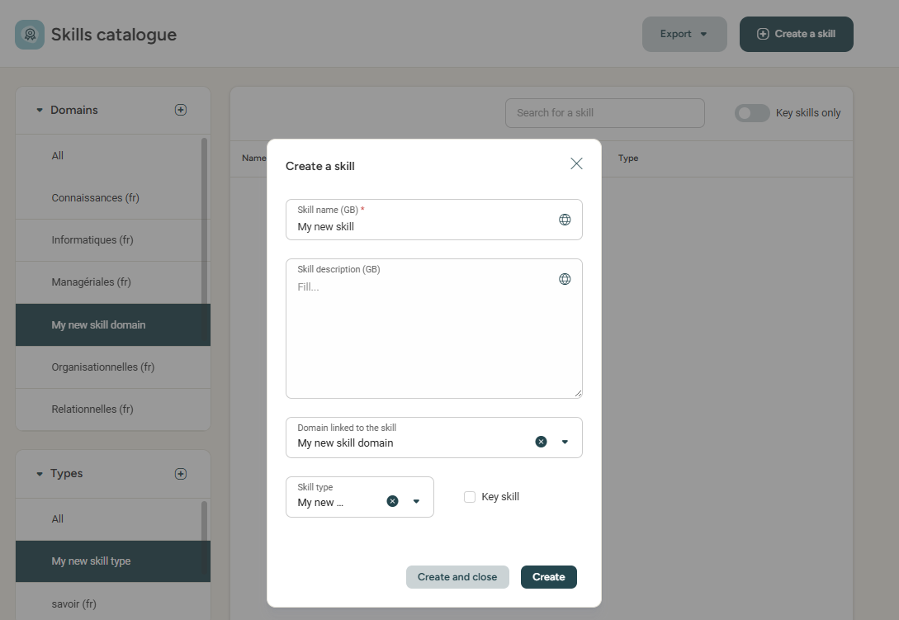
Managing a skills catalogue
Creating a skill
ACCESS: Menu > Skills > Skills catalogue
To create a new skill click :
Fill in the information :
Skill name
Skill description
Domain linked to the skill
Skill type
Check/Uncheck Key skill
Linking the skill domain and type is
not mandatory, but can be useful
in order to categorise/filter your skill catalogue.
A key skill is a skill that is essential in your company.
For example, speaking English is a key skill
for a company operating internationally.

Slide 8
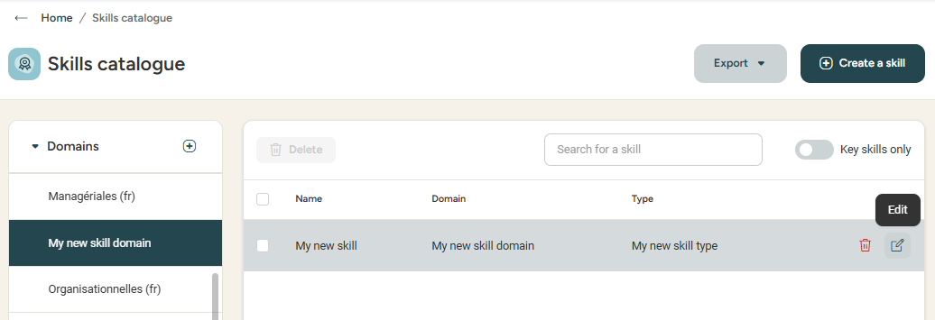
Managing a skills catalogue
editing a skill
ACCESS: Menu > Skills > Skills catalogue
To edit the info about a skill,
click the pen icon
Please note: A skill can not be deleted whilst still linked
to a job, training or employee.

Slide 9
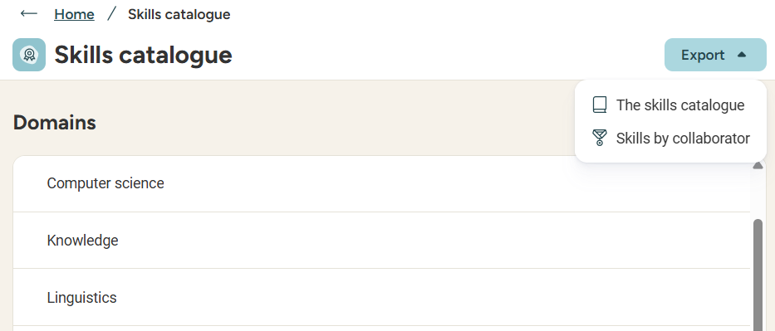
Managing a skills catalogue
Exporting the skill catalogue
ACCESS: Menu > Skills > Skills catalogue
Good to know! Exports are sent directly to your inbox.

Slide 10
Creating and editing job types

Slide 11
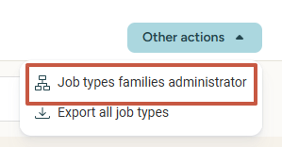
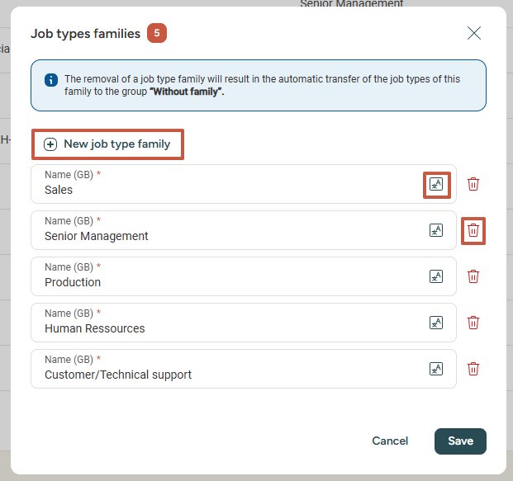
Managing a jobs catalogue
creating a job type family
ACCESS: Menu > Skills > Job types
Job types can be organised by families.
To access the existing job type families, click :
Add a new job type family
Add title translations in different languages
Delete a job type family

Slide 12
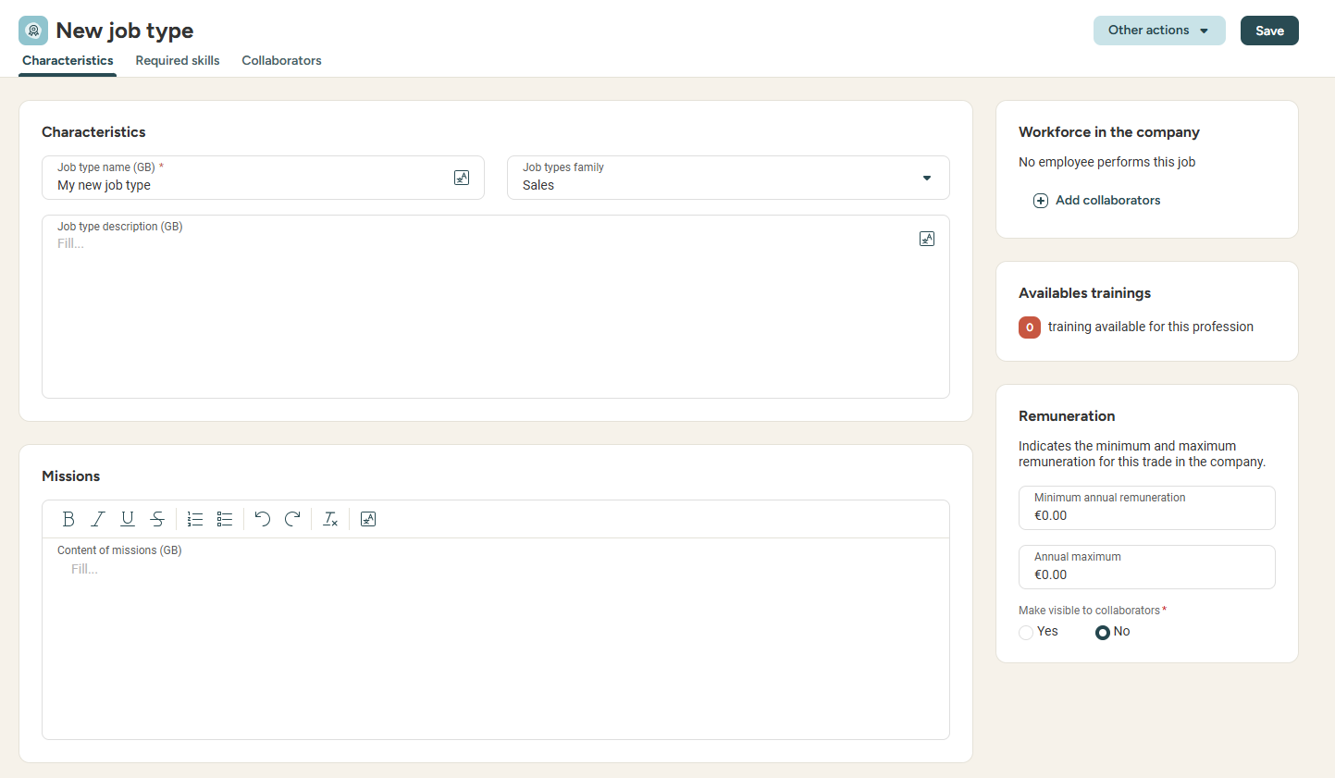

Managing a jobs catalogue
Creating a job type
ACCESS: Menu > Skills > Job types
From this menu, you can fill the relevant info for this job type :
Job type name
Job type family
Job type description
Missions
Minimal and maximal annual pay

Slide 13
Linking skills to a job type

Slide 14
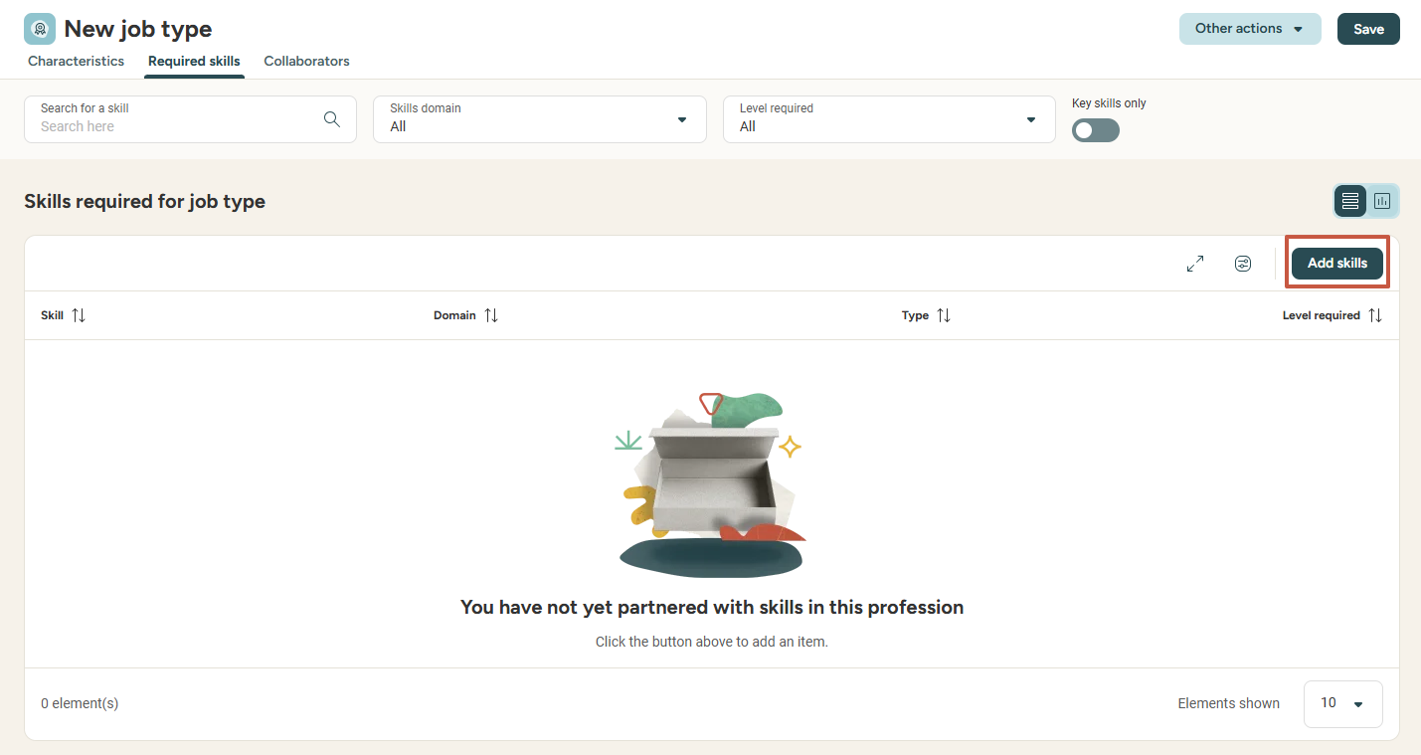
Managing a job type catalogue
Linking a skill to a job type
ACCESS: Menu > Skills > Job types
In order to finalise the job type creation, it is essential to link skills to it from the required skills tab.
Add as many skills as necessary to your job type.

Slide 15
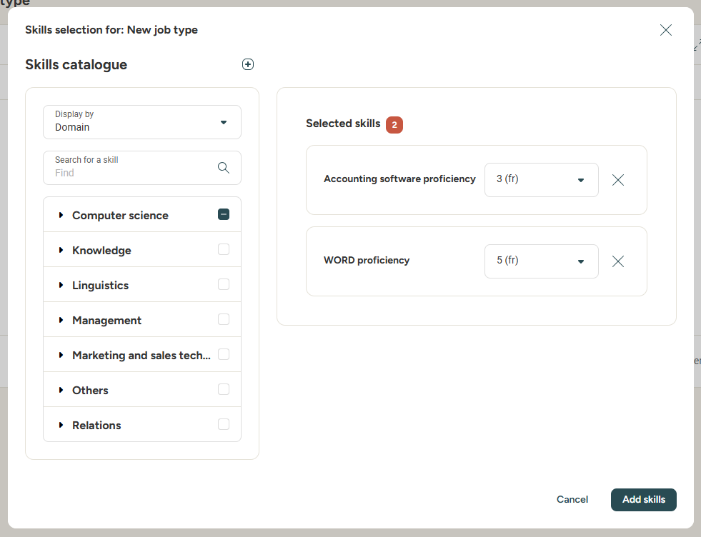
Managing a job type catalogue
Linking a skill to a job type
ACCESS: Menu > Skills > Job types
Select the level required for this skill.
Select the skill
you wish to link
(by checking the box)
Click add skills, and voila!

Slide 16
Linking a job type to an employee

Slide 17
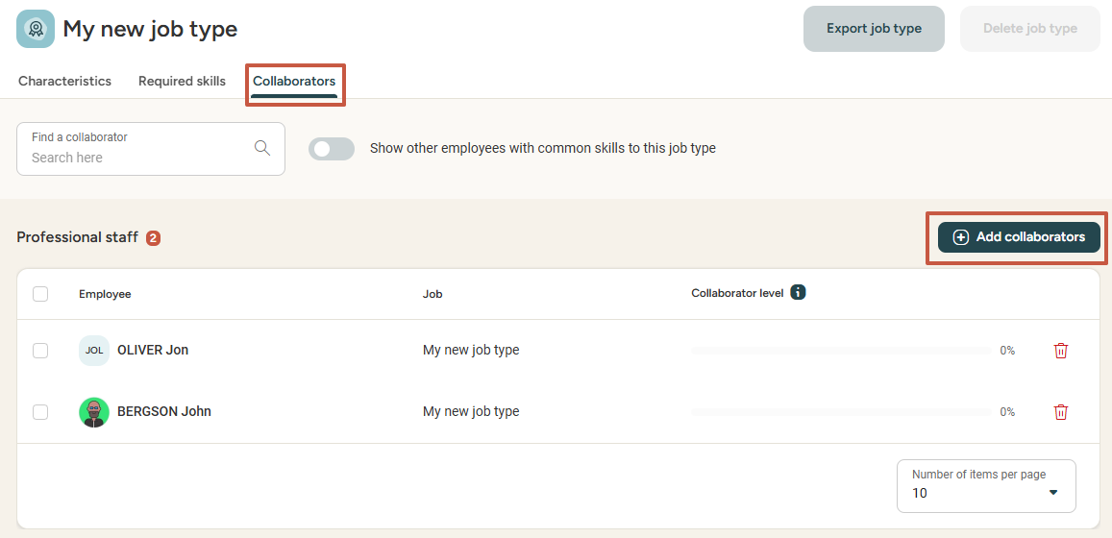
Managing a job type catalogue
Linking a job type to an employee
ACCESS: Menu > Skills > Job types
In order to finalise the job type creation, it is essential to identify collaborators who practise this job with the Add collaborators button
.
Doing this will enable you:
To analyse your company's skillset by filtering employees who have acquired selected skills.
Conduct skill evaluations (if the Interviews module is subscribed to)
Allow your employees to conduct self-evaluations on job types different to their own.

Slide 18
Accessing the skills overview

Slide 19
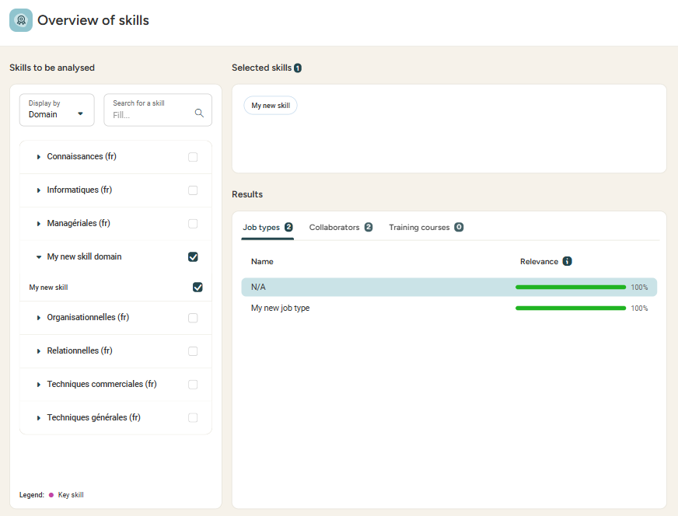
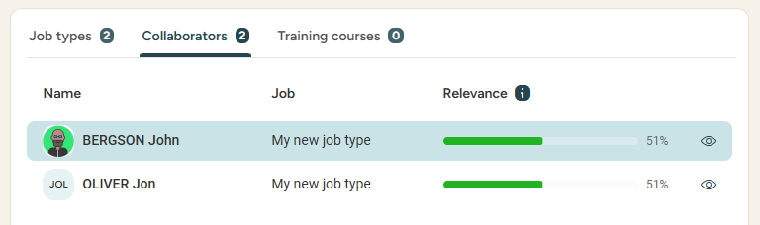
Exploiting the data
Skills overview
ACCESS: Menu > Skills > Overview of skills
Select the skills you wish to analyse.
Visualise the job types, employees and trainings linked to the skill.

Slide 20
Wage gap transparency​
06

Slide 21
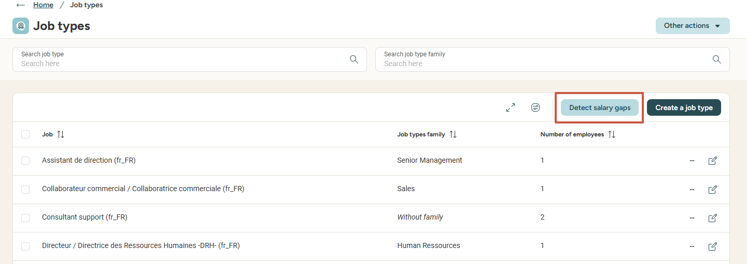
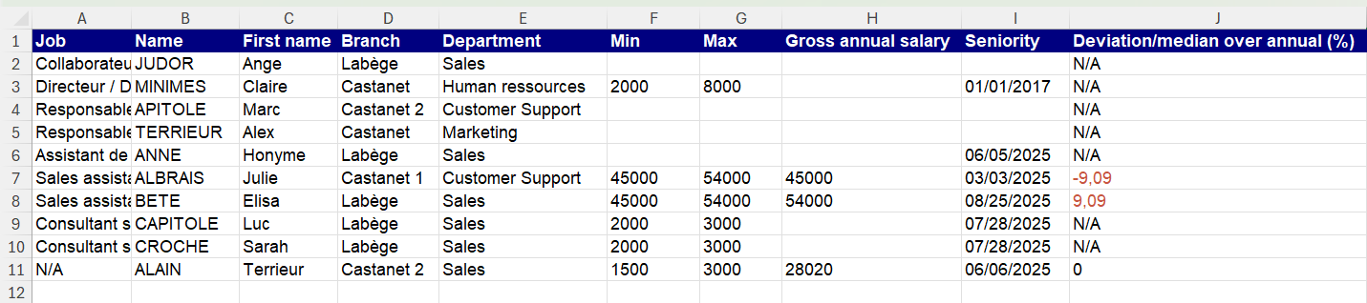
Data exploitation
Detecting wage gaps
ACCESS : Menu > Skills > Job types > Detect salary gaps
- With the help of Eurecia, you can analyse the pay gaps between your collaborator’s data and the job type median.
- Export an excel file with all your employees and their trades to identify pay gap. deviations are calculated from the median of wages per trade.

Slide 22
Admin area
02

Slide 23
Creating, editing, deactivating and deleting skill levels

Slide 24
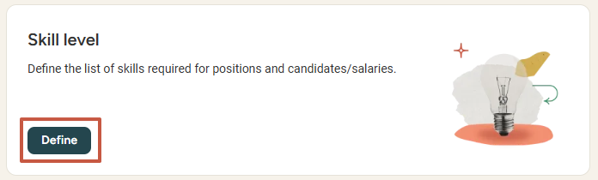
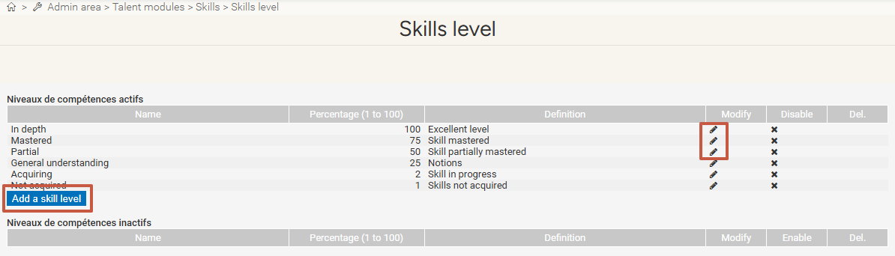
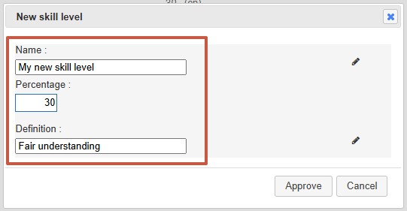
Managing skill levels
Creating / editing a skill level
ACCESS: Menu > Admin area > Skills
Click the pen icon
to edit the skill level
Click on Add a skill level
Fill in the name, percentage of completion and definition for the new/edited skill level,
then click approve.

Slide 25
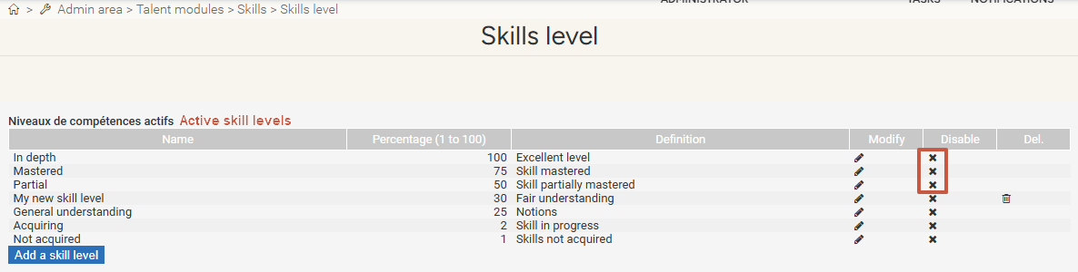
Managing skill levels
Deactivating / Deleting a skill level
ACCESS: Menu > Admin area > Skills
Click the cross to deactivate a skill level.
The skill level now appears in the disabled skill level category:
Click the bin icon to delete it.
Please note: You can disable but not delete default levels.

Slide 26
Still have questions?
All the answers are within your reach.
support@eurecia.com
Help center

