Slide 1


All you need to know about
General settings
Administrator training guide
Last updated
July 2025

Slide 2

At the end of this training, administrators will be able to:
Training objectives
Use the basic administration features for the platform

Slide 3

Admin Area
Training program
Accessing the help center and release notes
Creating and archiving users
Sending login details
Updating company records
Creating departments
Creating branches
Customising the platform design
Setting up approval cycles
Setting up alerts
Creating work shifts
Creating report criteria (analytics)
Creating custom user lists
Updating calendars and bank holidays

Slide 4
Admin area

Slide 5

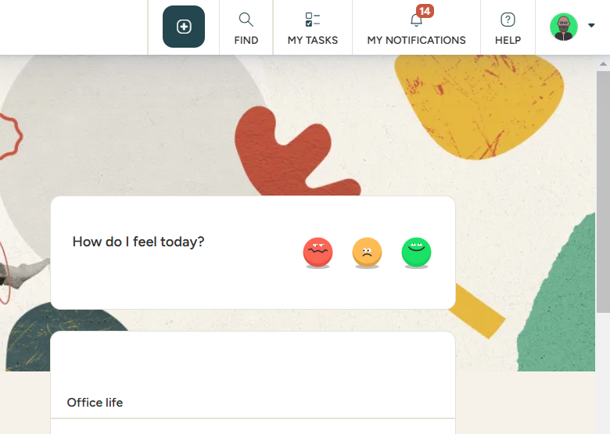
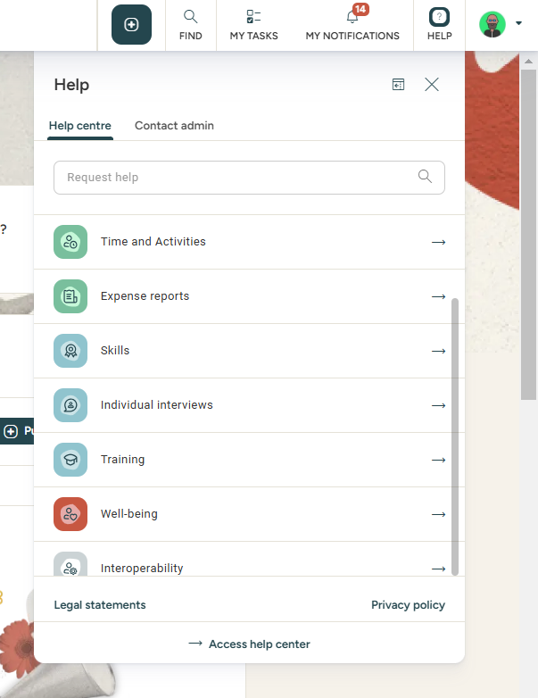

Accessing the help center
Accessing the help center
Access: Home page
You may look for specific articles by using keywords or by modules
By clicking Access help center, you can open the article in a separate tab.

Slide 6
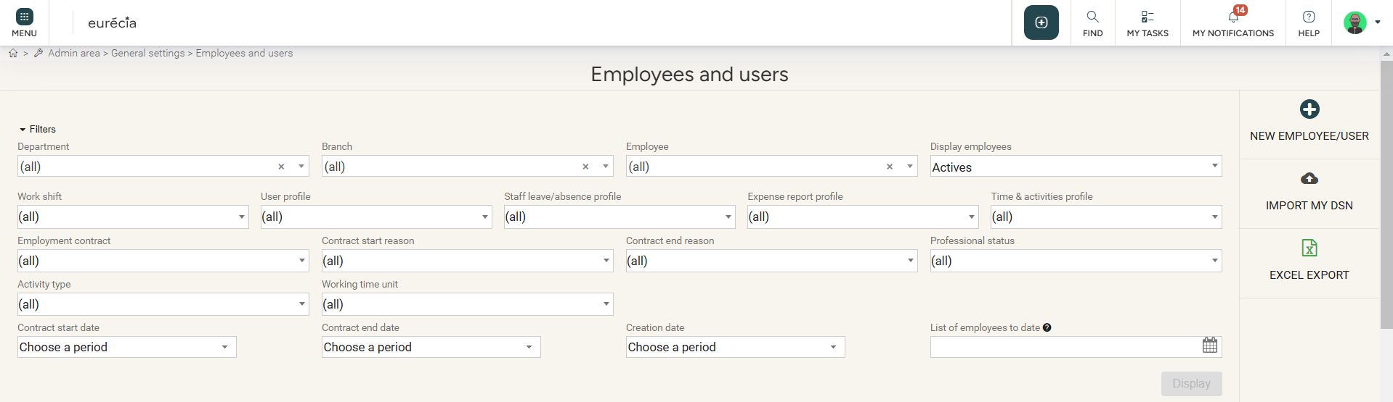
Creating new users
User creation
Access : Admin area > General settings > Employees & users : New employee/user

Slide 7
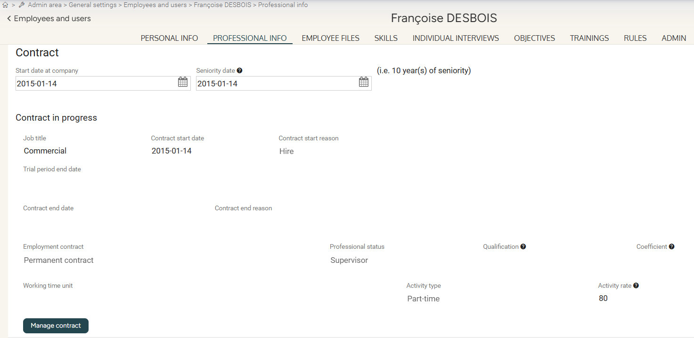
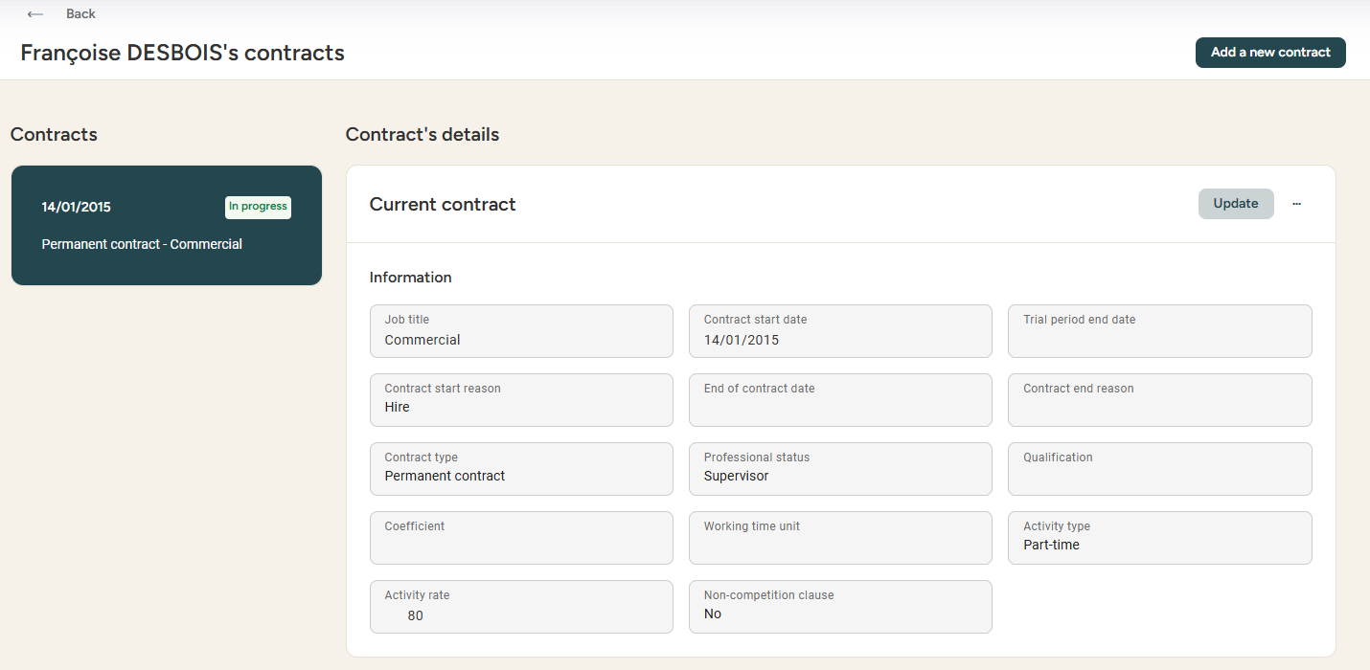

Archiving employees
Archiving employees
Access : Admin area > General settings > Employees & users
Managing contracts in employees' files
Updating contracts

Slide 8
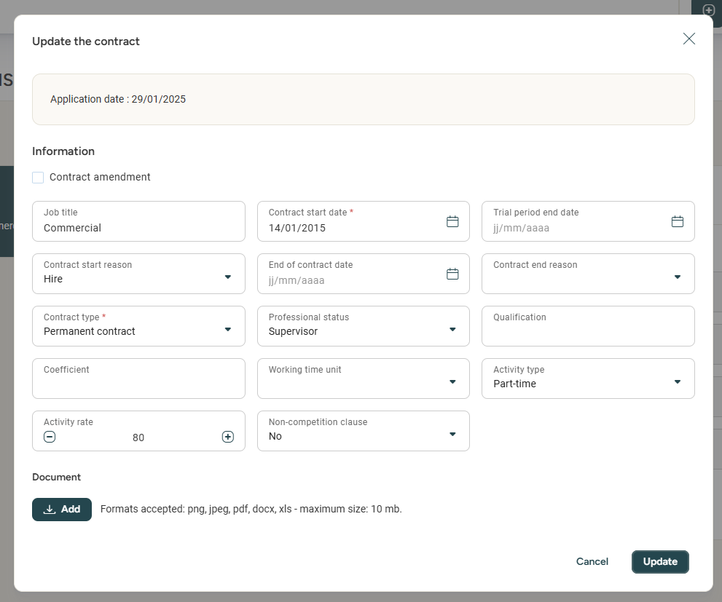
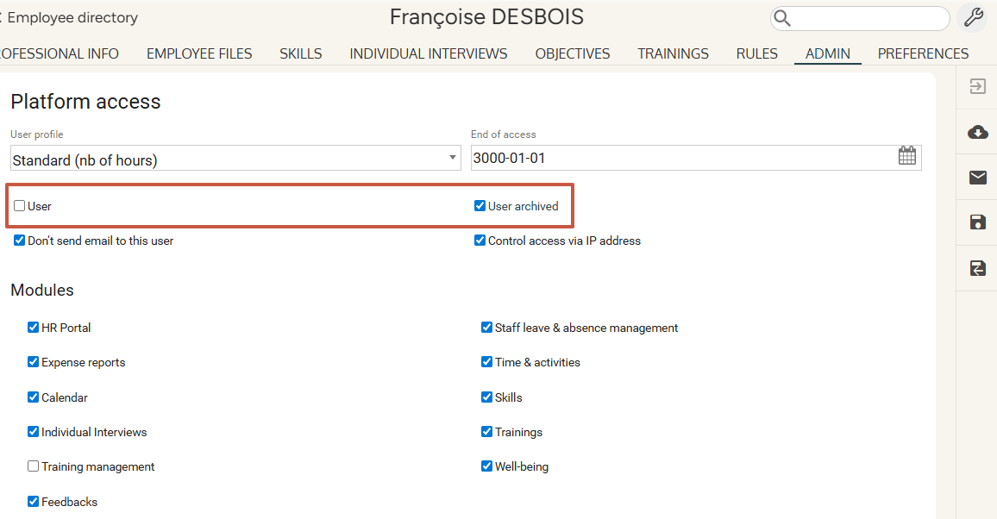
Archiving employees
Archiving employees
Access : Admin area > General parameters > Employees & users
Indicating an end of contract date
Archiving a user

Slide 9
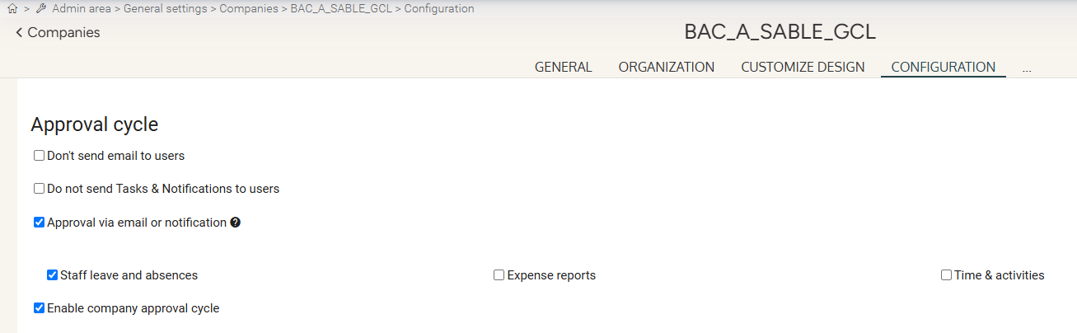
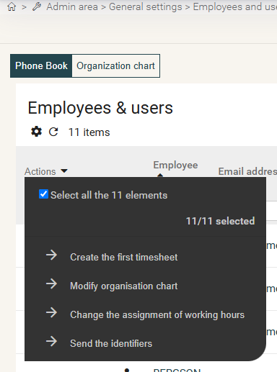
Sending login details
Activating emails and notifications
Access : Admin area > General settings > Company record > Configuration
Access : Admin area > General settings > Employees & users

Slide 10
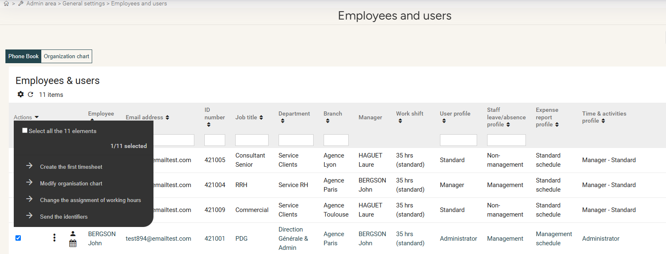
Creating the first timesheet
If applicable
Access: Admin area > General settings > Employees & users

Slide 11
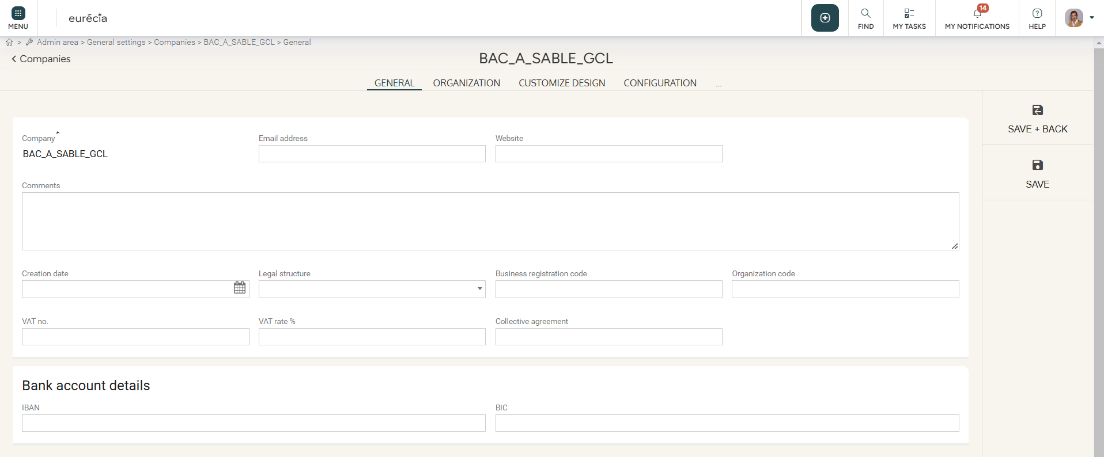
Company record
Your company
Access: Admin area > General settings > Company record > General
Enter your company’s information:

Slide 12
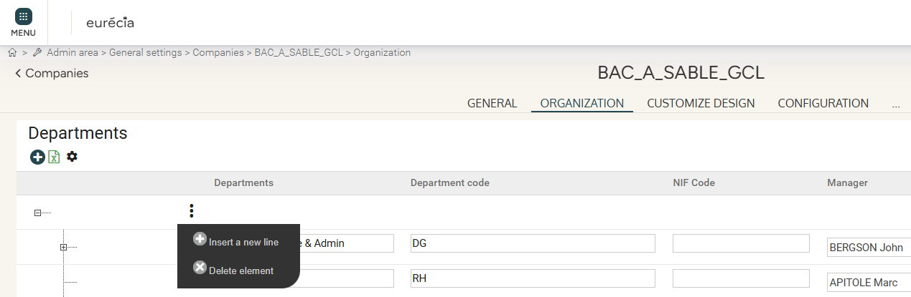
Company record
Creating departments
Access: Admin area > General settings > Company record> Organization

Slide 13
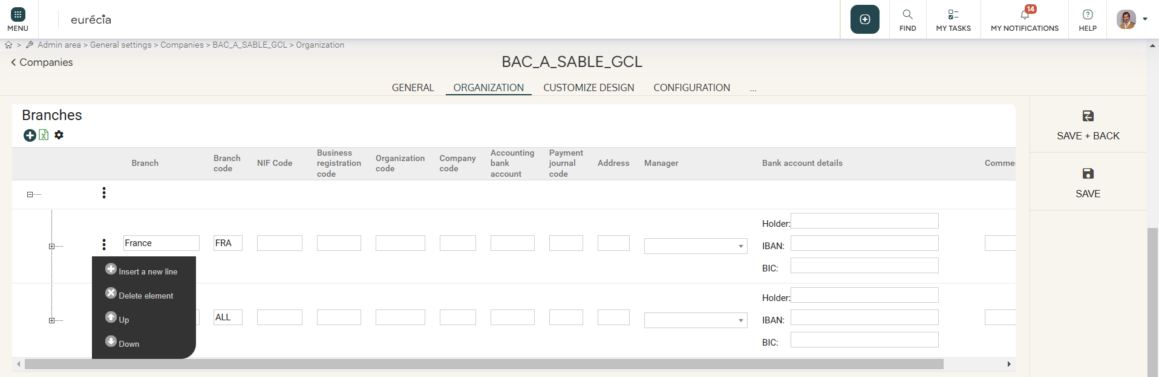
Company record
Creating branches
Access: Admin area > General settings > Company record > Organization

Slide 14
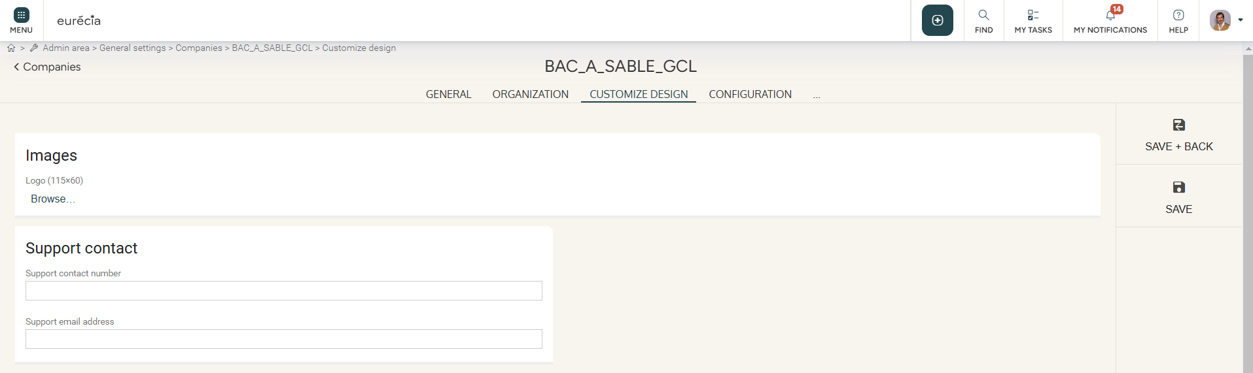
Company record
Insert a logo
Access : Admin area > General settings > Company record > Customize design
Select the logo to display on the homepage using the “Browse” button:

Slide 15
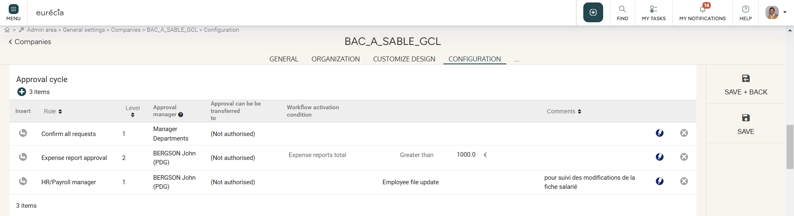
Company record
Creating an approval cycle
Access : Admin area > General settings > Company record > Organization

Slide 16
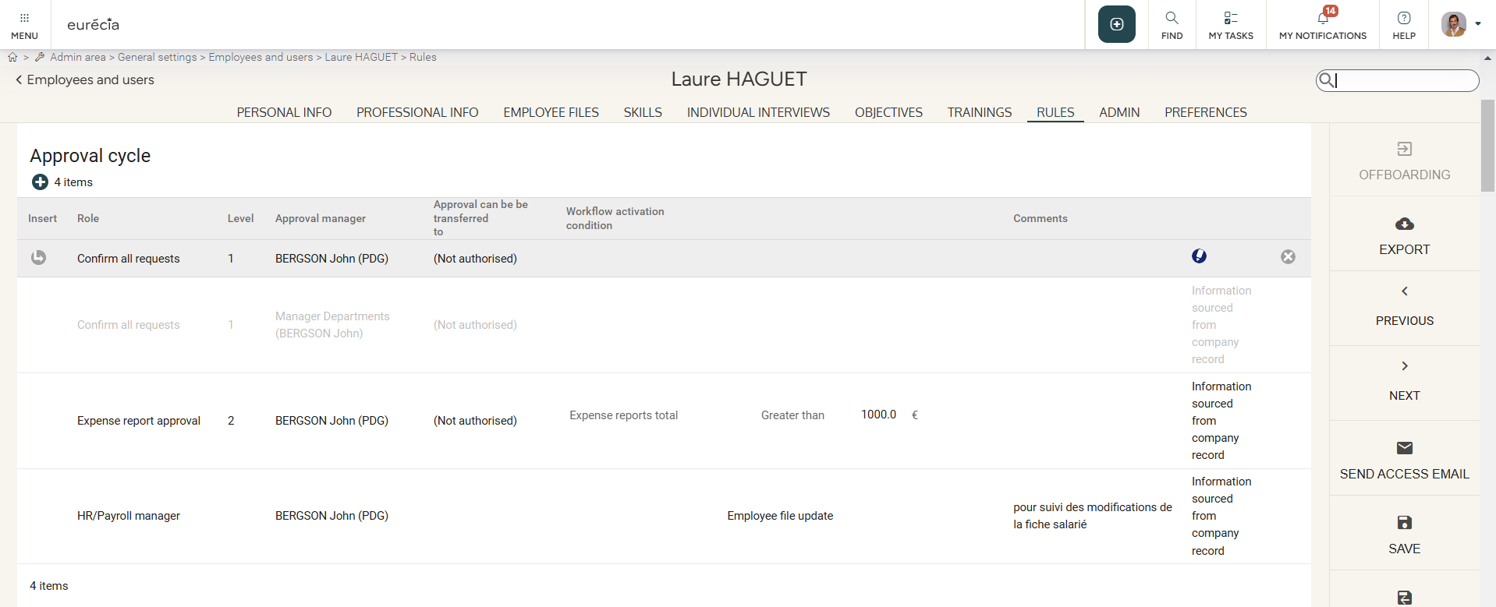
Company record
Creating an approval cycle for a specific employee
Access: Admin area > General settings > Employees & users > Select an employee > Rules
In the employee record, the line concerning the company validation process cannot be deleted;
the line is grayed out when a new validation process is added.
The information on the employee’s record takes precedence over the information on the company’s record.

Slide 17
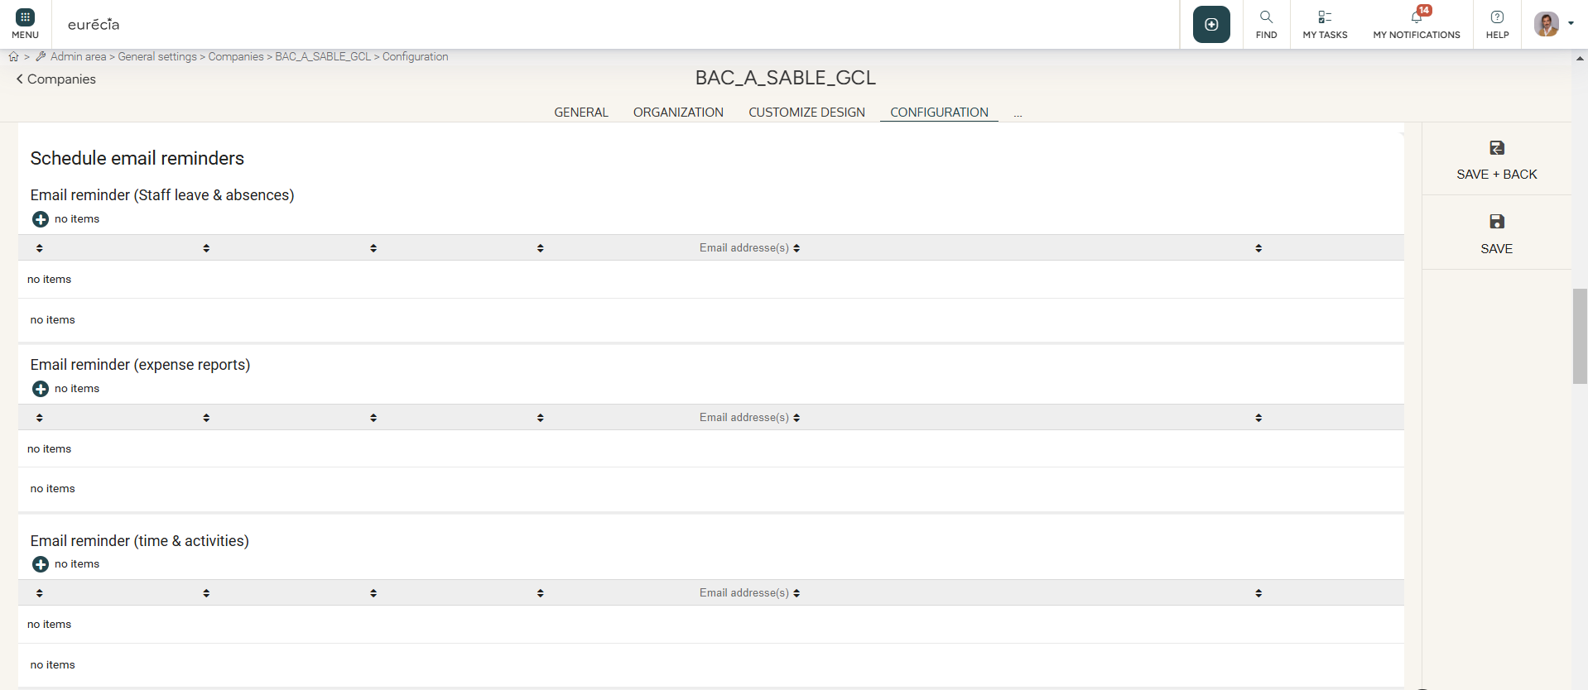
Company record
Setting up reminders
Access : Admin Area > General settings > Company record > Configuration

Slide 18
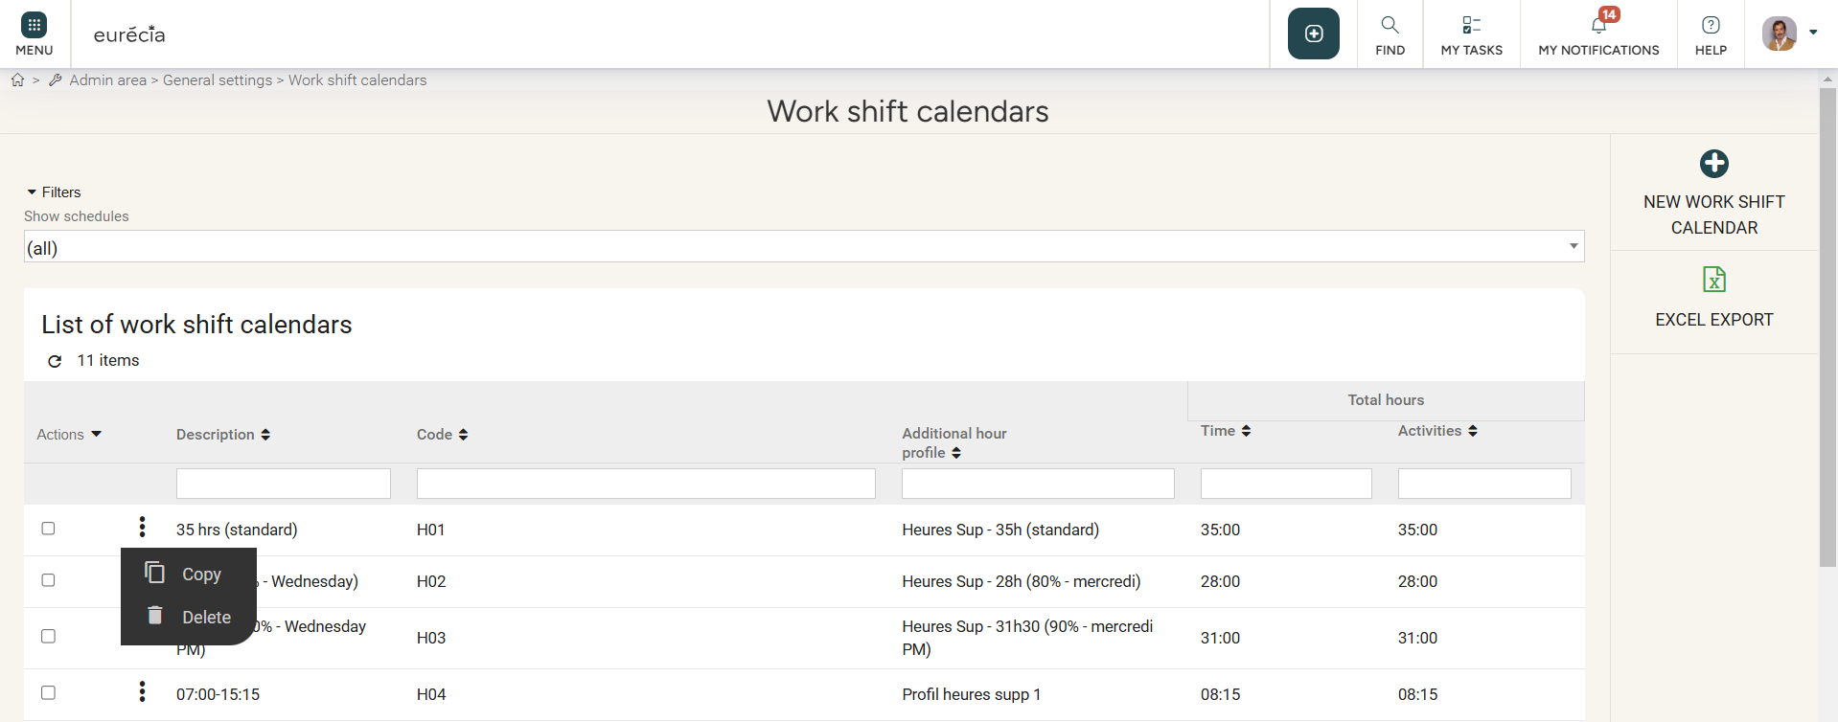
Work shift calendars
Creating work shift calendars
Access: Admin area > General settings > Work shift calendars

Slide 19
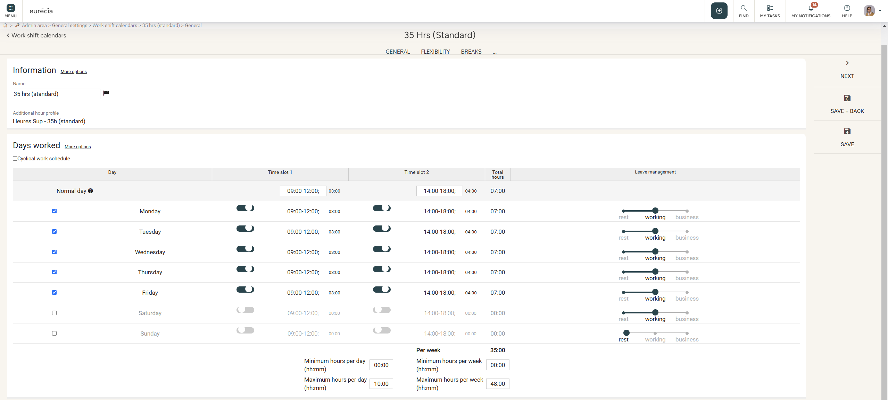
Work shift calendars
Creating work shift calendars
Access: Admin area > General settings > Work shift calendars

Slide 20
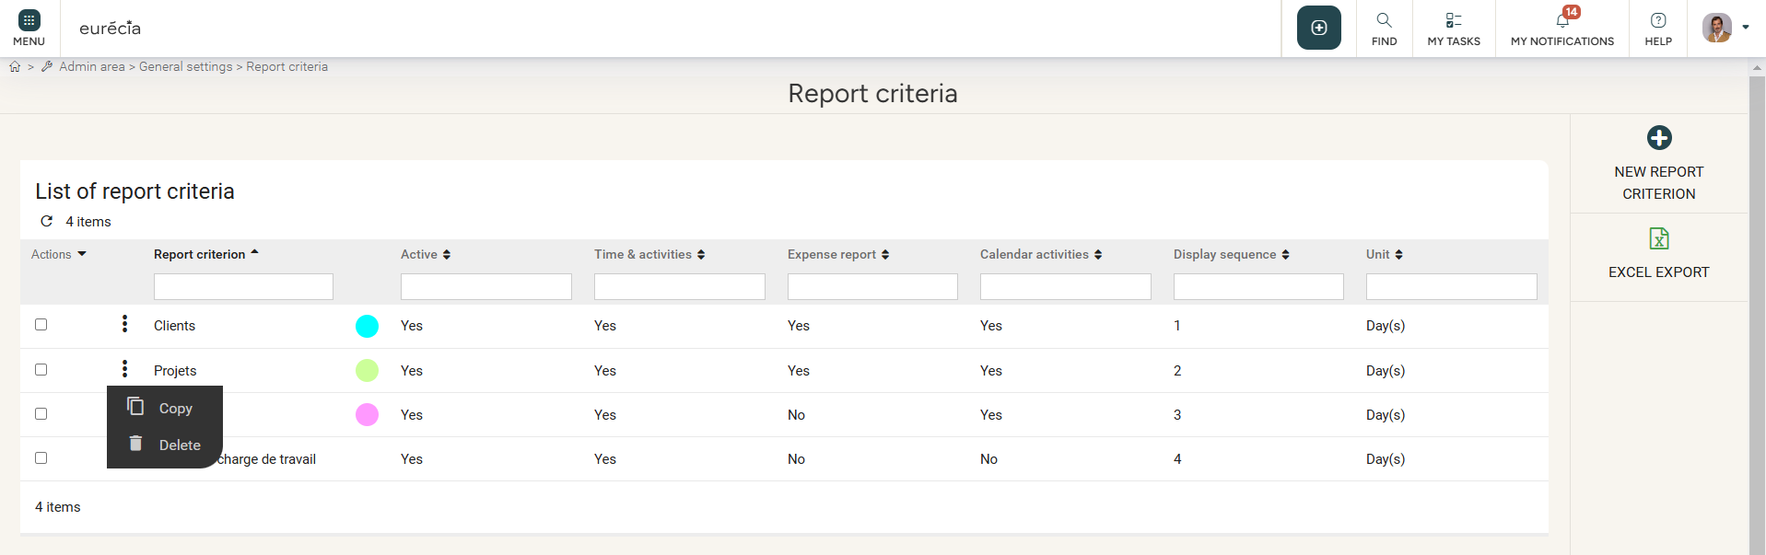
Report criteria
Creating report criteria (analytics)
Access: Admin area > General settings > Report criteria
You can only create 5 report criteria . However, you can create as many analytical accounts as you want.

Slide 21
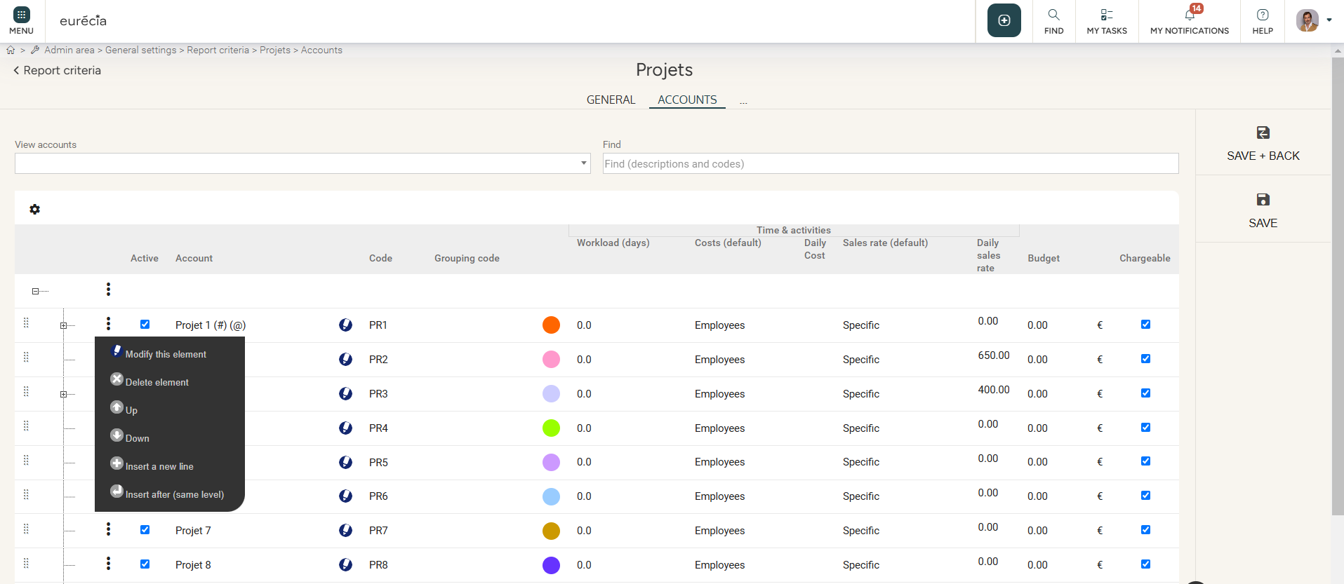
Analytical axes
Creating analytical accounts
Access: Admin area > General settings > Report criteria
Upon opening a report criterion:

Slide 22
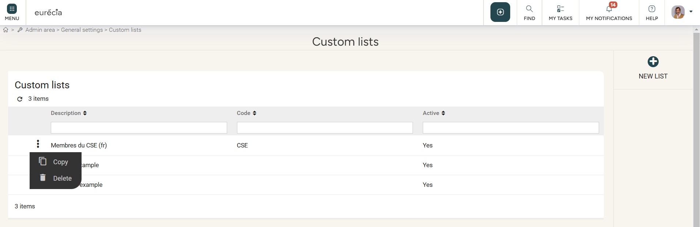
Custom user list
Creating custom user lists
Access: Admin area > General settings > Custom user lists

Slide 23
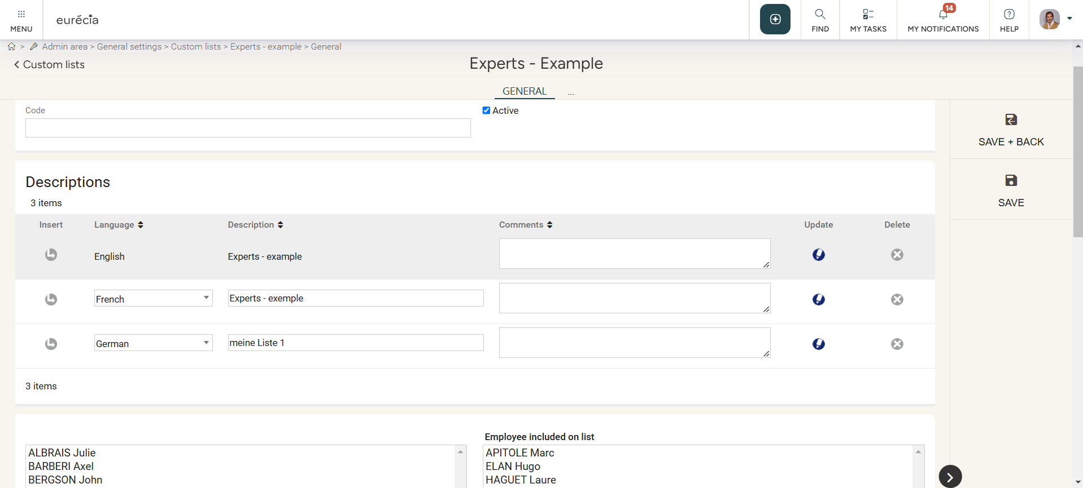
Custom user list
Creating custom user lists
Access: Admin area > General settings > Custom user lists

Slide 24
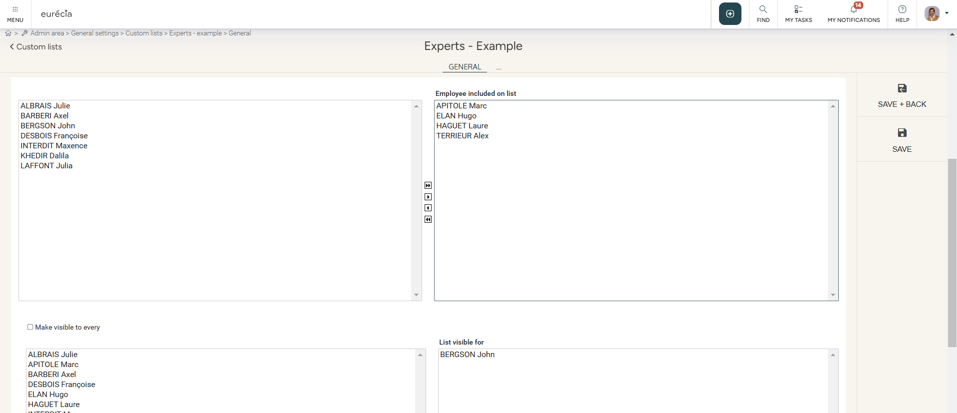
Custom user lists
Creating custom user lists
Access: Admin area > General settings > Custom user lists

Slide 25
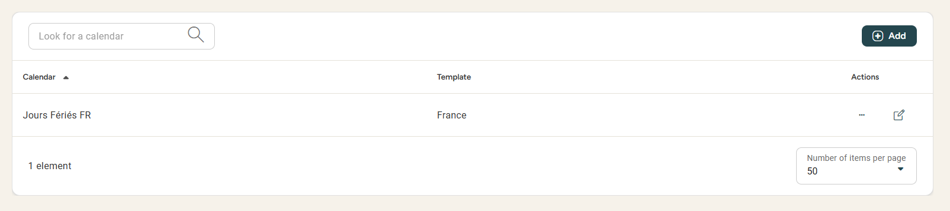
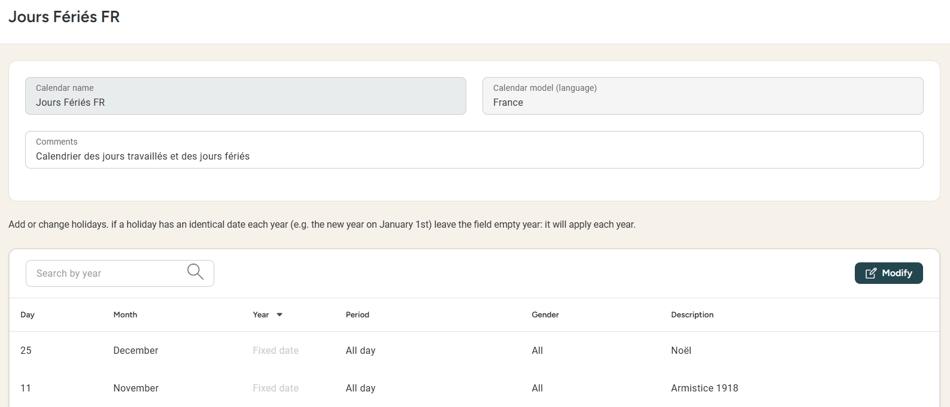
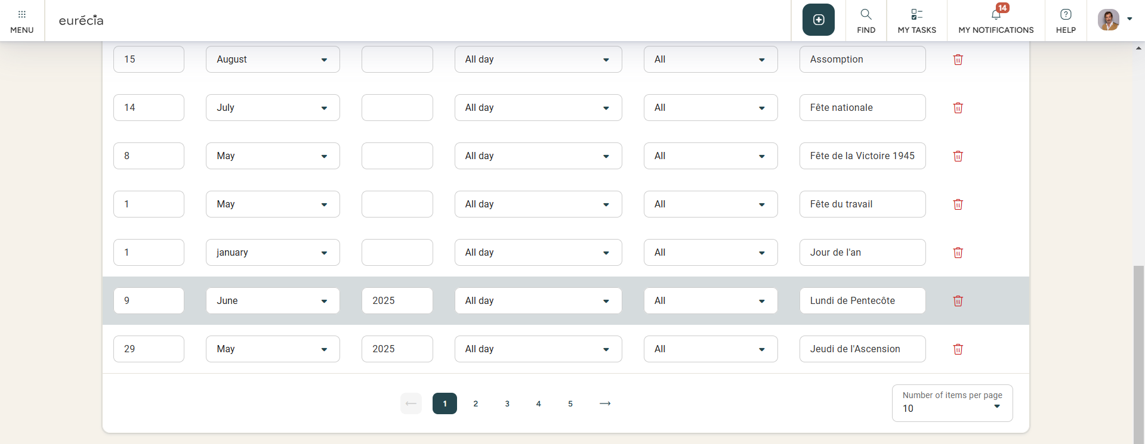
Public holiday calendar
Updating Public holiday calendars
Access : Admin area > General settings > Public holiday calendar
Example : Deleting a bank holiday such as the 9th of June 2025 (France)

Slide 26
Still have questions?
All the answers are within you reach.
support@eurecia.com
Help center

