Slide 1

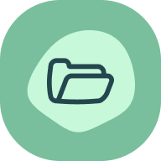
All you need to know about
HR Portal
Administrator training guide
Last updated
October 2025

Slide 2
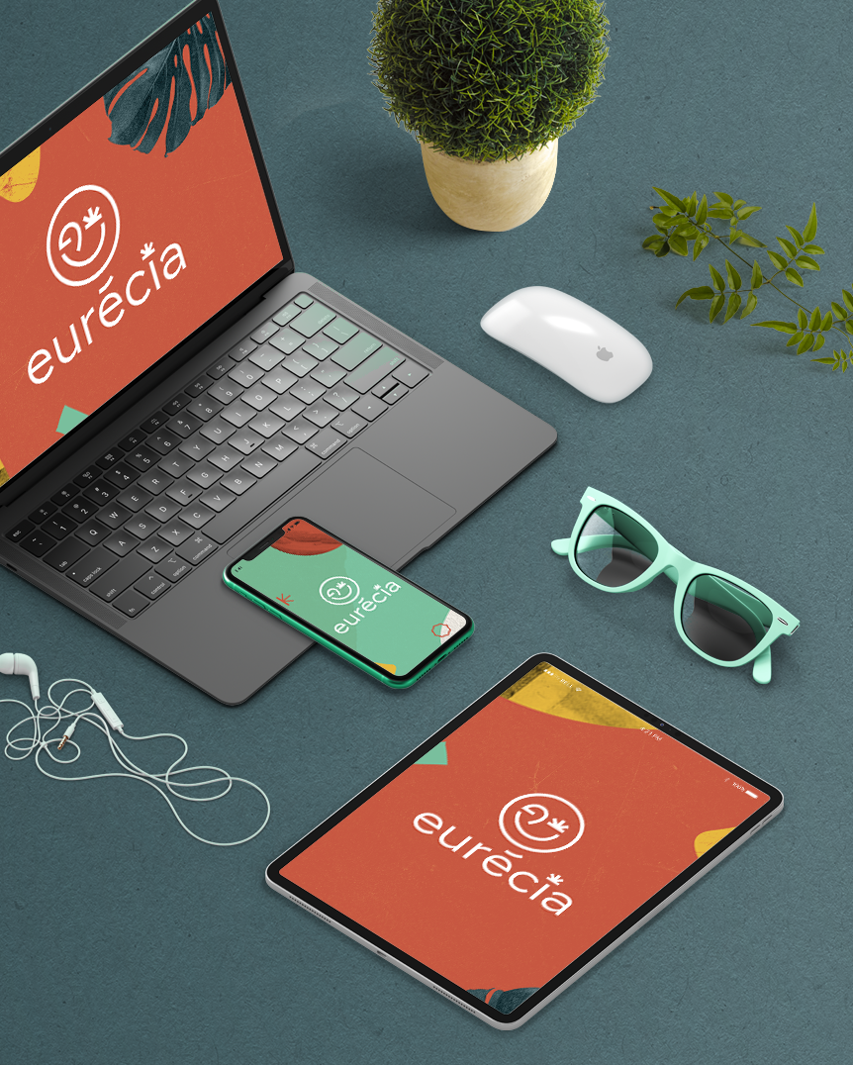
At the end of this training, administrators will be able to:
Training objectives
Manage the employee lifecycle and archive elements in their file
Add an element to the employees’ documents
Share documents
Import payslips
View HR dashboard
Prepare for the onboarding and offboarding of employees
Set up the new documents space and user sheet

Slide 3


Module features
Training program
Managing employee lifecycle
Administration of employees documents
Creation of document templates
Adding shared company documents
HR dashboard
Managing alerts
Onboarding/Offboarding management (Models, tasks, welcome email, onboarding form)
Payslips import
Admin area
Managing access to HR related tasks
Setting up the employee documents
Setting up user sheets

Slide 4
Module features

Slide 5
Managing the employee lifecycle

Slide 6
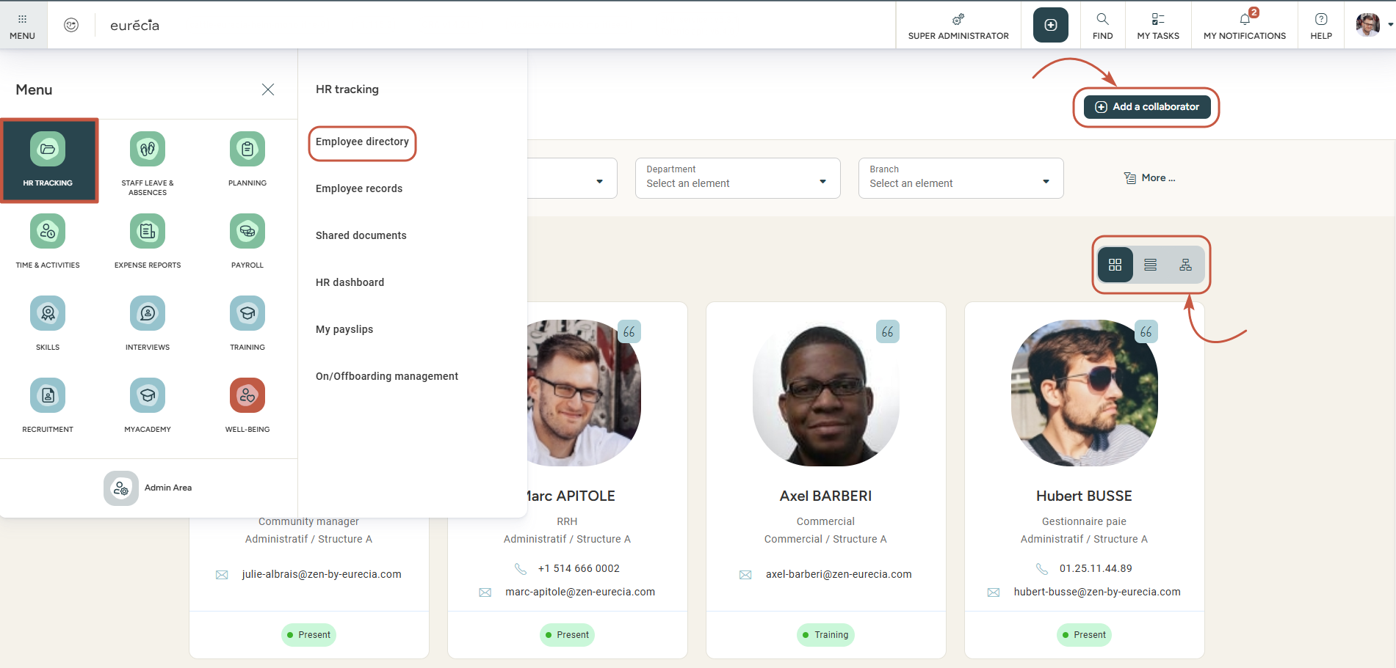
Managing employee lifecycle
Access n°1: HR portal > Employee directory
Add a new user from this screen
Display the directory as a list or as an organisational chart
Good to know ! By clicking on an employee’s line, you can access their employee file.

Slide 7
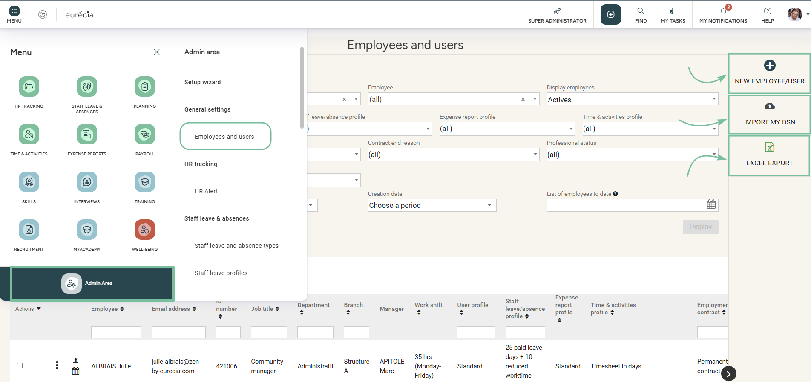
Managing employee lifecycle
Access N°2: admin area > general settings > employee directory
New employee/User
Import "DSN"
Export employee related data
DSN : Déclaration Sociale Nominative
-> Nominative Social Declaration

Slide 8
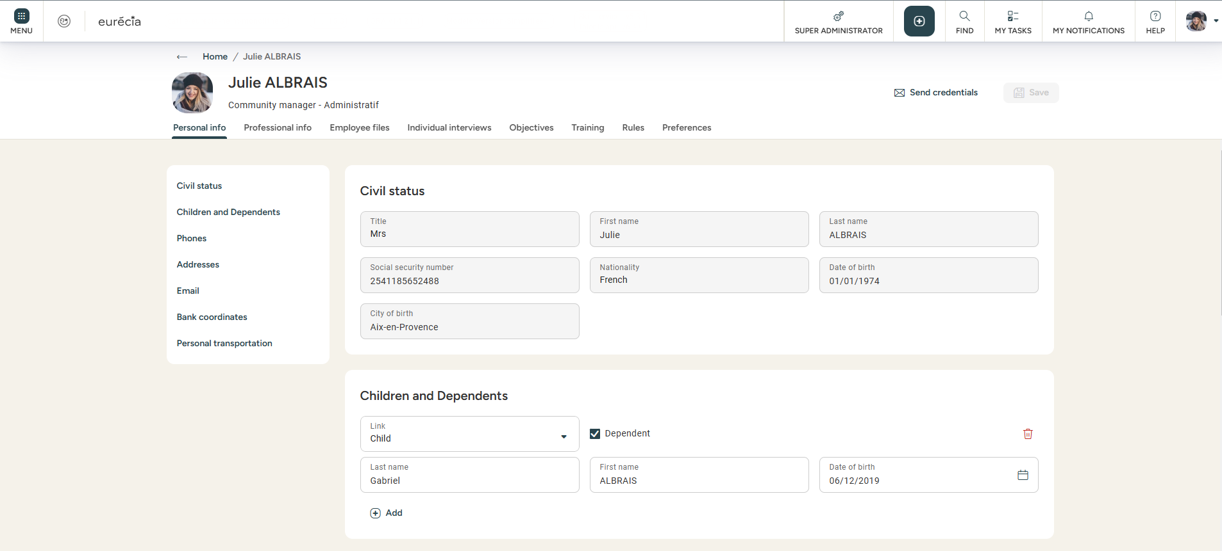
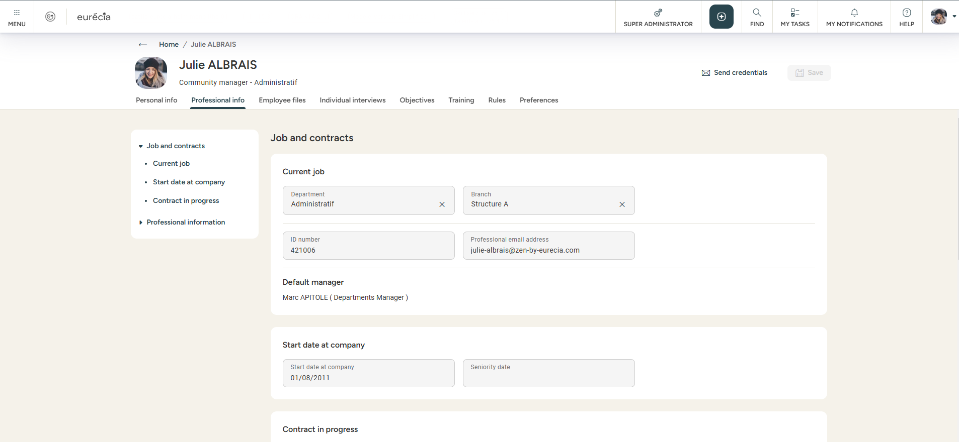
Managing employee lifecycle
Employee directory overview
You can change the employee’s information in the "Personal info" and "Professional Info« tabs.

Slide 9
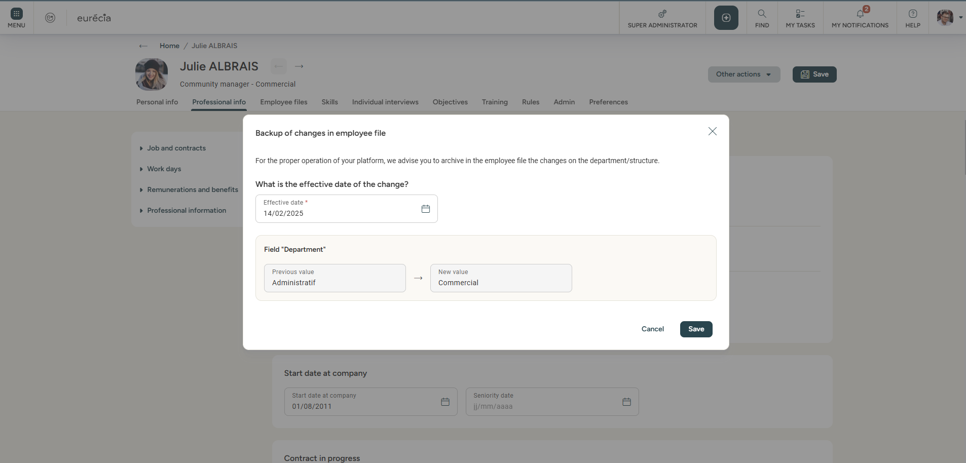
Managing employee lifecycle
Data history in the employee’s file
When you modify certain fields in the employee’s file, Eurécia suggests to store the values in the “Employee file” when you save it.
This allows you to track the chronology of the employee’s changes.

Slide 10
Employee documents

Slide 11
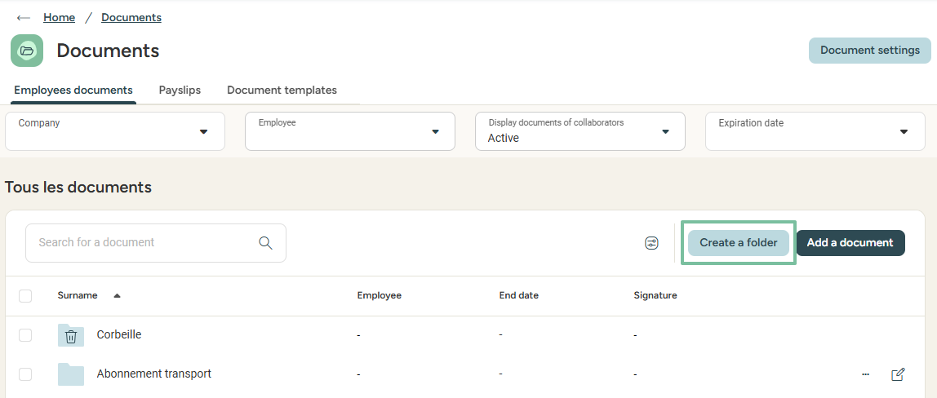
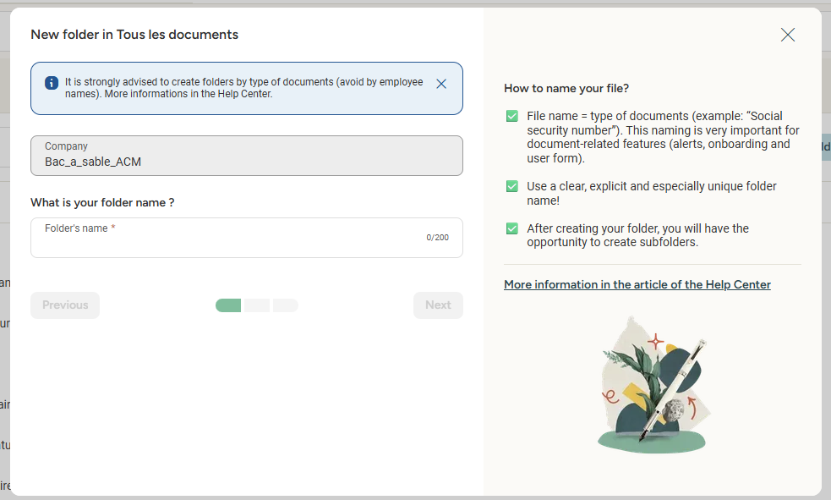
Organising the documents space
Creating folders to organise your data

Slide 12
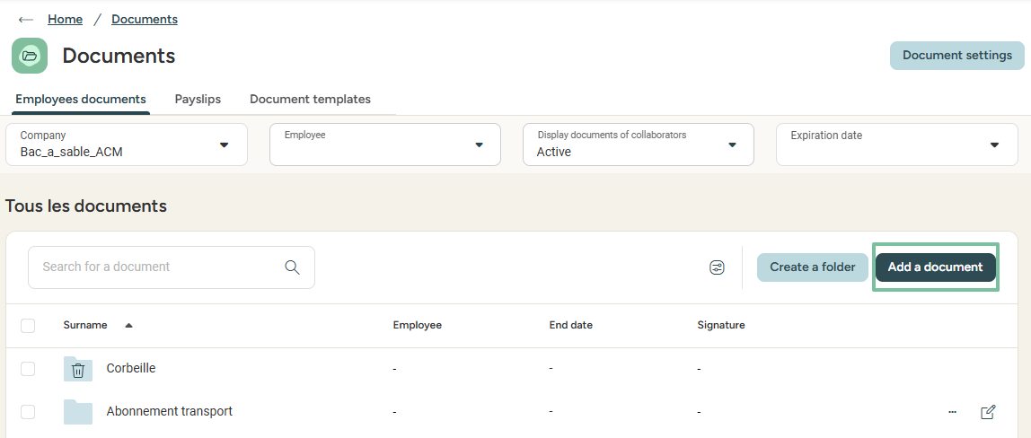
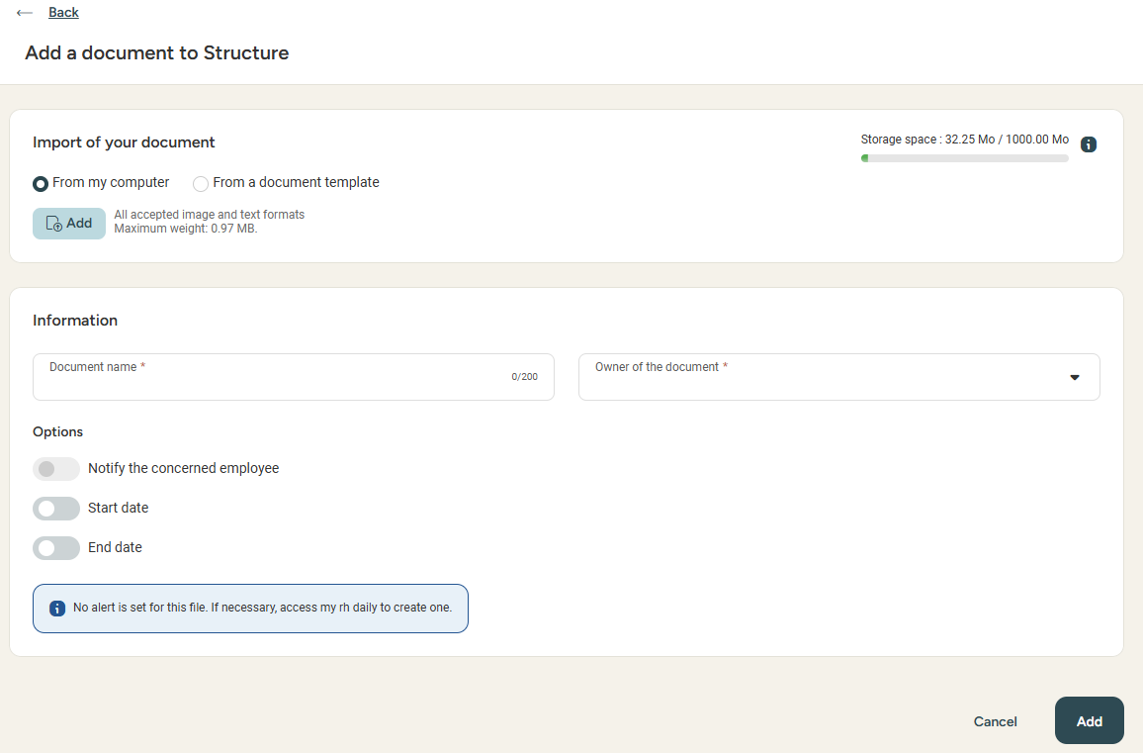
Adding a document
Access : HR Portal > documents
You can add a document in a folder
of your choice by clicking Add a document.
You can also notify the employee and/or add
an end date, allowing you to activate
a due date or renewal alert.
Good to know! You can add a document from your computer or from a document template!

Slide 13
Document Templates

Slide 14
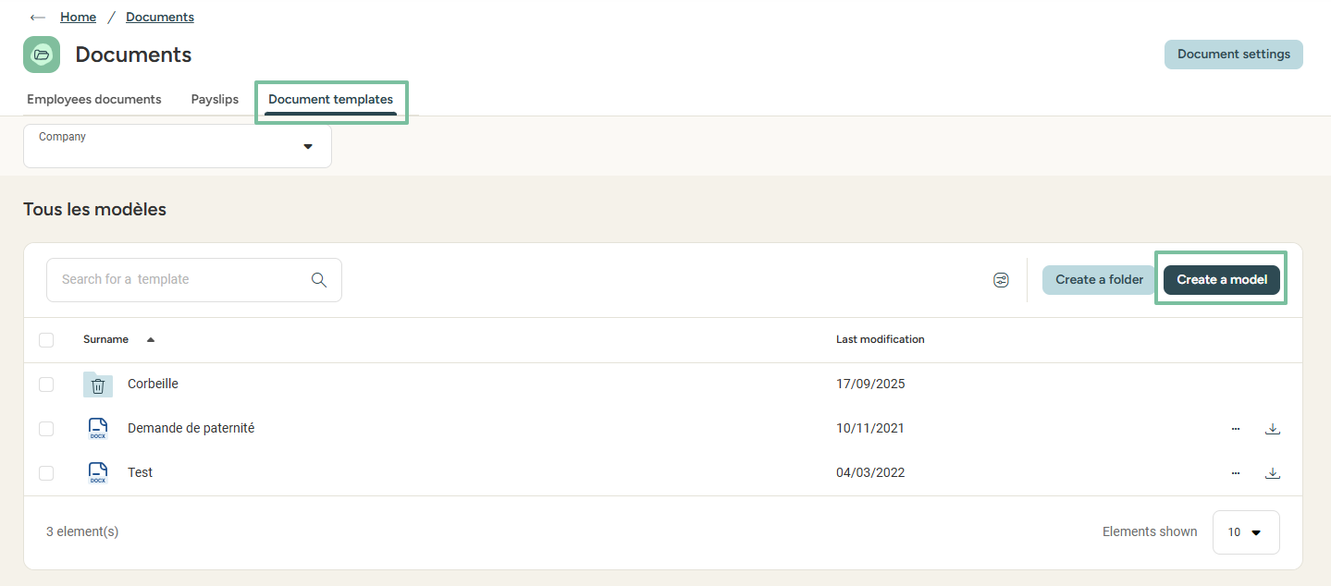
Creating document templates
Access: HR Portal > Documents > document templates

Slide 15
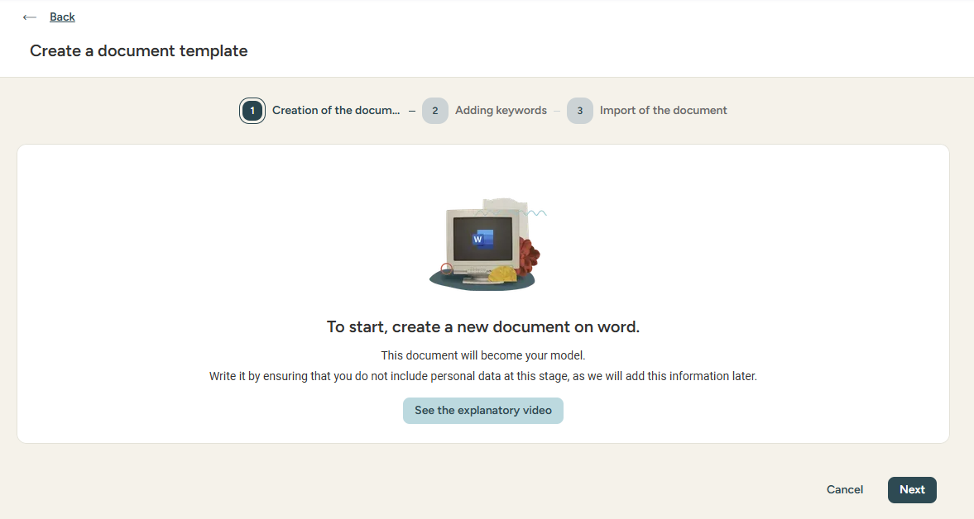
Creating document templates
Creating a new template

Slide 16
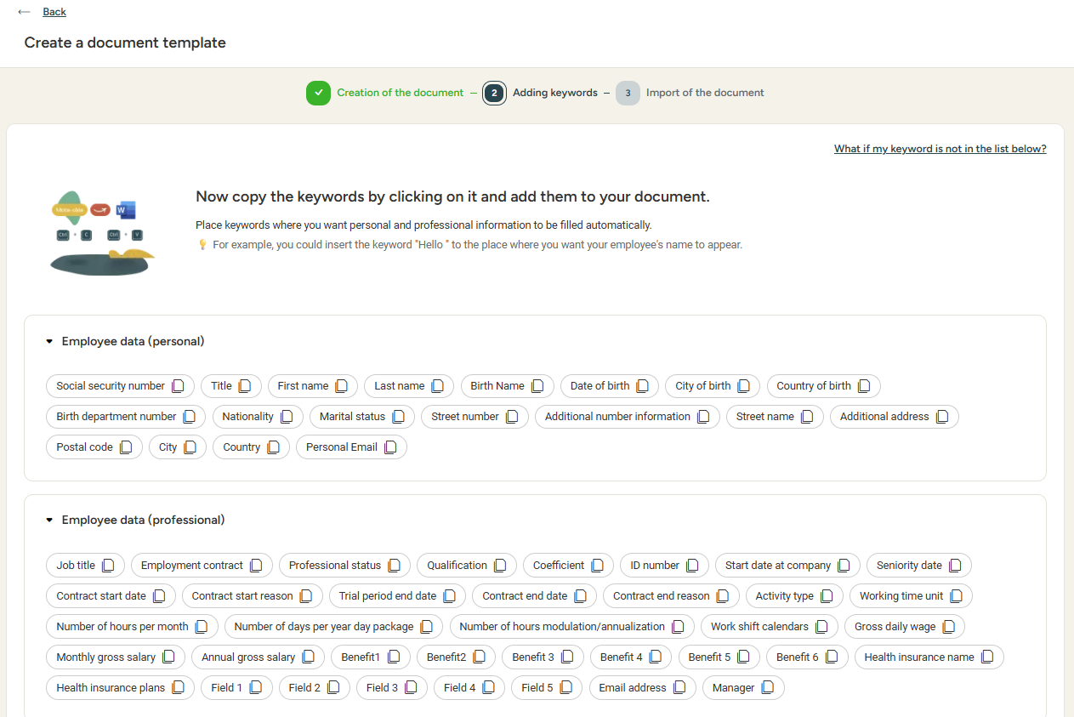
Creating document templates
Creating a new template
When creating templates via Microsoft Office Word, specific tags may be copied and pasted from Eurécia and integrated into the document.
This will allow the documents, upon generation, to be automatically filled in with related data from Eurécia.

Slide 17
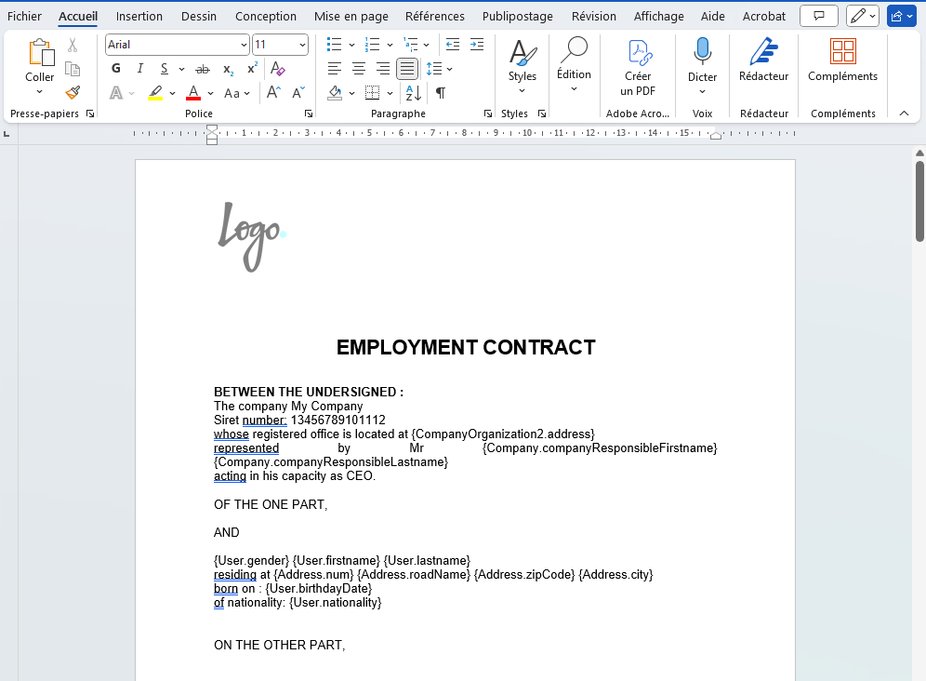
Creating document templates
Creating a new template
Step 1: In Eurécia, click on the tags you want to integrate into your document.
Step 2: Paste these tags into your Word document.
Step 3: you can copy and paste as many tags as you need to create your template.

Slide 18
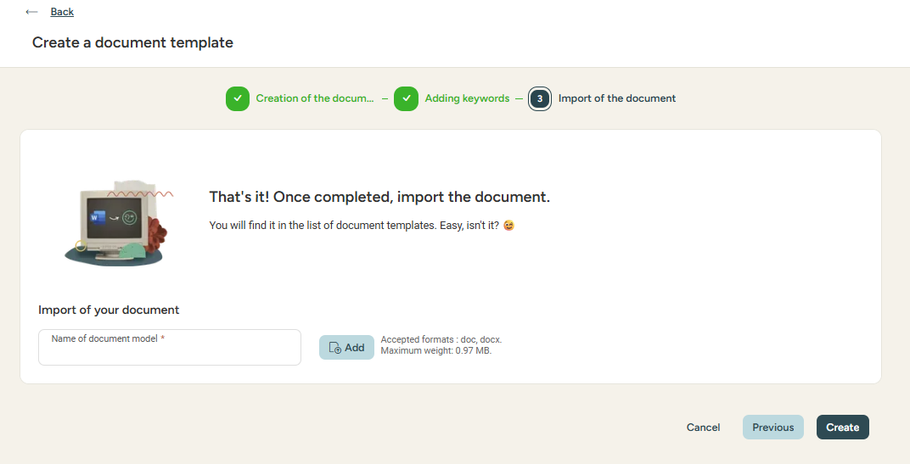
Creating document templates
Creating a new template
Save your Word document on your computer then go on to the next step in Eurécia and import the document.
You can now use it for any of your employees.

Slide 19
Shared documents

Slide 20
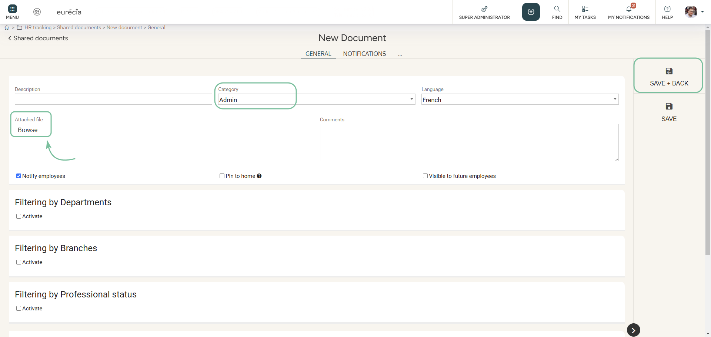
Company shared documents
Access: HR POrtal > Shared documents > Add a document
Click here to add a document from your computer
By default, the document will be visible to all employees in their HR portal > Shared documents.
Visibilities may be managed by Department, Structure and more…

Slide 21
HR dashboard

Slide 22
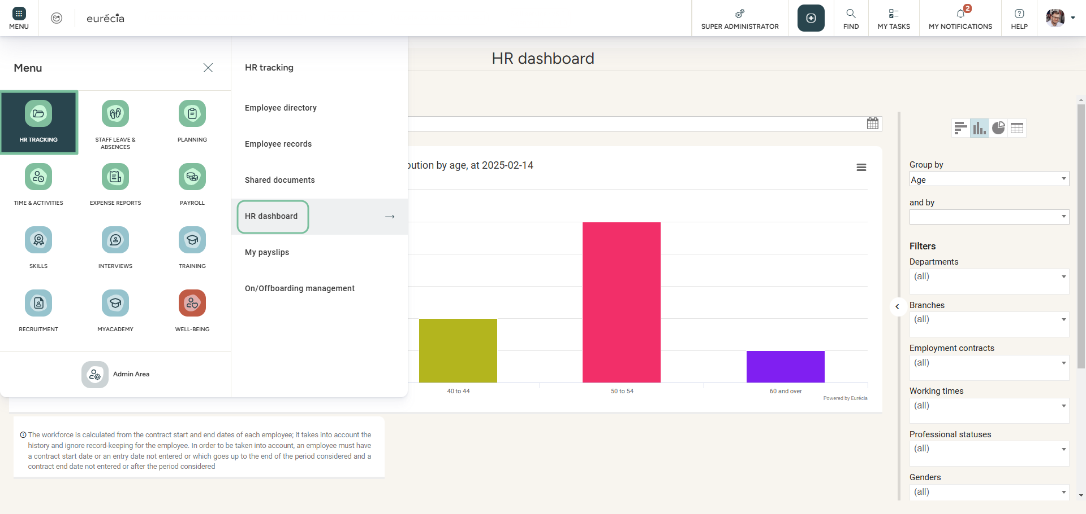
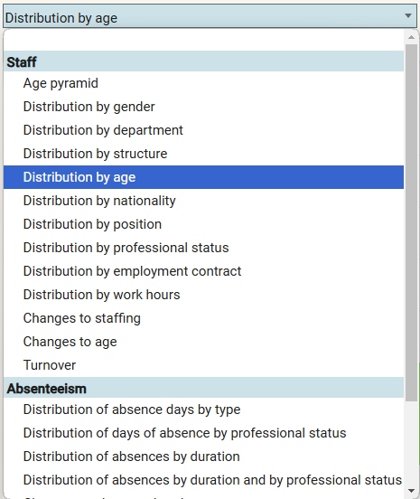
HR dashboard
Access: HR Portal > HR dashboard

Slide 23
My daily HR

Slide 24
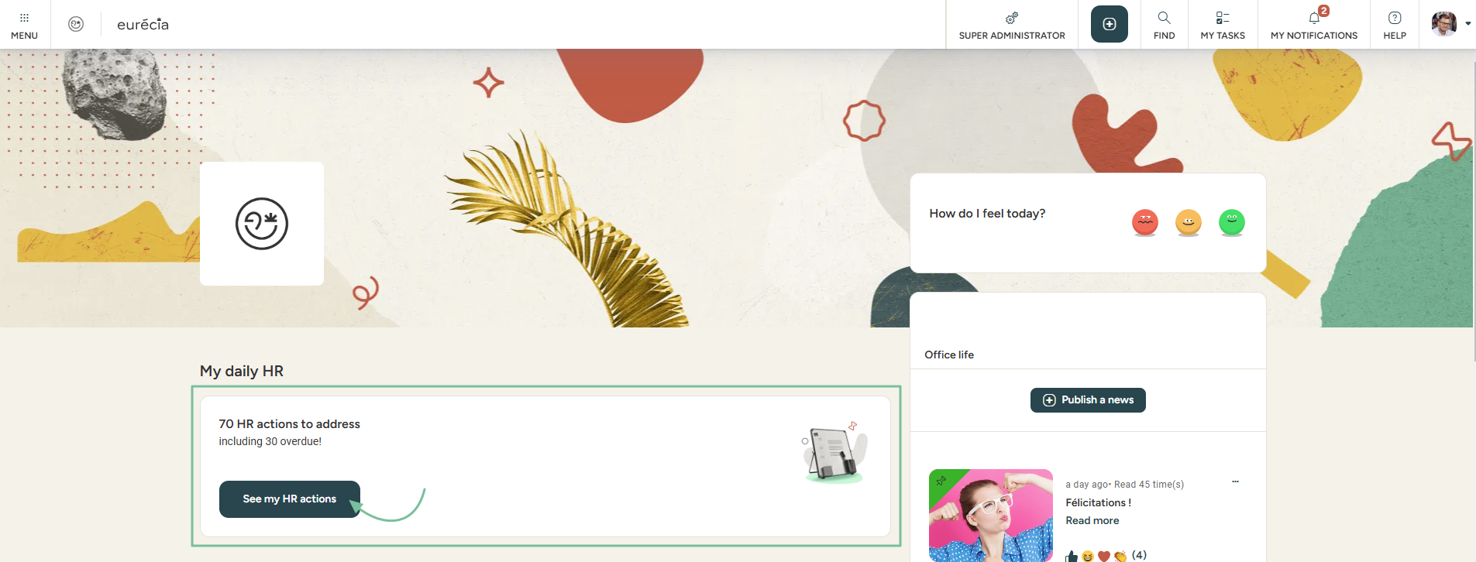
My daily HR – Managing my alerts
Access: Home page
Any employee with access to My Daily HR can create reminders and alerts for themselves and possibly other employees.
You can access a simple, visual, and collaborative to-do list with tasks.
Good to know ! Don’t have access to My Daily HR? It can be activated via :
Admin Area > General settings > Management of HR alerts.

Slide 25
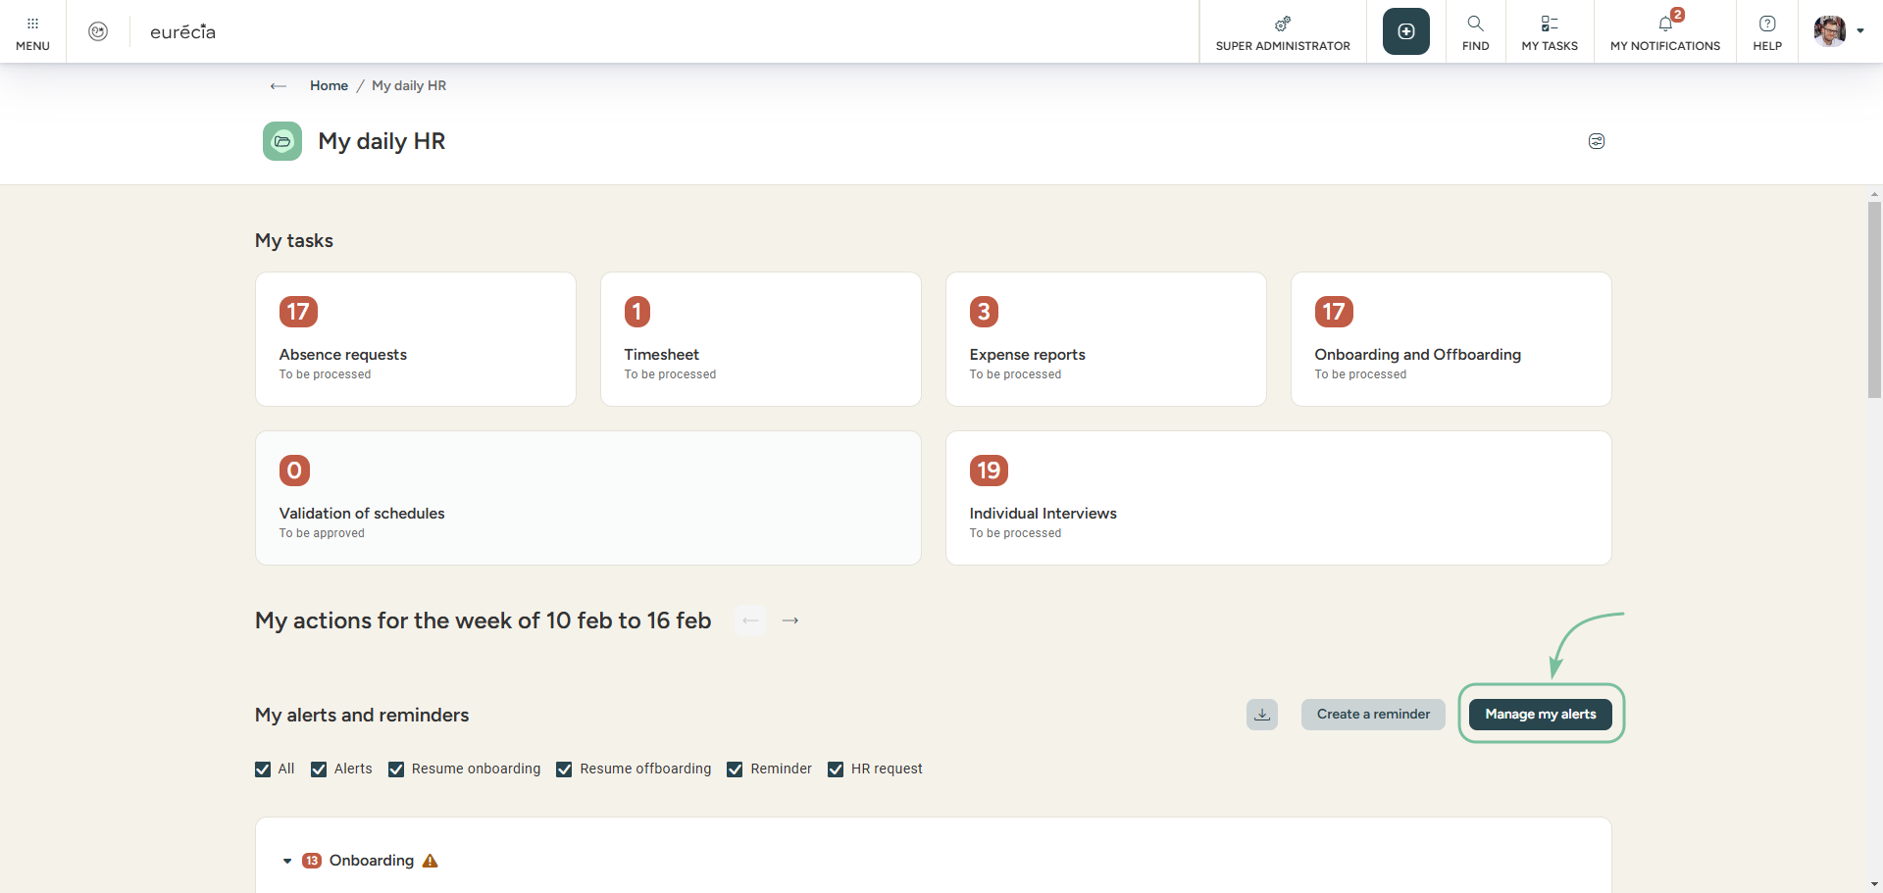
My daily HR – Managing my alerts
Creating new alerts
Click on "Manage my alerts"

Slide 26
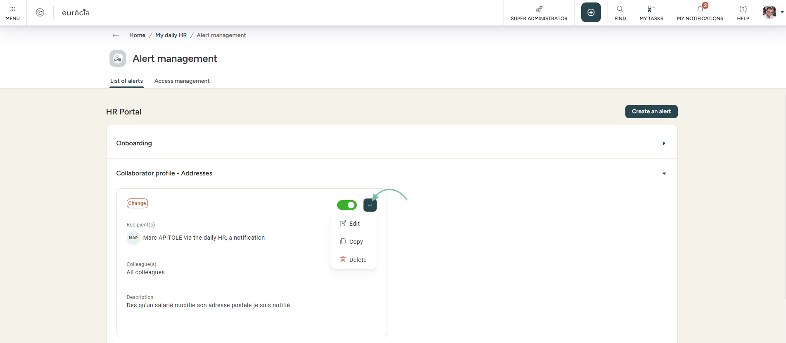

My daily HR – Managing my alerts
Creating new alerts
In the "List of alerts" tab, all my personalized alerts will be displayed. New alerts may be added by clicking on the button :
Good to know ! In order to facilitate the process, alerts can be duplicated.

Slide 27
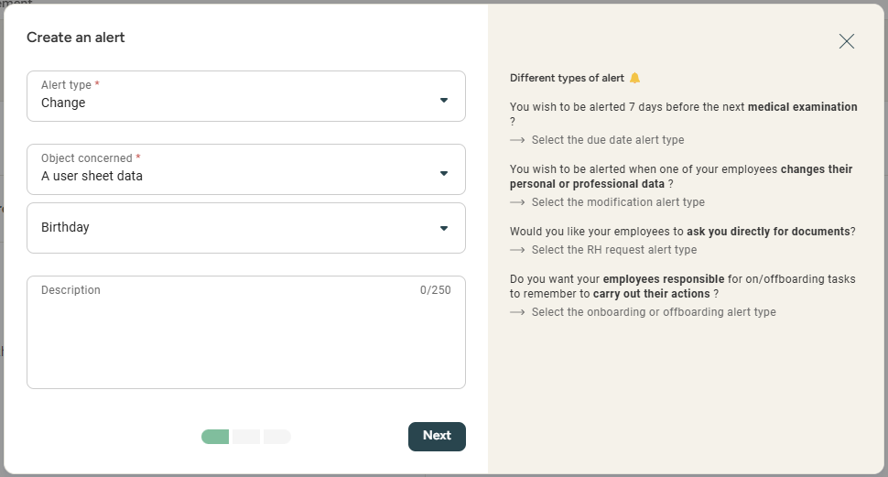
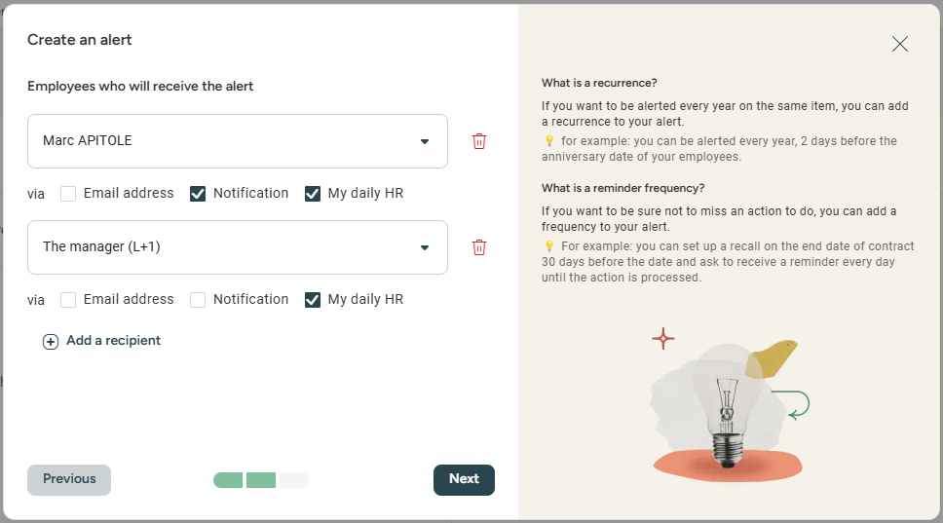
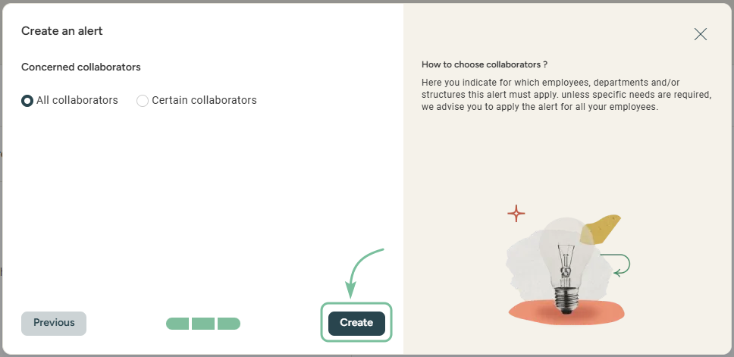
My daily HR – Managing my alerts
Creating new alerts
You can choose between different types of alerts : when a deadline is approaching, when sensitive elements have been changed or to anticipate an on/offboarding.
Once you’ve made a choice, you can select the reason for the alert: birthdays, contract end date, trial period end date and more…
Setting up alerts helps in notifying relevant recipients several days before an actual deadline or in case of any changes.

Slide 28
On/Offboarding Management

Slide 29
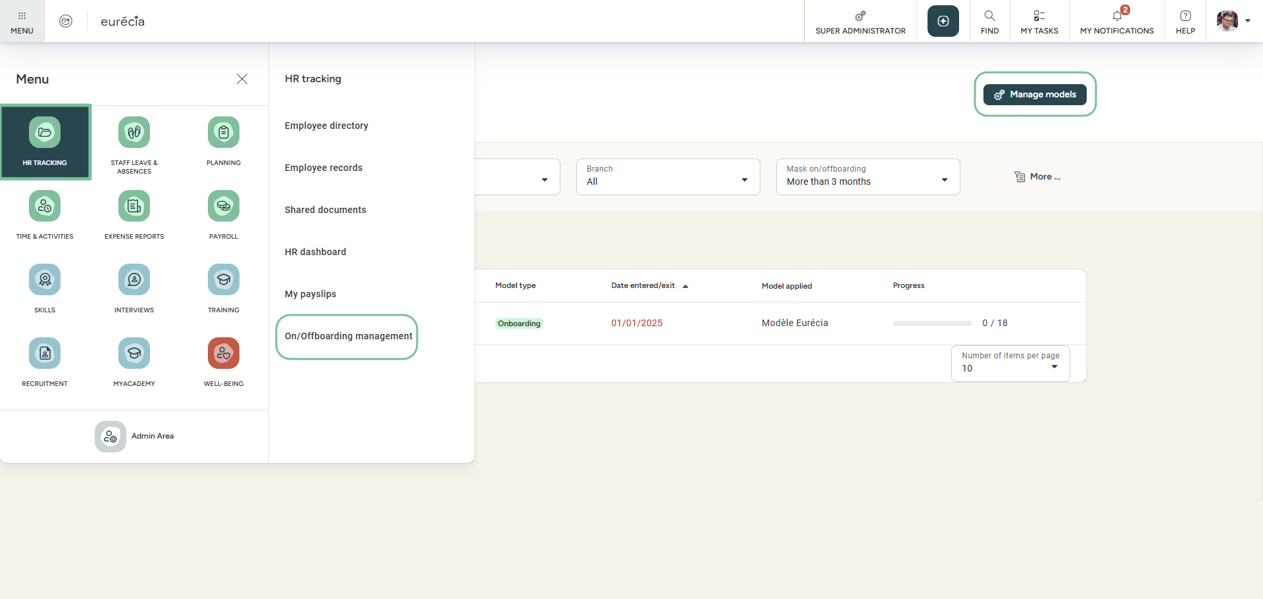
Managing On/Offboarding
Access: HR Portal > On/offboarding management
With the help of dashboards, you can get a clear idea of when your employees will be joining and leaving your company.
Progress can be monitored and manager. Tasks can be created using templates management.

Slide 30
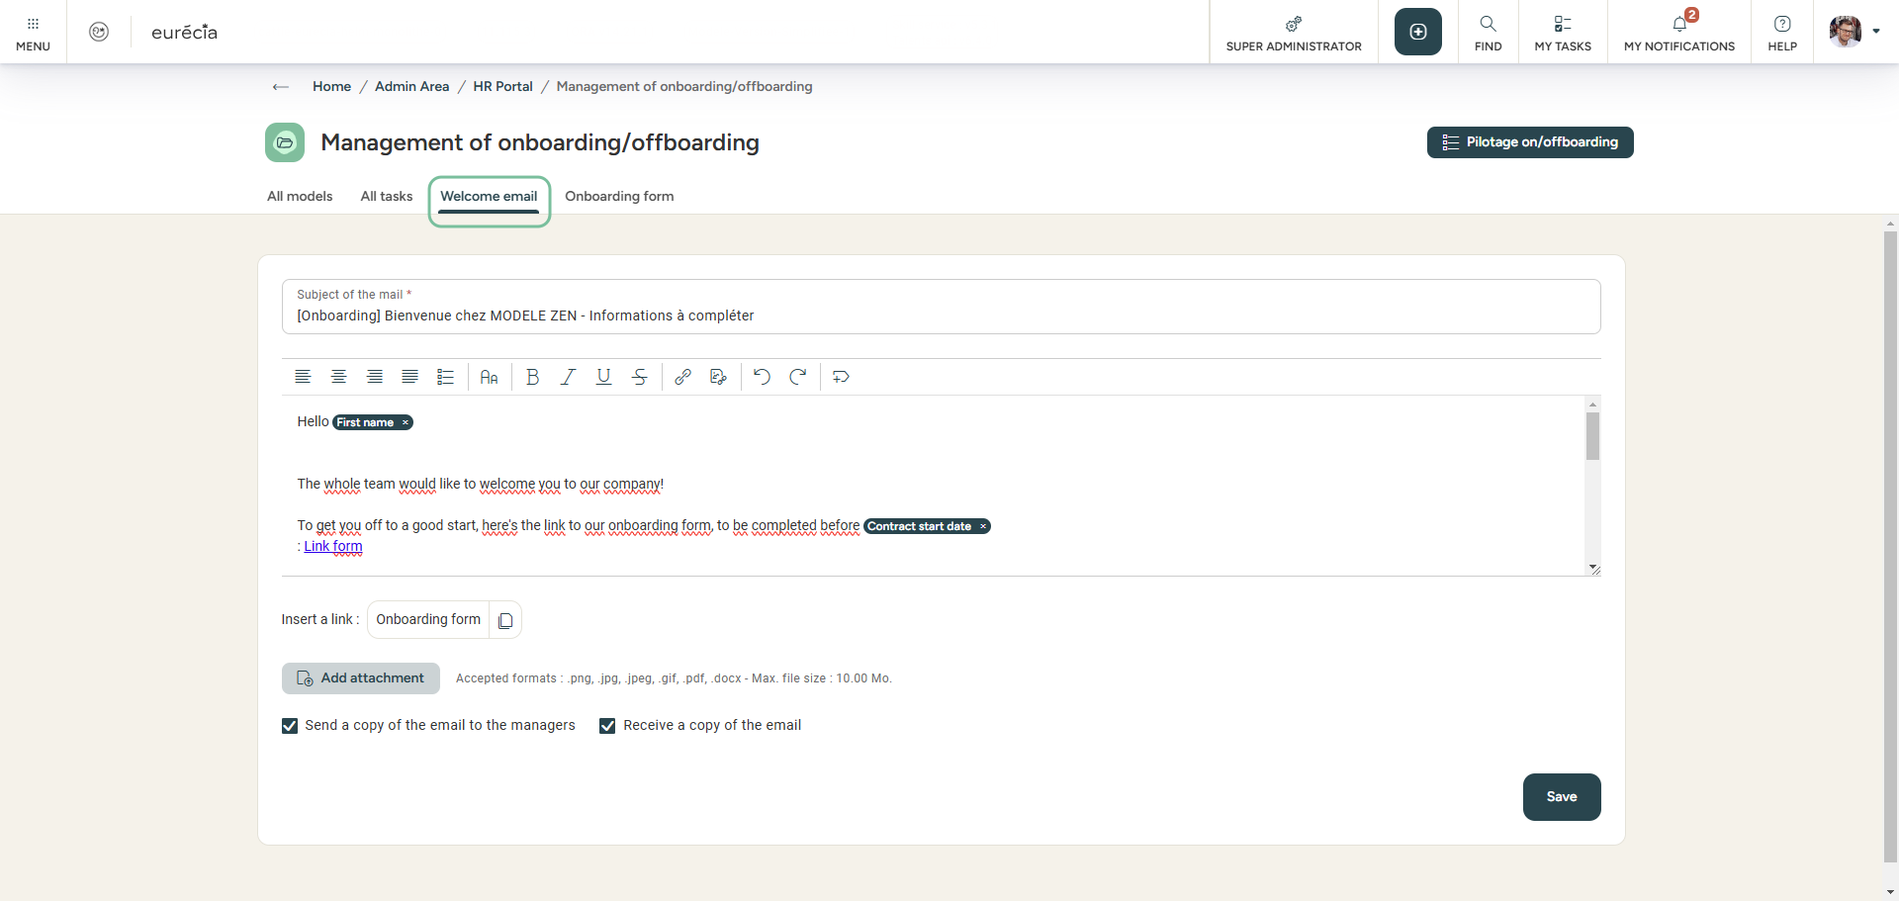
Managing On/Offboarding
Welcome email
You can set up a custom welcome e-mail.
The purpose of this e-mail is to inform the employee of the elements they need to communicate to their new employer.
It also gives them access to Eurécia to complete their employee file.

Slide 31
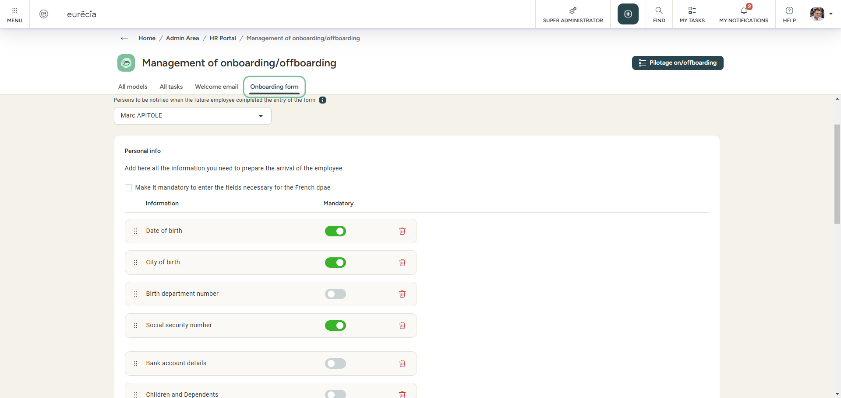
Managing On/Offboarding
Onboarding form
In the onboarding form, you can select elements that will be requested from the employee via the welcome email.
The links in the email will redirect the employee to the form, where they can fill in their personal information
and submit the required documents.
The documents and information are automatically transferred to the employee file and records.

Slide 32
Importing payslips

Slide 33
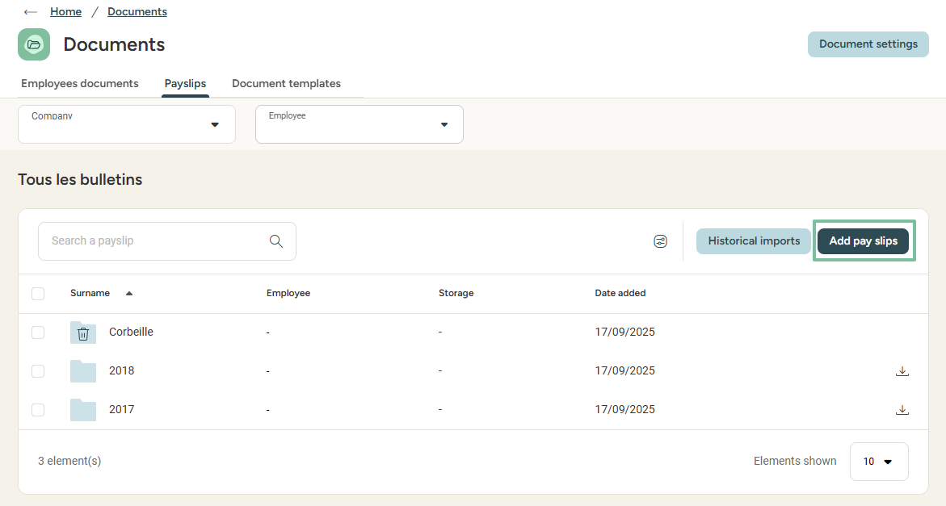
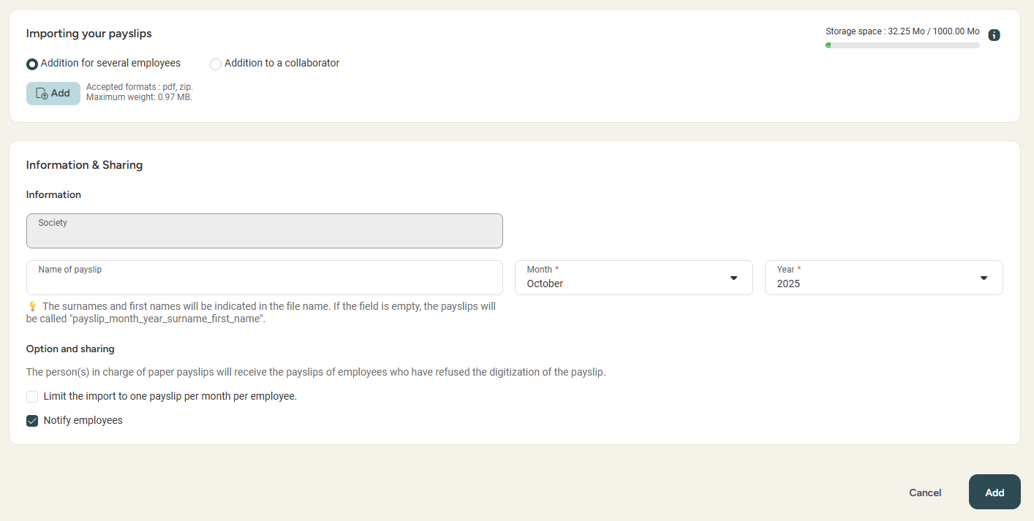
Payslips import
Access: Menu > HR portal > documents > payslips
Good to know ! For each employee, the social security number (national insurance number), first name, and last name must be identical in the payroll software and Eurécia.

Slide 34
Admin Area

Slide 35
Managing access to "My Daily HR"

Slide 36
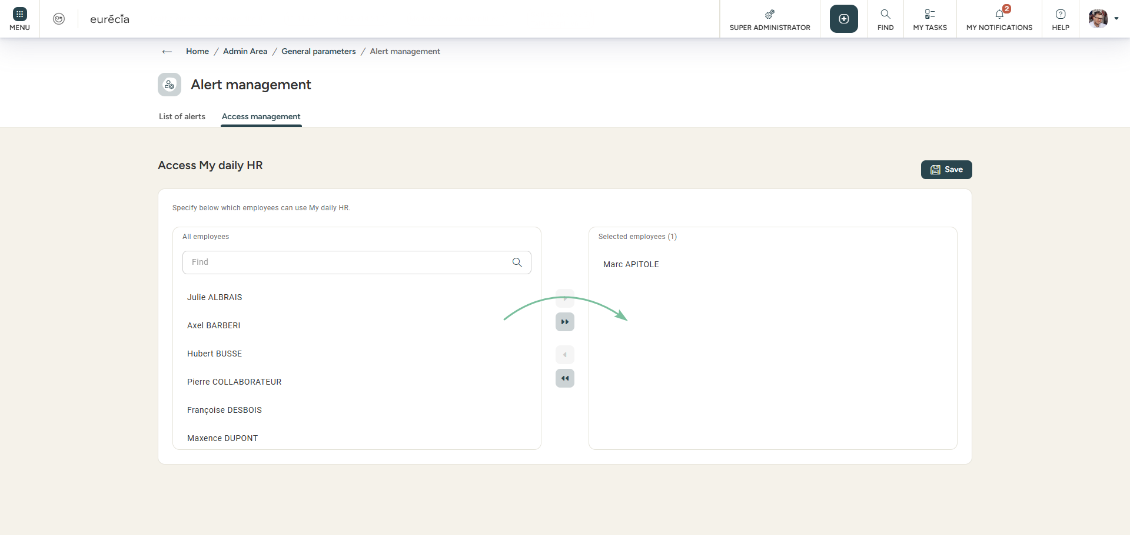
HR Alerts
Access: Admin area > general settings > Management of HR alerts
From the « Access management » tab, you can activate the daily HR for your employees.
They will be able to set their own alerts and benefit from the monitoring dashboard.

Slide 37
Setting up the employee documents

Slide 38
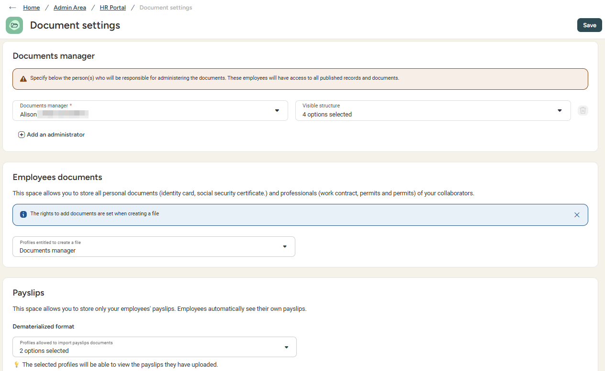

Visibility rights on the new documents space
Access: admin area > hr portal > drive configuration
Define which users can manage the documents. These users will have a visibility on 100% of the data!
Then, select what different profiles can act on (employee documents, payslips, document templates)

Slide 39
Setting up the new user sheet

Slide 40
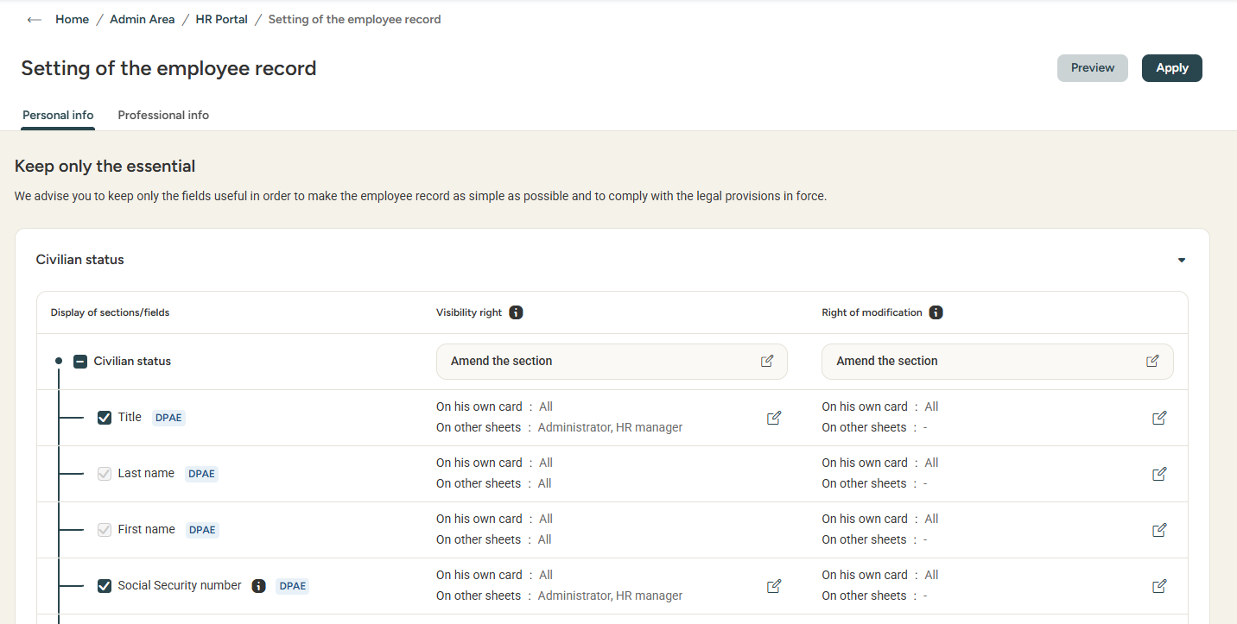
The new user sheet
Access: Admin area > general settings > user sheet configuration
With the new user sheet, you have more freedom to personalise what is visible and/or editable by your collaborators. If any info isn't relevant to you, you have the choice not to display it, so as to clear your form!
You can preview changes while working. Don't forget to apply them when you're done!

Slide 41
Still having doubts?
All answers within your reach.
support@eurecia.com
Help center

