Slide 1
o
+
+
o
o
+
Training tool
Collaborators & managers
+
o
+
Individual interview
Bien plus qu’un SIRH…

Slide 2
Individual interviews

Slide 3
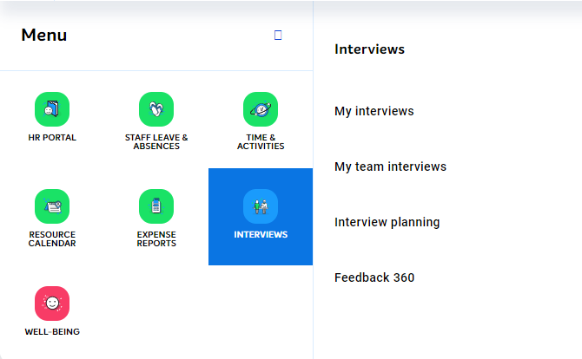
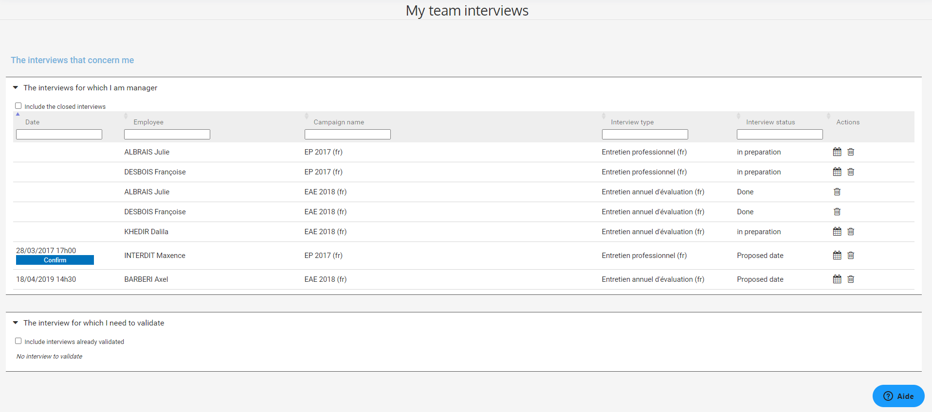
Manager – Access to my team’s interviews
Access to ‘in progress’ interviews

Slide 4
Manager – Prepare the interview of my collaborator
Suggest an interview date to my employee
I can confirm the date suggested by the employee by clicking on “Confirm”.
If my employee has not already done so, I suggest a date for the interview by clicking on
Either I accept or I refuse the one he suggests.

Slide 5
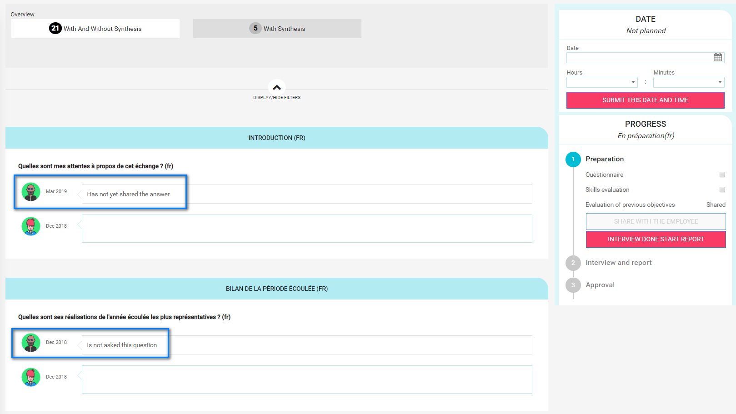
Manager – Prepare the interview of my collaborator
Prepare the answers
The interview will focus on several themes.
For each theme, I prepare the answers to the questions that will be used as a basis for the exchange with my collaborator during the interview.
If below the question, it is notified ‘Is not asked this question’, that means I do not need to prepare this question during the preparation, This question won’t be asked during the interview.
If the collaborator has shared is preparation, I am able to see the answers

Slide 6
Manager – Prepare the interview of my collaborator
Pre-assessment of skills (optional: only if the skills module has been subscribed)
For each skills, I pre-asses the level of my collaborator by clicking on the scale.
The level required is indicated by the icon ‘Required’
I can also visualize the assessment made during a previous assessment and the one made by my collaborator during his preparation (if he shared his preparation beforehand).

Slide 7
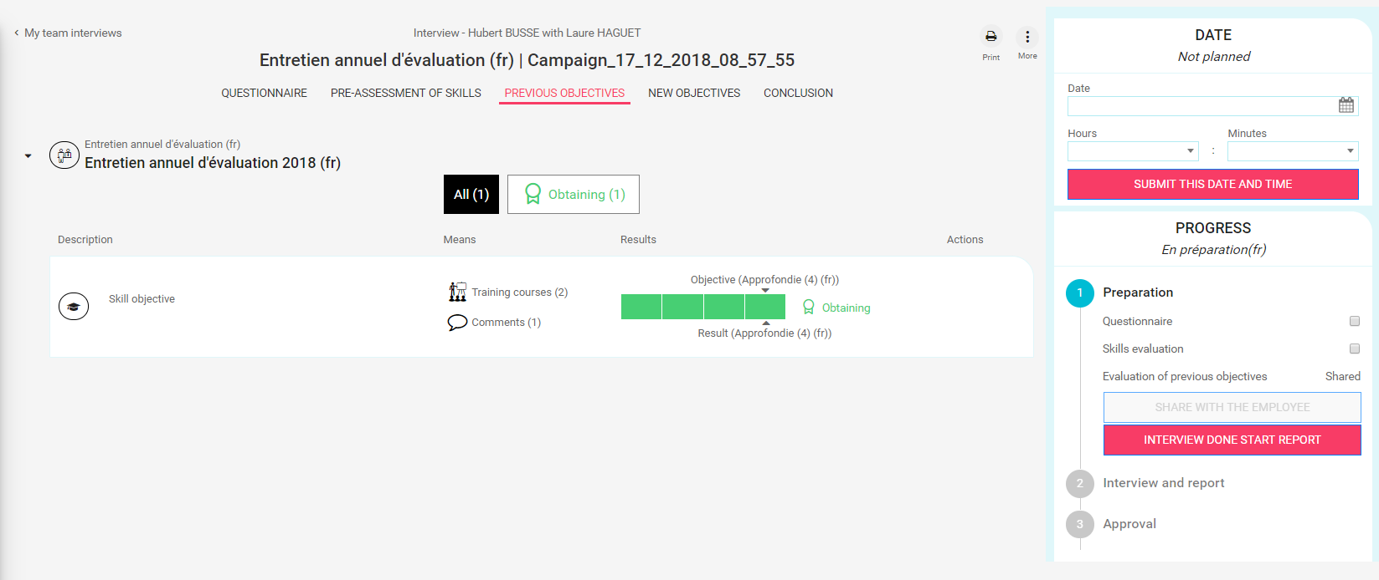
Manager – Prepare the interview of my collaborator
Pre-assess previous objective

Slide 8
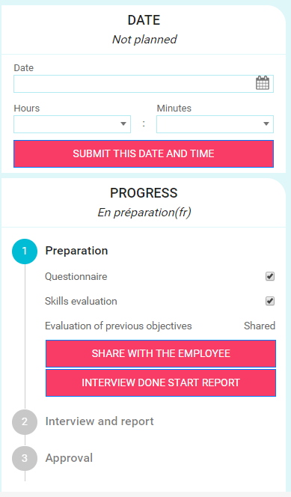
Manager – Prepare the interview of my collaborator
Share the preparation with the employee
I can share with the employee my preparation if I want to.

Slide 9
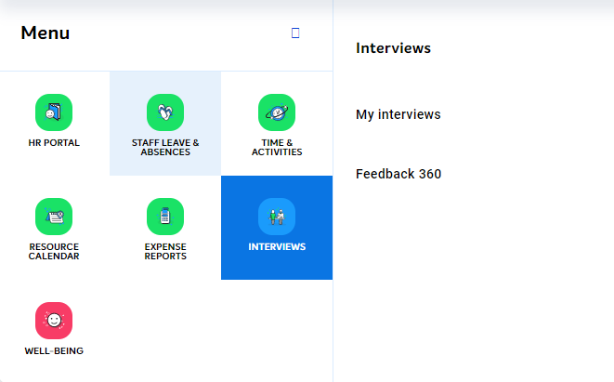
Collaborator – Access to my interview
Access to my ‘in progress’ interview

Slide 10
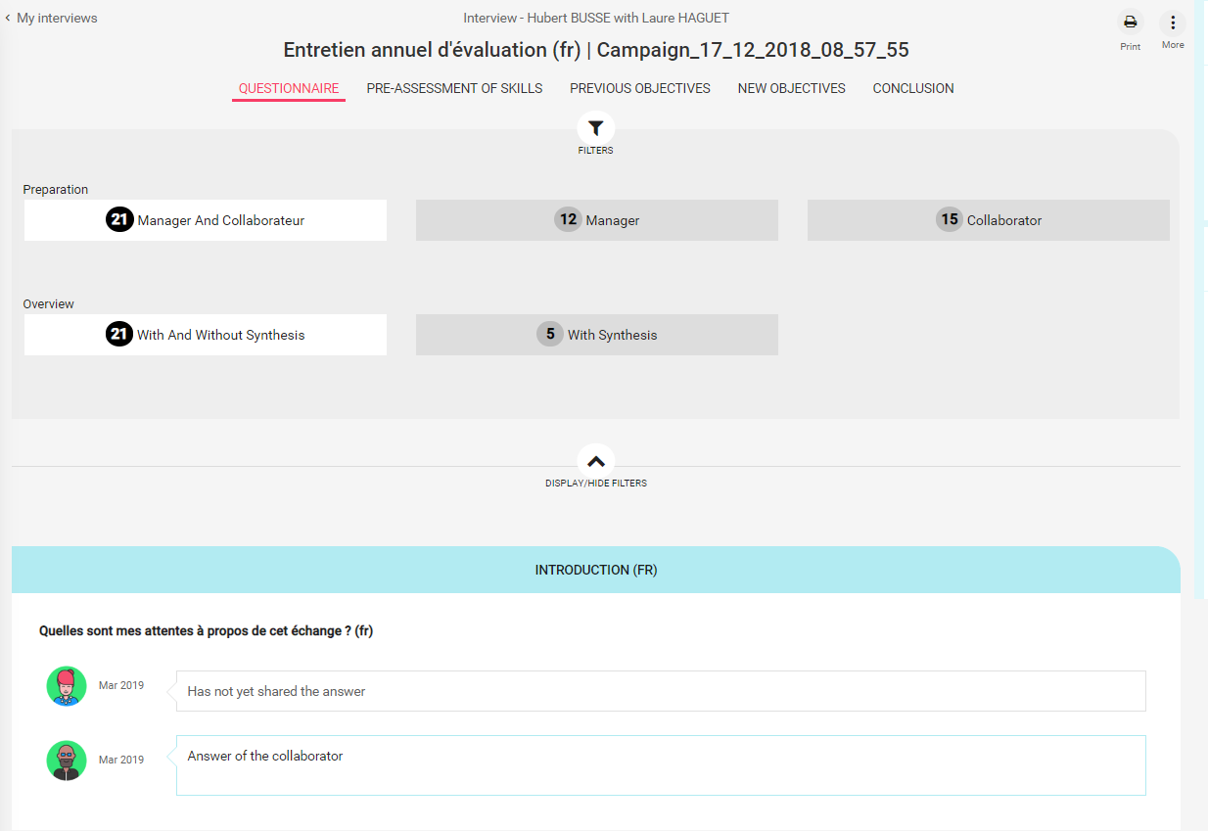
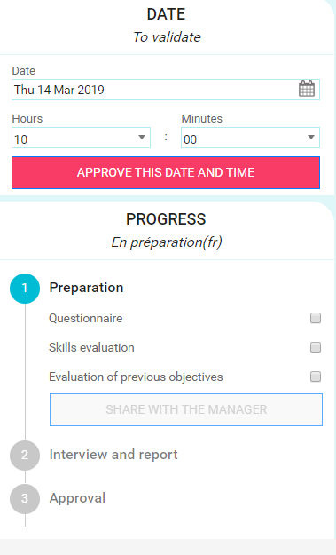
Collaborator – Prepare my interview
Accept or suggest a new date for the interview
I approve the interview date suggested by my manager.
I can also propose him a new date by changing this one.
If my manager didn’t suggest a date, I can suggest one.

Slide 11
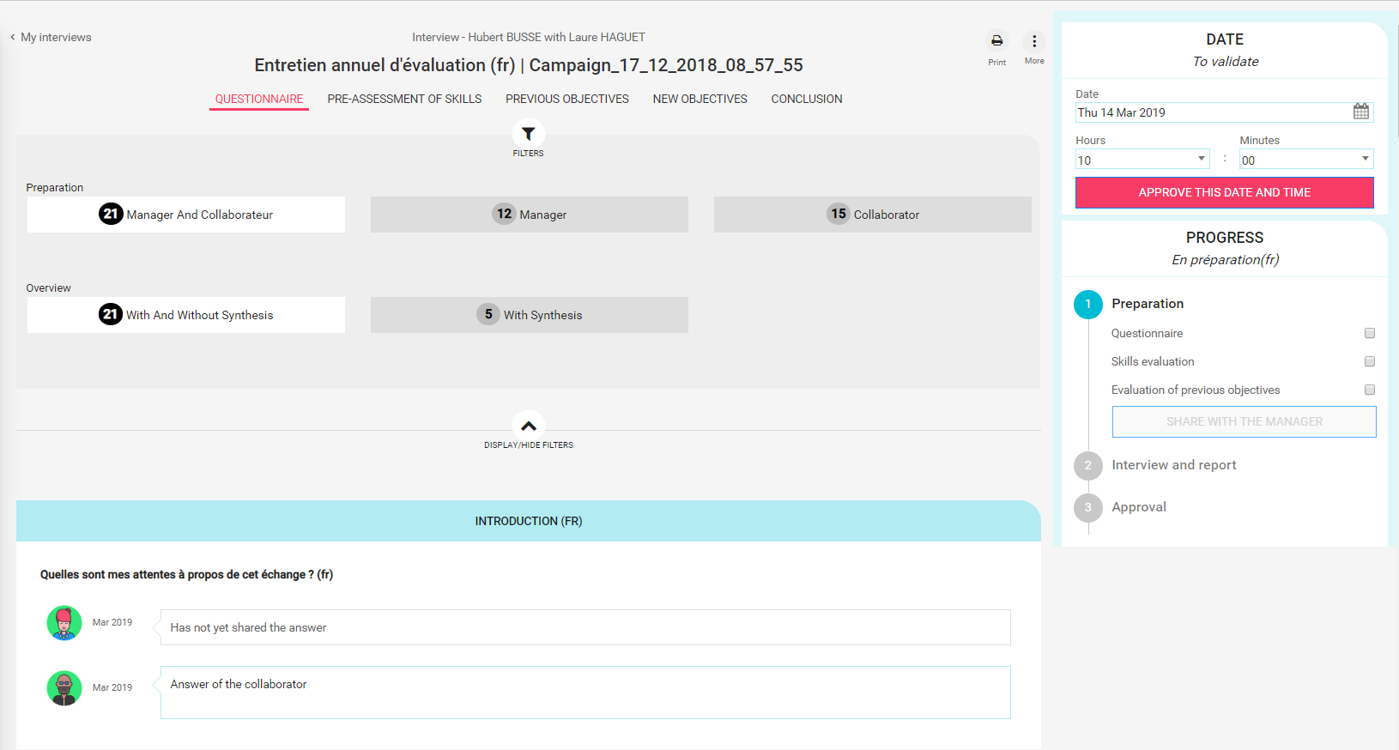
Collaborator – Prepare my interview
Prepare the answers
The interview will focus on several themes.
For each theme, I prepare the answers to the questions that will be asked during the interview.
If below the question, it is notified ‘Is not asked this question’, that means I do not need to prepare this question during the preparation, This question won’t be asked during the interview.
If my manager prepared the interview and shared his preparation, I can see his answers.

Slide 12
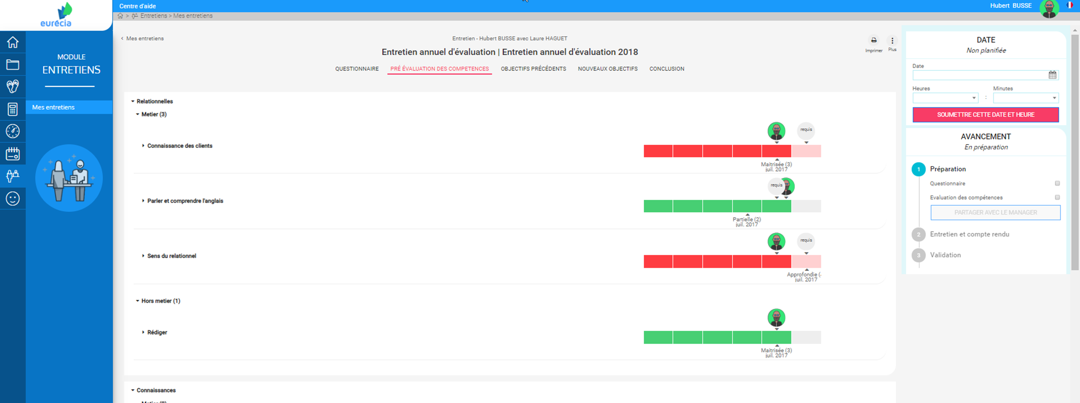
Collaborator – Prepare my interview
Pre-assessment of skills (optional: only if the skills module has been subscribed)
For each skills, I pre-asses my level by clicking on the scale.
The level required is indicated by the icon ‘Required’
I can also visualize my level assessed during a previous assessment and the one made by my manager during his preparation (if he shared his preparation beforehand).

Slide 13
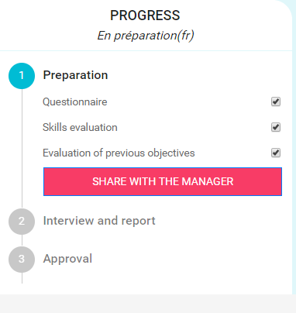
Collaborator – Prepare my interview
Share my preparation with my manager
I share with my manager the preparation of my interview if I want to.

Slide 14
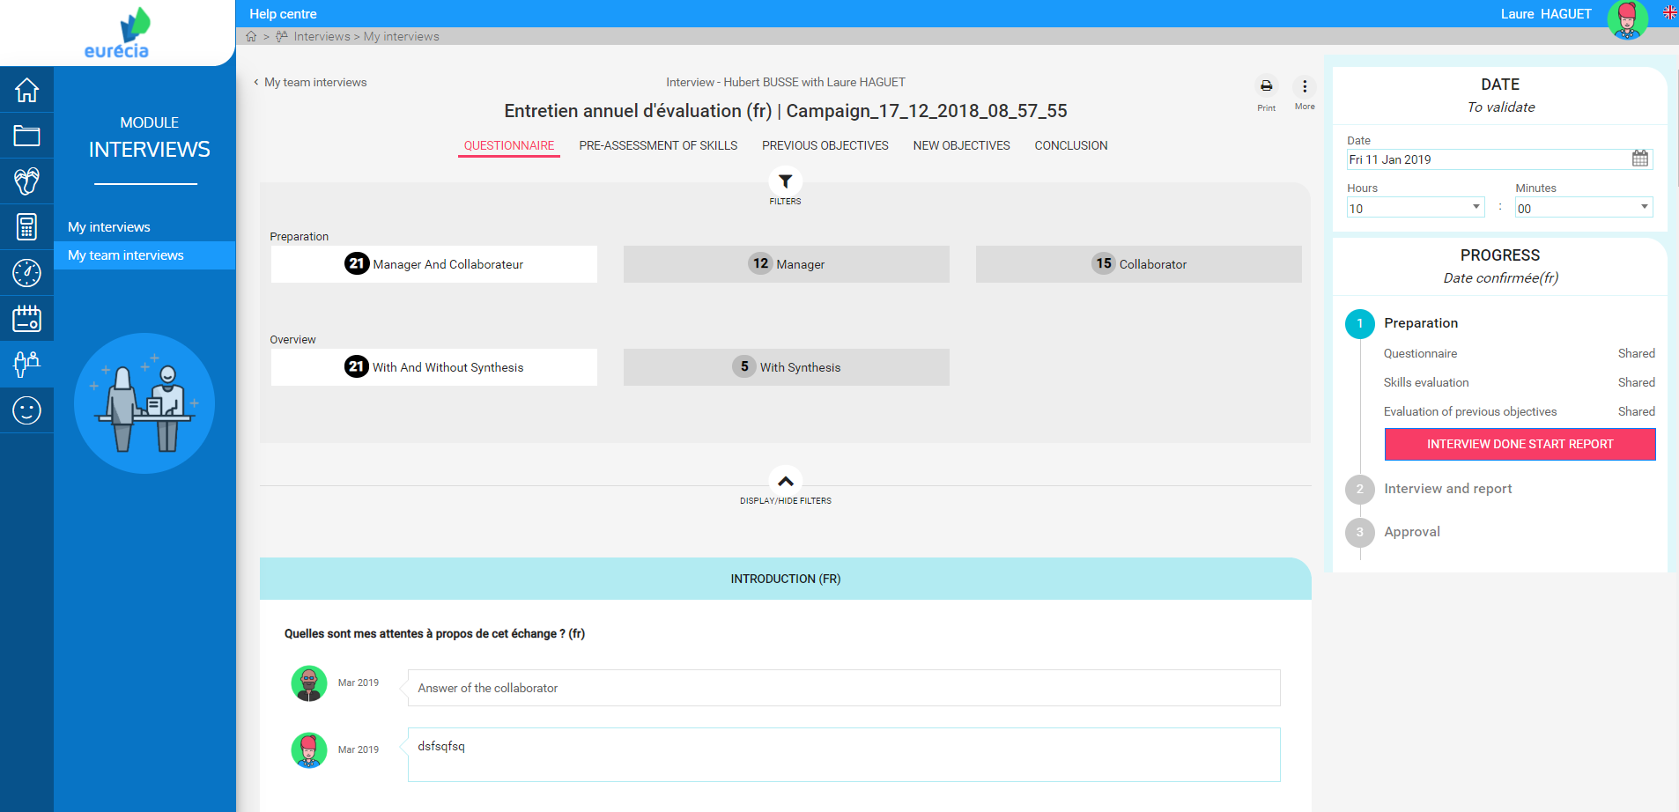
Manager – Conduct the interview
Starting the interview and report
I have access to my collaborator interview
I click on « Interview done start report » => I can start recording the interview that reflects the exchange with my employee.

Slide 15
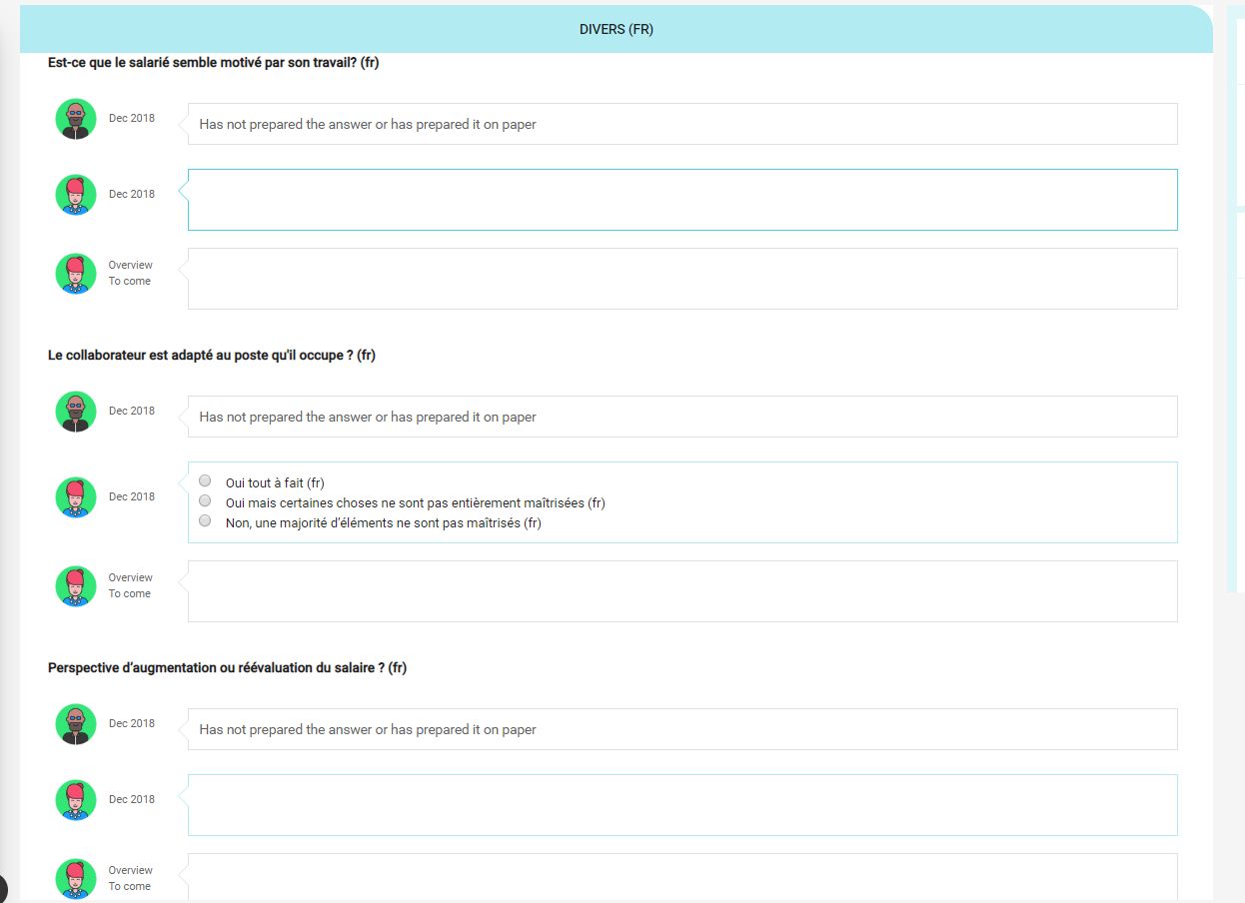
Manager – Conduct the interview
Complete the synthesis in ‘Overview to come’

Slide 16
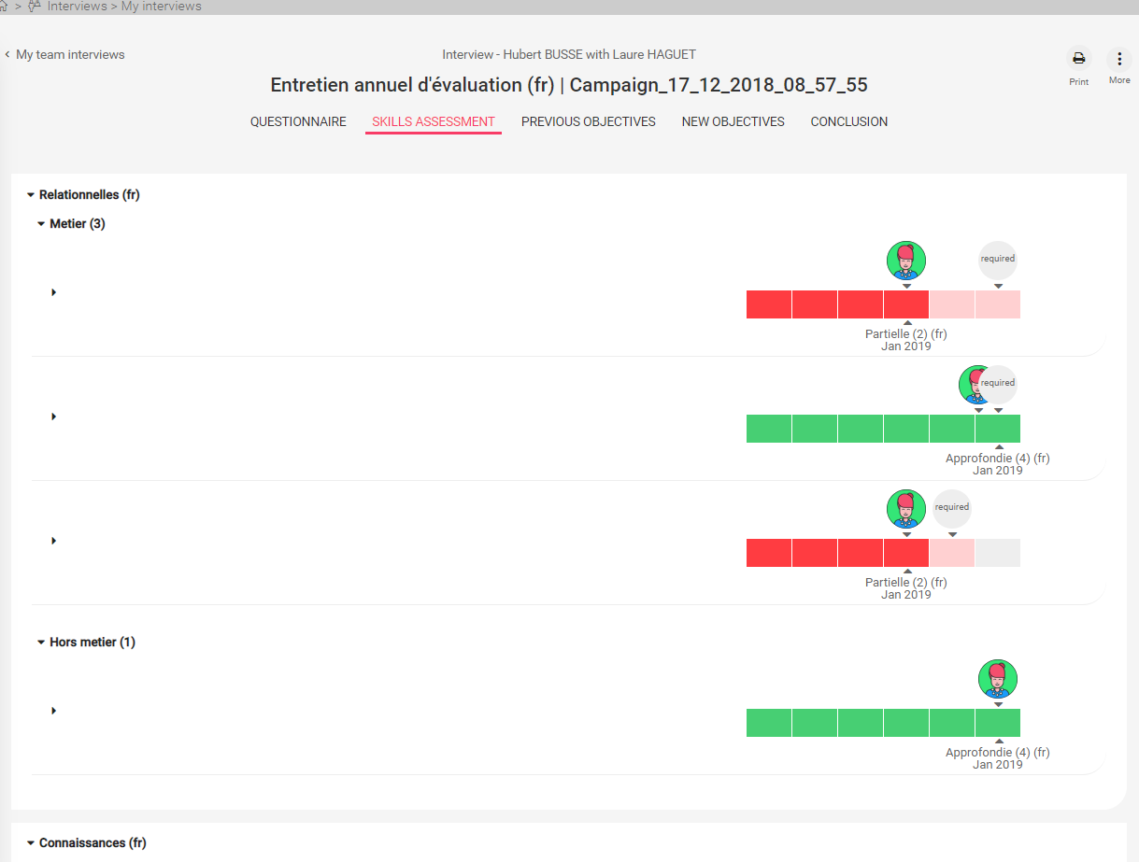
Manager – Conduct the interview
Complete the skills assessment (optional: only if the skills module has been subscribed)

Slide 17
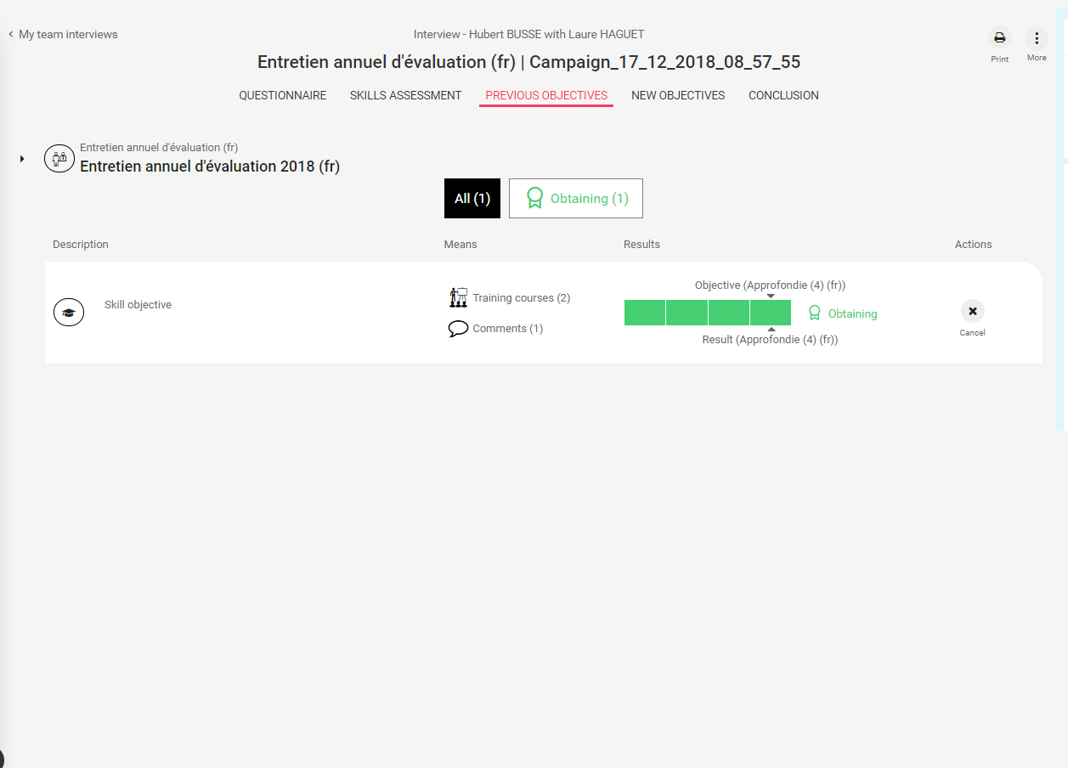
Manager – Conduct the interview
Complete the previous objective assessment

Slide 18
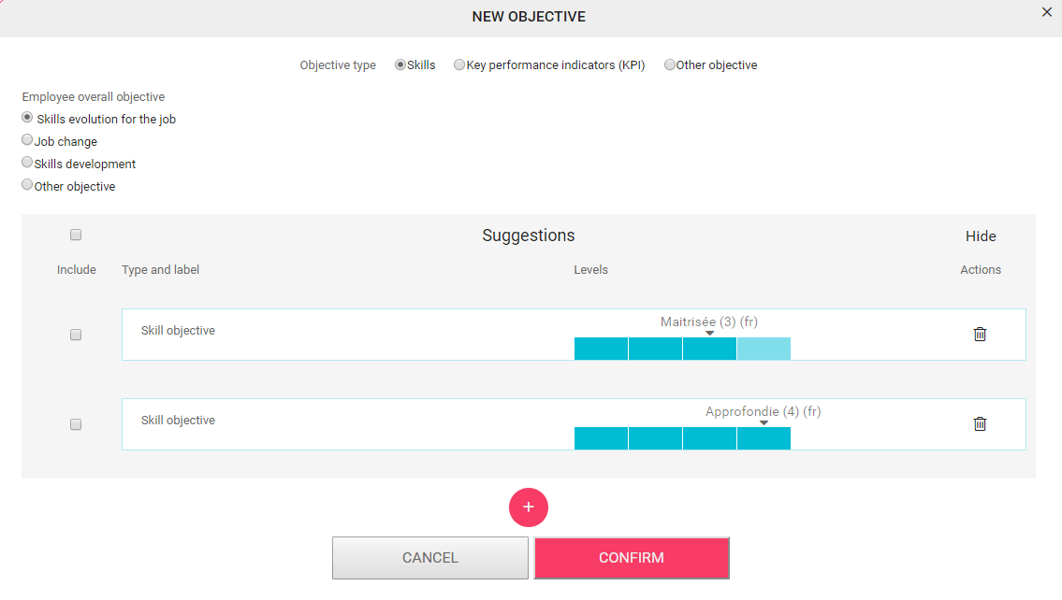
Manager – Conduct the interview
Enter the new objectives for the year to come

Slide 19
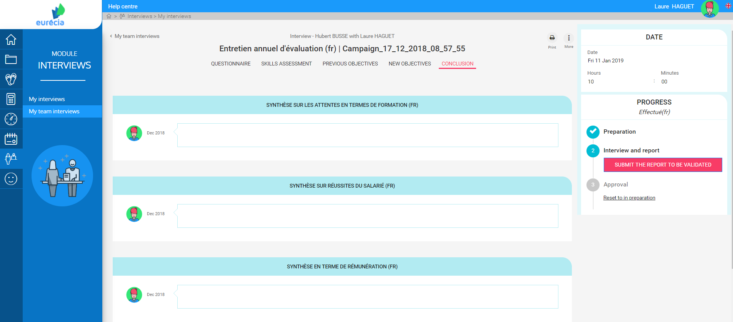
Manager – Conduct the interview
Enter the conclusions

Slide 20
Manager – Conduct the interview
Submit the report to be validated

Slide 21
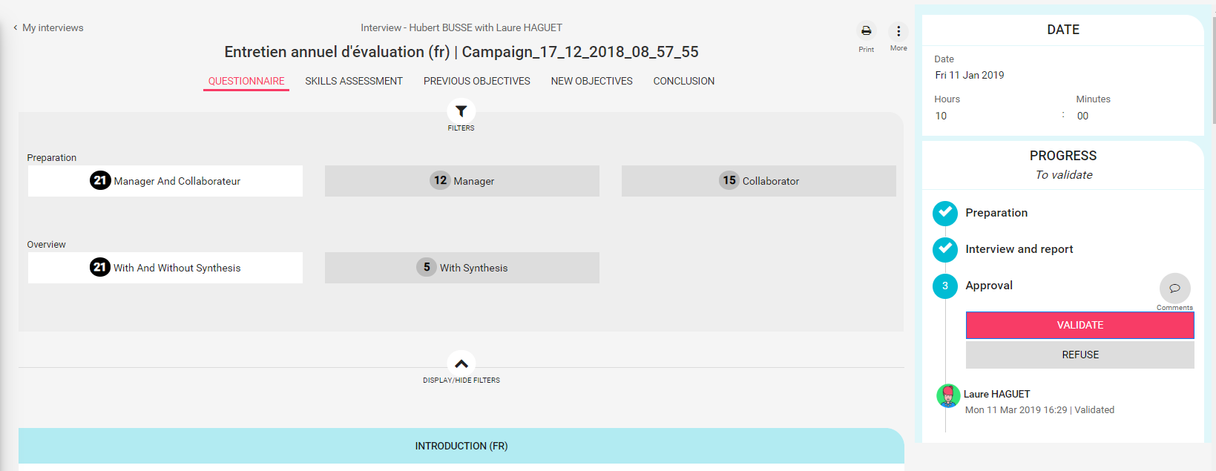
Collaborator – Validate (or refuse) my interview

Slide 22
Manager & Collaborator – Consultation
Consultation of the history of the interviews conducted
You have access to the history of the interviews conducted in the employee record, Interview Tab.

Slide 23
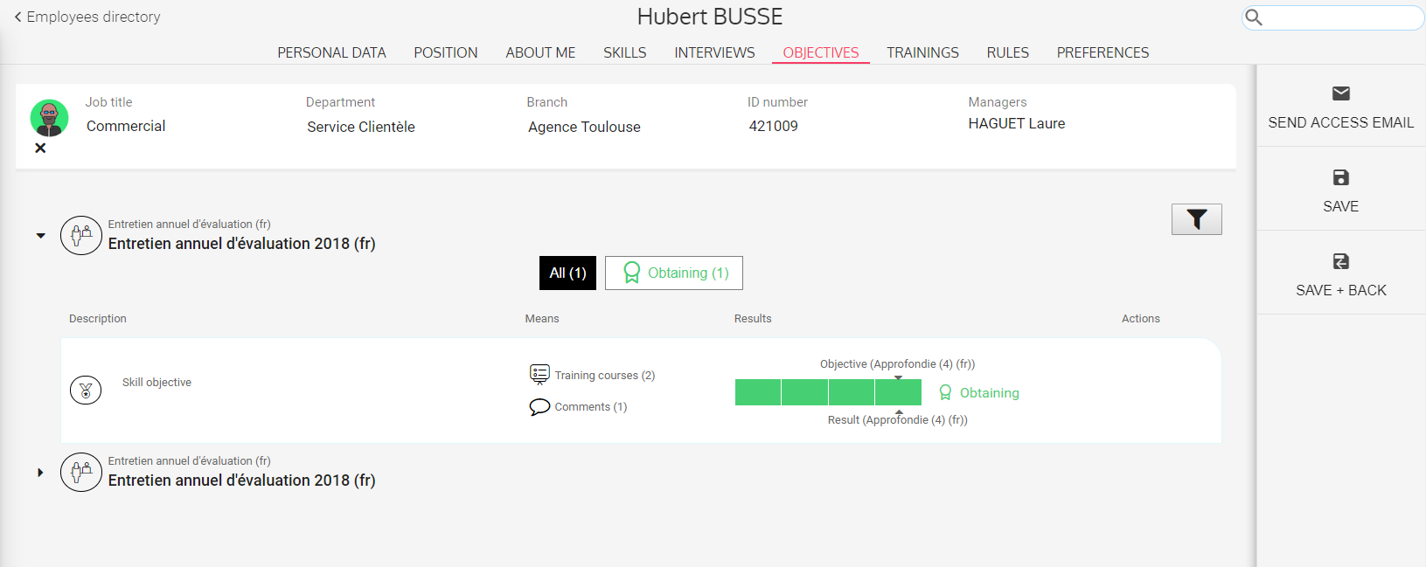
Manager & Collaborator – Consultation
Consult objectives
You have access to objectives fixed via the employee record, Objectives Tab.

Slide 24
Manager & Collaborator – Print the interview

Slide 25
Manager – Add objectives once the interview has been conducted

Slide 26
o
+
+
o
o
+
support@eurecia.com
+ 33 (0)5 62 20 49 37
www.eurecia.com
+
o
+
Much more than an HRIS...
www.eurecia.com

